Slide 1
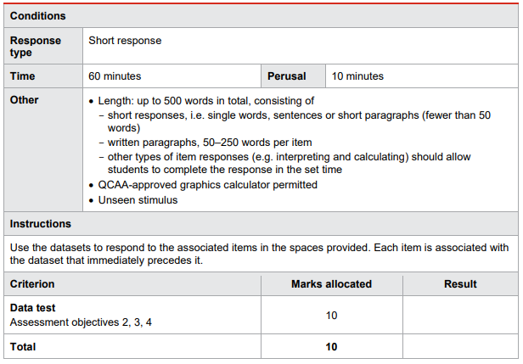
Practice data test
Name:
Result: /20 Mark: /10

Slide 2
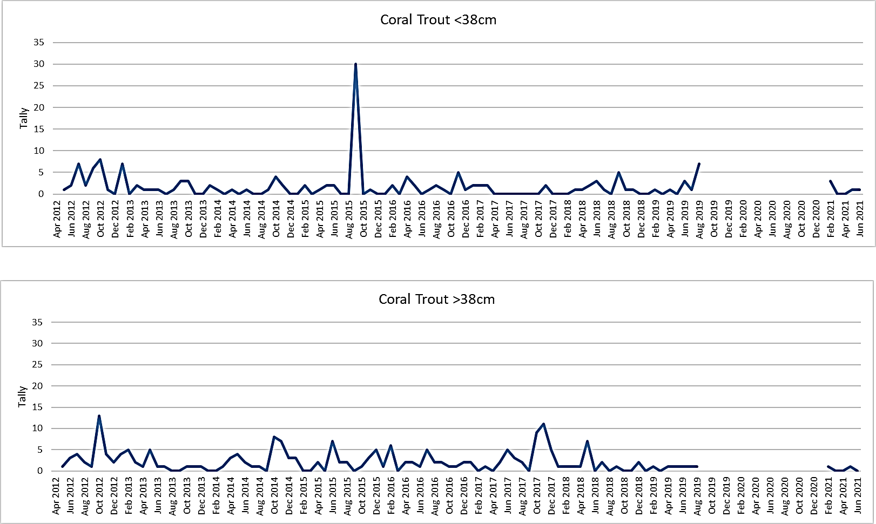
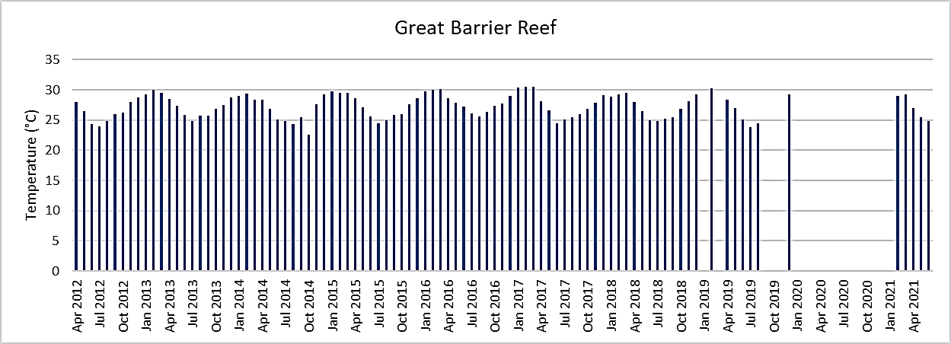
Dataset 1
Dataset 1
The top graph is a tally of coral trout <38cm from April 2012 to June 2021 in the GBR.
The bottom graph is a tally of coral trout >38cm from April 2012 to June 2021 in the GBR.
Below is a graph representing temperatures logged on GBRMPA’s Eye on the Reef over a 9 year period.

Slide 3
Dataset 1
Dataset 1
2 marks
Item 1 (apply understanding).
Determine the:
a. tally of coral trout <38cm in September 2015.
Answer:
b. the warmest summer year between 2012 and 2021.
Answer:
Item 2 (analyse evidence).
2 marks
Identify two trends, patterns or relationships.
Item 3 (interpret evidence).
3 marks
Predict the number of coral trout >38cm in June 2020. Justify your prediction using two pieces of evidence.

Slide 4
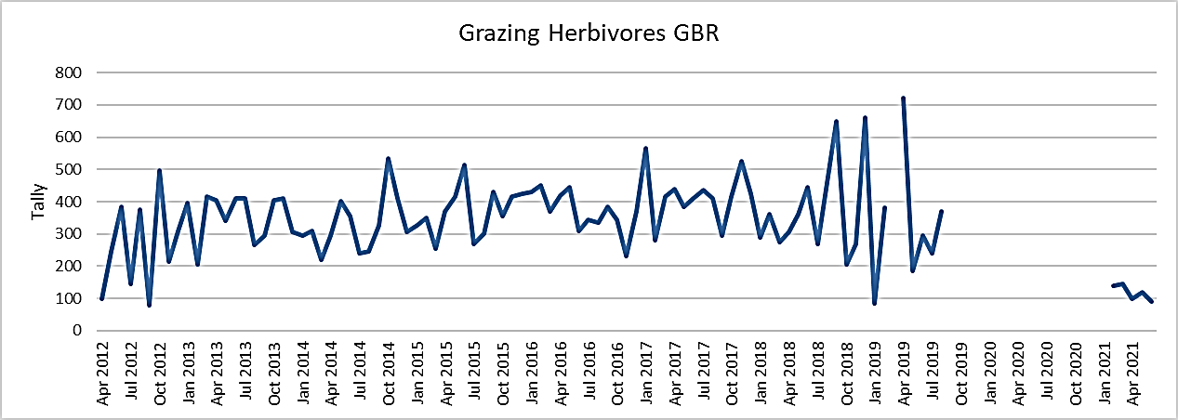
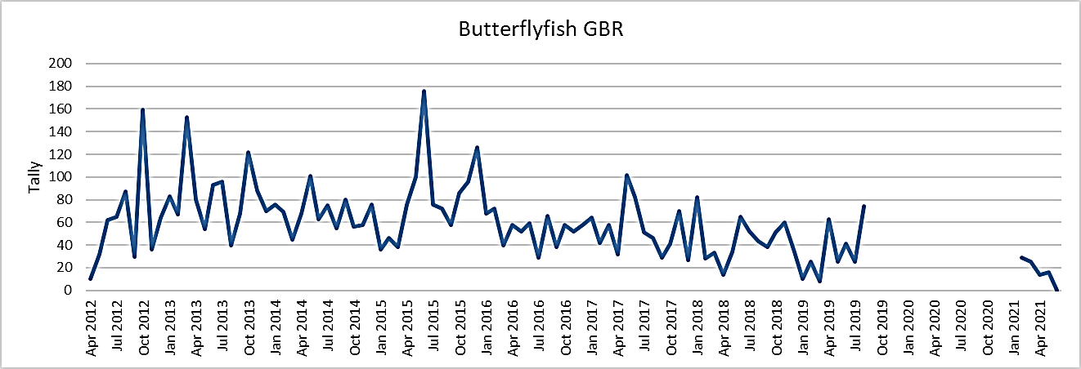
Dataset 2
Dataset 2
Below is a graph of the tally of grazing herbivores from April 2012 to April 2021 in the GBR.
Below is a graph of the tally of butterflyfish from April 2012 to April 2021 in the GBR.

Slide 5
Dataset 2
Dataset 2
2 marks
Item 4 (apply understanding).
Determine the:
a. month and year with the highest tally of grazing herbivores.
Answer:
b. month and year with the highest tally of butterflyfish.
Answer:
Item 2 (analyse evidence).
2 marks
Identify one limitation and one uncertainty.
Item 3 (interpret evidence).
3 marks
Compare the y-axis scales to draw a conclusion about the abundance of grazing herbivores versus the abundance of butterflyfish on the Great Barrier Reef.

Slide 6
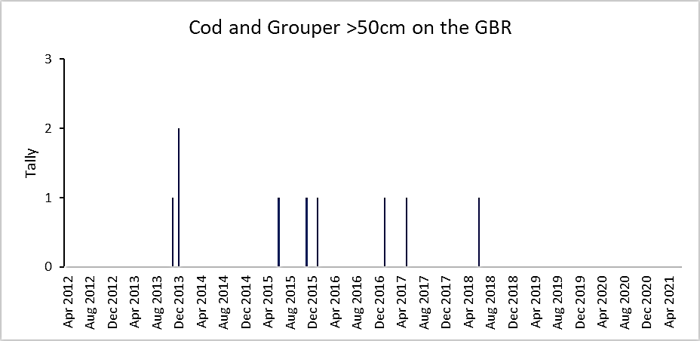
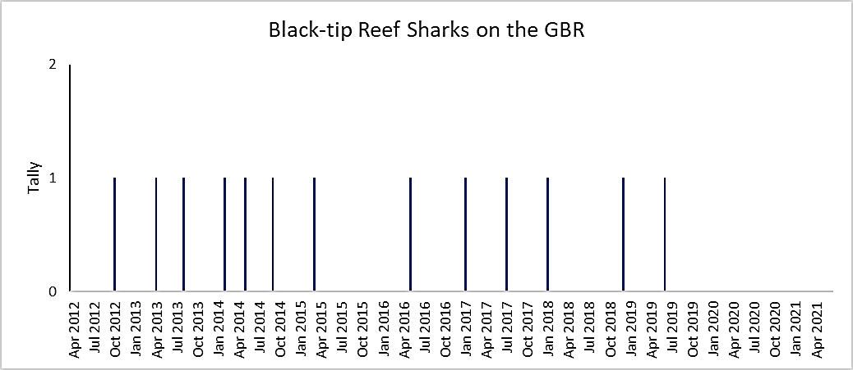
Dataset 3
Dataset 3
The Reef’s larger residents from April 2012 to April 2021 in the GBR are illustrated below.

Slide 7
Dataset 3
Dataset 3
2 marks
Item 7 (apply understanding).
Determine the highest number of cod and grouper >50cm in one tally.
Answer:
Item 8 (analyse evidence).
2 marks
Identify two trends, patterns or relationships.
Item 10 (interpret evidence).
3 marks
Use evidence to draw conclusions based on your analysis of the dataset.
END OF PAPER

Slide 8
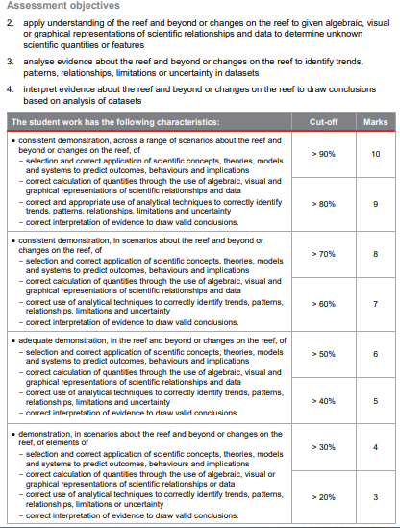
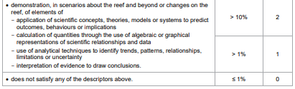
Notes:
https://www.qcaa.qld.edu.au/downloads/senior-qce/sciences/snr_marine_science_19_ia1_smple_ass_inst.pdf

