Slide 1
Be a Marine Biologist for a Day
Part 3: Making connections
Year 4
Notes:
Image: C. Jones, Copyright Commonwealth of Australia (GBRMPA)

Slide 2
Thank you for organising your trip to the reef with us. We had a great time and hope you did too.
This PowerPoint is Part 3 of the Be a Marine Biologist for a Day program designed for year 4 by the Great Barrier Reef Marine Park Authority (GBRMPA).
View this PowerPoint after your excursion, with the accompanying activity book.
This is Part 3: Making connections. This is the last part of the program. This is when your students make connections with all they’ve learned and experienced so far.
On your excursion, you conducted an Eye on the Reef citizen science activity with your reef guide. Now it’s time to upload your data to the GBRMPA website. It’s also time for students to check understanding by answering any questions in Parts 1 and 2.
The Great Barrier Reef Marine Park Authority would like to thank you for uploading your data to their Rapid Monitoring database. We hope to see you again next year!
Licensed by the Commonwealth of Australia for use under a Creative Commons By Attribution 4.0 International licence with the exception of content supplied by third parties and any photographs. http://creativecommons.org/licences/by/4.0

Slide 3
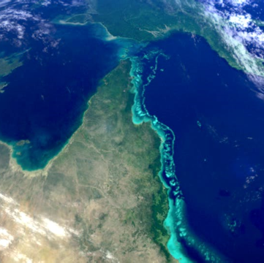
We would like to acknowledge all of the Aboriginal and Torres Straight Islander peoples who have connection to the Great Barrier Reef.
We recognise their continuing connection to land, water and community, and pay our respects to their Elders past, present and emerging.

Slide 4
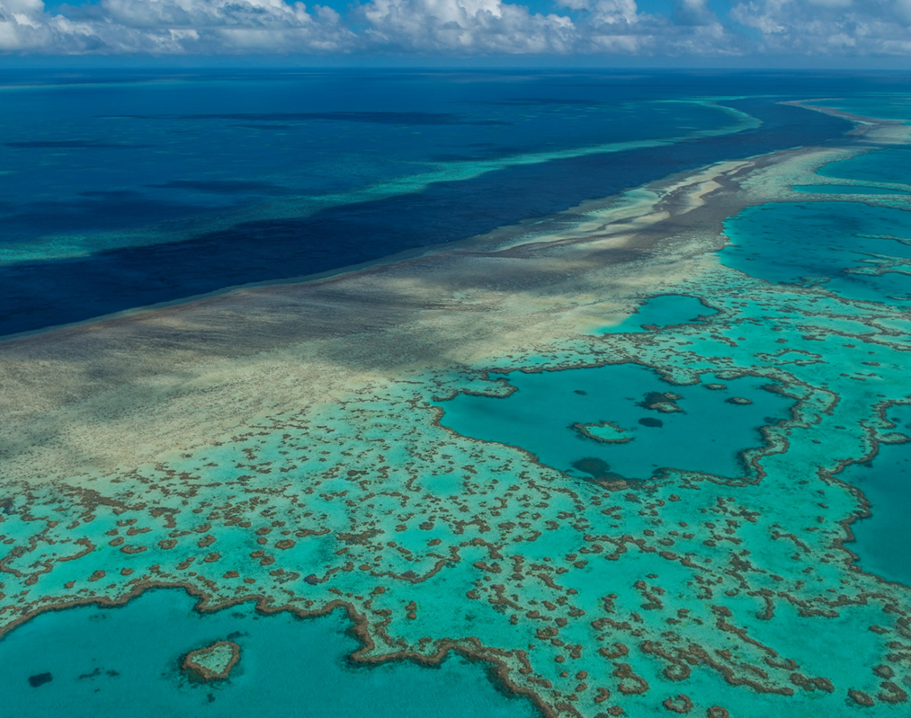
We would like to acknowledge the (insert name of local Traditional Owner group) peoples as the Traditional Owners of the Land and Sea Country that we visited as part of your excursion.

Slide 5
How can I help the Great Barrier Reef?
Notes:
This is the overarching inquiry question that encompasses the entire BAMBFAD Program and is the starting slide to this presentation.

Slide 6
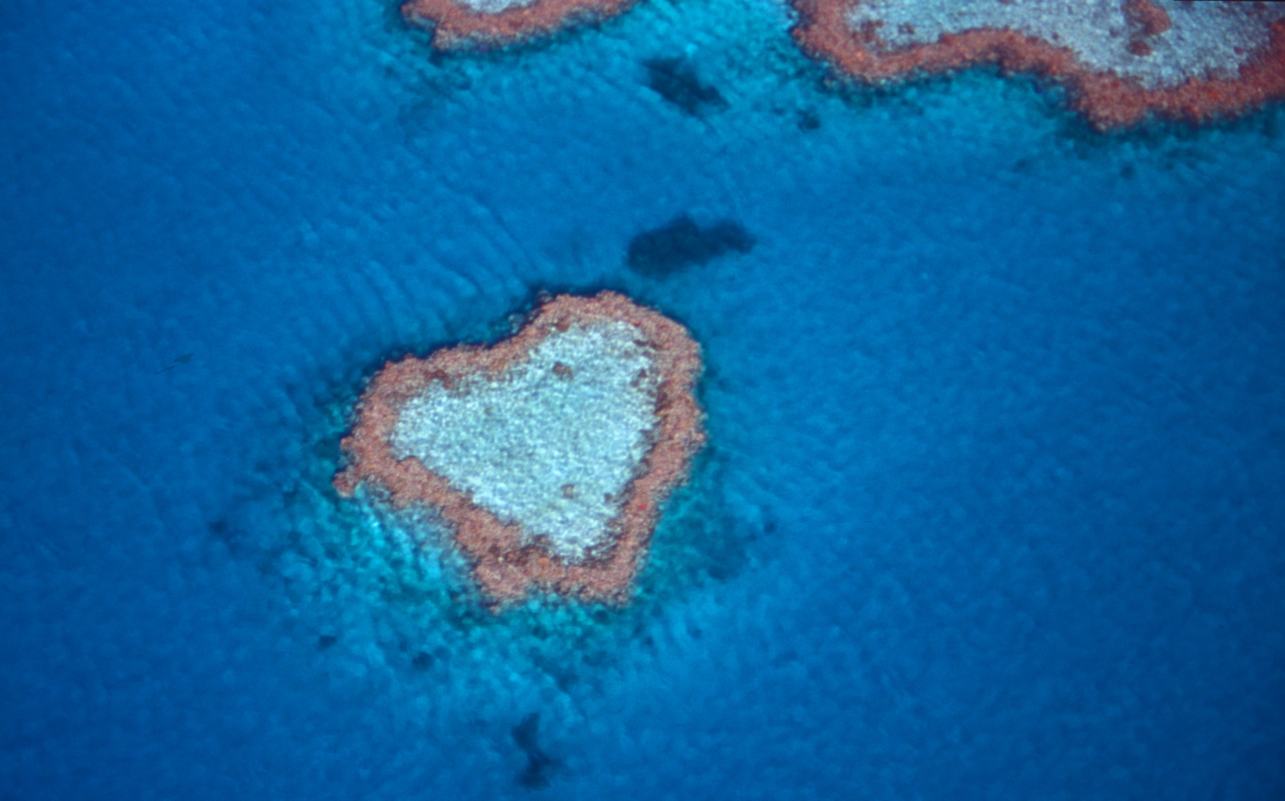
Notes:
Image: J. Johnson, Copyright Copyright Commonwealth of Australia (GBRMPA)

Slide 7
Hello again!
Thank you for helping me count the animals!
Notes:
Change name and picture to MRG (or not!)
Image: https://www.reefhq.com.au/_media/events/visit-reef-hq-digitally

Slide 8
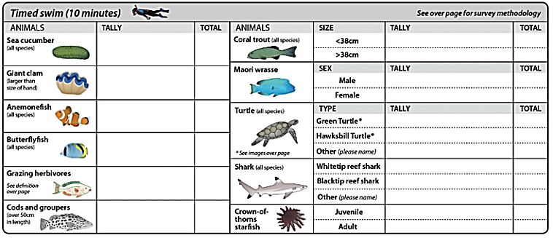
It’s now time to tell the Great Barrier Reef Marine Park Authority what you saw!

Slide 9
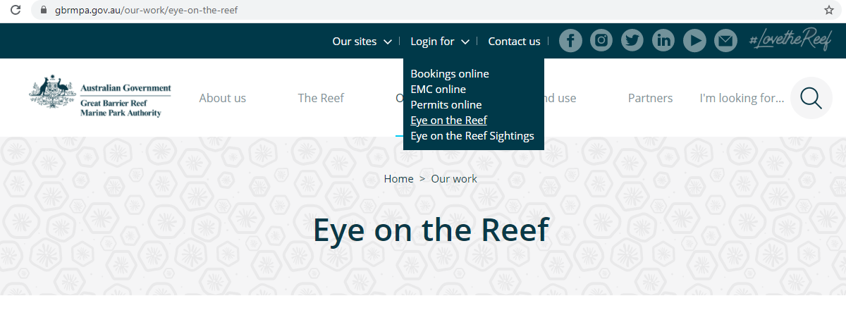
This is their website. The link to connect is provided at the end of this presentation.

Slide 10
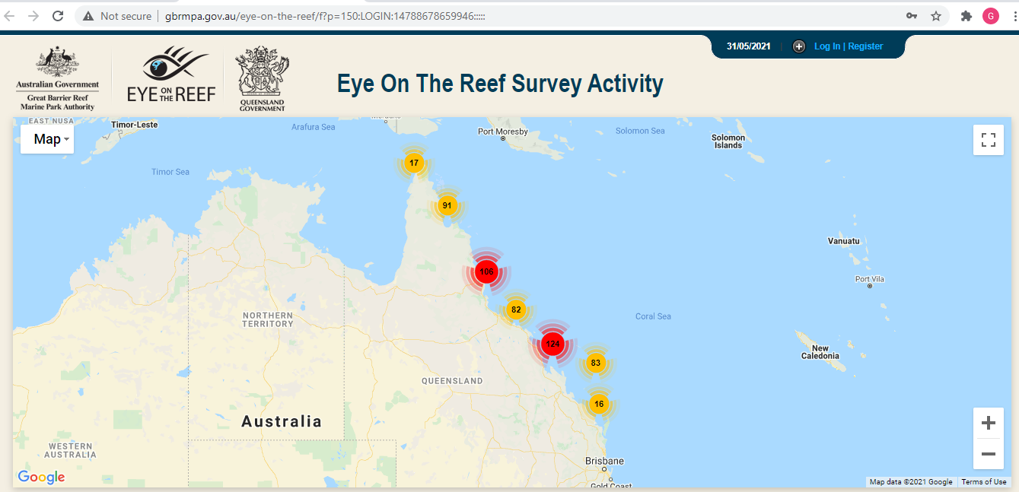
Login.

Slide 11
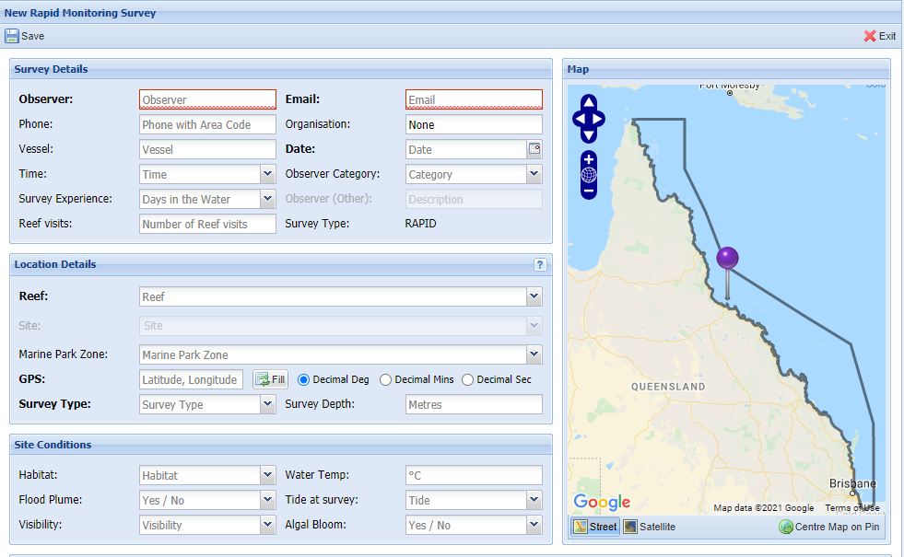
Select ‘Rapid Monitoring Survey’ tab.

Slide 12
Enter your data.

Slide 13
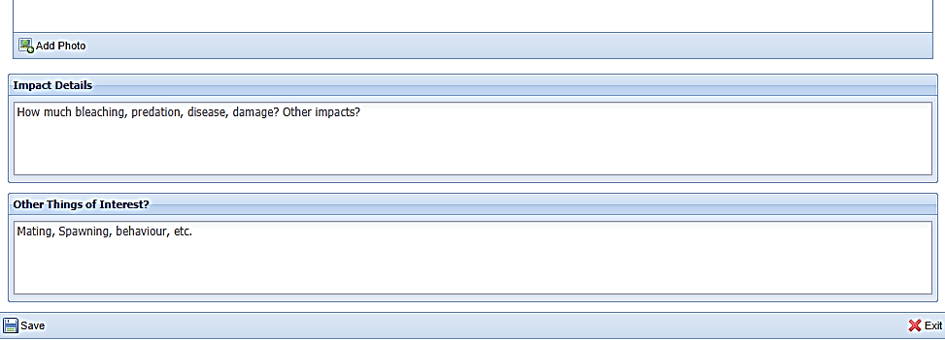
Save! Scroll down to the bottom of the page to ‘Save’.

Slide 14
Are you ready? Click on the image below to connect.
Notes:
www.gbrmpa.gov.au/our-work/eye-on-the-reef

Slide 15
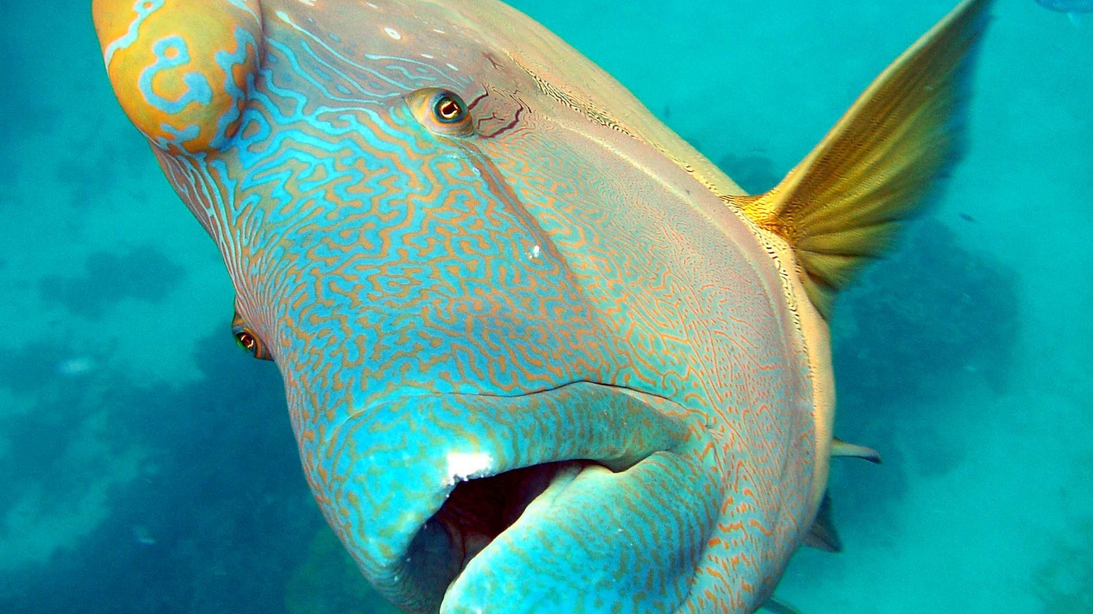
Thank you
Male Maori wrasse
Notes:
Image: C. Jones, Copyright Copyright Commonwealth of Australia (GBRMPA)

Slide 16
Check understanding.
Next, is what you’ve all been waiting for.
The answers to questions asked in Part 1 (before the excursion) and/or Part 2 (on the excursion).
Let’s check how you went!
Notes:
The following questions are straight from the Rapid Monitoring Survey course exam questions.

Slide 17
Sea cucumber
Notes:
Image: Copyright Commonwealth of Australia (GBRMPA)

Slide 18
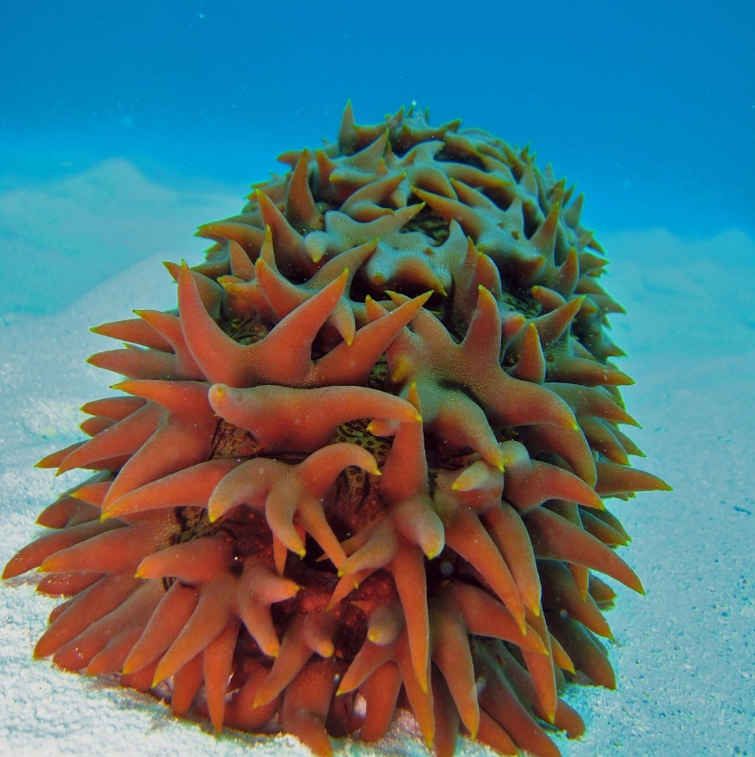
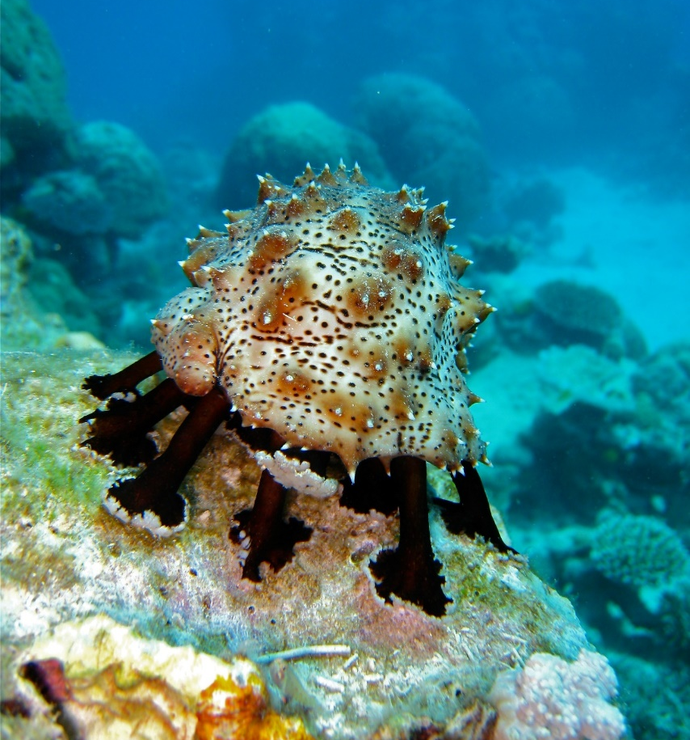
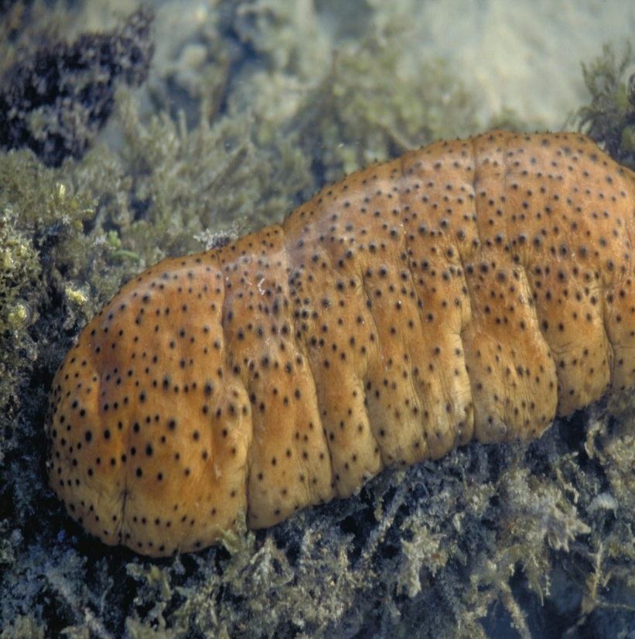
Why count sea cucumbers?
Notes:
Images: (Left) C. Jones, Copyright Copyright Commonwealth of Australia (GBRMPA); (Middle) C. Jones, Copyright Copyright Commonwealth of Australia (GBRMPA); (Right) J. Jones, Copyright Copyright Commonwealth of Australia (GBRMPA)

Slide 19
Hint: Sea cucumbers are the
vacuum cleaners of the sea.
Notes:
Image: J. Oliver, Copyright Commonwealth of Australia (GBRMPA)

Slide 20
They keep the sand clean and filtered.
Notes:
Image: C. Jones, Copyright Commonwealth of Australia (GBRMPA)

Slide 21
Giant clam
VULNERABLE TO EXTINCTION
Notes:
Image: Copyright Commonwealth of Australia (GBRMPA)

Slide 22
The biggest giant clam recorded was 1.4m.
Bigger than you!
Notes:
Image: K. Anthony, Copyright Commonwealth of Australia (GBRMPA)

Slide 23
Anemonefish
Notes:
Image: J. Sumerling, Copyright Commonwealth Government of Australia (GBRMPA)

Slide 24
How do anemonefish reproduce?
Notes:
Image: L. Zell, Copyright Commonwealth of Australia (GBRMPA)

Slide 25
They lay eggs.
Baby anemonefish can swim very fast soon after hatching.
Notes:
Image: L. Zell, Copyright Commonwealth of Australia (GBRMPA)

Slide 26
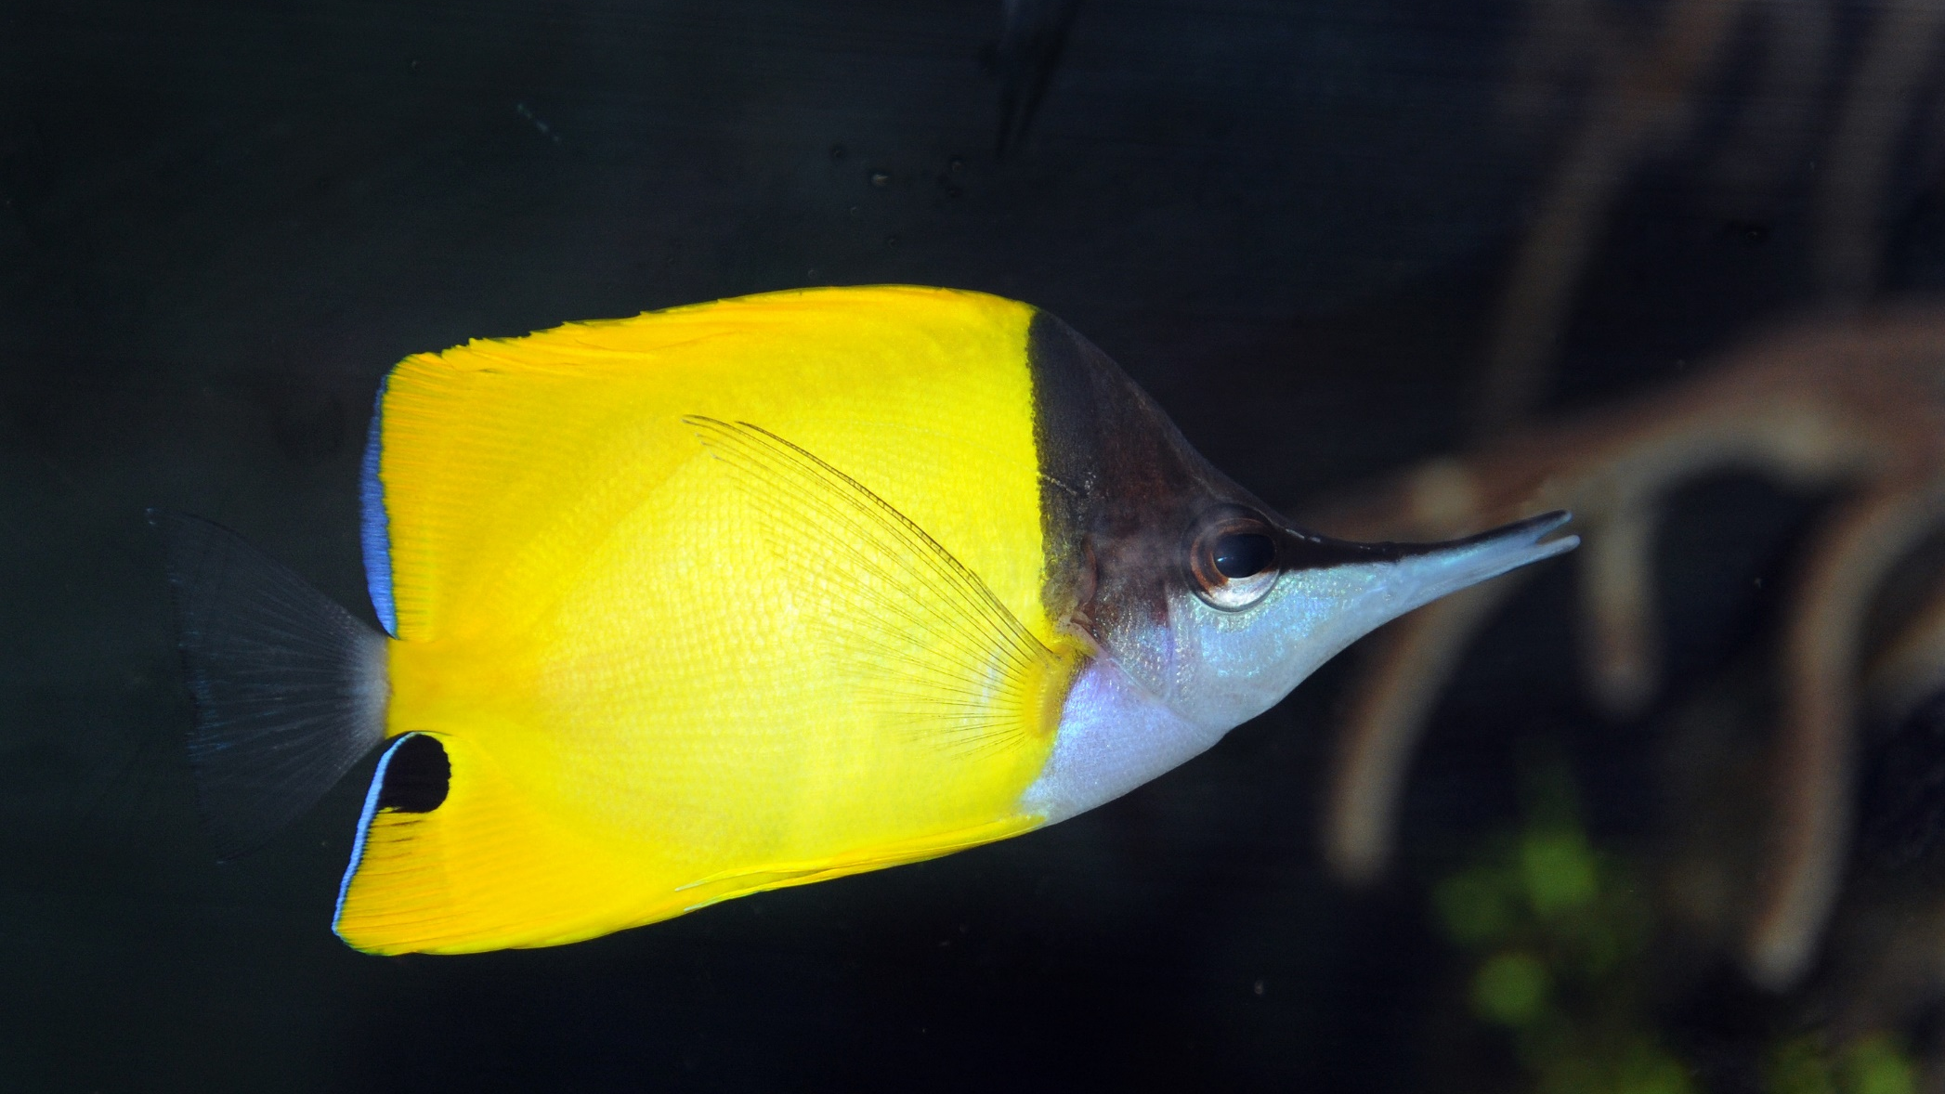
Butterflyfish
Bright colours and pretty patterns
Long snout and little mouth for eating coral polyps
Flat body
Notes:
Image: J. Jones, Copyright Commonwealth of Australia (GBRMPA)

Slide 27
Some have a fake eye spot.
Why?
Notes:
Image: J. Jones, Copyright Commonwealth of Australia (GBRMPA)

Slide 28
To trick their predators.
Notes:
Image: J. Jones, Copyright Commonwealth of Australia (GBRMPA)

Slide 29
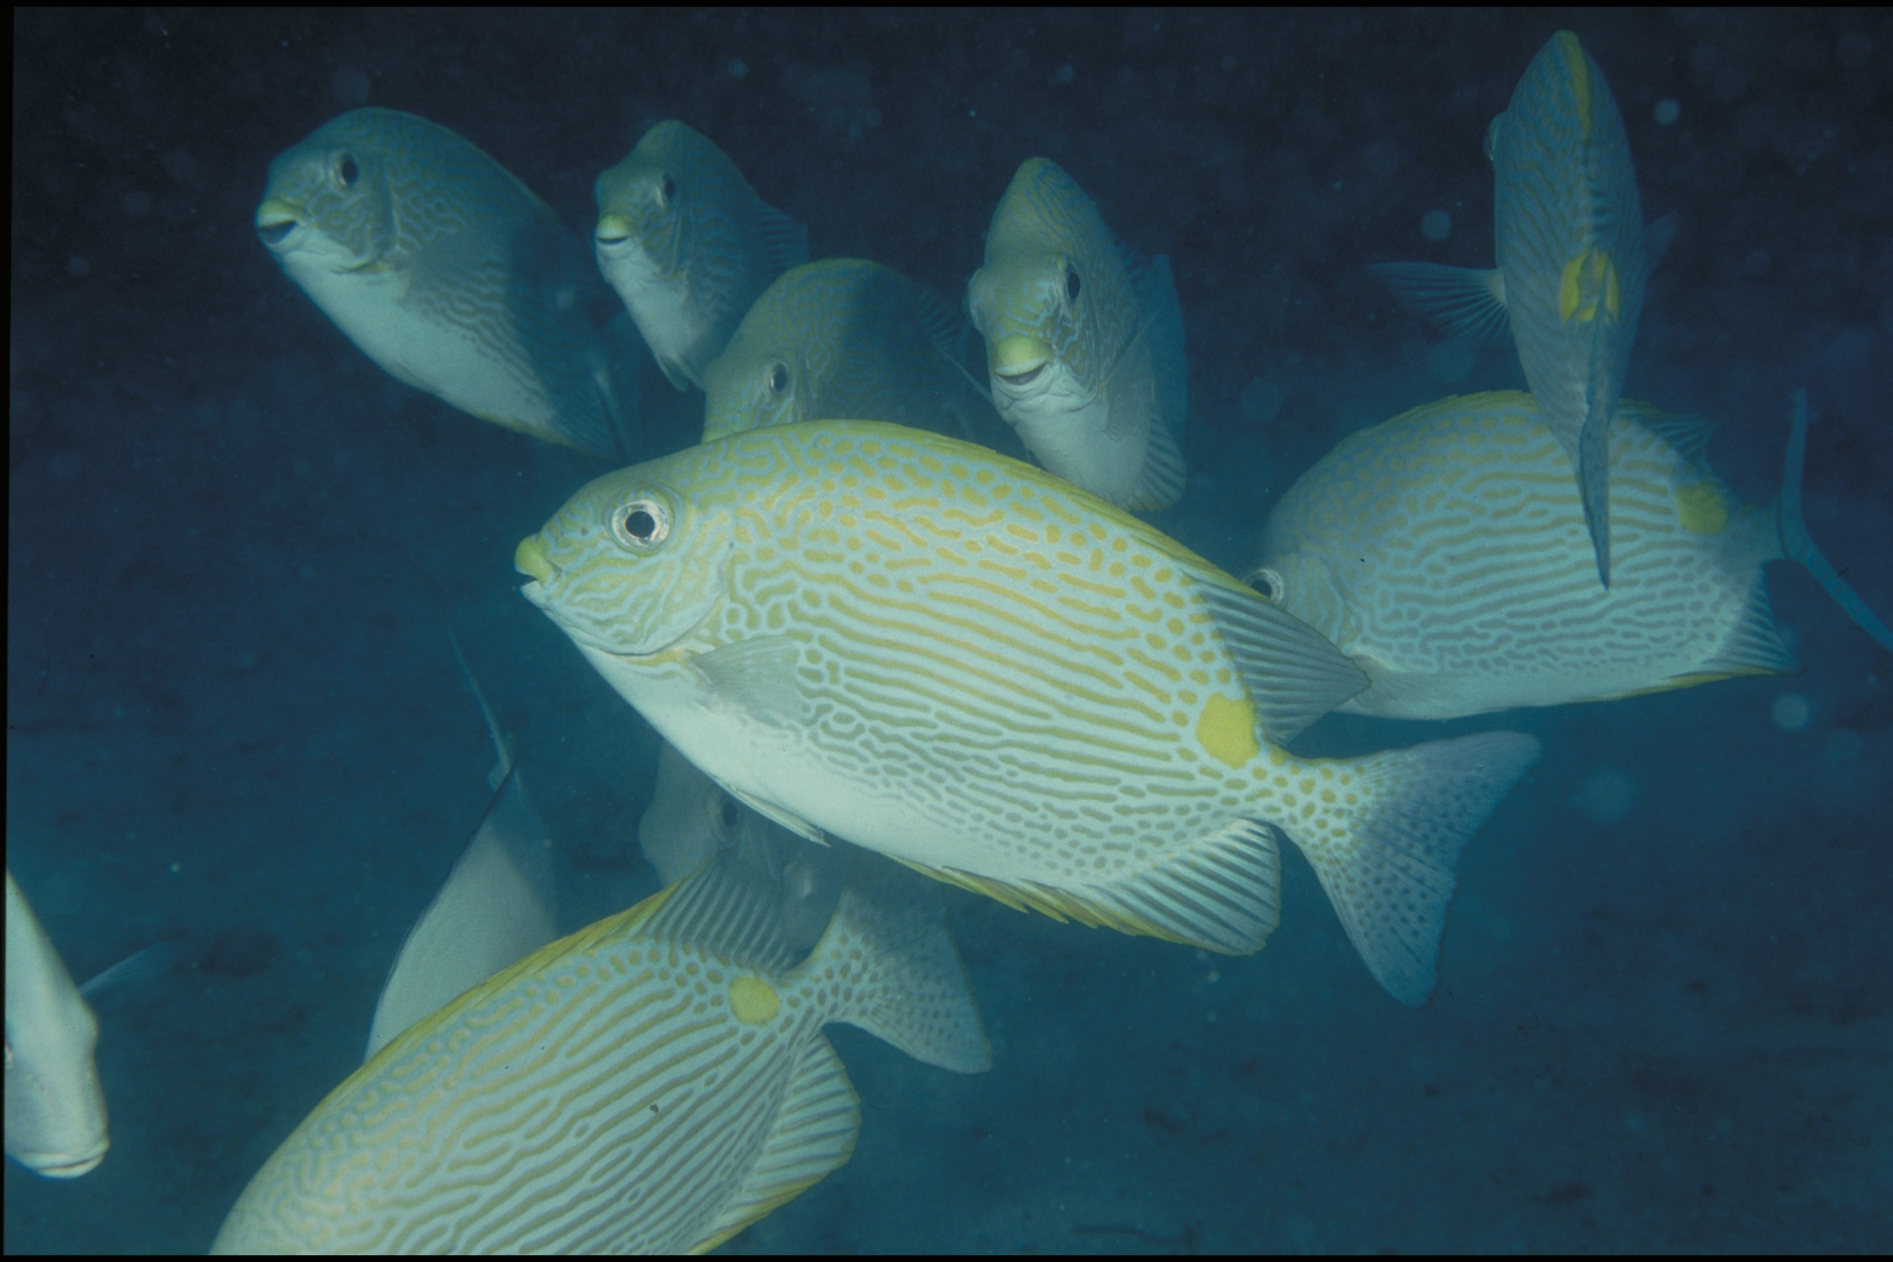
Grazing herbivores Parrotfish / Surgeonfish / Rabbitfish / Unicornfish
Notes:
Image: W. Gladstone, Copyright Commonwealth of Australia (GBRMPA)

Slide 30
Why are grazing herbivores called the lawnmowers of the Reef?
Notes:
Image: C. Jones, Copyright Commonwealth of Australia (GBRMPA)

Slide 31
Because they graze on so much algae.
Notes:
Image: C. Jones, Copyright Commonwealth of Australia (GBRMPA)

Slide 32
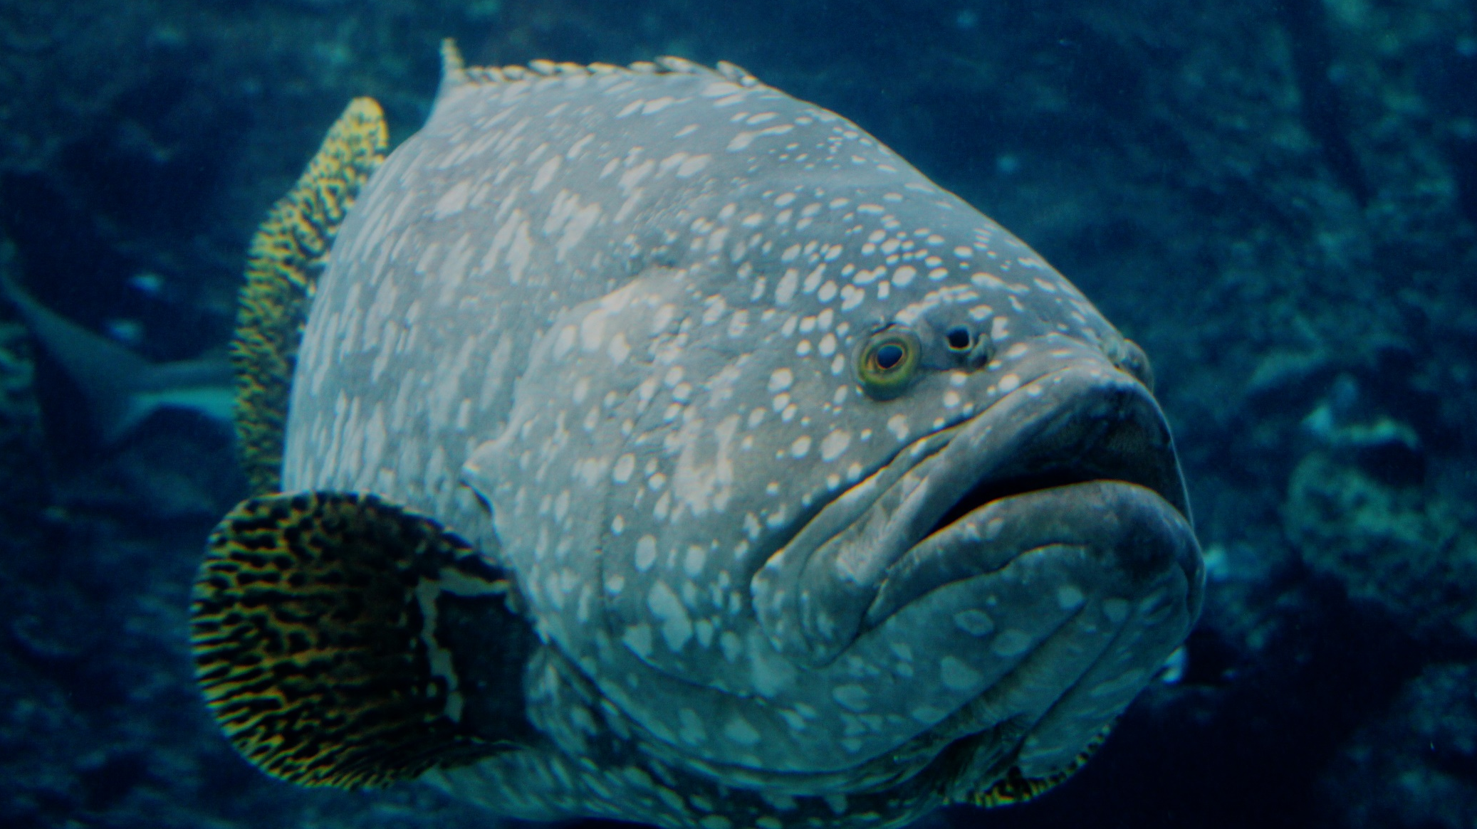
Cods and groupers Pronounced grow-per.
Notes:
Image: J. Hurford, Copyright Commonwealth of Australia (GBRMPA)

Slide 33
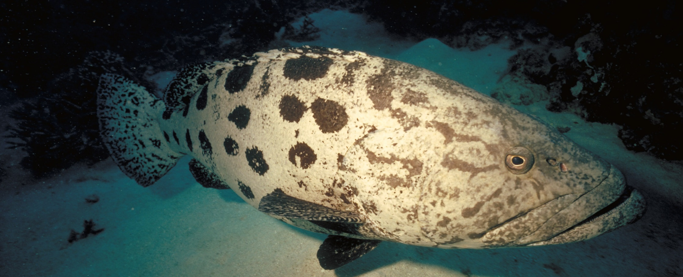
Is this big fish older than you?
Notes:
Image: P. McGinnity, Copyright Commonwealth of Australia (GBRMPA)

Slide 34
Yes!
Notes:
Image: P. McGinnity, Copyright Commonwealth of Australia (GBRMPA)

Slide 35
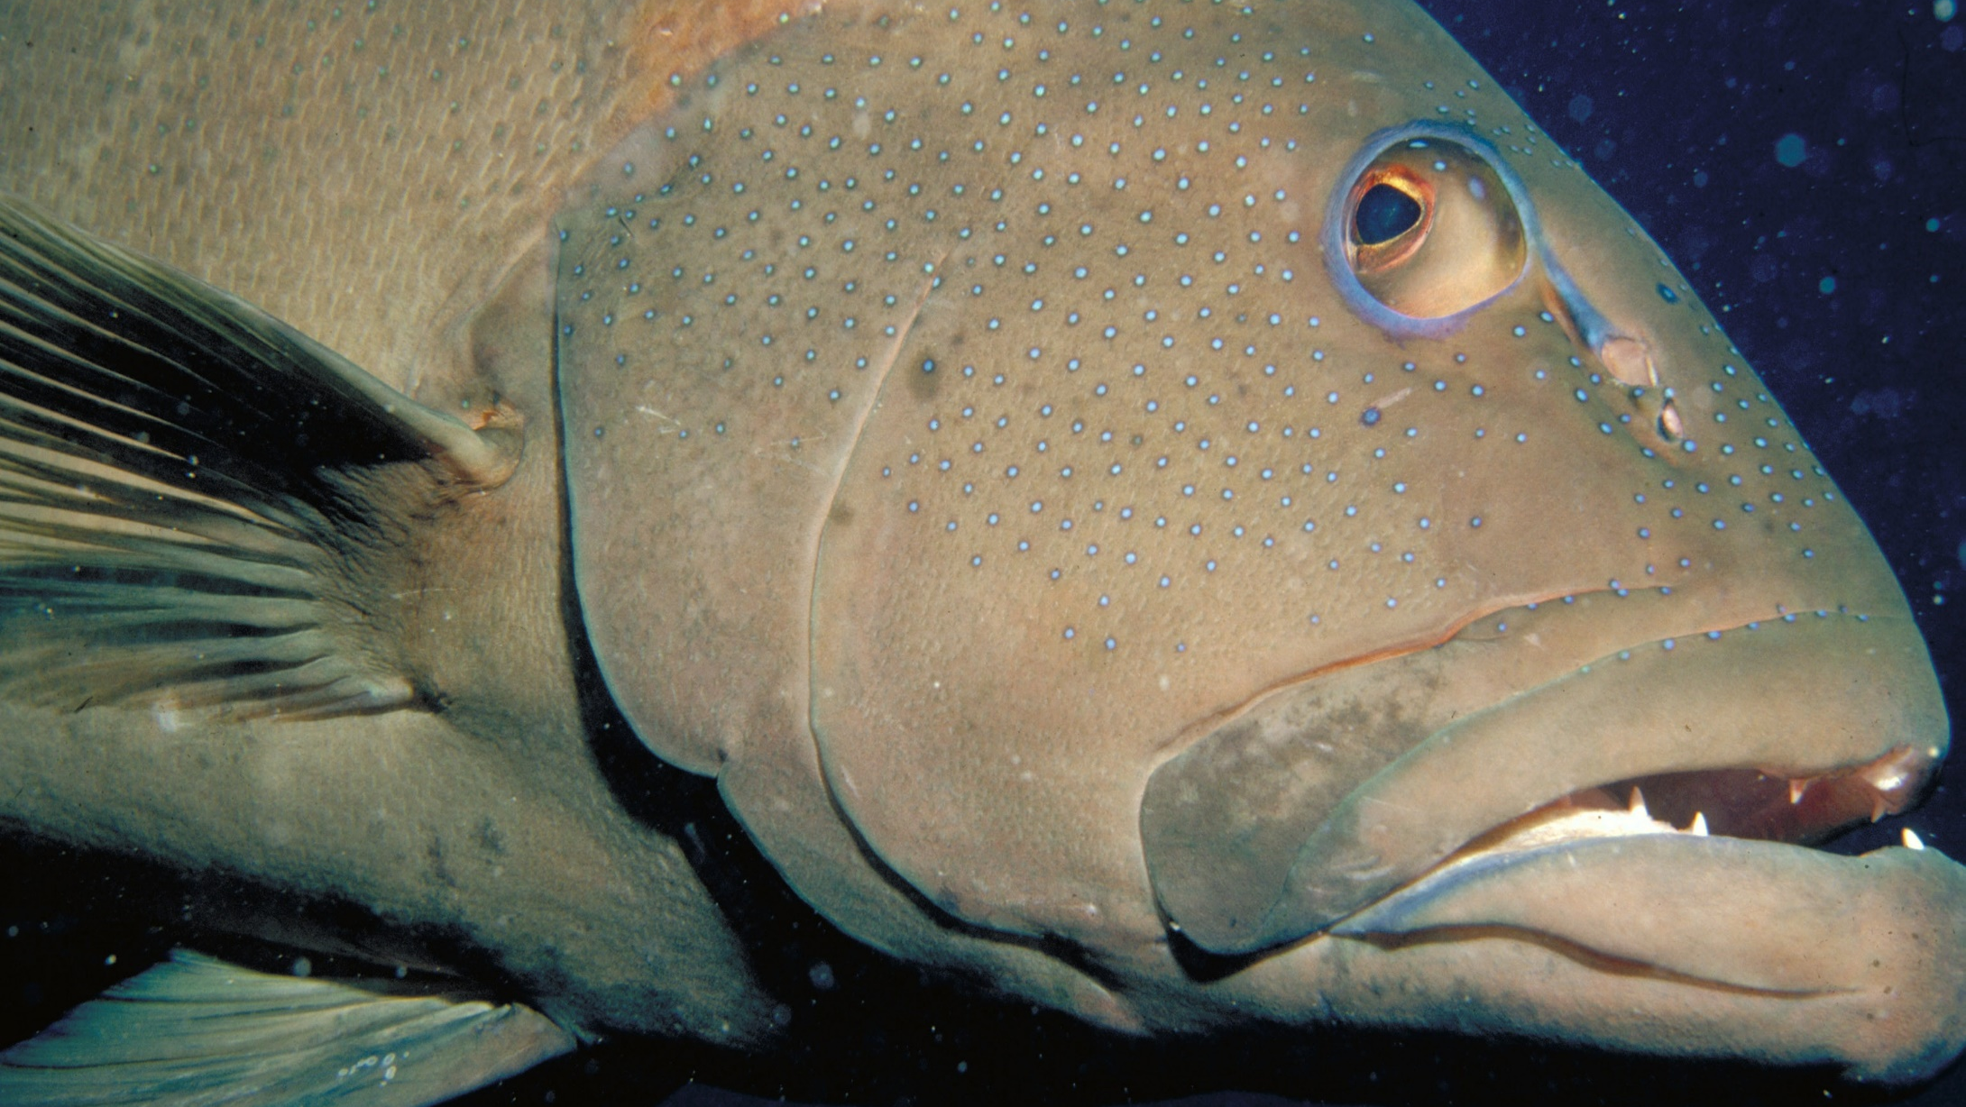
Coral trout
Notes:
Image: S. Summerhays, Copyright Commonwealth of Australia (GBRMPA)

Slide 36
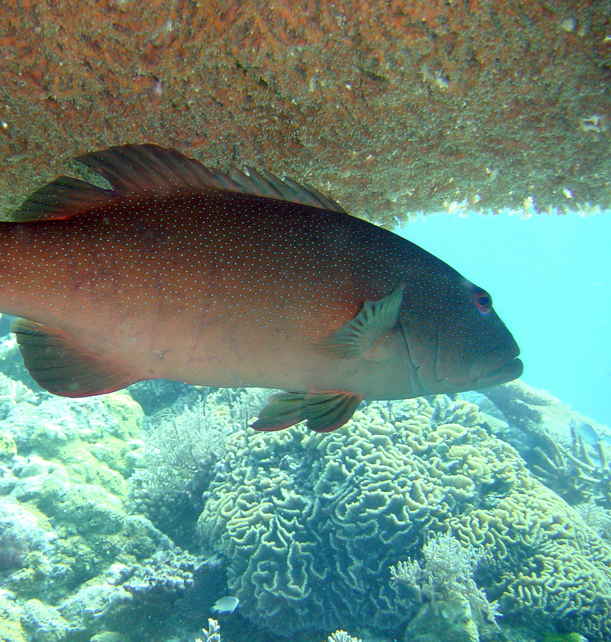
Where do they live?
Notes:
Image: G. Goby, Copyright Commonwealth of Australia (GBRMPA)

Slide 37
On the Reef, often hiding under ledges and overhangs.
Notes:
Image: T. Mayne, Copyright Commonwealth of Australia (GBRMPA)

Slide 38
How big must they be to keep?
Notes:
Image: A. Zell, Copyright Commonwealth of Australia (GBRMPA)

Slide 39
At least 38cm.
Notes:
Image: A. Zell, Copyright Commonwealth of Australia (GBRMPA)

Slide 40
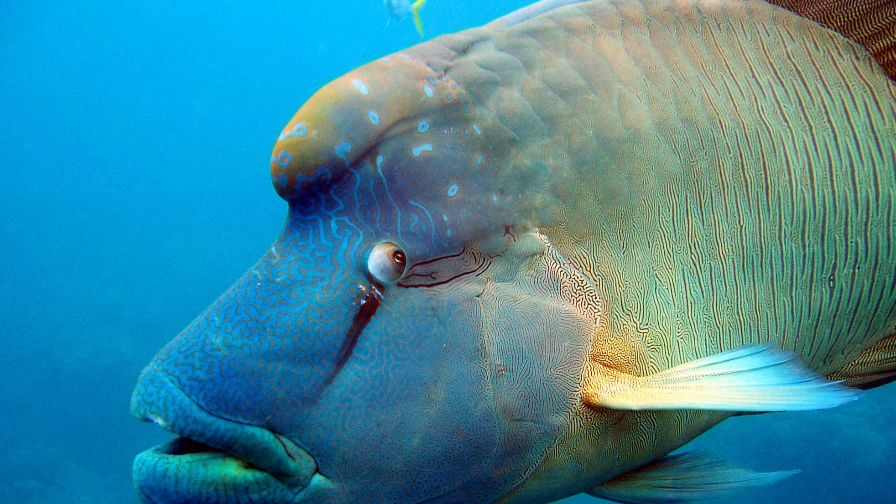
Maori wrasse also called humphead wrasse or Napoleon wrasse.
Notes:
Image: C. Jones, Copyright Commonwealth of Australia (GBRMPA)

Slide 41
Where do they live?
Notes:
Image: C. Jones, Copyright Commonwealth of Australia (GBRMPA)

Slide 42
Maori wrasse live on the Reef and occupy limited home ranges.
Notes:
Image: J. Monkivitch, Copyright Commonwealth of Australia (GBRMPA)

Slide 43
Adults swim across the reefs during the day, resting at night in caves and under coral ledges.
Notes:
Image: M. Simmons, Copyright Commonwealth of Australia (GBRMPA)

Slide 44
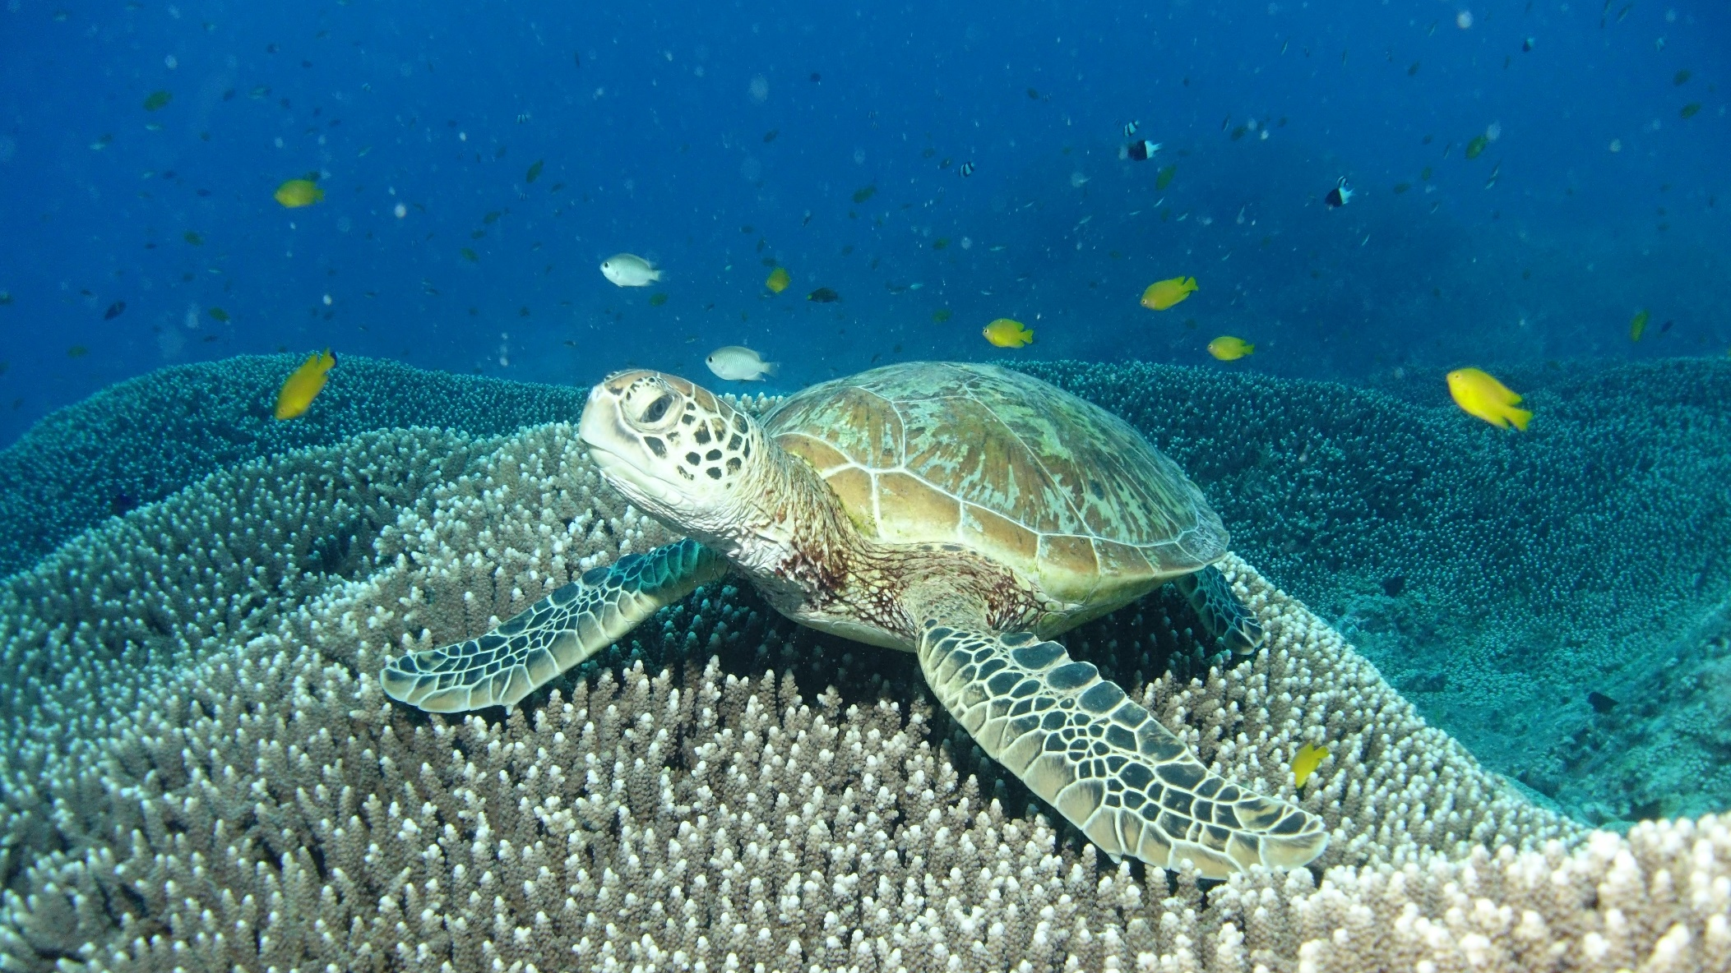
Sea turtles
Notes:
Image: C. Jones, Copyright Commonwealth of Australia (GBRMPA)

Slide 45
What do sea turtles eat that look like jellyfish?
Notes:
Image: C. Jones, Copyright Commonwealth of Australia (GBRMPA)

Slide 46
Plastic bags.
Notes:
Image: C. Jones, Copyright Commonwealth of Australia (GBRMPA)

Slide 47
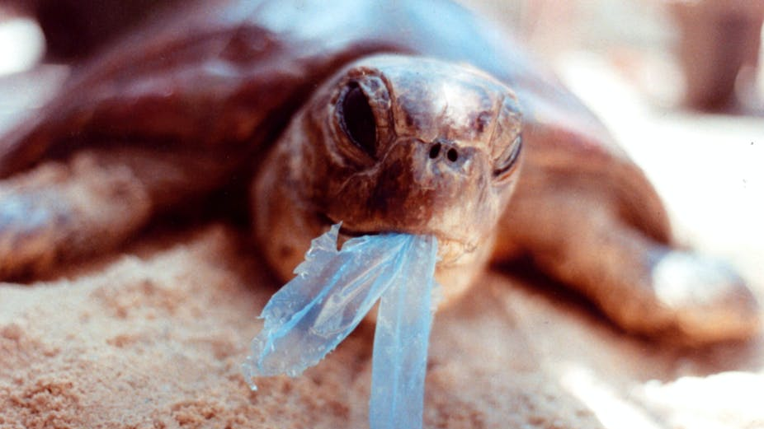
AAP Image/Department of the Environment and Heritage/Melbourne Zoo
Notes:
Image: https://theconversation.com/ghostnets-fish-on-marine-rubbish-threatens-northern-australian-turtles-11585

Slide 48
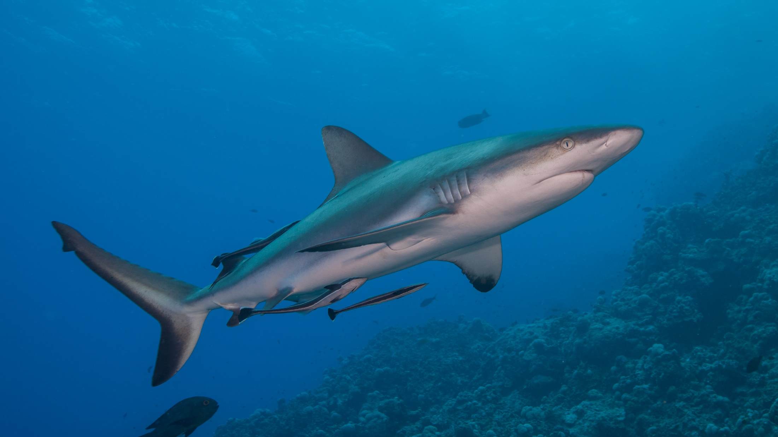
Sharks
Notes:
Image: J. Sumerling, Copyright Commonwealth of Australia (GBRMPA)

Slide 49
Do all sharks need to keep swimming to breathe?

Slide 50
No.
Some sharks sit on the bottom and breathe by ‘gulping’.
Notes:
Image: K. Hoppen, Copyright Commonwealth of Australia (GBRMPA)

Slide 51
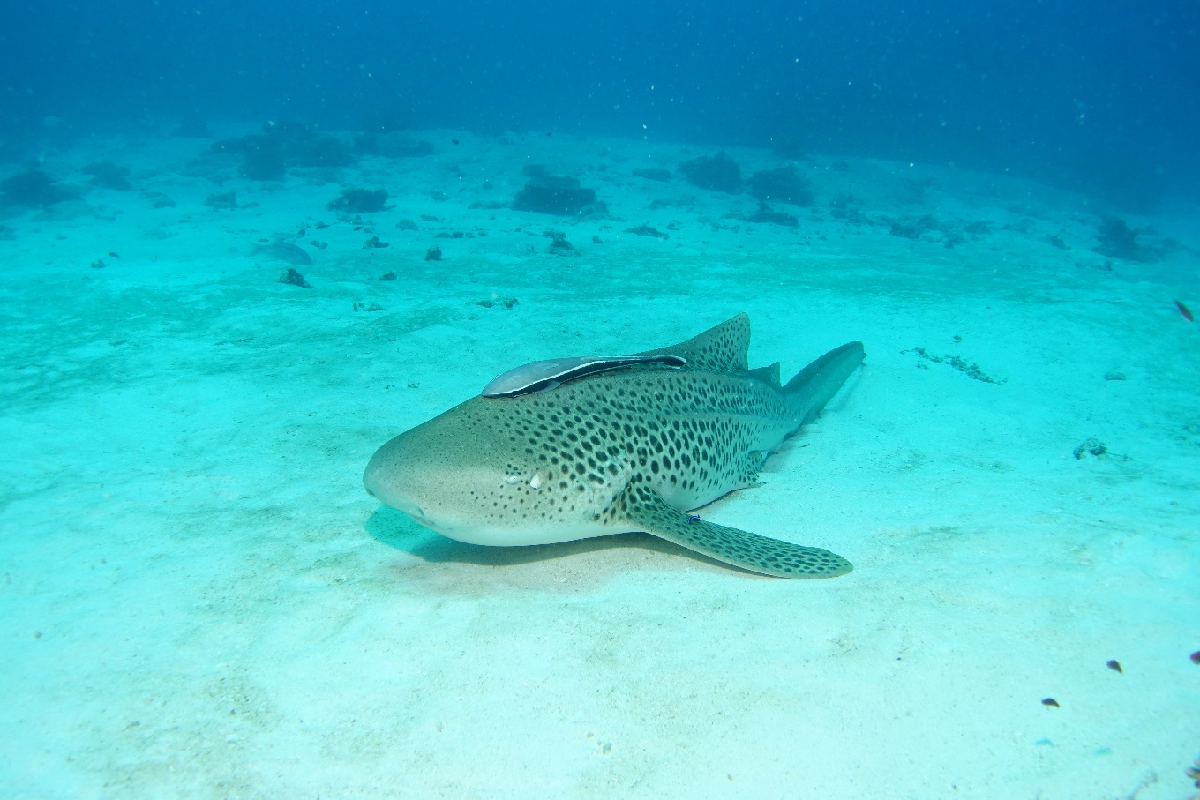
Why count sharks?
Notes:
Images: (Left) J. Sumerling, Copyright Commonwealth of Australia (GBRMPA); (Right) C. Jones, Copyright Commonwealth of Australia (GBRMPA)

Slide 52
Sharks keep the Reef balanced and healthy.
Notes:
Image: K. Hoppen, Copyright Commonwealth of Australia (GBRMPA)

Slide 53
Many sharks are threatened with extinction.
Notes:
Image: C. Jones, Copyright Commonwealth of Australia (GBRMPA)

Slide 54
How did you go?

Slide 55
Now that you have learnt about some of the animals on the Great Barrier Reef, how do you think you can help protect them?

Slide 56
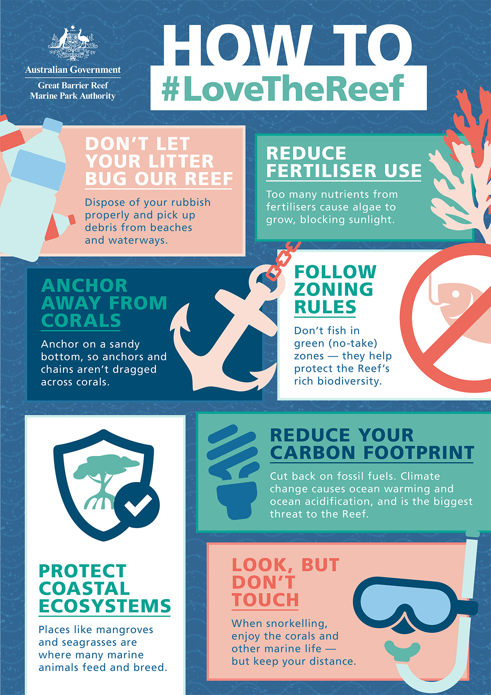
What actions can you take to protect the Great Barrier Reef?

Slide 57
Download the Eye on the Reef app.
Notes:
App image: https://www.gbrmpa.gov.au/__data/assets/pdf_file/0020/265430/Eye-on-the-Reef-app-poster.pdf

Slide 58
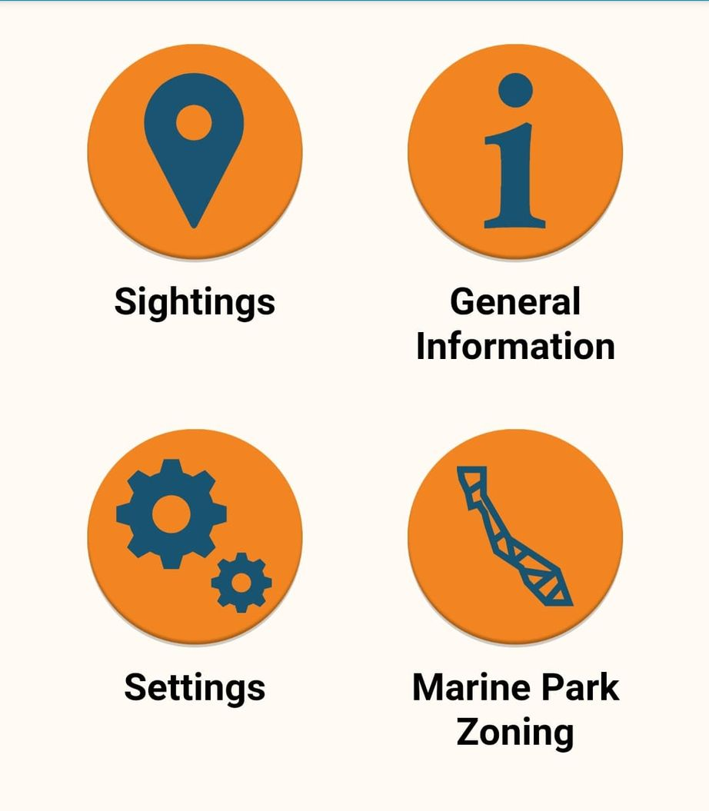
Press “Sightings” and “Create”.

Slide 59
Press “Wildlife”.

Slide 60
Marine mammals.
Select your animal and press “INFORMATION” to learn more.

Slide 61
Marine reptiles.

Slide 62
Sharks and rays.

Slide 63
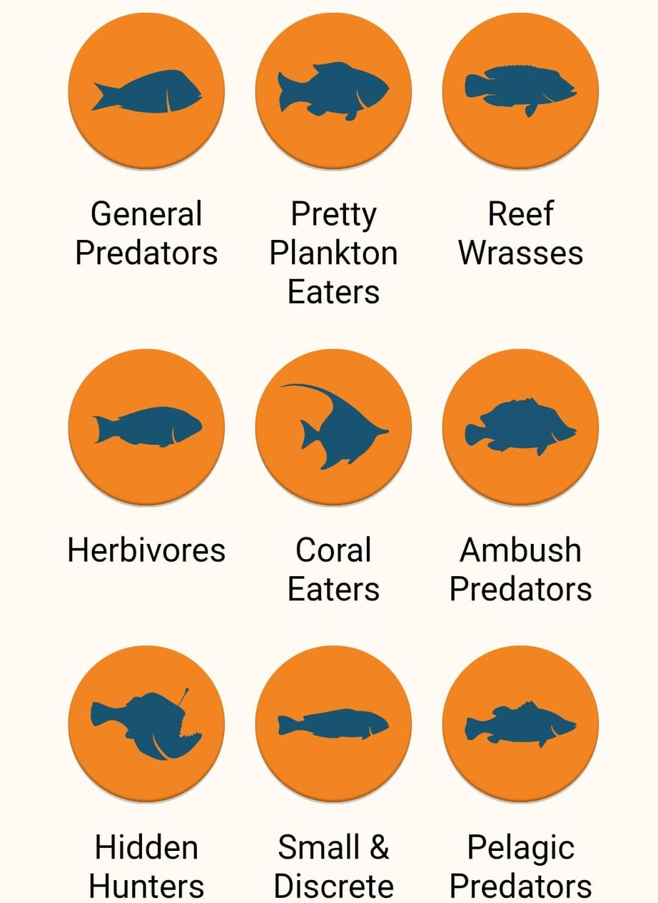
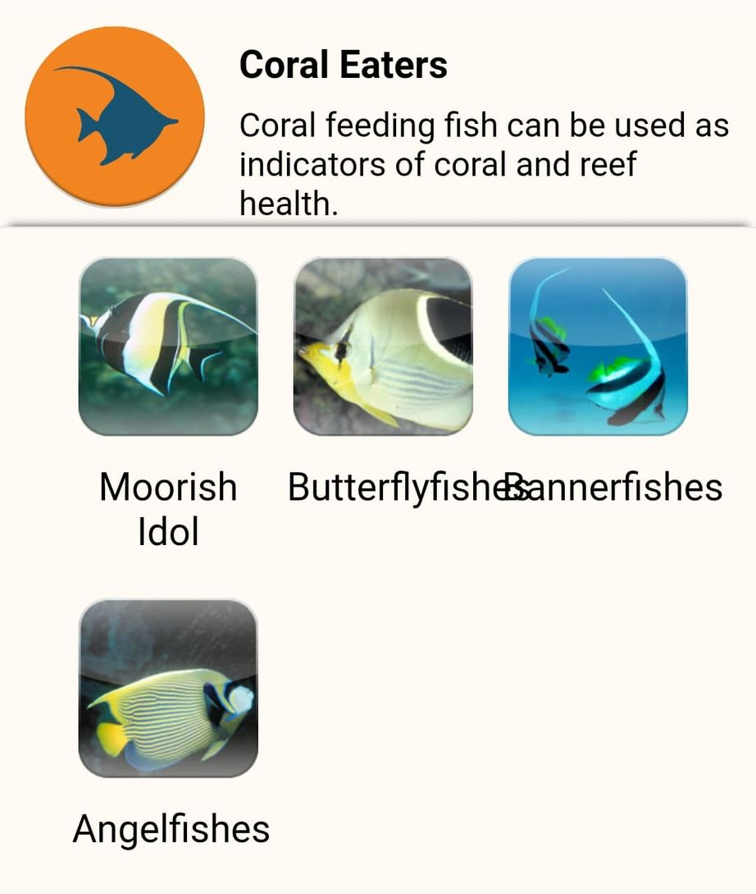
Fishes.

Slide 64
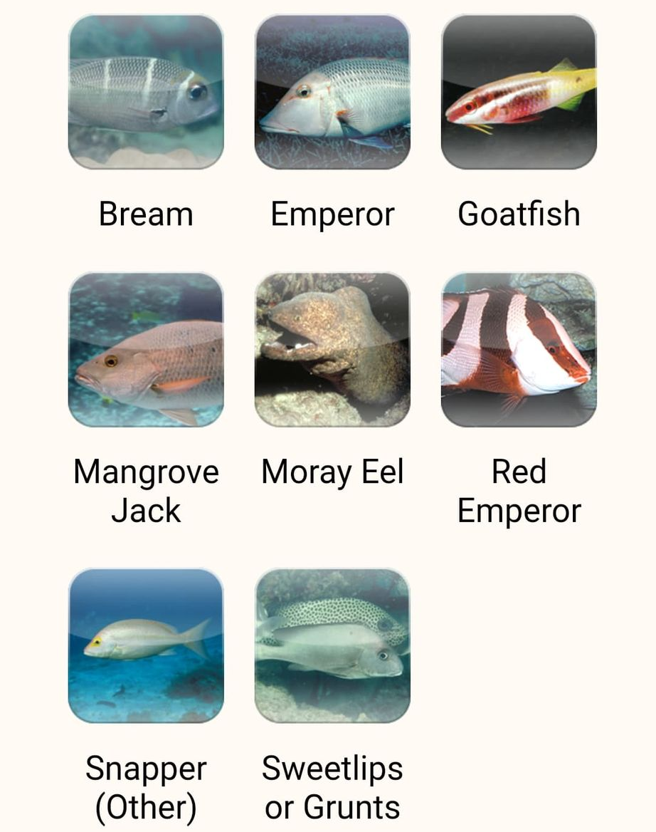

Slide 65
Birds.

Slide 66
Invertebrates.

Slide 67
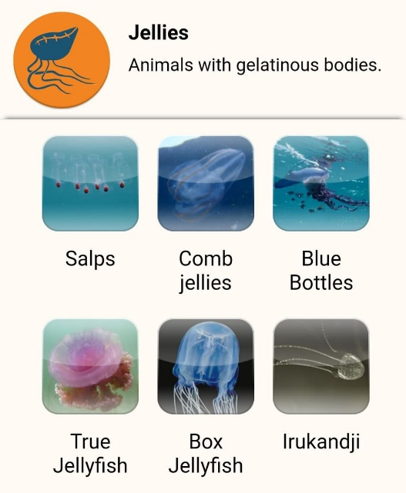
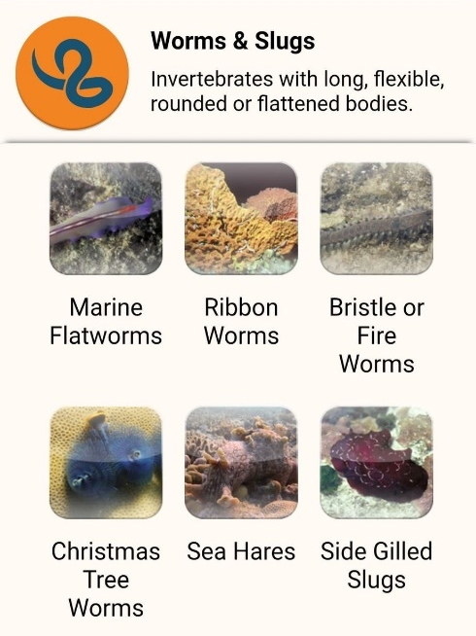
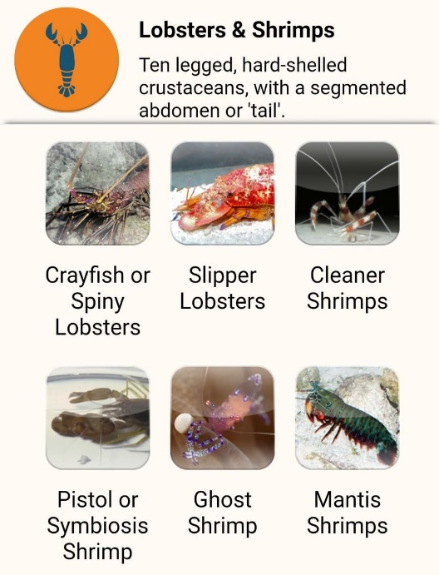
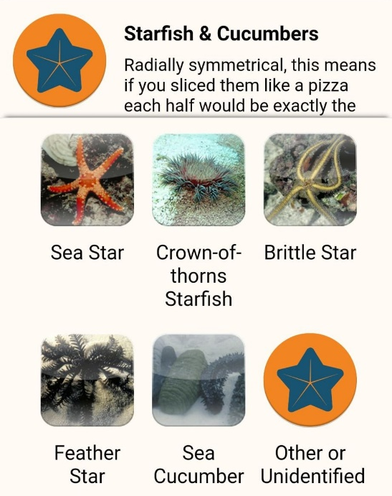
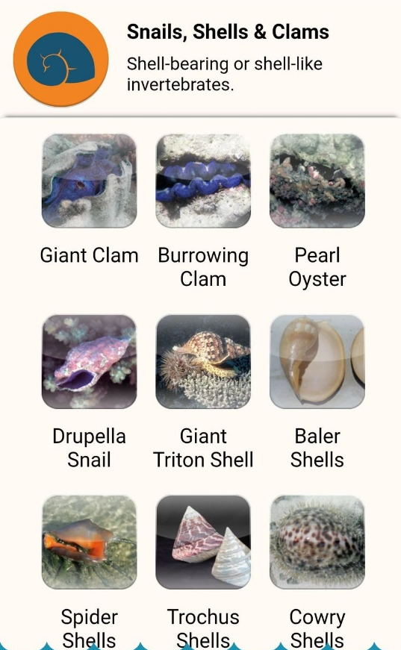
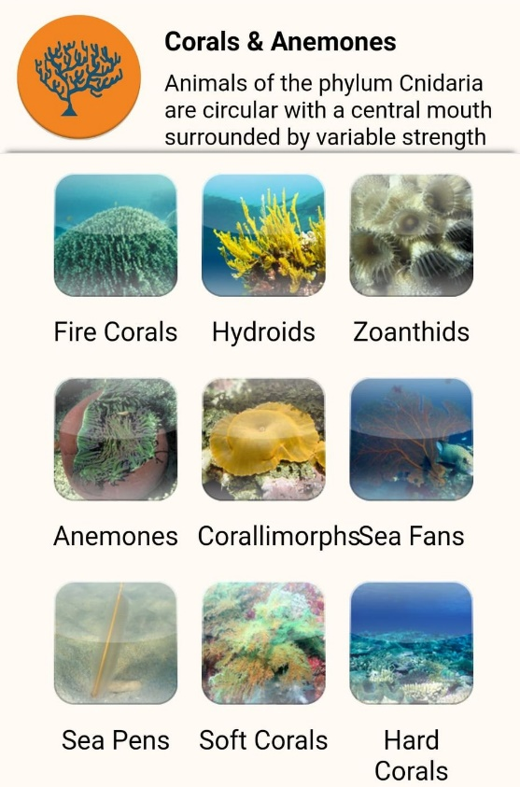
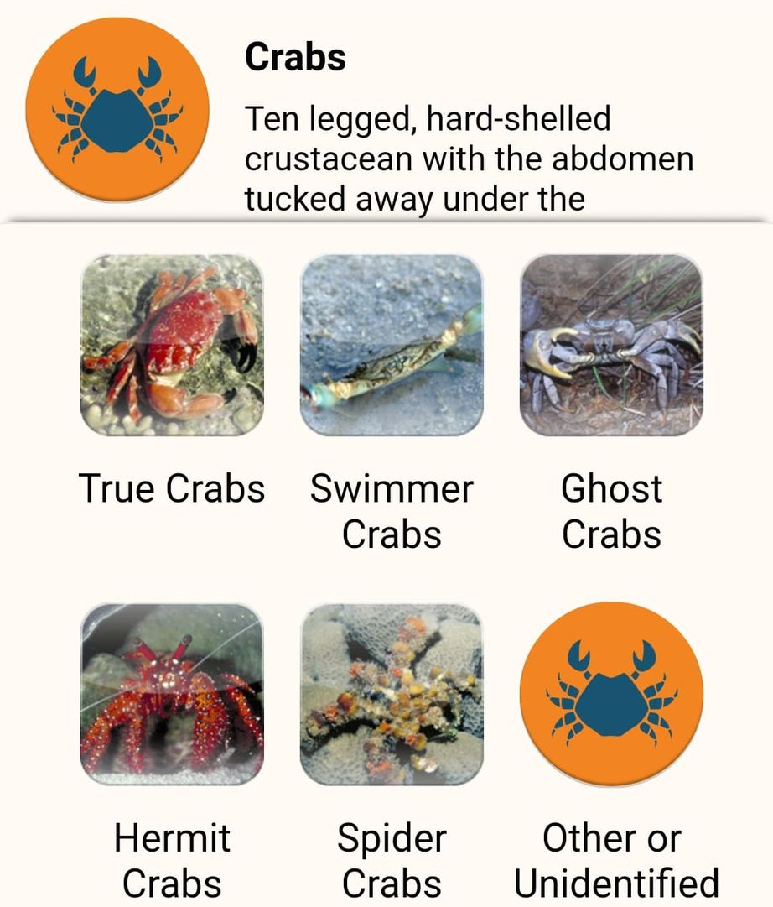

Slide 68
Explore the other tabs too!

Slide 69
Create a poster to answer the question:
How can I help the Great Barrier Reef?
Display it proudly in your classroom.
Notes:
This is the last slide for students to view. The remaining slides are for the teachers.

Slide 70
Thank you for helping the Great Barrier Reef!
See the Reef • Love the Reef • Protect the Reef

