Slide 1
Be a Marine Biologist for a Day
Part 2: Finding out
Primary School
Pre-snorkel presentation for modified 10 minute timed survey
Notes:
Image: C. Jones, Copyright Commonwealth of Australia (GBRMPA)

Slide 2
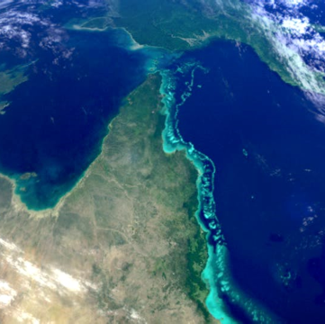
We would like to acknowledge all of the Aboriginal and Torres Straight Islander peoples who have connection to the Great Barrier Reef.
We recognise their continuing connection to land, water and community, and pay our respects to their Elders past, present and emerging.

Slide 3
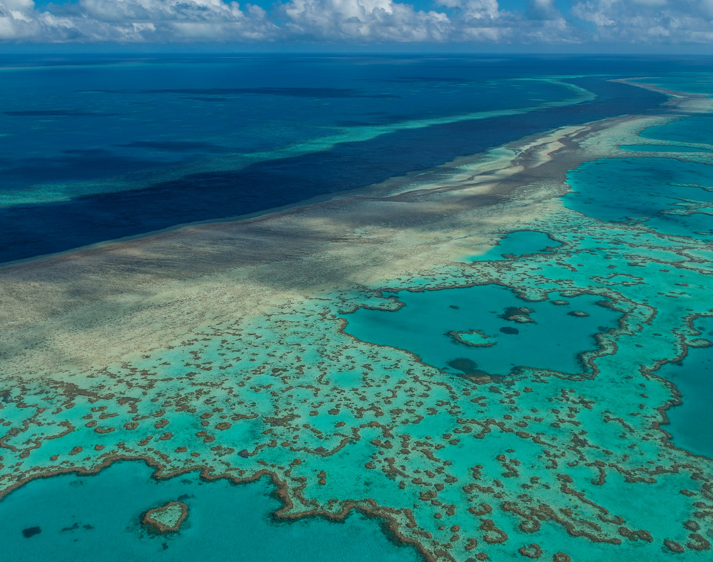
We would like to acknowledge the (insert name of local Traditional Owner group) peoples as the Traditional Owners of the Land and Sea Country that we are visiting as part of your excursion.

Slide 4
The pages are organised so that when you flip to the next page, and the students have it in front of them to see, you’re reading out loud the corresponding text on the back of the previous page.
Year | Mandatory ACARA Content Elaborations
Prep to year 3 | Biology – living things: Prep: Living things have basic needs, including food and water. Year 1: Living things have a variety of external features. Living things live in different places where their needs are met. Year 2: Living things grow, change and have offspring similar to themselves. Year 3: Living things can be grouped on the basis of observable features and can be distinguished from non-living things. Geography – places: Prep: The reasons why some places are special to people, and how they can be looked after. Year 1: The natural, managed and constructed features of places, their location, how they change and how they can be cared for. Year 2: The influence of purpose, distance and accessibility on the frequency with which people visit places. Year 3: The representation of Australia as states and territories and as Countries/Places of Aboriginal and Torres Strait Islander Peoples; and major places in Australia, both natural and human.
4 | Biology – life cycle, survival: Living things have life cycles. Living things depend on each other and the environment to survive. Geography – sustainability: The main characteristics of the continents of Africa and South America and the location of their major countries in relation to Australia. The importance of environments, including natural vegetation, to animals and people. The custodial responsibility Aboriginal and Torres Strait Islander Peoples have for Country/Place, and how this influences views about sustainability. The use and management of natural resources and waste, and the different views on how to do this sustainably.
5 | Biology – adaptations: Living things have structural features and adaptations that help them to survive in their environment. Geography – people and place: The influence of people on the environmental characteristics of places in Europe and North America and the location of their major countries in relation to Australia. The influence of people, including Aboriginal and Torres Strait Islander Peoples, on the environmental characteristics of Australian places The environmental and human influences on the location and characteristics of a place and the management of spaces within them. The impact of bushfires or floods on environments and communities, and how people can respond.
6 | Biology – growth, survival: The growth and survival of living things are affected by physical conditions of their environment. Geography – the world: The geographical diversity of the Asia region and the location of its major countries in relation to Australia. Differences in the economic, demographic and social characteristics of countries across the world. The world’s cultural diversity, including that of its indigenous peoples. Australia’s connections with other countries and how these change people and places.
Notes:
This PowerPoint is designed for you to (edit and) save as a PDF and print to use as a flip book at the snorkel site.
Print double-sided (along short side). Print and laminate. Or print on waterproof paper (sold at OfficeWorks).
Hole punch and secure along the top (ensure pages can flip over easily). Flip the pages over as you go.
The pages are organised so that when you flip to the next page, and the students have it in front of them to see, you’re reading out loud the corresponding text on the back of the previous page.

Slide 5
How can I help the Great Barrier Reef?
Notes:
This is the overarching inquiry question that encompasses the entire BAMBFAD Program and is the starting slide to this presentation.

Slide 6
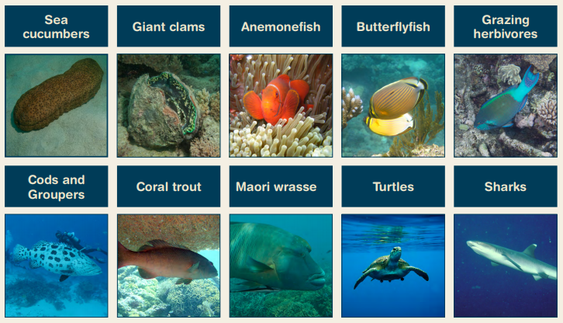
What we count in 10 minutes.
Notes:
Idea: you could organise a prize for the person with the most correct answers?

Slide 8
Sea cucumbers.
Prep – year 3
Year 4
Year 5
Year 6
Biology: living things Geography: places
What does a sea cucumber look like? Hint: Name. Answer: A cucumber.
How can you tell it’s alive? Answer: They move slow and poop lots!
Biology: life cycle, survival Geography: sustainability
Why are sea cucumbers called the vacuum cleaners of the sea? Answer: They clean and filter the sand, which keeps the reef healthy.
Biology: adaptations Geography: people & place
How do sea cucumbers move? This is an open inquiry question. Answer: With their tube feet and rhythmic contractions of their bodies.
Biology: growth, survival Geography: the world
Why has this sea cucumber ejected its internal organs? Answer: It felt threatened.
How long does it take to grow back? Answer: 2-3 weeks.

Slide 9
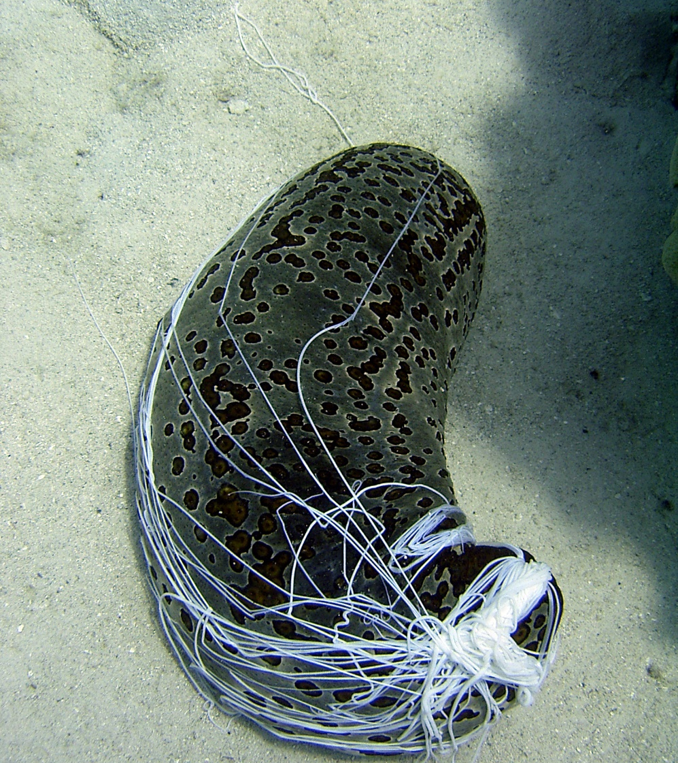
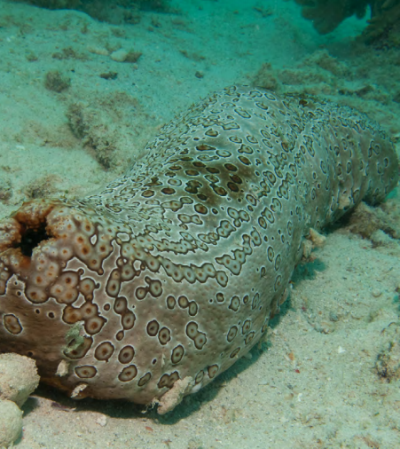
Sea cucumbers
Mouth
Anus
Sticky
internal organs
Notes:
Images: (Left) C. Jones, Copyright Commonwealth of Australia (GBRMPA); (Right) Copyright Commonwealth of Australia (GBRMPA)

Slide 10
Why count sea cucumbers?
Do not answer the question. Wait for an answer.
Sea cucumbers = clean sand = healthy reef.
Sea cucumbers are the vacuum cleaners of the sea.

Slide 11
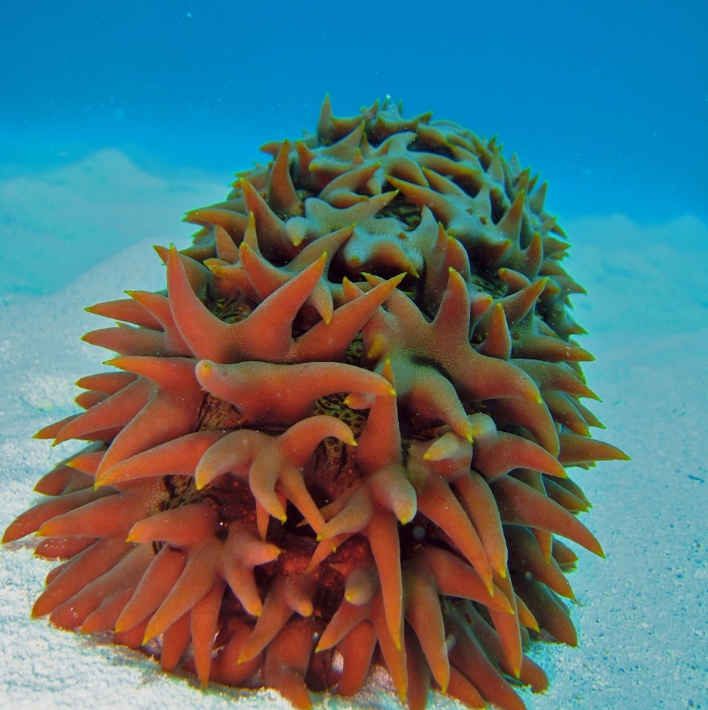
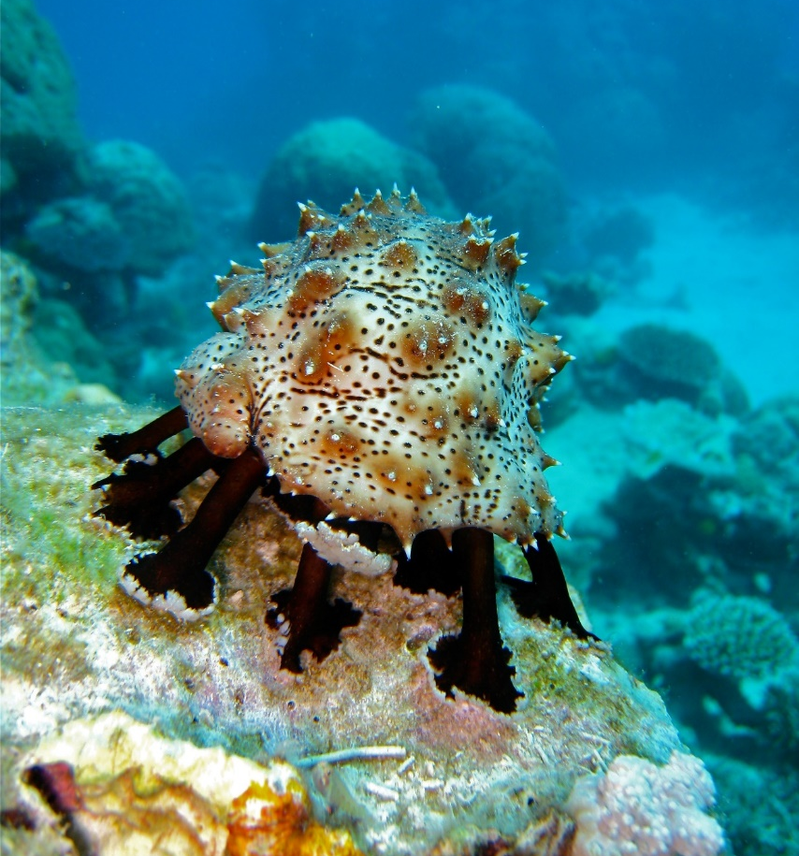
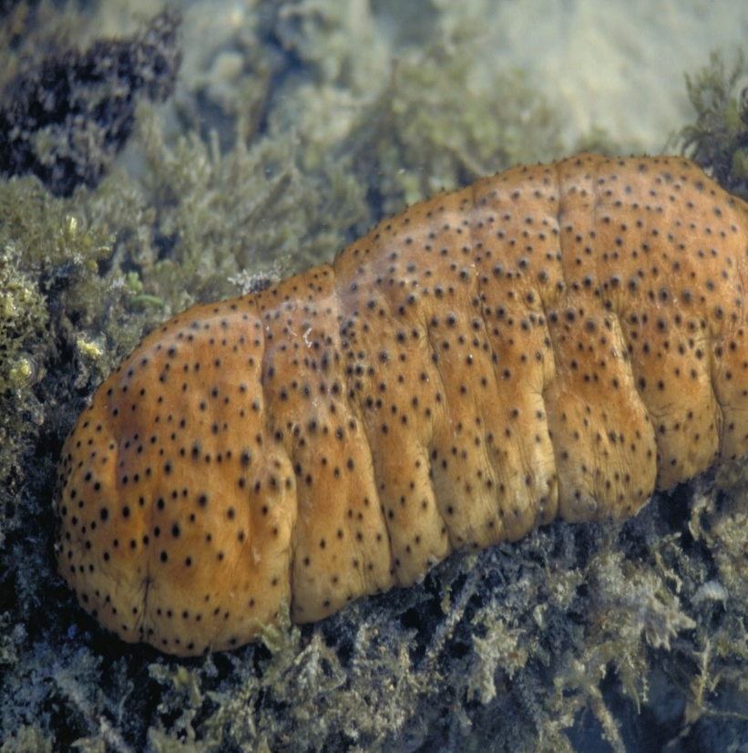
Why count sea cucumbers?
Notes:
Images: (Left) C. Jones, Copyright Copyright Commonwealth of Australia (GBRMPA); (Middle) C. Jones, Copyright Copyright Commonwealth of Australia (GBRMPA); (Right) J. Jones, Copyright Copyright Commonwealth of Australia (GBRMPA)

Slide 12
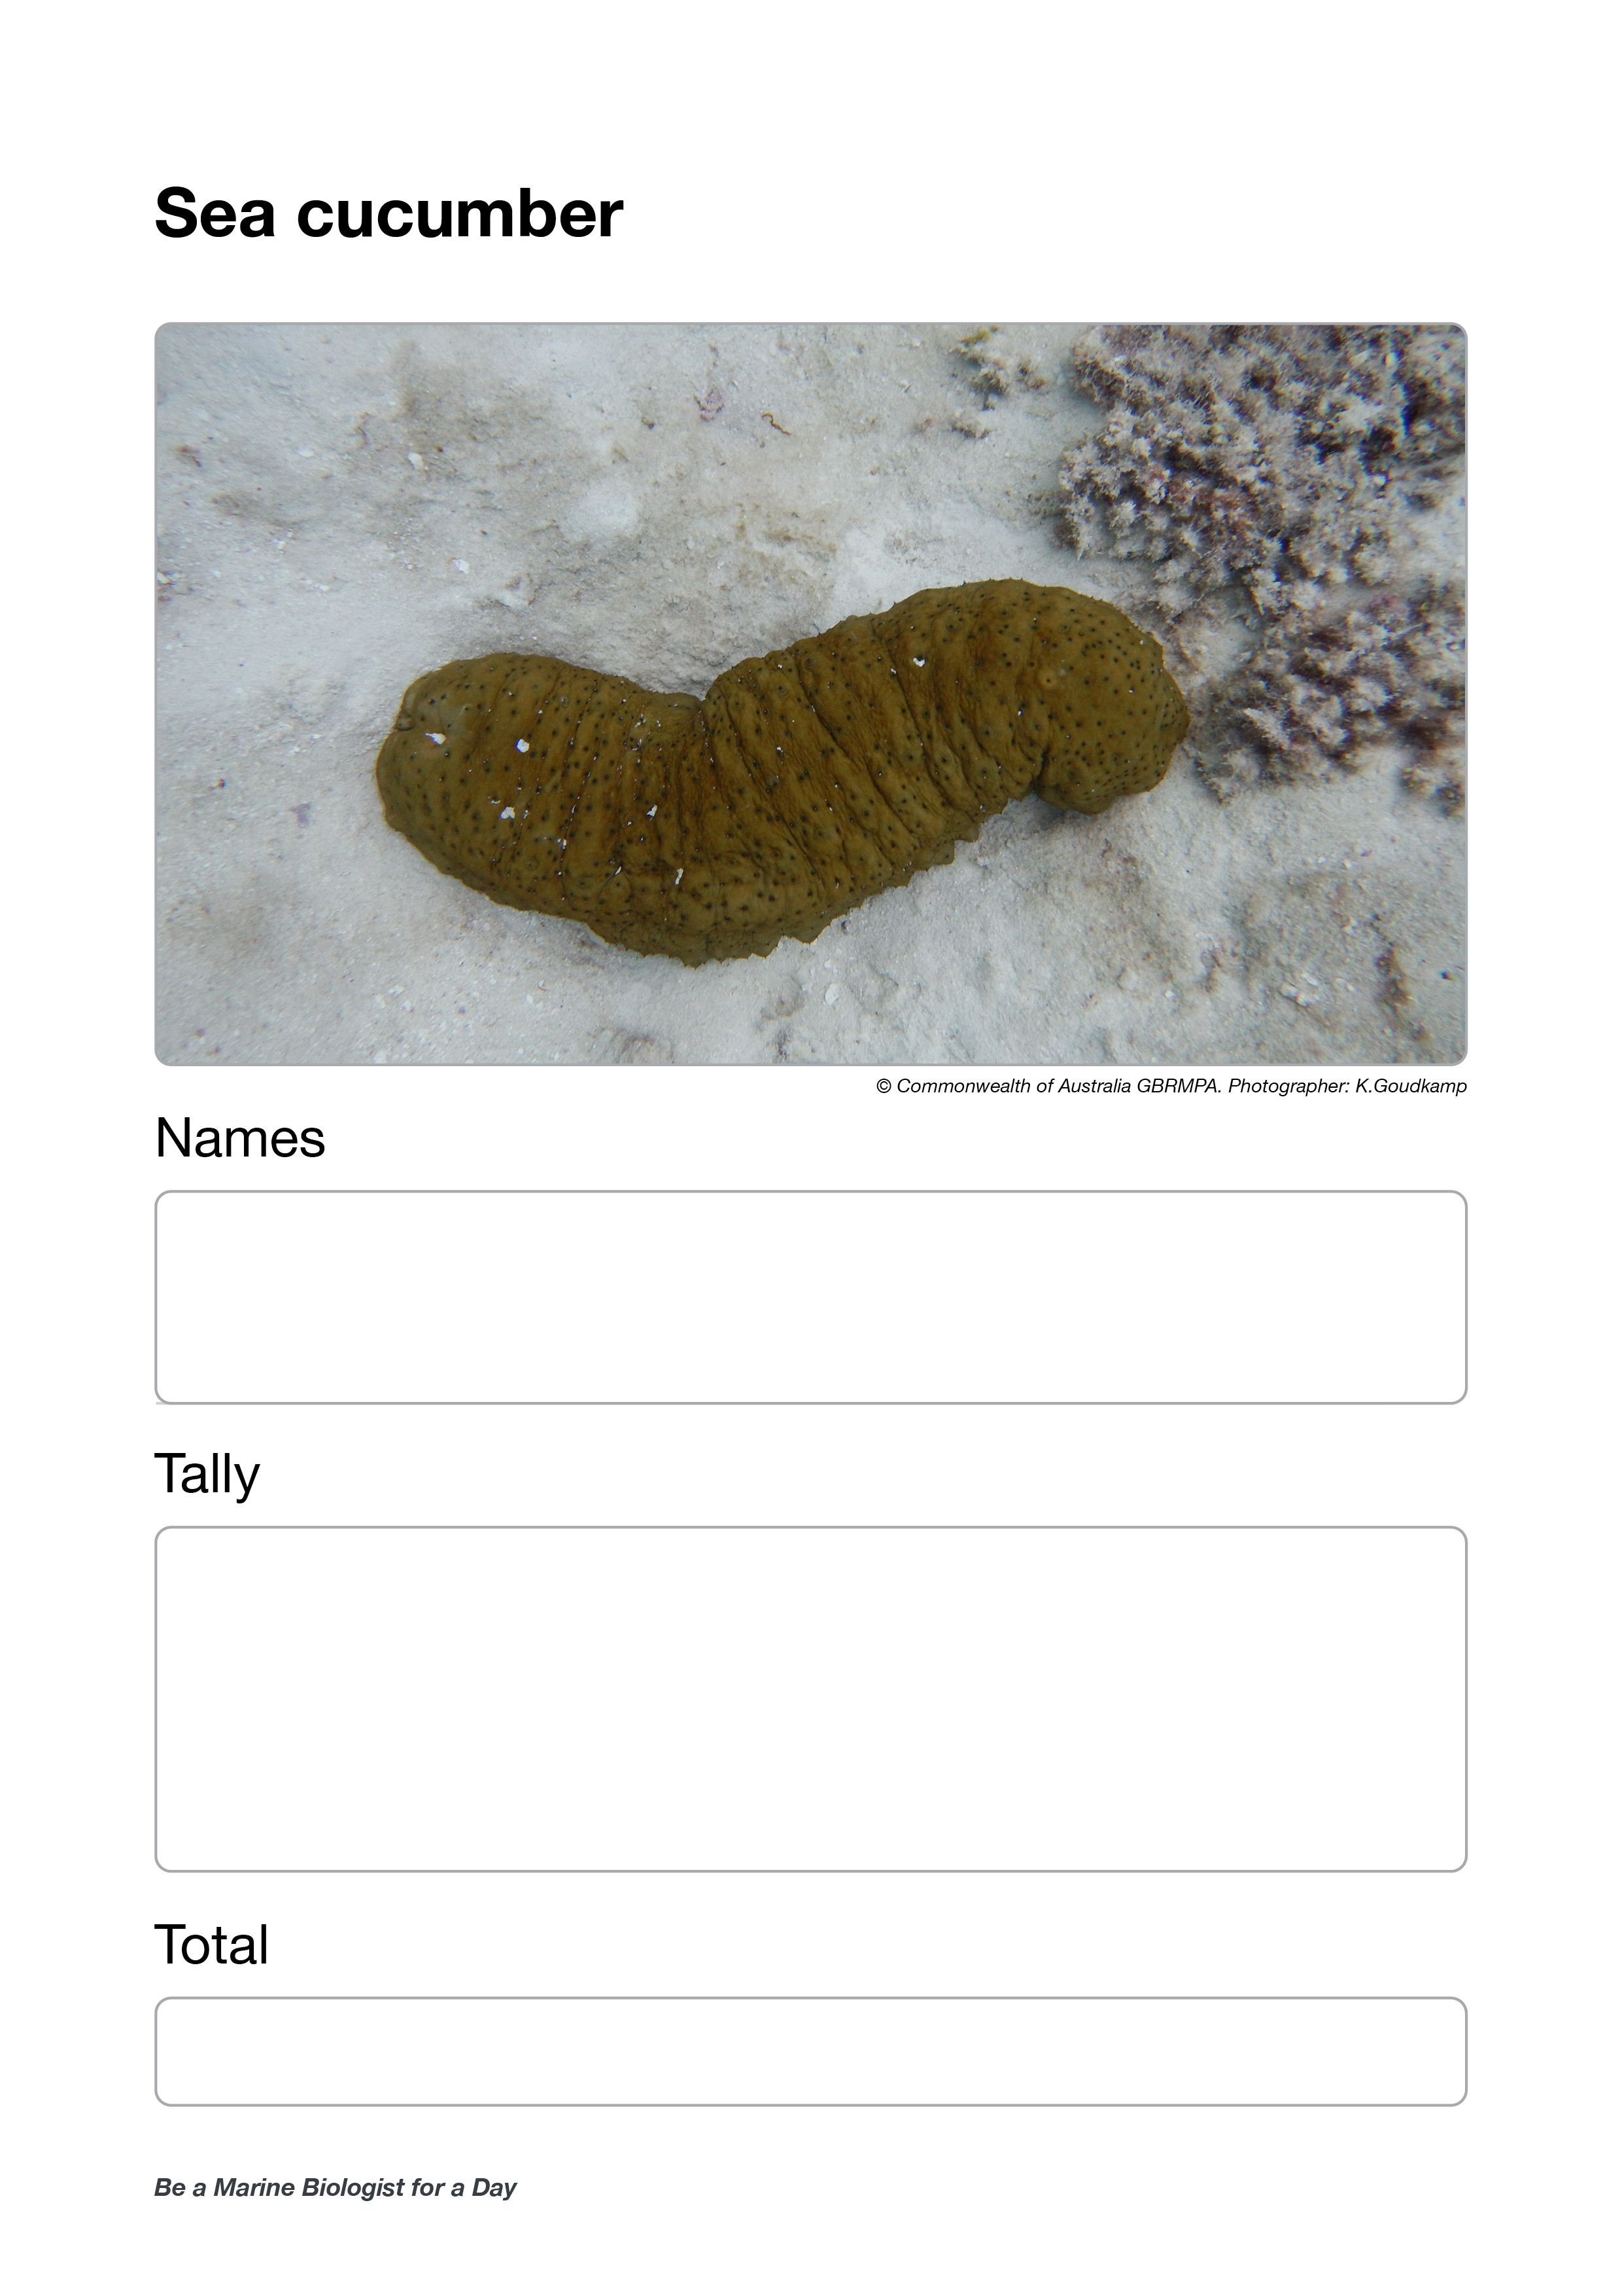
Who is counting the sea cucumbers?
Check buddy pair/s counting sea cucumbers have all their materials.

Slide 13
Who is counting the sea cucumbers?

Slide 14
Giant clams
Prep – year 3
Biology: living things Geography: places
What does a giant clam look like? Show me with your hands.
How can you tell it’s alive? Answer: It moves when you go near it. Water is going in and out of it.
Year 4
Biology: life cycle, survival Geography: sustainability
How long can giant clams live for? Answer: Over 100 years!
They are endangered (take a long time to recover after being taken).
Year 5
Biology: adaptations Geography: people & place
When we get back, I want you to tell me how many holes (siphons) there are in a giant clams mantle, and what the holes are for. Answer: 2 holes for filter feeding and spawning.
Year 6
Biology: growth, survival Geography: the world
What makes the mantle colourful? Answer: Algae (zooxanthellae), and specialized cells with reflective structures (like mirrors).
Plus, count the siphons (holes)!

Slide 15
Giant clam
VULNERABLE TO EXTINCTION
Notes:
Image: Copyright Commonwealth of Australia (GBRMPA)

Slide 16
Why count giant clams?
Giant clams are vulnerable to extinction.
If we know where they are, we can look after them and protect them.

Slide 17
Why count giant clams?
Notes:
Image: GBRMPA Image Library

Slide 18
Who is counting the giant clams >30cm?
Check buddy pair/s counting giant clams have all their materials.

Slide 19
Who is counting the giant clams?
>30cm

Slide 20
Anemonefish
Prep – year 3
Biology: living things Geography: places
Where do anemonefish live? Answer: On the reef in an anemone. If you find nemo, his anemone will be close by.
Do anemonefish always live in anemones? Answer: Yes.
Year 4
Biology: life cycle, survival Geography: sustainability
How do anemonefish reproduce?
If you see an anemone, look closely at the area beside the anemone.
Check to see if there are any eggs.
Year 5
Biology: adaptations Geography: people & place
What is a ‘behavioural’ adaptation that stops anemone fish being stung by the anemone?
Answer: Constantly swimming in the tentacles of the anemone (count how many times).
Year 6
Biology: growth, survival Geography: the world
Why are the anemonefish all different sizes? Answer: The largest is female. The second largest is her partner. The remaining fish are smaller juvenile males.

Slide 21
Anemonefish
Notes:
Image: J. Sumerling, Copyright Commonwealth Government of Australia (GBRMPA)

Slide 22
Why count anemonefish?
Do not answer the question. Wait for an answer.
Anemones rarely move and are long lived. So, if they go missing (or bleach white) this tells us that something is wrong.
The anemonefish help us to find the anemones.

Slide 23
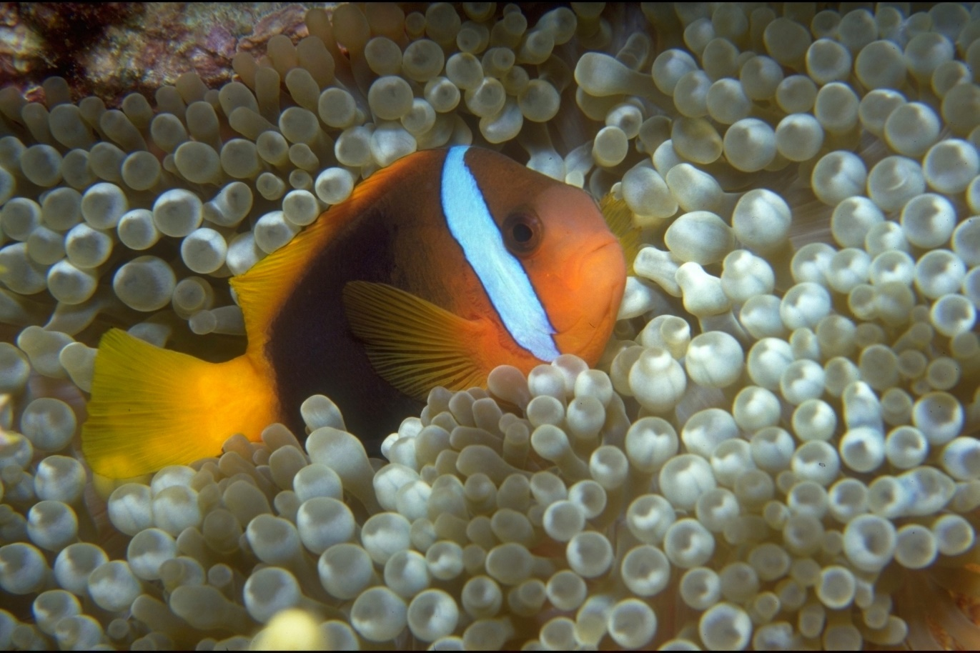
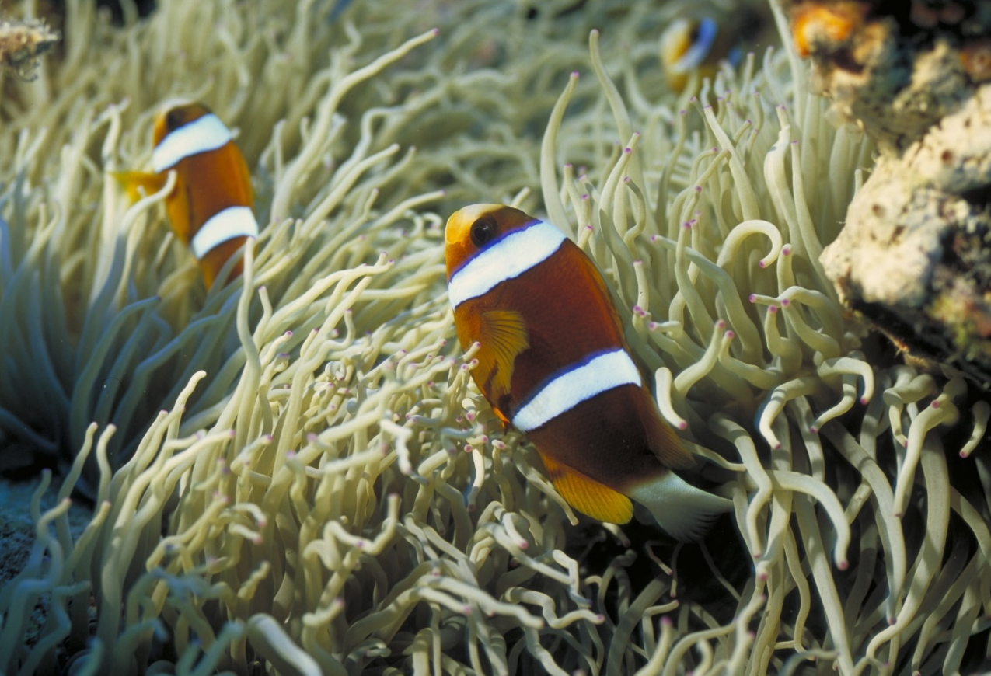
Why count anemonefish?
Notes:
Images: (Left) T. Mayne, Copyright Commonwealth of Australia (GBRMPA); (Right) D. Wachenfeld, Copyright Commonwealth of Australia (GBRMPA)

Slide 24
Who is counting the anemonefish?
Check buddy pair/s counting anemonefish have all their materials.

Slide 25
Who is counting the anemonefish?

Slide 26
Butterflyfish
Prep – year 3
Biology: living things Geography: places
Butterflyfish are pretty fish with lots of bright colours and patterns. They’re about the size of your hand, and often in pairs. Where do butterflyfish live? Answer: On reefs (they do laps!).
Year 4
Biology: life cycle, survival Geography: sustainability
Some butterflyfish have a fake eye spot. Why?
This is an open inquiry question.
Answer: To trick their predators.
Year 5
Biology: adaptations Geography: people & place
What structural adaptations make butterflyfish easy to identify? Answer: Disc-like shape, pretty patterns, fake eye spot, size of your hand, long snout, small mouth.
Year 6
Biology: growth, survival Geography: the world
Butterflyfish are often in pairs doing ‘laps’ of their home range. What do they eat? Answer: Mainly coral polyps, but some also feed on tiny invertebrates.

Slide 27
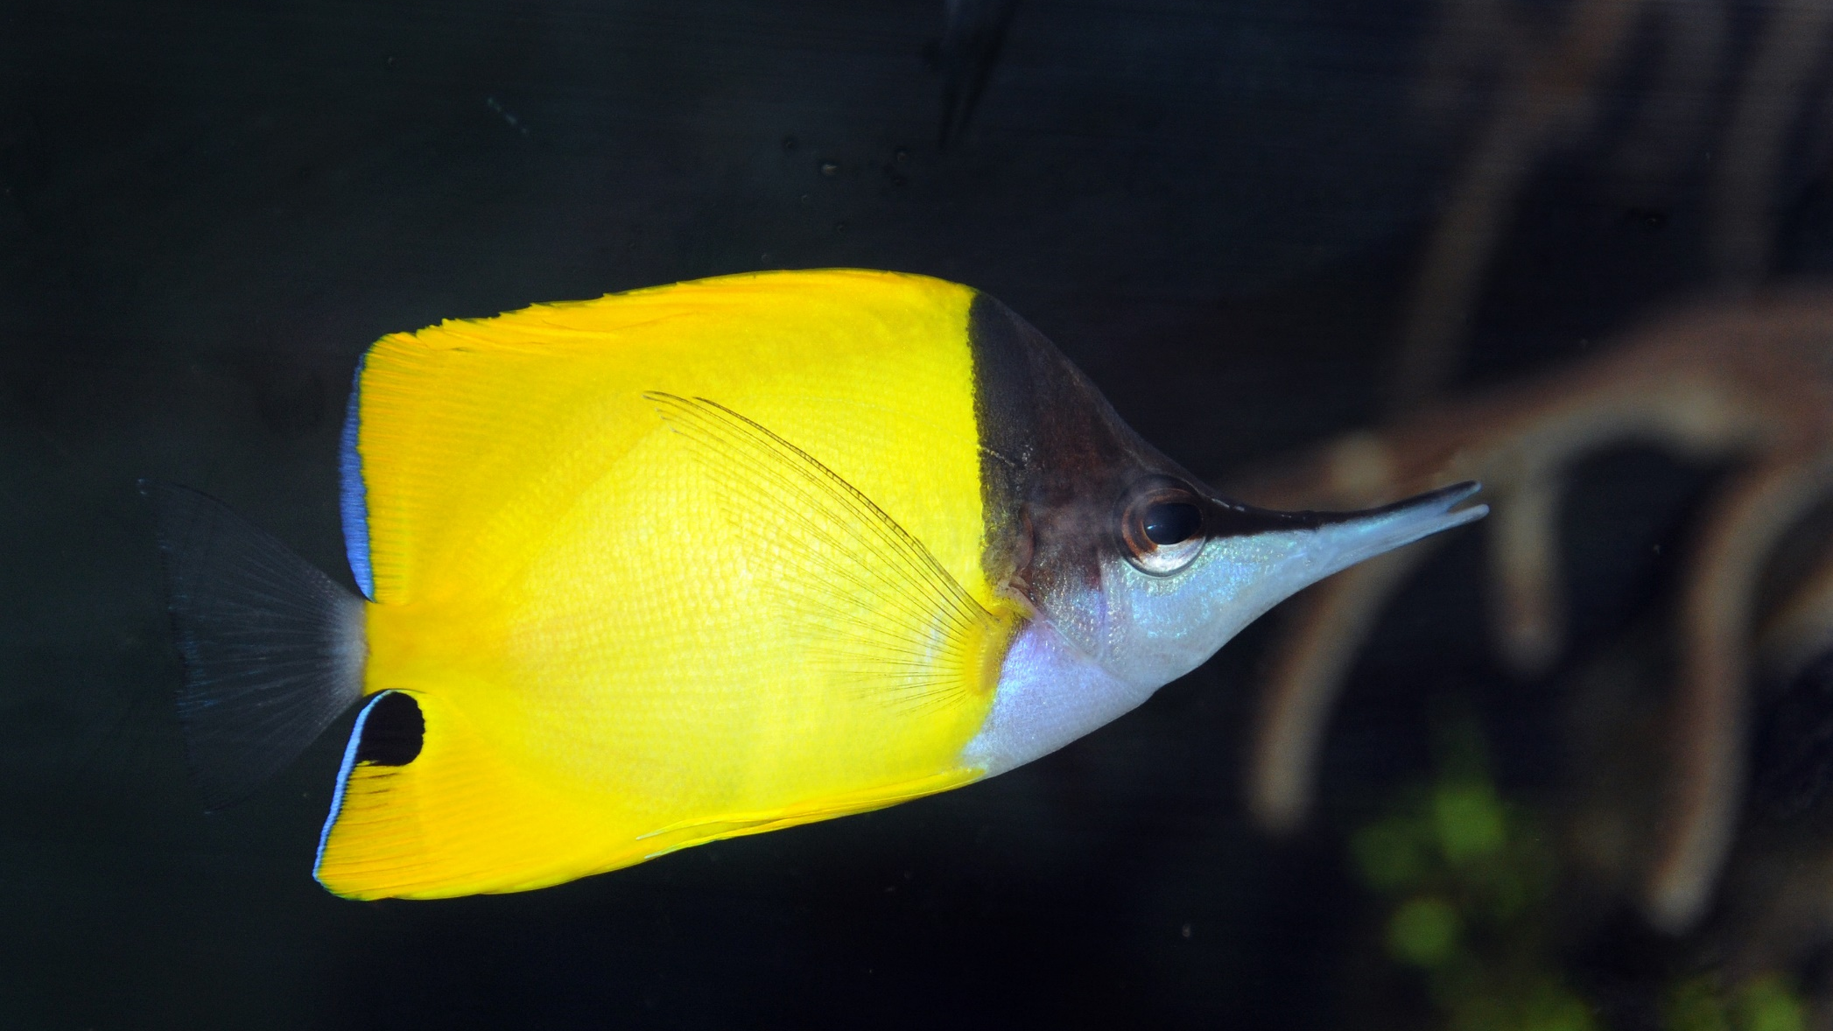
Butterflyfish
Notes:
Image: J. Jones, Copyright Commonwealth of Australia (GBRMPA)

Slide 28
Why count butterflyfish?
Do not answer the question. Wait for an answer.
Butterflyfish eat coral.
A healthy coral reef with lots of food can support lots of butterflyfish.
More coral means more butterflyfish.

Slide 29
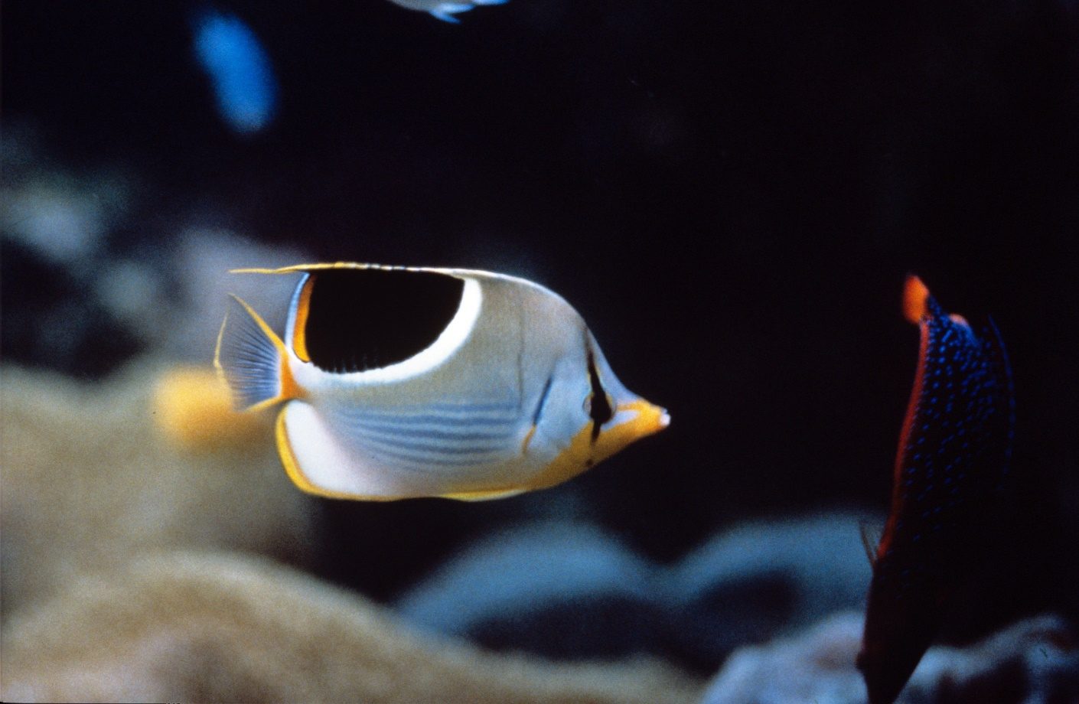
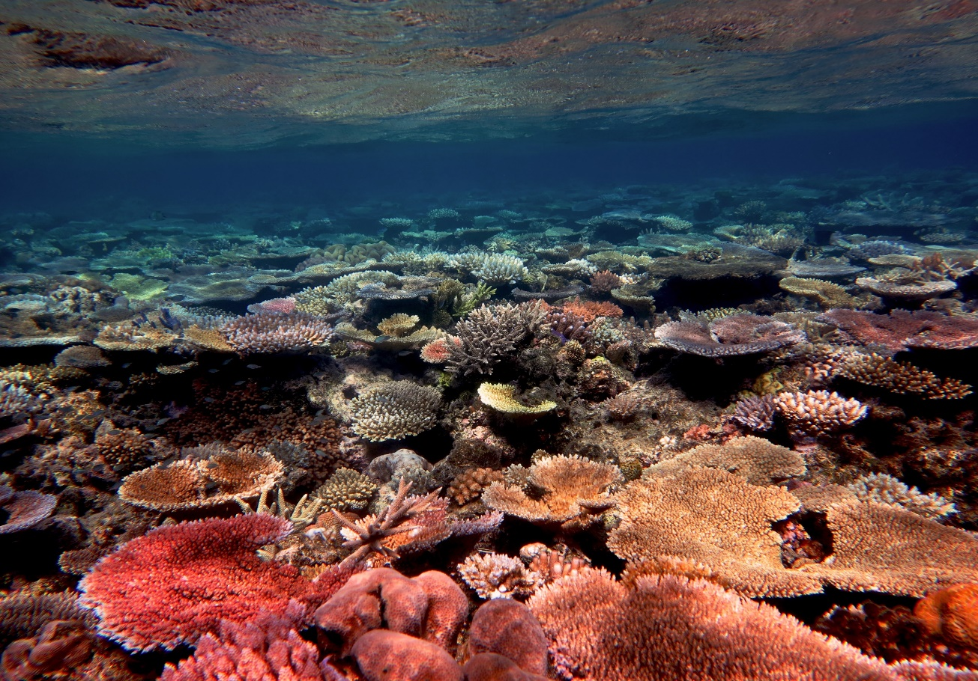
Why count butterflyfish?
Notes:
Images: (Left) J. Jones, Copyright Commonwealth of Australia (GBRMPA); (Right) R. Ramasamy, Copyright Commonwealth of Australia (GBRMPA)

Slide 30
Who is counting the butterflyfish?
Check buddy pair/s counting butterflyfish have all their materials.

Slide 31
Who is counting the butterflyfish?

Slide 32
Grazing herbivores
Prep – year 3
Biology: living things Geography: places
Look for a school of fish that are similar in appearance and size, moving slowly along the reef, foraging or grazing close to the reef substrate.
These are the grazing herbivores!
Year 4
Biology: life cycle, survival Geography: sustainability
Why are grazing herbivores called the lawnmowers of the Reef?
Answer: Because they graze on so much algae.
Year 5
Biology: adaptations Geography: people & place
How is the digestive system in a herbivore different to a carnivore?
Answer: Herbivores have
molar-like teeth, smaller mouths, and longer intestines.
Year 6
Biology: growth, survival Geography: the world
How does the grazing of algae help the Reef?
Answer: They eat the algae that compete with coral for space.

Slide 33
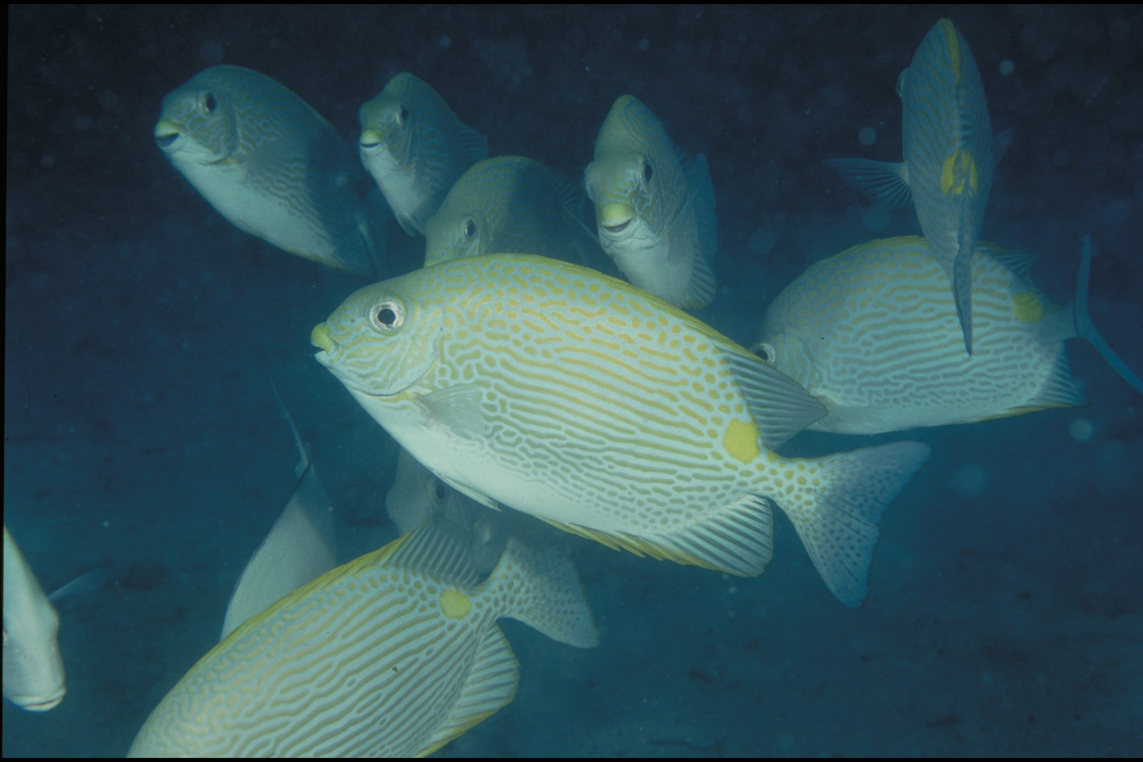
Grazing herbivores Parrotfish / Surgeonfish / Rabbitfish / Unicornfish
Notes:
Image: W. Gladstone, Copyright Commonwealth of Australia (GBRMPA)

Slide 34
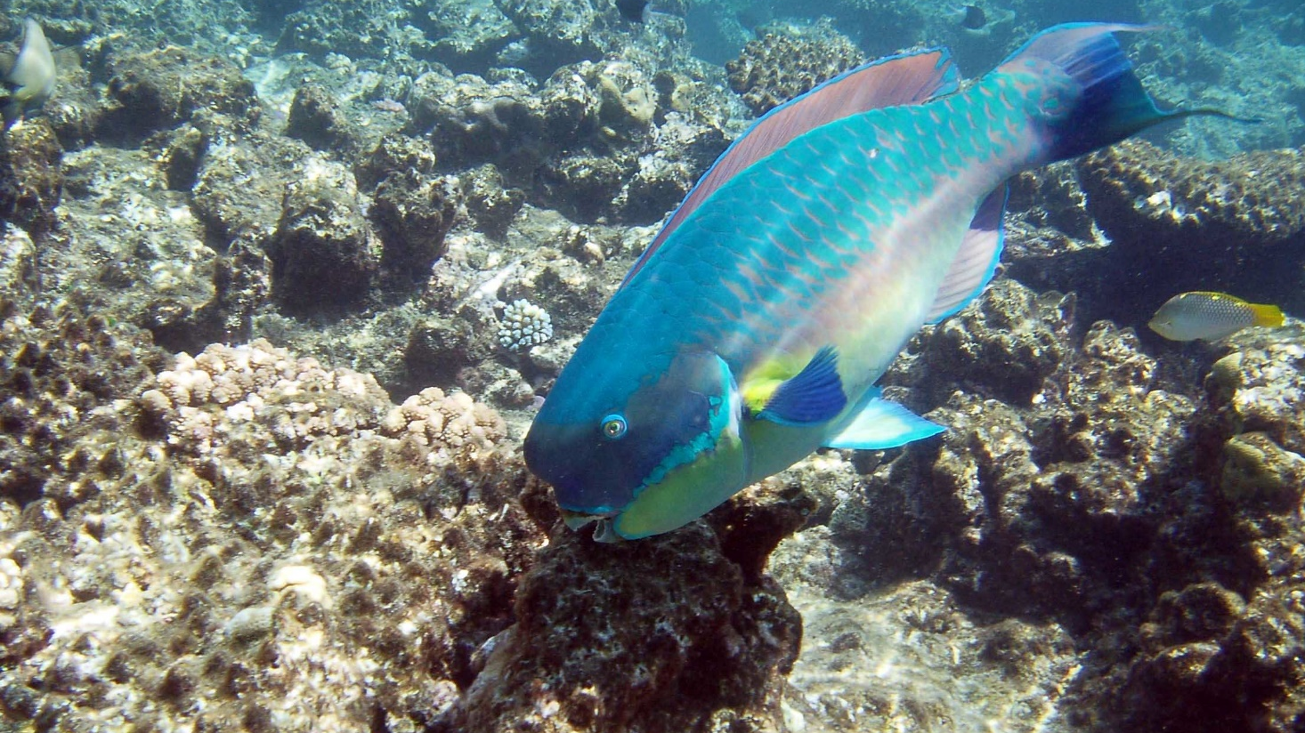
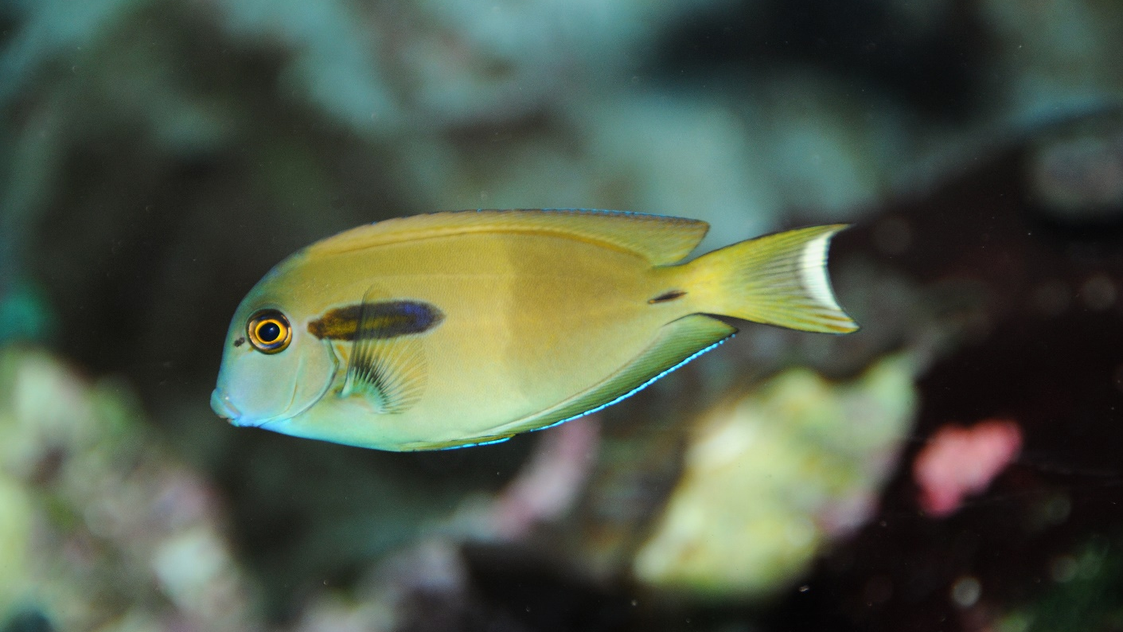
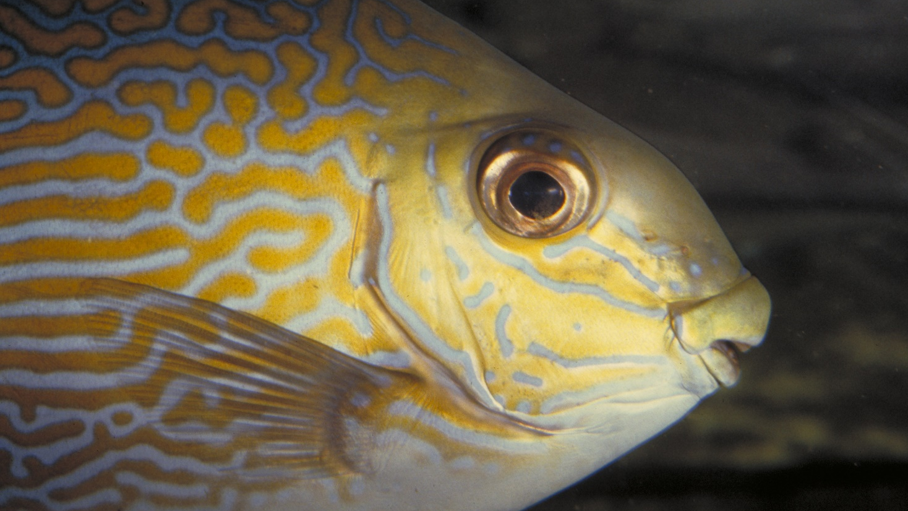
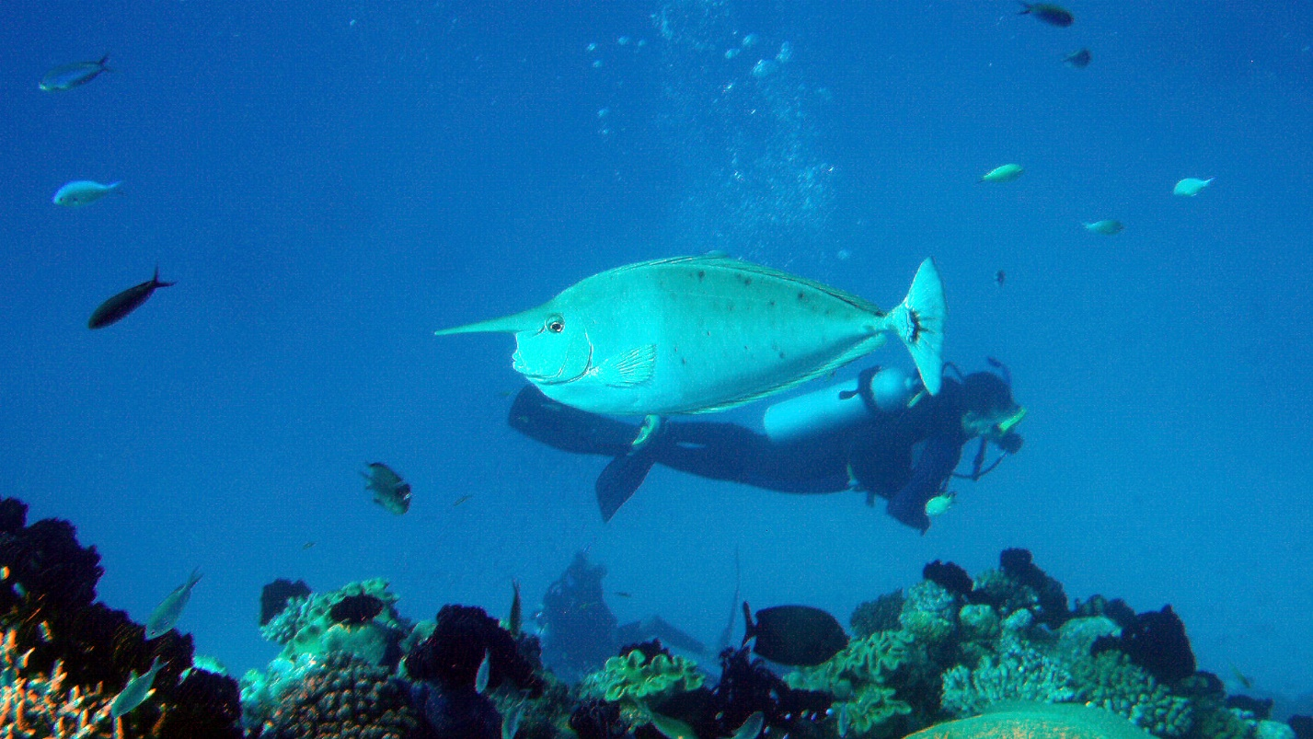
Parrotfish
Surgeonfish
Rabbitfish
Unicornfish
Notes:
Images: (Top Left) C. Jones, Copyright Commonwealth of Australia (GBRMPA); (Top Right) J. Jones, Copyright Commonwealth of Australia (GBRMPA); (Bottom Left) L. Zell, Copyright Commonwealth of Australia (GBRMPA); (Bottom Right) A. Smith, Copyright Commonwealth of Australia (GBRMPA)

Slide 35
Why count grazing herbivores?
Do not answer the question. Wait for an answer.
They are the lawnmowers of the Reef!
They eat the algae that compete with corals for space.
By limiting the growth and spread of algae, coral reefs stay healthy and resilient.

Slide 36
Why count grazing herbivores?
Notes:
Image: C. Jones, Copyright Commonwealth of Australia (GBRMPA)

Slide 37
Who is counting the grazing herbivores? Parrotfish / Surgeonfish / Rabbitfish / Unicornfish
Check buddy pair/s counting grazing herbivores have all their materials.

Slide 38
Who is counting the grazing herbivores?
Parrotfish / Surgeonfish Rabbitfish / Unicornfish

Slide 39
Cods and groupers
Prep – year 3
Biology: living things Geography: places
Cods and groupers swallow their prey whole. They sit and wait, then pounce and suck, swallowing it whole. How big is the mouth of a giant grouper?
Big! Show me using your arms.
Year 4
Biology: life cycle, survival Geography: sustainability
We only count the cods and groupers bigger than 50cm. At that size, are they older than you? Answer: Yes.
Year 5
Biology: adaptations Geography: people & place
Name a structural adaptation of a cod or grouper. Answer: Large upturned mouth with protruding lower jaw. Multiple rows of teeth. Torpedo shaped body. Thick and strong caudal peduncle (where the tail attaches to the body).
Year 6
Biology: growth, survival Geography: the world
Cods and groupers are solitary animals. They live alone. How do they find a mate to reproduce? Answer: They gather at large spawning aggregations.

Slide 40
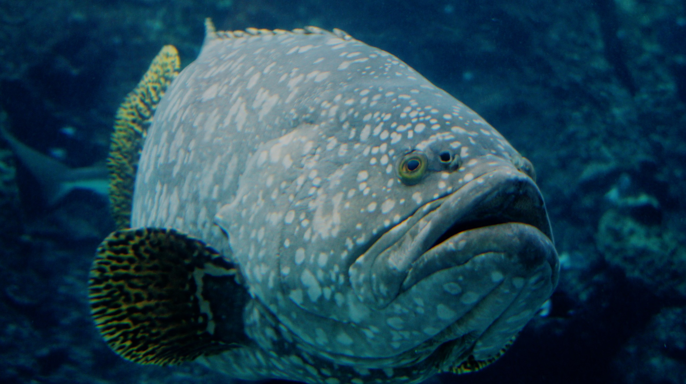
Cods and groupers Pronounced grow-per.
Notes:
Image: J. Hurford, Copyright Commonwealth of Australia (GBRMPA)

Slide 41
Why count cod and grouper?
Includes barramundi cod, potato cod, Queensland grouper.
Do not answer the question. Wait for an answer.
If we know where they are, we can look after them and protect them.

Slide 42
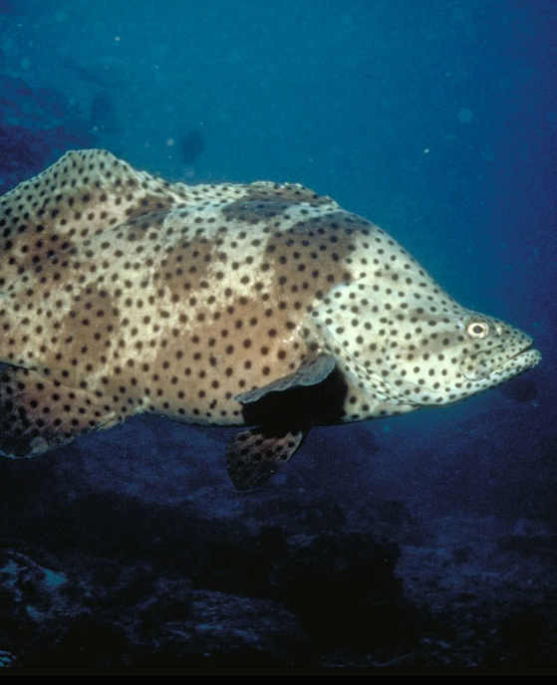
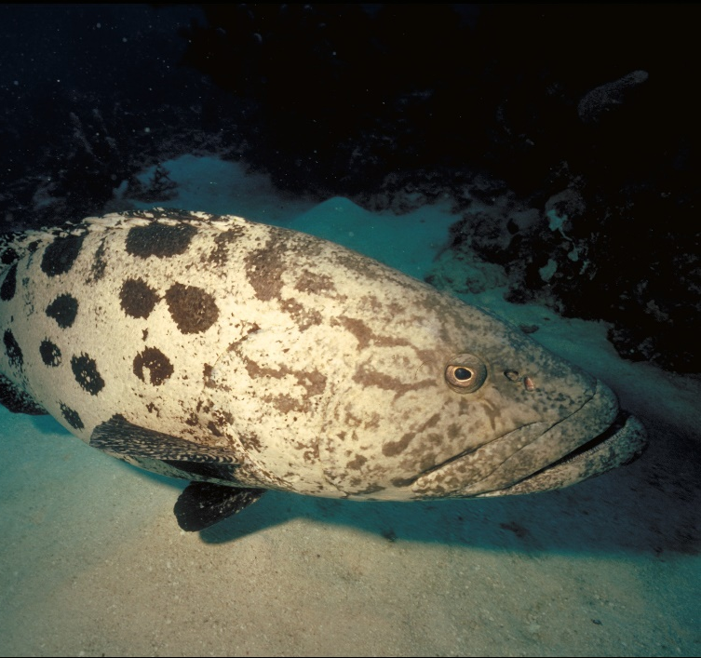
Why count the very big cods and groupers?
Barramundi cod
Qld grouper
Potato cod
Notes:
Images: (Left) K. McClymont, Copyright Commonwealth of Australia (GBRMPA); (Middle) J.Hurford, Copyright Commonwealth of Australia (GBRMPA); (Right) P. McGinnity, Copyright Commonwealth of Australia (GBRMPA)

Slide 43
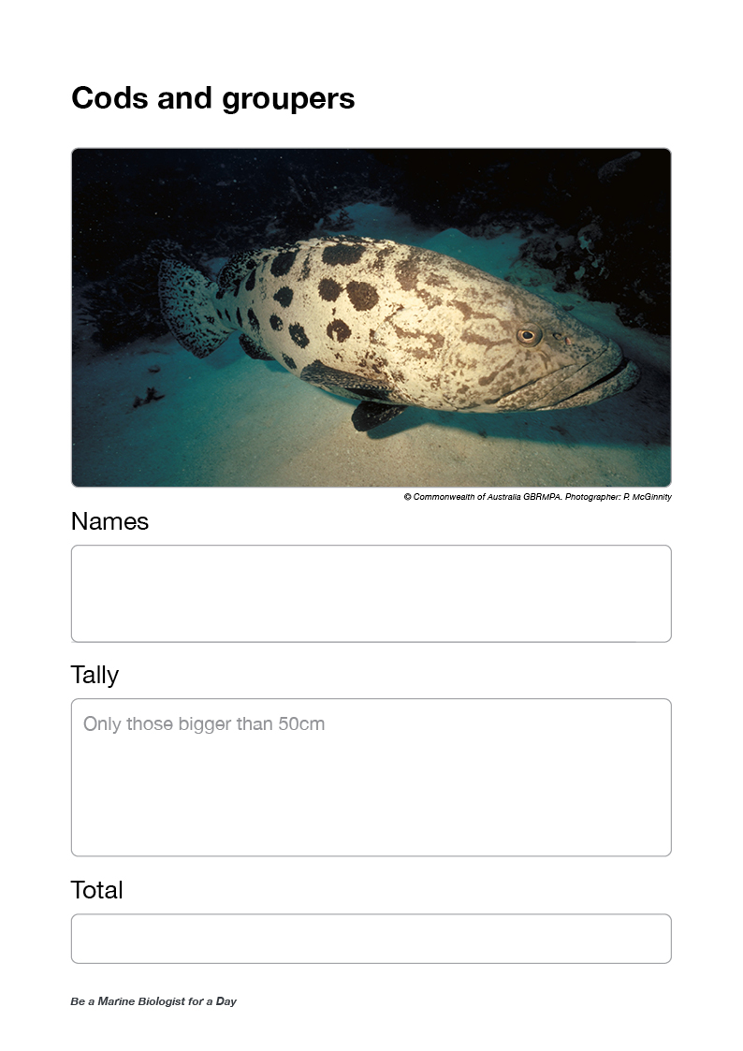
Who is counting the cods and groupers >50cm?
Check buddy pair/s counting cods and groupers have all their materials.

Slide 44
Who is counting the cods and groupers?
>50cm

Slide 45
Coral trout
Prep – year 3
Biology: living things Geography: places
Where do coral trout live? Answer: On reefs, often hiding under ledges.
Look for the fish that appears to be frowning, with lots of pretty bright blue spots!
Year 4
Biology: life cycle, survival Geography: sustainability
Lots of people like to eat coral trout. What size fish can people legally catch and keep? Answer: 38cm.
Year 5
Biology: adaptations Geography: people & place
Why do coral trout change from female to male when approx. 42cm? Answer: Increased reproductive success.
Large males, because of their superior competitive ability (in fights and contests with smaller males), are able to monopolize females and prevent smaller males from mating with them.
Year 6
Biology: growth, survival Geography: the world
The legal size for a coral trout is 38cm. What penalties apply for keeping undersize fish? Answer: Hundreds to thousands of dollars.

Slide 46
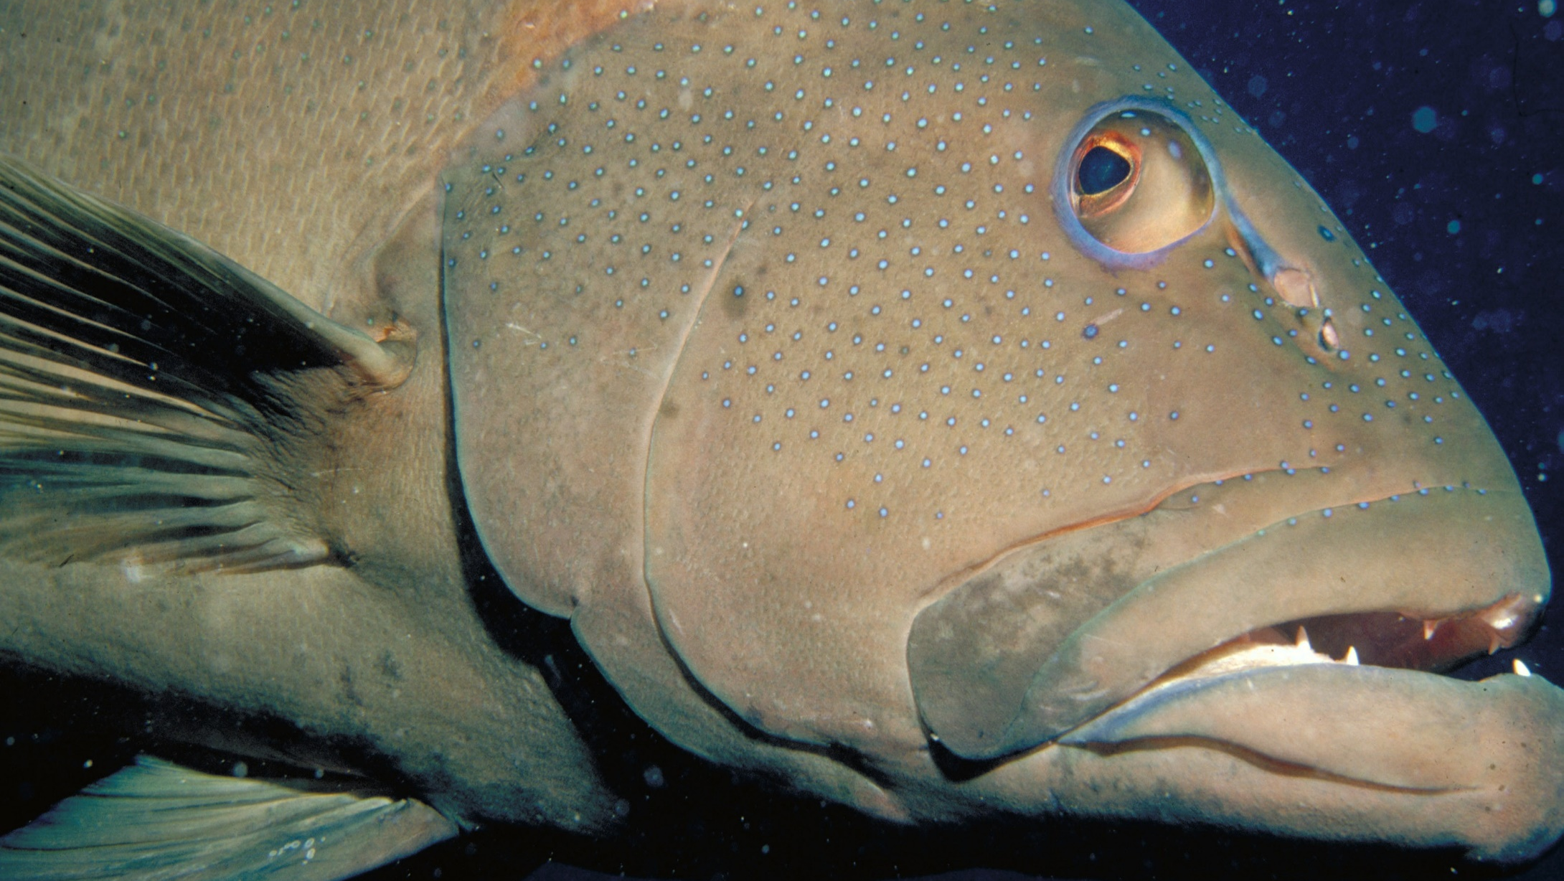
Coral trout
Notes:
Image: S. Summerhays, Copyright Commonwealth of Australia (GBRMPA)

Slide 47
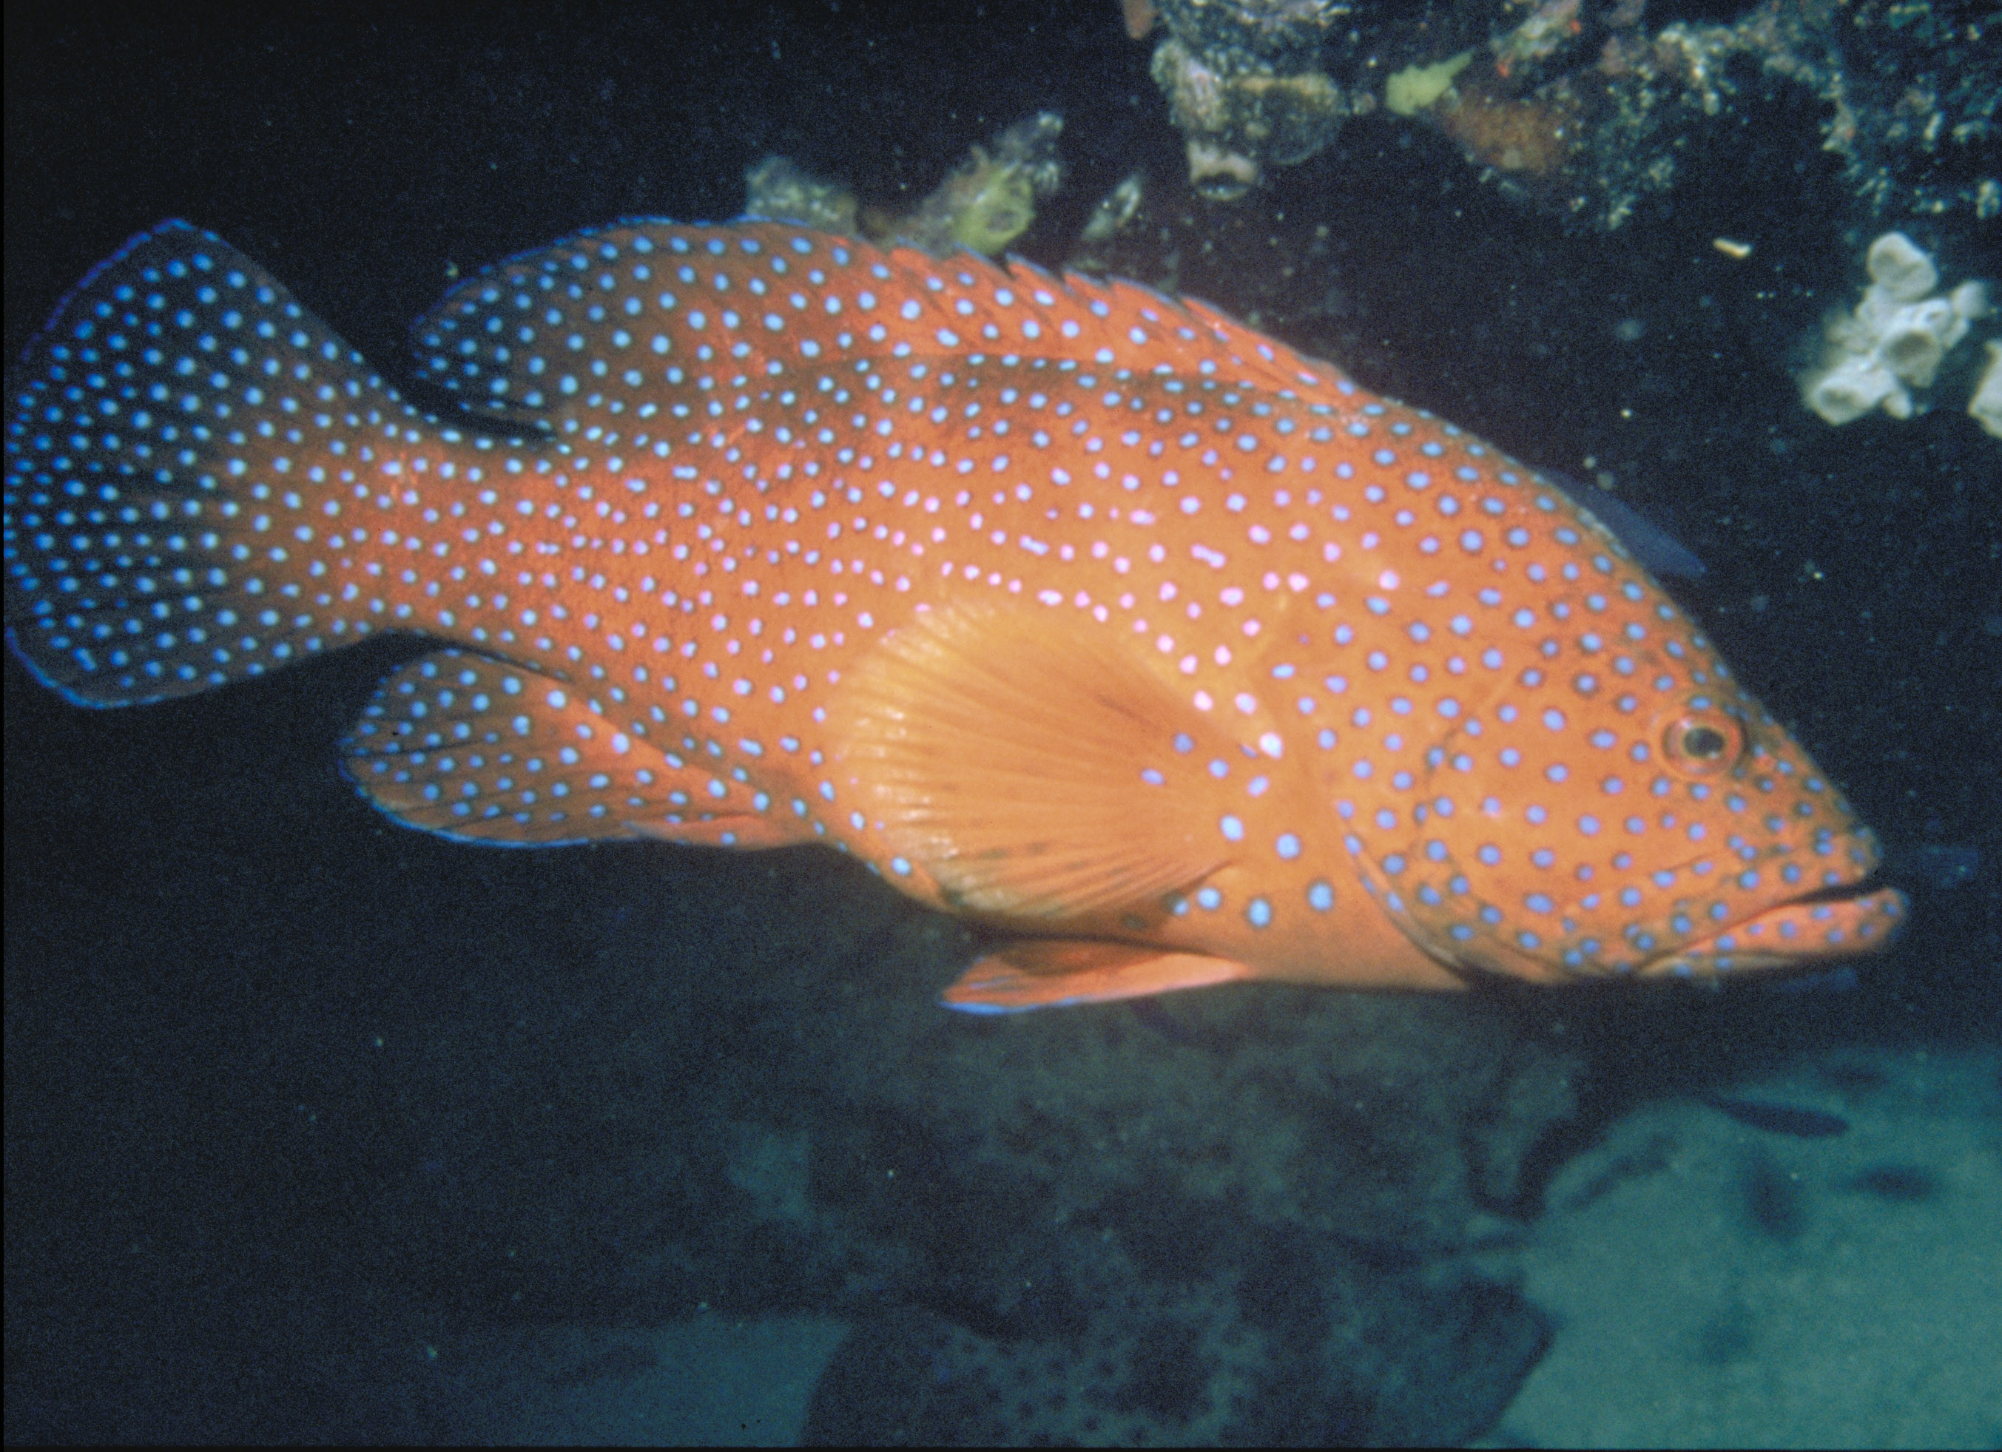
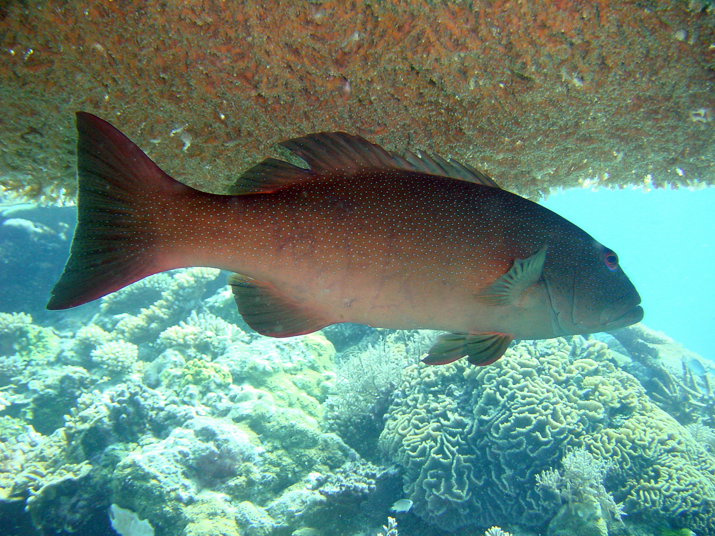
Spot the difference. Hint: compare the shape of the tail.
TAIL GOES OUT
TAIL GOES IN
Coral cod
Coral trout
Notes:
Images: (Left) N. Collins, Copyright Commonwealth of Australia (GBRMPA); (Right) G. Goby, Copyright Commonwealth of Australia (GBRMPA)

Slide 48
Why count coral trout?
Do not answer the question. Wait for an answer.
To calculate sustainable catch limits from accurate estimates of population size.

Slide 49
Why count coral trout?
Notes:
Image: T. Mayne, Copyright Commonwealth of Australia (GBRMPA)

Slide 50
Who is counting the coral trout < 38cm and > 38cm?
Check buddy pair/s counting coral trout have all their materials.

Slide 51
Who is counting coral trout?
<38cm / >38cm

Slide 52
Maori wrasse
Prep – year 3
Biology: living things Geography: places
What are some features that make male Maori wrasse easy to identify? Answers:
Big size
Hump on head
Friendly
Pretty blue/green colour
Year 4
Biology: life cycle, survival Geography: sustainability
Where do Maori wrasse live? Answer: On the reef, occupying limited home ranges. Adults swim across the reefs during the day, resting at night in caves and under coral ledges.
Year 5
Biology: adaptations Geography: people & place
What structural adaptation does a male Maori wrasse have, that a female Maori wrasse doesn’t have? Answer: Hump on head. Different colour and bigger size.
Year 6
Biology: growth, survival Geography: the world
Maori wrasse, like all fish, have a protective layer of mucous coating their body. Why is it important not to touch the animals, including this friendly fish? Answer: It removes the mucous, and they can get sick.

Slide 53
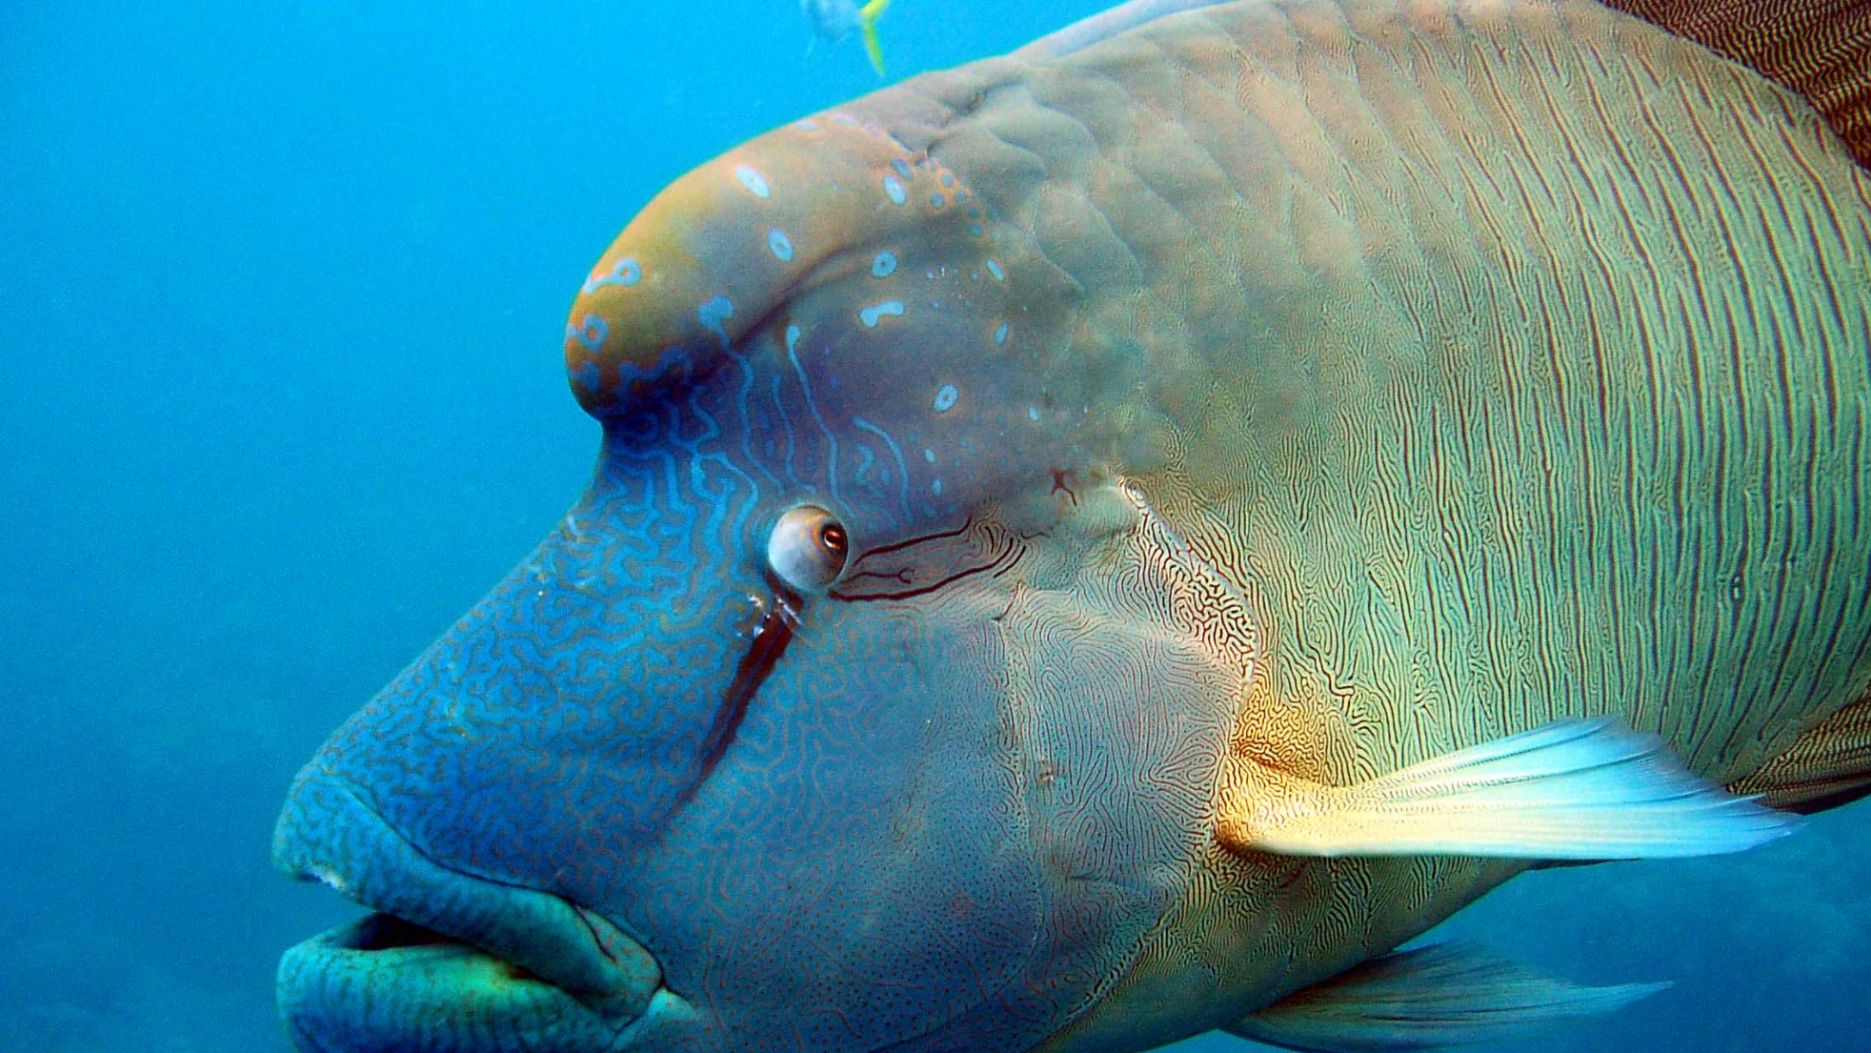
Maori wrasse also called humphead wrasse or Napoleon wrasse.
Notes:
Image: C. Jones, Copyright Commonwealth of Australia (GBRMPA)

Slide 54
Why count Maori wrasse?
Do not answer the question. Wait for an answer.
Maori wrasse are listed as endangered and we need them because they are great for tourism and they help corals by feeding on one of their prey, COTS.

Slide 55
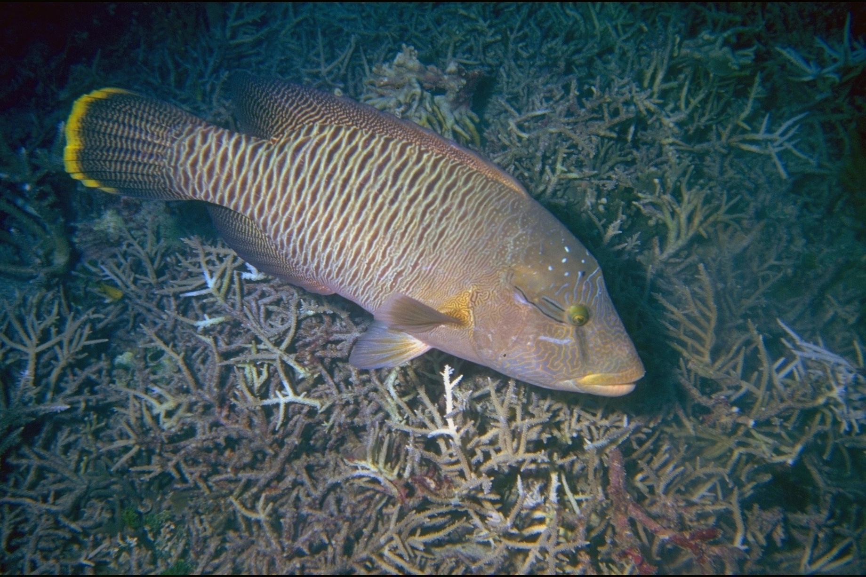
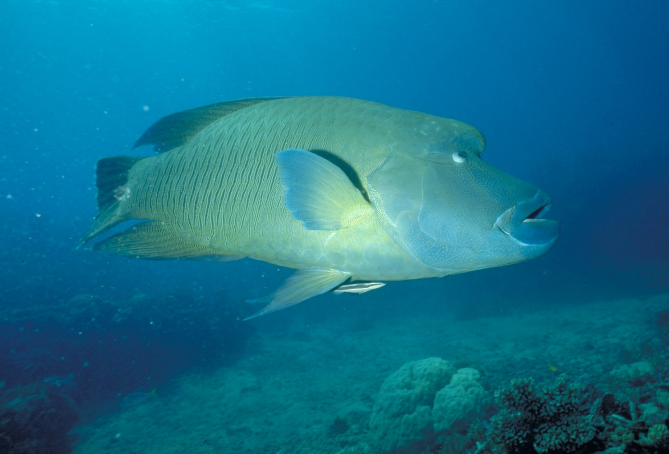
Why count Maori wrasse?
ENDANGERED
ENDANGERED
Female
Male
Notes:
Images: (Left) U. Engelhardt, Copyright Commonwealth of Australia (GBRMPA); (Right) M. Simmons, Copyright Commonwealth of Australia (GBRMPA)

Slide 56
Who is counting the male and female Maori wrasse?
Check buddy pair/s counting Maori wrasse have all their materials.

Slide 57
Who is counting Maori wrasse?
Female / Male

Slide 58
Sea turtles – green, hawksbill and loggerhead turtles
Prep – year 3
Biology: living things Geography: places
What do all sea turtles like to eat?
Answer: Jellyfish.
Year 4
Biology: life cycle, survival Geography: sustainability
What do turtles eat that look like jellyfish?
Answer: Plastic bags.
Year 5
Biology: adaptations Geography: people & place
How long can sea turtles hold their breath? This is an open inquiry question. Answer: 4-7 hours if relaxed. Much less if stressed.
Year 6
Biology: growth, survival Geography: the world
When is turtle breeding season? Answer: Summer. Warm sand produces more females. Cool sand produces more males.
‘Girls are hot’ ‘Boys are cool’

Slide 59
Sea turtles
Green turtle
Hawksbill turtle
Loggerhead turtle
Notes:
Image: (Left) K. Hoppen, Copyright Commonwealth of Australia (GBRMPA); (Middle) K. Hoppen, Copyright Commonwealth of Australia (GBRMPA); (Right) M. Simmons, Copyright Commonwealth of Australia (GBRMPA)

Slide 60
Plastic bags look like yummy jellyfish!
Notes:
Image: C. Jones, Copyright Commonwealth of Australia (GBRMPA)

Slide 61
Most rubbish enters the sea via overflowing bins or litter on the ground that is carried by the wind. It also travels to the sea via storm water drains, rivers and flood waters.
The “Great Pacific Garbage Patch”, is a large area in the Pacific Ocean that is approximately the size of South Australia with debris extending 6 meters down into the water column.
Researchers have estimated that for every 1 kilogram of plankton in the Garbage Patch, there is 6 kilograms of plastic.
Notes:
Image: https://www.gbrmpa.gov.au/our-work/threats-to-the-reef/marine-debris
Data: https://www.seeturtles.org/ocean-plastic

Slide 62
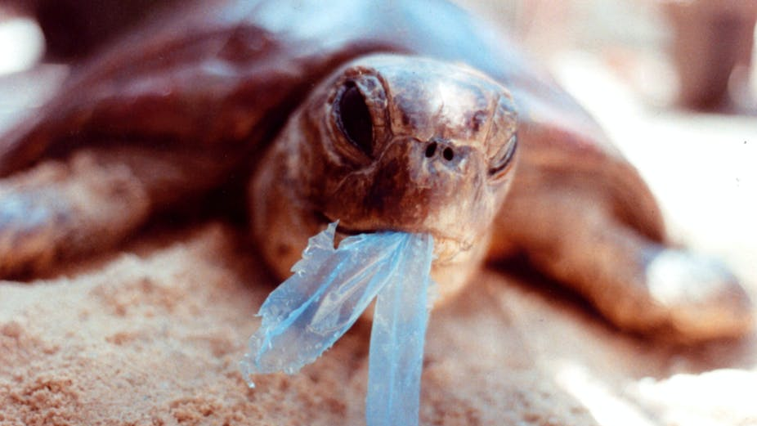
AAP Image/Department of the Environment and Heritage/Melbourne Zoo
Notes:
Image: https://theconversation.com/ghostnets-fish-on-marine-rubbish-threatens-northern-australian-turtles-11585

Slide 63
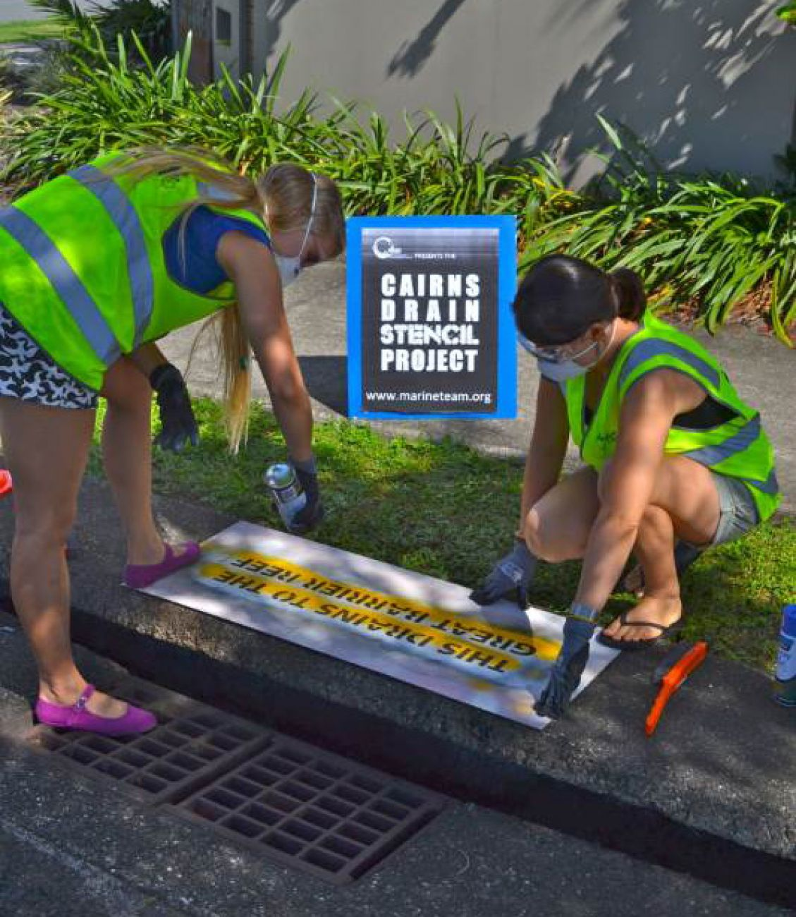
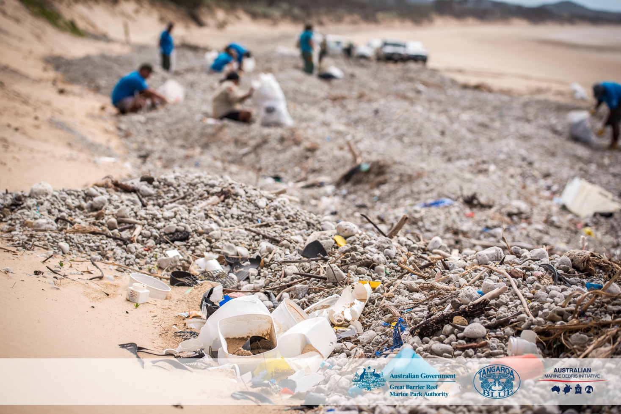
All storm water drains lead to the sea. How can I help the Great Barrier Reef?
Notes:
Images: (Left) https://www.gbrmpa.gov.au/our-work/threats-to-the-reef/marine-debris; (Right) C. Miller, Copyright Commonwealth of Australia (GBRMPA)

Slide 64
Why count sea turtles?
Do not answer the question. Wait for an answer.
All are threatened with extinction.

Slide 65
Why count sea turtles?
Notes:
Image: A. Simmonds, Copyright Commonwealth of Australia (GBRMPA)

Slide 66
Who is counting the Green, Hawksbill and all other sea turtles?
Check buddy pair/s counting sea turtles have all their materials.

Slide 67
Who is counting sea turtles?
Green / Hawksbill / other

Slide 68
Sharks
Prep – year 3
Biology: living things Geography: places
Are sharks dangerous?
Answer: Not all sharks are dangerous. The biggest shark alive, the whale shark, have small teeth. However, as filter feeders, they don’t use them.
Year 4
Biology: life cycle, survival Geography: sustainability
Do all sharks need to keep swimming to breathe?
This is an open inquiry question.
Answer: No.
Some sharks sit on the bottom and breathe by ‘gulping’.
Year 5
Biology: adaptations Geography: people & place
Sharks have all the senses that we have. They can see, hear, smell, taste and feel. What else can they sense that we can’t sense? Answer: Electricity from muscle movement (heart beating).
Year 6
Biology: growth, survival Geography: the world
A lot of sharks are killed in shark nets designed to keep swimmers safe. Are all sharks dangerous? Answer: No.

Slide 69
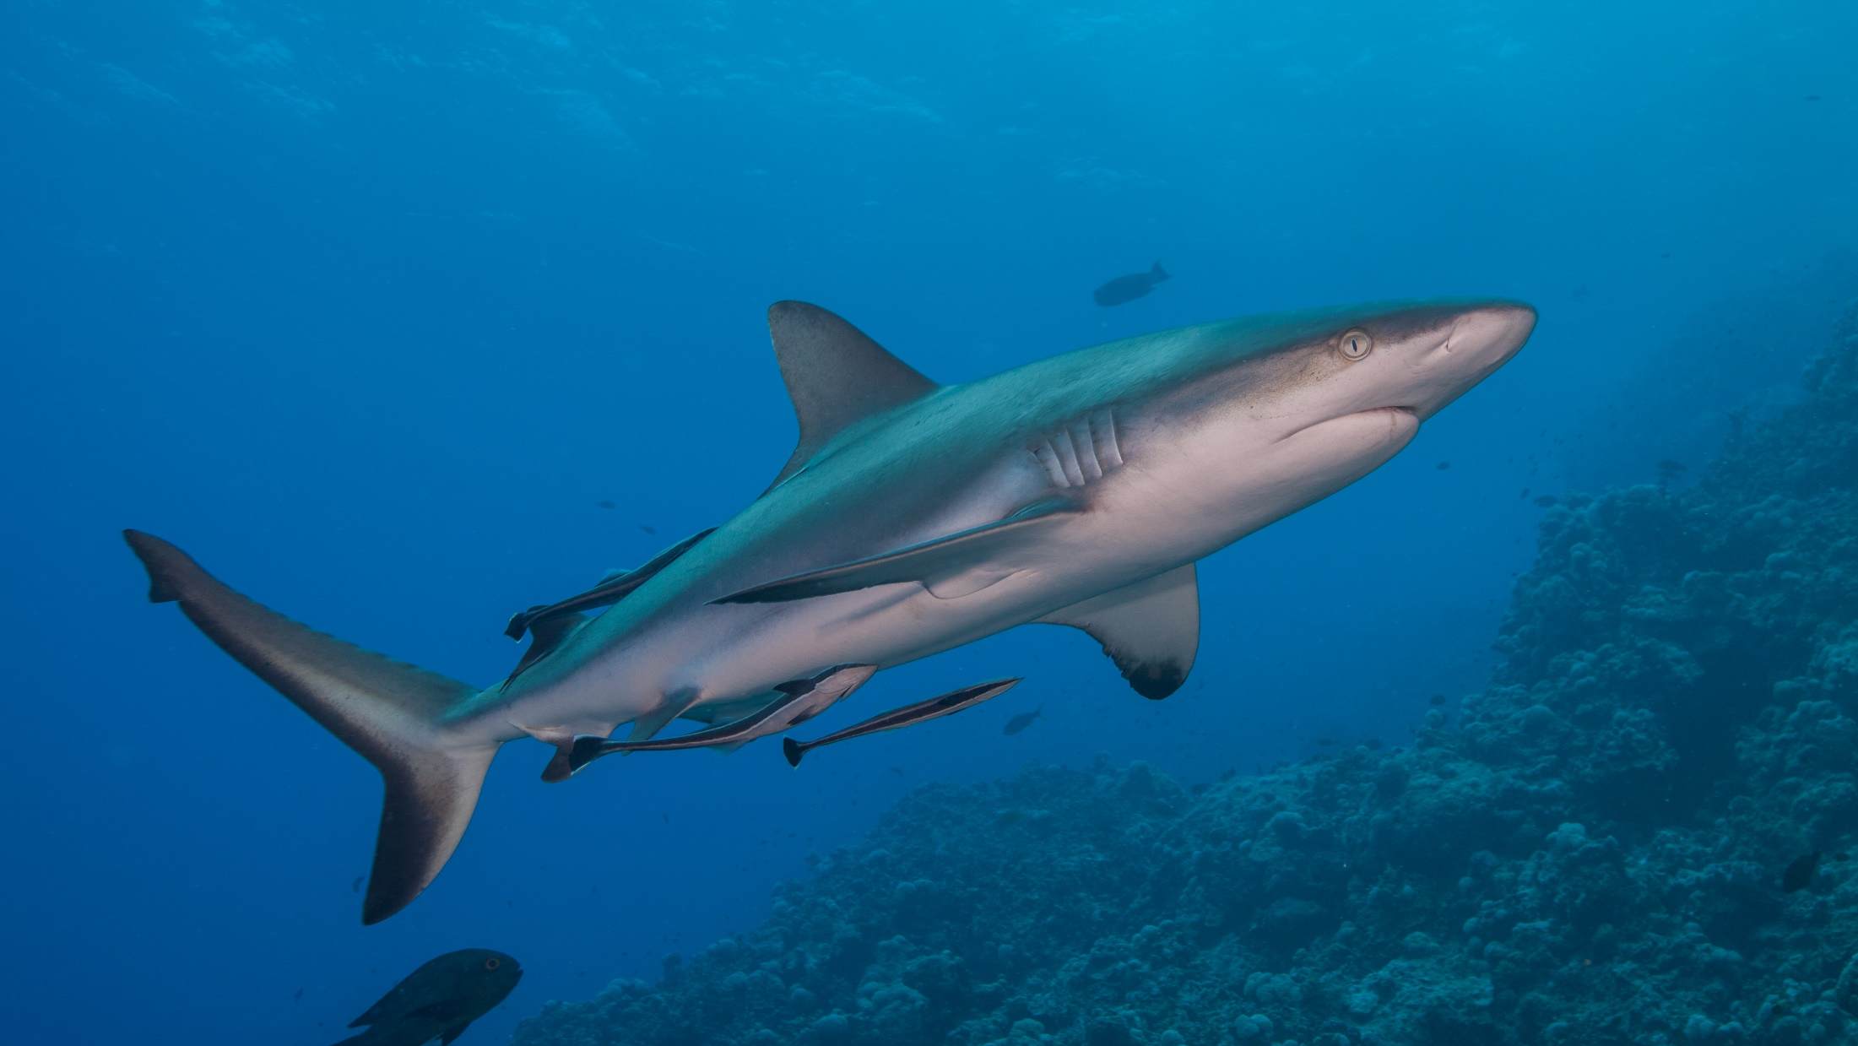
Sharks
Notes:
Image: J. Sumerling, Copyright Commonwealth of Australia (GBRMPA)

Slide 70
Whitetip reef shark
VULNERABLE TO EXTINCTION
White tip on fin
Notes:
Image: T. Mayne, Copyright Commonwealth of Australia (GBRMPA)

Slide 71
Blacktip reef shark
VULNERABLE TO EXTINCTION
Black tip on fin
Notes:
Image: K. Hoppen, Copyright Commonwealth of Australia (GBRMPA)

Slide 72
Epaulette shark
Notes:
Image: P. Marshall, Copyright Commonwealth of Australia (GBRMPA)

Slide 73
Why count sharks?
Do not answer the question. Wait for an answer.
Sharks are at the top of the food chain.
They help regulate the number of prey species and maintain ecological balance. Sharks are a keystone species.
Without sharks, ecosystems are dramatically different.
Many sharks are endangered.

Slide 74
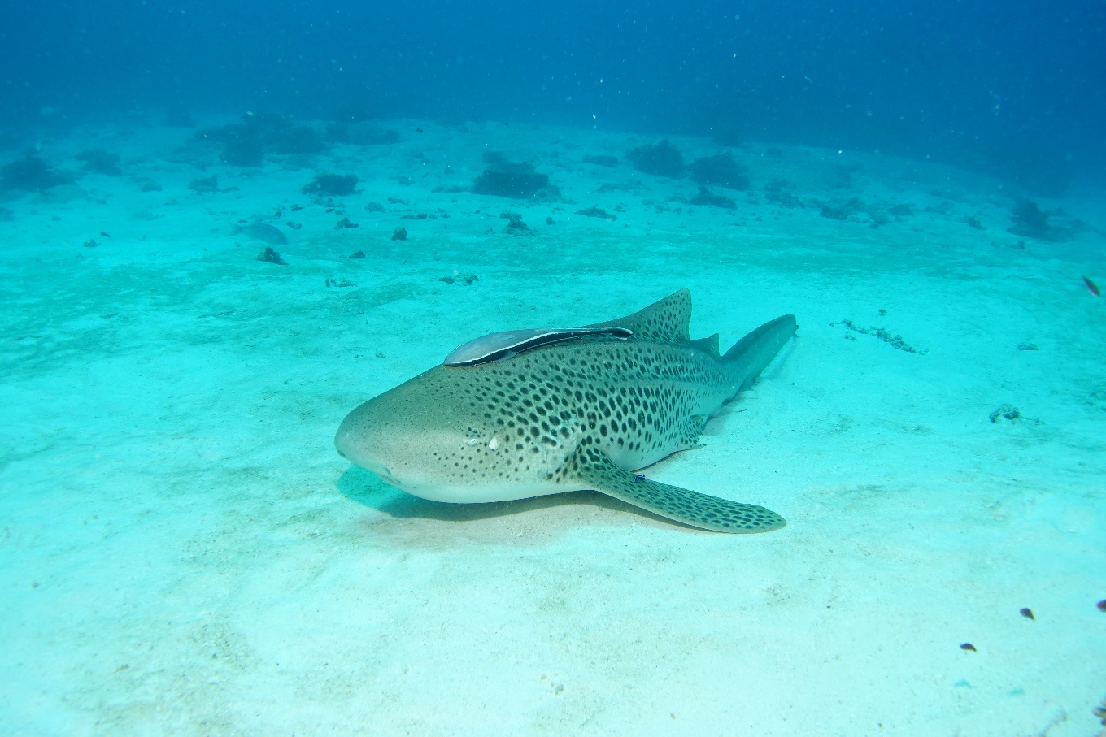
Why count sharks?
Notes:
Images: (Left) J. Sumerling, Copyright Commonwealth of Australia (GBRMPA); (Right) C. Jones, Copyright Commonwealth of Australia (GBRMPA)

Slide 75
Who is counting the whitetip, blacktip and all other sharks?
Check buddy pair/s counting sharks have all their materials.

Slide 76
Who is counting sharks?
Whitetip / Blacktip / other

Slide 77
Everybody must look out for crown-of-thorns starfish.
Venomous spines. Do not touch!

Slide 78
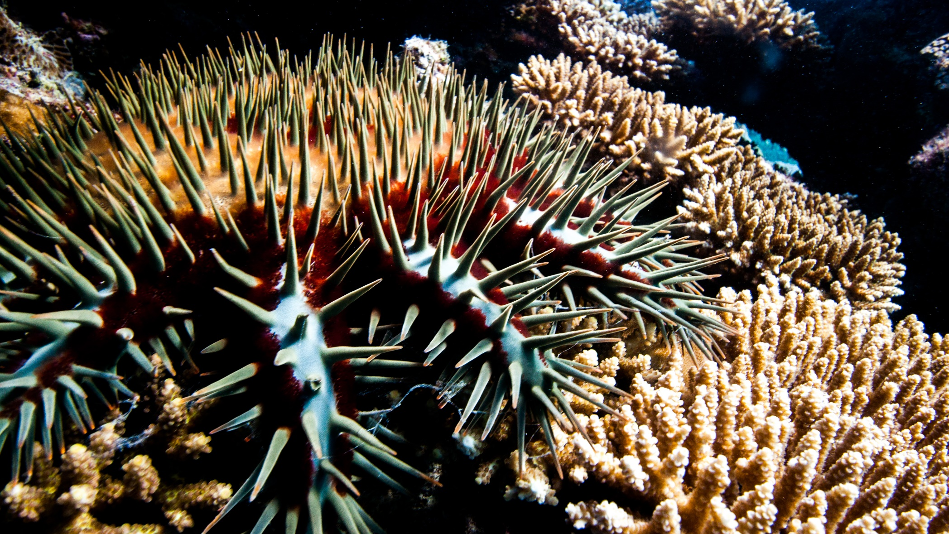
Crown-of-Thorns Starfish (COTS)
Venomous spines. Do not touch!
Notes:
Image: J. Hurford, Copyright Commonwealth of Australia (GBRMPA)

Slide 79
Count the adults (larger than your hand) and juveniles (smaller than your hand).

Slide 80
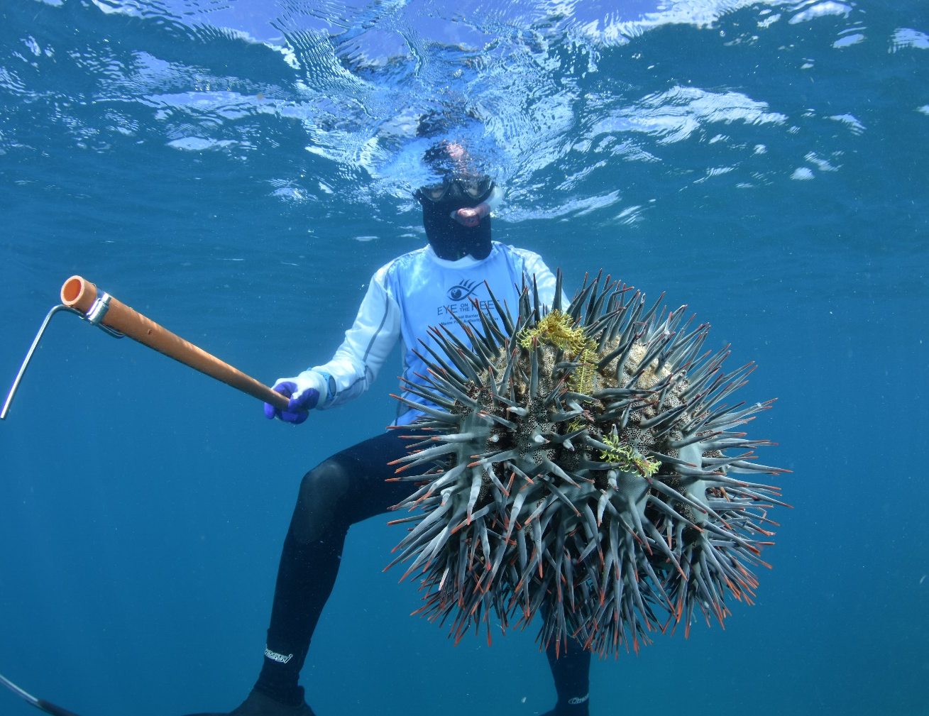
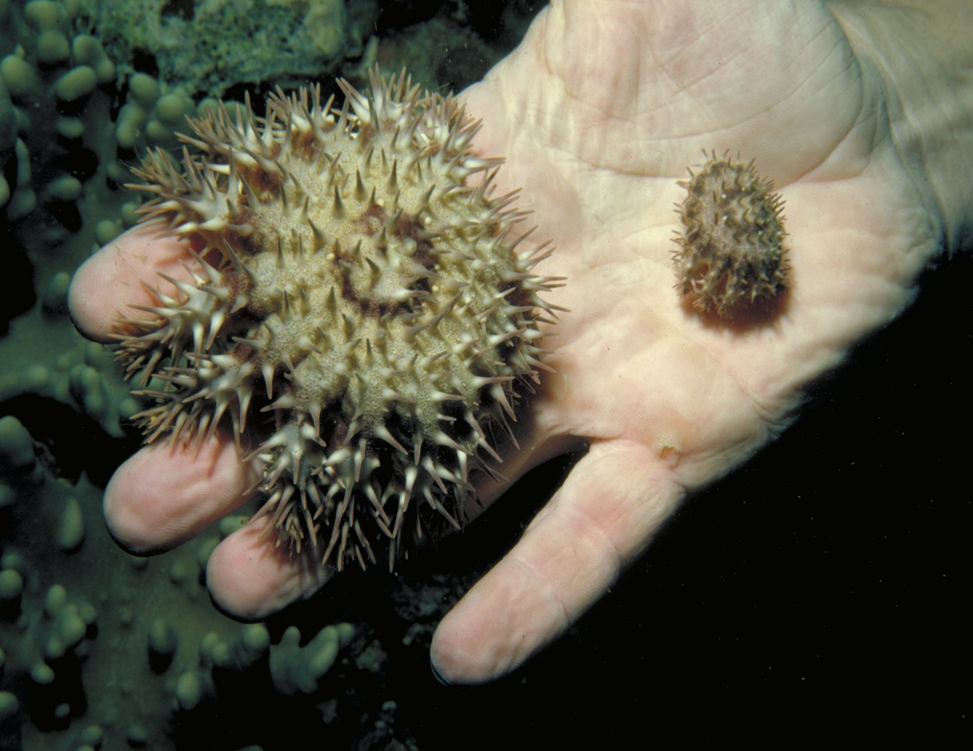
Count the adults and juveniles. Juveniles are smaller than your hand.
Notes:
Images: (Left) M. Curnock, Copyright Commonwealth of Australia (GBRMPA); (Right) Copyright Commonwealth of Australia (GBRMPA)

Slide 81
Why report all crown-of-thorns starfish?
It informs GBRMPA of potential outbreaks.

Slide 82
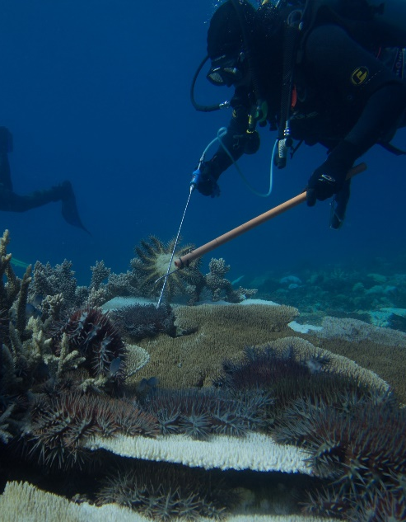
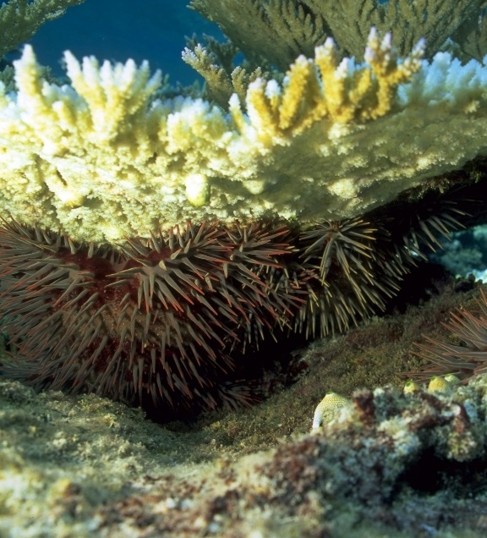
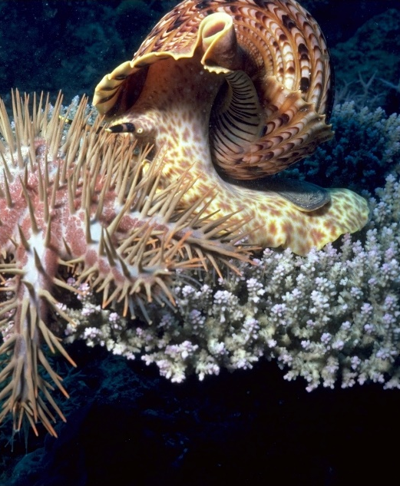
Why report all crown-of-thorns starfish?
Diver injecting COTS
Can be hiding under coral
Giant triton snail eating COTS
Notes:
Images: (Left) D. Shultz, Copyright Commonwealth of Australia (GBRMPA); (Middle) D. Wachenfeld, Copyright Commonwealth of Australia (GBRMPA); (Right) K. Garnett, Copyright Commonwealth of Australia (GBRMPA)

Slide 83
Look out for all these!

Slide 84
Look out for all these!

Slide 85
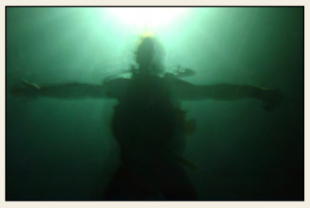
Measure depth and visibility.
<5m 5-10m >10m

Slide 86
Measure depth and visibility.
<5m 5-10m >10m

Slide 87
In-water safety brief.

Slide 88
In-water
safety brief.

Slide 89
10 minute timed swim.
Boundaries of the swim area?
Set timer/listen for signal (10 minute).
Swim in one direction.
Swim slowly.
Be as quiet as possible.
Notes:
Taken from Rapid Monitoring Survey Slides.

Slide 90
10 minute timed swim.
Look ahead every 60 seconds.
Look out for unique fish (for app later).
Do not touch or chase the animals.
Write your names on slate.
Tally as you go [ I=1 III=3 IIII=5 ].
Notes:
Taken from Rapid Monitoring Survey Slides.

Slide 91
Listen to your guide at all times.
Always wear a mask, snorkel and fins.
Use a floatation device (e.g. pool noodle).
Stay together with your buddy at all times.
In the water, keep checking on your position.
Listen for when 10 minutes is finished.
Do not touch or chase the animals.
If you get into trouble, wave one hand high above the water to attract the attention of the person on surface watch.
Stay safe for a memorable experience!

Slide 92
Listen to your guide at all times.
Always wear a mask, snorkel and fins.
Use a floatation device (e.g. pool noodle).
Stay together with your buddy at all times.
In the water, keep checking on your position.
Listen for when 10 minutes is finished.
Do not touch or chase the animals.
If you get into trouble, wave one hand high above the water to attract the attention of the person on surface watch.
Stay safe for a memorable experience!

Slide 93
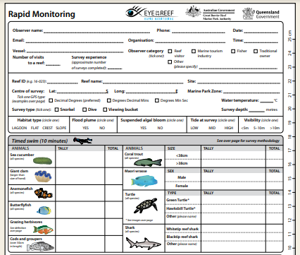
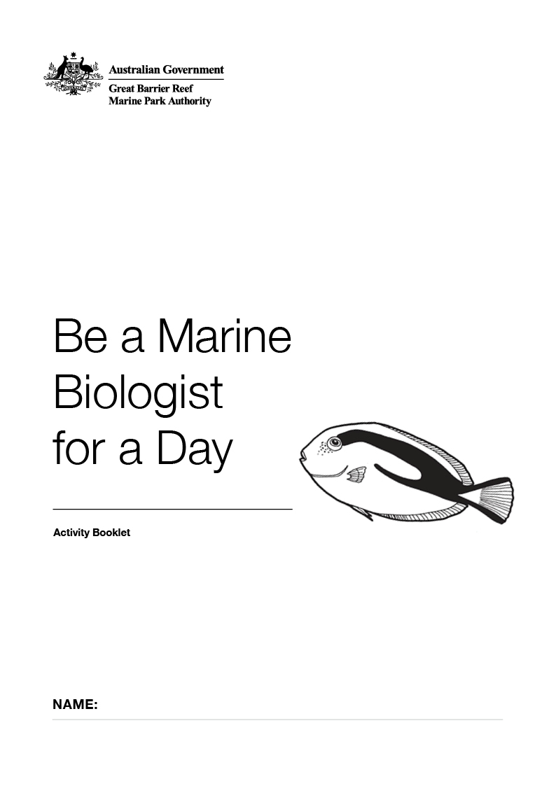
After the survey, you will be shown how to fill in this form. There is a copy in your activity book. Bring your data too!

Slide 94
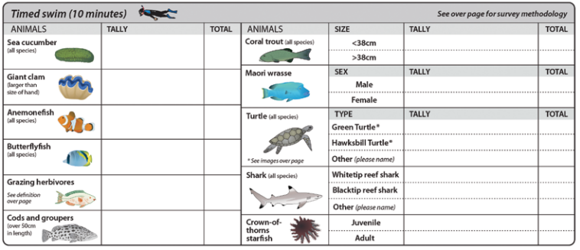
After the count, you will be shown how to fill in this form. Bring your activity books (and results sheets) with you!

Slide 95
Let’s go!
Any last comments/ instructions put here
Notes:
Optional: personalise, by changing to a picture from your operation.
Image: Copyright Commonwealth of Australia (GBRMPA)

Slide 96
Let’s go!
Notes:
Optional: personalise, by changing to a picture from your operation.
Image: Copyright Commonwealth of Australia (GBRMPA)

