Slide 1
Be a Marine Biologist for a Day
Part 2: Finding out
Advanced only
Pre-snorkel presentation for 360° survey
Notes:
Image: K. Goudkamp, Copyright Commonwealth of Australia (GBRMPA)

Slide 2
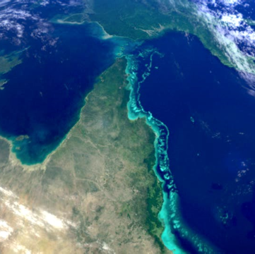
We would like to acknowledge all of the Aboriginal and Torres Straight Islander peoples who have connection to the Great Barrier Reef.
We recognise their continuing connection to land, water and community, and pay our respects to their Elders past, present and emerging.

Slide 3
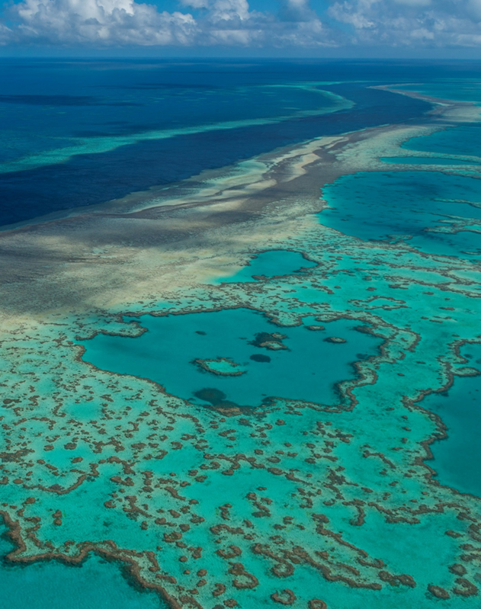
We would like to acknowledge the (insert name of local Traditional Owner group) peoples as the Traditional Owners of the Land and Sea Country that we are visiting as part of your excursion.

Slide 4
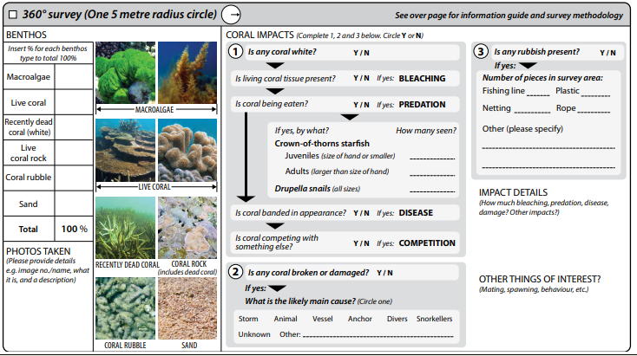

Slide 5
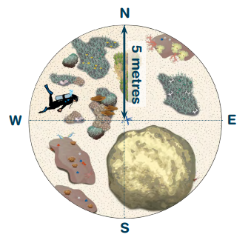
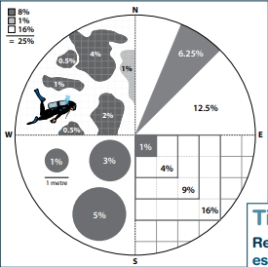
360° survey methods.
Notes:
Copyright Commonwealth of Australia (GBRMPA)

Slide 6
360° survey methods checklist.
Choose site typical of the area
Central point easy to identify
Visualise circle as 4 quadrants
Mark out perimeter
Swim 5m from centre N, S, E, W
Calibrate distance as fin kicks
3 fin kicks = approx. 5 metres
Swim the perimeter
Look towards the centre
Get an overview of benthos
Absent benthos? (write 0)
Most abundant benthos?
2nd most abundant benthos?
3rd most abundant benthos?
4th, 5th, 6th etc…
Least abundant benthos?
Use whole percentages only
Swim around your circle again
Check your % estimates
Check they add up to 100%
Notes:
Copyright Commonwealth of Australia (GBRMPA)

Slide 7
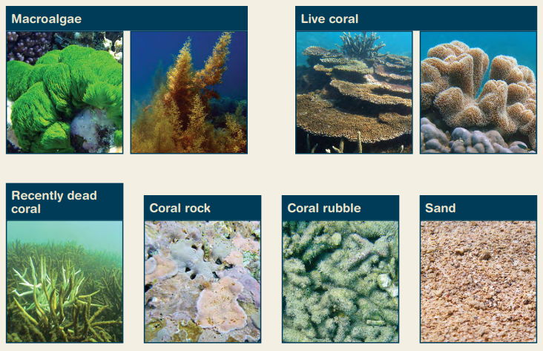
Benthos categories.
Notes:
Copyright Commonwealth of Australia (GBRMPA)

Slide 8
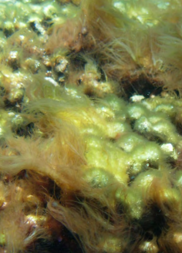
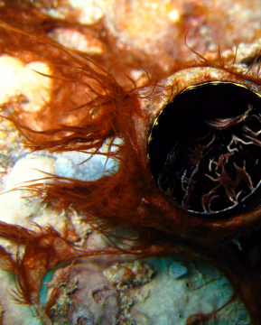
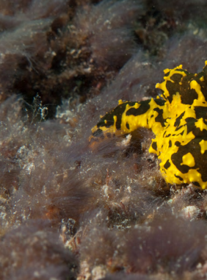
Macroalgae (slime).
Notes:
Copyright Commonwealth of Australia (GBRMPA)

Slide 9
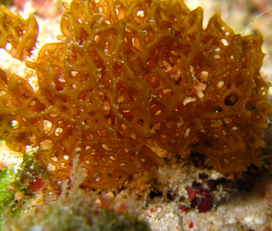
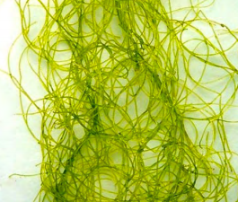
Macroalgae (entangled/mat-like).
Notes:
Copyright Commonwealth of Australia (GBRMPA)

Slide 10
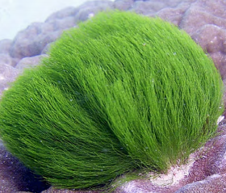
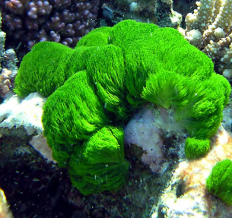
Macroalgae (filamentous).
Notes:
Copyright Commonwealth of Australia (GBRMPA)

Slide 11
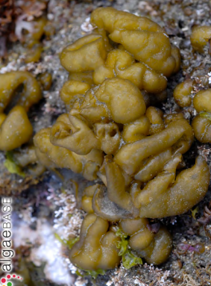
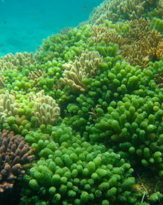
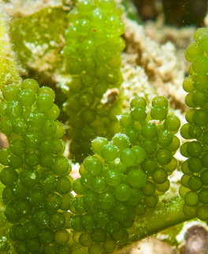
Macroalgae (leafy/fleshy).
Notes:
Copyright Commonwealth of Australia (GBRMPA)

Slide 12
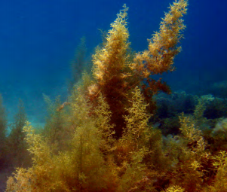
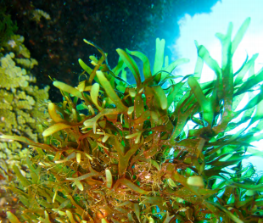
Macroalgae (tree/bush-like).
Notes:
Copyright Commonwealth of Australia (GBRMPA)

Slide 13
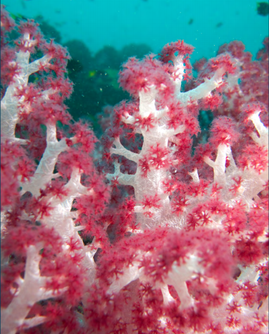
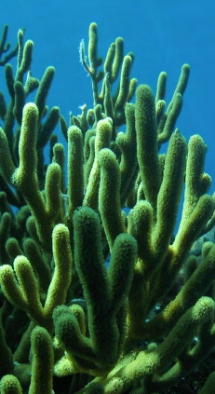
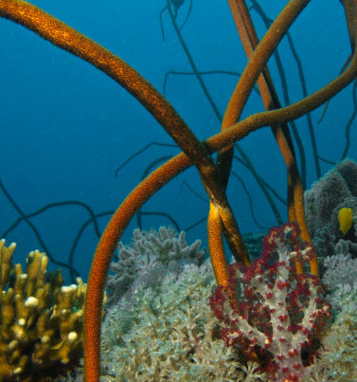
Live coral.
Notes:
Copyright Commonwealth of Australia (GBRMPA)

Slide 14
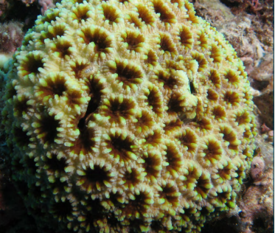
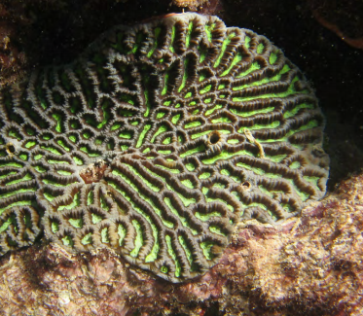
Live coral.
Notes:
Copyright Commonwealth of Australia (GBRMPA)

Slide 15
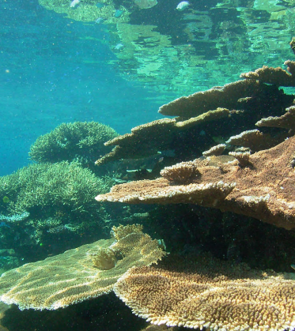
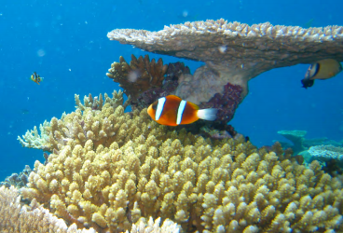
Live coral.
Notes:
Copyright Commonwealth of Australia (GBRMPA)

Slide 16
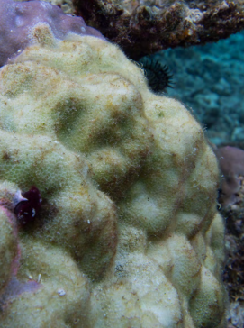
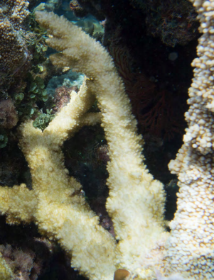
Recently dead coral (white).
Coral has died recently either by disease, bleaching, or predation.
No polyps or flesh.
Skeletal structure still visible under light covering of algae.
Early warning that something is wrong on the reef.
Notes:
Copyright Commonwealth of Australia (GBRMPA)

Slide 17
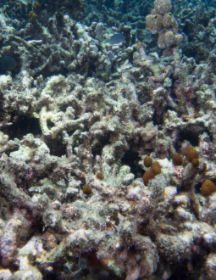
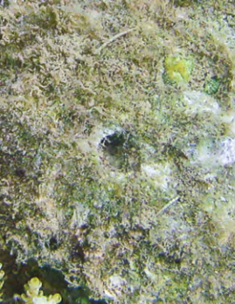
Live coral rock.
No algae >1 thumbnail high.
Provides a surface for the settlement of larvae.
Bare rock.
Coral skeletons.
Coral rubble. Cemented together (can’t move!).
Notes:
Copyright Commonwealth of Australia (GBRMPA)

Slide 18
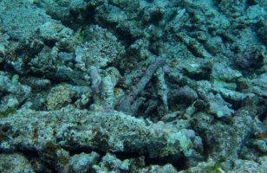
Coral rubble (able to move).
Dead, broken-off bits of coral.
Can be moved by wave action.
Like the branches of trees on a forest floor.
When coral rubble is cemented together with calcareous algae, it is categorised as live coral rock.
Notes:
Copyright Commonwealth of Australia (GBRMPA)

Slide 19
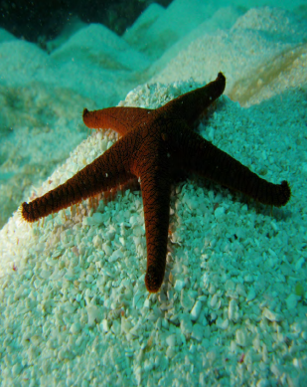
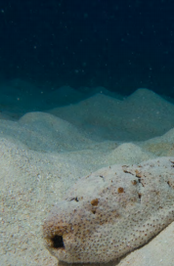
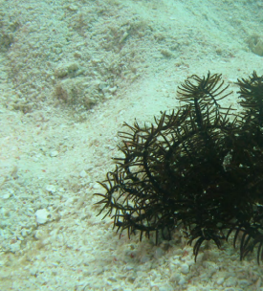
Sand
Notes:
Copyright Commonwealth of Australia (GBRMPA)

Slide 20
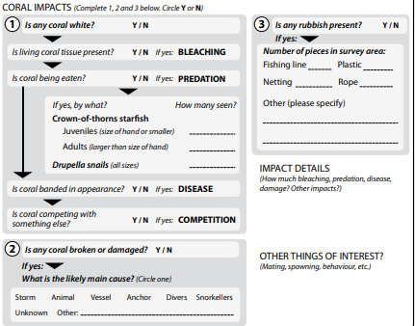
Coral impacts. Within the 360° survey area.
Coral bleaching
Coral predation
Coral disease
Coral competition
Broken coral
Rubbish
More details
Other things of interest
Notes:
Copyright Commonwealth of Australia (GBRMPA)

Slide 21
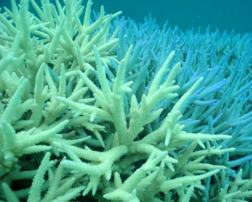
Coral bleaching.
Coral is still alive.
You can see the coral polyps and flesh above a white skeleton.
Coral colours may still be present and fluorescent.
Notes:
Copyright Commonwealth of Australia (GBRMPA)

Slide 22
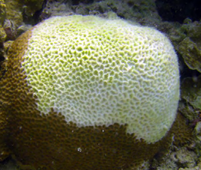
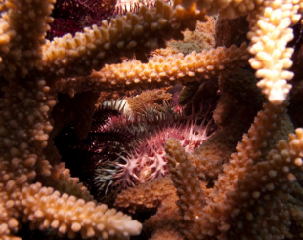
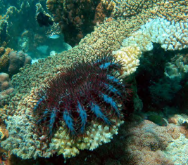
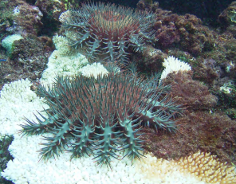
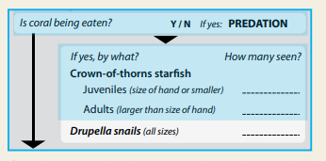
Predation by crown-of-thorns starfish.
Look for feeding scars (round white patches on live coral).
Only record the COTS that you see.
Juveniles < size of hand.
Notes:
Copyright Commonwealth of Australia (GBRMPA)

Slide 23
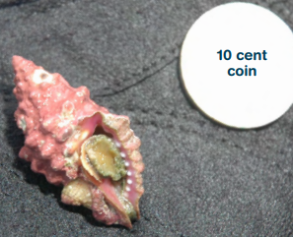
Predation by Drupella cornus snails.
Look for feeding scars (white sections of live coral).
Only record the Drupella that you see (look closely around the base of the coral).
Shell colour pink to dark red.
Notes:
Copyright Commonwealth of Australia (GBRMPA)

Slide 24
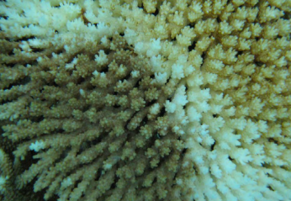
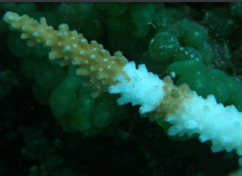
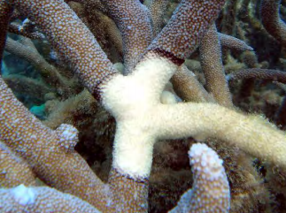
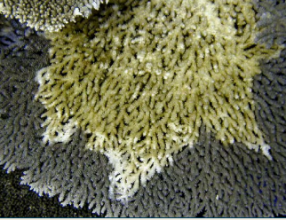
Coral disease.
Band of colour between live and dead coral.
Or, a gradual colour change from white to green/brown.
Notes:
Copyright Commonwealth of Australia (GBRMPA)

Slide 25
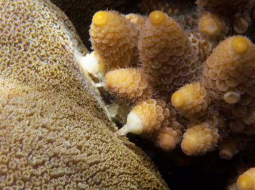
Coral competition.
2 different coral colonies compete for light and space.
No algae present.
Could be confused with disease.
Notes:
Copyright Commonwealth of Australia (GBRMPA)

Slide 26
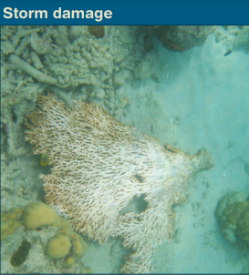
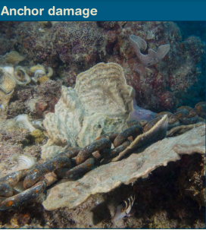
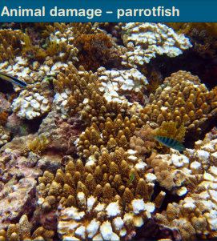
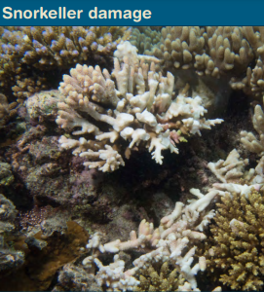
Causes of coral damage.
Animal damage: minor damage to tips or edges.
Anchor damage: distinctive corridor/line of damage.
Look around for clues.
Consider recent weather conditions.
Notes:
Copyright Commonwealth of Australia (GBRMPA)

Slide 27
Types of rubbish present (count pieces).
Notes:
Copyright Commonwealth of Australia (GBRMPA)

Slide 28
Impact details and things of interest.
More details about the impacts you’ve reported.
Any relevant information about the site or survey.
Notes:
Copyright Commonwealth of Australia (GBRMPA)

Slide 29
Questions?
Notes:
Copyright Commonwealth of Australia (GBRMPA)

Slide 30
Enjoy your trip to the Great Barrier Reef!
See the Reef • Love the Reef • Protect the Reef

