Slide 1
Be a Marine Biologist for a Day
Part 2: Finding out
Senior School
Pre-snorkel presentation for modified 10 minute timed swim
Notes:
Image: C. Golino, Copyright Commonwealth of Australia (GBRMPA)

Slide 2
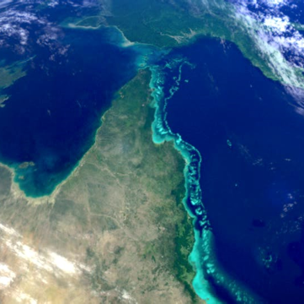
We would like to acknowledge all of the Aboriginal and Torres Straight Islander peoples who have connection to the Great Barrier Reef.
We recognise their continuing connection to land, water and community, and pay our respects to their Elders past, present and emerging.

Slide 3
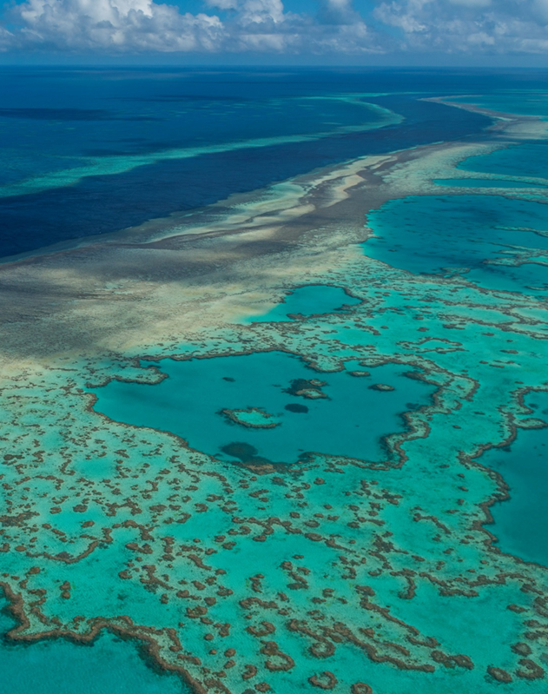
We would like to acknowledge the (insert name of local Traditional Owner group) peoples as the Traditional Owners of the Land and Sea Country that we will be visiting as part of your excursion.

Slide 4
The pages are organised so that when you flip to the next page, and the students have it in front of them to see, you’re reading out loud the corresponding text on the back of the previous page.
Mandatory ACARA Content Elaborations
Marine science Units 1–4: Oceanography, Marine Biology, Marine systems – connections and change, Ocean issues and resource management. Assessment IA1: Data Test (10%), IA2: Student Experiment (20%), IA3: Research Investigation (20%), EA: External Assessment (Exam 50%). Note: the IA2 requires students to collect primary data. The IA2 is a modification of a mandatory practical. Mandatory practicals Conduct water quality tests on a water sample. Conduct an investigation to determine factors of population dynamics (e.g. density or distribution) and assess abiotic components of a local ecosystem case study. Emphasis should be placed on assessing the processes and limitations of the chosen technique (e.g. quadrat, transect). When students identify and describe marine species, they should use field guides and identification keys. Examine the concept of connectivity within or between a habitat by investigating the impact of water quality on reef health. Investigate the effects an altered ocean pH has on marine carbonate structures. Apply the Lincoln Index in a modelled capture-recapture scenario. Aquatic practices Areas of study: Environmental, Recreational, Commercial, Cultural, Safety and management practices. Environmental: Environmental Conditions, Ecosystems, conservation and sustainability, Citizen science (elective) Recreational: Entering aquatic environments, Aquatic Activities (elective) Commercial: Employment, Aquaculture aquaponics and aquariums (elective), Boat building and marine engineering (elective) Cultural: Cultural understandings, Historical understandings (elective) Safety and management practices: Legislation, rules and regulations for aquatic environments, equipment maintenance and operation, first aid and safety, management practices. Assessment Project, Investigation, Extended Response, Examination, Performance.
Notes:
This PowerPoint is designed for you to (edit and) save as a PDF and print to use as a flip book at the snorkel site.
Print double-sided (along short side). Print and laminate. Or print on waterproof paper (sold at OfficeWorks).
Hole punch and secure along the top (ensure pages can flip over easily). Flip the pages over as you go.
The pages are organised so that when you flip to the next page, and the students have it in front of them to see, you’re reading out loud the corresponding text on the back of the previous page.

Slide 5
How can I help the Great Barrier Reef?
Notes:
This is the overarching inquiry question that encompasses the entire BAMBFAD Program and is the starting slide to this presentation.

Slide 6
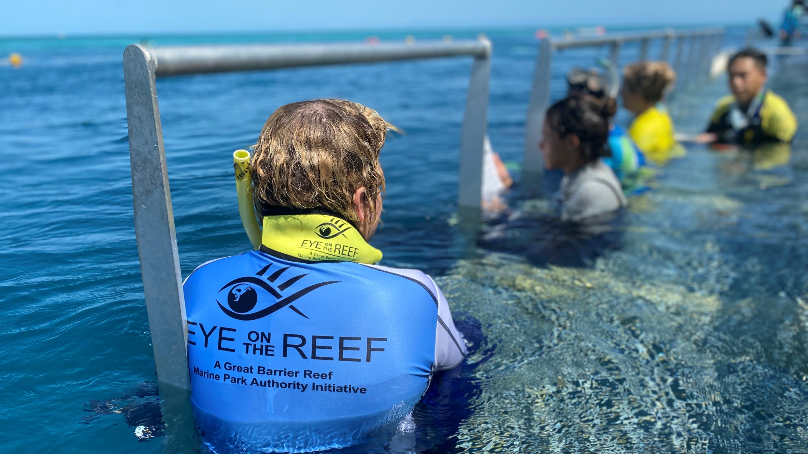
Citizen Science
Notes:
Optional: Replace with pictures of your operation and your Master Reef Guide/s here.
Image: M. Knapton, Copyright Commonwealth of Australia (GBRMPA)

Slide 7
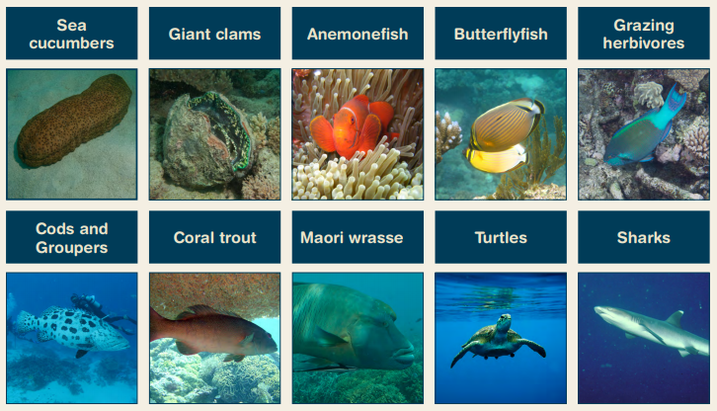
What we count in 10 minutes.
Notes:
Idea: you could organise a prize for the person with the most correct answers?

Slide 9
Why GBRMPA counts these species.

Slide 11
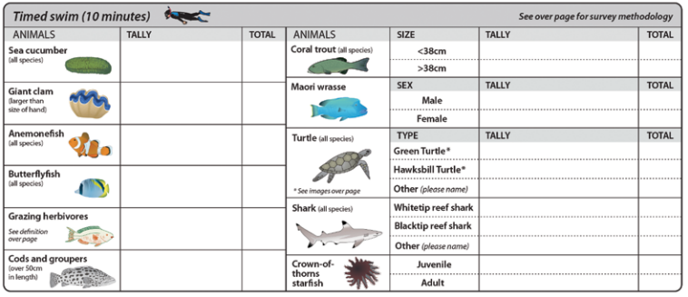
You are to complete this table.

Slide 12
Tally as you go. Total at the end.
13

Slide 13
Why count sea cucumbers?
Remind students sea cucumbers could be used as a dependent variable for a research question.
Why are sea cucumbers called the vacuum cleaners of the sea?
What is the commercial value of sea cucumbers?

Slide 14
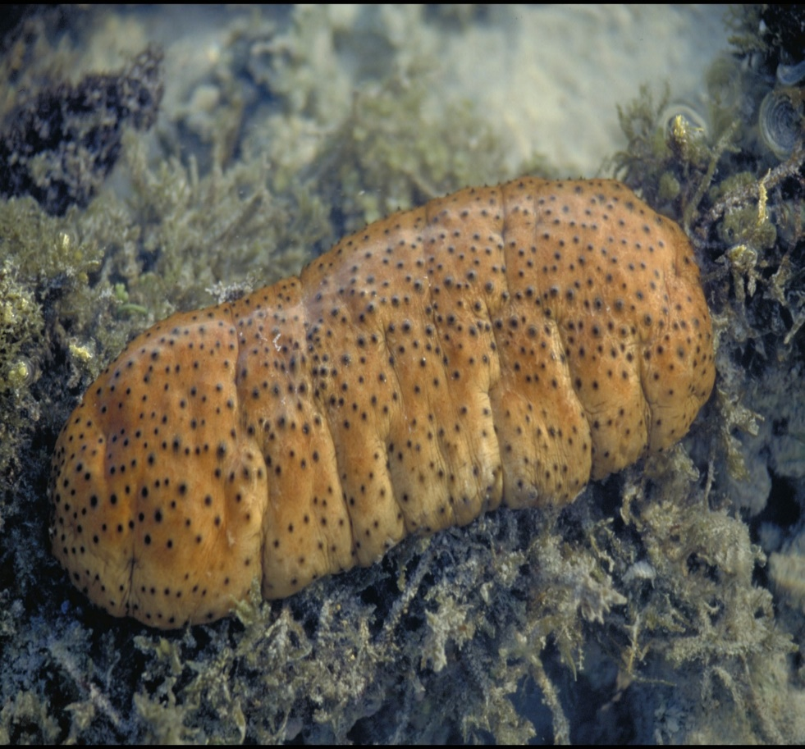
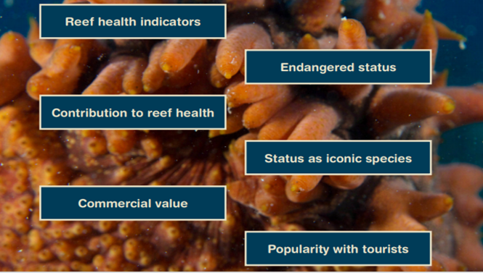
Why count sea cucumbers?
Notes:
Image: J. Jones, Copyright Commonwealth of Australia (GBRMPA)

Slide 15
Why count giant clams? >30cm
Giant clams are endangered.
Is a giant clam a habitat former? Is the clam a form of habitat for other organisms?
How many people are excited to see a giant clam? Remember we only count those >30cm.

Slide 16
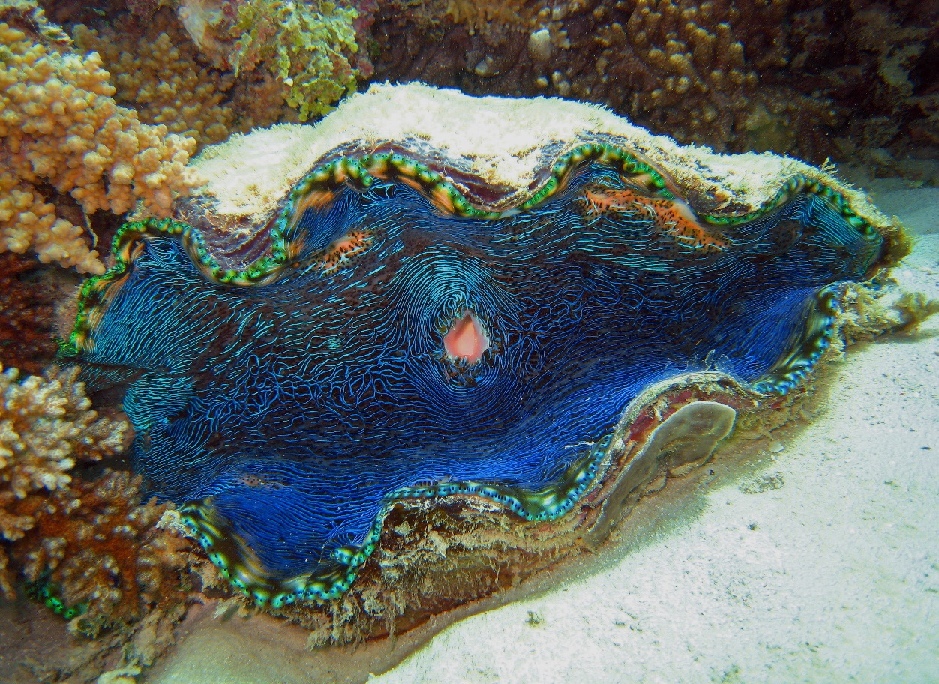
Why count giant clams? >30cm
Notes:
Image: C. Jones, Copyright Commonwealth of Australia (GBRMPA)

Slide 17
Why count anemonefish?
Anemones rarely move and are long lived. So, if they go missing (or bleach white) this tells us that something is wrong. The anemone fish help us to find the anemones.
Why are anemonefish so iconic?
How many people are excited to see an anemone?

Slide 18
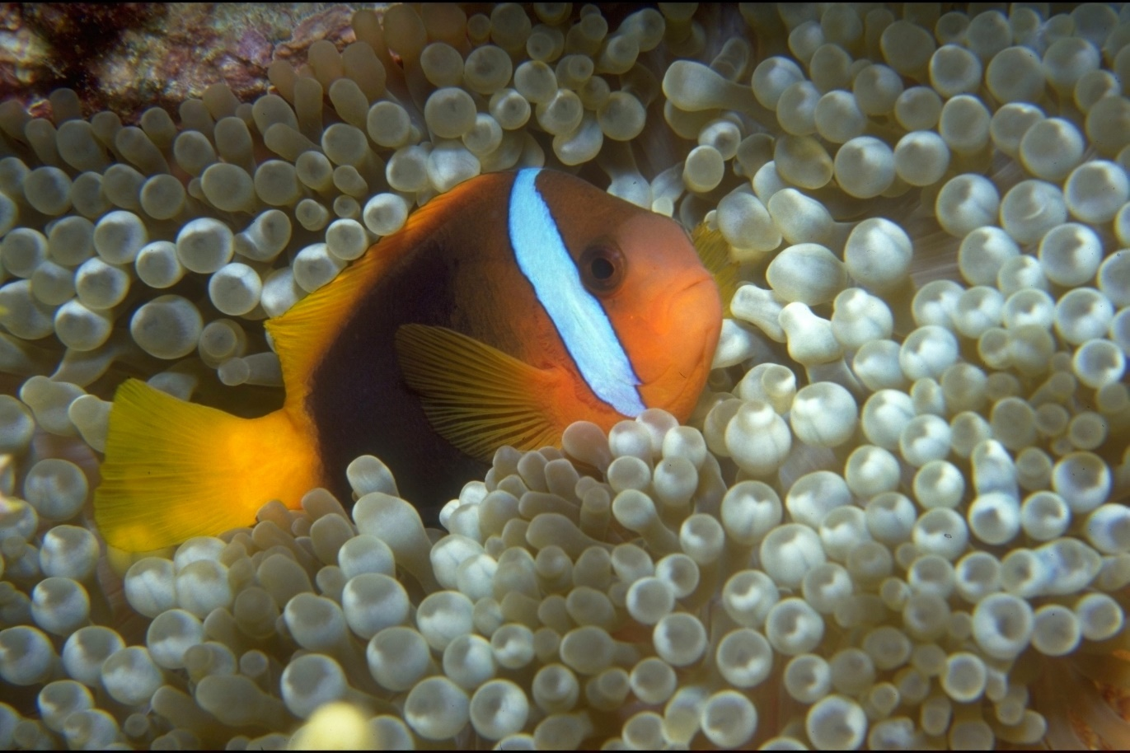
Why count anemonefish?
Notes:
Image: T. Mayne, Copyright Commonwealth of Australia (GBRMPA)

Slide 19
Why count butterflyfish?
Butterflyfish eat coral. A healthy coral reef with lots of food can support lots of butterflyfish. More coral means more butterflyfish.
Ask students to pay attention to what the butterflyfish are eating.
Butterflyfish are very colourful and pretty making them popular with tourists.

Slide 20
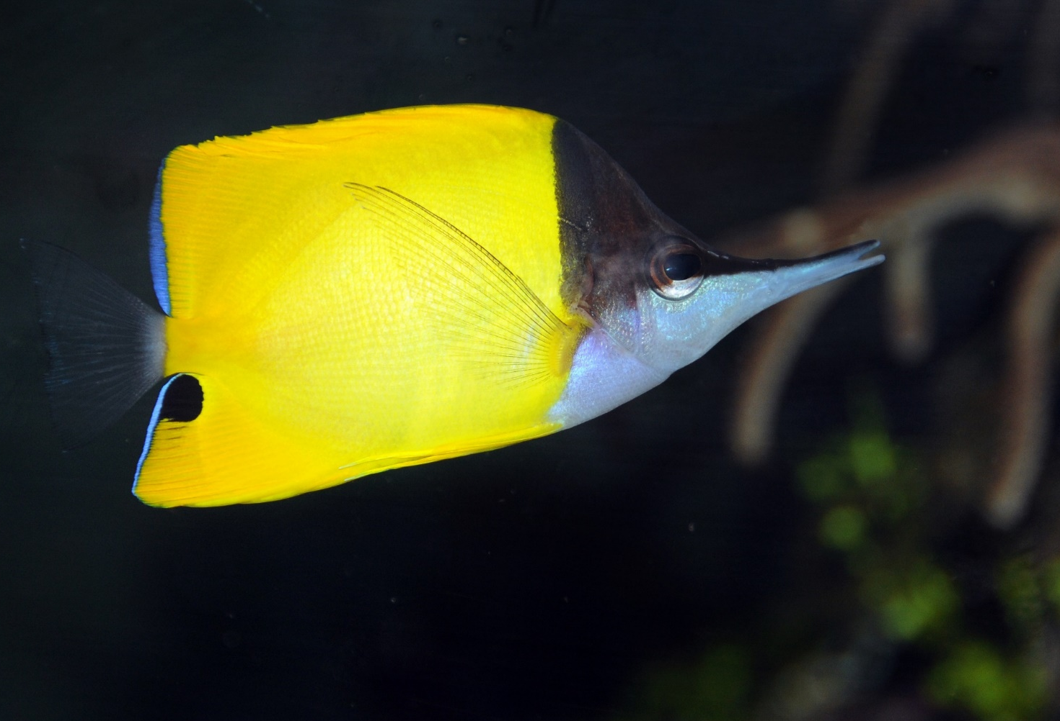
Why count butterflyfish?
Notes:
Image: J. Jones, Copyright Commonwealth of Australia (GBRMPA)

Slide 21
Why count grazing herbivores? Parrotfish / Surgeonfish / Rabbitfish / Unicornfish
Grazing herbivores are the lawnmowers of the Reef! They eat the algae that compete with corals for space. By limiting the growth and spread of algae, coral reefs stay healthy and resilient.
Remind students grazing herbivores could be used as a dependent variable to answer a research question.
Encourage the students to listen to them grazing and note what they’re grazing on. Is it the same for each?

Slide 22
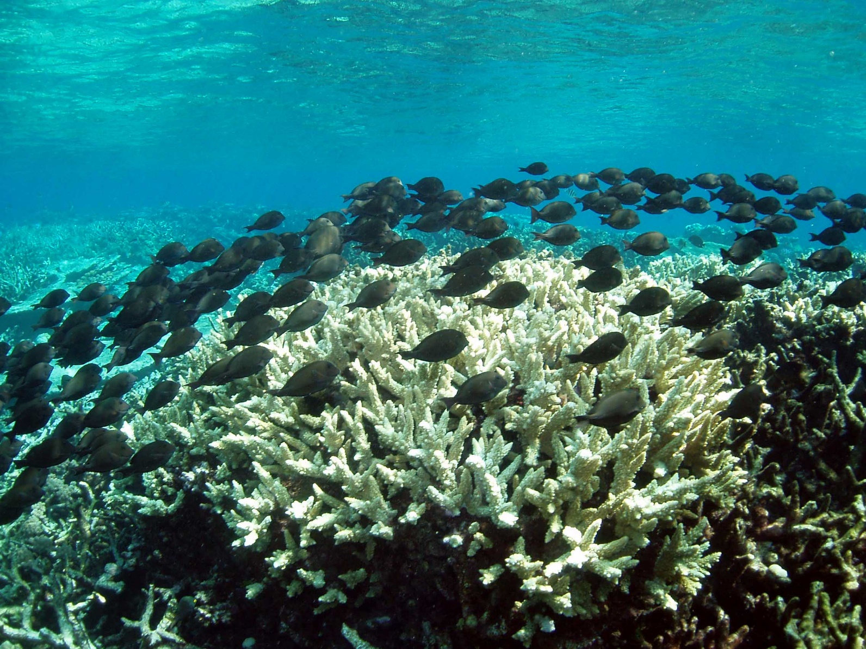
Why count grazing herbivores? Parrotfish / Surgeonfish / Rabbitfish / Unicornfish
Notes:
Image: C. Jones, Copyright Commonwealth of Australia (GBRMPA)

Slide 23
Why count cods and groupers?
>50cm
Queensland groupers and potato cod can grow very big!
Their massive size and friendly nature makes them iconic, and popular with tourists.
Remember we’re only counting those >50cm.

Slide 24
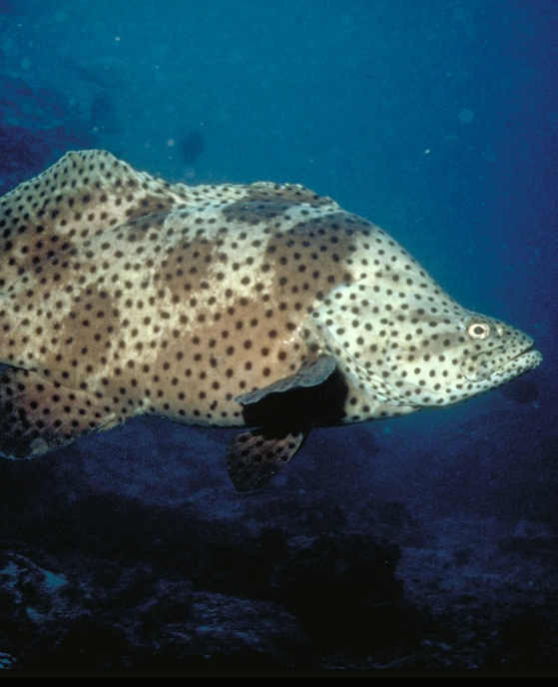
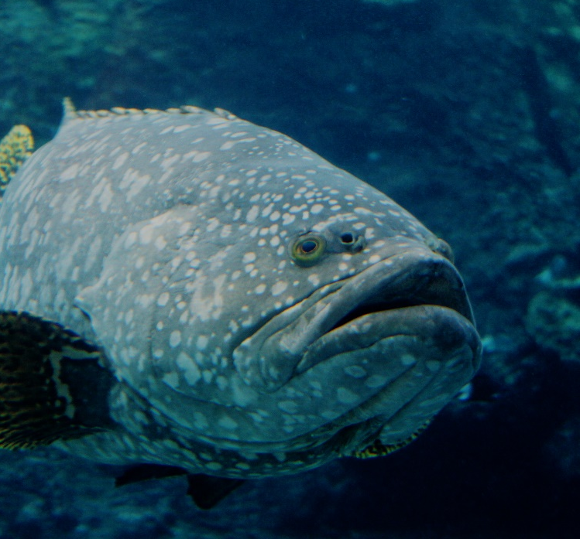
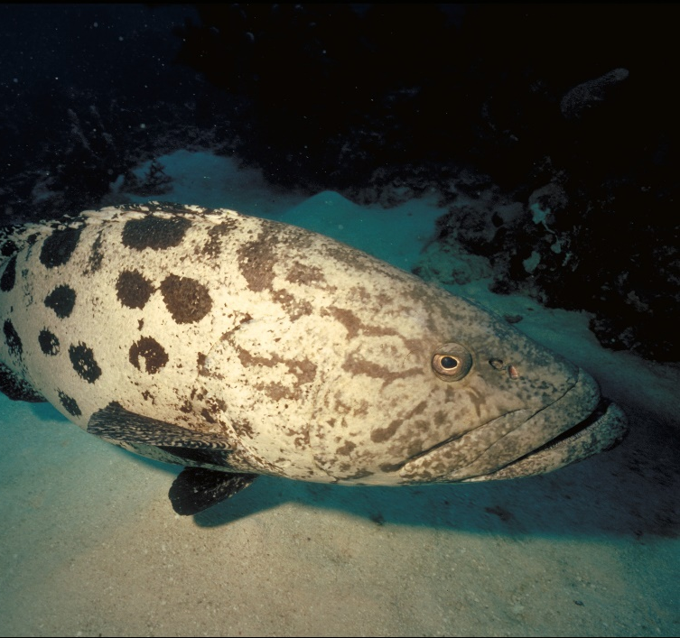
Why count cods and groupers? >50cm
Barramundi cod
Qld grouper
Potato cod
Notes:
Images: (Left) K. McClymont, Copyright Commonwealth of Australia (GBRMPA); (Middle) J.Hurford, Copyright Commonwealth of Australia (GBRMPA); (Right) P. McGinnity, Copyright Commonwealth of Australia (GBRMPA)

Slide 25
Why count coral trout? <38cm / >38cm
What is the legal size of a coral trout?
Remember to count all those less than 38cm and all those more than 38cm.
Show me with your hands how big that is. Note: ruler on form.

Slide 26
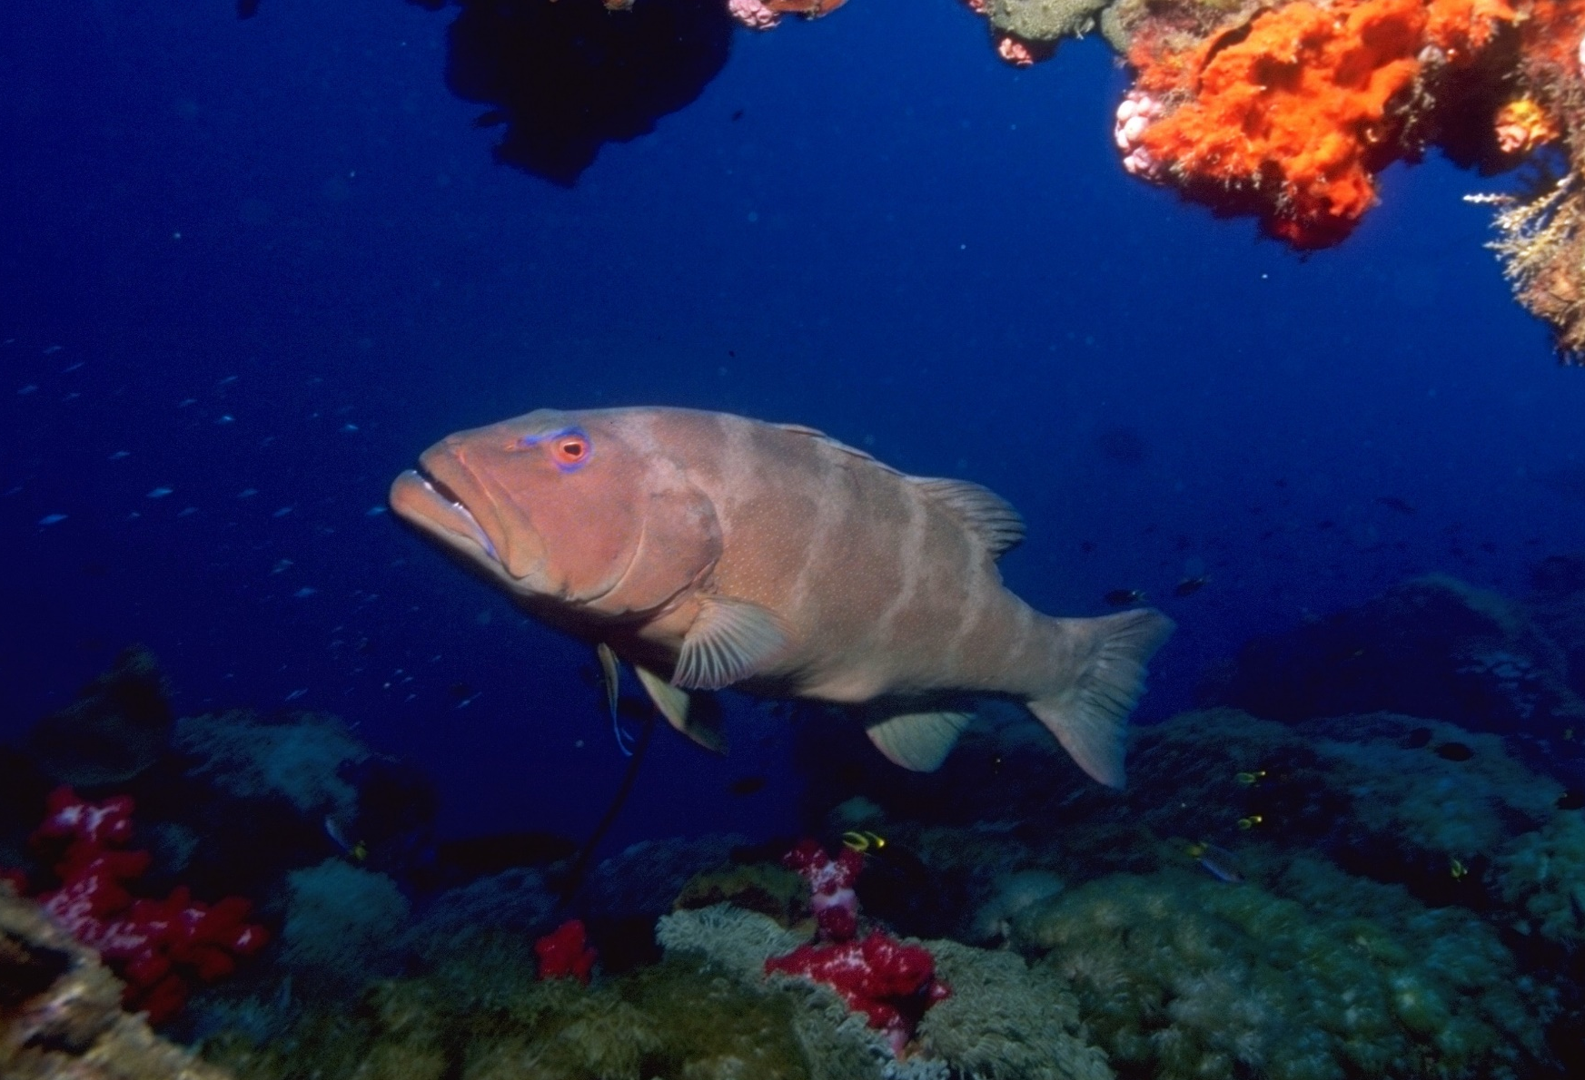
Why count coral trout? <38cm / >38cm
Notes:
Image: T. Mayne, Copyright Commonwealth of Australia (GBRMPA)

Slide 27
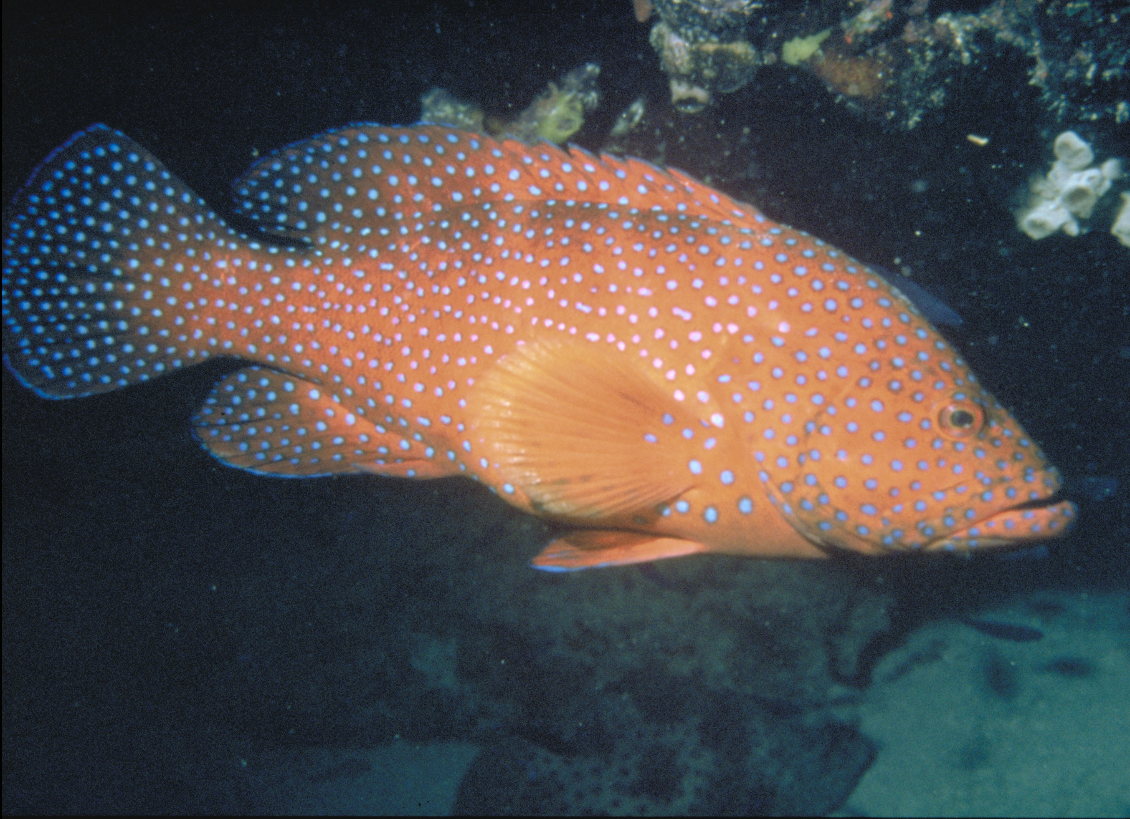
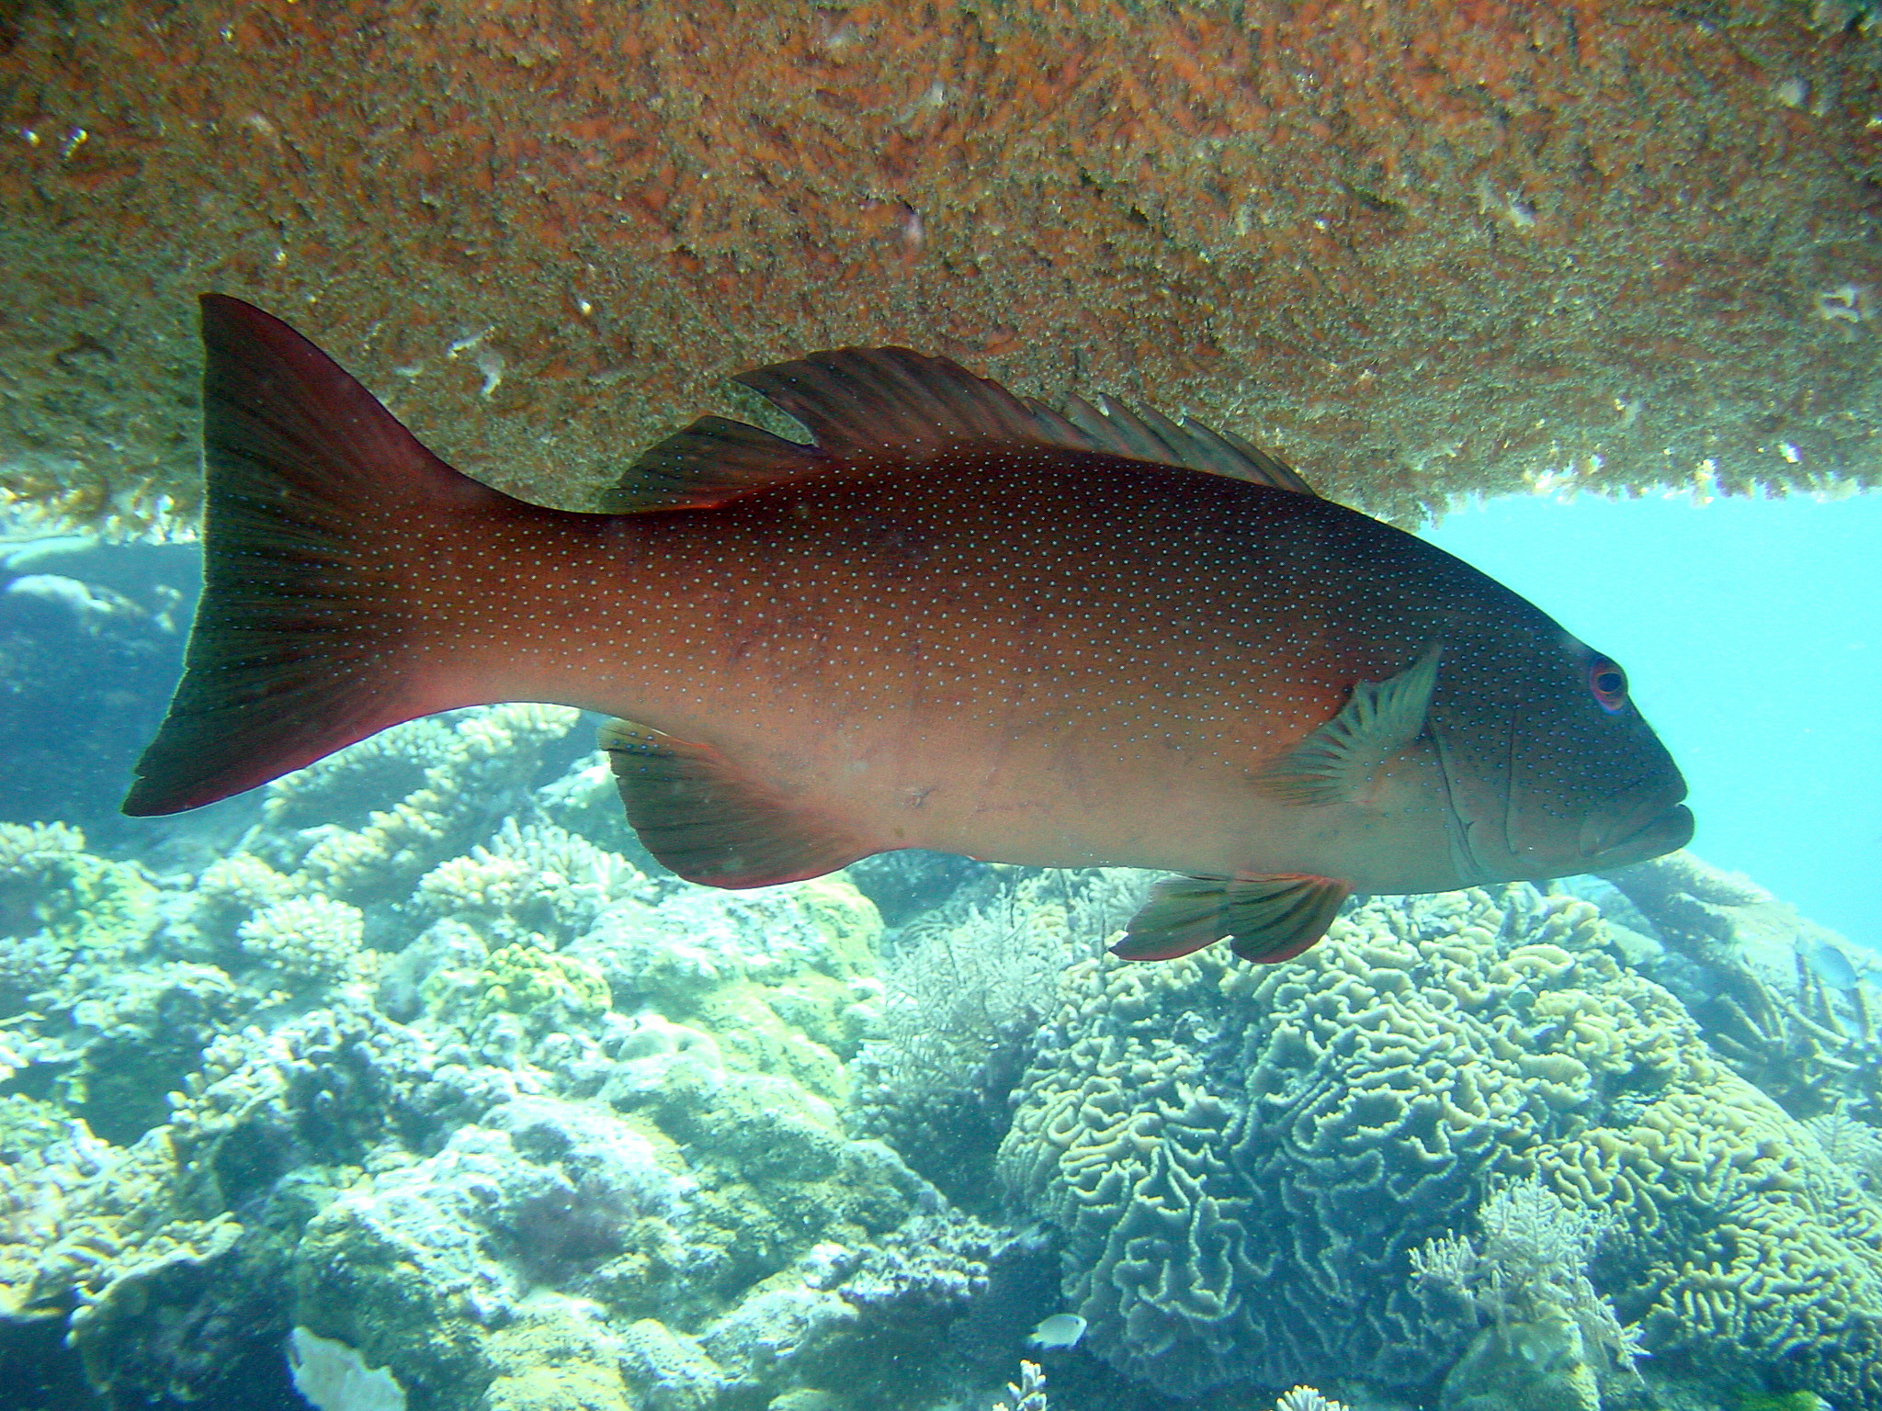
Spot the difference. Hint: compare the shape of the tail.
CONVEX TAIL
CONCAVE TAIL
Coral cod
Coral trout
Notes:
Images: (Left) N. Collins, Copyright Commonwealth of Australia (GBRMPA); (Right) G. Goby, Copyright Commonwealth of Australia (GBRMPA)

Slide 28
Why count Maori wrasse? Female / Male
Maori wrasse are endangered.
Male Maori wrasse grow very big!
Their massive size and friendly nature makes them iconic, and popular with tourists. Do not touch!
They eat COTS

Slide 29
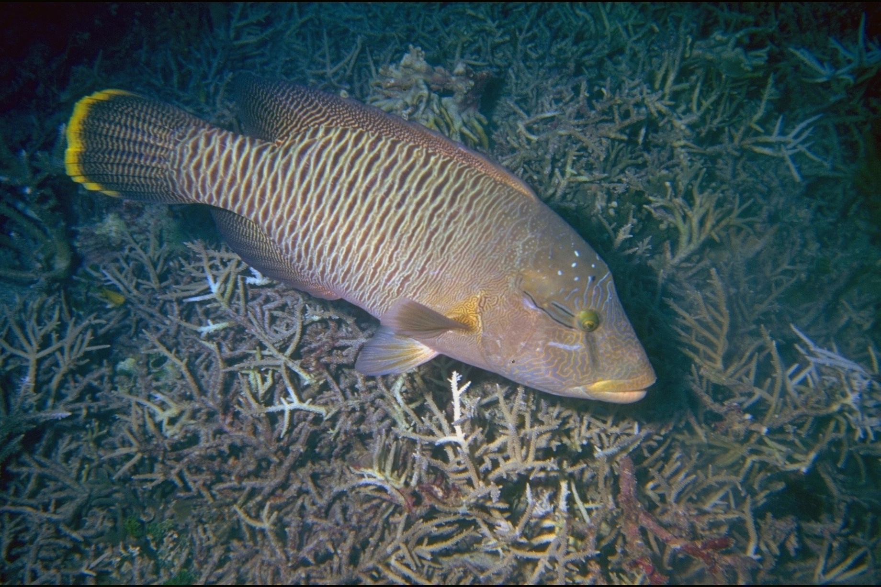
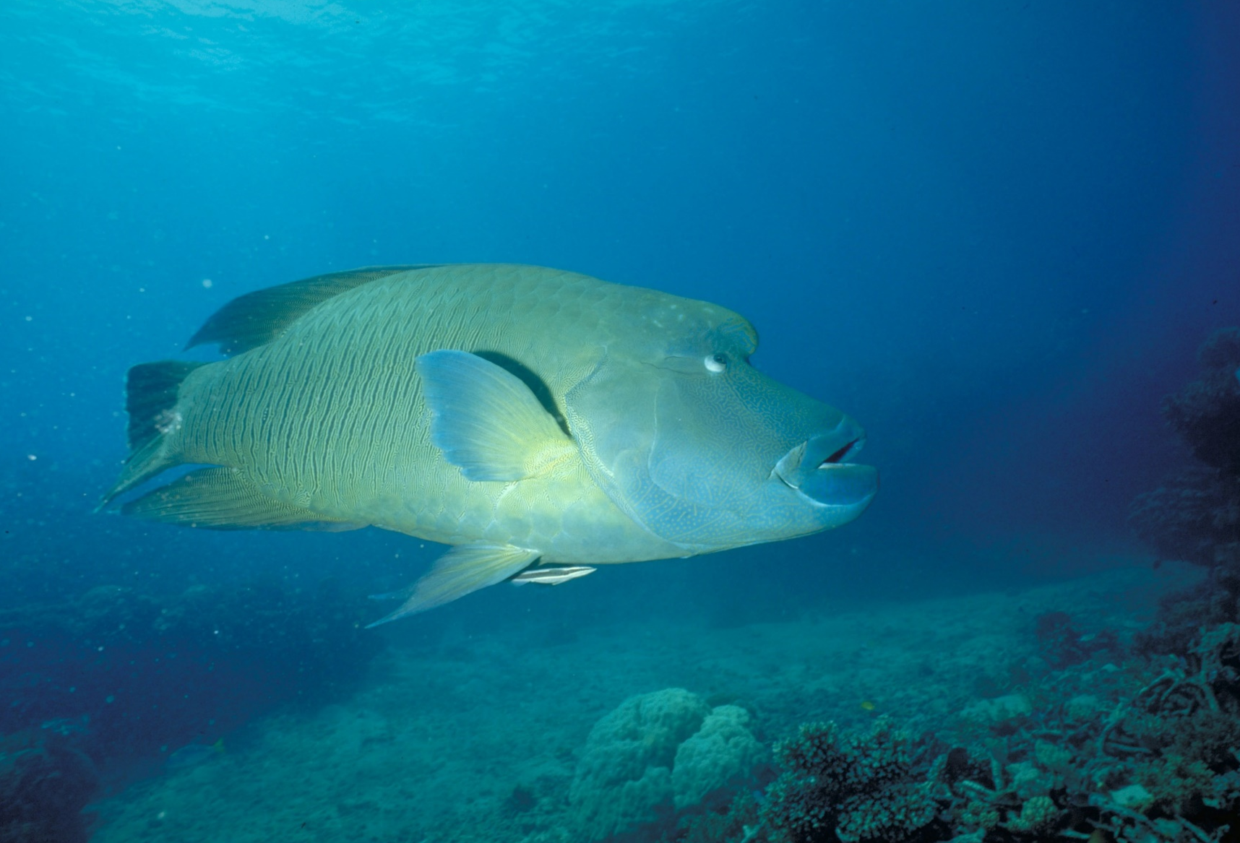
Why count Maori wrasse?
ENDANGERED
ENDANGERED
Female
Male
Notes:
Images: (Left) U. Engelhardt, Copyright Commonwealth of Australia (GBRMPA); (Right) M. Simmons, Copyright Commonwealth of Australia (GBRMPA)

Slide 30
Why count sea turtles?
Green / Hawksbill / other
Sea turtles are endangered.
Their massive size and friendly nature makes them iconic, and popular with tourists. Do not touch!

Slide 31
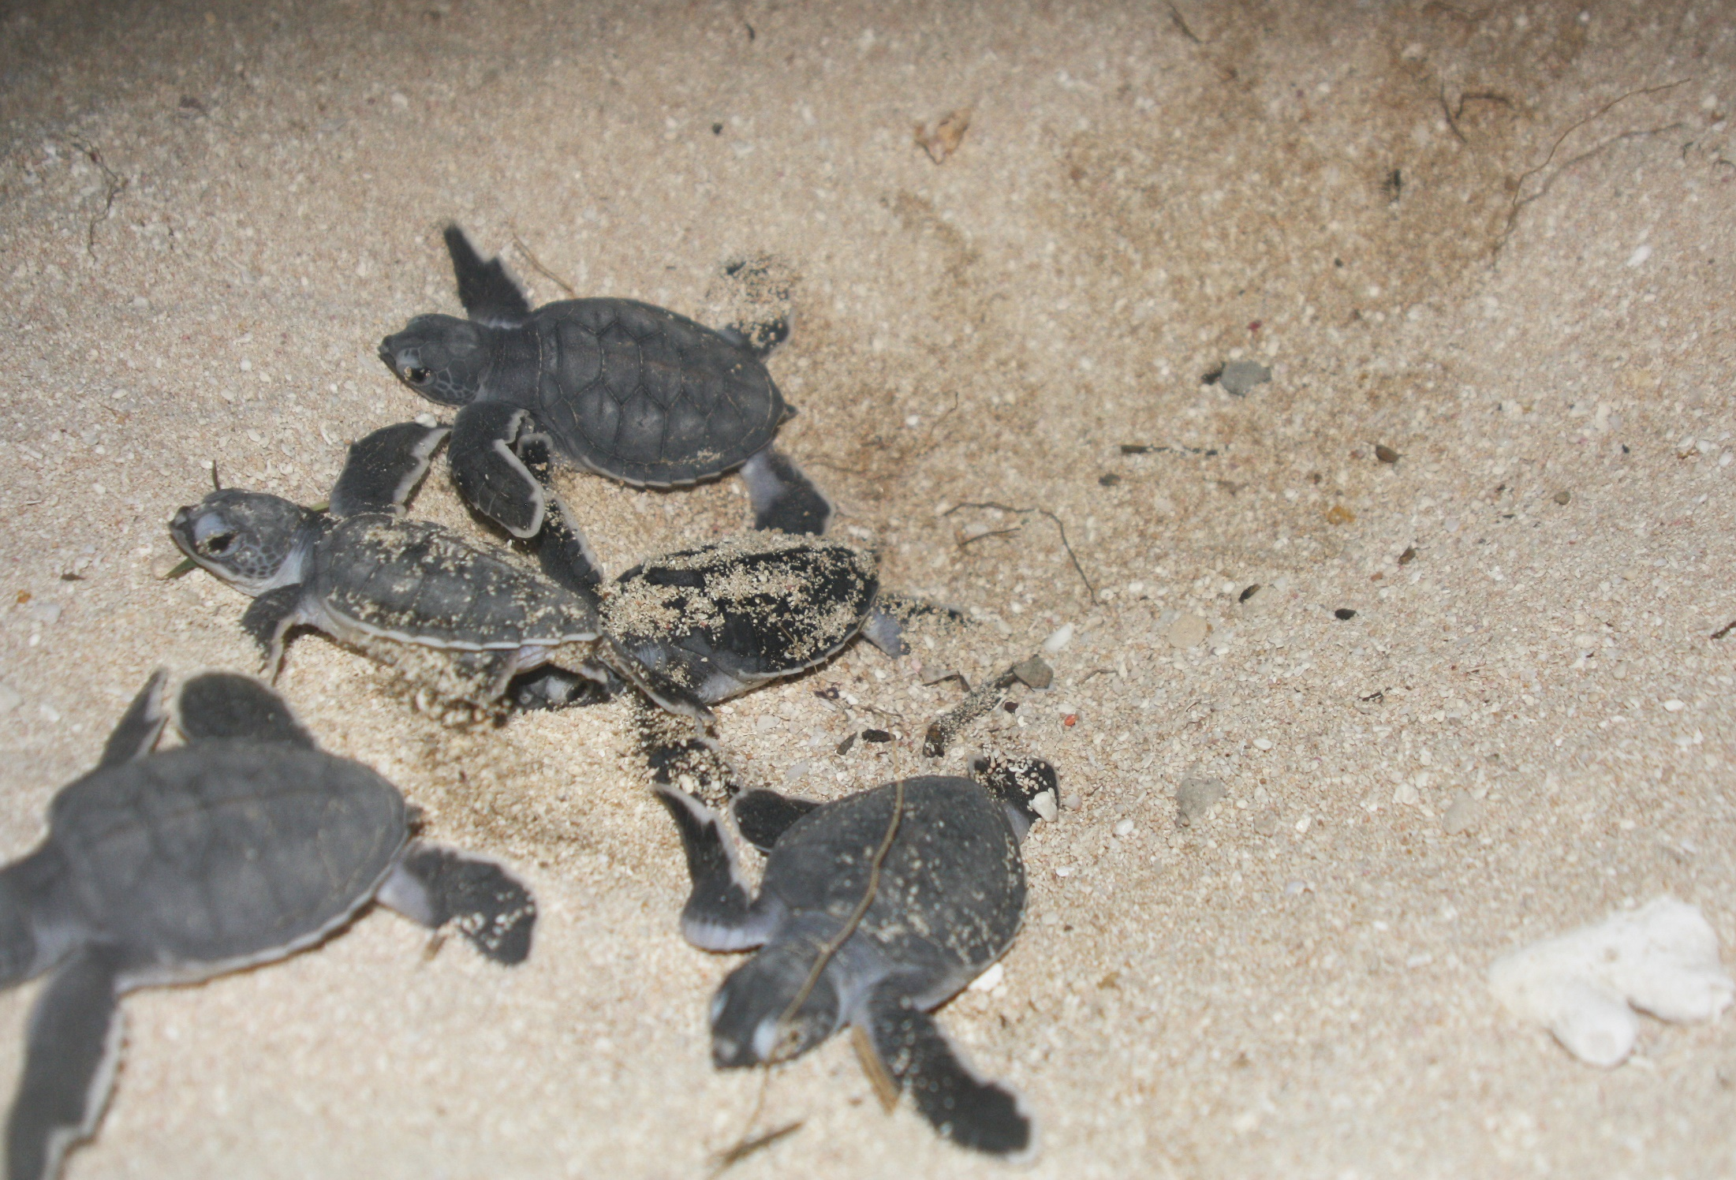
Why count sea turtles? Green / Hawksbill / other
Notes:
Image: M. Turner, Copyright Commonwealth of Australia (GBRMPA)

Slide 32
Green turtle (Chelonia mydas)
Small head.
High domed carapace (shell).
Carapace colour – cream and rusty brown to grey.
4 pairs of costal scutes (side scales) on carapace.
ENDANGERED
1
2
3
4
Notes:
Image: K. Hoppen, Copyright Commonwealth of Australia (GBRMPA)

Slide 33
1 pair of pre-frontal scales above beak.
ENDANGERED
1 pair
Notes:
Image: C. Jones, Copyright Commonwealth of Australia (GBRMPA)

Slide 34
Hawksbill turtle (Eretmochelys imbricata)
Small head.
Black scales on head and flippers.
Carapace with serrated edges (smaller turtles only).
4 pairs of costal scutes (side scales) on carapace
Overlapping scutes (like fish scales).
CRITICALLY ENDANGERED
1
2
3
4
Serrated edges
Notes:
Image: K. Hoppen, Copyright Commonwealth of Australia (GBRMPA)

Slide 35
2 pairs of pre-frontal scales.
Hawk-like beak.
CRITICALLY ENDANGERED
1st pair
2nd pair
Hawk-like beak
© naturepl.com / Inaki Relanzon / WWF
Notes:
Image: Hawksbill turtle (Eretmochelys imbricata) swimming underwater, Nosy Be, North Madagascar. Image: naturepl.com / Inaki Relanzon / WWF © naturepl.com / Inaki Relanzon / WWF Source: https://australian.museum/learn/animals/reptiles/hawksbill-sea-turtle/

Slide 36
Loggerhead turtle (Caretta caretta)
Big head!
5 pairs of costal scutes
VULNERABLE TO EXTINCTION
4
5
3
2
1
Notes:
Image: M. Simmons, Copyright Commonwealth of Australia (GBRMPA)

Slide 37
Why count sharks? Whitetip / Blacktip / other
Lots of sharks = healthy reef (lots of food).
Many sharks are endangered.
Sharks are keystone species.
Their massive size and reputation makes them iconic, and popular with tourists.
Check they know how to ID whitetip and blacktips.

Slide 38
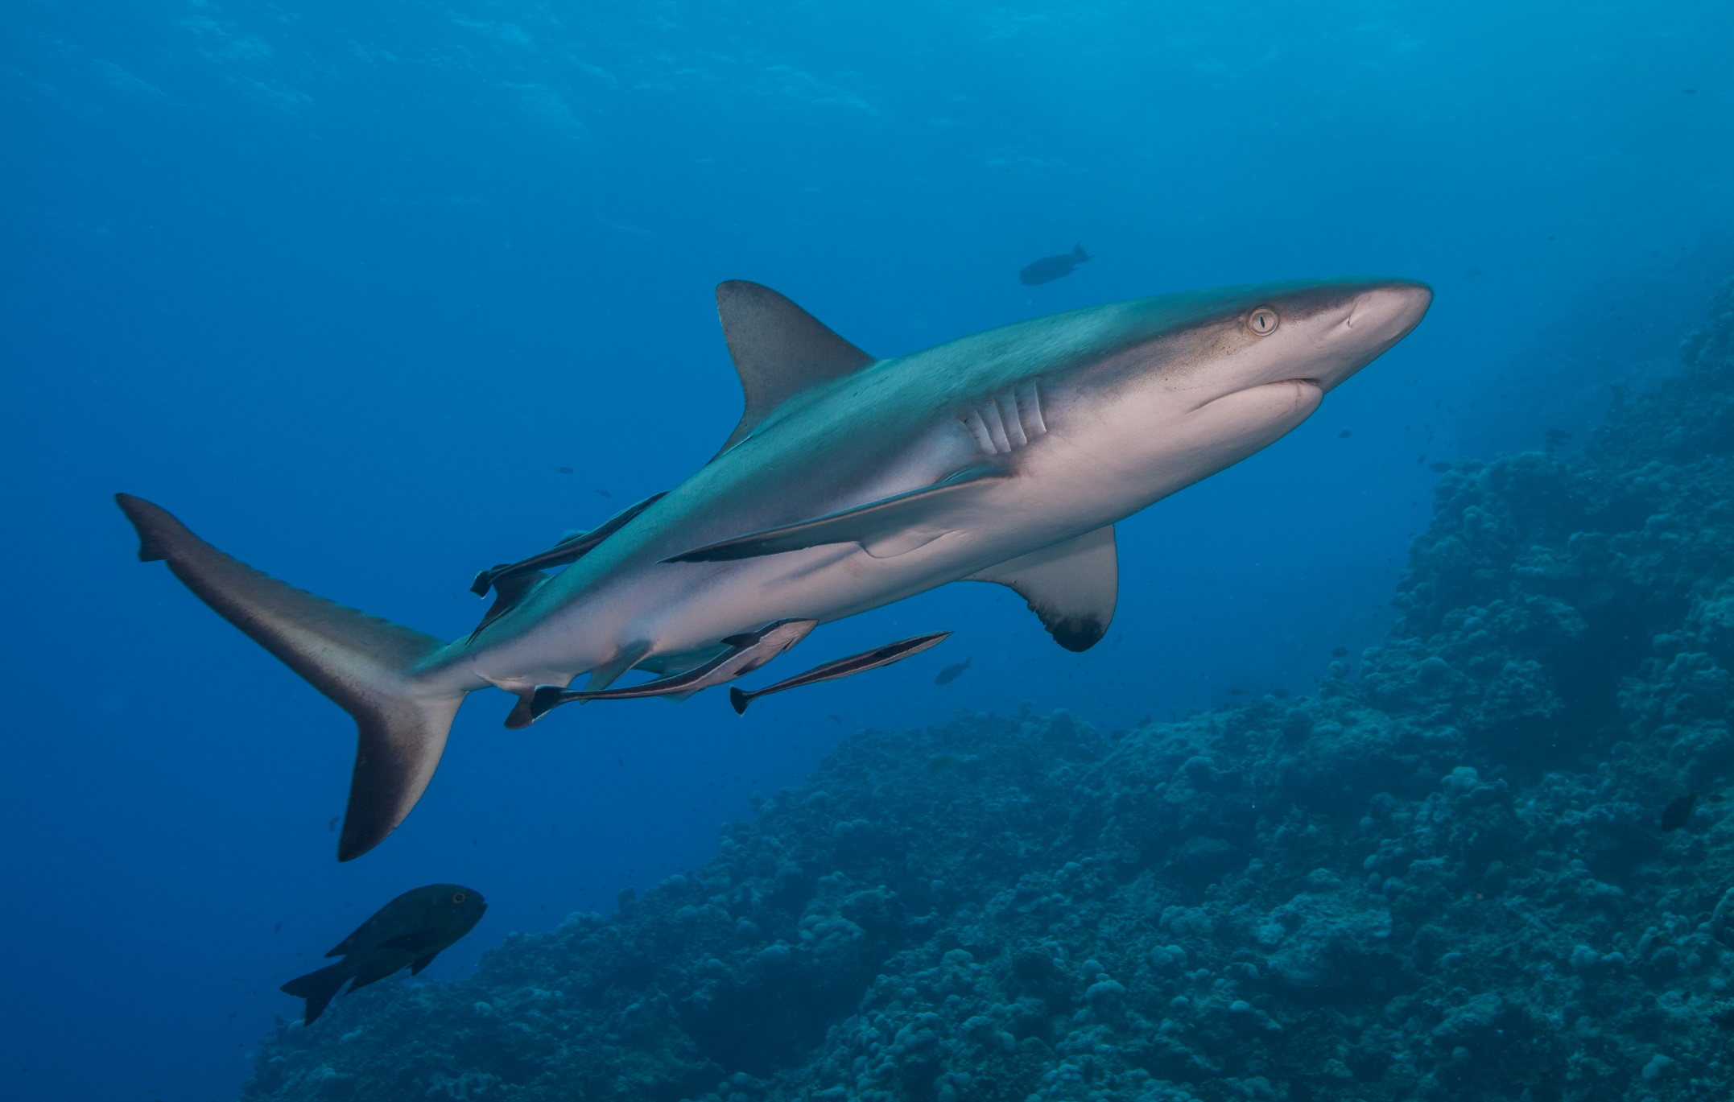
Why count sharks? Whitetip / Blacktip / other
Notes:
Image: J. Sumerling, Copyright Commonwealth of Australia (GBRMPA)

Slide 39
Everybody must look out for crown-of-thorns starfish.
Venomous spines. Do not touch!

Slide 40
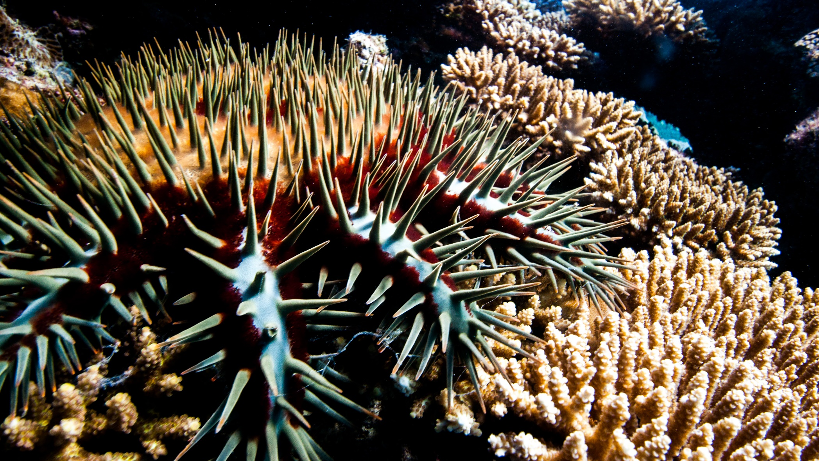
Crown-of-Thorns Starfish (COTS)
Venomous spines. Do not touch!
Notes:
Image: J. Hurford, Copyright Commonwealth of Australia (GBRMPA)

Slide 41
Count the adults (larger than your hand) and juveniles (smaller than your hand).

Slide 42
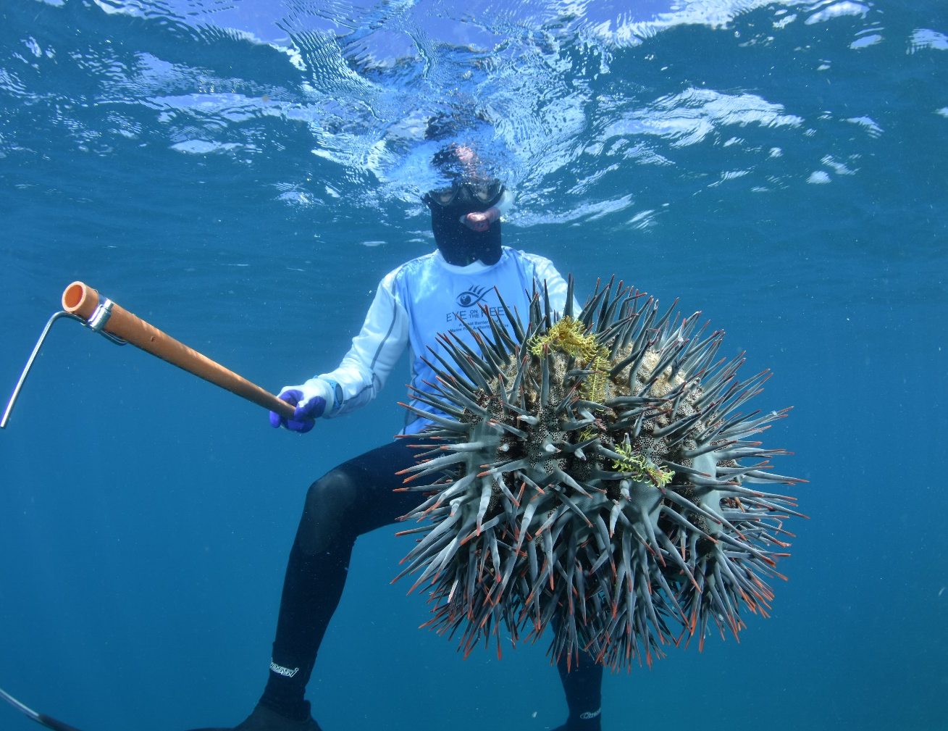
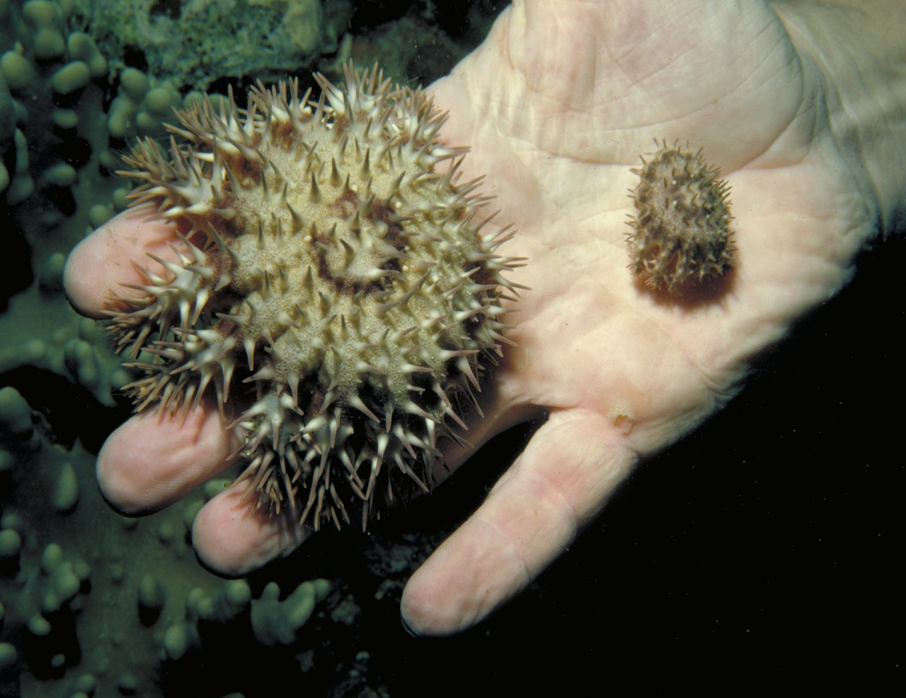
Count the adults and juveniles. Juveniles are smaller than your hand.
Notes:
Images: (Left) M. Curnock, Copyright Commonwealth of Australia (GBRMPA); (Right) Copyright Commonwealth of Australia (GBRMPA)

Slide 43
Why report all crown-of-thorns starfish?
It informs GBRMPA of potential outbreaks.

Slide 44
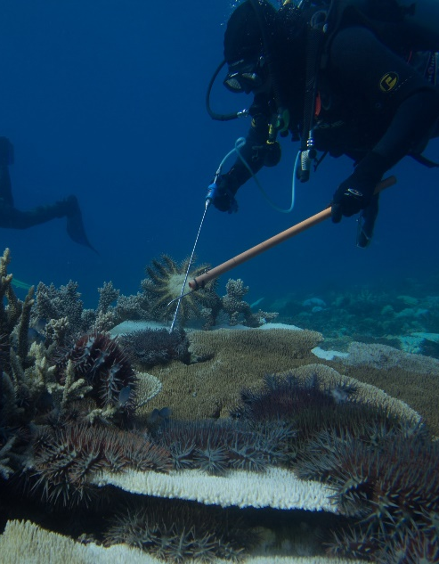
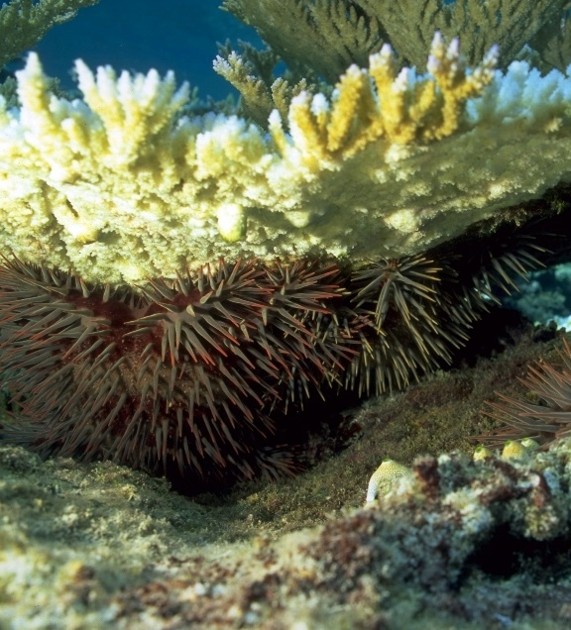
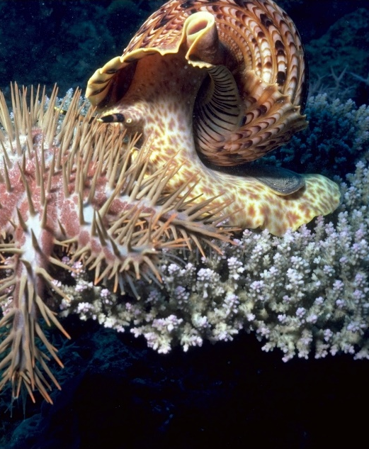
Why report all crown-of-thorns starfish?
Diver injecting COTS
Can be hiding under coral
Giant triton snail eating COTS
Notes:
Images: (Left) D. Shultz, Copyright Commonwealth of Australia (GBRMPA); (Middle) D. Wachenfeld, Copyright Commonwealth of Australia (GBRMPA); (Right) K. Garnett, Copyright Commonwealth of Australia (GBRMPA)

Slide 45
Look out for all these!

Slide 46
Look out for all these!

Slide 47
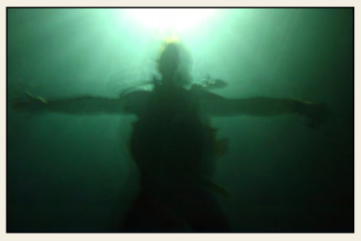
Measure depth and visibility.
<5m 5-10m >10m

Slide 48
Measure depth and visibility.
<5m 5-10m >10m

Slide 49
In-water safety brief.

Slide 50
In-water
safety brief.

Slide 51
10 minute timed swim.
Boundaries of the swim area?
Set timer/listen for signal (10 minute).
Swim in one direction.
Swim slowly.
Be as quiet as possible.
Notes:
Taken from Rapid Monitoring Survey Slides.

Slide 52
10 minute timed swim.
Look ahead every 60 seconds.
Look out for unique fish (for app later).
Do not touch or chase the animals.
Write your names on slate.
Tally as you go [ I=1 III=3 IIII=5 ].
Notes:
Taken from Rapid Monitoring Survey Slides.

Slide 53
Listen to your guide at all times.
Always wear a mask, snorkel and fins.
Use a floatation device (e.g. pool noodle).
Stay together with your buddy at all times.
In the water, keep checking on your position.
Listen for when 10 minutes is finished.
Do not touch or chase the animals.
If you get into trouble, wave one hand high above the water to attract the attention of the person on surface watch.
Stay safe for a memorable experience!

Slide 54
Listen to your guide at all times.
Always wear a mask, snorkel and fins.
Use a floatation device (e.g. pool noodle).
Stay together with your buddy at all times.
In the water, keep checking on your position.
Listen for when 10 minutes is finished.
Do not touch or chase the animals.
If you get into trouble, wave one hand high above the water to attract the attention of the person on surface watch.
Stay safe for a memorable experience!

Slide 55
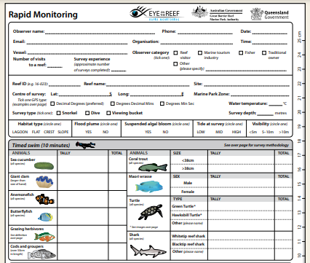
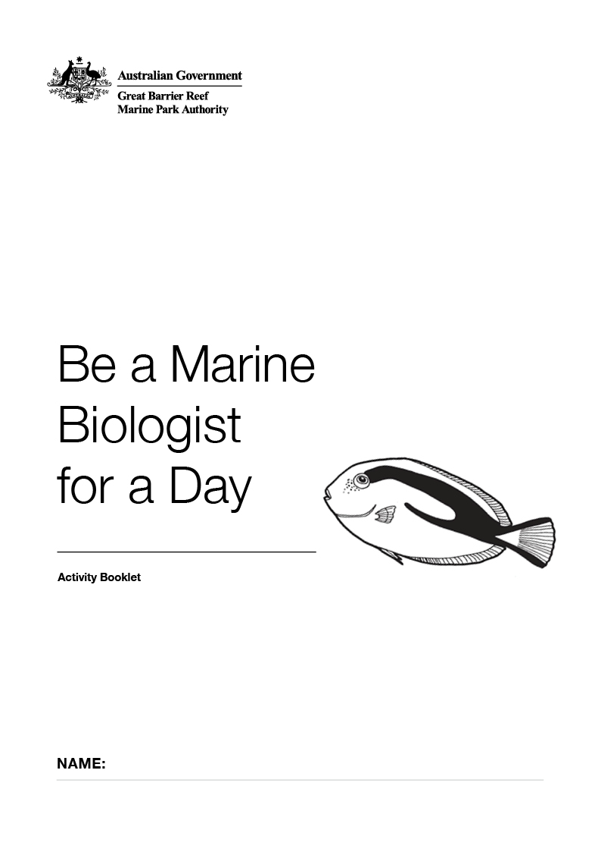
After the survey, you will be shown how to fill in this form. There is a copy in your activity book. Bring your data too!

Slide 56
After the count, you will be shown how to fill in this form. Bring your activity books (and results sheets) with you!

Slide 57
Let’s go!
Any last comments/ instructions put here
Notes:
Optional: personalise, by changing to a picture from your operation.
Image: Copyright Commonwealth of Australia (GBRMPA)

Slide 58
Let’s go!
Notes:
Optional: personalise, by changing to a picture from your operation.
Image: Copyright Commonwealth of Australia (GBRMPA)

