Slide 1
Be a Marine Biologist for a Day
Part 2: Finding out
Middle School
Pre-snorkel presentation for modified 10 minute timed survey
Notes:
Image: L. Zell, Copyright Commonwealth of Australia (GBRMPA)

Slide 2
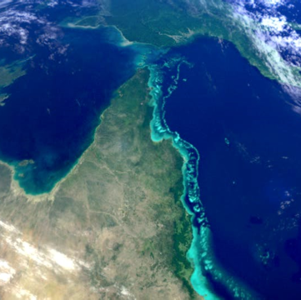
We would like to acknowledge all of the Aboriginal and Torres Straight Islander peoples who have connection to the Great Barrier Reef.
We recognise their continuing connection to land, water and community, and pay our respects to their Elders past, present and emerging.

Slide 3
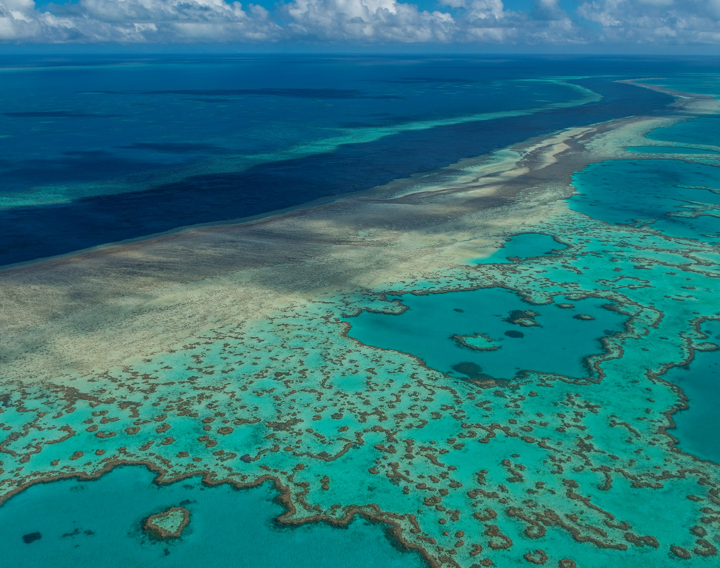
We would like to acknowledge the (insert name of local Traditional Owner group) peoples as the Traditional Owners of the Land and Sea Country that we are visiting as part of your excursion.

Slide 4
The pages are organised so that when you flip to the next page, and the students have it in front of them to see, you’re reading out loud the corresponding text on the back of the previous page.
Year | Mandatory ACARA Content Elaborations
7 | Biology – classification, food chains, humans Classification helps organise the diverse group of organisms. Interactions between organisms, including the effects of human activities can be represented by food chains and food webs.
8 | Biology – cells, systems, survival and reproduction Cells are the basic units of living things; they have specialised structures and functions. Multi-cellular organisms contain systems of organs carrying out specialised functions that enable them to survive and reproduce.
9 | Biology – systems of life, responding to the world Multi-cellular organisms rely on coordinated and interdependent internal systems to respond to changes to their environment. Ecosystems consist of communities of interdependent organisms and abiotic components of the environment; matter and energy flow through these systems.
10 | Biology – DNA Transmission of heritable characteristics from one generation to the next involves DNA and genes. The theory of evolution by natural selection explains the diversity of living things and is supported by a range of scientific evidence. Earth and space science: Global systems, including the carbon cycle, rely on interactions involving the biosphere, lithosphere, hydrosphere and atmosphere. Geography: Environmental change and management: people in environments - Humans Tourism: Tourism as an industry, the travel experience, sustainable tourism - Tourism
Notes:
This PowerPoint is designed for you to (edit and) save as a PDF and print to use as a flip book at the snorkel site.
Print double-sided (along short side). Print and laminate. Or print on waterproof paper (sold at OfficeWorks).
Hole punch and secure along the top (ensure pages can flip over easily). Flip the pages over as you go.
The pages are organised so that when you flip to the next page, and the students have it in front of them to see, you’re reading out loud the corresponding text on the back of the previous page.

Slide 5
How can I help the Great Barrier Reef?
Notes:
This is the overarching inquiry question that encompasses the entire BAMBFAD Program and is the starting slide to this presentation.

Slide 6
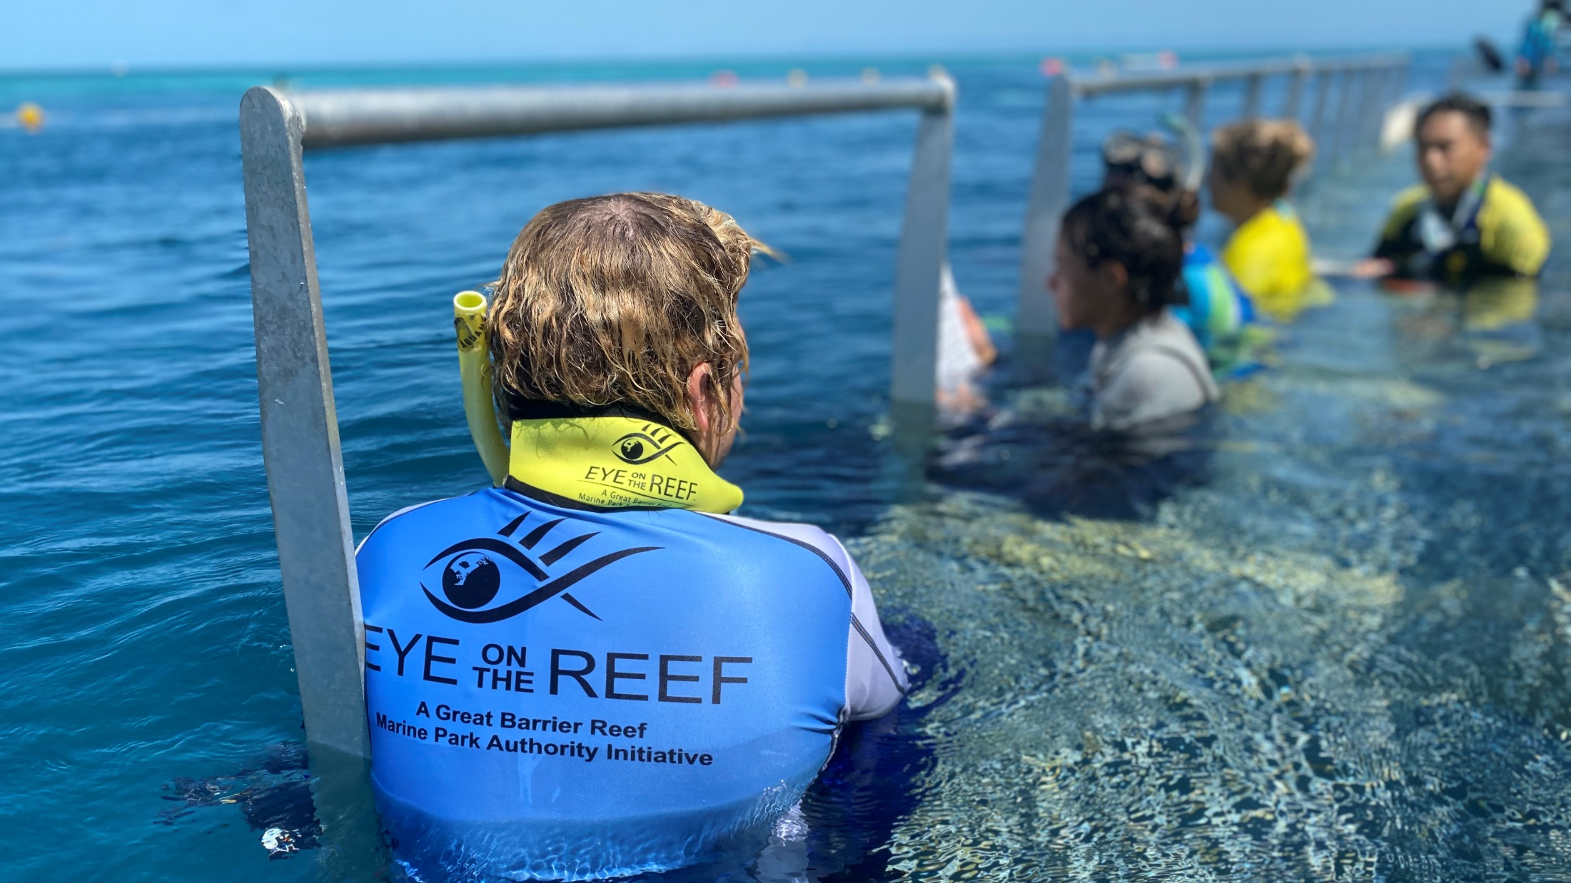
Citizen Science
Notes:
Optional: Replace with pictures of your operation and your Master Reef Guide/s here.
Image: M. Knapton, Copyright Commonwealth of Australia (GBRMPA)

Slide 7
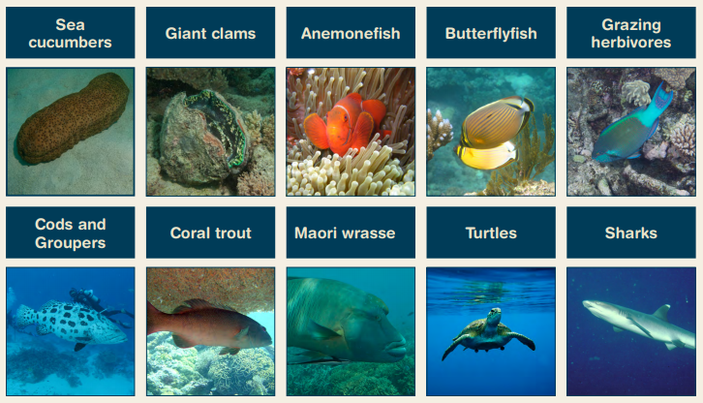
What we count in 10 minutes.
Notes:
Idea: you could organise a prize for the person with the most correct answers?

Slide 9
Why we count these species.
“I am going to show you some pictures now
and ask how well you know my fishy friends. Are you ready?”

Slide 11
Sea cucumbers
Year 7
Biology: classification, food chains, humans
Sea cucumbers are Echinoderms related to sea stars and sea urchins. What do they all have in common? Answer: Radial symmetry, tube feet and powers of regeneration.
Year 8
Biology: cells, systems, survival and reproduction
If sea cucumbers don’t have a heart and blood, what is their circulatory system made of? Answer: Veins of water in a water vascular system.
Year 9
Biology: systems of life. Responding to the world
When threatened some sea cucumbers eject their internal organs. Why? Answer: Organs are very sticky and predators risk becoming entangled.
Year 10
Biology: earth systems, DNA, tourism, humans
Sea cucumbers have remarkable powers of regeneration.
Instructions on how to regrow lost body parts (i.e. intestines) are found encoded in their DNA.

Slide 12
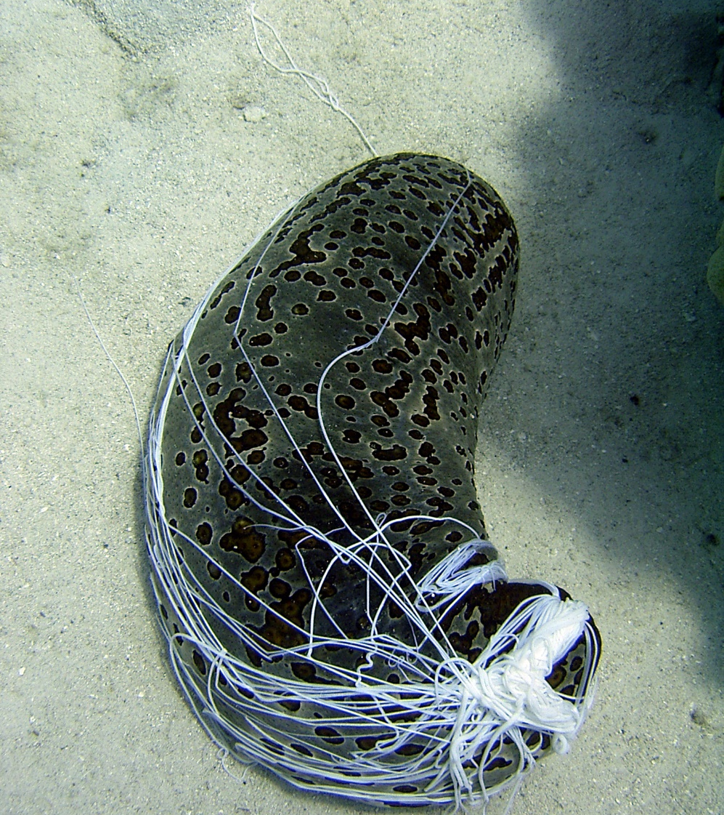
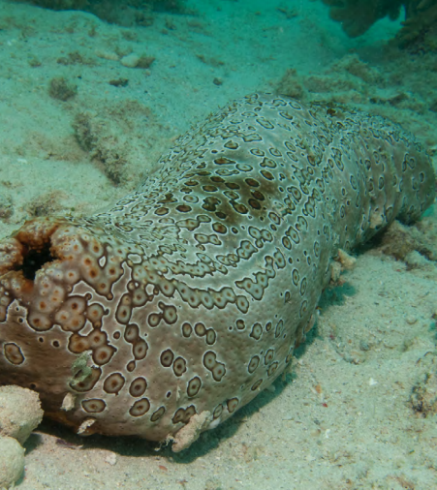
Sea cucumbers
Mouth
Anus
Sticky
internal organs
Notes:
Images: (Left) C. Jones, Copyright Commonwealth of Australia (GBRMPA); (Right) Copyright Commonwealth of Australia (GBRMPA)

Slide 13
Why count sea cucumbers?
Do not answer the question. Wait for an answer.
Sea cucumbers = clean sand = healthy reef.
Sea cucumbers are the vacuum cleaners of the sea.
A healthy population of sea cucumbers on a hectare of reef (size of 2.5 football fields) collectively pass ~150 tonnes (about 75 cars worth) of sand and other seafloor material through their tubular digestive tracts each year.

Slide 14
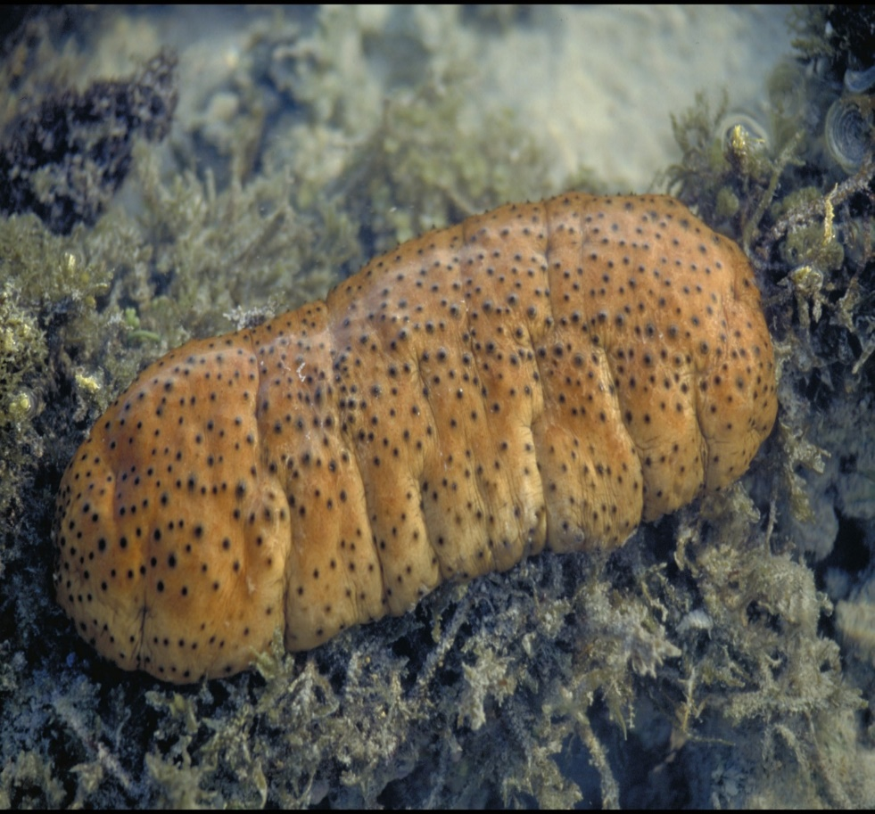
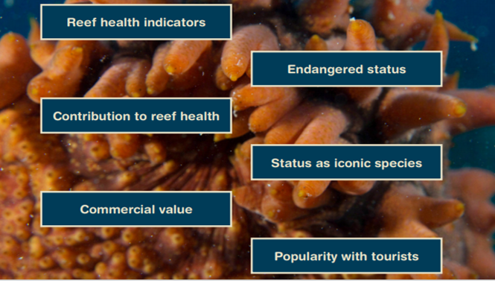
Why count sea cucumbers?
Notes:
Image: J. Jones, Copyright Commonwealth of Australia (GBRMPA)

Slide 15
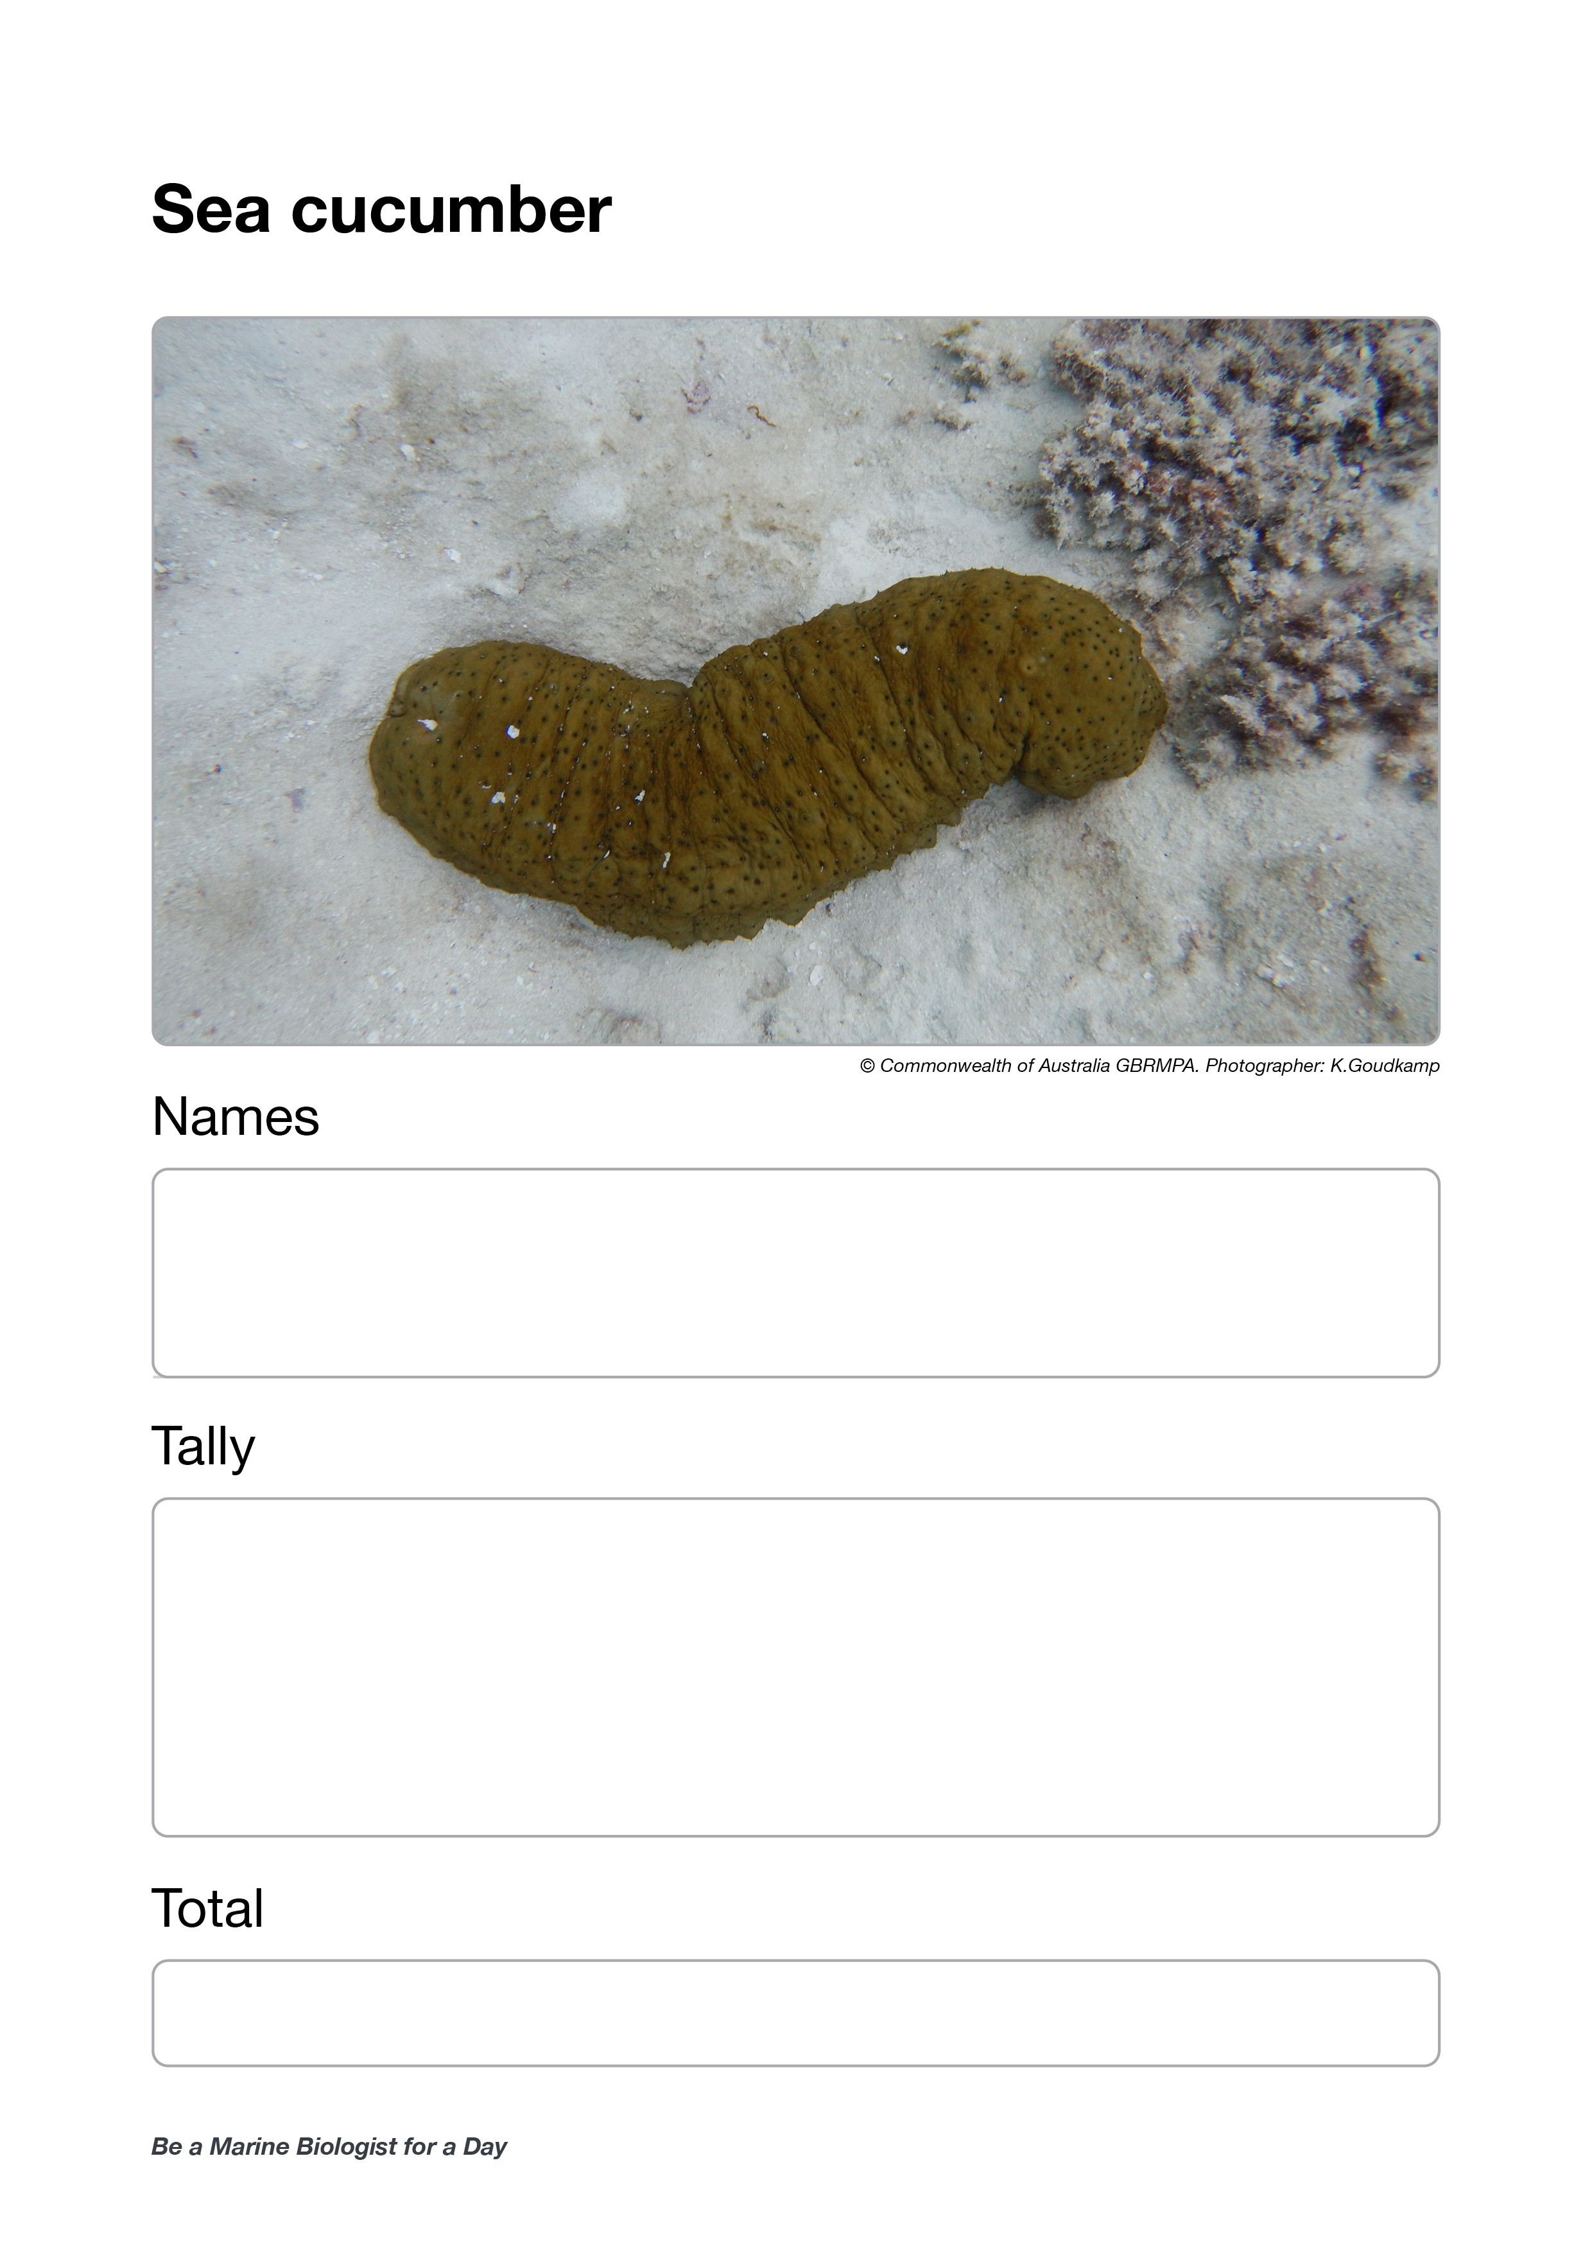
Who is counting the sea cucumbers?
Check buddy pair/s counting sea cucumbers have all their materials.

Slide 16
Who is counting the sea cucumbers?

Slide 17
Giant clams
Year 7
Biology: classification, food chains, humans
Why does a giant clam stay open? Answer: To provide sunlight for the zooxanthellae (algae) in its mantle to photosynthesize (turning sunlight into energy) and feed the clam.
Year 8
Biology: cells, systems, survival and reproduction
How do sessile (stationary) giant clams manage to reproduce? Answer: Synchronous spawning (they usually spawn when other giant clams are spawning too).
Year 9
Biology: systems of life. Responding to the world
What does a giant clam
do when threatened? Answer: Tries to close its shell. Large clams are unable to close completely.
Year 10
Biology: earth systems, DNA, tourism, humans
You’ve heard of coral bleaching. Have you heard of clam bleaching? What is it? Answer: When clams expel their algae and bleach white from a stress event such as a heat wave.

Slide 18
Giant clam
VULNERABLE TO EXTINCTION
Notes:
Image: Copyright Commonwealth of Australia (GBRMPA)

Slide 19
Why count giant clams?
Do not answer the question. Wait for an answer.
Giant clams are VULNERABLE TO EXTINCTION
If we know where they are, we can look after them and protect them.

Slide 20
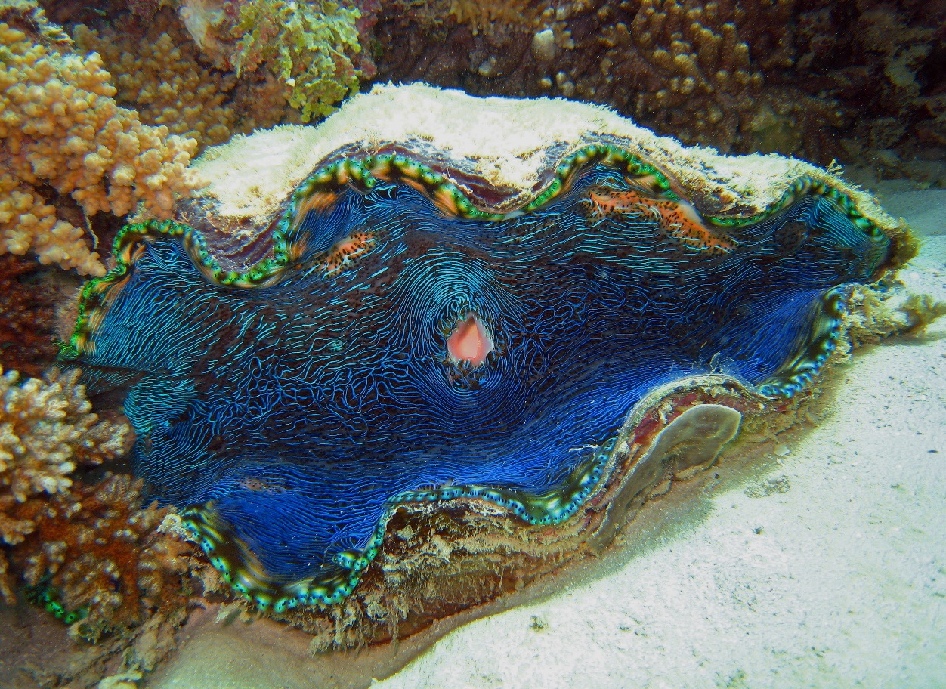
Why count giant clams?
VULNERABLE TO EXTINCTION
Notes:
Image: C. Jones, Copyright Commonwealth of Australia (GBRMPA)

Slide 21
Who is counting the giant clams >30cm?
Check buddy pair/s counting giant clams have all their materials.

Slide 22
Who is counting the giant clams?
>30cm

Slide 23
Anemonefish
Year 7
Biology: classification, food chains, humans
If anemones and jellyfish are both Cnidarians, what feature do they have in common? Answer: They both have stinging tentacles. Anemones are like an upside-down jellyfish.
Year 8
Biology: cells, systems, survival and reproduction
Do anemonefish change sex from male to female? Answer: Yes. The largest fish is the female. The next largest is the breeding male. All they others are subordinate males. Don’t forget to check for eggs!
Year 9
Biology: systems of life. Responding to the world
When does the dominant male anemonefish change sex to a female? Answer: When his female partner dies.
Don’t forget to check for eggs!
Year 10
Biology: earth systems, DNA, tourism, humans
Millions of years ago, when it is believed that anemonefish first started living in anemones, what might have been the reason for this adaptation? Answer: To improve their chance of survival.

Slide 24
Anemonefish
Notes:
Image: J. Sumerling, Copyright Commonwealth Government of Australia (GBRMPA)

Slide 25
Why count anemonefish?
Do not answer the question. Wait for an answer.
Anemones rarely move and are long lived.
So, if they go missing (or bleach white) this tells us that something is wrong.
The anemonefish help us to find the anemones.

Slide 26
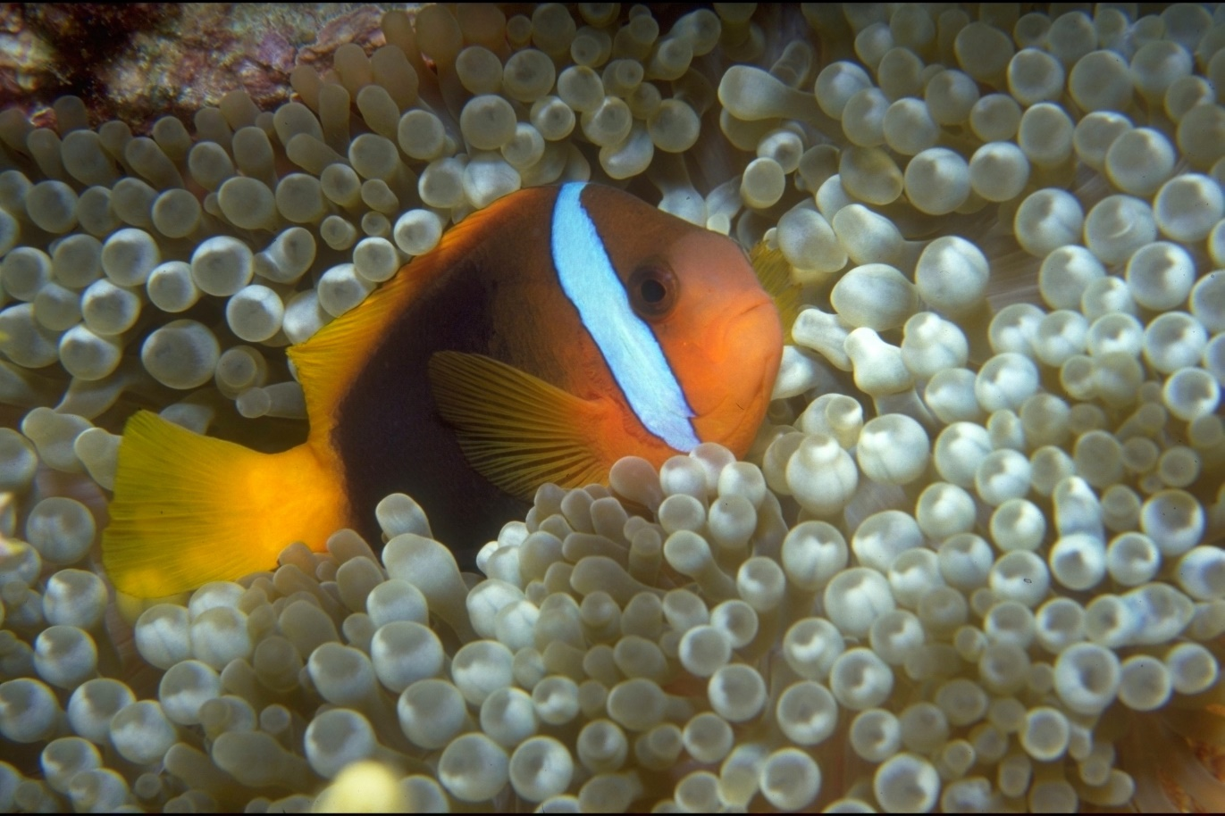
Why count anemonefish?
Notes:
Image: T. Mayne, Copyright Commonwealth of Australia (GBRMPA)

Slide 27
Who is counting the anemonefish?
Check buddy pair/s counting anemonefish have all their materials.

Slide 28
Who is counting the anemonefish?

Slide 29
Butterflyfish
Year 7
Biology: classification, food chains, humans
Butterflyfish are often in pairs doing ‘laps’ of their home range. What do they eat? Answer: Mainly coral polyps, but some also feed on tiny invertebrates.
Year 8
Biology: cells, systems, survival and reproduction
Butterflyfish stay in pairs and often mate for life. What is the reproductive benefit of having a mate for life? Answer: Guarantees a mate for reproduction.
Year 9
Biology: systems of life. Responding to the world
Butterflyfish linked their lateral line to their swim bladder to detect and amplify sounds. Make sure you put your ears in the water and listen to the reef.
Year 10
Biology: earth systems, DNA, tourism, humans
What is the function of the bright colours and patterns of butterflyfish?
This is an open inquiry question.

Slide 30
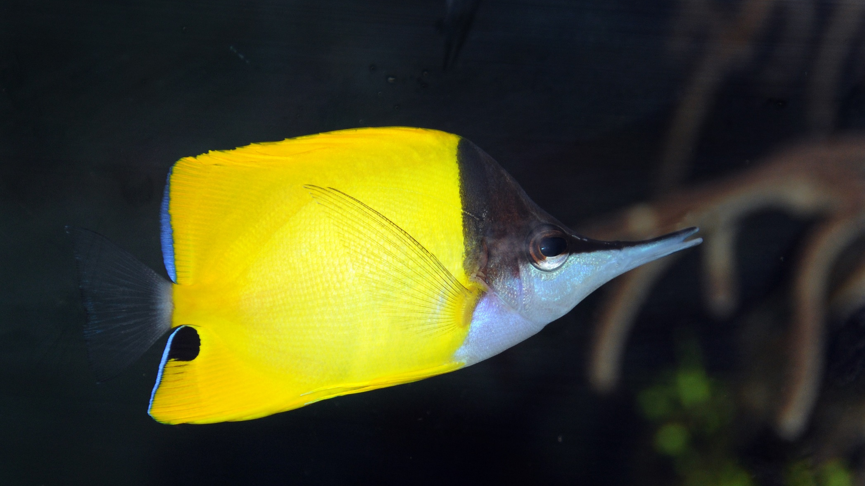
Butterflyfish
Notes:
Image: J. Jones, Copyright Commonwealth of Australia (GBRMPA)

Slide 31
Why count butterflyfish?
Do not answer the question. Wait for an answer.
Butterflyfish eat coral.
A healthy coral reef with lots of food can support lots of butterflyfish.
More coral means more butterflyfish.

Slide 32
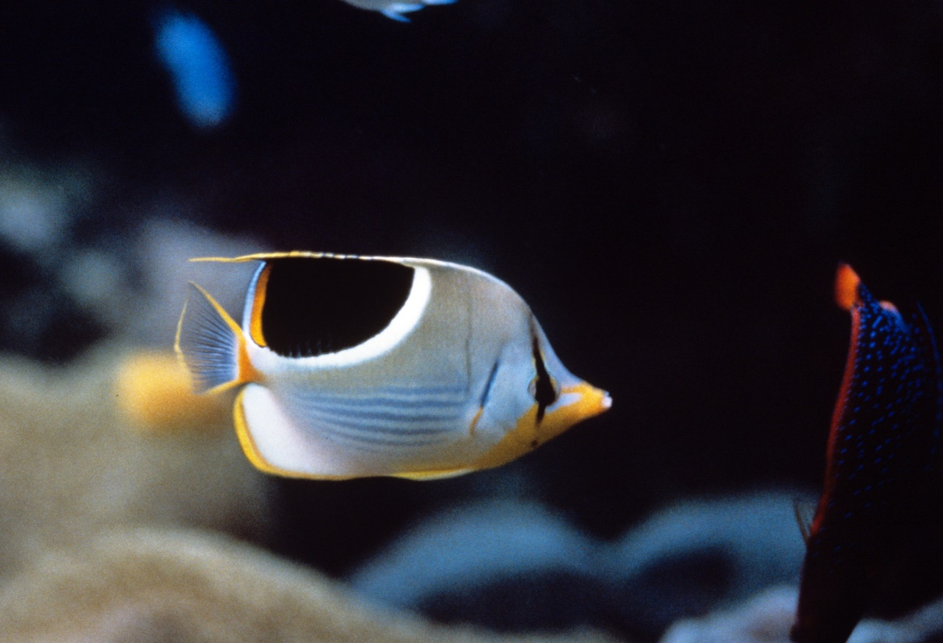
Why count butterflyfish?
Notes:
Image: J. Jones, Copyright Commonwealth of Australia (GBRMPA)

Slide 33
Who is counting the butterflyfish?
Check buddy pair/s counting butterflyfish have all their materials.

Slide 34
Who is counting the butterflyfish?

Slide 35
Grazing herbivores
Year 7
Biology: classification, food chains, humans
Look for a school of fish that are similar in appearance and size, moving slowly along the reef, foraging or grazing close to the reef substrate.
These are the grazing herbivores!
Year 8
Biology: cells, systems, survival and reproduction
Look for a school of fish that are similar in appearance and size, moving slowly along the reef, foraging or grazing close to the reef substrate.
These are the grazing herbivores!
Year 9
Biology: systems of life. Responding to the world
Look for a school of fish that are similar in appearance and size, moving slowly along the reef, foraging or grazing close to the reef substrate.
These are the grazing herbivores!
Year 10
Biology: earth systems, DNA, tourism, humans
Look for a school of fish that are similar in appearance and size, moving slowly along the reef, foraging or grazing close to the reef substrate.
These are the grazing herbivores!

Slide 36
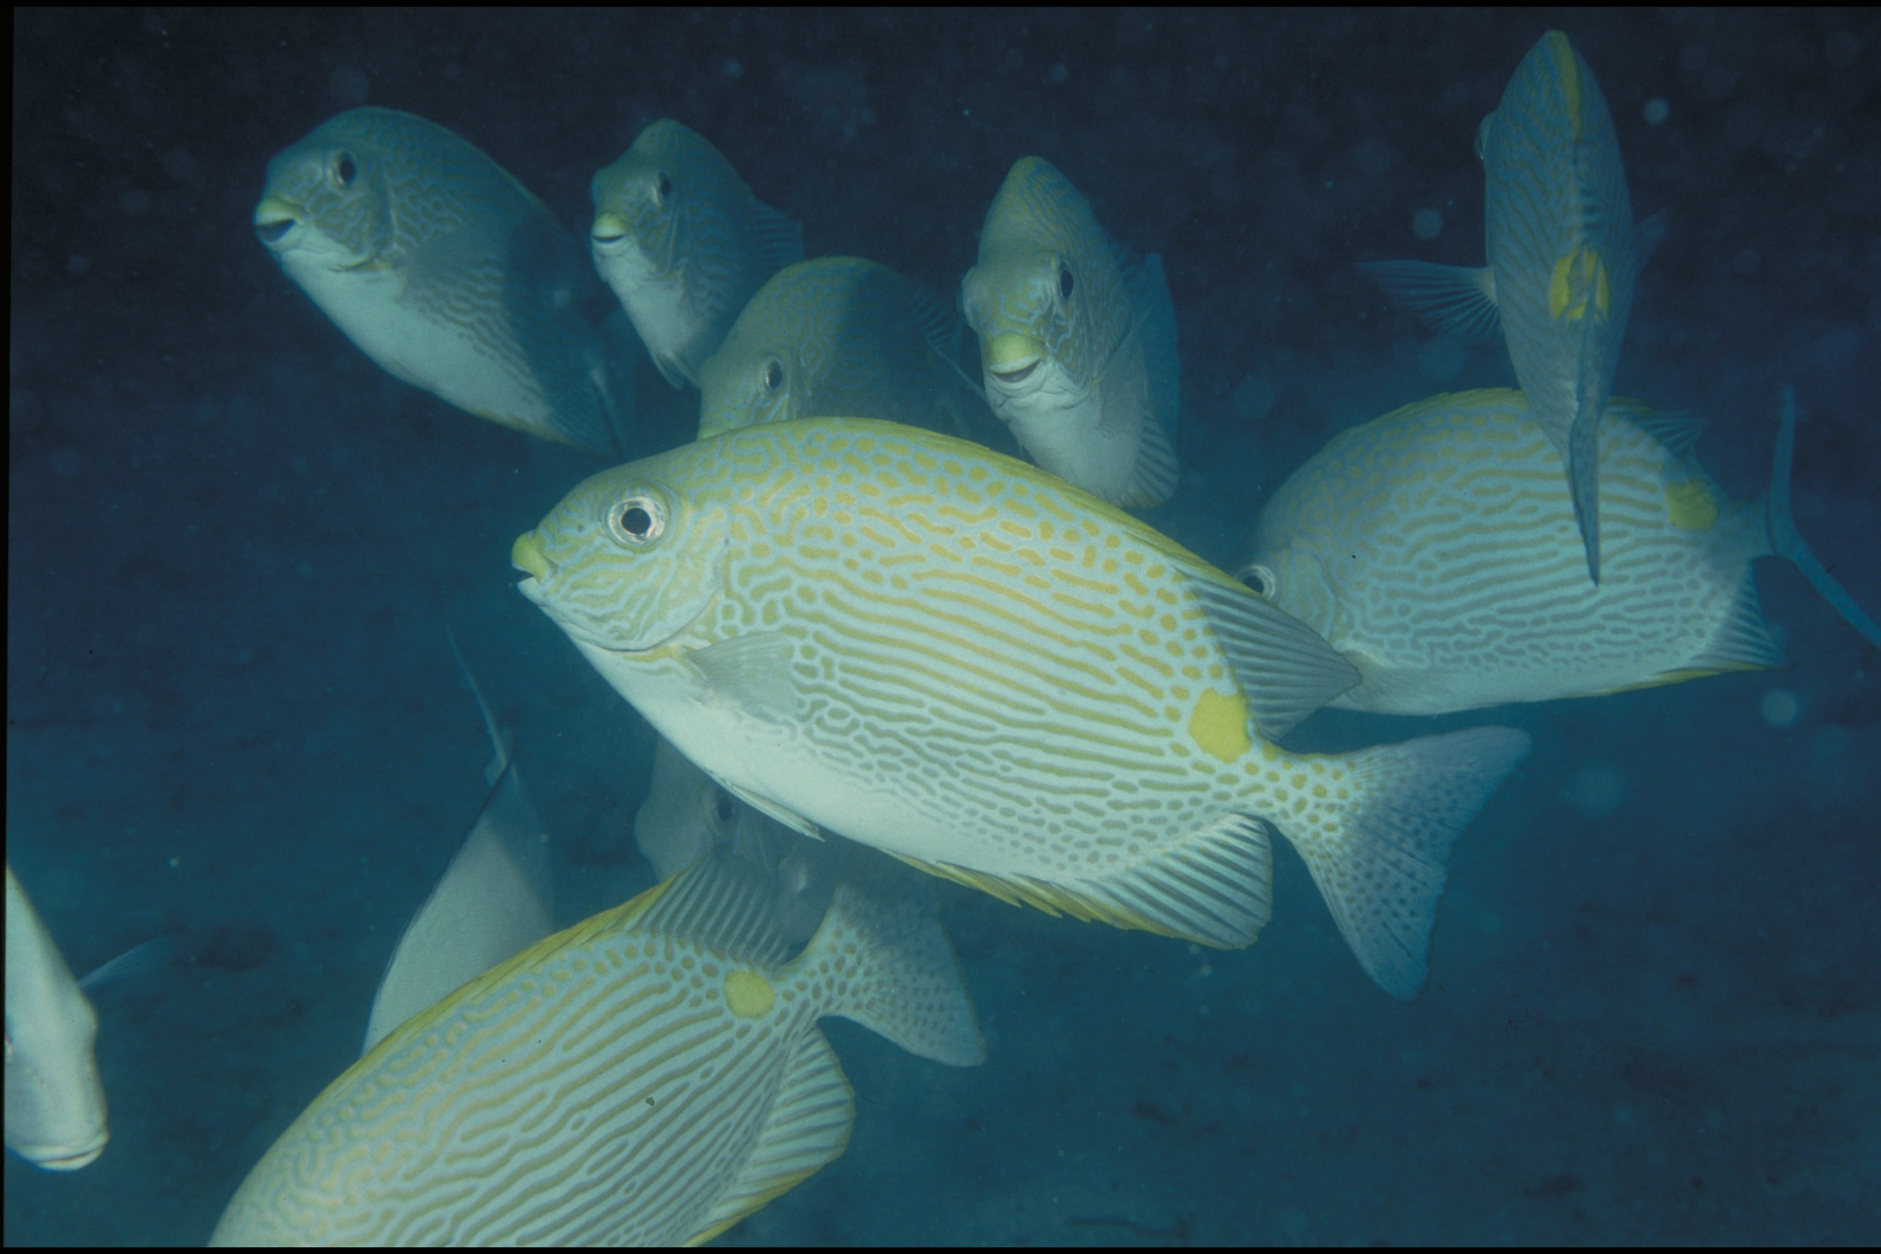
Grazing herbivores Parrotfish / Surgeonfish / Rabbitfish / Unicornfish
Notes:
Image: W. Gladstone, Copyright Commonwealth of Australia (GBRMPA)

Slide 37
Grazing herbivores - parrotfish
Year 7
Biology: classification, food chains, humans
A parrotfish is a grazing herbivore. Its fused teeth form a parrot-like beak which it uses to scrape algae (and chomp the coral).
You can hear it go scrape, scrape, scrape…
Year 8
Biology: cells, systems, survival and reproduction
A parrotfish is a grazing herbivore. To reproduce, males and females gather at the same location to release sperm and eggs into the water at the same time above the reef. This is called broadcast spawning.
Year 9
Biology: systems of life. Responding to the world
A parrotfish is a grazing herbivore. Through their feeding strategies, parrotfish create much of the sand around a reef.
Watch them poop!
Year 10
Biology: earth systems, DNA, tourism, humans
A parrotfish is a grazing herbivore. Why is it important to have grazing herbivores? Answer: They keep reefs healthy by eating algae that compete with coral for space.

Slide 38
Parrotfish
Notes:
Image: C. Jones, Copyright Commonwealth of Australia (GBRMPA)

Slide 39
Grazing herbivores - surgeonfish
Year 7
Biology: classification, food chains, humans
A surgeonfish is a grazing herbivore. Why are grazing herbivores called the lawnmowers of the Reef? Answer: Because they eat algae that competes with corals for space.
Year 8
Biology: cells, systems, survival and reproduction
A surgeonfish is a grazing herbivore. Surgeonfish also gather in large spawning aggregations to breed. Spawning all at once increases the chance of fertilization.
Year 9
Biology: systems of life. Responding to the world
A surgeonfish is a grazing herbivore. They have a scalpel-like blade near their tail. Why? Answer: Fighting and self-defence.
Year 10
Biology: earth systems, DNA, tourism, humans
A surgeonfish is a grazing herbivore. Surgeonfish, like parrotfish, poop out lots of sand whilst feeding. How many poops do you think a surgeonfish will make per minute? This is an open inquiry question.

Slide 40
Surgeonfish
Sharp blade
Notes:
Image: J. Jones, Copyright Commonwealth of Australia (GBRMPA)

Slide 41
Grazing herbivores - rabbitfish
Year 7
Biology: classification, food chains, humans
A rabbitfish has a rabbit-like nose and mouth. Rabbitfish are popular among aquarists because they eat algae that grow on rocks and walls in aquariums.
Year 8
Biology: cells, systems, survival and reproduction
A rabbitfish is a grazing herbivore. How is the digestive system of a herbivore different to a carnivore? Answer: Different teeth and longer intestines.
Year 9
Biology: systems of life. Responding to the world
A rabbitfish is a grazing herbivore. Rabbitfish have venom in their dorsal and anal fin spines. These fish are also called ‘happy moments’ due to the pain from the venom.
Year 10
Biology: earth systems, DNA, tourism, humans
A rabbitfish is a grazing herbivore. Algae come in lots of different colours and sizes. What colour and size is brown macroalgae? Answer: Brown, large.

Slide 42
Rabbitfish
Venomous fin spines
Rabbit-like nose and mouth
Notes:
Image: W. Gladetone, Copyright Commonwealth of Australia (GBRMPA)

Slide 43
Grazing herbivores - unicornfish
Year 7
Biology: classification, food chains, humans
A unicornfish is a grazing herbivore. They belong to the same Family as the surgeonfish, called Acanthuridae.
They have multiple sets of scalpel-like blades near their tail, not just one.
Year 8
Biology: cells, systems, survival and reproduction
A unicornfish is a grazing herbivore. Males perform displays using rapid changes in the colour of the horn, head and body when courting females.
Year 9
Biology: systems of life. Responding to the world
A unicornfish is a grazing herbivore. They roam in schools grazing on algae.
Although generally not aggressive, when they do fight, they use their scalpel-blades near their tail, not their horn.
Year 10
Biology: earth systems, DNA, tourism, humans
A unicornfish is a grazing herbivore. Have a closer look to see what type of algae the unicornfish eat.
Or, what type of algae any of the grazing herbivores are eating.

Slide 44
Unicornfish
Notes:
Image: A. Smith, Copyright Commonwealth of Australia (GBMPA)

Slide 45
Why count grazing herbivores?
Do not answer the question. Wait for an answer.
They are the lawnmowers of the Reef! They eat the algae that compete with corals for space.
By limiting the growth and spread of algae, coral reefs stay healthy and resilient.

Slide 46
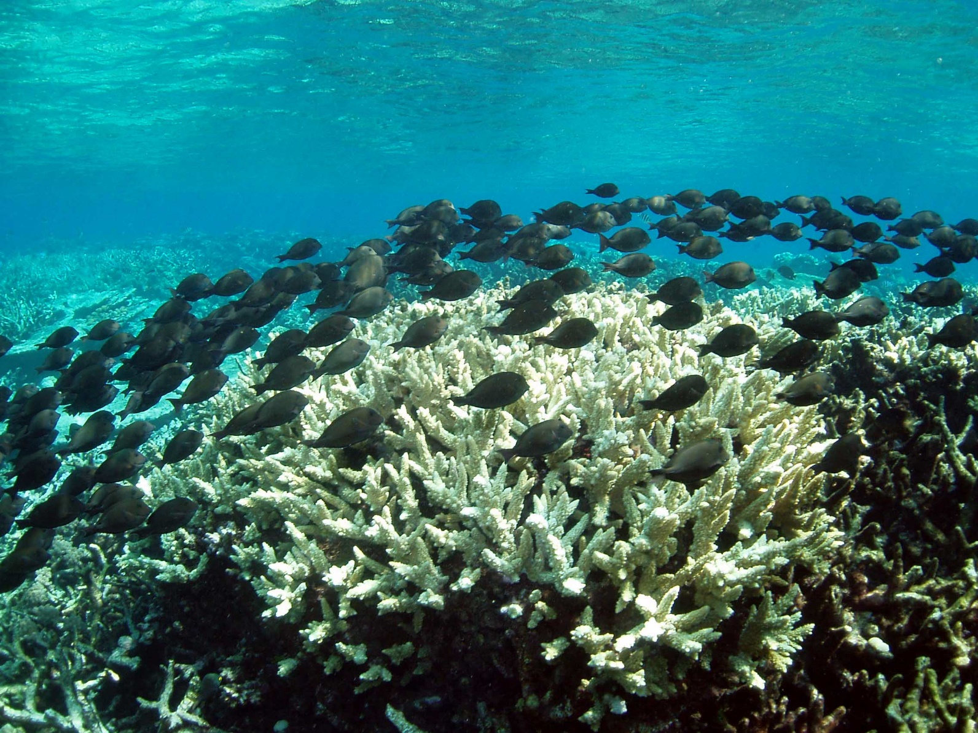
Why count grazing herbivores? Parrotfish / Surgeonfish / Rabbitfish / Unicornfish
Notes:
Image: C. Jones, Copyright Commonwealth of Australia (GBRMPA)

Slide 47
Who is counting the grazing herbivores? Parrotfish / Surgeonfish Rabbitfish / Unicornfish
Check buddy pair/s counting grazing herbivores have all their materials.

Slide 48
Who is counting the grazing herbivores?
Parrotfish / Surgeonfish Rabbitfish / Unicornfish

Slide 49
Cods and groupers
Year 7
Biology: classification, food chains, humans
How do cods and groupers hunt? Answer: They are opportunistic ambush predators. They sit and wait until prey is in range. Then quickly pounce, opening their huge mouth to suck in their prey before swallowing it whole.
Year 8
Biology: cells, systems, survival and reproduction
Cods and groupers are solitary animals that live alone. How do they find a mate to reproduce? Answer: Males and females gather in large spawning aggregations.
Year 9
Biology: systems of life. Responding to the world
Queensland grouper can exhibit territorial behaviour. They threaten intruders by shaking their body, opening their mouth or using their swim bladder to make a loud booming noise.
Do not get too close.
Year 10
Biology: earth systems, DNA, tourism, humans
Are cods and groupers protected in the Great Barrier Reef Marine Park? Answer: Yes.
What should you do if you catch one? Answer: It must be kept in the water and released unharmed.

Slide 50
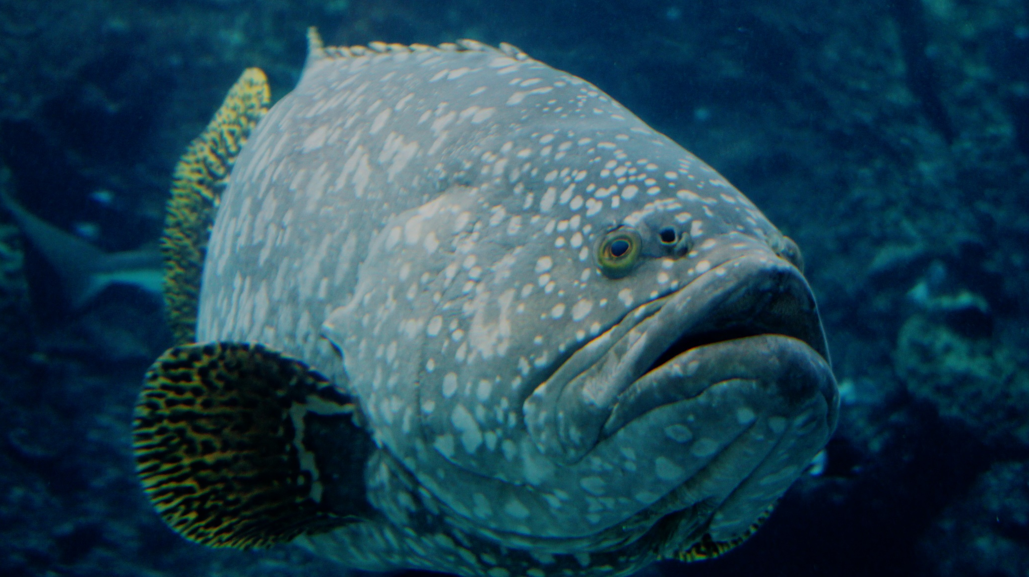
Cods and groupers Pronounced grow-per.
Notes:
Image: J. Hurford, Copyright Commonwealth of Australia (GBRMPA)

Slide 51
Why count cods and grouper?
Includes barramundi cod, potato cod, Qld grouper.
Do not answer the question. Wait for an answer.
If we know where they are, we can look after them and protect them.

Slide 52
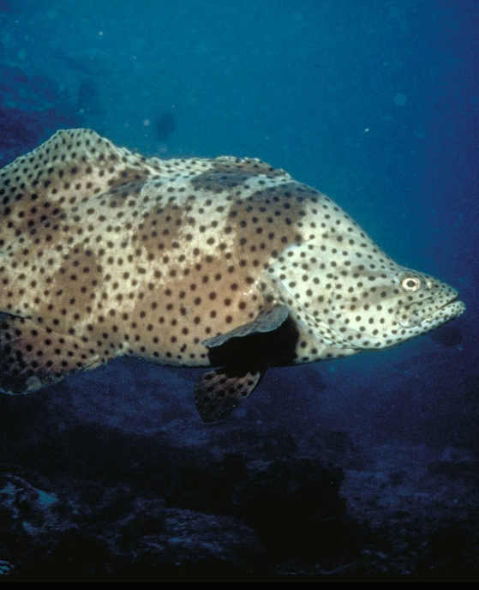
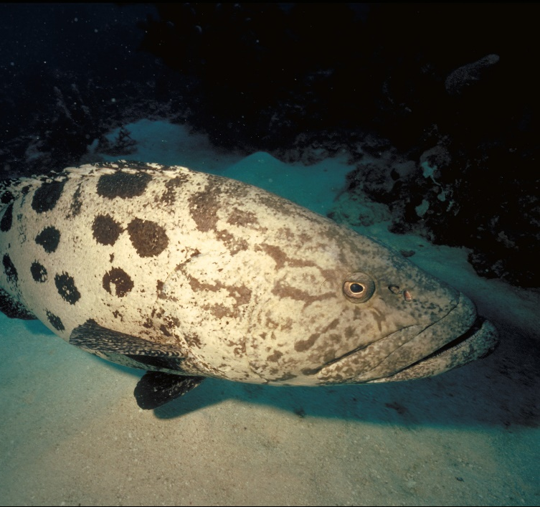
Why count cods and groupers?
Barramundi cod
Qld grouper
Potato cod
Notes:
Images: (Left) K. McClymont, Copyright Commonwealth of Australia (GBRMPA); (Middle) J.Hurford, Copyright Commonwealth of Australia (GBRMPA); (Right) P. McGinnity, Copyright Commonwealth of Australia (GBRMPA)

Slide 53
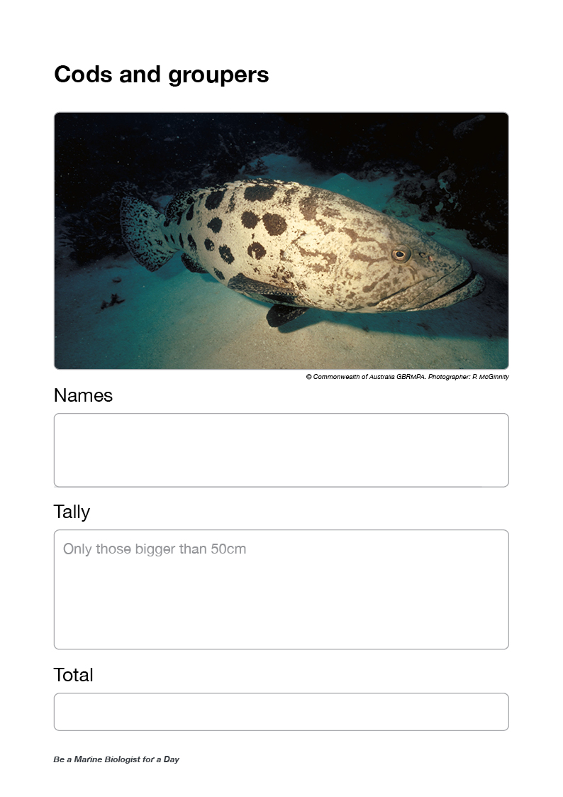
Who is counting the cods and groupers >50cm?
Check buddy pair/s counting cods and groupers have all their materials.

Slide 54
Who is counting the cods and groupers?
>50cm

Slide 55
Coral trout
Year 7
Biology: classification, food chains, humans
Lots of people like to eat coral trout. What size coral trout can people legally catch and keep? Answer: 38cm.
Year 8
Biology: cells, systems, survival and reproduction
As they grow, coral trout change from female to male. At what size do they change gender? Answer: 42cm.
Year 9
Biology: systems of life. Responding to the world
What is ciguatera poisoning? Answer: Large fish, including coral trout >6kg, bioaccumulate a toxin from eating lots of smaller contaminated fish. Eat them and you can become very ill.
Year 10
Biology: earth systems, DNA, tourism, humans
The legal size for a coral trout is 38cm. What penalties apply for keeping undersize fish? Answer: Fines that can be hundreds to thousands of dollars.

Slide 56
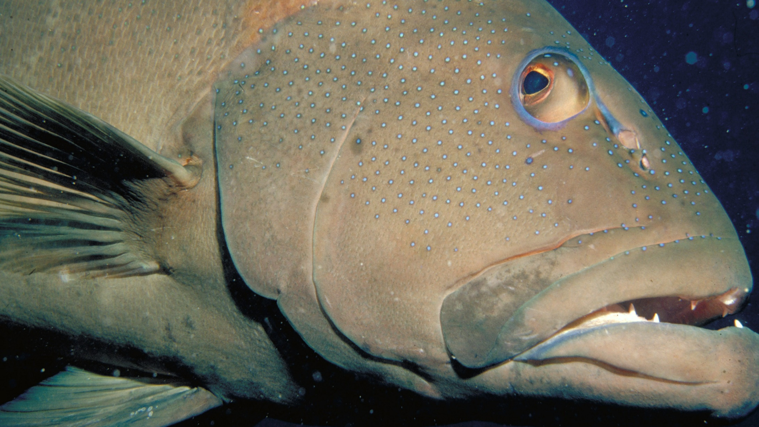
Coral trout
Notes:
Image: S. Summerhays, Copyright Commonwealth of Australia (GBRMPA)

Slide 57
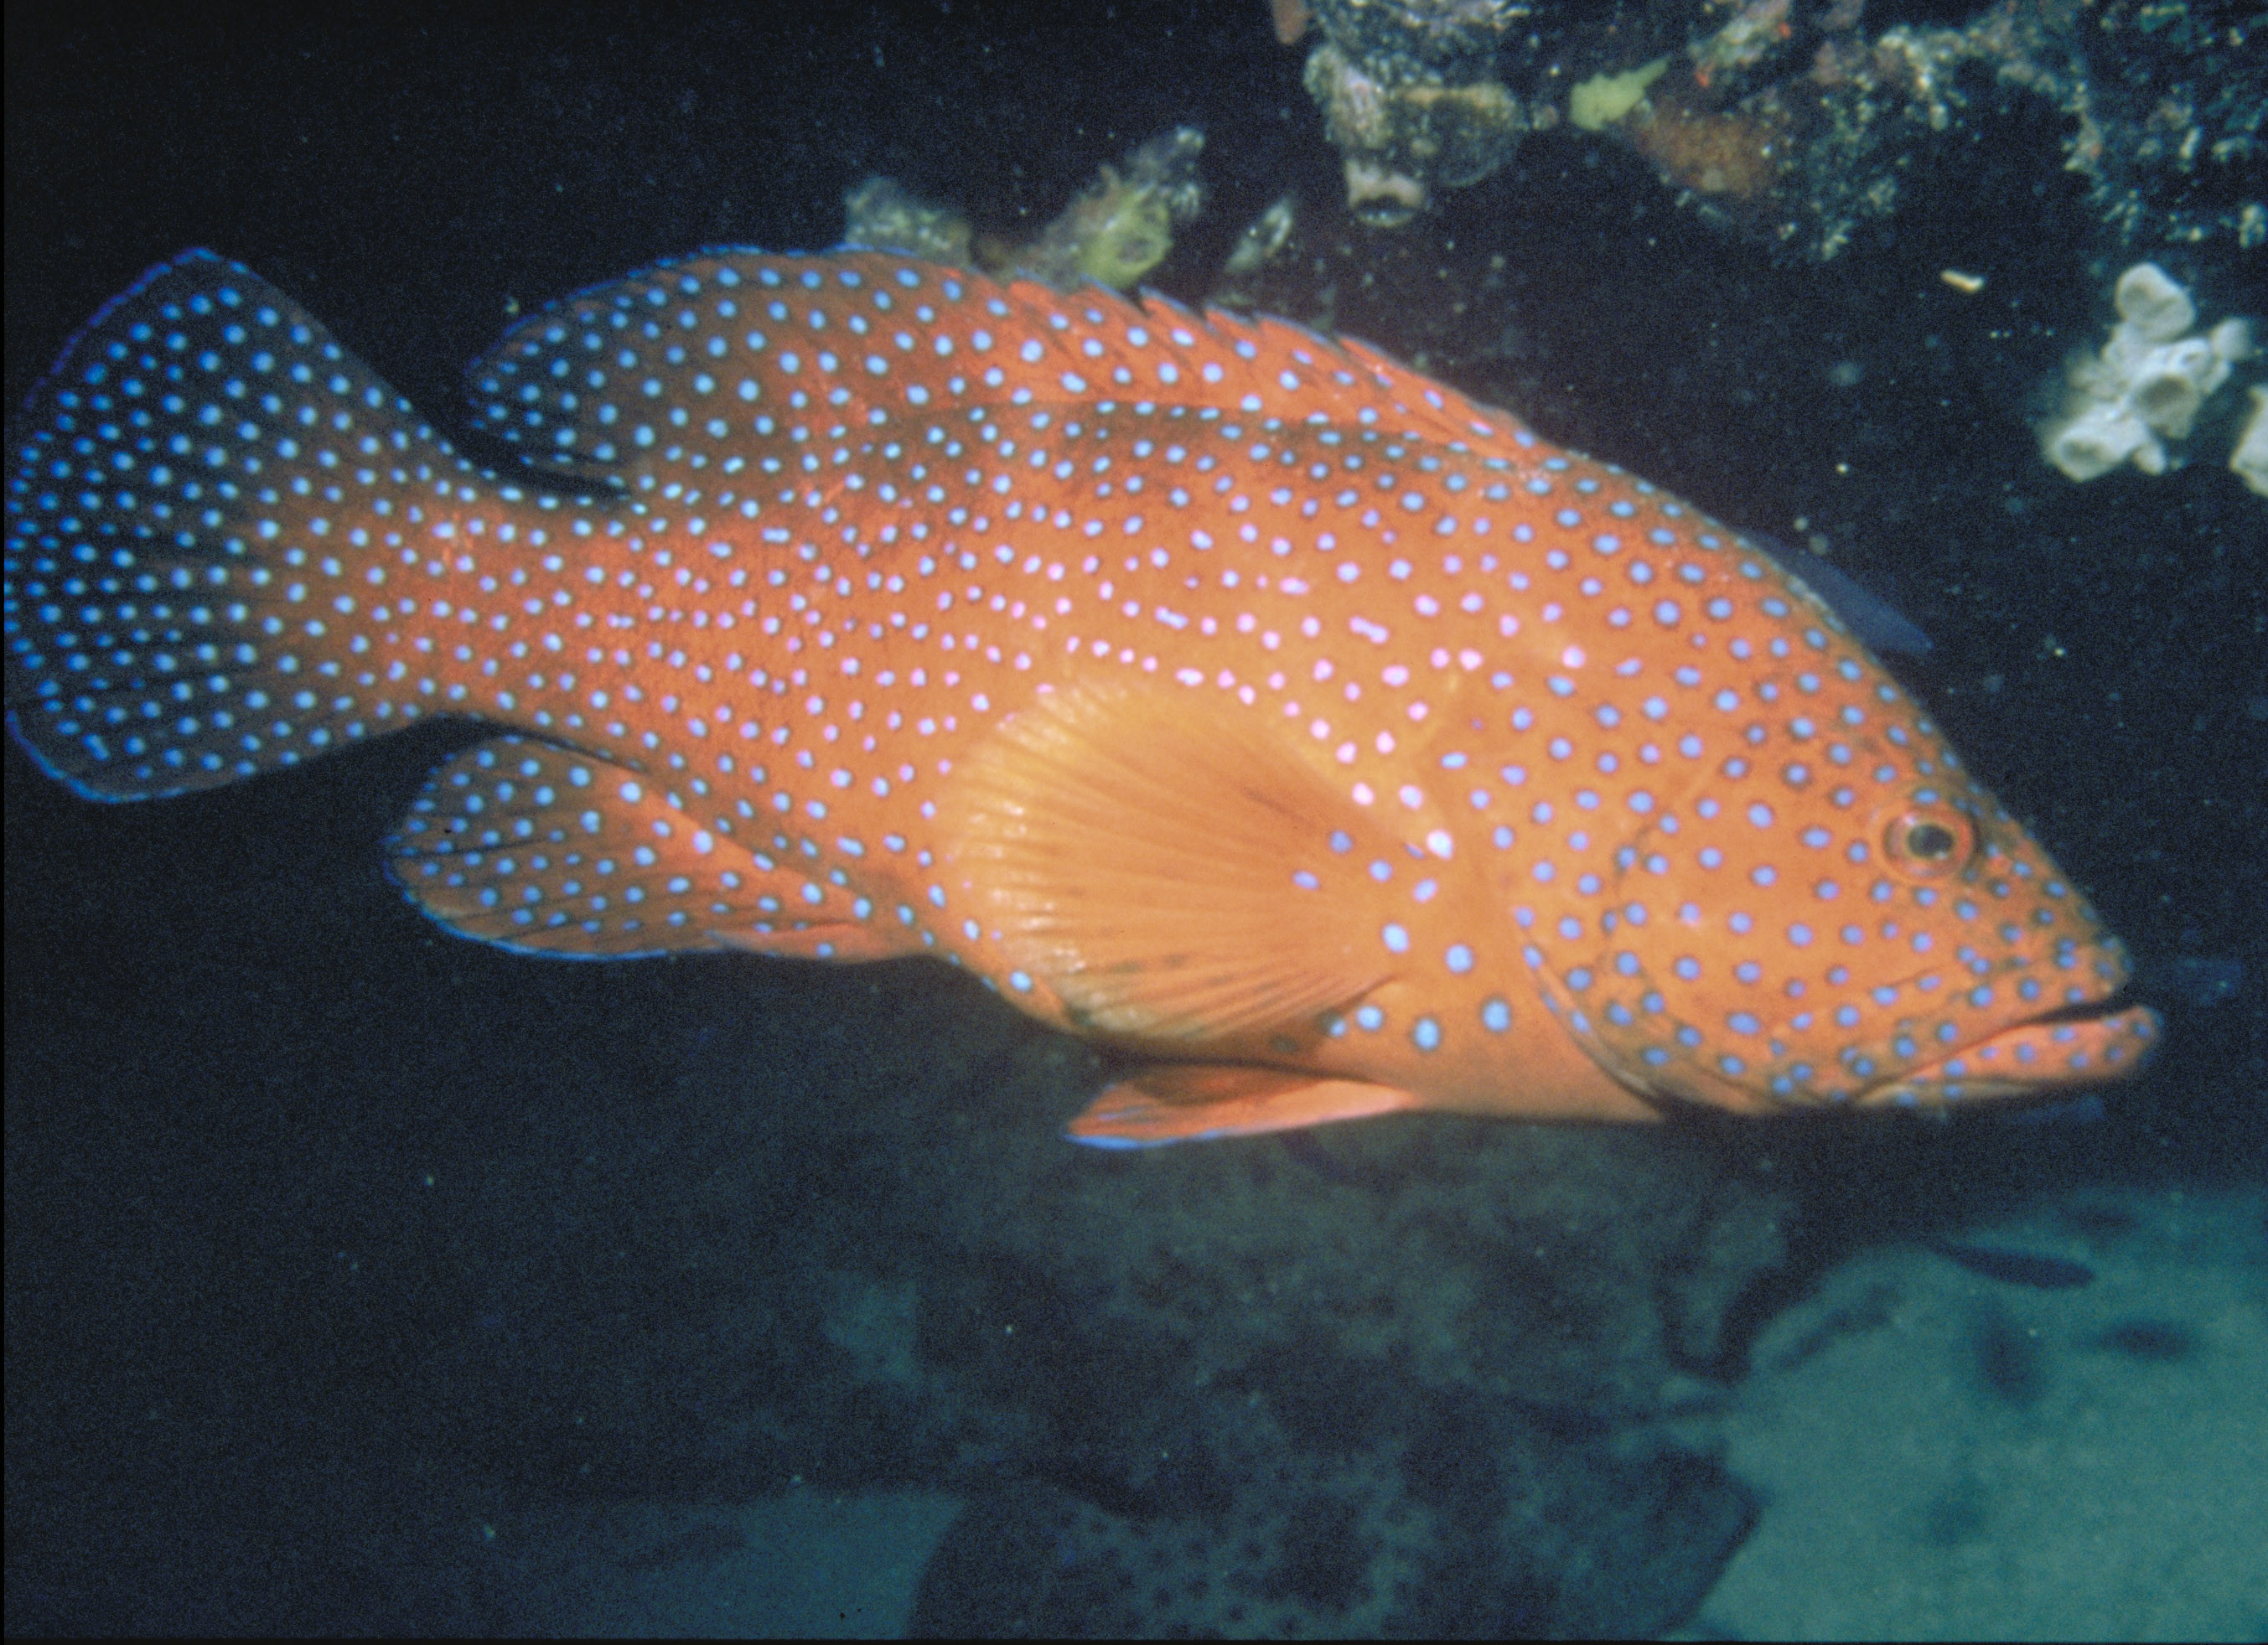
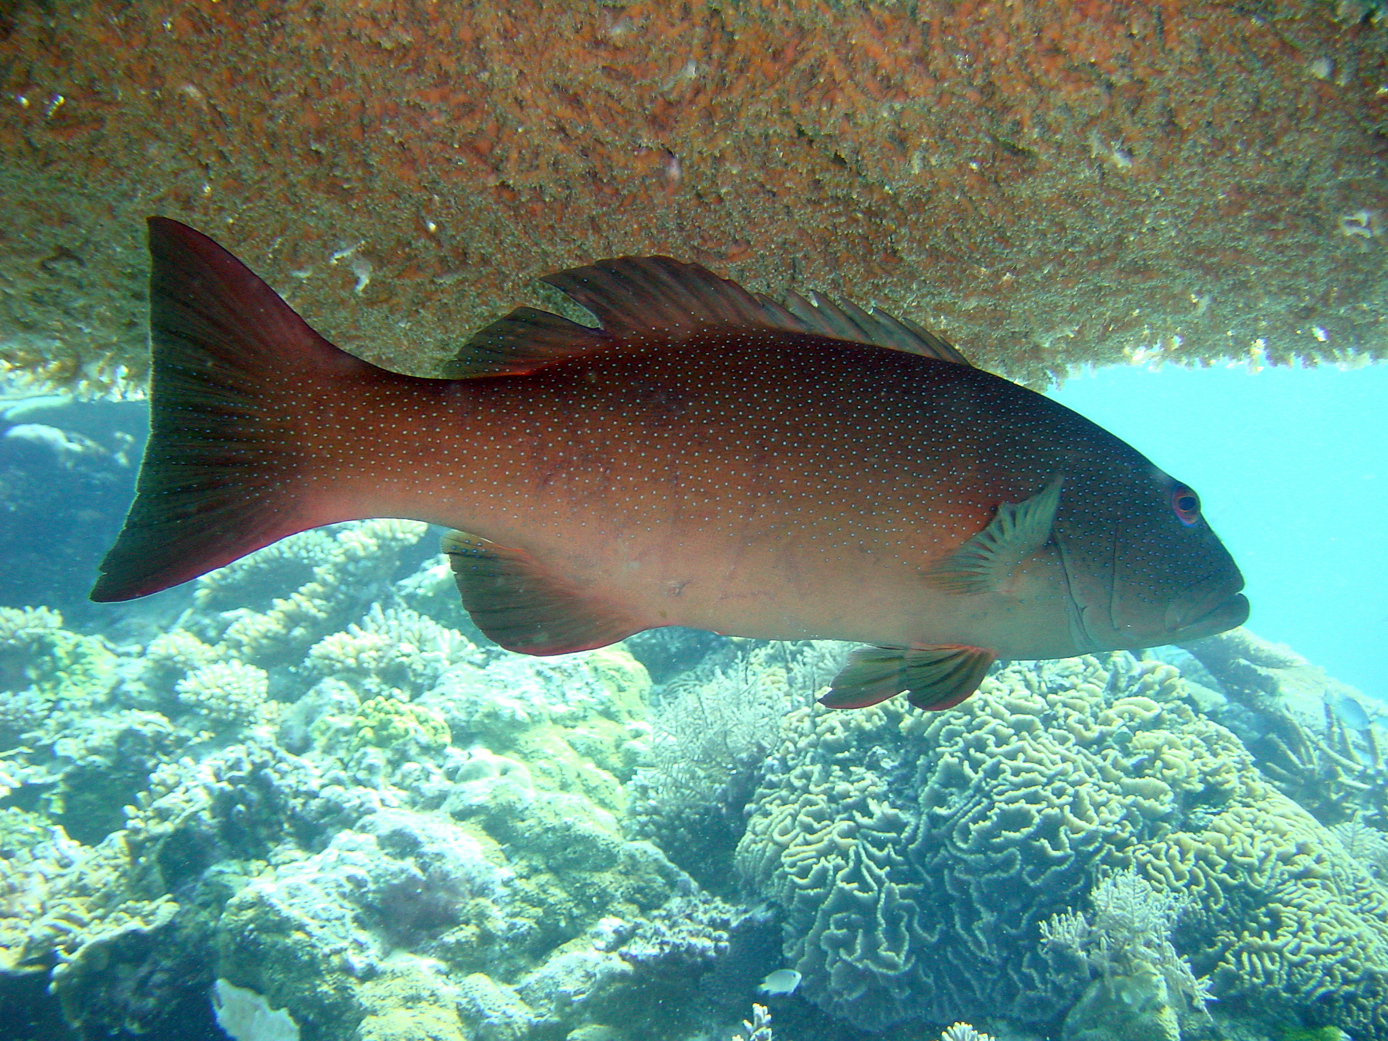
Spot the difference. Hint: compare the shape of the tail.
CONVEX TAIL
CONCAVE TAIL
Coral cod
Coral trout
Notes:
Images: (Left) N. Collins, Copyright Commonwealth of Australia (GBRMPA); (Right) G. Goby, Copyright Commonwealth of Australia (GBRMPA)

Slide 58
Why count coral trout?
Do not answer the question. Wait for an answer.
To calculate sustainable catch limits from accurate estimates of population size.

Slide 59
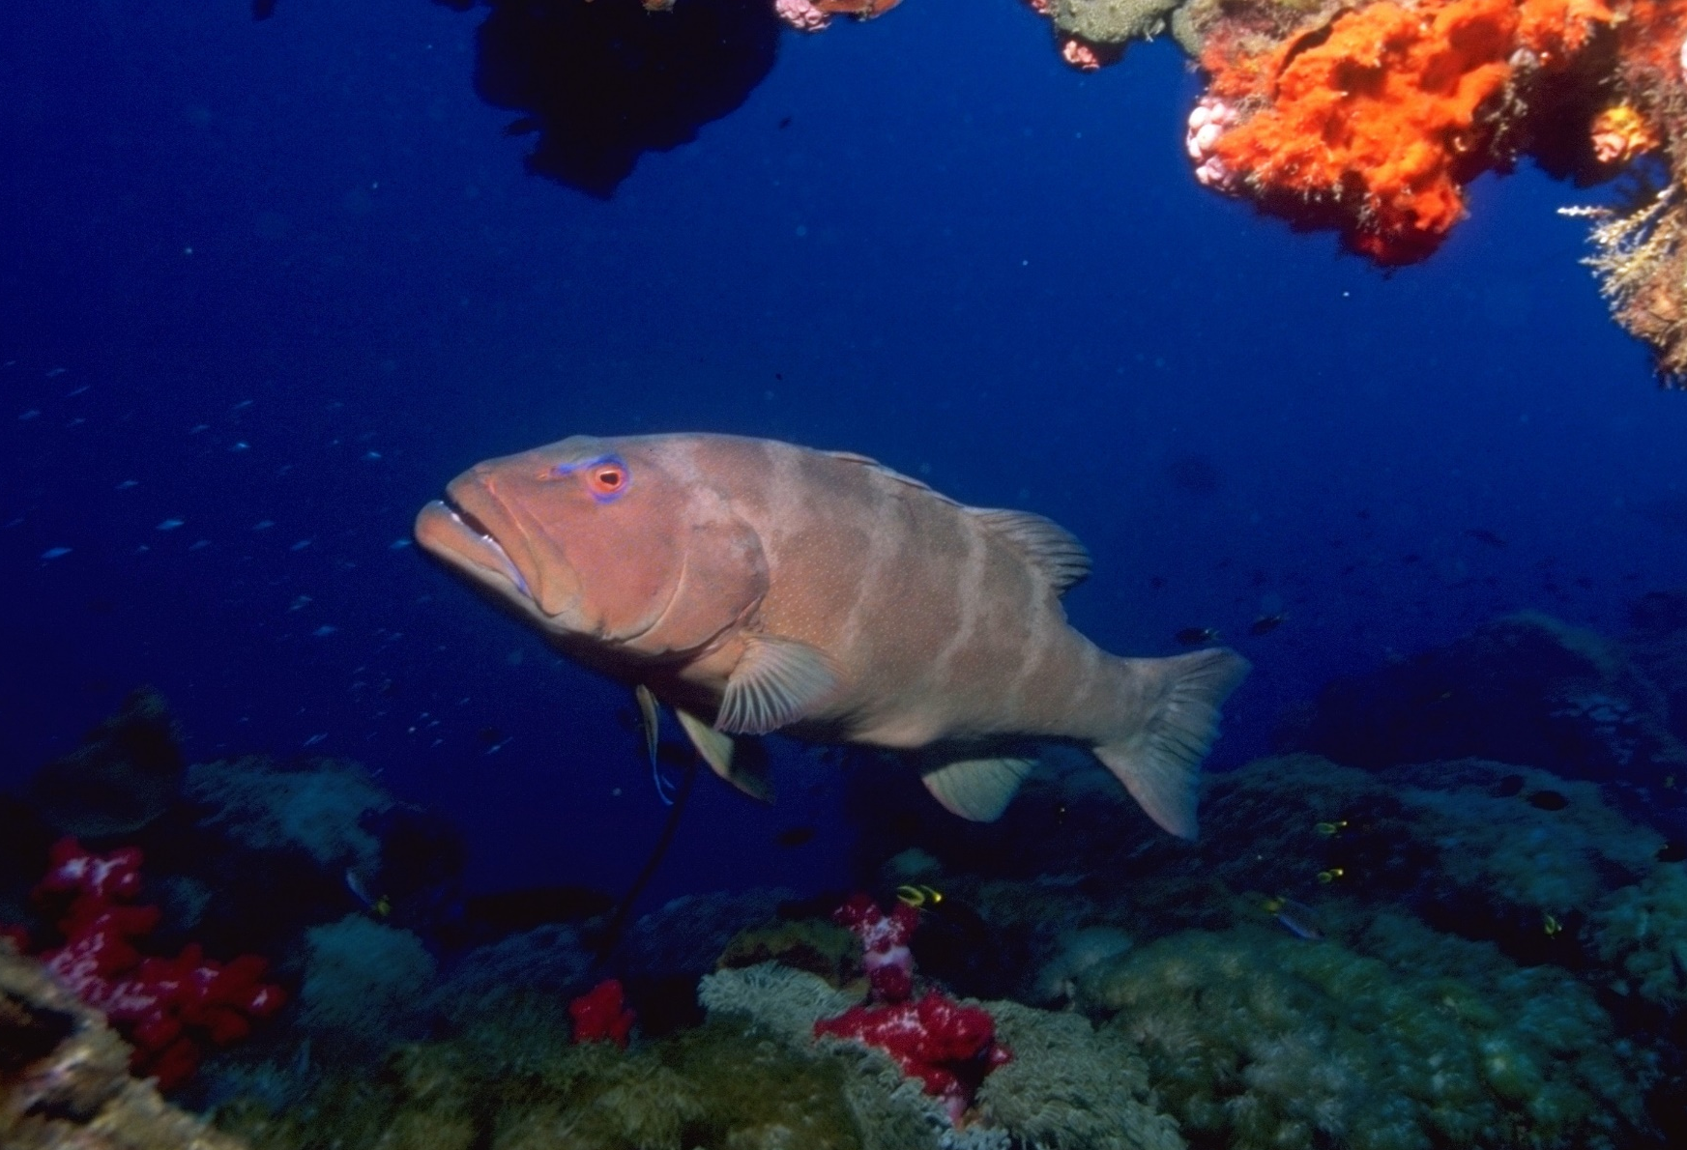
Why count coral trout?
Notes:
Image: T. Mayne, Copyright Commonwealth of Australia (GBRMPA)

Slide 60
Who is counting the coral trout < 38cm and > 38cm?
Check buddy pair/s counting coral trout have all their materials.

Slide 61
Who is counting coral trout?
<38cm / >38cm

Slide 62
Maori wrasse
Year 7
Biology: classification, food chains, humans
Maori wrasse can become super friendly and are great for tourism. Unfortunately they are endangered. Why? Answer: Mostly because they are a highly valued fish in the luxury live reef fish trade.
Year 8
Biology: cells, systems, survival and reproduction
Maori wrasse, like all fish, have a protective mucous coating on their body. Why is it important not to touch the animals, including this friendly fish? Answer: It removes the mucous and they can get sick.
Year 9
Biology: systems of life. Responding to the world
Maori wrasse occupy limited home ranges.
Adults swim across the reefs during the day, resting at night in caves and under coral ledges.
They are ENDANGERED.
Year 10
Biology: earth systems, DNA, tourism, humans
Resident Maori wrasse bring in lots of money to the tourism industry. How much would you pay to see one up close? This is an open inquiry question.

Slide 63
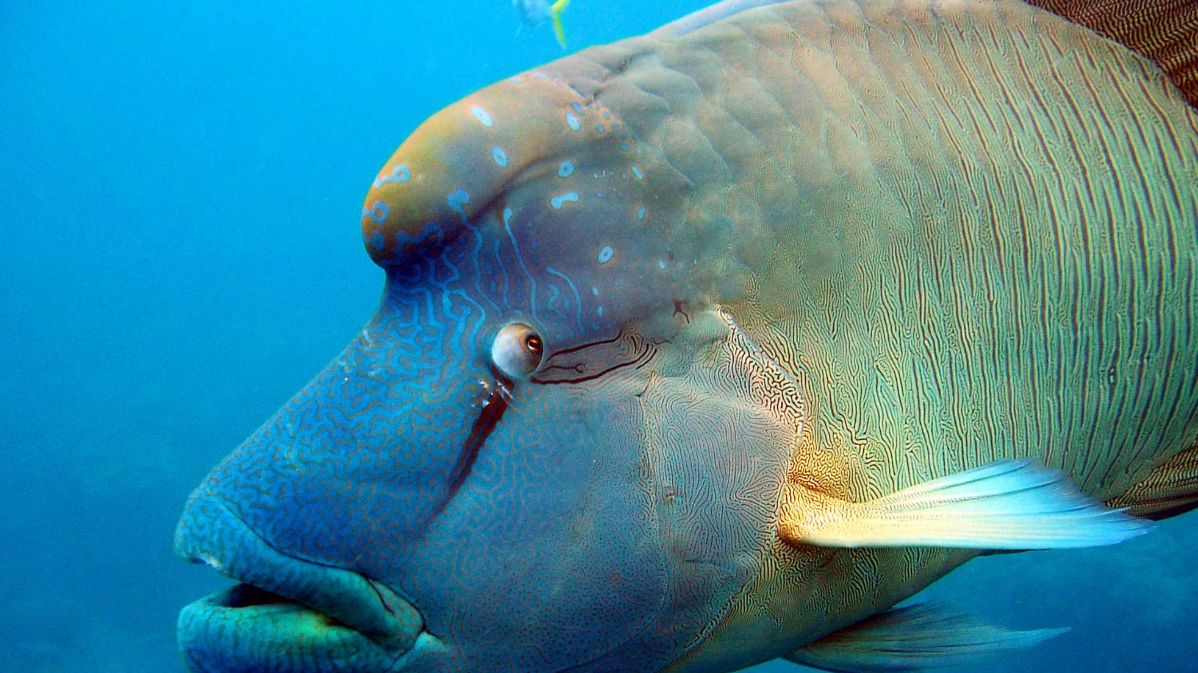
Maori wrasse also called humphead wrasse or Napoleon wrasse.
ENDANGERED
Notes:
Image: C. Jones, Copyright Commonwealth of Australia (GBRMPA)

Slide 64
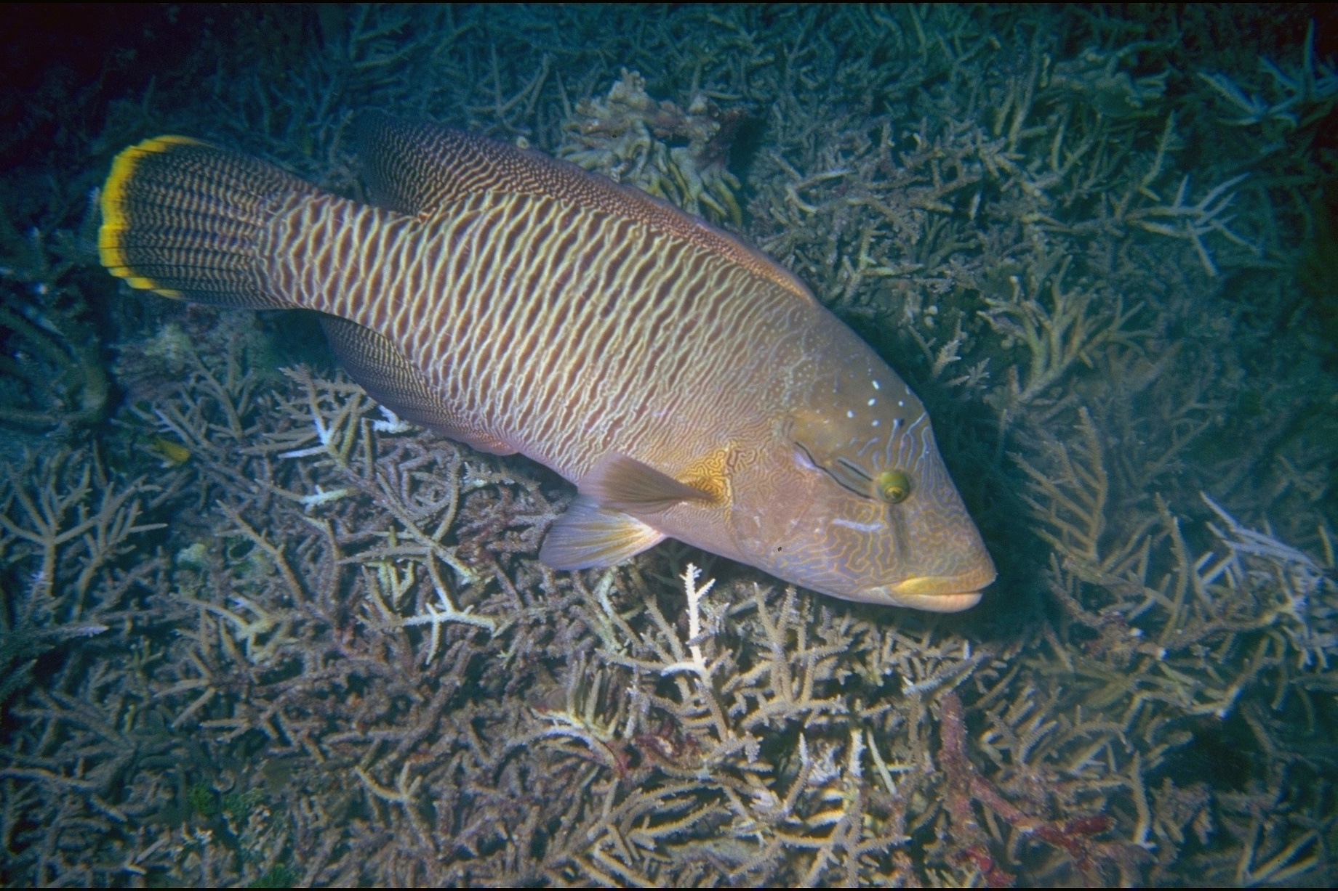
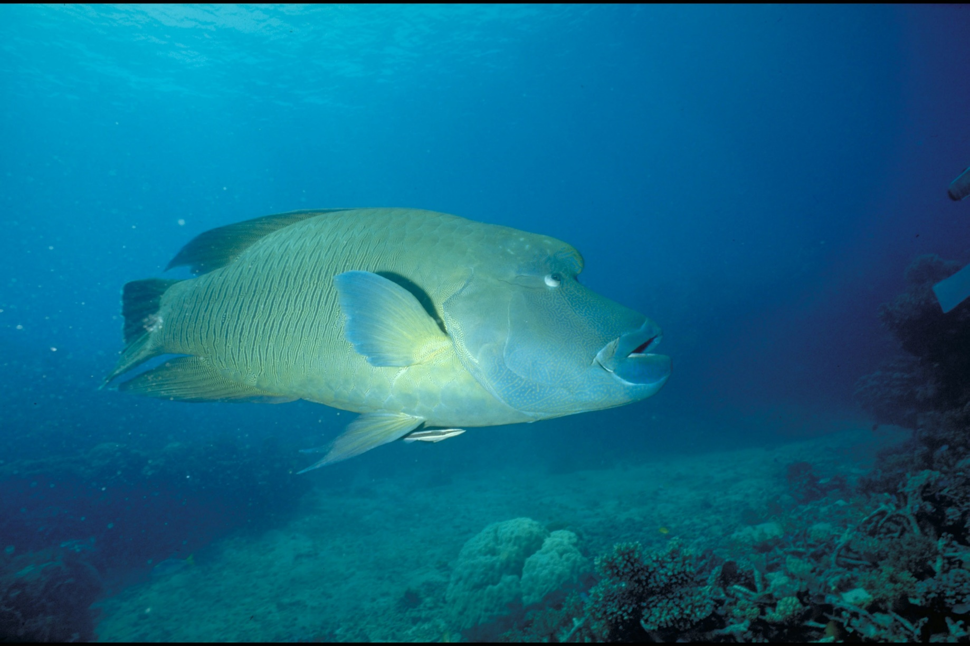
Female
Male
Bronze
No hump
Smaller
0–9 years
Blue-green
Hump
Bigger
9–30 years
Notes:
Images: (Left) U. Englehardt, Copyright Commonwealth of Australia (GBRMPA); (Right) M. Simmons, Copyright Commonwealth of Australia (GBRMPA)

Slide 65
Why count Maori wrasse?
Do not answer the question. Wait for an answer.
Maori wrasse are listed as endangered.
We need them because they are great for tourism and they help protect corals, and the Reef, by feeding on crown-of-thorns starfish.

Slide 66
Why count Maori wrasse?
ENDANGERED
ENDANGERED
Female
Male
Notes:
Images: (Left) U. Engelhardt, Copyright Commonwealth of Australia (GBRMPA); (Right) M. Simmons, Copyright Commonwealth of Australia (GBRMPA)

Slide 67
Who is counting the male and female Maori wrasse?
Check buddy pair/s counting Maori wrasse have all their materials.

Slide 68
Who is counting Maori wrasse?
Female and Male

Slide 69
Sea turtles
Year 7
Biology: classification, food chains, humans
What do sea turtles eat that look like jellyfish? Answer: Plastic bags.
What do turtles get entangled in? Answer: Discarded fishing gear and other marine debris.
Year 8
Biology: cells, systems, survival and reproduction
When is turtle breeding season? Answer: Summer.
If the sand is hot in temperature, do the baby turtles hatch as boys or girls? Answer: Girls. ‘Girls are hot’ ‘Boys are cool’
Year 9
Biology: systems of life. Responding to the world
Some turtles travel long distances, hitch-hiking rides in ocean currents such as the EAC and ocean gyres. Is it possible that a large turtle on the GBR has travelled to New Caledonia and back? Answer: Yes.
Year 10
Biology: earth systems, DNA, tourism, humans
Finding Crush! DNA is a natural genetic tag that can be used to estimate the birth place of a turtle.
What is another way to identify and track turtles? Answer: Metal tags.

Slide 70
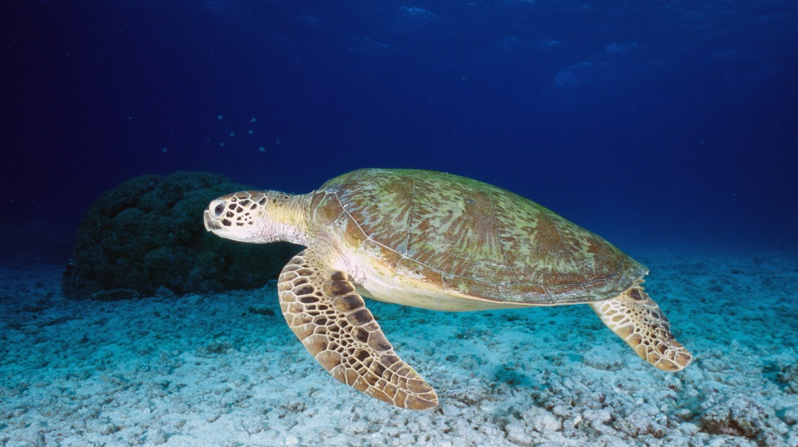
Sea turtles
Notes:
Image: K. Hoppen, Copyright Commonwealth of Australia (GBRMPA)

Slide 71
Plastic bags look like yummy jellyfish!
Notes:
Image: C. Jones, Copyright Commonwealth of Australia (GBRMPA)

Slide 72
Most rubbish enters the sea via overflowing bins or litter on the ground that is carried by the wind. It also travels to the sea via storm water drains, rivers and flood waters.
The “Great Pacific Garbage Patch”, is a large area in the Pacific Ocean that is approximately the size of South Australia with debris extending 6 meters down into the water column.
Researchers have estimated that for every 1 kilogram of plankton in the “Garbage Patch”, there is 6 kilograms of plastic.
Notes:
Image: https://www.gbrmpa.gov.au/our-work/threats-to-the-reef/marine-debris
Data: https://www.seeturtles.org/ocean-plastic

Slide 73
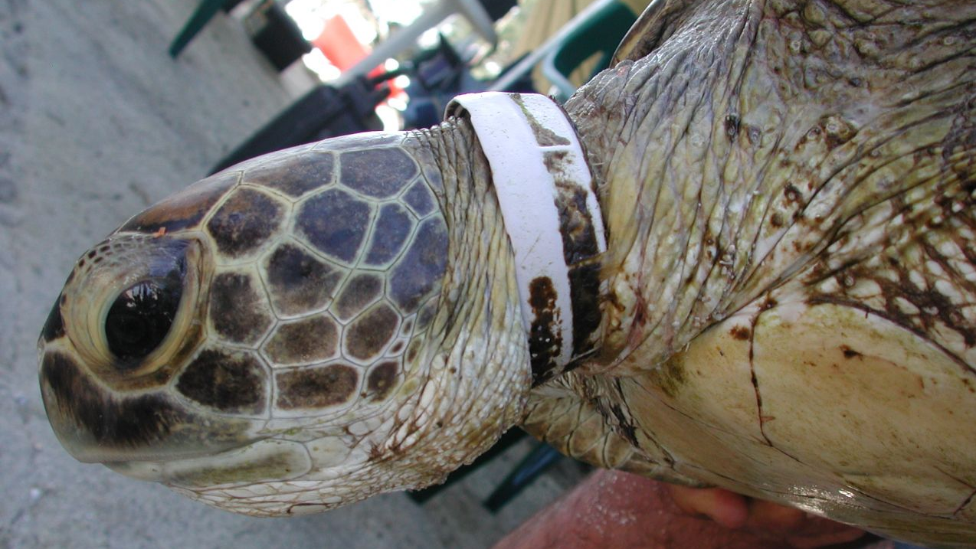
Notes:
Image: https://www.gbrmpa.gov.au/our-work/threats-to-the-reef/marine-debris

Slide 74
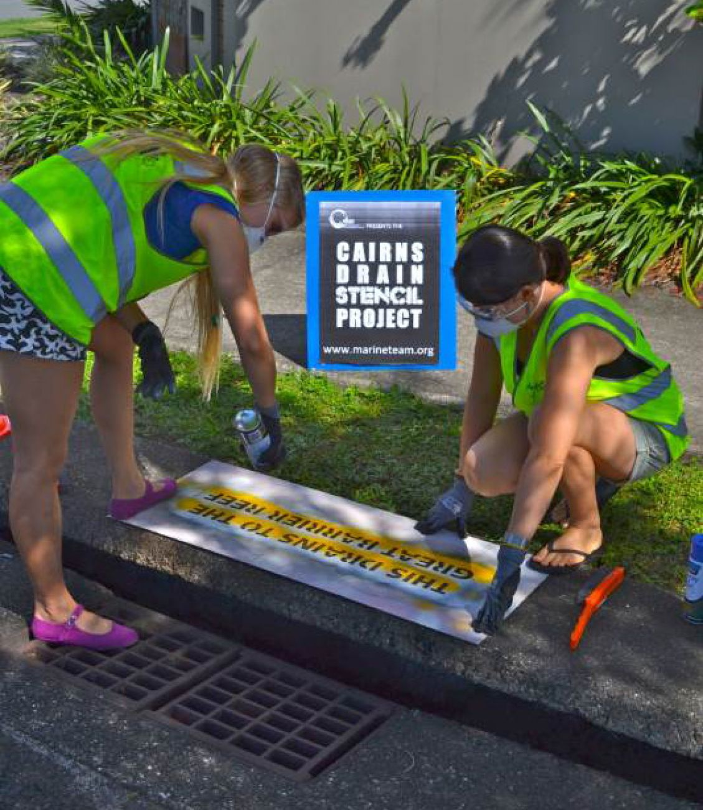
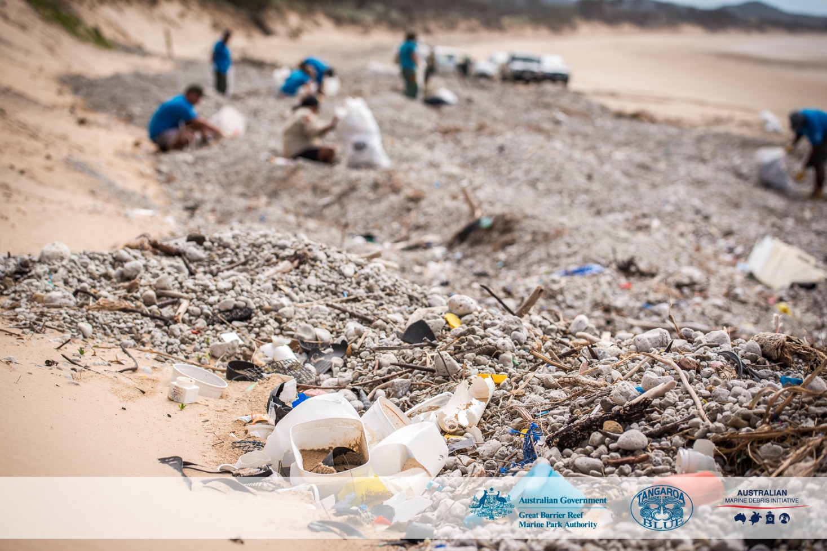
All storm water drains lead to the sea. How can I help the Great Barrier Reef?
Notes:
Images: (Left) https://www.gbrmpa.gov.au/our-work/threats-to-the-reef/marine-debris; (Right) C. Miller, Copyright Commonwealth of Australia (GBRMPA)

Slide 75
Green turtle (Chelonia mydas)
Small head.
High domed carapace (shell).
Carapace colour – cream and rusty brown to grey.
4 pairs of costal scutes (side scales) on carapace.
ENDANGERED
1
2
3
4
Notes:
Image: K. Hoppen, Copyright Commonwealth of Australia (GBRMPA)

Slide 76
1 pair of pre-frontal scales above beak.
ENDANGERED
1 pair
Notes:
Image: C. Jones, Copyright Commonwealth of Australia (GBRMPA)

Slide 77
Hawksbill turtle (Eretmochelys imbricata)
Small head.
Black scales on head and flippers.
Carapace with serrated edges (smaller turtles only).
4 pairs of costal scutes (side scales) on carapace
Overlapping scutes (like fish scales).
CRITICALLY ENDANGERED
1
2
3
4
Serrated edges
Notes:
Image: K. Hoppen, Copyright Commonwealth of Australia (GBRMPA)

Slide 78
2 pairs of pre-frontal scales.
Hawk-like beak.
CRITICALLY ENDANGERED
1st pair
2nd pair
Hawk-like beak
© naturepl.com / Inaki Relanzon / WWF
Notes:
Image: Hawksbill turtle (Eretmochelys imbricata) swimming underwater, Nosy Be, North Madagascar. Image: naturepl.com / Inaki Relanzon / WWF © naturepl.com / Inaki Relanzon / WWF Source: https://australian.museum/learn/animals/reptiles/hawksbill-sea-turtle/

Slide 79
Loggerhead turtle (Caretta caretta)
Big head!
5 pairs of costal scutes on carapace.
VULNERABLE TO EXTINCTION
4
5
3
2
1
Notes:
Image: M. Simmons, Copyright Commonwealth of Australia (GBRMPA)

Slide 80
Why count sea turtles?
Do not answer the question. Wait for an answer.
All sea turtles are threatened with extinction.
Count every turtle you see.
But tally the Green turtles and Hawksbill turtles separately.

Slide 81
Why count sea turtles?
Notes:
Image: A. Simmonds, Copyright Commonwealth of Australia (GBRMPA)

Slide 82
Who is counting the Green, Hawksbill and all other sea turtles?
Check buddy pair/s counting sea turtles have all their materials.

Slide 83
Who is counting sea turtles?
Green / Hawksbill / other

Slide 84
Sharks
Year 7
Biology: classification, food chains, humans
Where are sharks positioned in the food chain? Answer: At the top. They are the apex predators.
They help regulate the number of prey species and maintain ecological balance.
Year 8
Biology: cells, systems, survival and reproduction
How do you tell the difference between a male and female shark? Answer: Males have claspers.
Model the claspers by putting your hands side by side (joined at the thumbs), with fingers together. Slip the thumbs outwards so the pointer fingers are now together. The two thumbs are the two claspers.
Year 9
Biology: systems of life. Responding to the world
Sharks have all the senses we have (smell, taste, touch, eyesight, and hearing).
However, they can also sense electricity and vibrations in the water using electroreceptors. These look are tiny black dots around the mouth.
Year 10
Biology: earth systems, DNA, tourism, humans
The great white shark has 1½ times more chromosomes than humans.
What is something sharks can do that humans can’t do? Answer: Sense electricity and vibrations via senses on the snout. Heal faster. Suppress cancer.

Slide 85
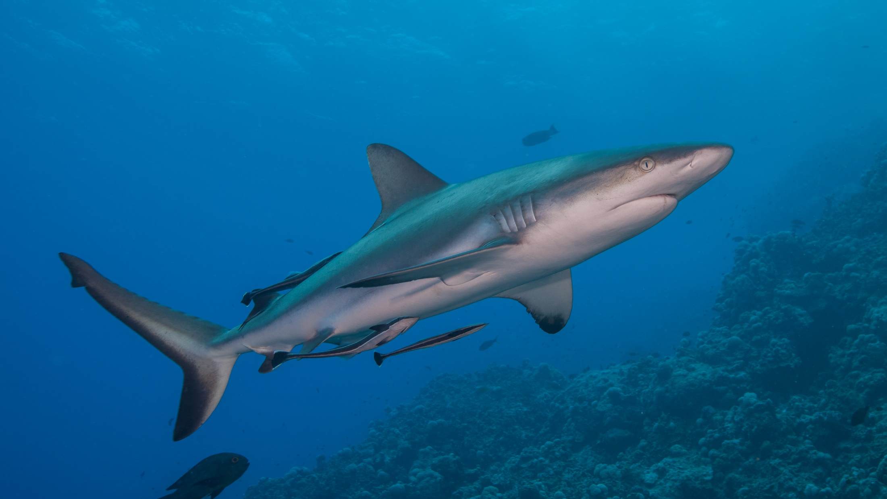
Sharks
Notes:
Image: J. Sumerling, Copyright Commonwealth of Australia (GBRMPA)

Slide 86
Whitetip reef shark
VULNERABLE TO EXTINCTION
White tip on fin
Notes:
Image: T. Mayne, Copyright Commonwealth of Australia (GBRMPA)

Slide 87
Blacktip reef shark
VULNERABLE TO EXTINCTION
Black tip on fin
Notes:
Image: K. Hoppen, Copyright Commonwealth of Australia (GBRMPA)

Slide 88
Epaulette shark
Notes:
Image: P. Marshall, Copyright Commonwealth of Australia (GBRMPA)

Slide 89
Why count sharks?
Do not answer the question. Wait for an answer.
Sharks are at the top of the food chain. They help regulate the number of prey species and maintain ecological balance.
Sharks are a keystone species.
Without sharks, ecosystems are dramatically different.
Many sharks are endangered.

Slide 90
Why count sharks?
Notes:
Image: J. Sumerling, Copyright Commonwealth of Australia (GBRMPA)

Slide 91
Who is counting the whitetip, blacktip and all other sharks?
Check buddy pair/s counting sharks have all their materials.

Slide 92
Who is counting sharks?
Whitetip / Blacktip / other

Slide 93
Everybody must look out for crown-of-thorns starfish.
Venomous spines. Do not touch!

Slide 94
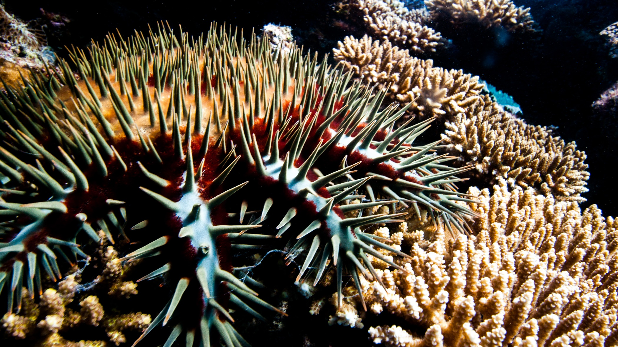
Crown-of-Thorns Starfish (COTS)
Venomous spines. Do not touch!
Notes:
Image: J. Hurford, Copyright Commonwealth of Australia (GBRMPA)

Slide 95
Count the adults (larger than your hand) and juveniles (smaller than your hand).

Slide 96
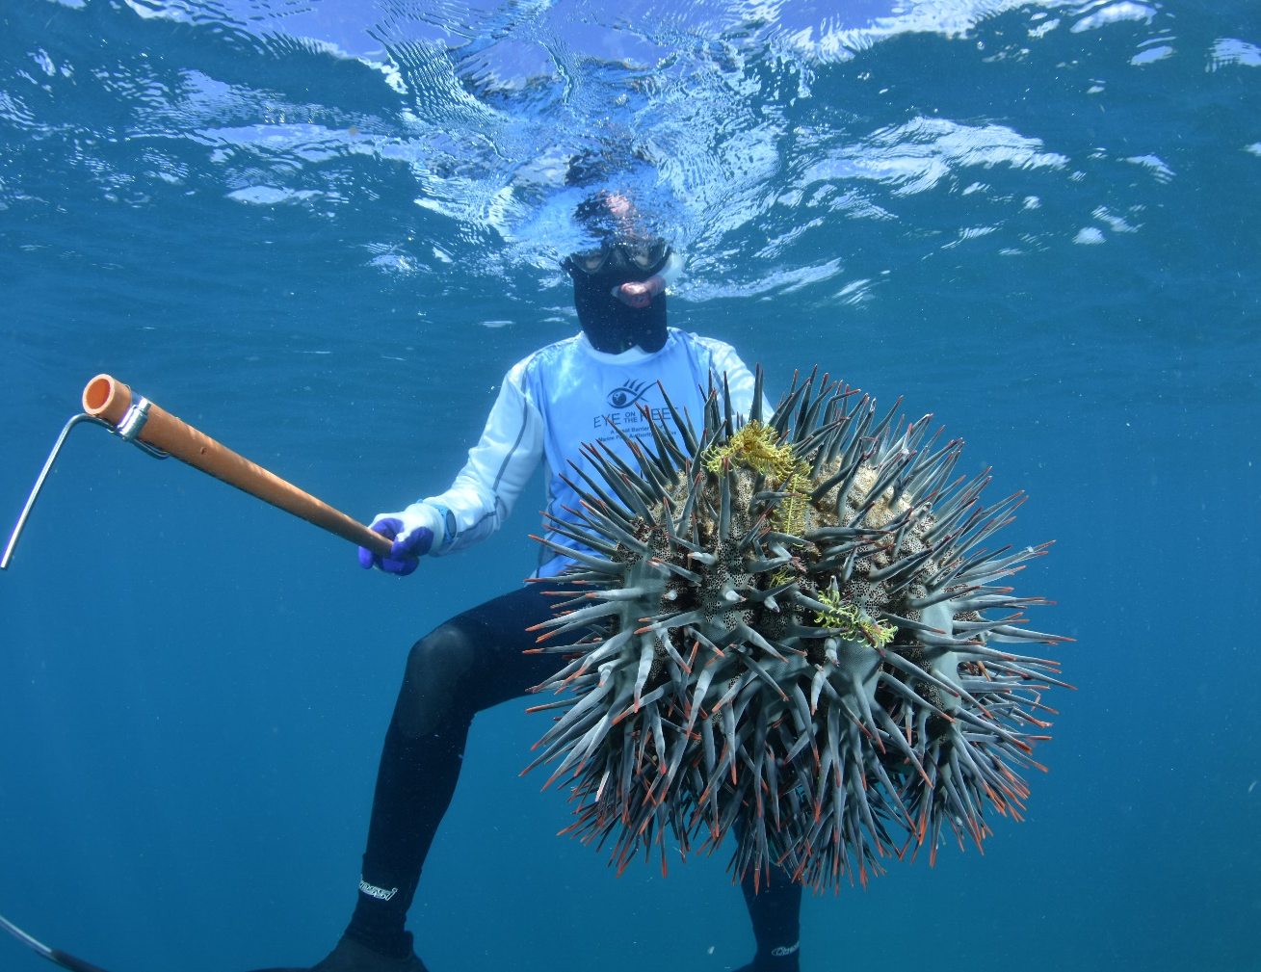
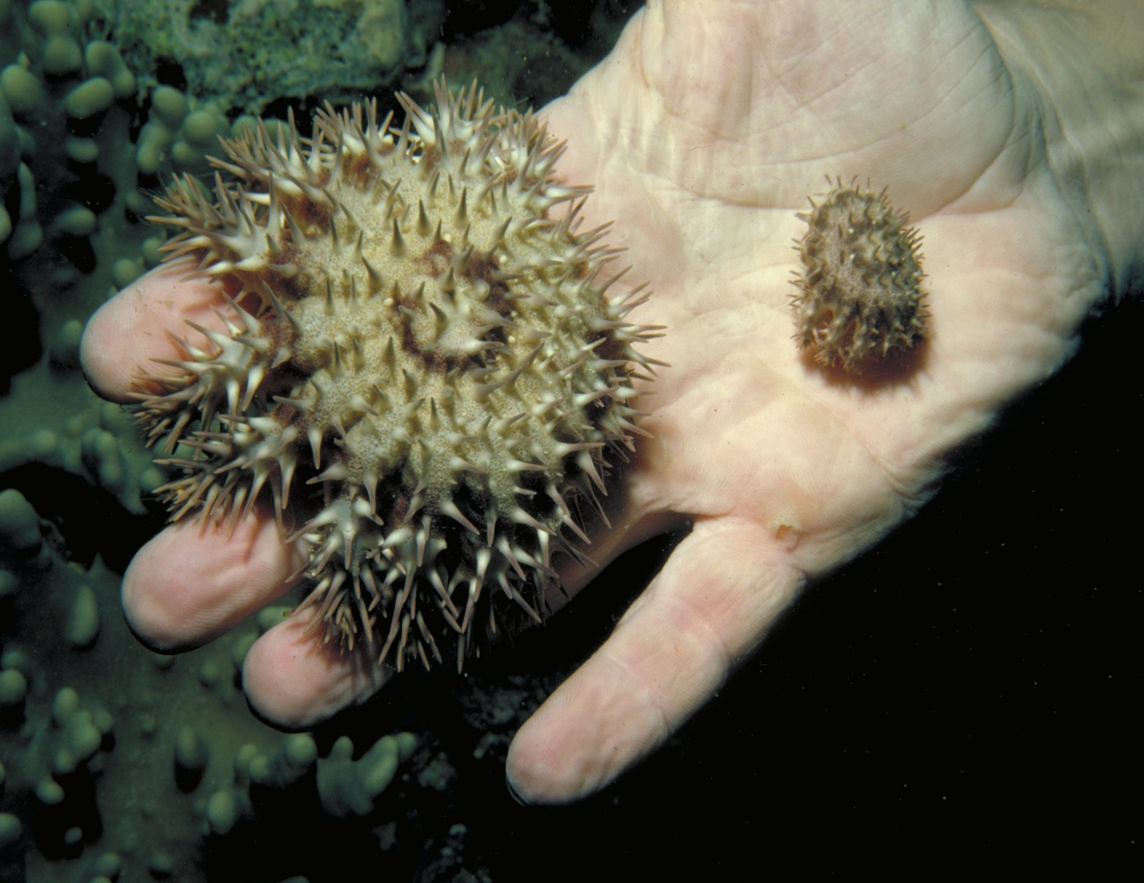
Count the adults and juveniles. Juveniles are smaller than your hand.
Notes:
Images: (Left) M. Curnock, Copyright Commonwealth of Australia (GBRMPA); (Right) Copyright Commonwealth of Australia (GBRMPA)

Slide 97
Why report all crown-of-thorns starfish?
It informs GBRMPA of potential outbreaks.

Slide 98
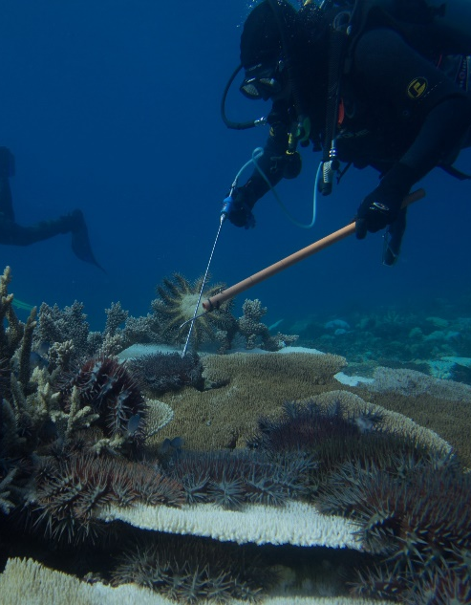
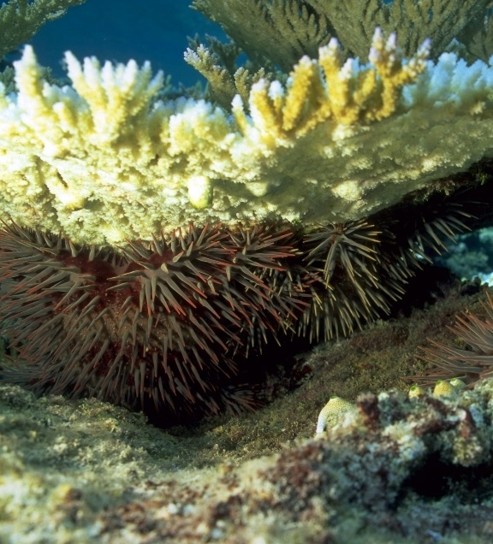
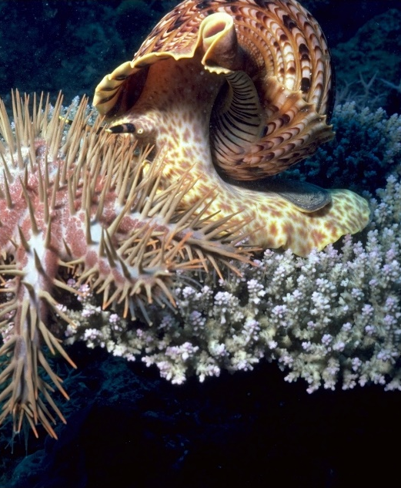
Why report all crown-of-thorns starfish?
Diver injecting COTS
Can be hiding under coral
Giant triton snail eating COTS
Notes:
Images: (Left) D. Shultz, Copyright Commonwealth of Australia (GBRMPA); (Middle) D. Wachenfeld, Copyright Commonwealth of Australia (GBRMPA); (Right) K. Garnett, Copyright Commonwealth of Australia (GBRMPA)

Slide 99
Look out for all these!

Slide 100
Look out for all these!

Slide 101
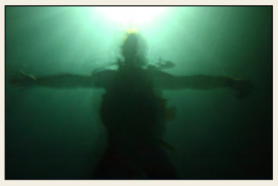
Measure depth and visibility.
<5m 5-10m >10m

Slide 102
Measure depth and visibility.
<5m 5-10m >10m

Slide 103
In-water safety brief.

Slide 104
In-water safety brief.

Slide 105
10 minute timed swim.
Boundaries of the swim area?
Set timer/listen for signal (10 minute).
Swim in one direction.
Swim slowly.
Be as quiet as possible.
Notes:
Taken from Rapid Monitoring Survey Slides.

Slide 106
10 minute timed swim.
Look ahead every 60 seconds.
Look out for unique fish (for app later).
Do not touch or chase the animals.
Write your names on slate.
Tally as you go [ I=1 III=3 IIII=5 ].
Notes:
Taken from Rapid Monitoring Survey Slides.

Slide 107
Listen to your guide at all times.
Always wear a mask, snorkel and fins.
Use a floatation device (e.g. pool noodle).
Stay together with your buddy at all times.
In the water, keep checking on your position.
Listen for when 10 minutes is finished.
Do not touch or chase the animals.
If you get into trouble, wave one hand high above the water to attract the attention of the person on surface watch.
Stay safe for a memorable experience!

Slide 108
Listen to your guide at all times.
Always wear a mask, snorkel and fins.
Use a floatation device (e.g. pool noodle).
Stay together with your buddy at all times.
In the water, keep checking on your position.
Listen for when 10 minutes is finished.
Do not touch or chase the animals.
If you get into trouble, wave one hand high above the water to attract the attention of the person on surface watch.
Stay safe for a memorable experience!

Slide 109
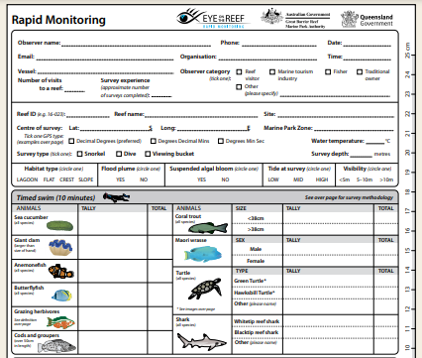
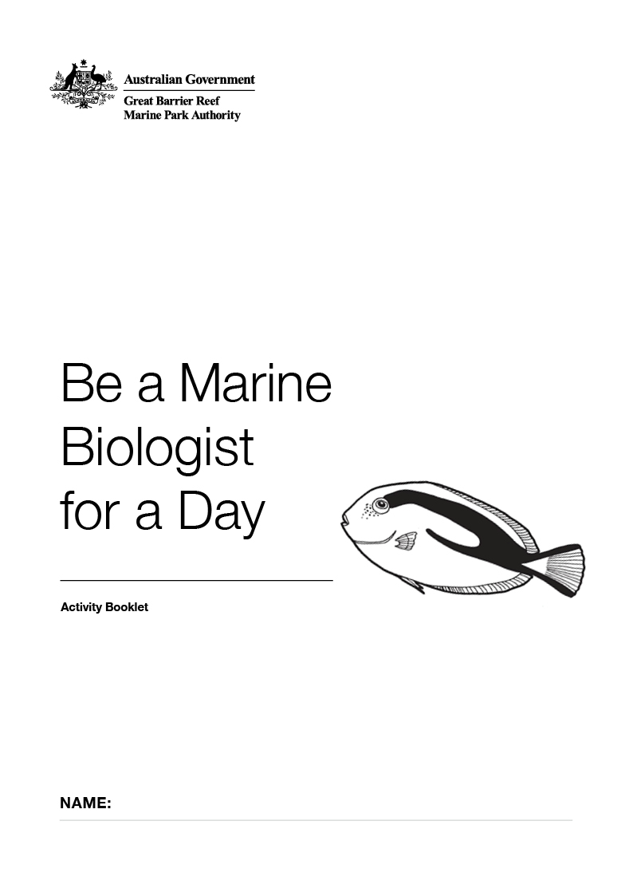
After the survey, you will be shown how to fill in this form. There is a copy in your activity book. Bring your data too!

Slide 110
After the survey, you will be shown how to fill in this form. There is a copy in your activity book. Bring your data too!

Slide 111
Let’s go!
Any last comments/ instructions put here.
Notes:
Optional: personalise, by changing to a picture from your operation.
Image: Copyright Commonwealth of Australia (GBRMPA)

Slide 112
Let’s go!
Notes:
Optional: personalise, by changing to a picture from your operation.
Image: Copyright Commonwealth of Australia (GBRMPA)

