Slide 1
Be a Marine Biologist for a Day
Part 2: Finding out
Middle School
Post-snorkel presentation for 10 minute timed survey.
Notes:
Image: L. Zell, Copyright Commonwealth of Australia (GBRMPA)

Slide 2
How will I help the Great Barrier Reef today? By getting my data ready to tell the Great Barrier Reef Marine Park Authority what I counted and saw.

Slide 3
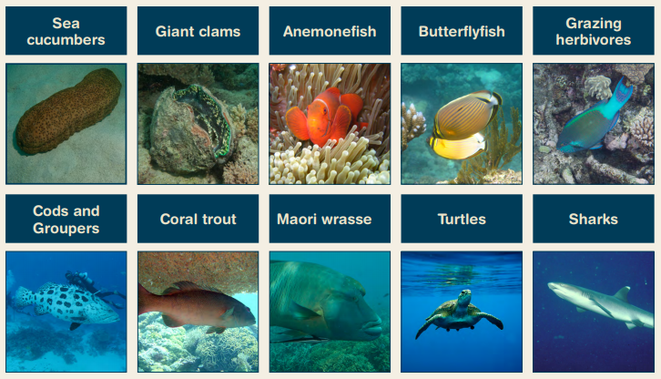
What we counted in 10 minutes.
Notes:
Idea: you could organise a prize for the person with the most correct answers?

Slide 5
“Are you ready to share your data and complete this form? We will do it together. I will show you how. Do you have your data sheets and activity books ready?”
Check each student has their data sheets and activity books (and a pencil). (activity books have a copy of the Rapid Monitoring form)
or
Check they have their data somewhere and a Rapid Monitoring survey form and a pencil each (that they can take home with them).
This is a good time to collect any borrowed equipment.

Slide 6
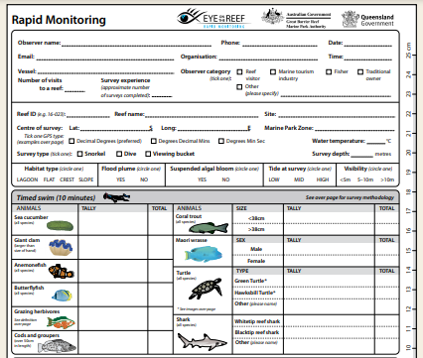
Are you ready to complete this form?
Rapid Monitoring survey form
(in activity book).

Slide 7
Filling out the form
Walk students through each line:
Observer name
Date
Time

Slide 8
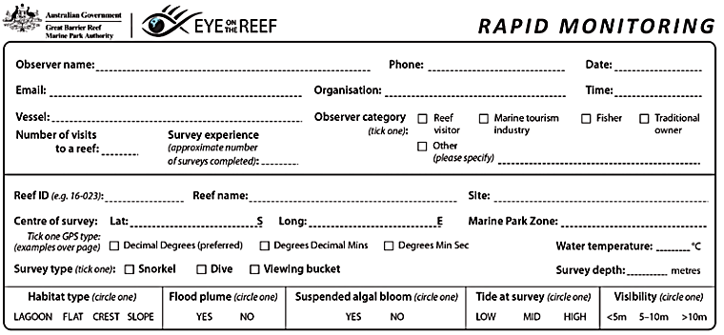
Observer name:
Date:
Time (of snorkel):
Your name
The date
am/pm

Slide 9
Filling out the form
Walk students through each line:
Organisation
Vessel name
Observer category (i.e. name of school and grade)

Slide 10
Organisation: name of the business
Vessel: name of the vessel/s
Observer category: tick Other (name of school)
Name of business
Name of vessel
Name of school and grade

Slide 11
Filling out the form
Walk students through each line:
Reef ID

Slide 12
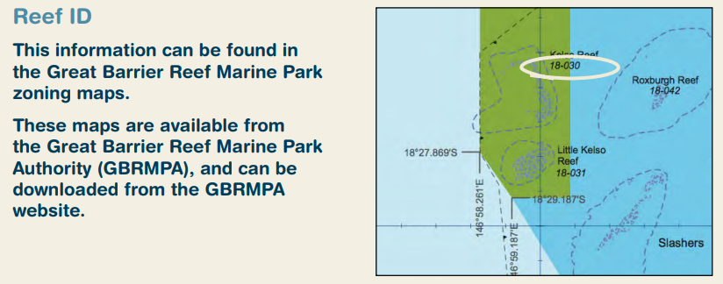
Reef ID: 18-030 (example only).
Notes:
Change the REEF ID number on the slide!!!

Slide 13
Filling out the form
Walk students through each line:
Reef name

Slide 14
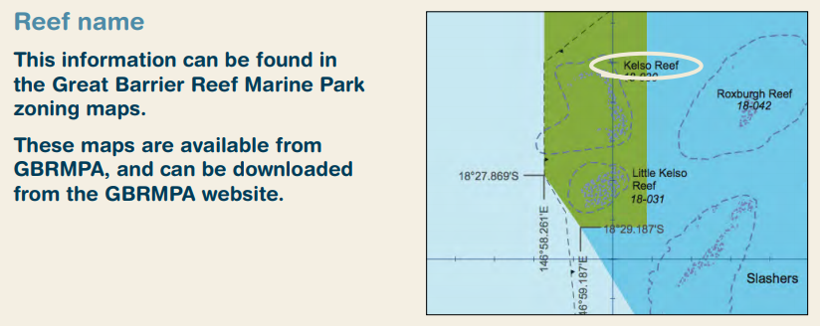
Reef name: Kelso Reef (example only).
Notes:
Change the REEF NAME on the slide!!!

Slide 15
Filling out the form
Walk students through each line:
Name of site

Slide 16
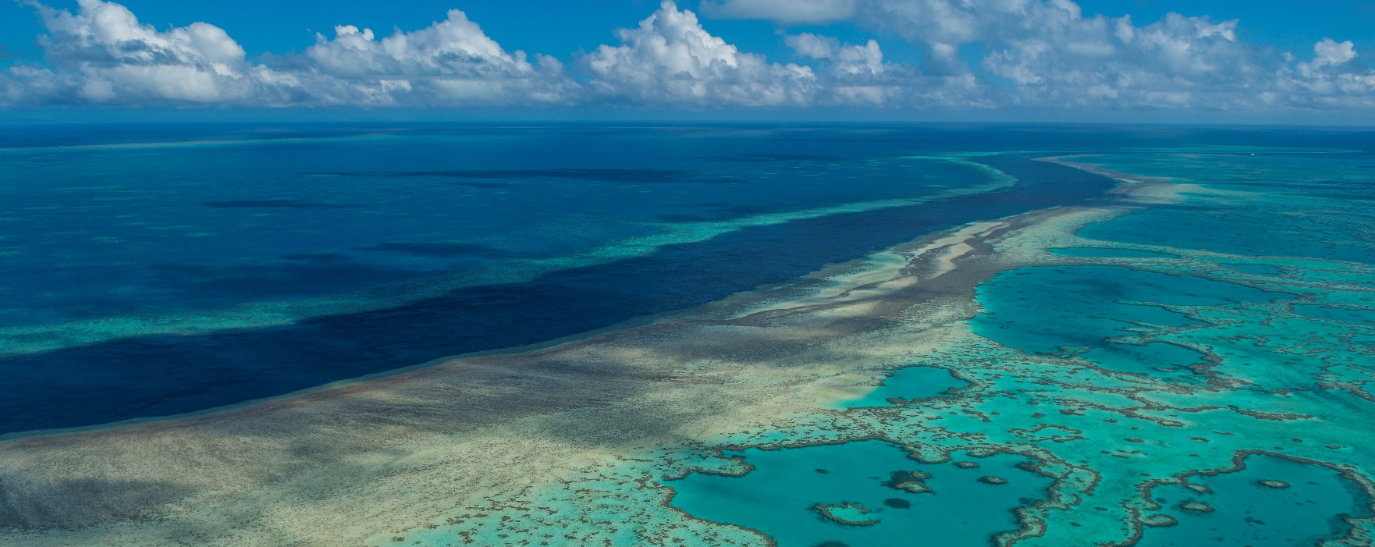
Site: The lagoon (example only).
Notes:
Change the SITE NAME on the slide!! Replace with a photo of YOUR site (same as previous slide)
Image: Copyright Commonwealth of Australia (GBRMPA)

Slide 17
Filling out the form
Walk students through each line:
Colour of marine park zone

Slide 18
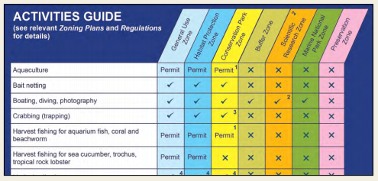
Marine Park Zone: Green (example only).
Notes:
Add the colour of the zone/s that you snorkel

Slide 19
Filling out the form
At this point, check if students have the following filled:
Student’s name
Date
Business name
Time
Observer category (i.e. name of school and grade)
Reef ID
Name of reef
Name of site
Colour of marine park zone

Slide 20
Check point.
Your name
The date
Name of business
am/pm
Name of vessel
Name of school
?
Name of reef
Name of site
Colour of zone

Slide 21
Filling out the form
Walk students through each line:
Lat and Long
Tick decimal degrees

Slide 22
Latitude (Lat):
Longitude (Long):
18.6582°
146.489°

Slide 23
Filling out the form
Walk students through each line:
Tick snorkel
Record water temperature
Record survey depth

Slide 24
Water temperature:
Survey type: tick snorkel
Survey depth:
?
?

Slide 25
Filling out the form
Walk students through each line:
Circle habitat type

Slide 26
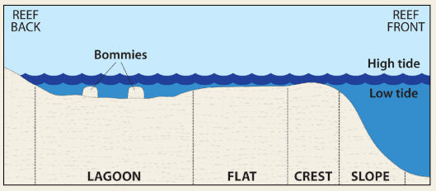
Habitat type.
Notes:
Add the colour of the zone/s that you snorkel

Slide 27
Filling out the form
Walk students through each line:
Circle if flood plume present

Slide 28
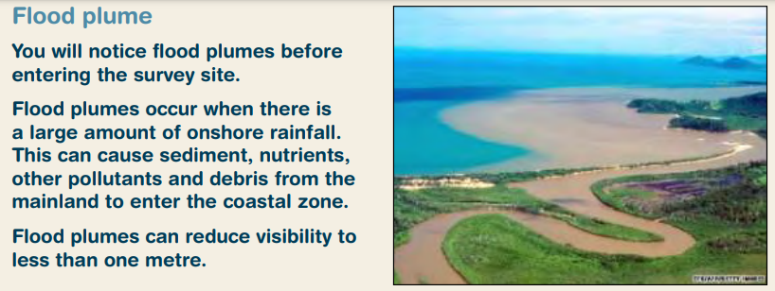
Flood plume. YES NO
Notes:
Add the colour of the zone/s that you snorkel

Slide 29
Filling out the form
Walk students through each line:
Circle if suspended algal bloom present

Slide 30
Suspended algal bloom. YES NO
Notes:
Add the colour of the zone/s that you snorkel

Slide 31
Filling out the form
Walk students through each line:
Circle tide at survey

Slide 32
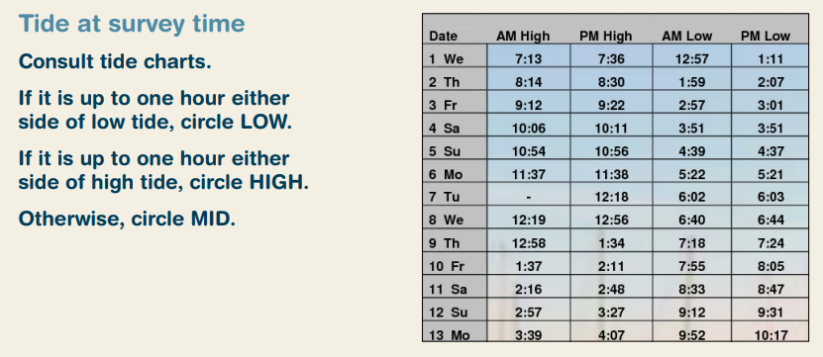
Tide at survey. LOW MID HIGH
Notes:
Add the colour of the zone/s that you snorkel

Slide 33
Filling out the form
Walk students through each line:
Circle visibility

Slide 34
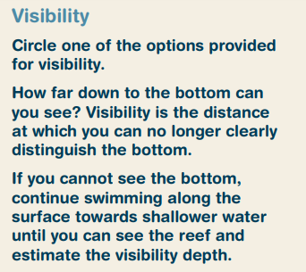
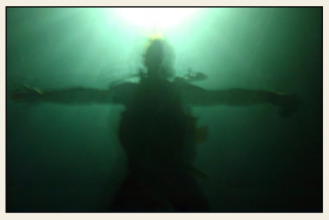
Visibility. <5m 5-10m >10m
Notes:
Add the colour of the zone/s that you snorkel

Slide 35
Filling out the form
At this point, check if students have the following circled:
Habitat type
Flood plume present
Suspended algal bloom present
Tide at survey
Visibility

Slide 36
Check point.
Your name
The date
Name of business
am/pm
Name of vessel
Name of school and grade
?
Name of reef
Name of site
Colour of zone
?
?

Slide 37
Filling out the form
Check if students are ready to proceed to the next section.

Slide 38
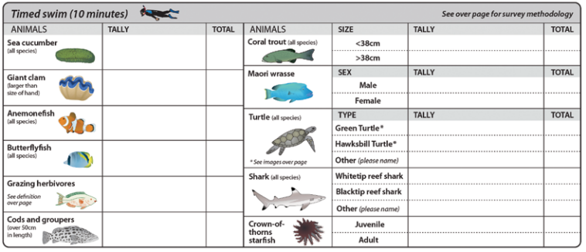
Are you ready to complete the next section?

Slide 39
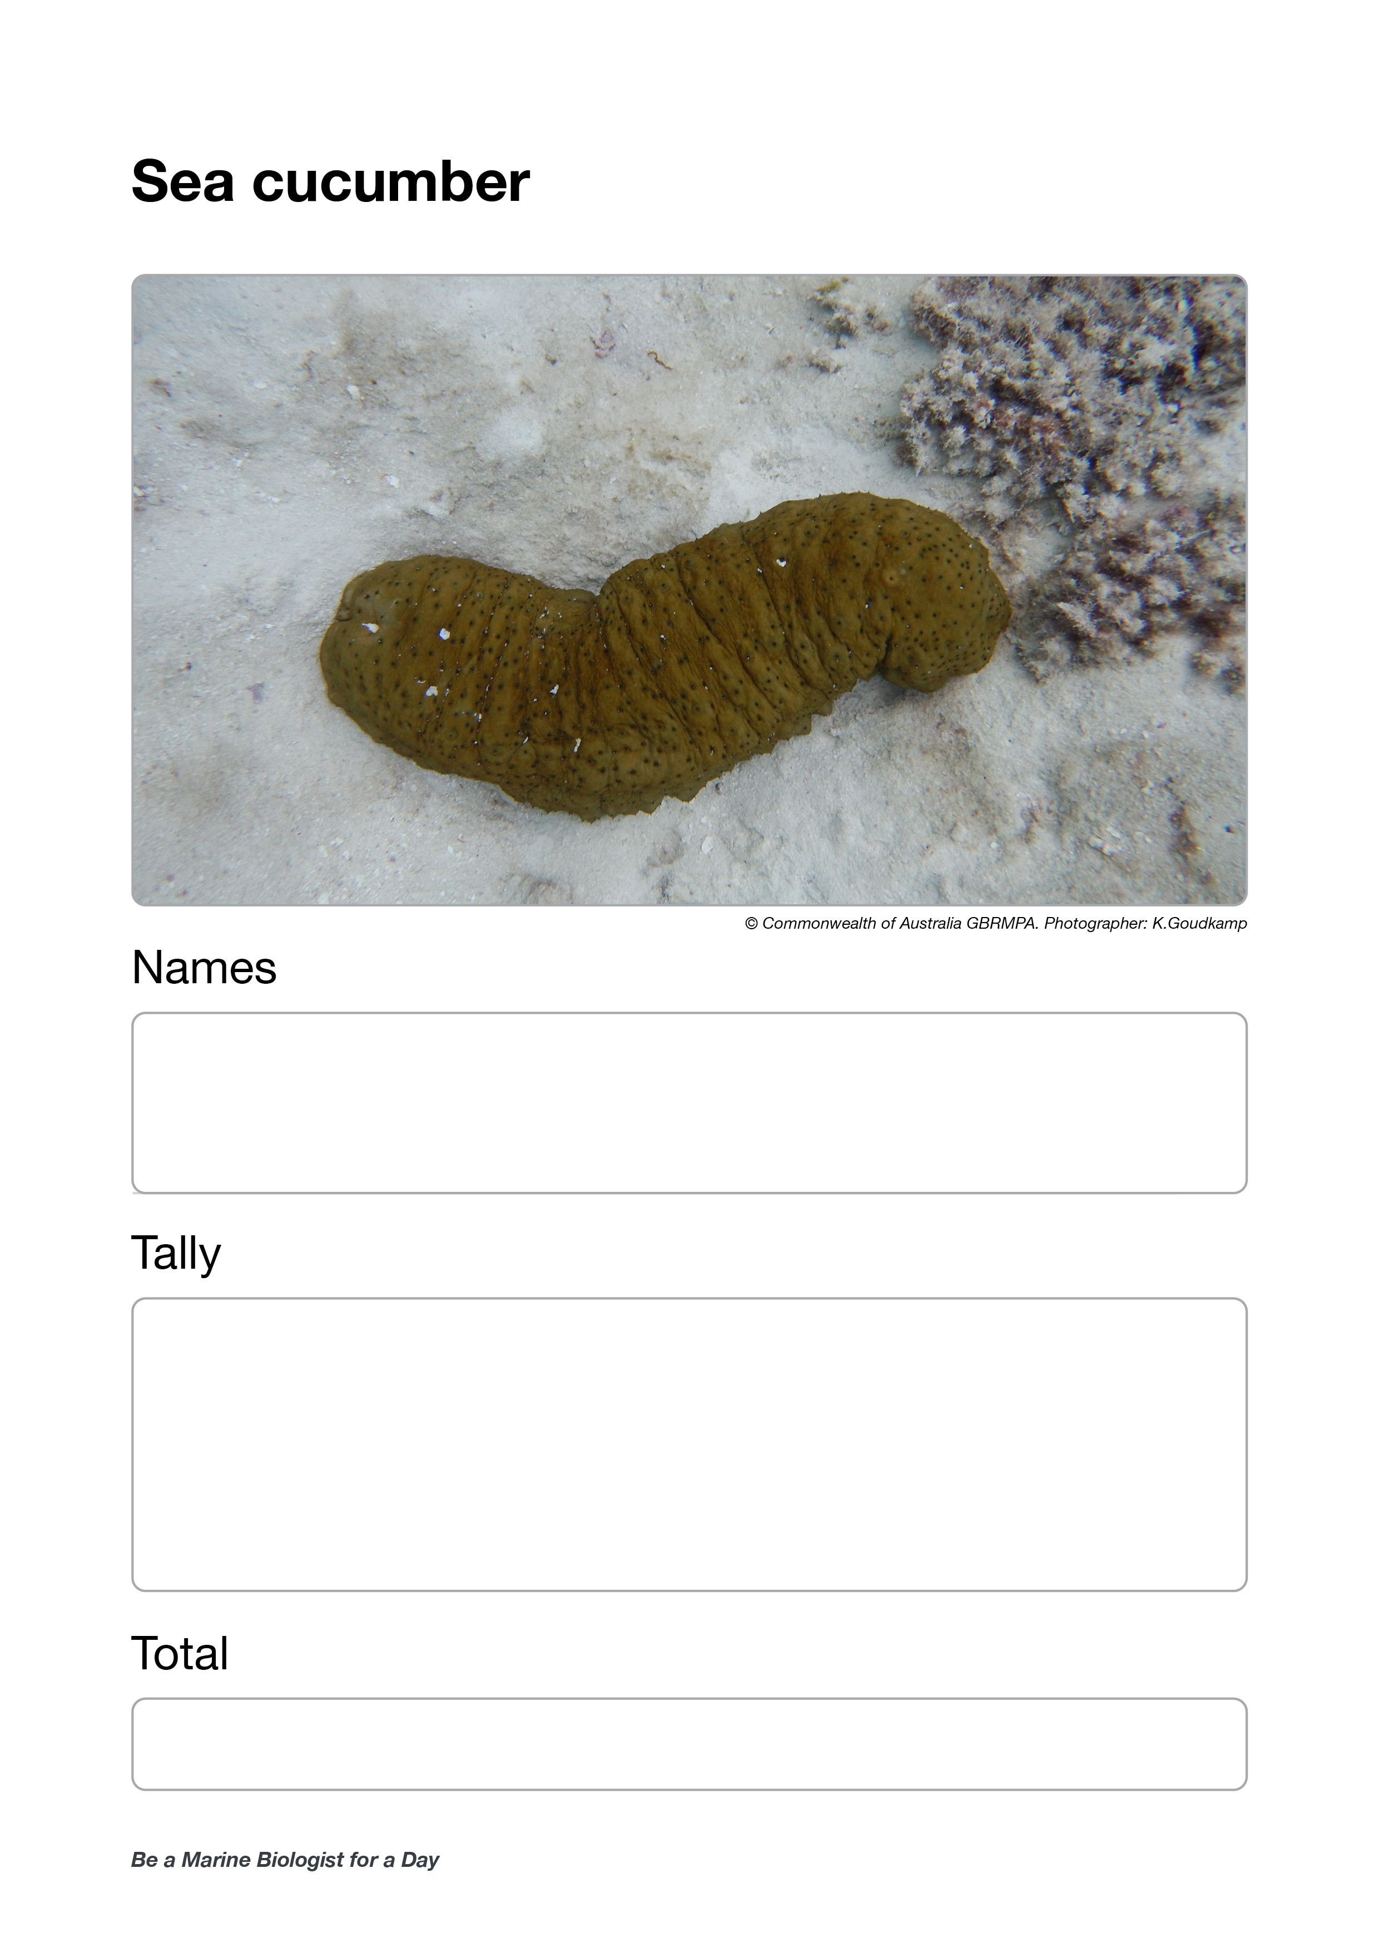
Ask for sea cucumber data (and collect results sheets).
Out loud, read the tally/average.
Note: students only learn to calculate average in year 8.
Wait for everybody to write it down (flip to next page).

Slide 40
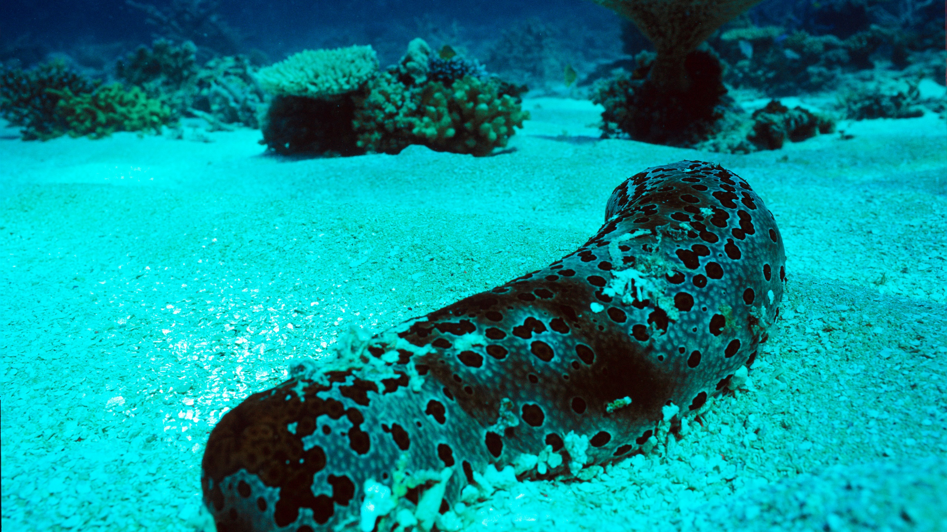
Sea cucumber
Notes:
Image: J. Oliver, Copyright Commonwealth of Australia (GBRMPA)

Slide 41
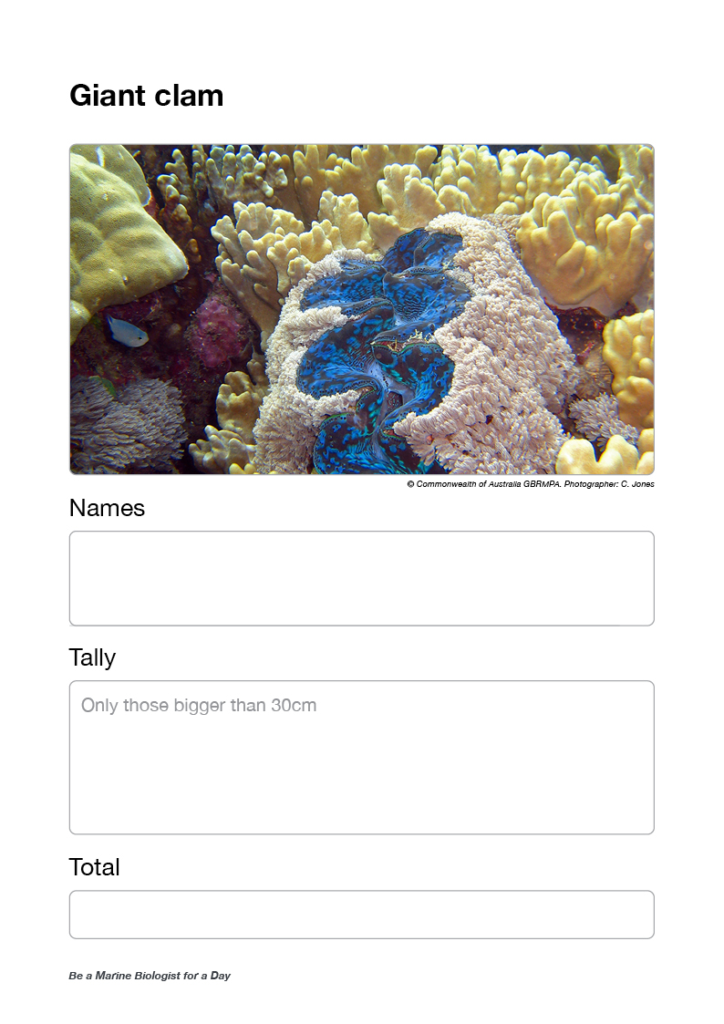
Ask for giant clam data (and collect results sheets).
Out loud, read the tally/average.
Questions:
Did anyone look for the eye spots on the clam’s mantle?
Did anyone see a clam try to close?
Did it close all the way?

Slide 42
Giant clam
VULNERABLE TO EXTINCTION
Notes:
Image: Copyright Commonwealth of Australia (GBRMPA)

Slide 43
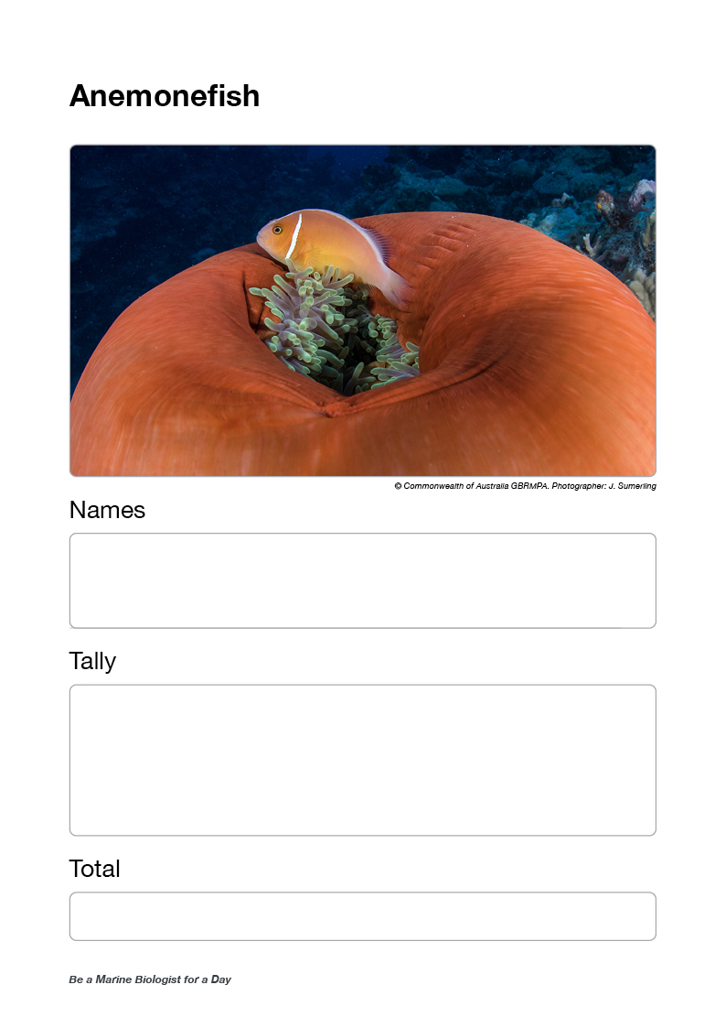
Ask for anemonefish data (and collect results sheets).
Out loud, read the tally/average.
Questions:
What did you see first, the anemone or the anemonefish?
Did you notice the fish were different sizes? Do you know why?
How many times did the anemonefish keep returning to their anemone?
Did you see any aggression from the anemonefish?
Did anyone check to see if there were any eggs close to the anemone?
Were there any other animals living in the anemone?

Slide 44
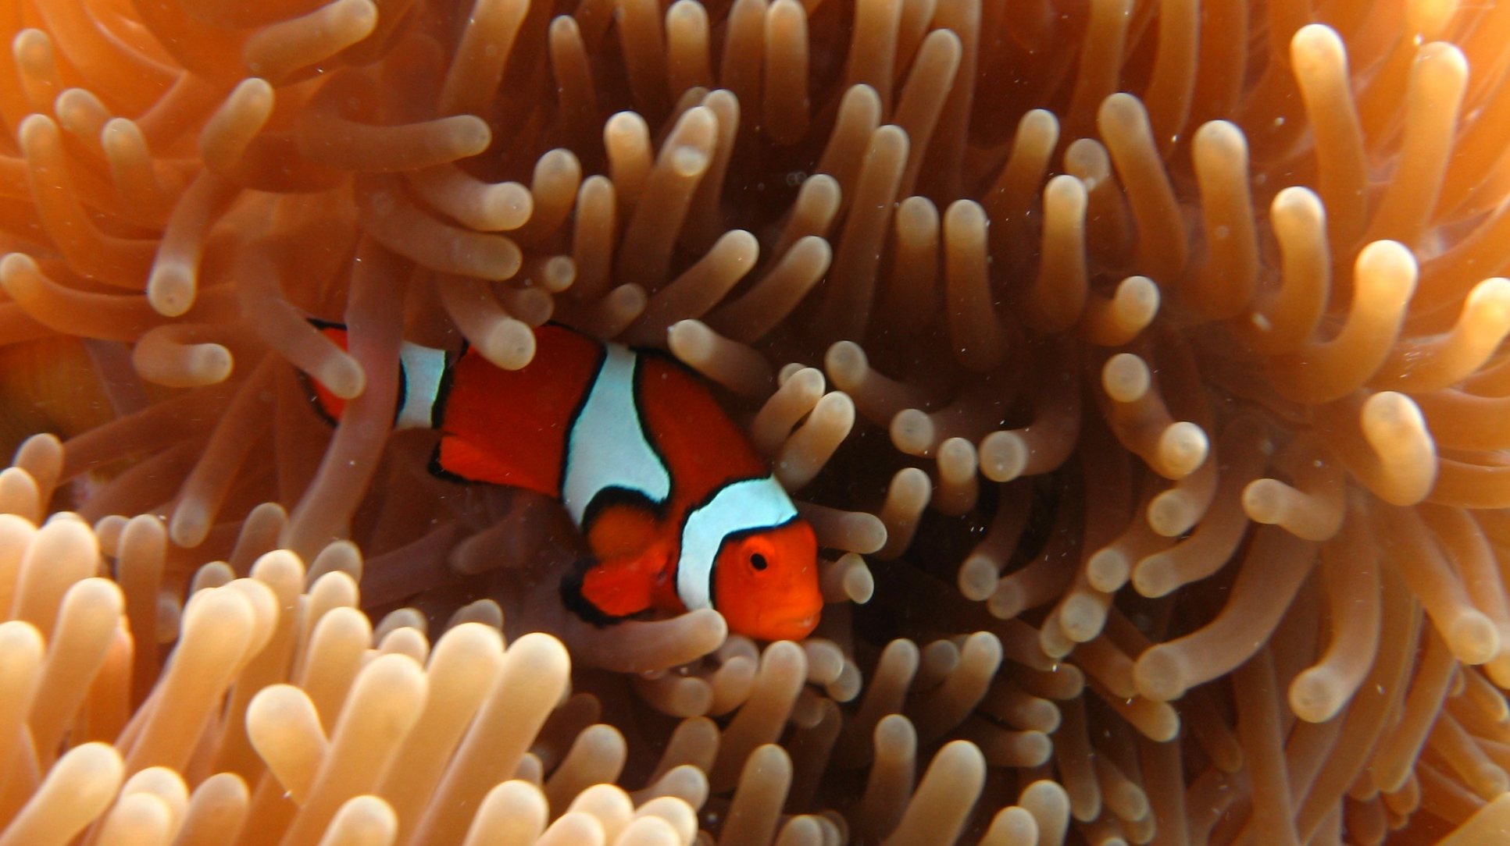
Anemonefish
Notes:
Image: E. Smart, Copyright Commonwealth of Australia (GBRMPA)

Slide 45
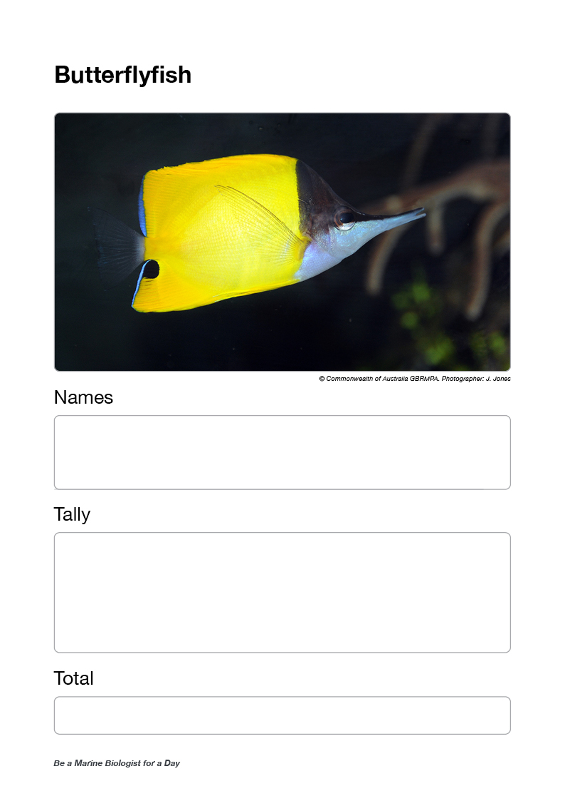
Ask for butterflyfish data (and collect results sheets).
Out loud, read the tally/average.
Questions:
Did anyone hear the sounds of the reef?
Has anyone figured out why they are so bright and pretty?
Did anyone see what they were eating?
Did you notice any in pairs?

Slide 46
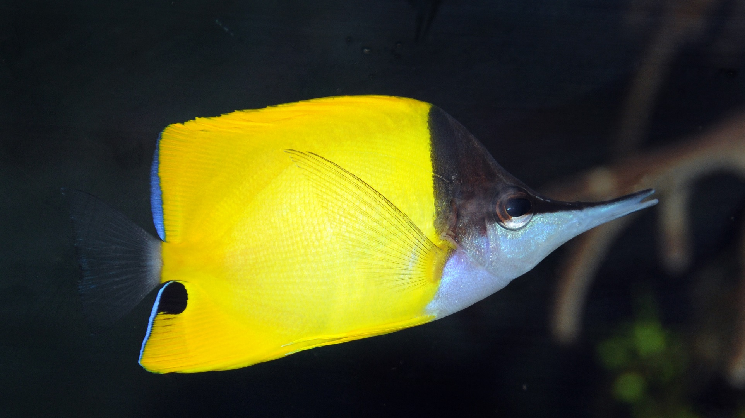
Butterflyfish
Notes:
Image: J. Jones, Copyright Commonwealth of Australia (GBRMPA)

Slide 47
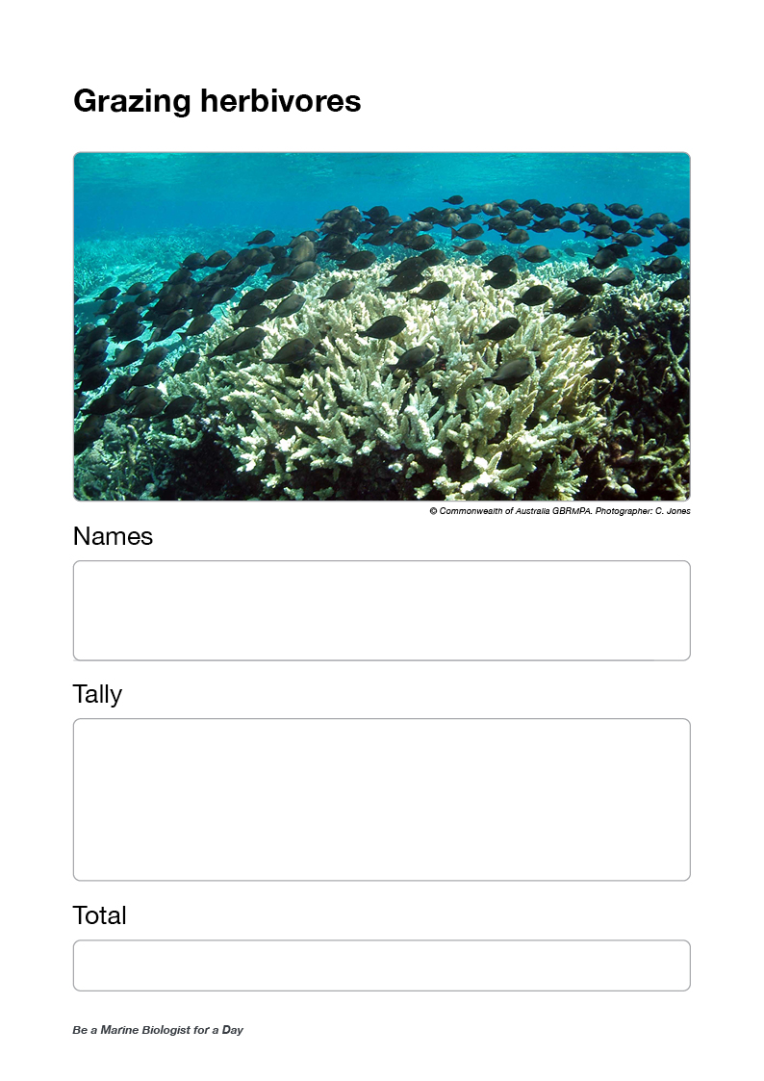
Ask for grazing herbivore data (and collect results sheets).
Out loud, read the tally/average.
Questions:
Did anyone see a grazing herbivore poop?
Could anyone hear it eating?
Did anyone pay attention to what it was eating?

Slide 48
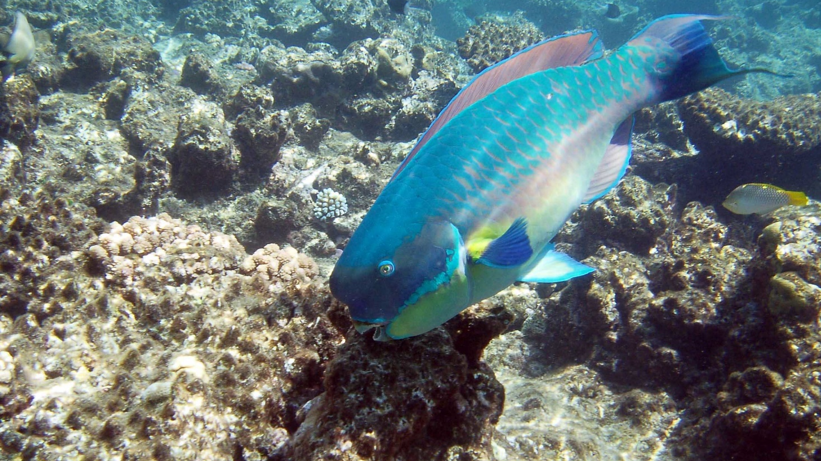
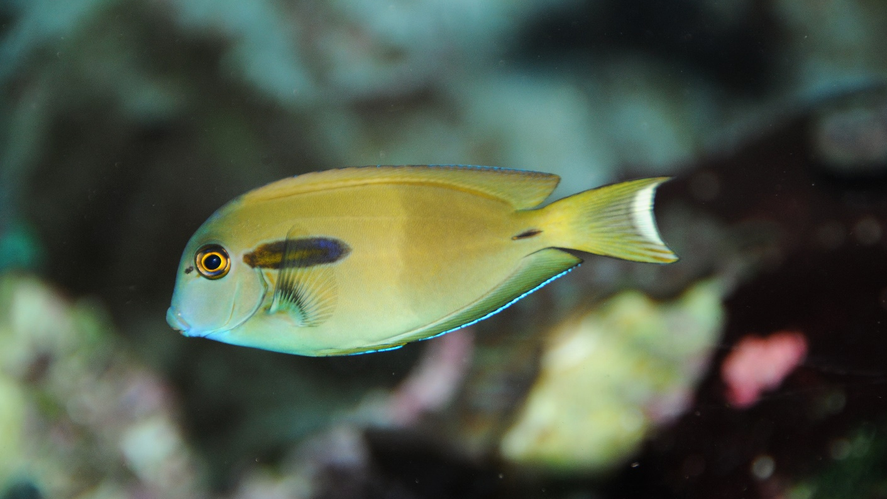
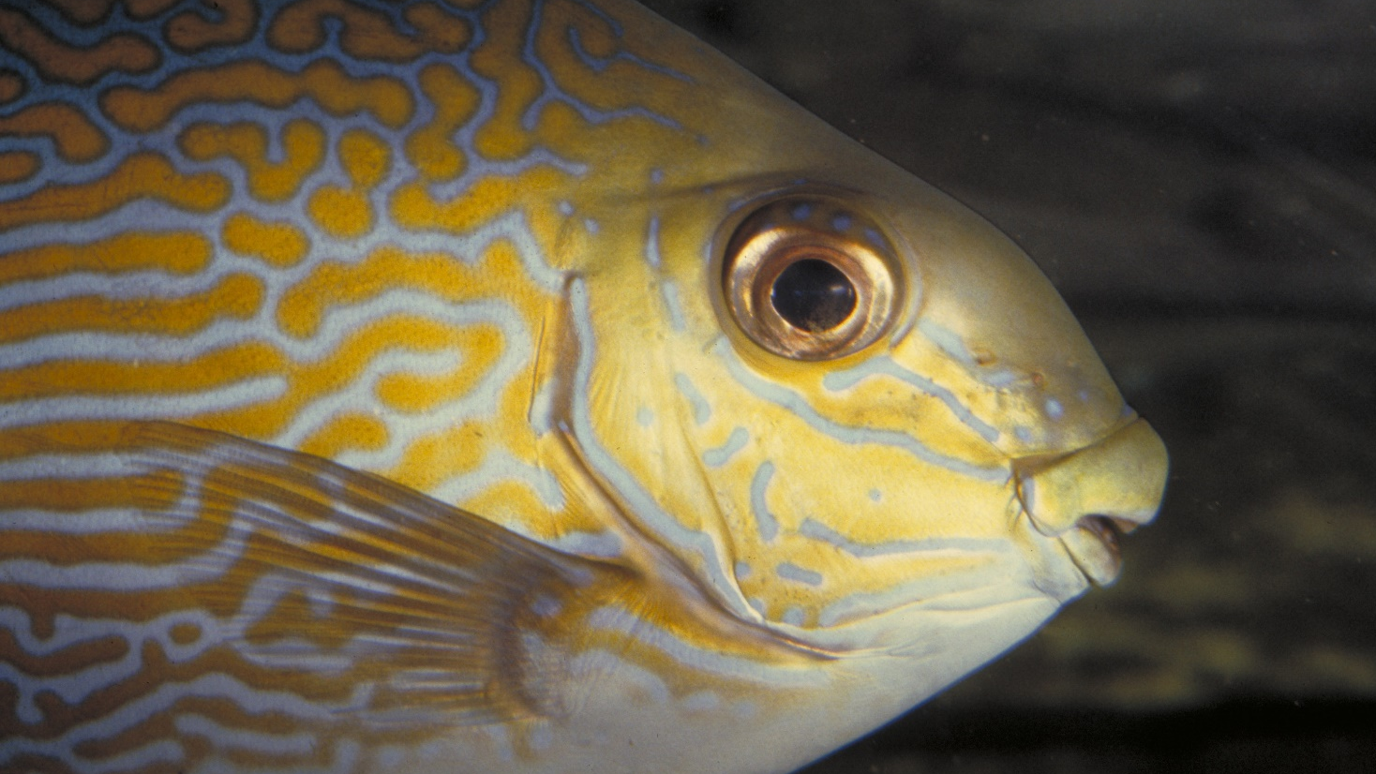
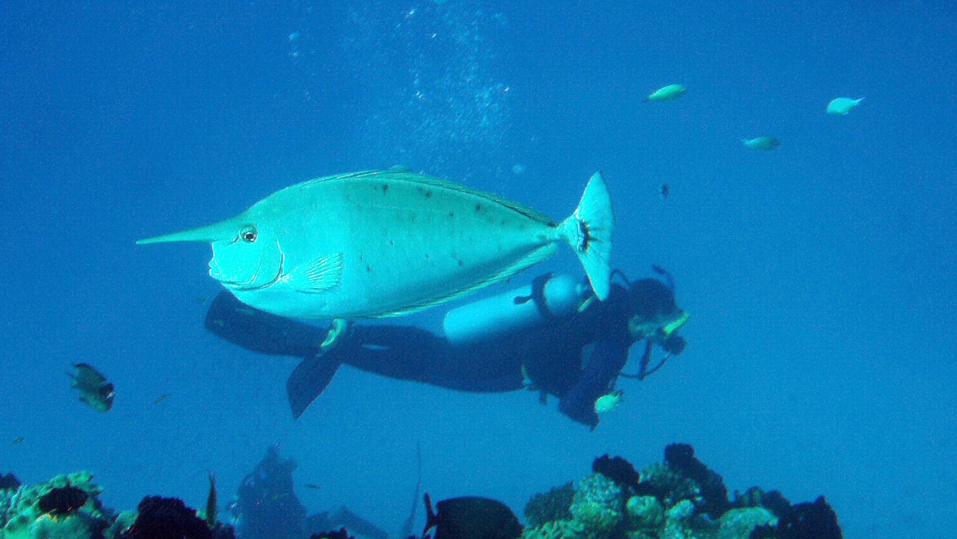
Grazing herbivores
Parrotfish
Surgeonfish
Rabbitfish
Unicornfish
Notes:
Images: (Top Left) C. Jones, Copyright Commonwealth of Australia (GBRMPA); (Top Right) J. Jones, Copyright Commonwealth of Australia (GBRMPA); (Bottom Left) L. Zell, Copyright Commonwealth of Australia (GBRMPA); (Bottom Right) A. Smith, Copyright Commonwealth of Australia (GBRMPA)

Slide 49
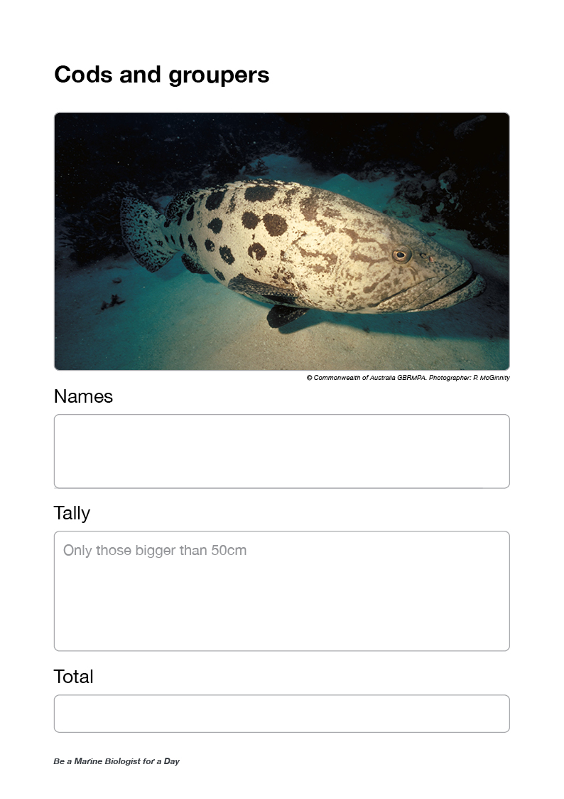
Ask for cods and groupers data (and collect results sheets).
Out loud, read the tally/average.
Questions:
Did anyone see a cod or grouper eat something?
How big was it?
Did anyone see it getting cleaned?

Slide 50
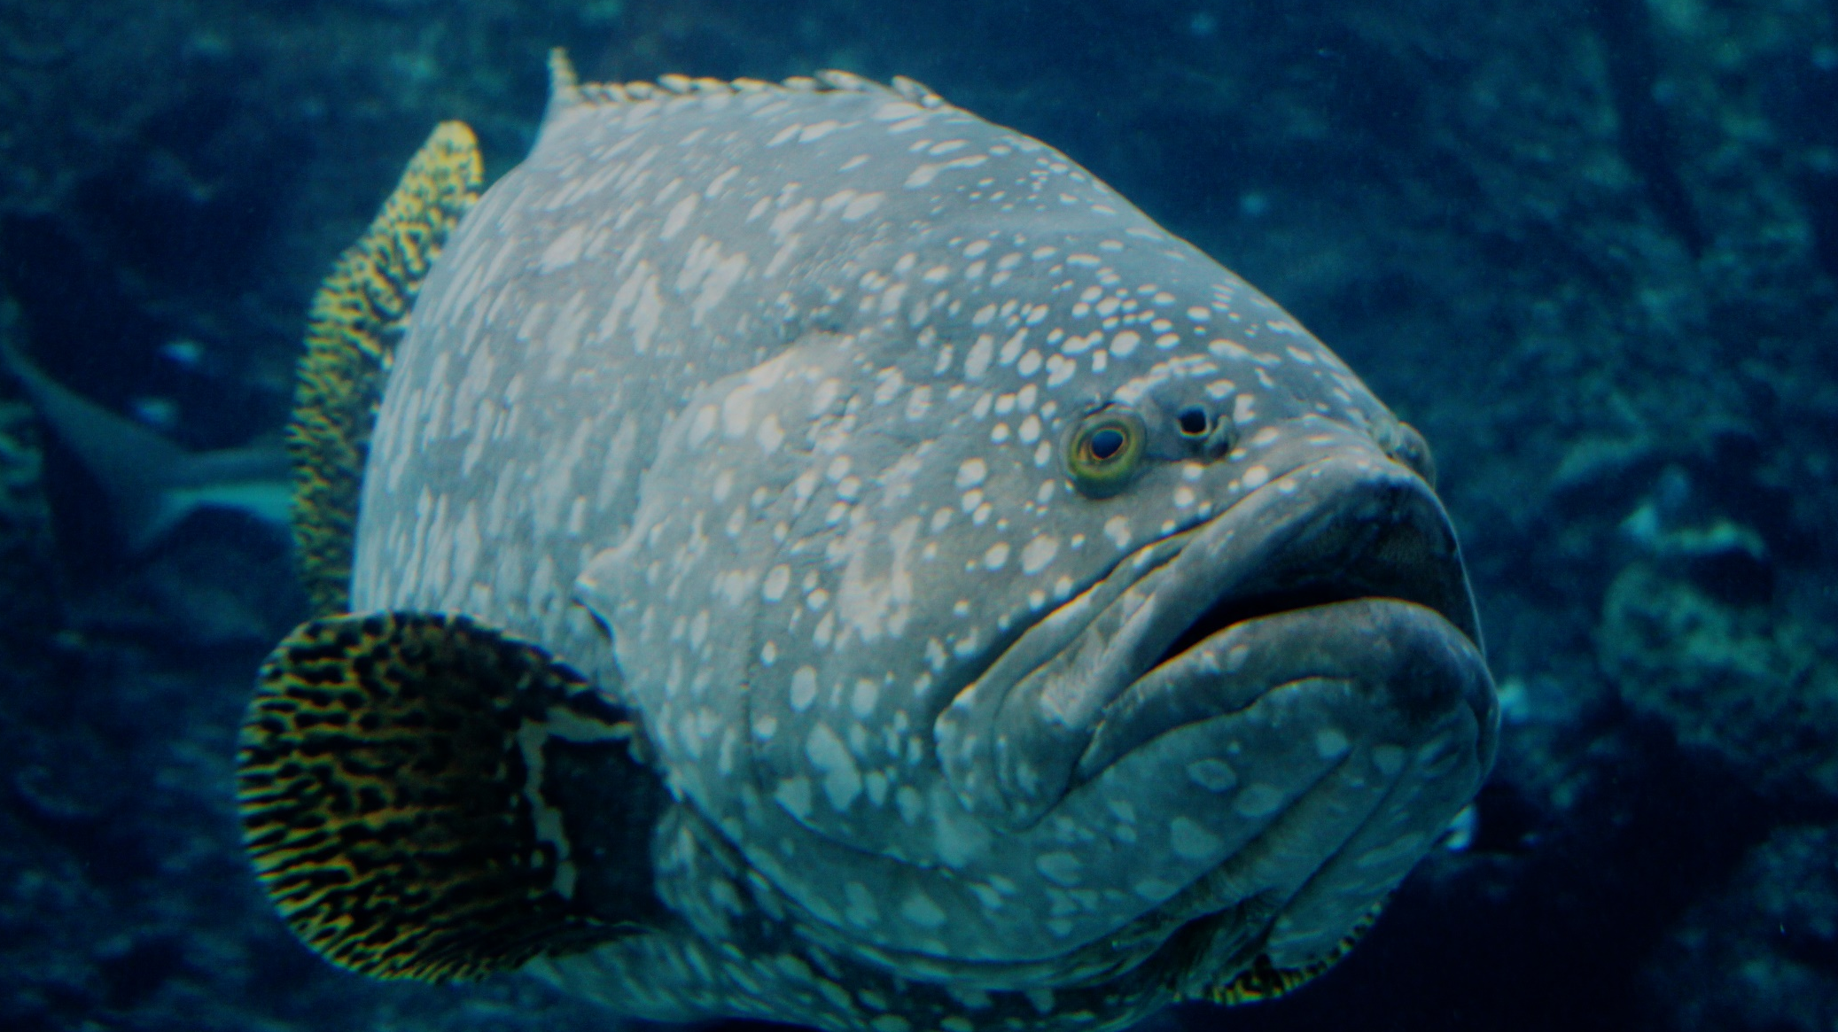
Cods and groupers >50cm
Notes:
Image: J. Hurford, Copyright Commonwealth of Australia (GBRMPA)

Slide 51
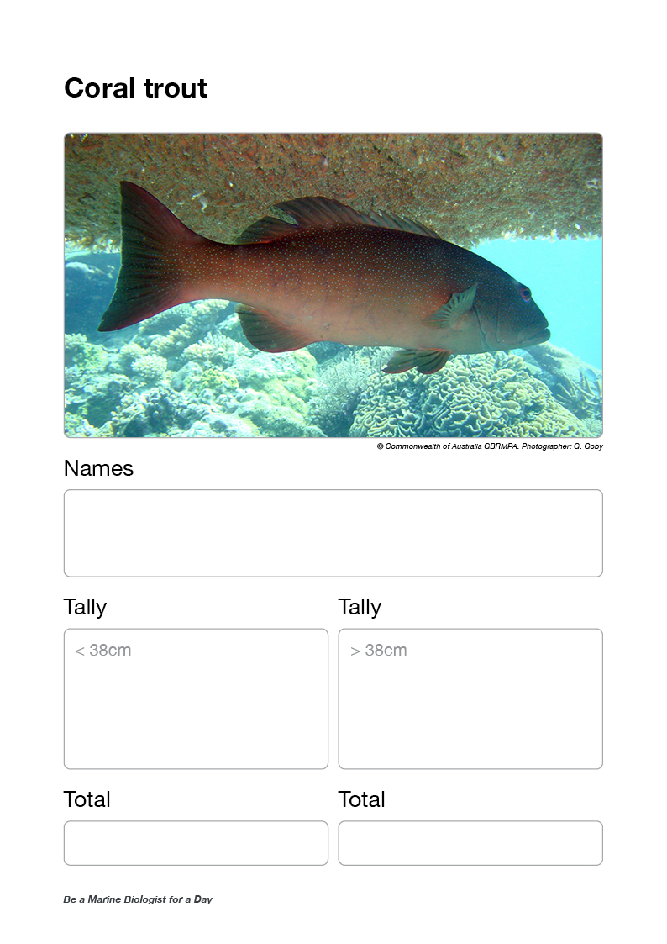
Ask for coral trout data <38cm.
Out loud, read the tally/average.
Ask for coral trout data >38cm.
Out loud, read the tally/average.
Questions:
Did anyone see a really big coral trout?
Do you think it might have been a male or female?

Slide 52
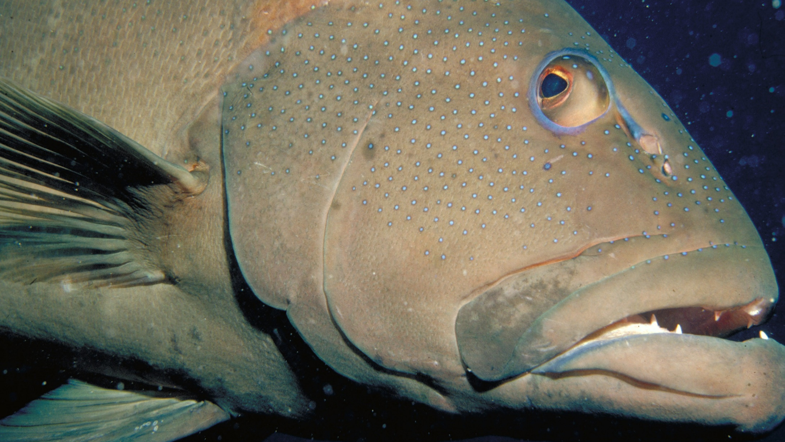
Coral trout
<38cm / >38cm
Notes:
Image: S. Summerhays, Copyright Commonwealth of Australia (GBRMPA)

Slide 53
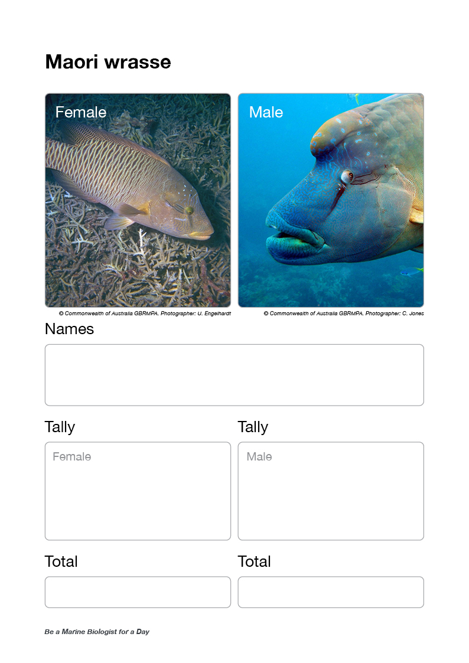
Ask for Maori wrasse data [female], ask for Maori wrasse data [male] (and collect results sheets).
Out loud, read the tally/average.
Questions:
If they saw one, ask, where was it?
Did it move very far?
How big was the hump?
Did it get very close?
Why was it important not to touch it?

Slide 54
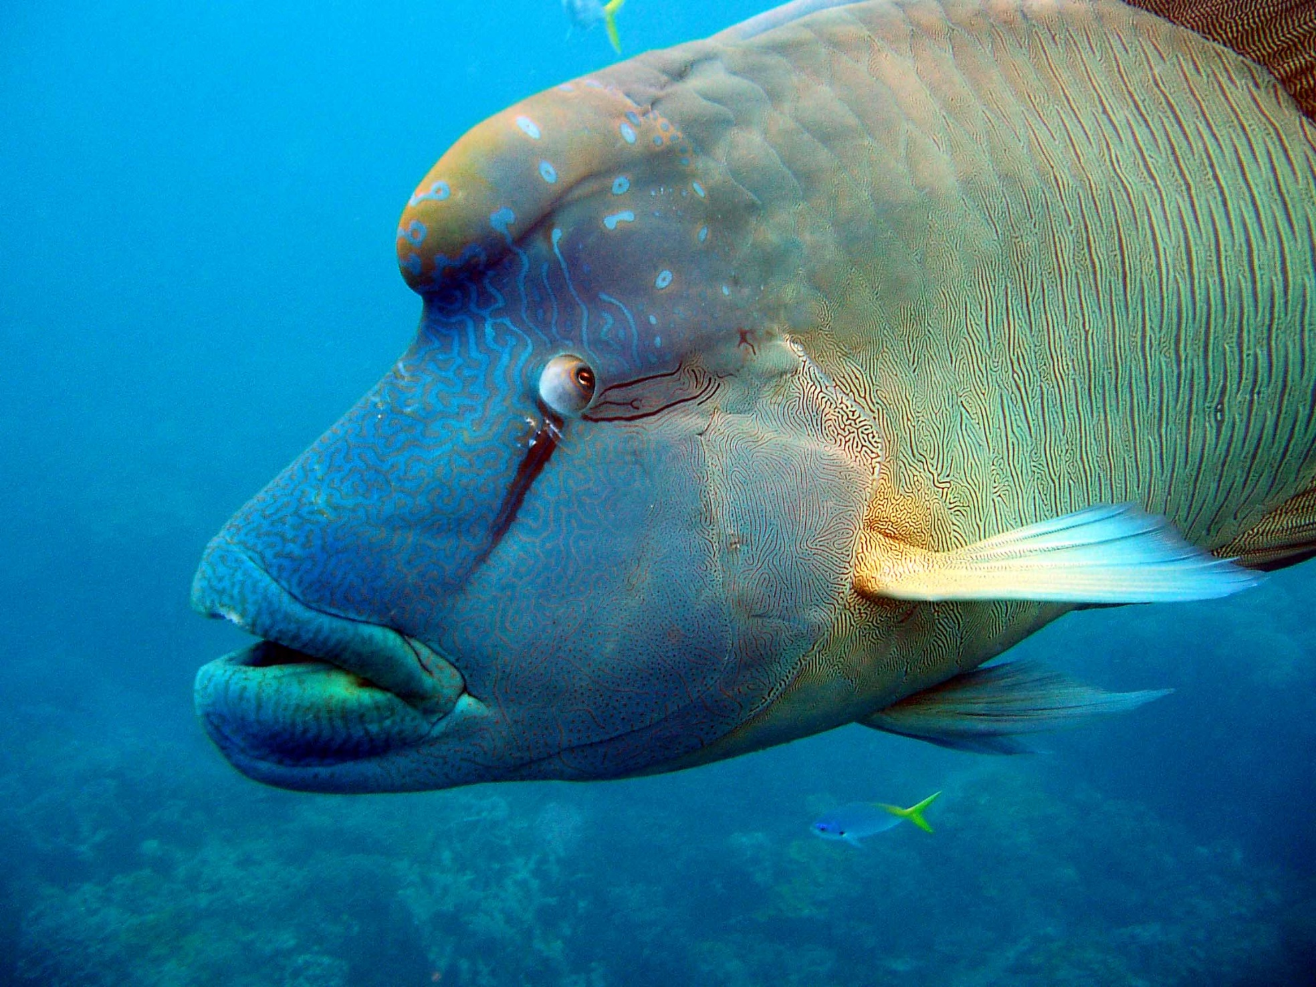
Maori wrasse Female / Male
Notes:
Image: C. Jones, Copyright Commonwealth of Australia (GBRMPA)

Slide 55
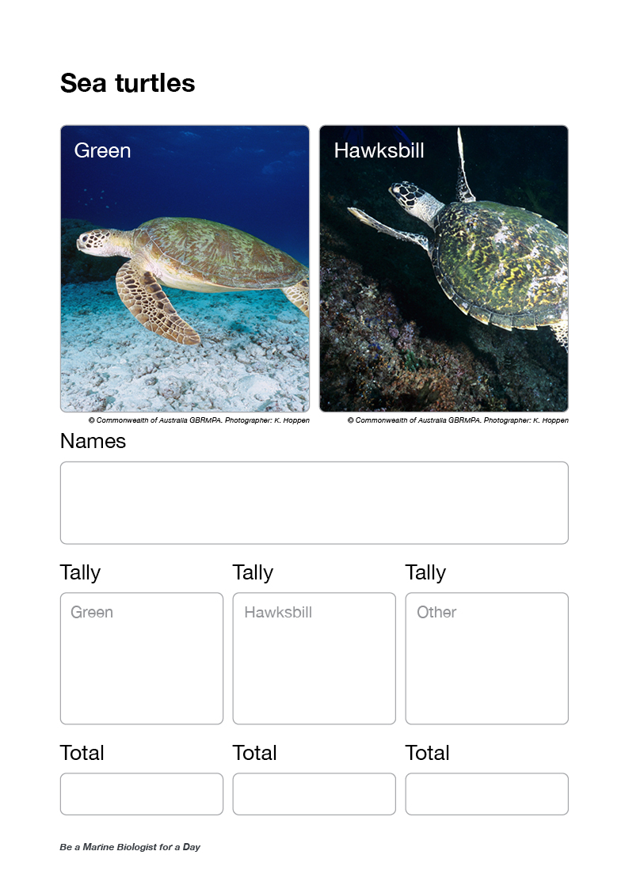
Ask for turtle data [green turtle], ask for turtle data [hawksbill turtle], ask for turtle data [other] (and collect results sheets).
Out loud, read the tally/average.
Questions:
Did anyone see a tag on its flipper?
How long do you think it can hold its breath for?
Were there any other animals cruising around with it?
Were there any barnacles on its shell (carapace)?
How big was it? How old do you think it might be?

Slide 56
Sea turtles
Green / Hawksbill / other
Green turtle
Hawksbill turtle
Loggerhead turtle
Notes:
Image: (Left) K. Hoppen, Copyright Commonwealth of Australia (GBRMPA); (Middle) K. Hoppen, Copyright Commonwealth of Australia (GBRMPA); (Right) M. Simmons, Copyright Commonwealth of Australia (GBRMPA)

Slide 57
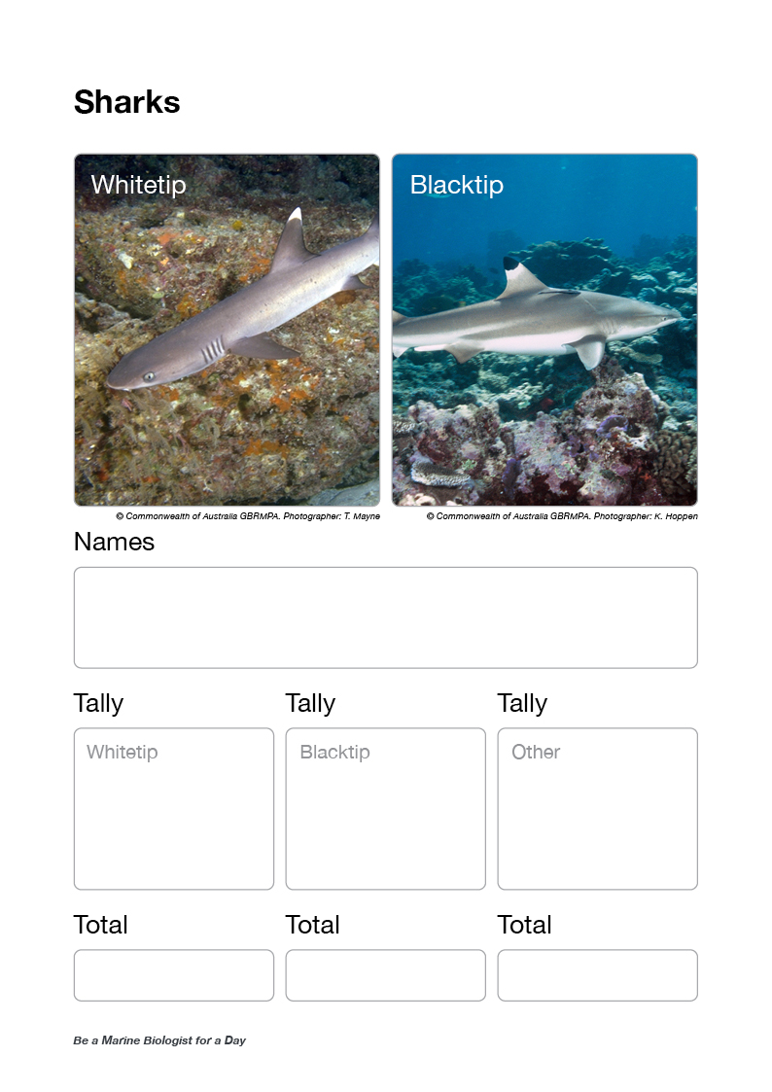
Ask for shark data [whitetip reef shark], ask for shark data [blacktip reef shark], ask for shark data [other] (and collect results sheets).
Out loud, read the tally/average.
Questions:
Could you see if it was a male or female?
Was it swimming, or sitting on the bottom?
Could you see it breathing?
Were you scared?
Has your opinion of sharks changed?

Slide 58
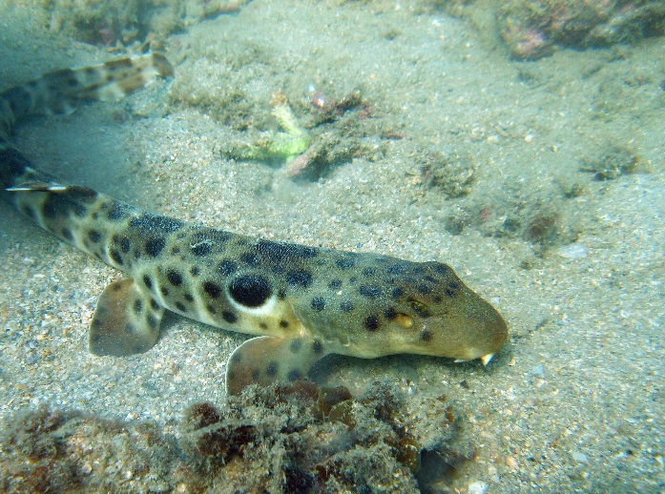
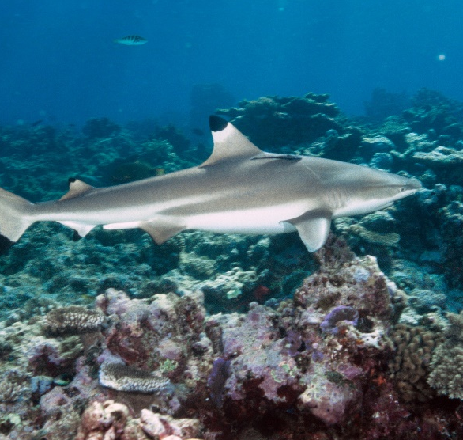
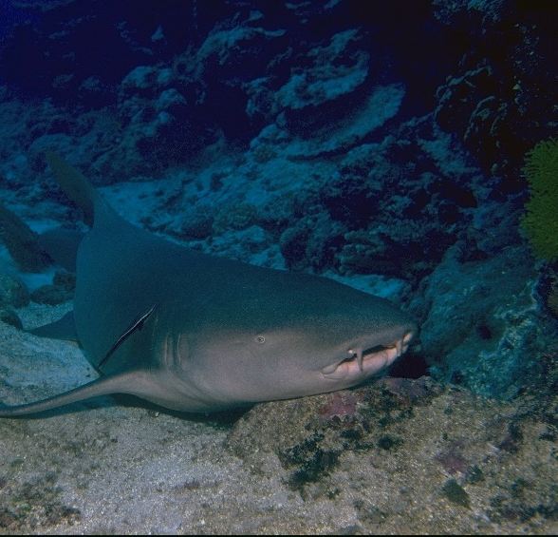
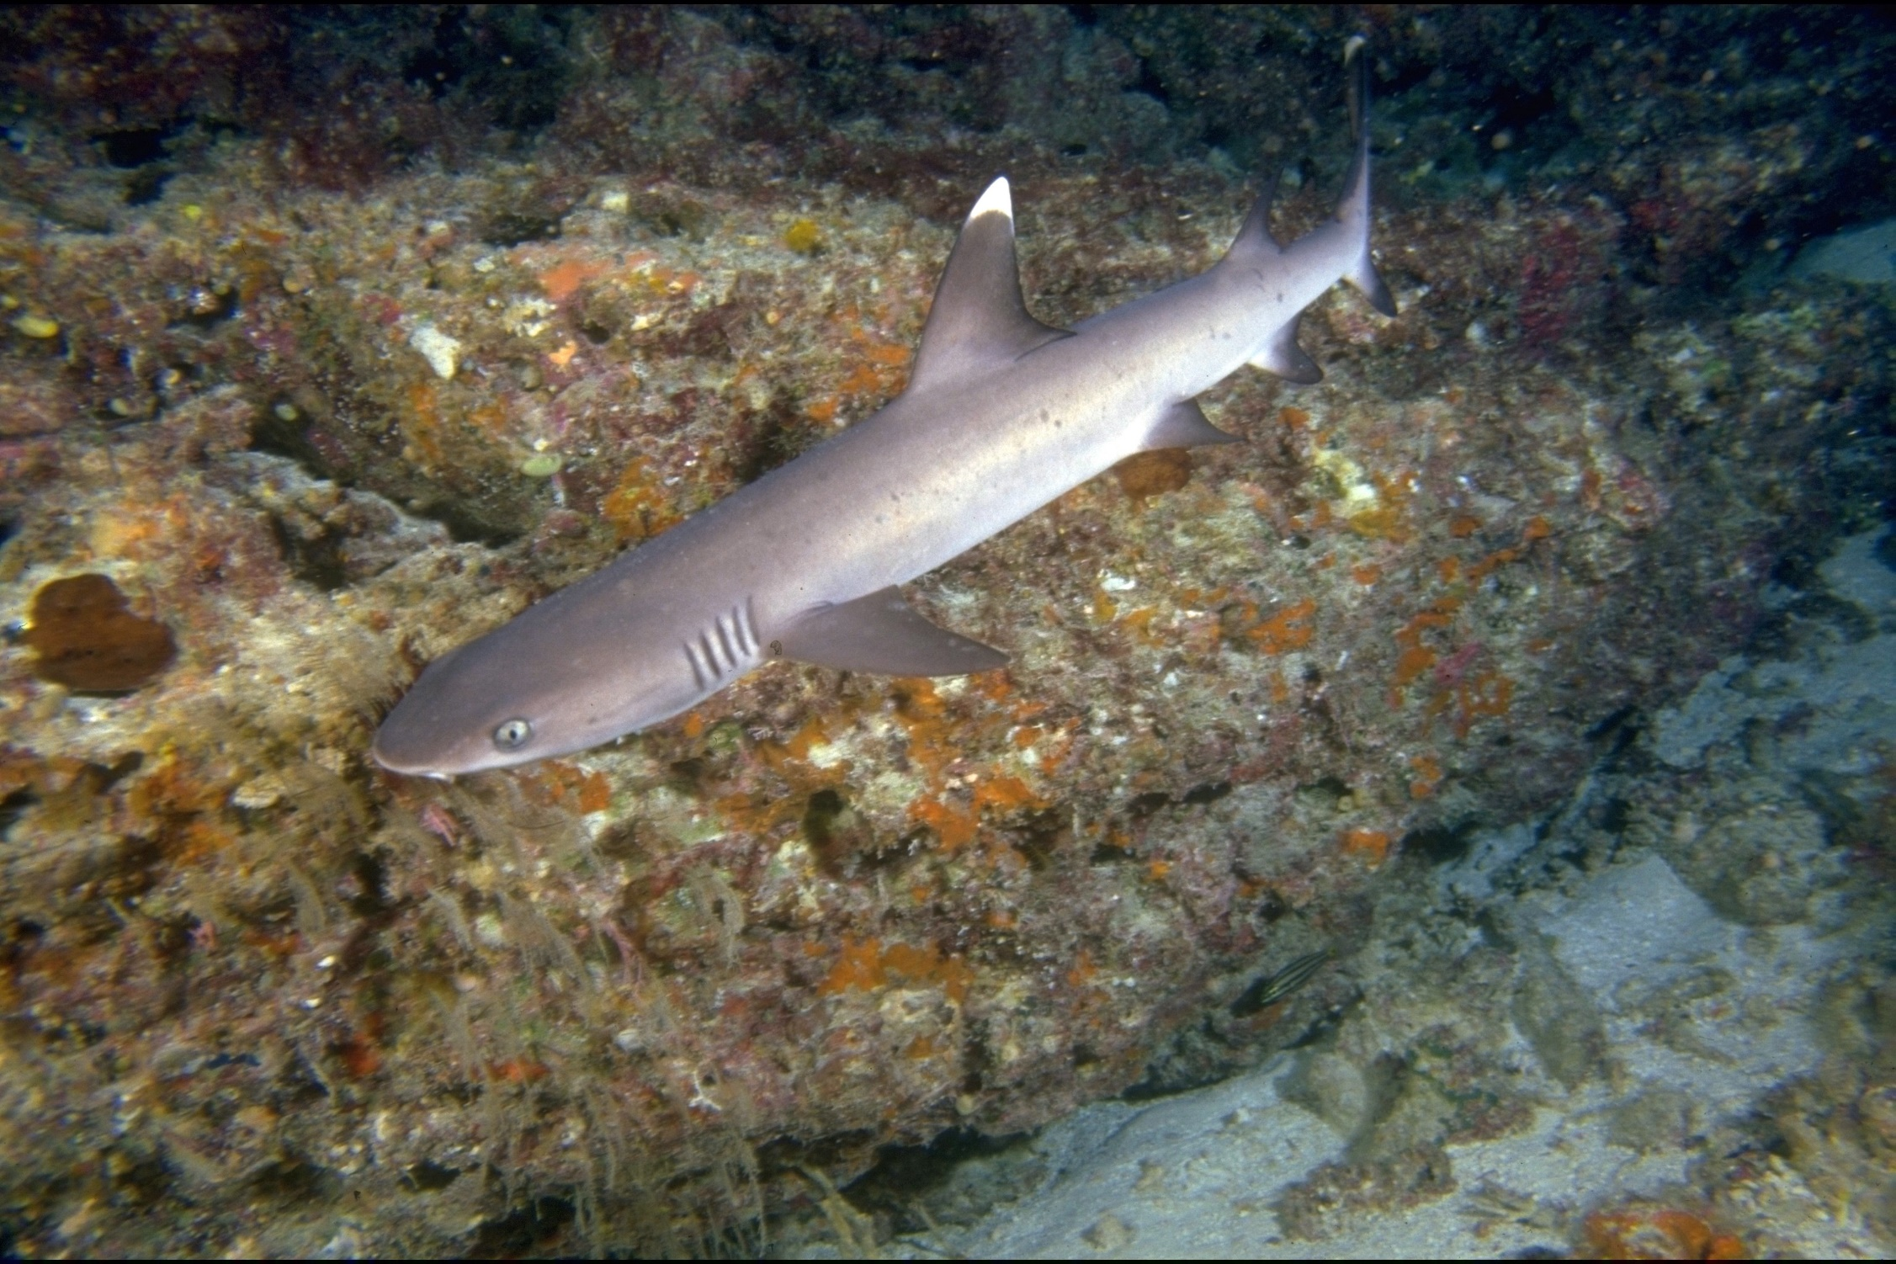
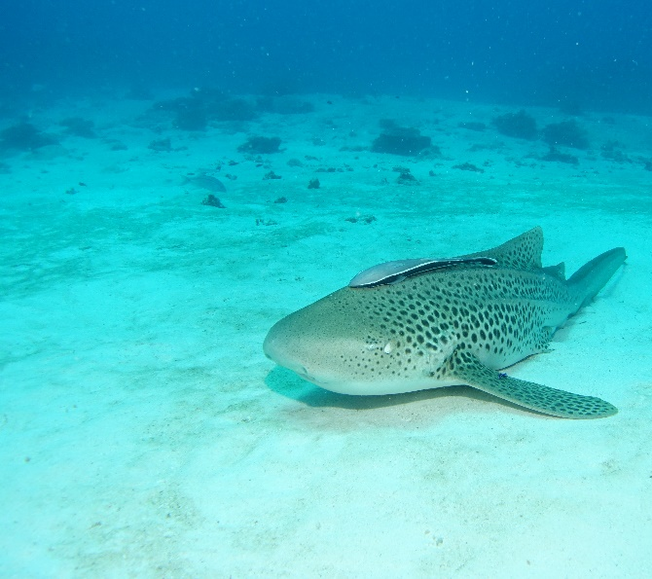
Sharks
Whitetip / Blacktip / other
Epaulette
Blacktip
Tawny nurse
Whitetip
Wobbegong
Leopard
Notes:
Images: (Top Left) C. Jones, Copyright Commonwealth of Australia (GBRMPA); (Bottom Left) T. Mayne, Copyright Commonwealth of Australia (GBRMPA); (Top Middle) K. Hoppen, Copyright Commonwealth of Australia (GBRMPA); (Bottom Middle) C. Jones, Copyright Commonwealth of Australia (GBRMPA); (Top Right) R. Berklemans, Copyright Commonwealth of Australia (GBRMPA); (Bottom Right) C. Jones, Copyright Commonwealth of Australia (GBRMPA)

Slide 59
Ask if anyone saw any COTS [juvenile]? Ask if anyone saw any COTS [adult]?
Out loud, read the tally/average.
Questions:
Was it somewhere out and about and easy to see?
Could you recognise where it had been feeding?

Slide 60
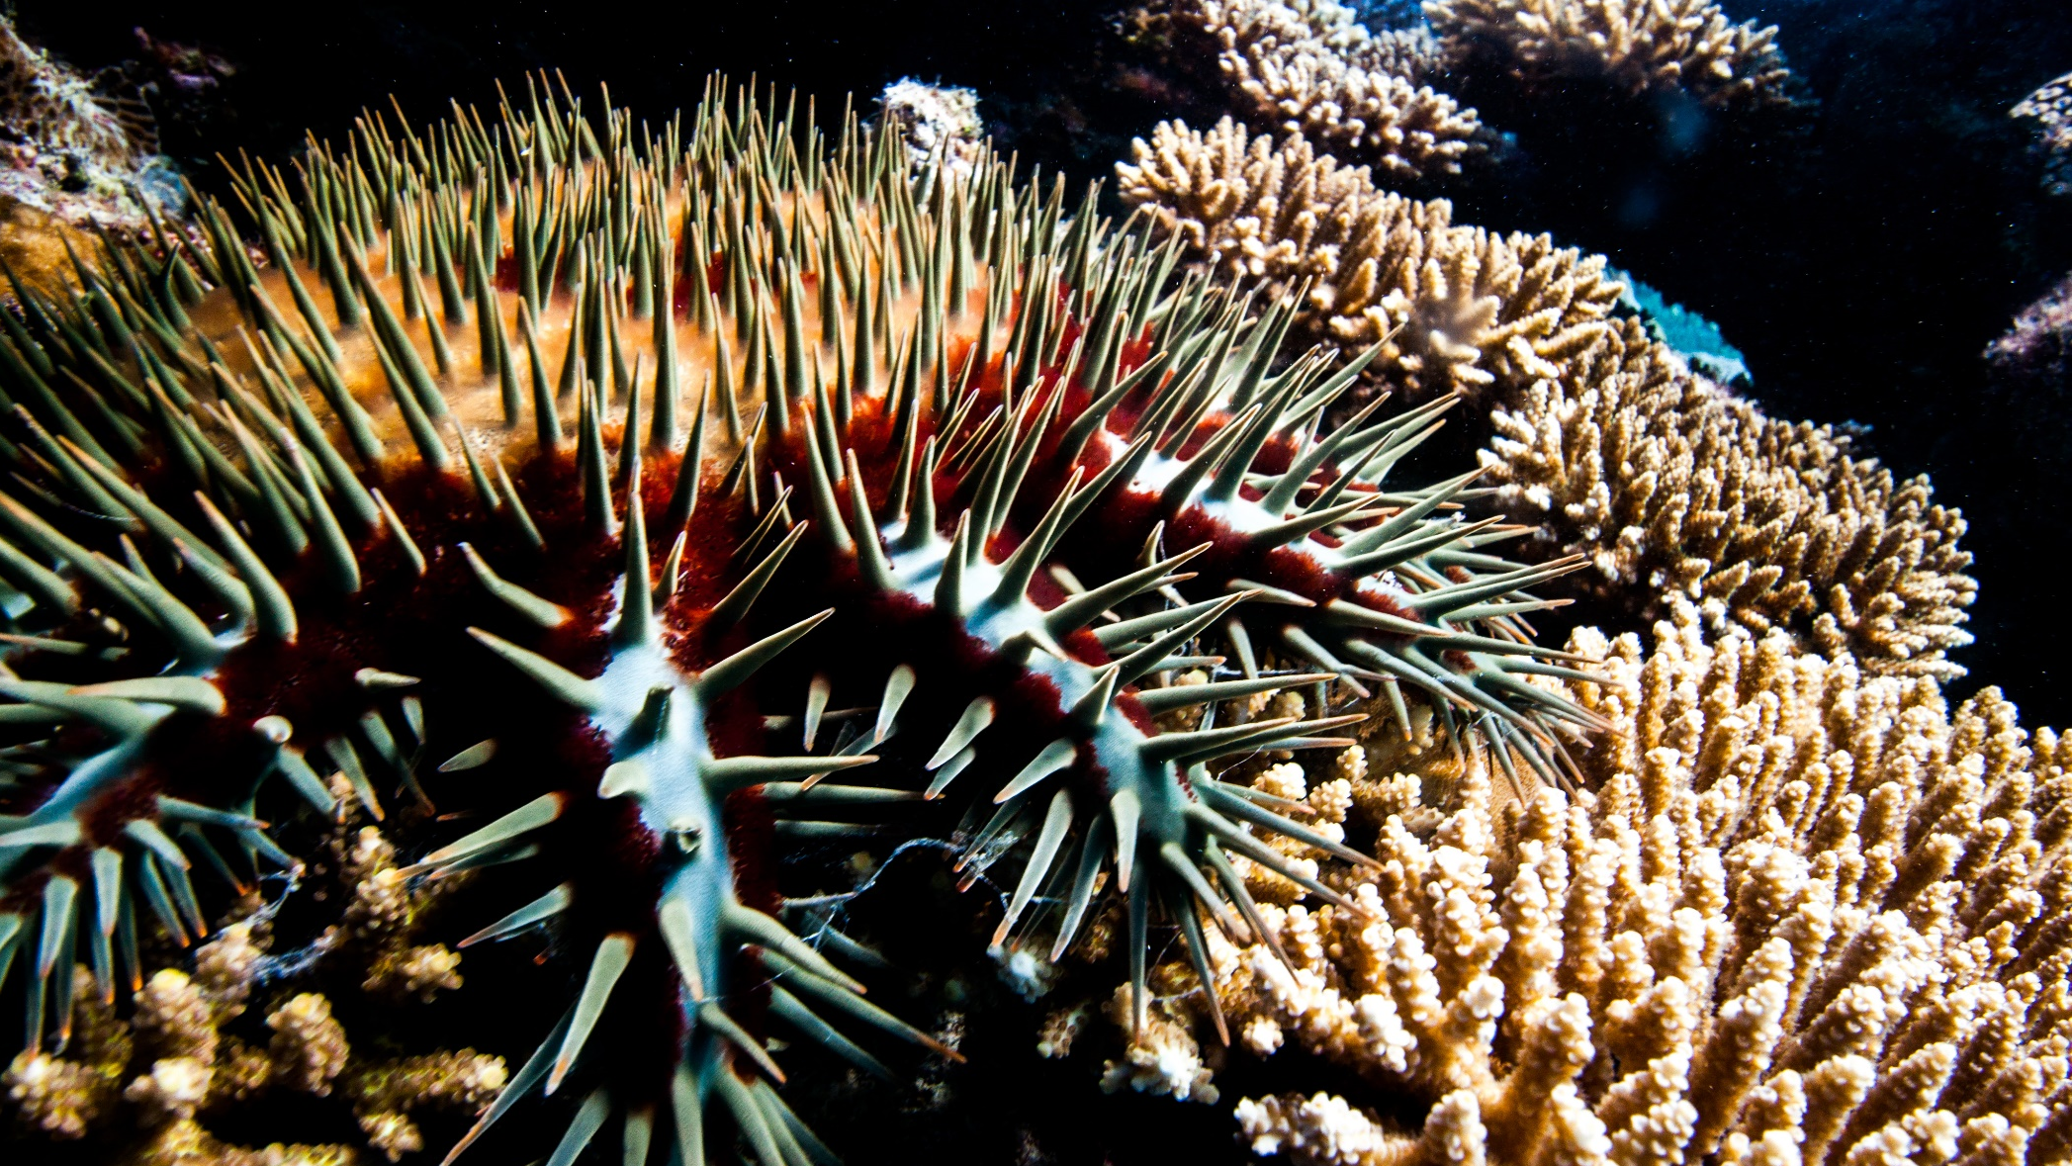
Crown-of-Thorns Starfish (COTS)
Juvenile / Adult
Notes:
Image: J. Hurford, Copyright Commonwealth of Australia (GBRMPA)

Slide 61
Filling out the form
Check if all fields covered have been filled.

Slide 62
Check point.

Slide 63
Ask why it is important to count these animals?
Questions:
What do sea cucumbers and grazing herbivores like to eat? [pause for answer]; What do you think would happen if they were all gone?
What do cods and groupers, coral trout and sharks eat? [pause for answer]; What do you think would happen if they were all gone?
What do Maori wrasse eat? [pause for answer]; What do you think would happen if they were all gone?
What do butterflyfish eat? [pause for answer]; If there are a lot of butterflyfish, that means there is a lot of?
Who really wanted to see an anemonefish or a turtle today? [pause]; Do you think people from all over the world want to see them too?
What would happen to all these animals if the coral reef wasn’t here?

Slide 64
Why is it important to count these animals?

Slide 65
Next step? Back at school, you will login with your teacher and tell GBRMPA how many you counted!
Schools are shown how to register to Eye on the Reef (Rapid Monitoring and Sightings) pre-excursion (Part 1) and how to login and upload their data post excursion (Part 3).
Confirm the teacher has registered.

Slide 66
What can I do now?

Slide 67
What can I do now?
You can download the Eye on the Reef app on your smart device to record what you saw today.

Slide 68
Download the Eye on the Reef app
to record what you saw today!
Notes:
App image: https://www.gbrmpa.gov.au/__data/assets/pdf_file/0020/265430/Eye-on-the-Reef-app-poster.pdf

Slide 69
What can I do now?
You can record any animal you saw on your trip today.

Slide 70
This is what you can record on the app.

Slide 71
What can I do now?
This is the home screen of the Eye on the Reef app.
To create a sighting, ‘click’ on Sightings.

Slide 72
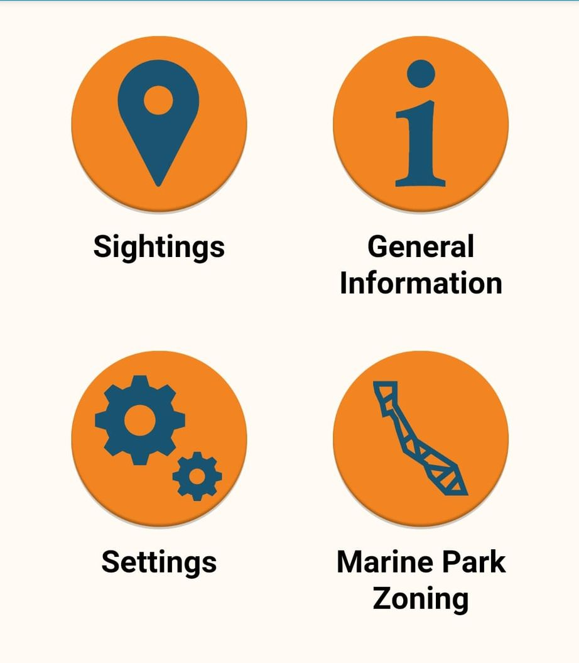

Slide 73
What can I do now?
‘Click’ on Wildlife

Slide 75
What can I do now?
You can pick the type of animals you saw today.

Slide 76
Marine mammals.

Slide 77
What can I do now?
You can pick the type of animals you saw today.

Slide 78
Marine reptiles.

Slide 79
What can I do now?
You can pick the type of animals you saw today.

Slide 80
Sharks and rays.

Slide 81
What can I do now?
You can pick the type of animals you saw today.

Slide 82
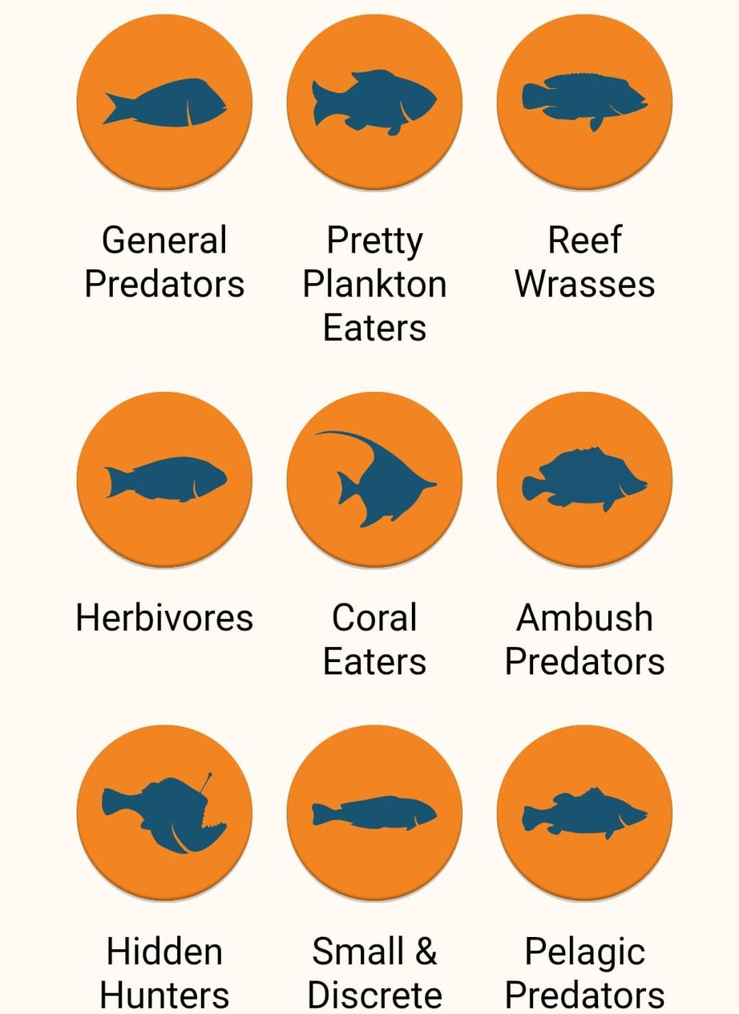
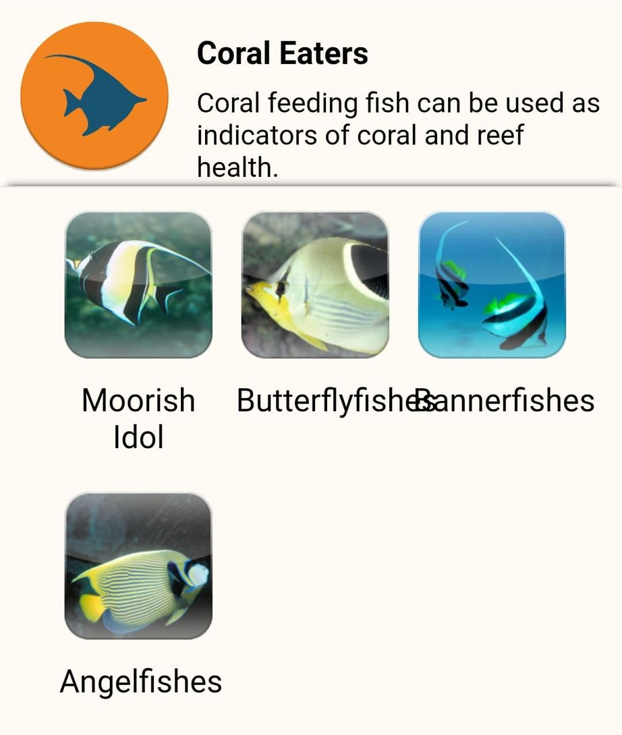
Fishes.

Slide 83
What can I do now?
As you can see, there are many different fish on the Reef. How many did you see?

Slide 84
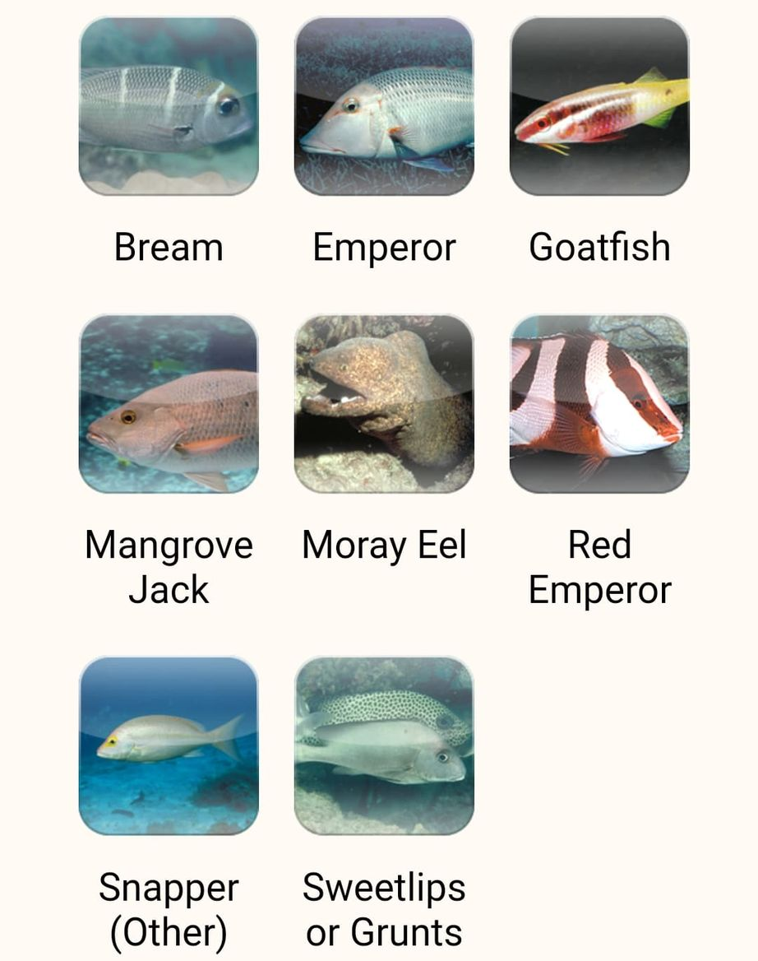

Slide 85
What can I do now?
You can pick the type of animals you saw today.

Slide 86
Birds.

Slide 87
What can I do now?
You can pick the type of animals you saw today.

Slide 88
Invertebrates.

Slide 89
What can I do now?
As you can see, there are many different invertebrates on the Reef. How many did you see?

Slide 90
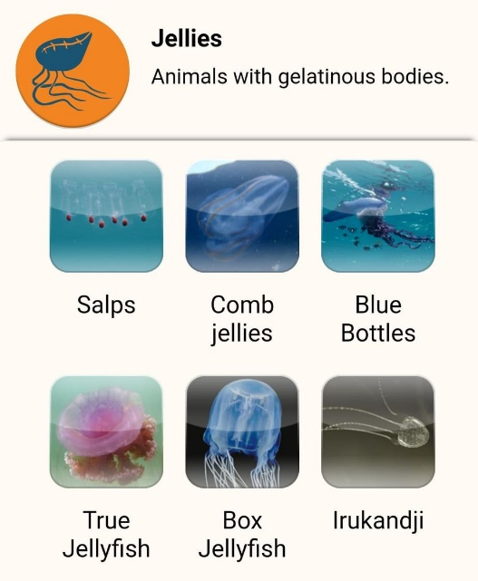
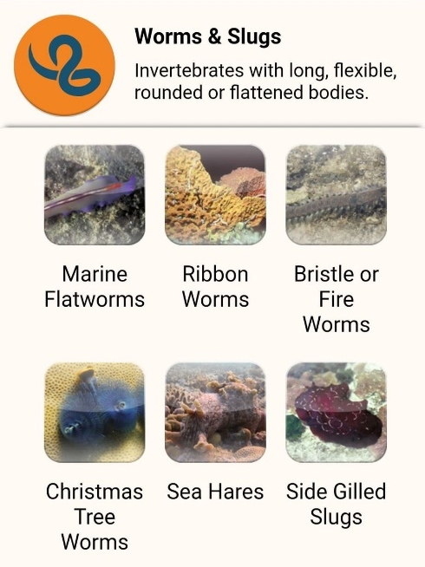
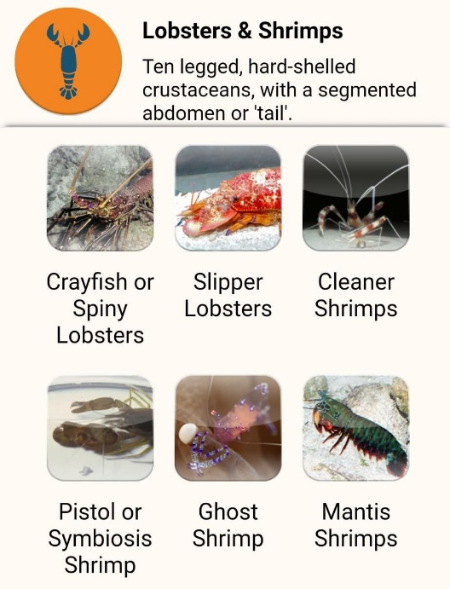
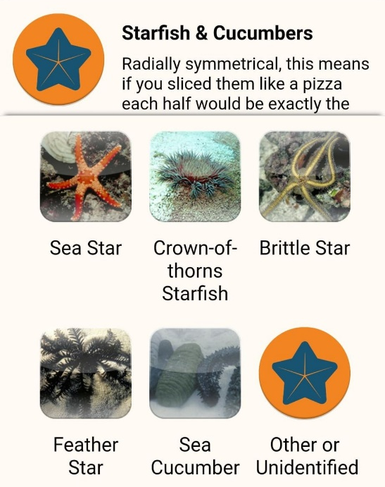
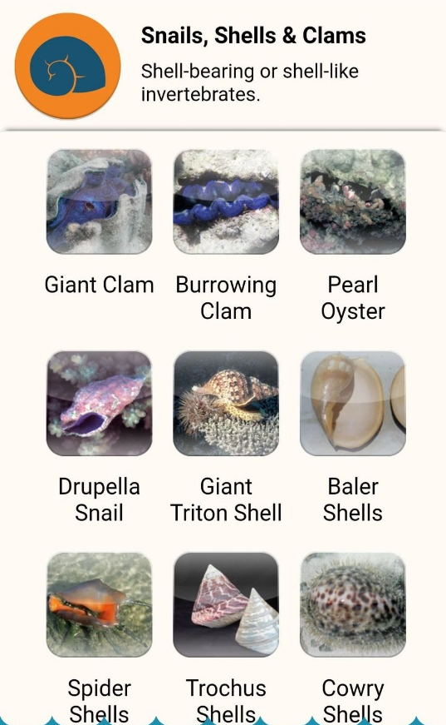
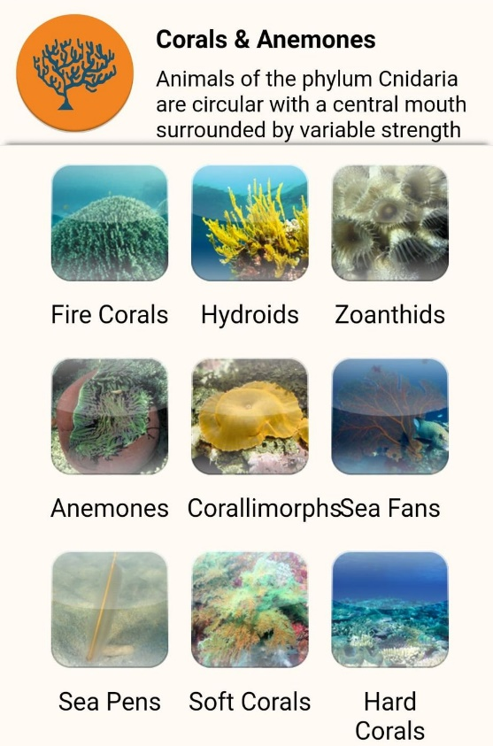
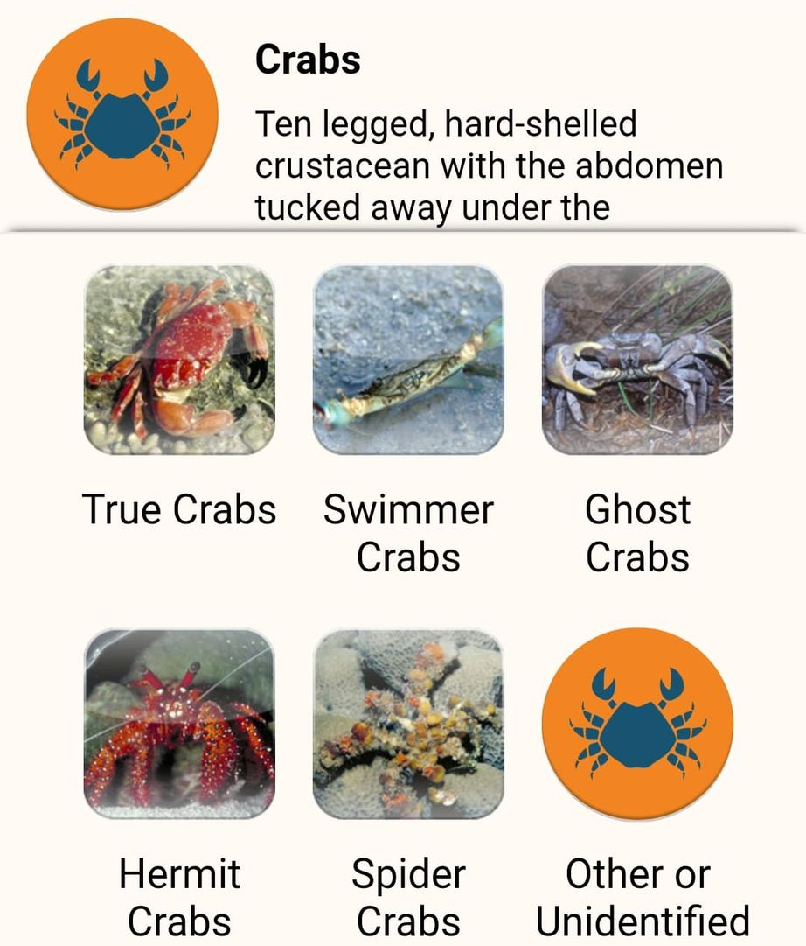

Slide 91
What can I do now?
You can pick the type of incidents you saw today (if any).

Slide 93
What can I do now?
You can pick the type of incidents you saw today (if any).

Slide 94
Incident.

Slide 95
What can I do now?
You can pick if you saw any bleaching today.

Slide 97
What can I do now?
You can pick if you saw any bleaching today.

Slide 98
Bleaching.

Slide 99
Ask What actions can you take to protect what you have seen today?
Link to climate change actions,

Slide 100
What actions can you take to protect what you have seen today?
Notes:
App image: https://www.gbrmpa.gov.au/__data/assets/pdf_file/0020/265430/Eye-on-the-Reef-app-poster.pdf

Slide 101
Thank you for helping the Great Barrier Reef!

Slide 102
We hope you enjoyed you day visiting the Great Barrier Reef!
See the Reef • Love the Reef • Protect the Reef

