Slide 1

Be a Marine
Biologist for a Day
Part 3: Making connections
Year 10
Notes:
Image: L. Zell, Copyright Commonwealth of Australia (GBRMPA)

Slide 2


Thank you for organising your trip to the reef with us.
We had a great time and hope you did too.
This PowerPoint is Part 3 of the Be a Marine Biologist for a Day program designed for year 10 by the Great Barrier Reef Marine Park Authority (GBRMPA).
View this PowerPoint after your excursion, with the accompanying activity book.
This is Part 3: Making connections. This is the last part of the program. This is when your students make connections with all they’ve learned and experienced so far.
On your excursion, you conducted an Eye on the Reef citizen science activity with your reef guide. Now it’s time to upload your data to the GBRMPA website. It’s also time for students to check understanding by answering any questions in Parts 1 and 2.
The Great Barrier Reef Marine Park Authority would like to thank you for uploading your data to their Rapid Monitoring database. We hope to see you again next year!
Licensed by the Commonwealth of Australia for use under a Creative Commons By Attribution 4.0 International licence with the exception of content supplied by third parties and any photographs. http://creativecommons.org/licences/by/4.0

Slide 3

We would like to acknowledge all of the Aboriginal and Torres Straight Islander peoples who have connection to the Great Barrier Reef.
We recognise their continuing connection to land, water and community, and pay our respects to their Elders past, present and emerging.

Slide 4

We would like to acknowledge the (insert name of local Traditional Owner group) peoples as the Traditional Owners of the Land and Sea Country that we visited as part of your excursion.

Slide 5

How can I help the
Great Barrier Reef?
Notes:
This is the overarching inquiry question that encompasses the entire BAMBFAD Program and is the starting slide to this presentation.

Slide 6

Notes:
Image: J. Johnson, Copyright Copyright Commonwealth of Australia (GBRMPA)

Slide 7
Eye on the Reef
Rapid Monitoring survey
10 MINUTE TIMED SWIM

Slide 8
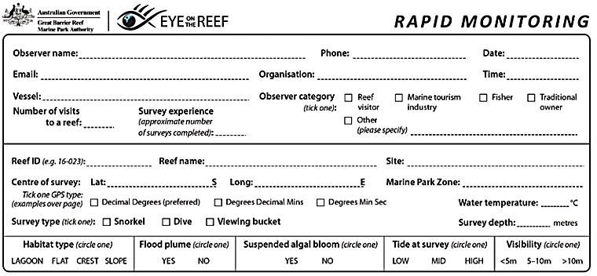
Have you got your data ready?

Slide 9

Because it’s time to upload it to GBRMPA!

Slide 10

This is the website for GBRMPA’s Eye on the Reef.
The link to connect is provided at the end of this presentation.

Slide 11

Login.

Slide 12

Select ‘Rapid Monitoring Survey’ tab.

Slide 13


Enter your data.

Slide 14

If you also completed the (more advanced) 360°survey, complete all questions. Otherwise, leave blank.

Slide 15

Save!
Scroll down to the bottom of the page to ‘Save’.

Slide 16
Are you ready?
Click on the image below to connect.
Notes:
www.gbrmpa.gov.au/our-work/eye-on-the-reef

Slide 17

Thank
you
Male Maori wrasse
Notes:
Image: C. Jones, Copyright Copyright Commonwealth of Australia (GBRMPA)

Slide 18
Check understanding.
Next, is what you’ve all been waiting for.
The answers to questions asked in Part 1 (before the excursion) and/or Part 2 (on the excursion).
Let’s check how you went!
Notes:
The following questions are straight from the Rapid Monitoring Survey course exam questions.

Slide 19


Sea cucumber
Notes:
Image: Copyright Commonwealth of Australia (GBRMPA)

Slide 20
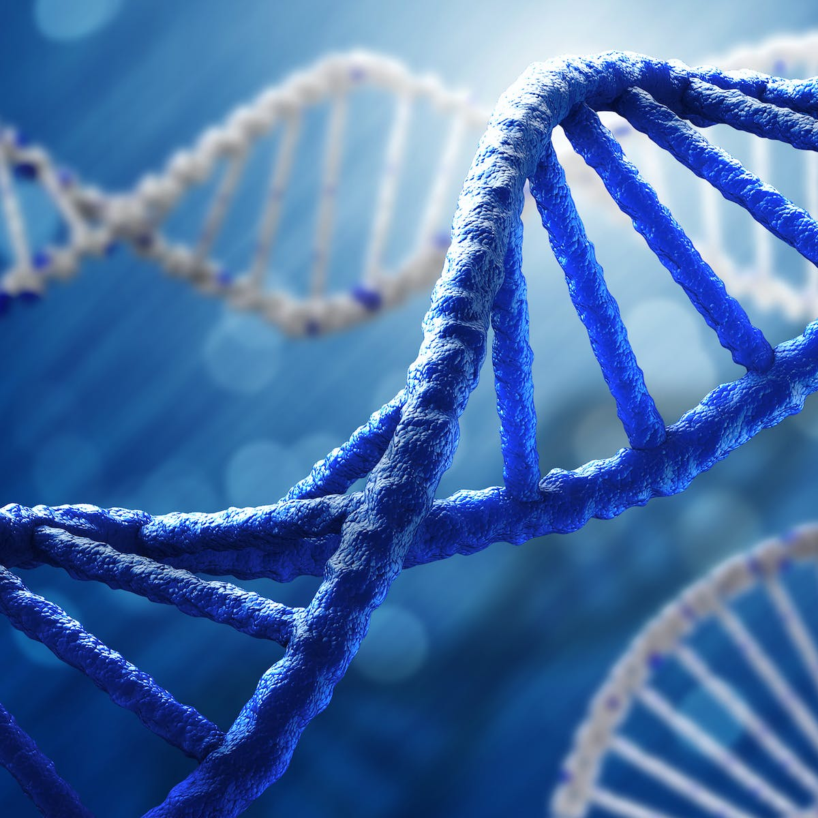
Sea cucumbers have remarkable powers of regeneration.
What is the role of DNA in this process?
Notes:
These are questions from the pre-snorkel brief on the excursion. Repeating information helps with long term memory retention and builds confidence.

Slide 21
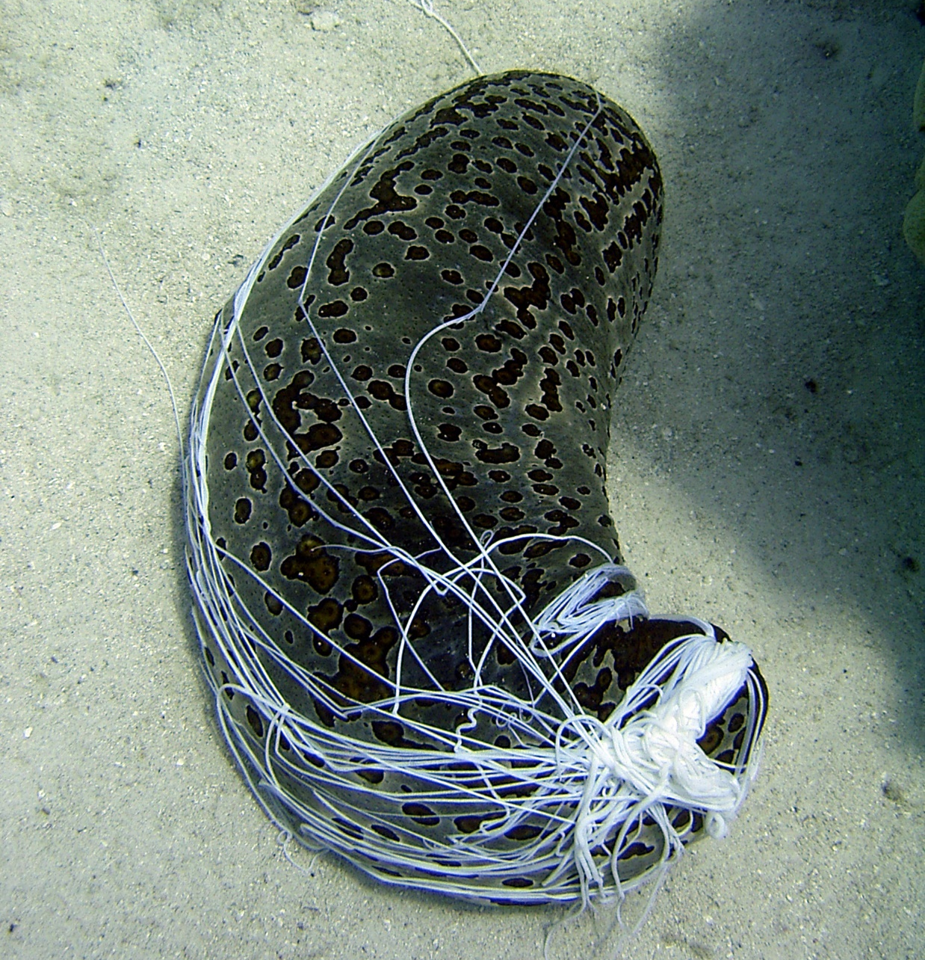
Instructions on how to regrow expelled organs is found as code in their DNA.
Notes:
Image: C. Jones, Copyright Commonwealth of Australia (GBRMPA)

Slide 22
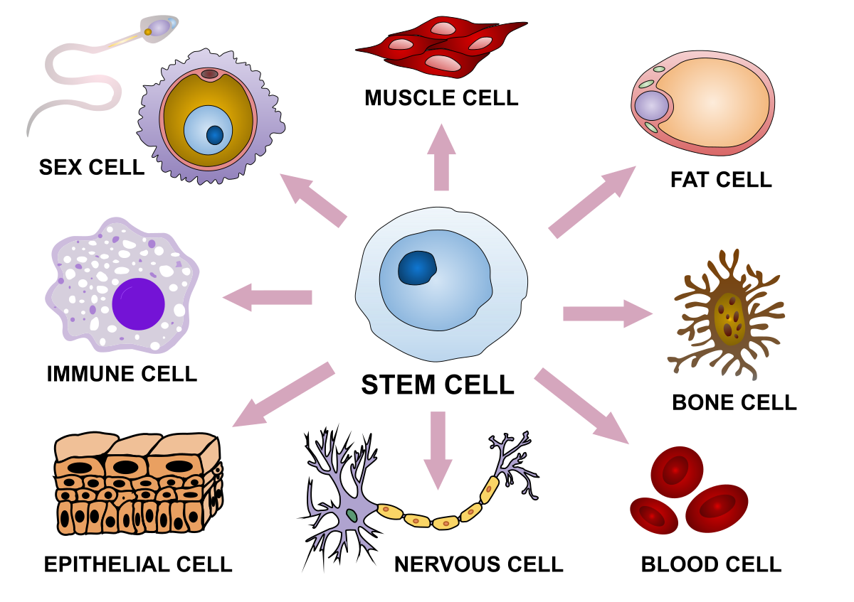
The code includes instructions for
cell migration, proliferation, differentiation,
and organ/tissue reconstruction.
Notes:
Image: https://en.wikipedia.org/wiki/Cellular_differentiation

Slide 23

Restoring normal function within
2-3 weeks.
Notes:
Image: J. Jones, Copyright Commonwealth of Australia (GBRMPA)

Slide 24
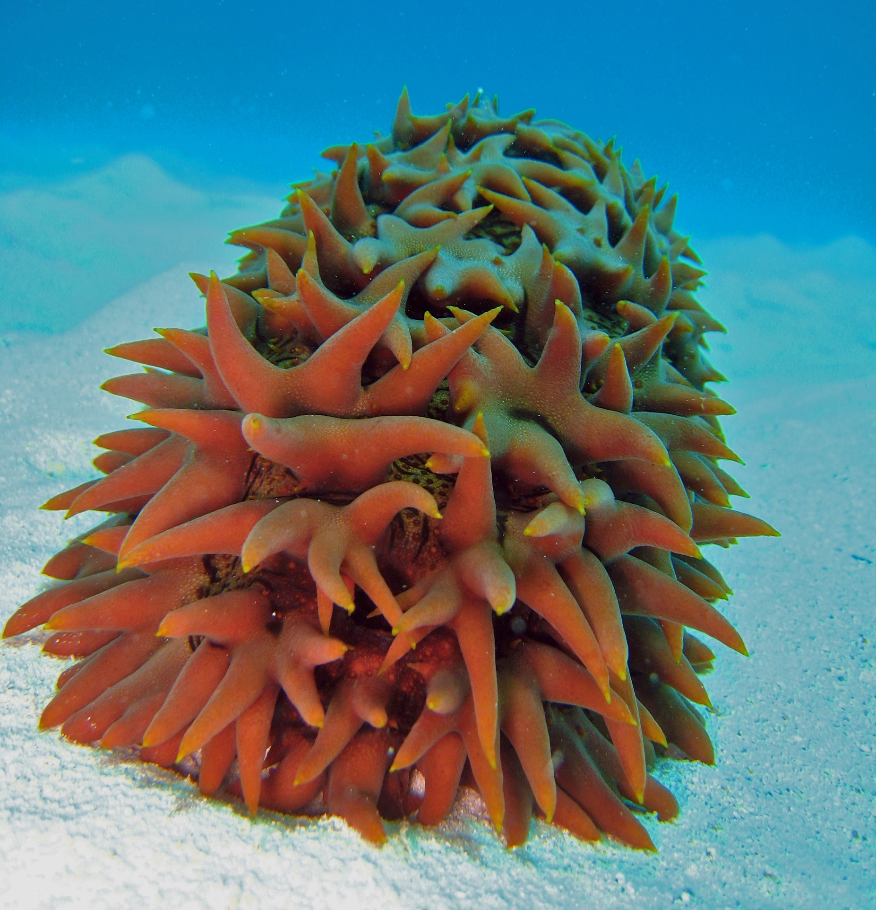
Sea cucumber DNA may hold the secret to alleviate the symptoms of aging through cell and tissue regeneration and organ failure treatment.
Notes:
Image: C. Jones, Copyright Commonwealth of Australia (GBRMPA)

Slide 25

Giant clam
VULNERABLE TO EXTINCTION
Notes:
Image: Copyright Commonwealth of Australia (GBRMPA)

Slide 26
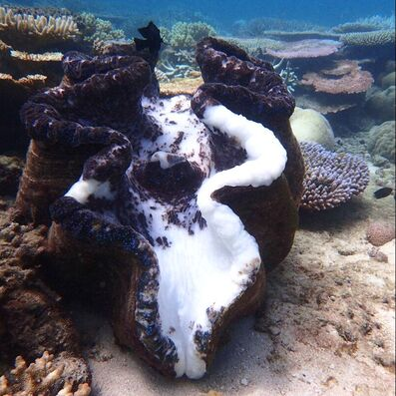
Did you see any signs of bleaching in giant clams?
What causes giant clams to bleach?
https://missionbeachislandreefadventures.com.au/giant-clams.html
Notes:
Image: https://missionbeachislandreefadventures.com.au/giant-clams.html

Slide 27

Giant clams (like coral) share a mutualistic symbiotic relationship with an algae, called zooxanthellae.
Notes:
Image: J. Sumerling, Copyright Commonwealth of Australia (GBRMPA)

Slide 28
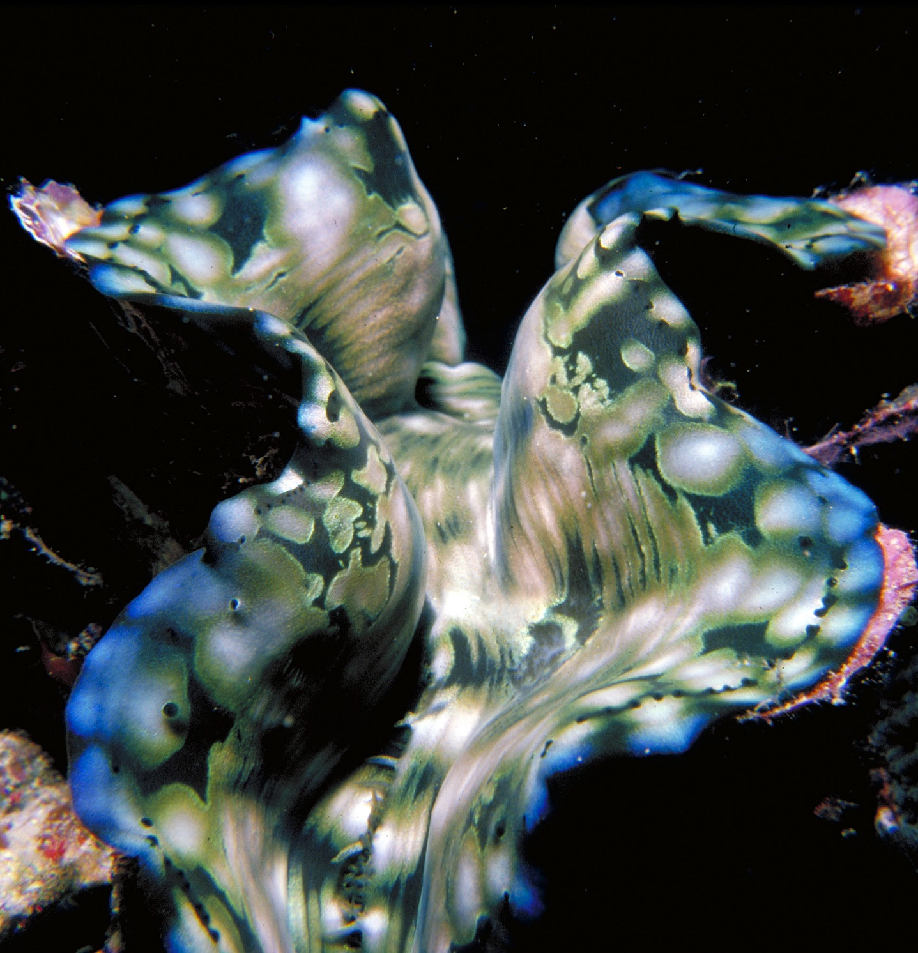
The algae live in
the clams mantle and carry out photosynthesis.
A byproduct of photosynthesis is oxygen.
Notes:
Image: R. Berklemans, Copyright Commonwealth of Australia (GBRMPA)
Ans. oxygen

Slide 29
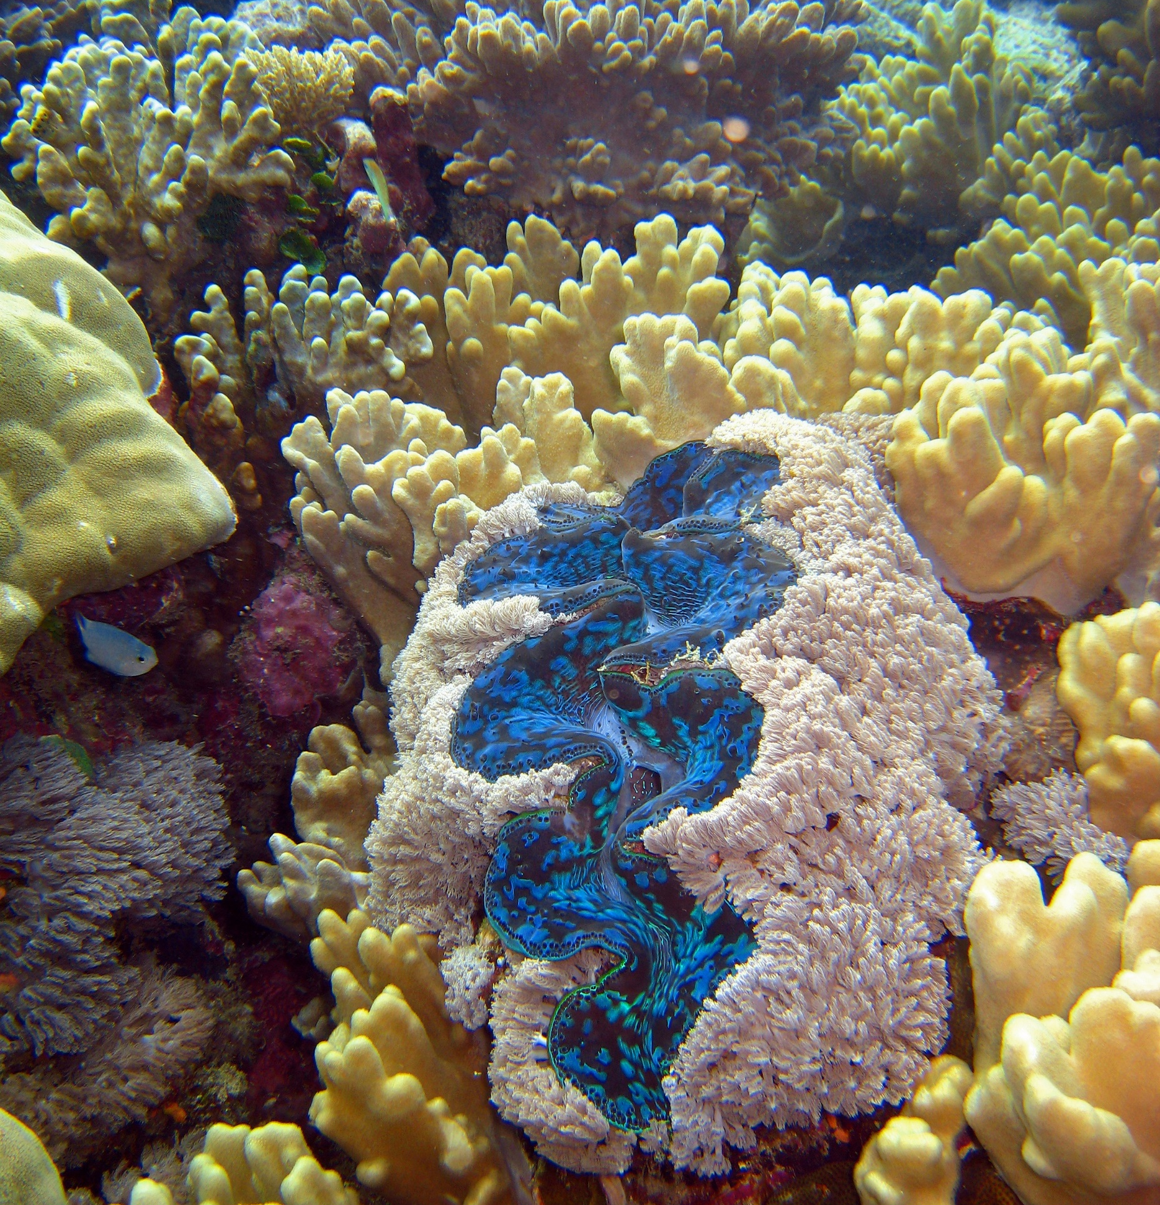
A stress event, such as a marine heat wave, causes the zooxanthellae to produce toxic levels of oxygen. They are then expelled by the clam.
Notes:
Image: C. Jones, Copyright Commonwealth of Australia (GBRMPA)

Slide 30
Without their colourful zooxanthellae, the
mantle tissue is
transparent. Making the clam appear ‘bleached’.
https://missionbeachislandreefadventures.com.au/giant-clams.html
Notes:
Image: https://missionbeachislandreefadventures.com.au/giant-clams.html

Slide 31

If the temperature cools, and the clam is still alive, the zooxanthellae returns ☺.
Notes:
Image: C. Jones, Copyright Commonwealth of Australia (GBRMPA)

Slide 32

Anemonefish
Notes:
Image: J. Sumerling, Copyright Commonwealth Government of Australia (GBRMPA)

Slide 33

Anemonefish are hermaphrodites.
What does this mean?
Notes:
Image: T. Mayne, Copyright Commonwealth of Australia (GBRMPA)

Slide 34
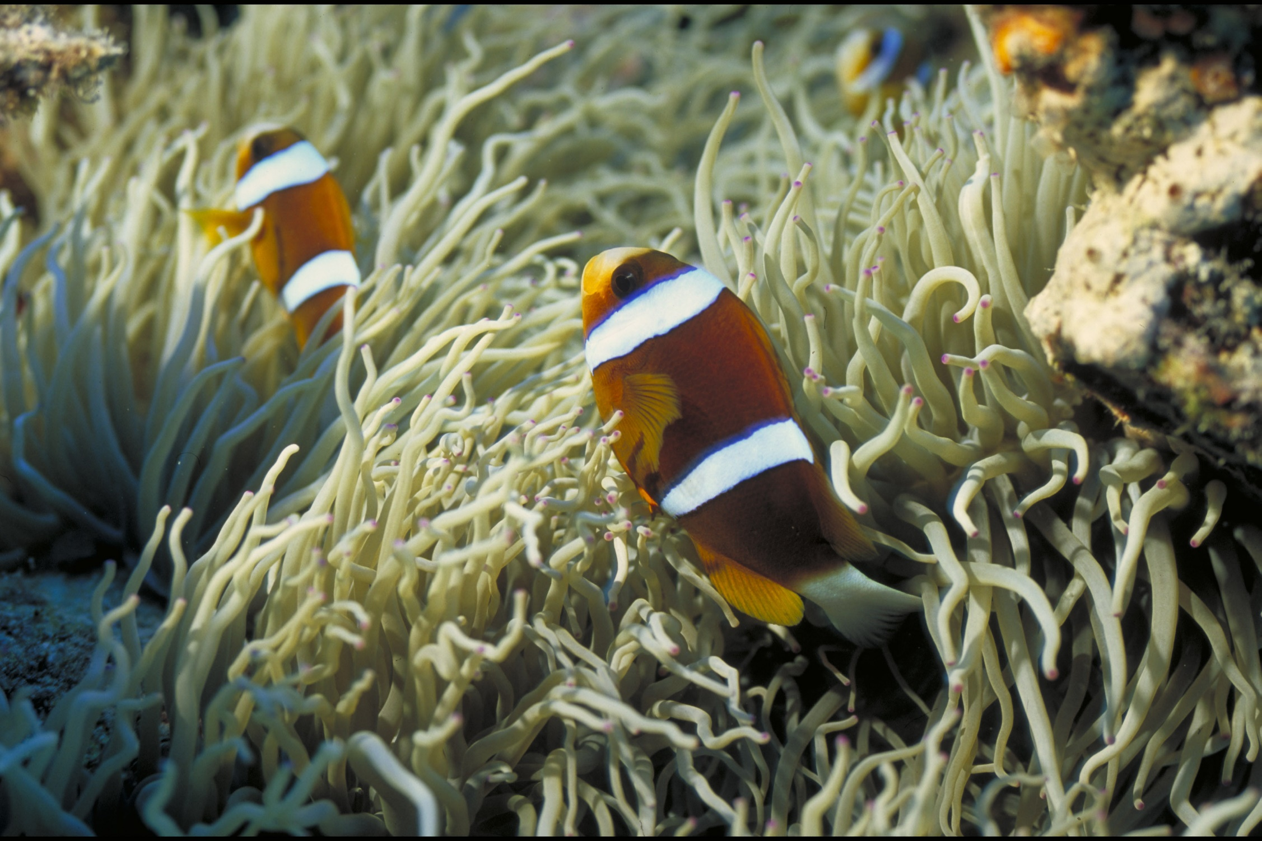
It means they produce both male and female gametes (at different stages in their life).
Hermaphroditism is very common in fish.
Notes:
Image: D. Wachenfeld, Copyright Commonwealth of Australia (GBRMPA)

Slide 35
The biggest anemonefish
is always the female, and the second largest is the breeding male.
All of the other fish are subordinate males (who don’t breed).
Subordinate male
Male
Female
Notes:
Image: D. Wachenfeld, Copyright Commonwealth of Australia (GBRMPA)

Slide 36
When the female dies,
her male partner turns into
a female, and the next largest male becomes the breeding male.
Subordinate male
Male
Female
Notes:
Image: D. Wachenfeld, Copyright Commonwealth of Australia (GBRMPA)

Slide 37

Butterflyfish
Bright colours and pretty patterns
Long snout and little mouth for eating coral polyps
Flat body
Notes:
Image: J. Jones, Copyright Commonwealth of Australia (GBRMPA)

Slide 38
Did you see any butterflyfish with a fake eye spot?
What is the
reason for the fake eye spot?
Notes:
Image: J. Jones, Copyright Commonwealth of Australia (GBRMPA)

Slide 39
To avoid
predation.
Designed to trick
their predators about the location of their head.
Notes:
Image: J. Jones, Copyright Commonwealth of Australia (GBRMPA)

Slide 40
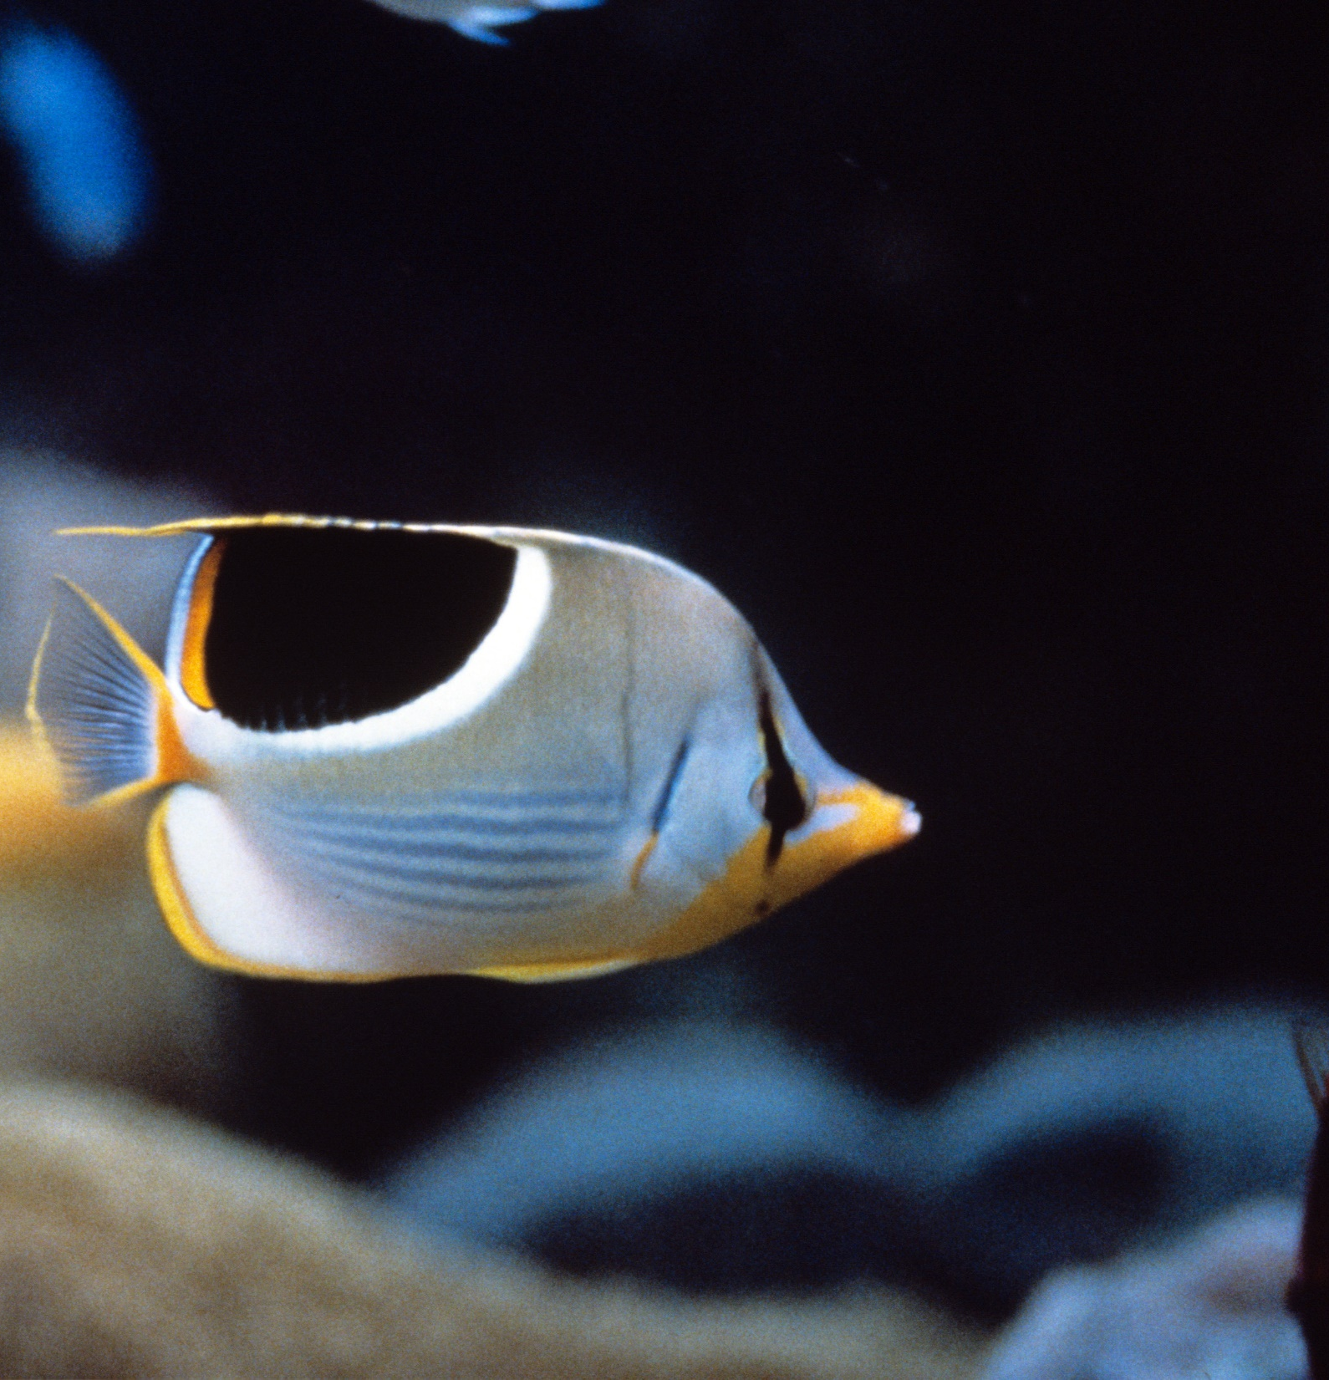
Did you see
what the butterflyfish were eating?
Notes:
Image: R. Walls, Copyright Commonwealth of Australia (GBRMPA)

Slide 41

Some eat tiny invertebrates.
Or pluck off bits of larger organisms, such as the tube feet of echinoderms.
Notes:
Image: L. Zell, Copyright Commonwealth of Australia (GBRMPA)

Slide 42

Most feed
directly on living coral polyps.
Notes:
Image: R. Berkelmans, Copyright Commonwealth of Australia (GBRMPA)

Slide 43

Grazing herbivores
Parrotfish / Surgeonfish / Rabbitfish / Unicornfish
Notes:
Image: W. Gladstone, Copyright Commonwealth of Australia (GBRMPA)

Slide 44

Why is it important to have grazing herbivores?
Notes:
Image: C. Jones, Copyright Commonwealth of Australia (GBRMPA)

Slide 45

They keep reefs healthy by eating algae that compete with coral for space.
Notes:
Image: C. Jones, Copyright Commonwealth of Australia (GBRMPA)

Slide 46
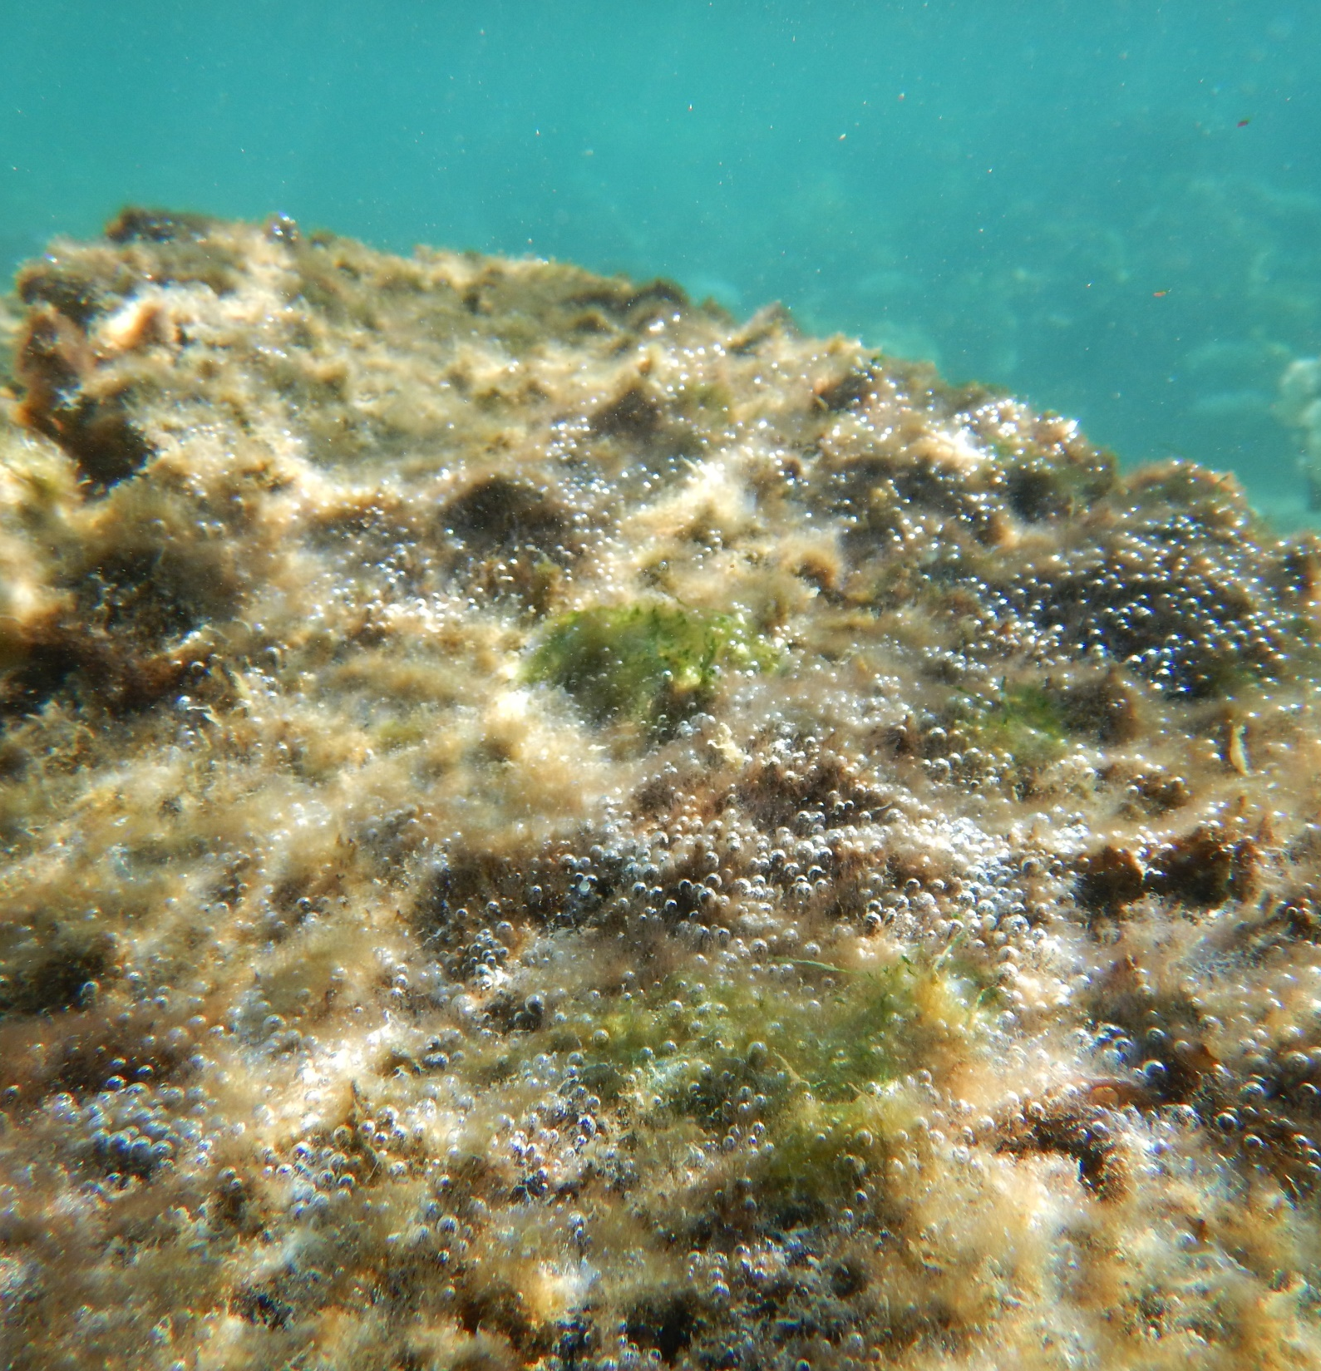
Algae come in lots
of different sizes
and colours.
What colour and size is brown macroalgae?
Notes:
Image: N. Mattocks, Copyright Commonwealth of Australia (GBRMPA)

Slide 47
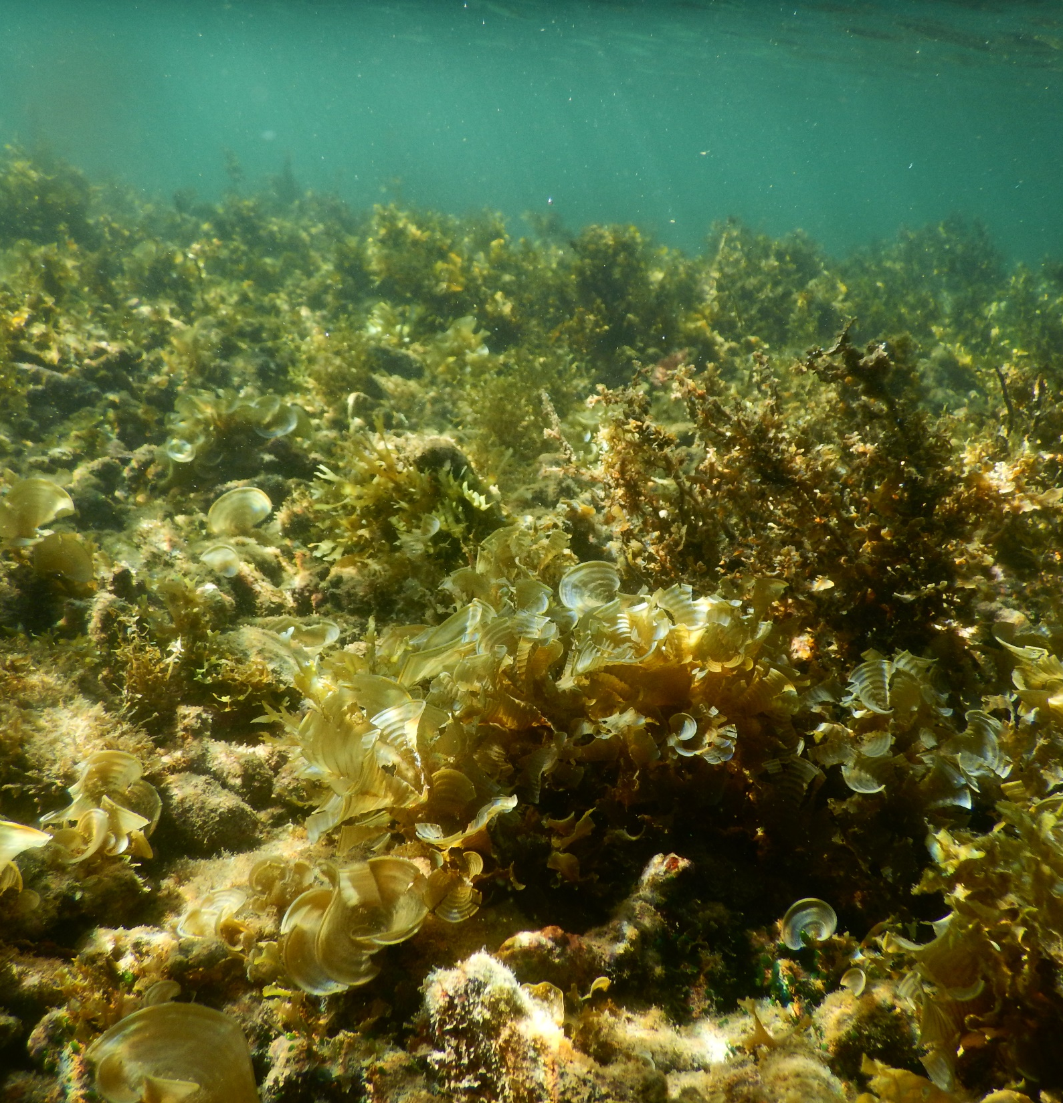
Brown and large.
Macro means ‘large’.
Notes:
Image: N. Mattocks, Copyright Commonwealth of Australia (GBRMPA)

Slide 48
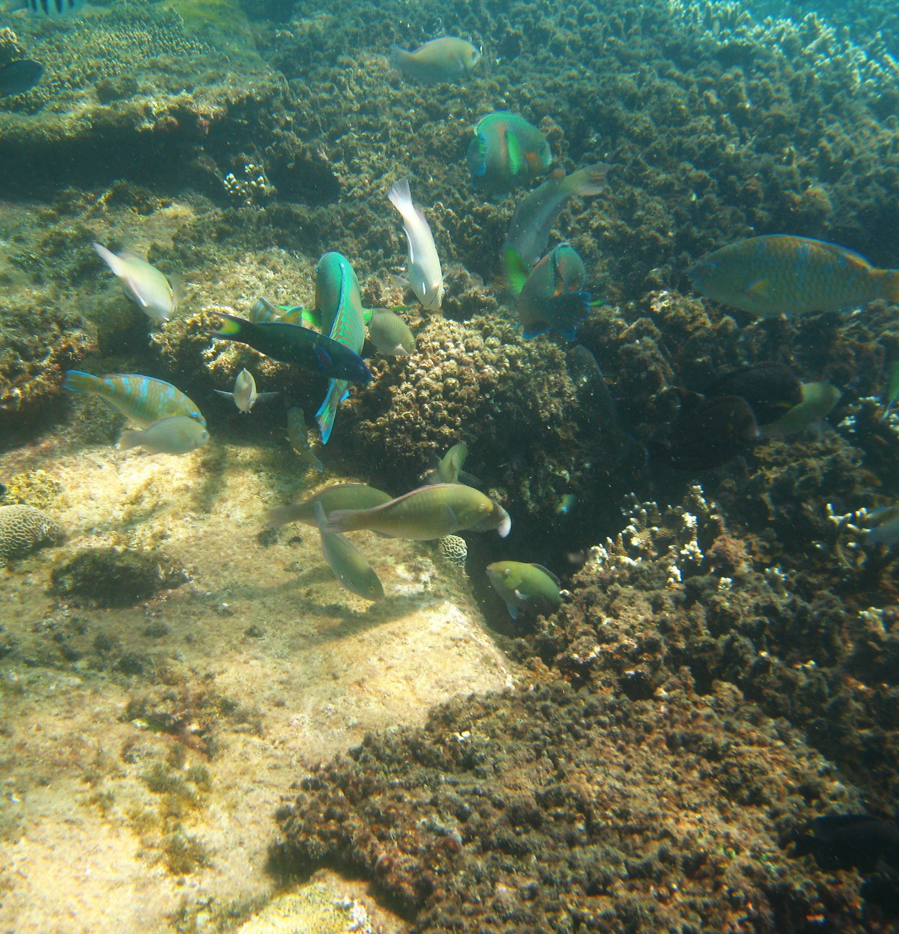
Parrotfish
and surgeonfish poop lots!
Their feeding strategies create much of the sand around a reef.
Notes:
Image: J. Maynard, Copyright Commonwealth of Australia (GBRMPA)

Slide 49
Did you count the number of poops from a grazing herbivore?
What type of algae were they eating?
Notes:
Image: C. Jones, Copyright Commonwealth of Australia (GBRMPA)

Slide 50

Cods and groupers
Notes:
Image: J. Hurford, Copyright Commonwealth of Australia (GBRMPA)

Slide 51
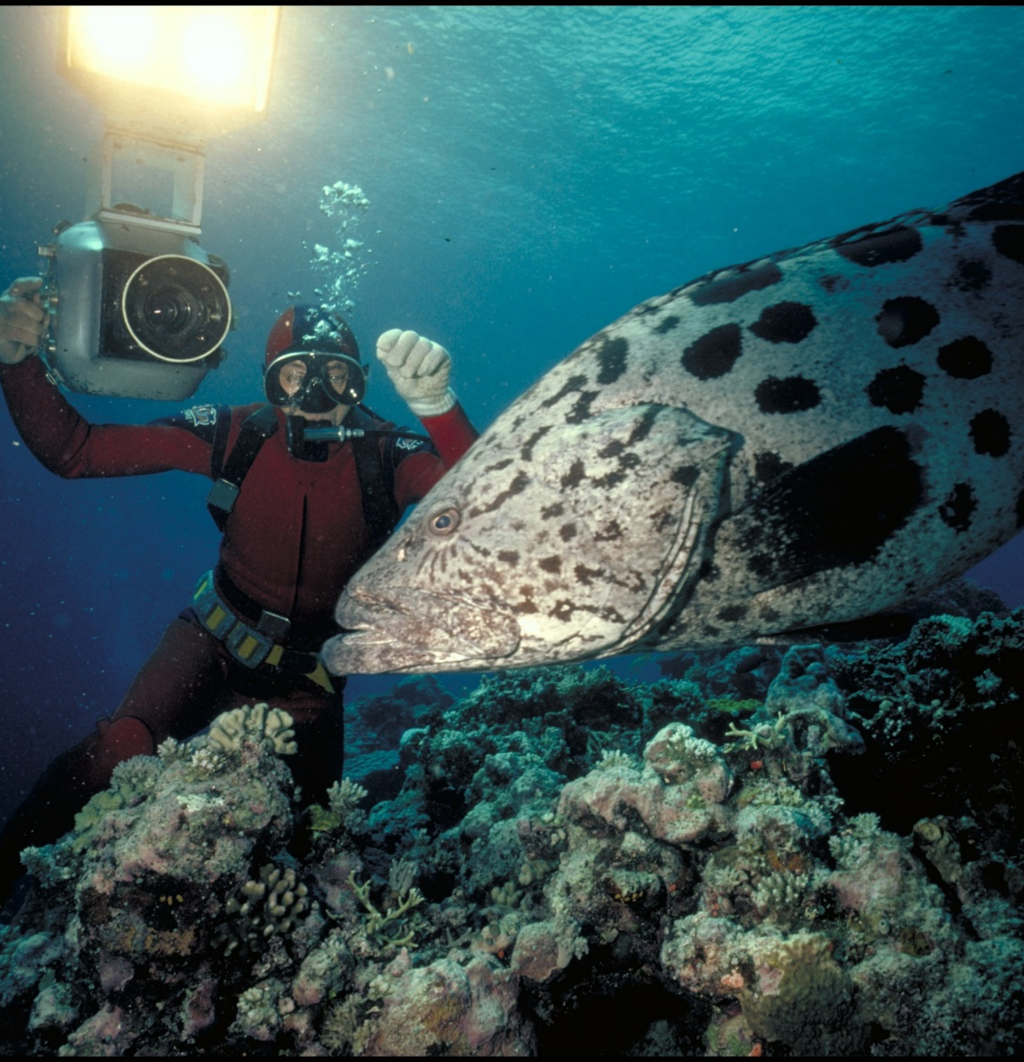
Are Queensland grouper, potato cod and barramundi cod protected in the Great Barrier Reef Marine Park?
Yes.
Notes:
Image: Ron & Valerie Taylor, Copyright Commonwealth of Australia (GBRMPA)

Slide 52
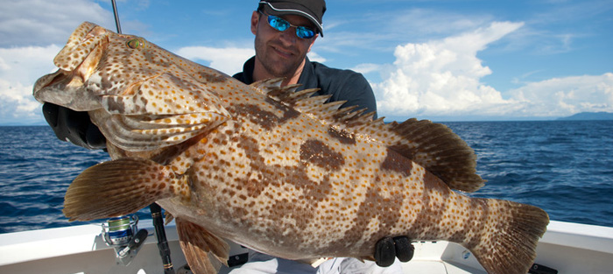
What should you do if you catch one?
Not this!
Notes:
Image: https://www.reelpursuits.com/7-tips-on-how-to-catch-big-grouper/

Slide 53
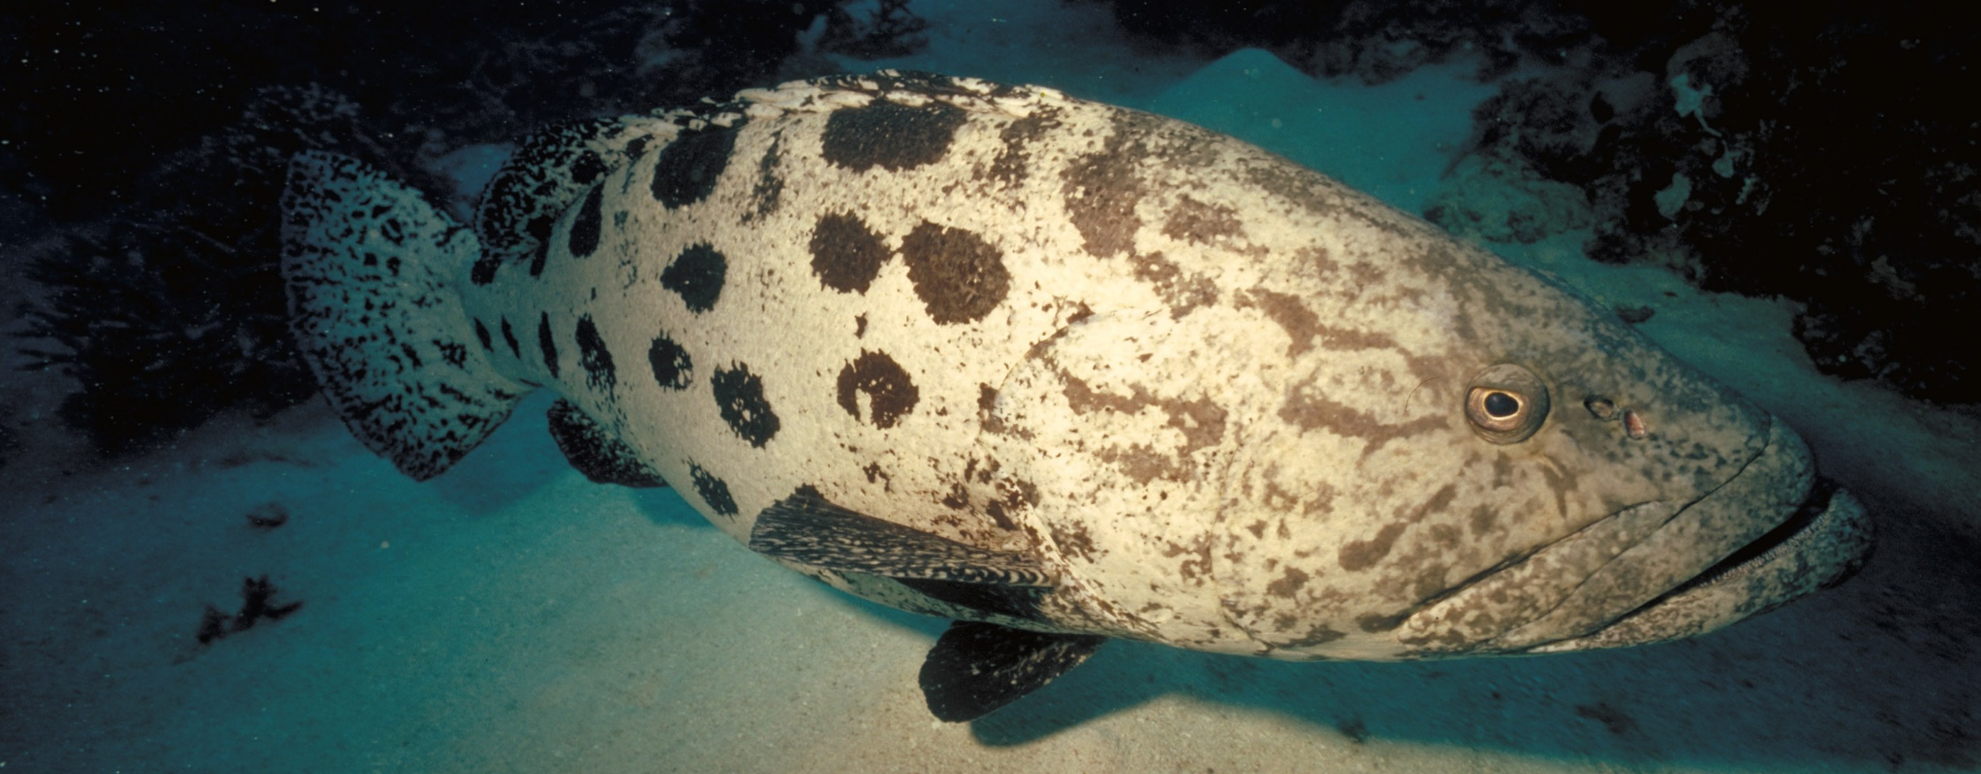
Use best practice methods to release it.
E.g. avoid lifting into the boat.
Notes:
Image: P. McGinnity, Copyright Commonwealth of Australia (GBRMPA)

Slide 54

Coral trout
Notes:
Image: S. Summerhays, Copyright Commonwealth of Australia (GBRMPA)

Slide 55
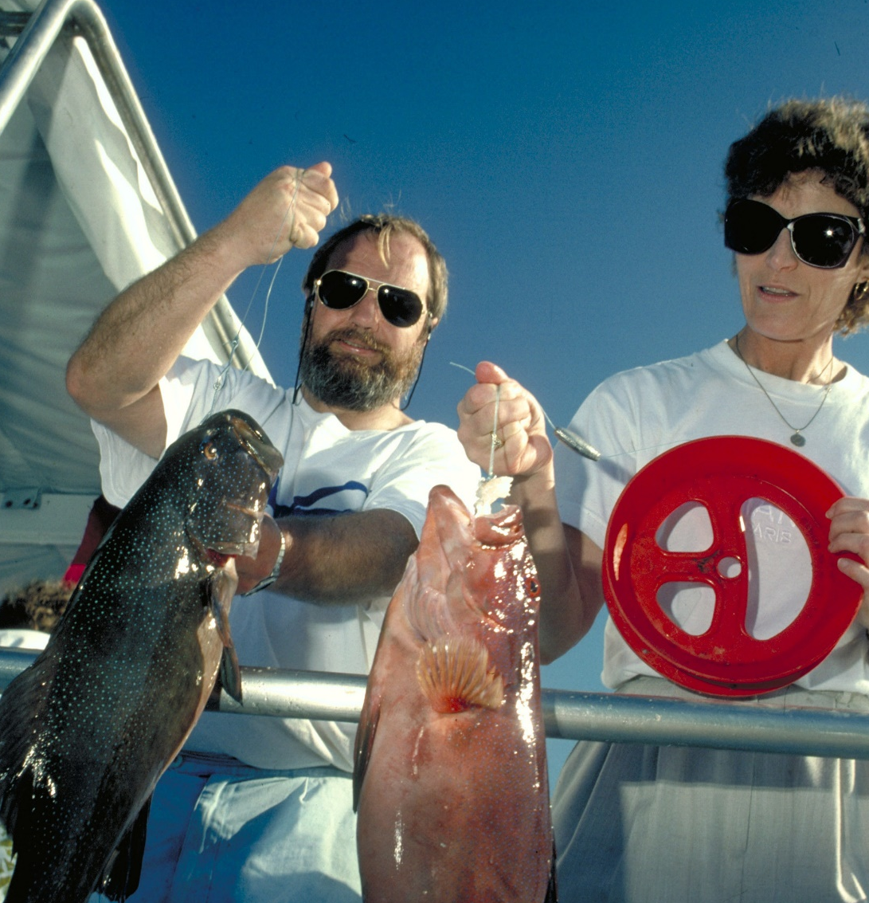
Lots of people like to eat coral trout.
What is the legal size of a coral trout?
Notes:
Image: A. Elliott, Copyright Commonwealth of Australia (GBRMPA)

Slide 56
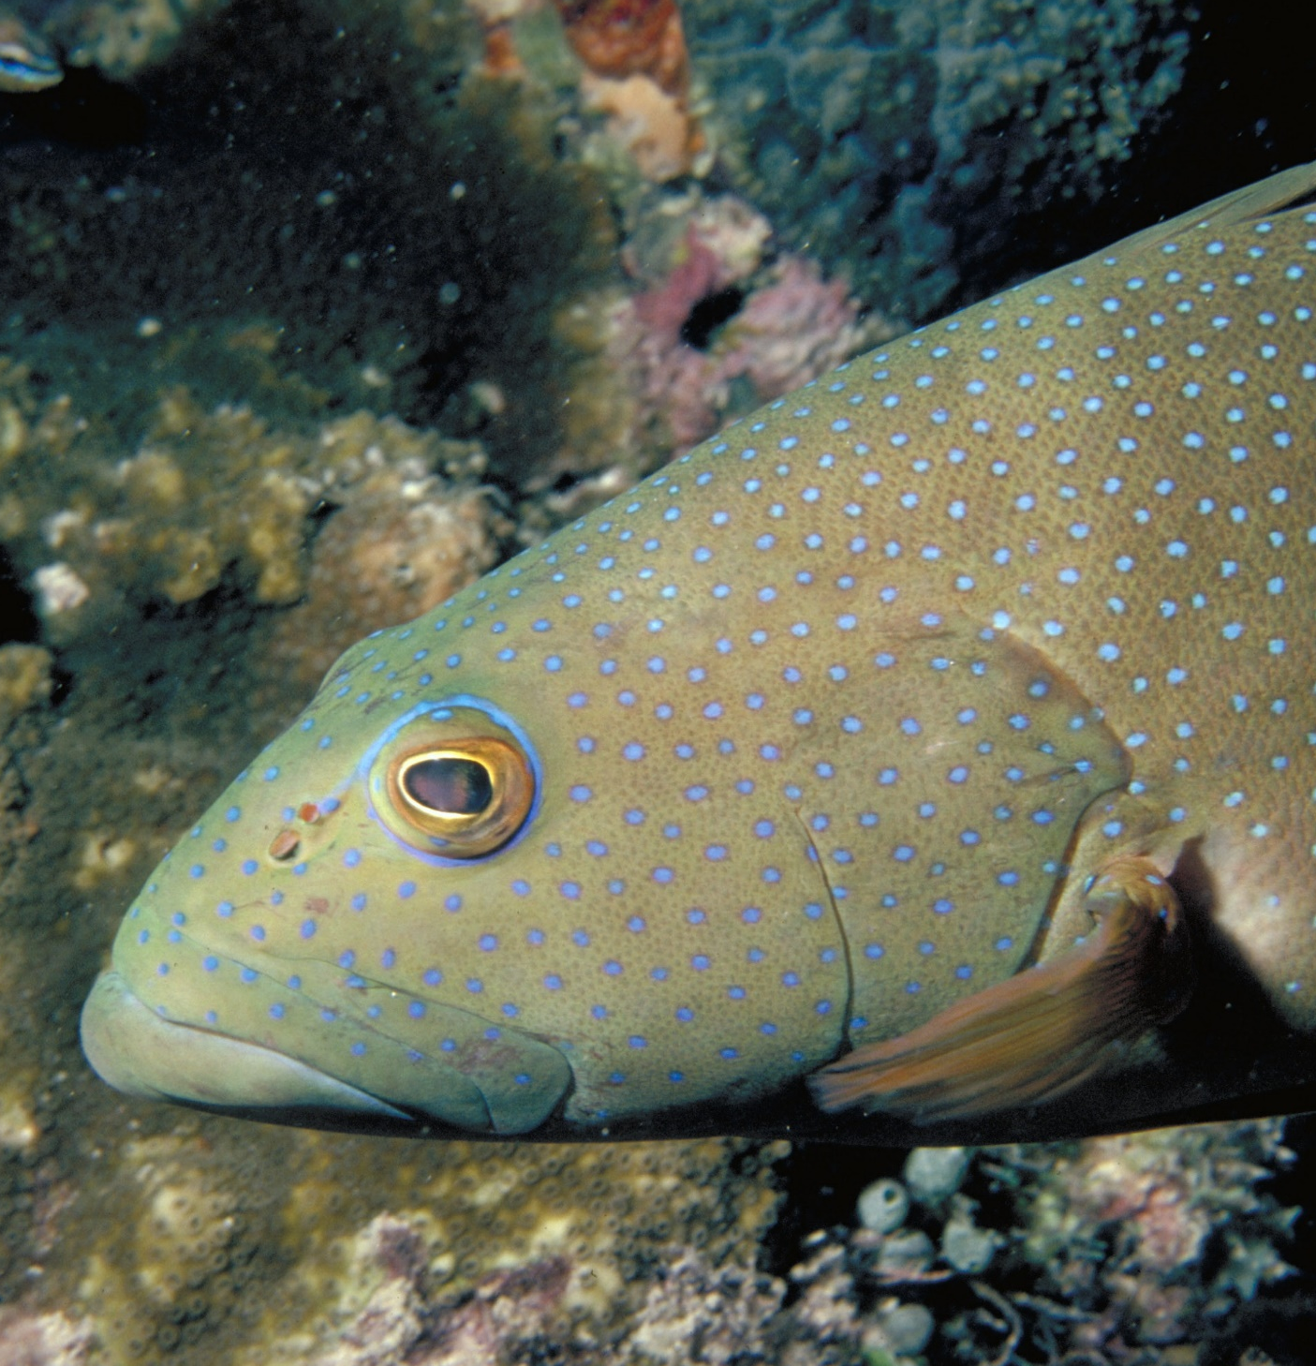
The legal size for
a coral trout is 38cm.
What penalties
apply for keeping undersize fish?
Notes:
Image: L. Zell, Copyright Commonwealth of Australia (GBRMPA)

Slide 57
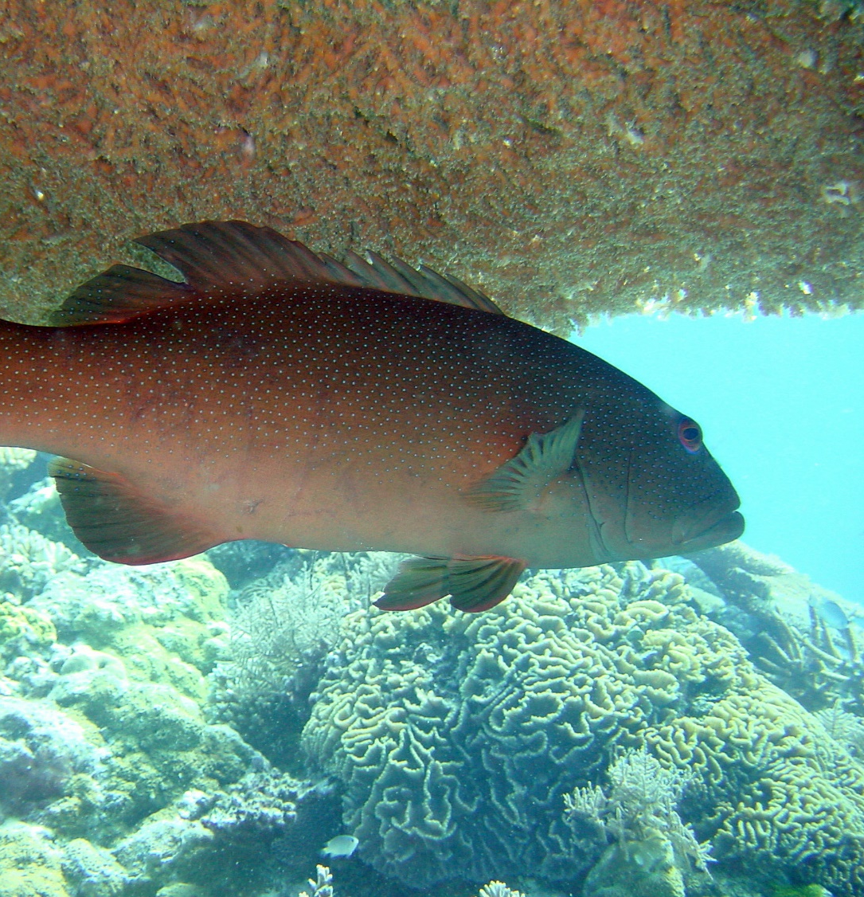
Fines of hundreds
to thousands
of dollars.
Notes:
Image: G. Goby, Copyright Commonwealth of Australia (GBRMPA)

Slide 58

Why is it bad
to eat extra-large reef fish?
Notes:
Image: T. Mayne, Copyright Commonwealth of Australia (GBRMPA)

Slide 59
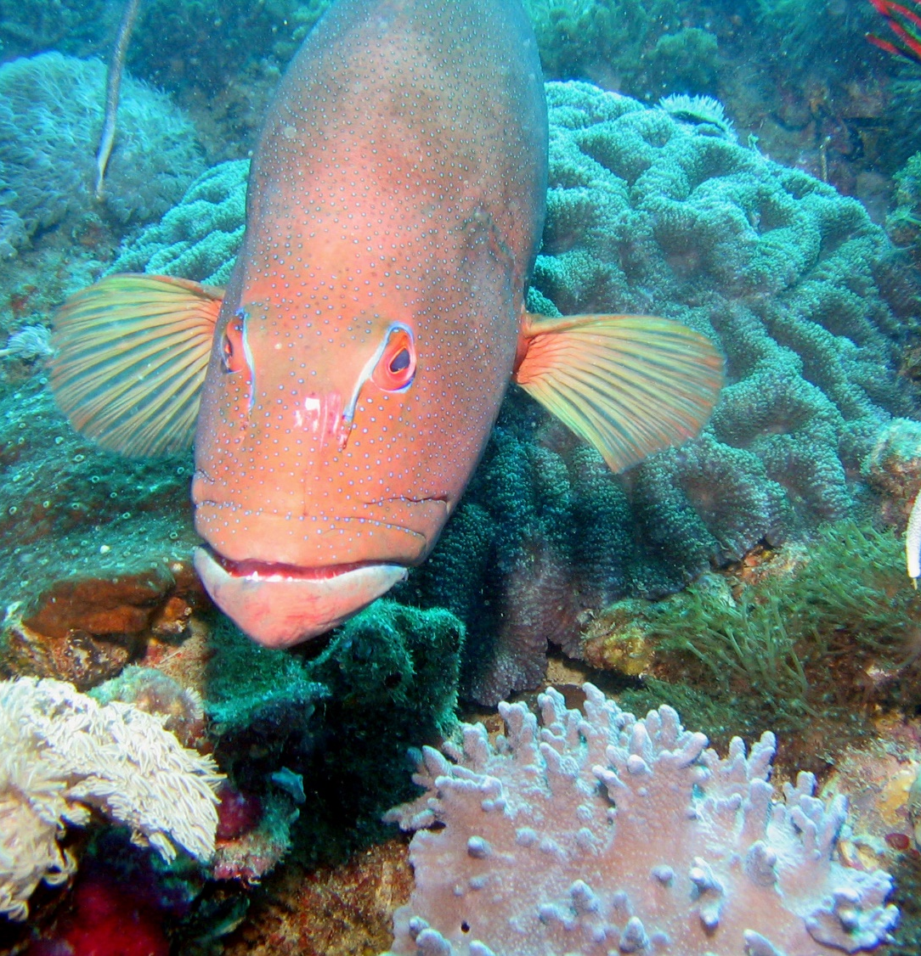
You risk getting very sick with ciguatera poisoning.
Notes:
Image: J. Mokivitch, Copyright Commonwealth of Australia (GBRMPA)

Slide 60

Maori wrasse
also called humphead wrasse or Napoleon wrasse.
Notes:
Image: C. Jones, Copyright Commonwealth of Australia (GBRMPA)

Slide 61
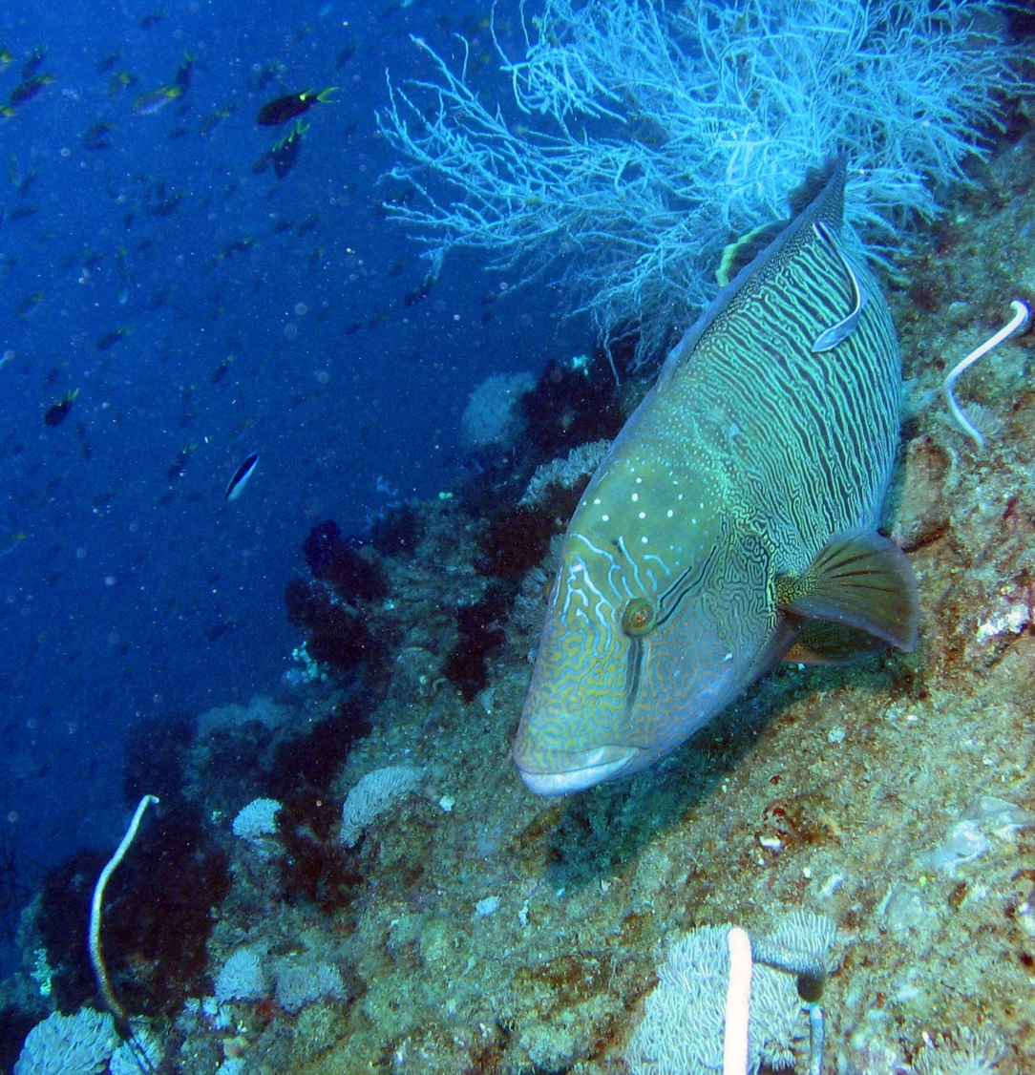
Where do Maori wrasse live?
Notes:
Image: J. Monkivitch, Copyright Commonwealth of Australia (GBRMPA)

Slide 62

Maori wrasse live
on the Reef and occupy limited
home ranges.
Male
Notes:
Image: M. Simmons, Copyright Commonwealth of Australia (GBRMPA)

Slide 63
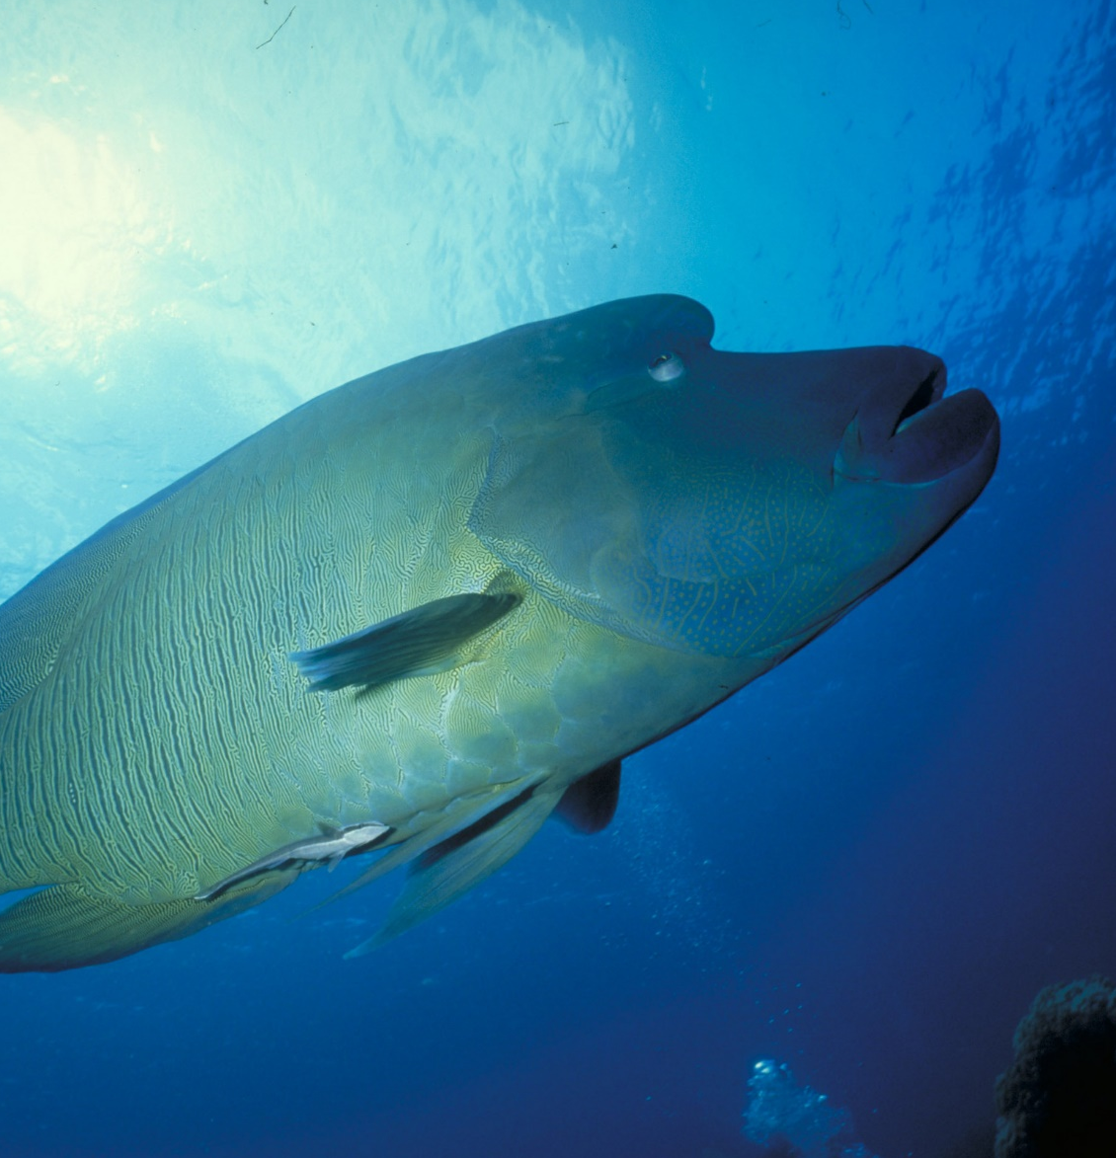
Adults swim across the reefs during the day, resting at night in caves and under coral ledges.
Male
Notes:
Image: M. Simmons, Copyright Commonwealth of Australia (GBRMPA)

Slide 64

What happens
if people touch
a Maori wrasse
and remove its protective coating
of fish mucus?
Notes:
Image: C. Jones Copyright Commonwealth of Australia (GBRMPA)

Slide 65
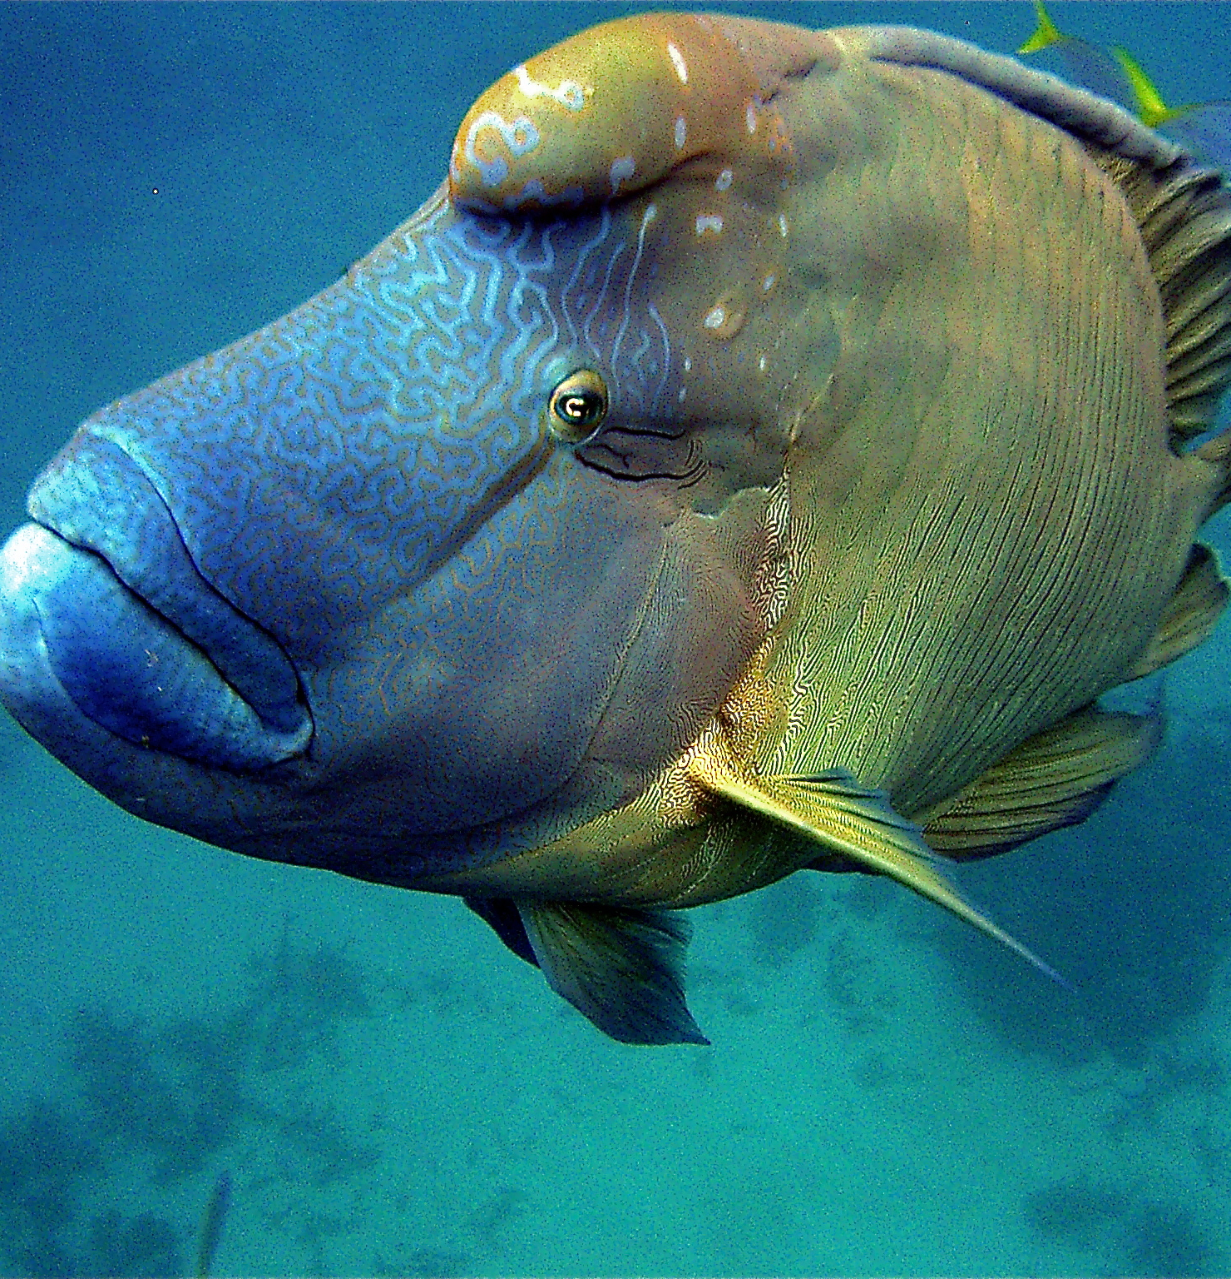
They can
get sick.
Notes:
Image: C. Jones, Copyright Commonwealth of Australia (GBRMPA)

Slide 66

Sea turtles
Notes:
Image: C. Jones, Copyright Commonwealth of Australia (GBRMPA)

Slide 67

How many sea turtles pictured below are threatened with extinction?
Notes:
Image: GBRMPA Image Library

Slide 68
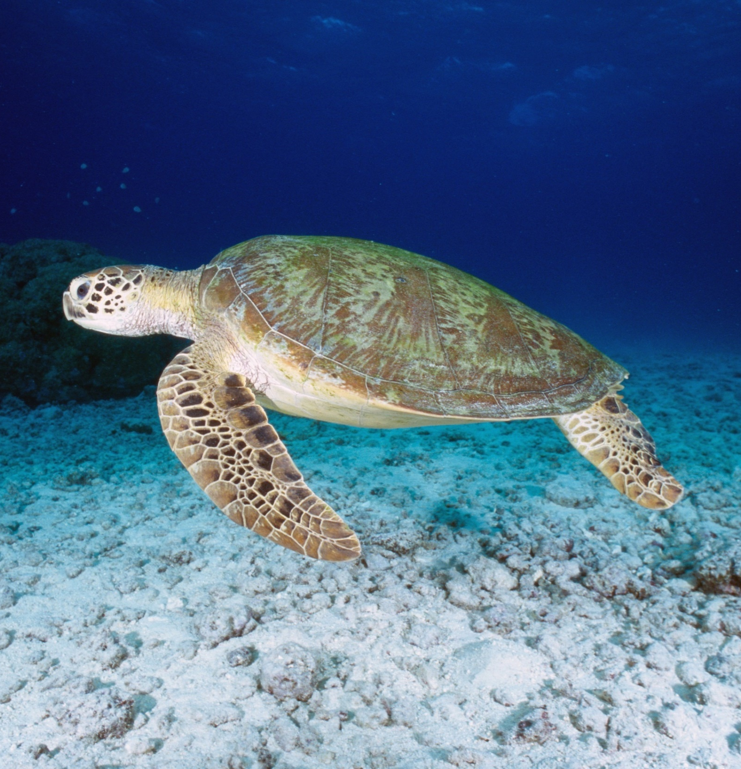
Some turtles migrate long distances, hitch-hiking rides in ocean currents such as the East Australian Current and ocean gyres.
Notes:
Image: K. Hoppen, Copyright Commonwealth of Australia (GBRMPA)

Slide 69
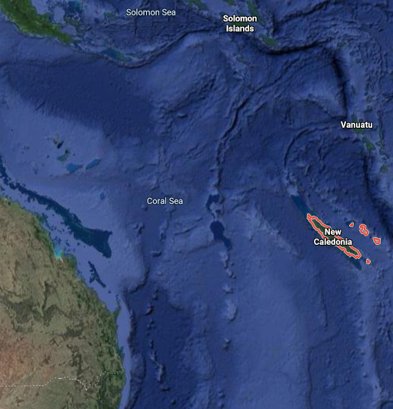
For example, turtles nesting in New Caledonia were found feeding on Heron Island, and turtles nesting on Heron Island were found feeding in New Caledonia!
Notes:
Fun Fact Source: https://parksaustralia.gov.au/marine/parks/coral-sea/explore/sea-turtles/

Slide 70
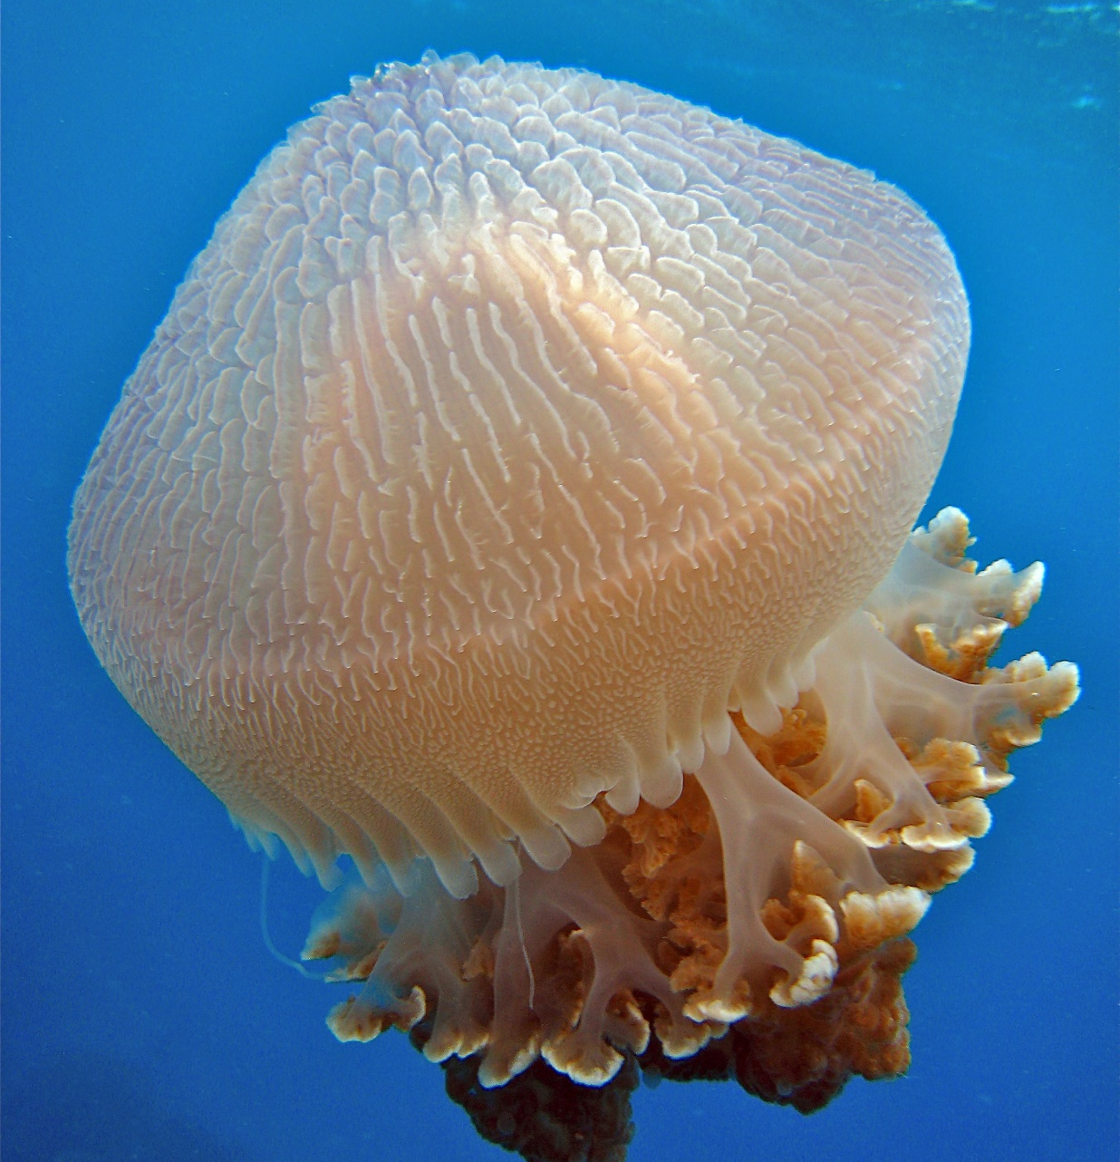
What do sea
turtles eat that look like jellyfish?
Notes:
Image: C. Jones, Copyright Commonwealth of Australia (GBRMPA)

Slide 71
Plastic
bags.
Notes:
Image: C. Jones, Copyright Commonwealth of Australia (GBRMPA)

Slide 72
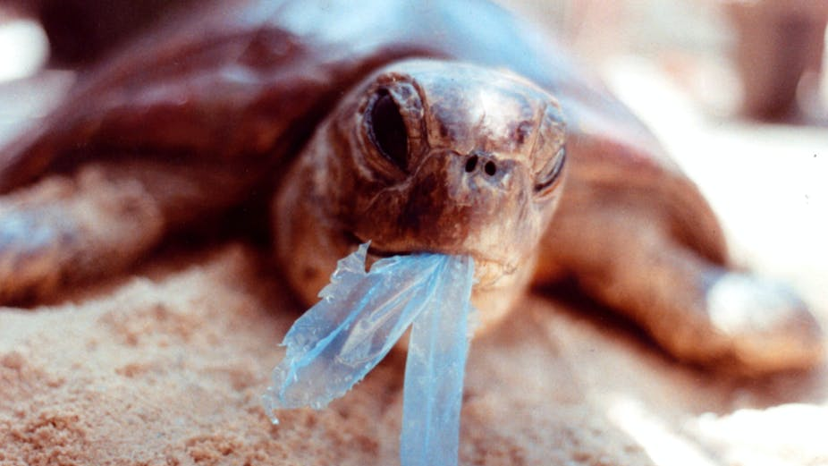
AAP Image/Department of the Environment and Heritage/Melbourne Zoo
Notes:
Image: https://theconversation.com/ghostnets-fish-on-marine-rubbish-threatens-northern-australian-turtles-11585

Slide 73
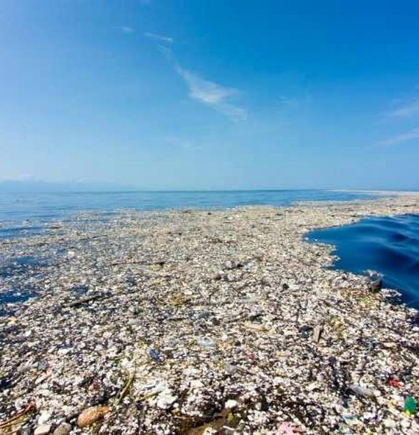
How many
kilograms of plastic are there for every kilogram of plankton in the Great Pacific Garbage Patch?
Notes:
Image: https://theoceancleanup.com/

Slide 74
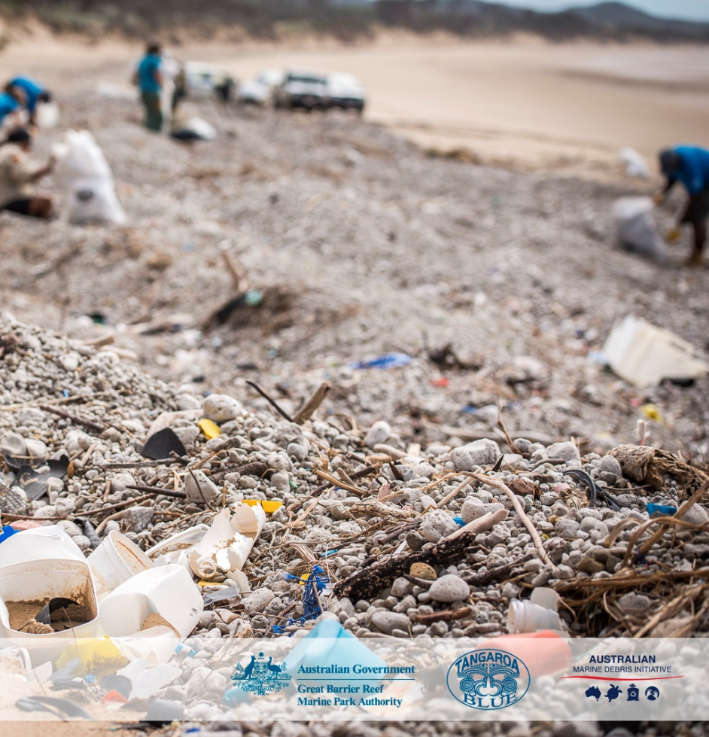
6kg
Notes:
Image: C. Miller, Copyright Commonwealth of Australia (GBRMPA)

Slide 75

Sharks
Notes:
Image: J. Sumerling, Copyright Commonwealth of Australia (GBRMPA)

Slide 76
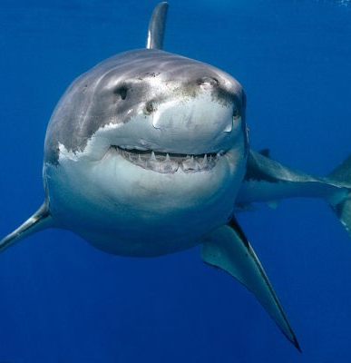
How many chromosomes
does a great white shark have?
Image: Chris Fallows
Notes:
Image: https://conservationaction.co.za/recent-news/shark-mystery-where-have-south-africas-great-whites-gone/

Slide 77

41 pairs.
Notes:
Image: K. Hoppen, Copyright Commonwealth of Australia (GBRMPA)

Slide 78
Quiz time!
30 questions. Answers are
provided at the end.
Notes:
The following questions are straight from the Rapid Monitoring Survey course exam questions.

Slide 79
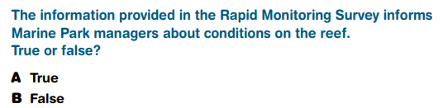
Question 1.

Slide 80
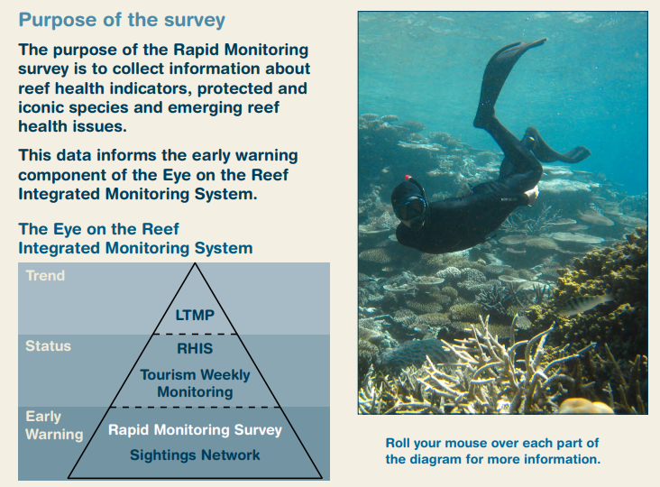
Read to answer the next question.

Slide 81
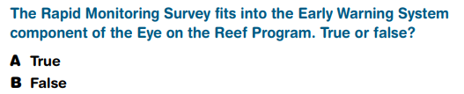
Question 2.

Slide 82
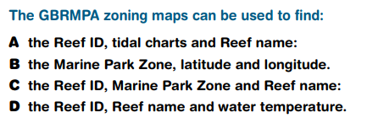
Question 3.

Slide 83
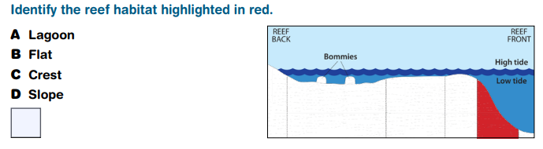
Question 4.

Slide 84
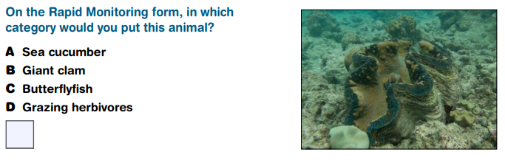
Question 5.

Slide 85
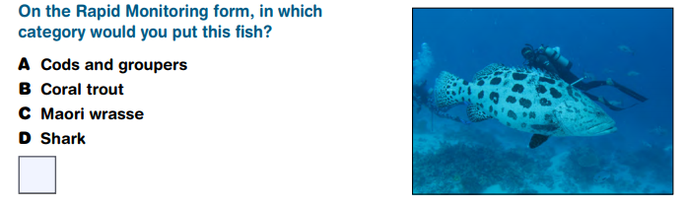
Question 6.

Slide 86
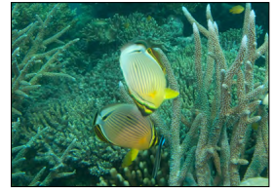
Question 7.

Slide 87
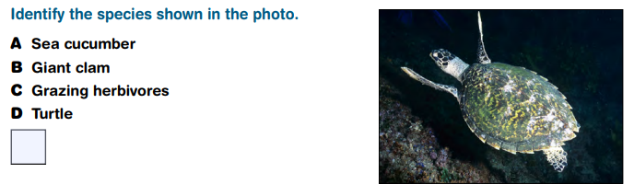
Question 8.
Hawksbill turtle

Slide 88
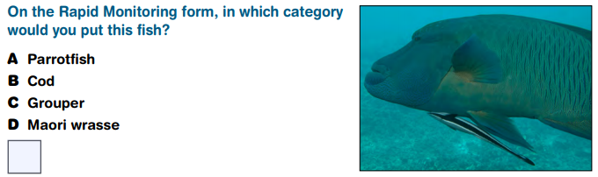
Question 9.

Slide 89
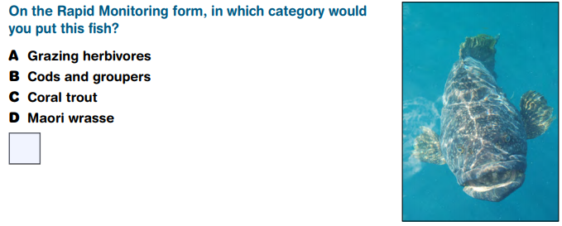
Question 10.

Slide 90
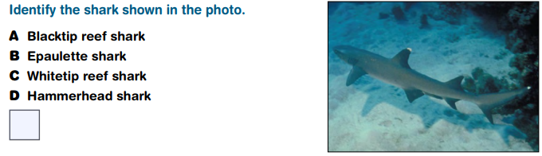
Question 11.

Slide 91
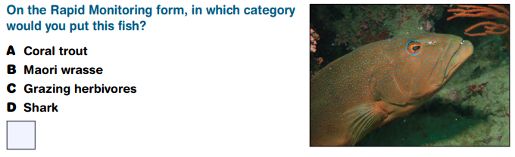
Question 12.

Slide 92
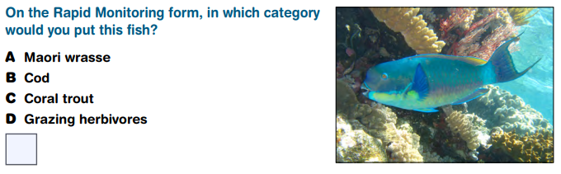
Question 13.

Slide 93
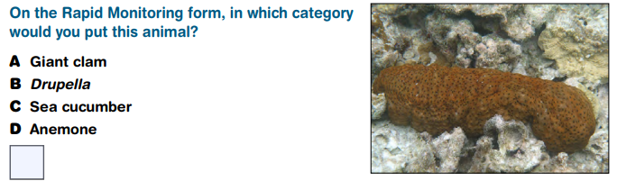
Question 14.

Slide 94
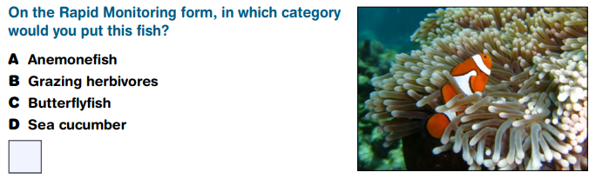
Question 15.

Slide 95
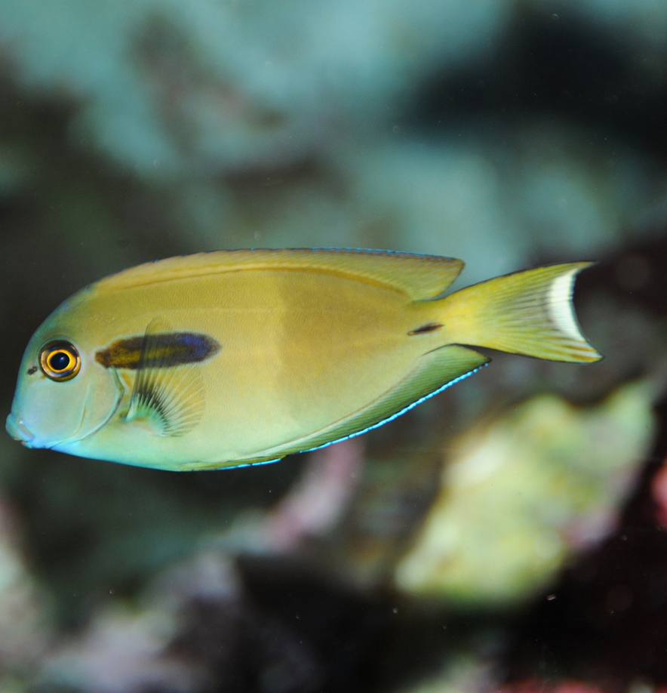
Question 16.

Slide 96
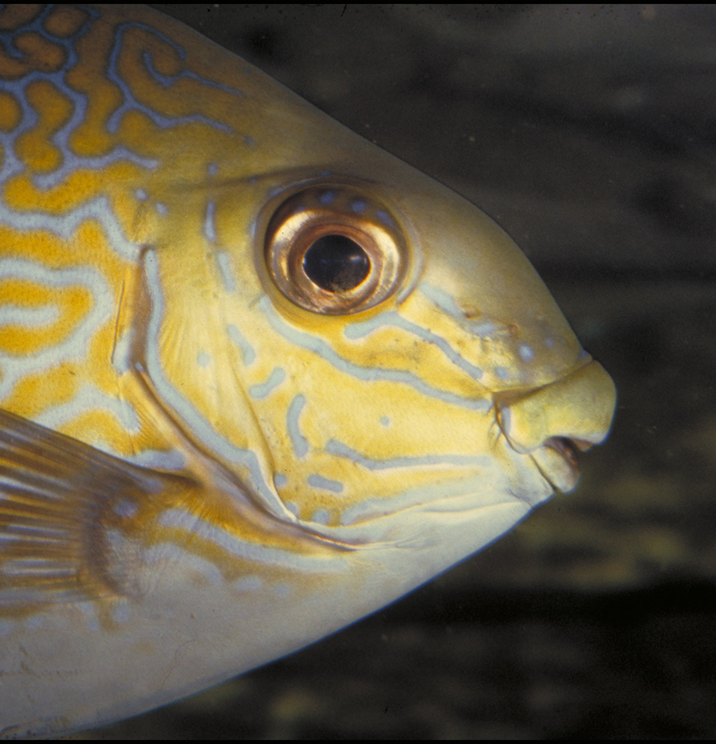
Question 17.

Slide 97
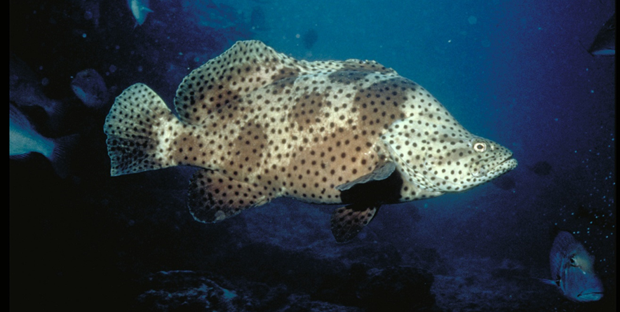
Question 18.

Slide 98
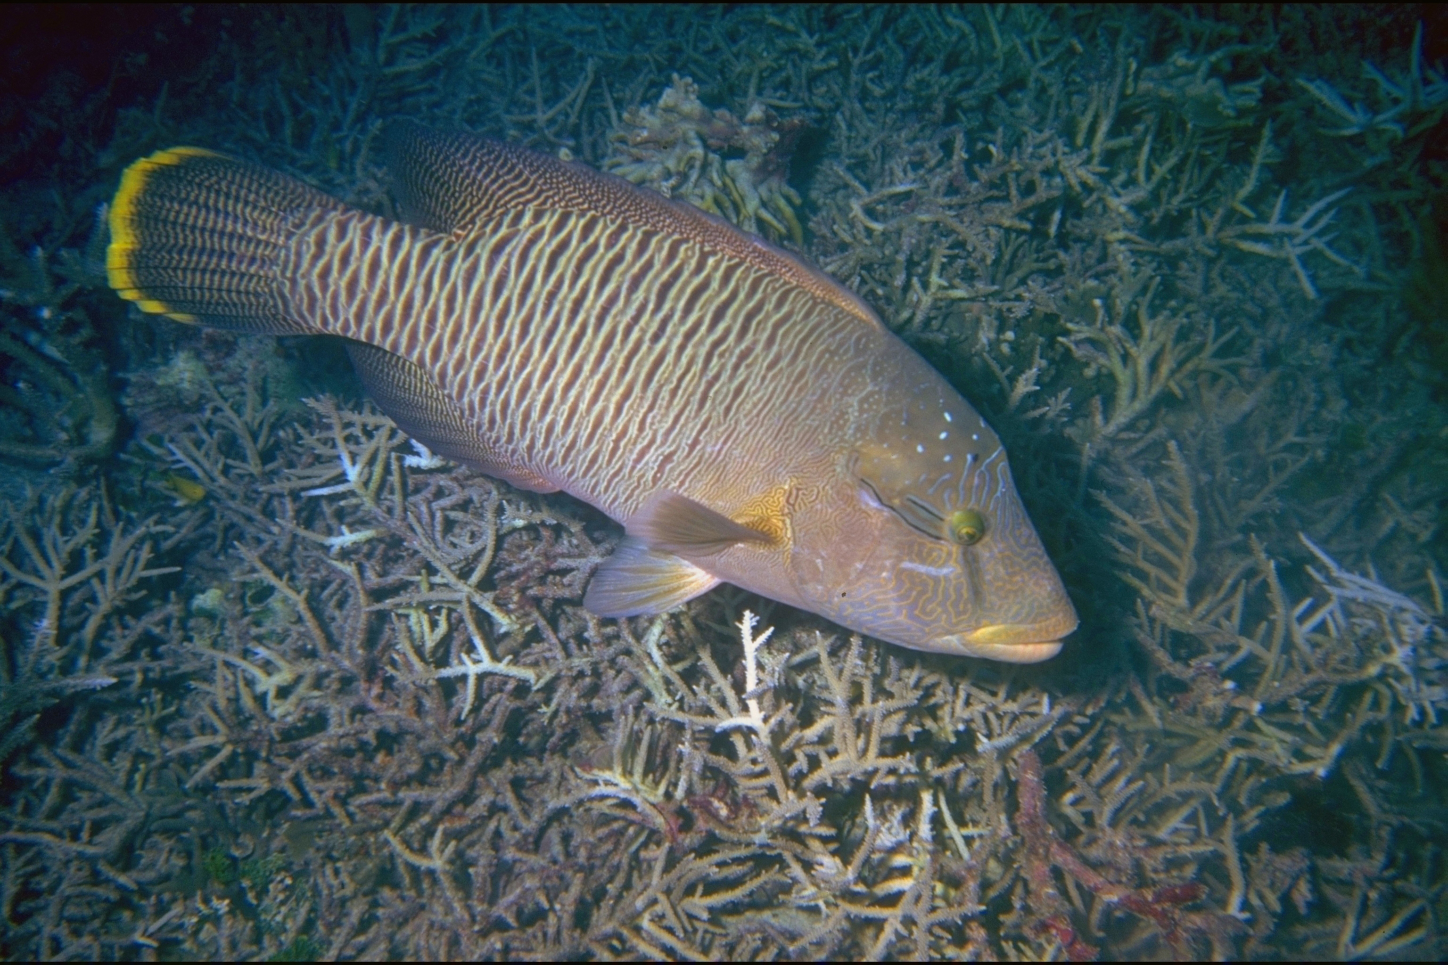
Question 19.
FEMALE

Slide 99

Question 20.
On the Rapid Monitoring form, in which category would you put this animal?
Crown-of-thorns starfish

Slide 100

Question 21.
True or False?
Sea cucumbers have remarkable powers of regeneration and can regrow body parts within 2-3 weeks.
Notes:
These are questions from the pre-snorkel brief on the excursion. Repeating information helps with long term memory retention and builds confidence.

Slide 101
Question 22.
Is it possible for giant clams to bleach when under stress?
Yes
No
Notes:
These are questions from the pre-snorkel brief on the excursion. Repeating information helps with long term memory retention and builds confidence.

Slide 102

Question 23.
What is the cue for the dominant male anemonefish to change sex to a female?
A When his female partner dies.
B When he is 9 years old.
C An environmental cue.
D When he is approximately 15cm.
Notes:
These are questions from the pre-snorkel brief on the excursion. Repeating information helps with long term memory retention and builds confidence.

Slide 103

Question 24.
What is believed to be the function of the fake eye spot on some butterflyfish?
A To fool predators.
B To attract a mate.
C To warn predators that it’s toxic.
D None of the above.
Notes:
These are questions from the pre-snorkel brief on the excursion. Repeating information helps with long term memory retention and builds confidence.

Slide 104

Question 25.
True or False?
Through their feeding strategies, parrotfish and surgeonfish create much of the sand around a reef.
Notes:
These are questions from the pre-snorkel brief on the excursion. Repeating information helps with long term memory retention and builds confidence.

Slide 105

Question 26.
Are cod and grouper protected in the Great Barrier Reef Marine Park?
Yes
No
Notes:
These are questions from the pre-snorkel brief on the excursion. Repeating information helps with long term memory retention and builds confidence.

Slide 106

Question 27.
What is ciguatera poisoning?
A When you get stung by jellyfish.
B When you get sick from swimming in
poor water quality.
C When you get sick from eating very
small reef fish.
D When you get sick from eating very big
reef fish.
Notes:
These are questions from the pre-snorkel brief on the excursion. Repeating information helps with long term memory retention and builds confidence.

Slide 107

Question 28.
Is it possible that a large turtle on the Great Barrier Reef has travelled to South America and back?
Yes
No
Notes:
These are questions from the pre-snorkel brief on the excursion. Repeating information helps with long term memory retention and builds confidence.

Slide 108

Question 29.
Researchers have estimated that for every 1 kilogram of plankton in the Great Pacific Garbage Patch, there are how many kilograms of plastic?
A 1
B 2
C 3
D 6
Notes:
These are questions from the pre-snorkel brief on the excursion. Repeating information helps with long term memory retention and builds confidence.

Slide 109

Question 30.
What do sharks use to sense electricity and vibrations in the water?
A Ampullae of Lorenzini.
B Electroreceptors.
C Tiny black dots around their mouth
and nose
D All the above
Notes:
These are questions from the pre-snorkel brief on the excursion. Repeating information helps with long term memory retention and builds confidence.

Slide 110
Answers
Notes:
The following questions are straight from the Rapid Monitoring Survey course exam questions.

Slide 111
Question 1.

Slide 112
Read to answer the next question.

Slide 113
Question 2.

Slide 114
Question 3.

Slide 115
Question 4.
D

Slide 116
Question 5.
B

Slide 117
Question 6.
A

Slide 118
Question 7.
C

Slide 119
Question 8.
Hawksbill turtle
D

Slide 120
Question 9.
D

Slide 121
Question 10.
B

Slide 122
Question 11.
C

Slide 123
Question 12.
A

Slide 124
Question 13.
D

Slide 125
Question 14.
C

Slide 126
Question 15.
A

Slide 127
Question 16.
B

Slide 128
Question 17.
B

Slide 129

Question 18.
B

Slide 130
Question 19.
B
FEMALE

Slide 131
Question 20.
On the Rapid Monitoring form, in which category would you put this animal?
animal?
Crown-of-thorns starfish
B

Slide 132
Question 21.
True or False?
Sea cucumbers have remarkable powers of regeneration and can regrow body parts within 2-3 weeks.
True
Notes:
These are questions from the pre-snorkel brief on the excursion. Repeating information helps with long term memory retention and builds confidence.

Slide 133
Question 22.
Is it possible for giant clams to bleach when under stress?
Yes
No
Yes
Notes:
These are questions from the pre-snorkel brief on the excursion. Repeating information helps with long term memory retention and builds confidence.

Slide 134
Question 23.
What is the cue for the dominant male anemonefish to change sex to a female?
A When his female partner dies.
B When he is 9 years old.
C An environmental cue.
D When he is approximately 15cm.
A
Notes:
These are questions from the pre-snorkel brief on the excursion. Repeating information helps with long term memory retention and builds confidence.

Slide 135
Question 24.
What is believed to be the function of the fake eye spot on some butterflyfish?
A To fool predators.
B To attract a mate.
C To warn predators that it’s toxic.
D None of the above.
A
Notes:
These are questions from the pre-snorkel brief on the excursion. Repeating information helps with long term memory retention and builds confidence.

Slide 136
Question 25.
True or False?
Through their feeding strategies, parrotfish and surgeonfish create much of the sand around a reef.
True
Notes:
These are questions from the pre-snorkel brief on the excursion. Repeating information helps with long term memory retention and builds confidence.

Slide 137
Question 26.
Are cod and grouper protected in the Great Barrier Reef Marine Park?
Yes
No
Yes
Notes:
These are questions from the pre-snorkel brief on the excursion. Repeating information helps with long term memory retention and builds confidence.

Slide 138

Question 27.
What is ciguatera poisoning?
A When you get stung by jellyfish.
B When you get sick from swimming in
poor water quality.
C When you get sick from eating very
small reef fish.
D When you get sick from eating very big
reef fish.
D
Notes:
These are questions from the pre-snorkel brief on the excursion. Repeating information helps with long term memory retention and builds confidence.

Slide 139
Question 28.
Is it possible that a large turtle on the Great Barrier Reef has travelled to South America and back?
Yes
No
Yes
Notes:
These are questions from the pre-snorkel brief on the excursion. Repeating information helps with long term memory retention and builds confidence.

Slide 140
Question 29.
Researchers have estimated that for every 1 kilogram of plankton in the Great Pacific Garbage Patch, there are how many kilograms of plastic?
A 1
B 2
C 3
D 6
D
Notes:
These are questions from the pre-snorkel brief on the excursion. Repeating information helps with long term memory retention and builds confidence.

Slide 141

Question 30.
What do sharks use to sense electricity and vibrations in the water?
A Ampullae of Lorenzini.
B Electroreceptors.
C Tiny black dots around their mouth
and nose
D All the above
D
Notes:
These are questions from the pre-snorkel brief on the excursion. Repeating information helps with long term memory retention and builds confidence.

Slide 142
How did you go?

Slide 143

Do you think next time, you could count all the animals yourself?

Slide 144
You’ve now learnt that the Great Barrier Reef is one of the world’s most biodiverse ecosystems.

Slide 145
Coral reefs are dependent on many factors. They are highly interconnected ecosystems.

Slide 146

Notes:
Image: Copyright Commonwealth of Australia (GBRMPA)

Slide 147
The Great Barrier Reef faces many threats that impact on its health and resilience.

Slide 148

Notes:
Image: Copyright Commonwealth of Australia (GBRMPA)

Slide 149

What actions can you take to protect the Great Barrier Reef?

Slide 150
Remember, the Great Barrier
Reef Marine Park Authority also
has an Eye on the Reef app.
Do you remember this from your excursion?
It’s also a great tool for learning more about the
animals you saw!
Do you recognize any wildlife in the app?

Slide 151

Download
the Eye on the
Reef app.
Notes:
App image: https://www.gbrmpa.gov.au/__data/assets/pdf_file/0020/265430/Eye-on-the-Reef-app-poster.pdf

Slide 152


Press “Sightings” and “Create”.

Slide 153


Press “Wildlife”.

Slide 154


Marine mammals.
Select your animal and press “INFORMATION” to learn more.

Slide 155


Marine reptiles.

Slide 156




Sharks and rays.

Slide 157



Fishes.

Slide 158












Slide 159





Birds.

Slide 160


Invertebrates.

Slide 161










Slide 162
Explore the other tabs too!

Slide 163
Create a poster to answer the question:
How can I help the Great Barrier Reef?
Display it proudly in your classroom.
Notes:
This is the last slide for students to view. The remaining slides are for the teachers.

Slide 164
Thank you for helping the Great Barrier Reef!
See the Reef • Love the Reef • Protect the Reef

