Slide 1
Be a Marine
Biologist for a Day
Part 3: Making connections
Year 6
Notes:
Image: C. Jones, Copyright Commonwealth of Australia (GBRMPA)

Slide 2


Thank you for organising your trip to the reef with us.
We had a great time and hope you did too.
This PowerPoint is Part 3 of the Be a Marine Biologist for a Day program designed for year 6 by the Great Barrier Reef Marine Park Authority (GBRMPA).
View this PowerPoint after your excursion, with the accompanying activity book.
This is Part 3: Making connections. This is the last part of the program. This is when your students make connections with all they’ve learned and experienced so far.
On your excursion, you conducted an Eye on the Reef citizen science activity with your reef guide. Now it’s time to upload your data to the GBRMPA website. It’s also time for students to check understanding by answering any questions in Parts 1 and 2.
The Great Barrier Reef Marine Park Authority would like to thank you for uploading your data to their Rapid Monitoring database. We hope to see you again next year!
Licensed by the Commonwealth of Australia for use under a Creative Commons By Attribution 4.0 International licence with the exception of content supplied by third parties and any photographs. http://creativecommons.org/licences/by/4.0

Slide 3

We would like to acknowledge all of the Aboriginal and Torres Straight Islander peoples who have connection to the Great Barrier Reef.
We recognise their continuing connection to land, water and community, and pay our respects to their Elders past, present and emerging.

Slide 4

We would like to acknowledge the (insert name of local Traditional Owner group) peoples as the Traditional Owners of the Land and Sea Country that we visited as part of your excursion.

Slide 5

How can I help the
Great Barrier Reef?
Notes:
This is the overarching inquiry question that encompasses the entire BAMBFAD Program and is the starting slide to this presentation.

Slide 6

Notes:
Image: J. Johnson, Copyright Copyright Commonwealth of Australia (GBRMPA)

Slide 7
Eye on the Reef
Rapid Monitoring survey
MODIFIED 10 MINUTE TIMED SURVEY

Slide 8

Are you ready to upload your data to GBRMPA?

Slide 9

This is the website for GBRMPA’s Eye on the Reef.
The link to connect is provided at the end of this presentation.

Slide 10

Login.

Slide 11

Select ‘Rapid Monitoring Survey’ tab.

Slide 12


Enter your data.

Slide 13

If you also completed the (more advanced) 360°survey, complete all questions. Otherwise, leave blank.

Slide 14

Save!
Scroll down to the bottom of the page to ‘Save’.

Slide 15
Are you ready?
Click on the image below to connect.
Notes:
www.gbrmpa.gov.au/our-work/eye-on-the-reef

Slide 16

Thank
you
Male Maori wrasse
Notes:
Image: C. Jones, Copyright Copyright Commonwealth of Australia (GBRMPA)

Slide 17
Check understanding.
Next, is what you’ve all been waiting for.
The answers to questions asked in Part 1 (before the excursion) and/or Part 2 (on the excursion).
Let’s check how you went!
Notes:
The following questions are straight from the Rapid Monitoring Survey course exam questions.

Slide 18


Sea cucumber
Notes:
Image: Copyright Commonwealth of Australia (GBRMPA)

Slide 19
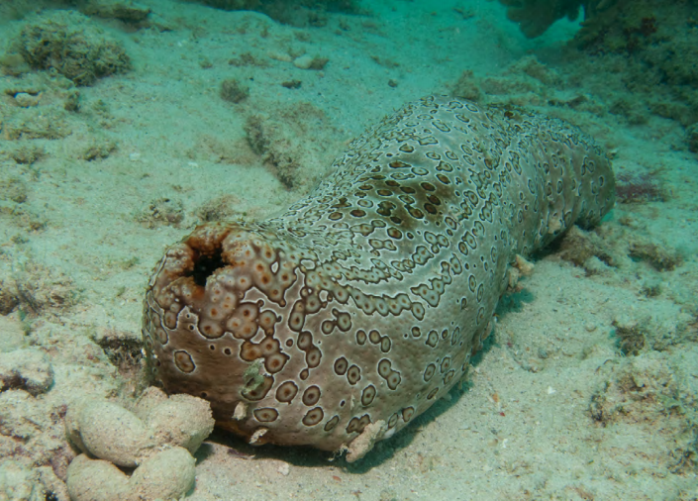
How do they breathe?
Notes:
Image: Copyright Commonwealth of Australia (GBRMPA)

Slide 20
By taking in
water through
their anus!
Mouth
Anus
Notes:
Image: Copyright Commonwealth of Australia (GBRMPA)

Slide 21
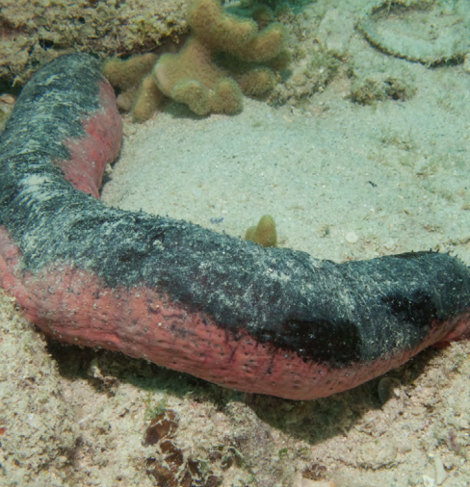
How do
they move?
Notes:
Image: Copyright Commonwealth of Australia (GBRMPA)

Slide 22
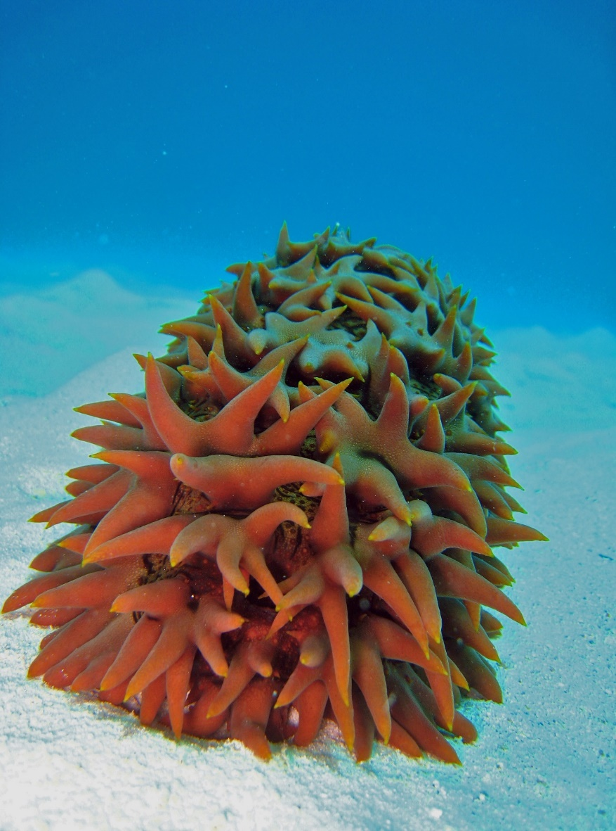
With their tube
feet and rhythmic contractions of
their bodies.
Notes:
Image: C. Jones, Copyright Commonwealth of Australia (GBRMPA)

Slide 23
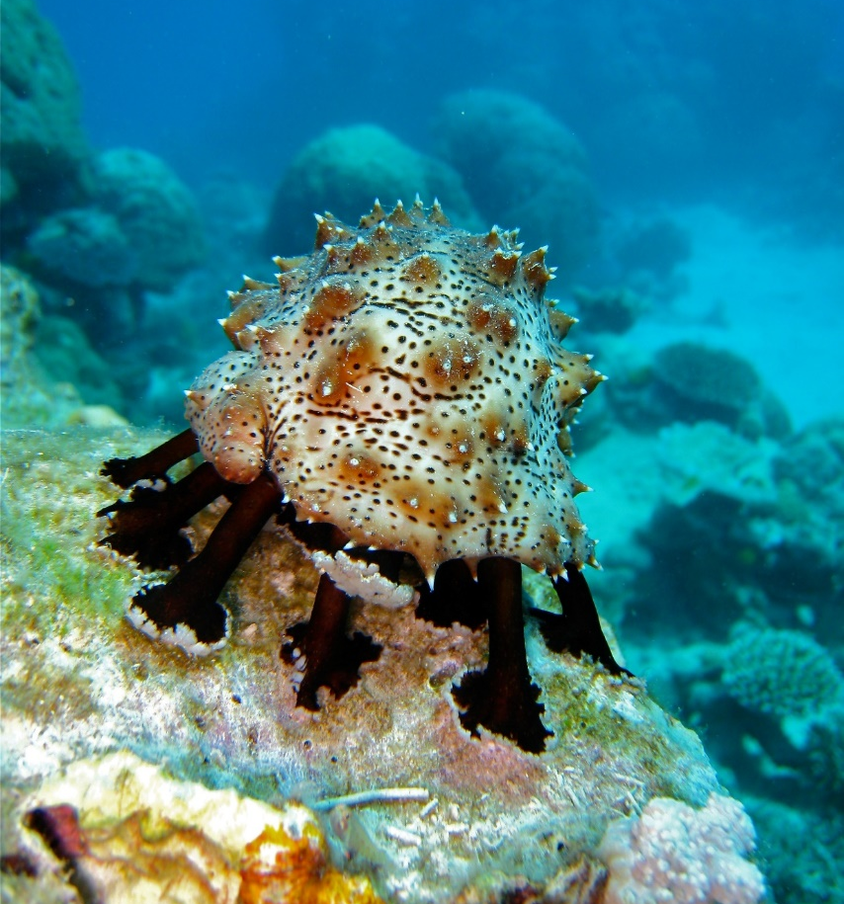

Why count sea cucumbers?
Notes:
Images: (Left) C. Jones, Copyright Copyright Commonwealth of Australia (GBRMPA); (Middle) C. Jones, Copyright Copyright Commonwealth of Australia (GBRMPA); (Right) J. Jones, Copyright Copyright Commonwealth of Australia (GBRMPA)

Slide 24
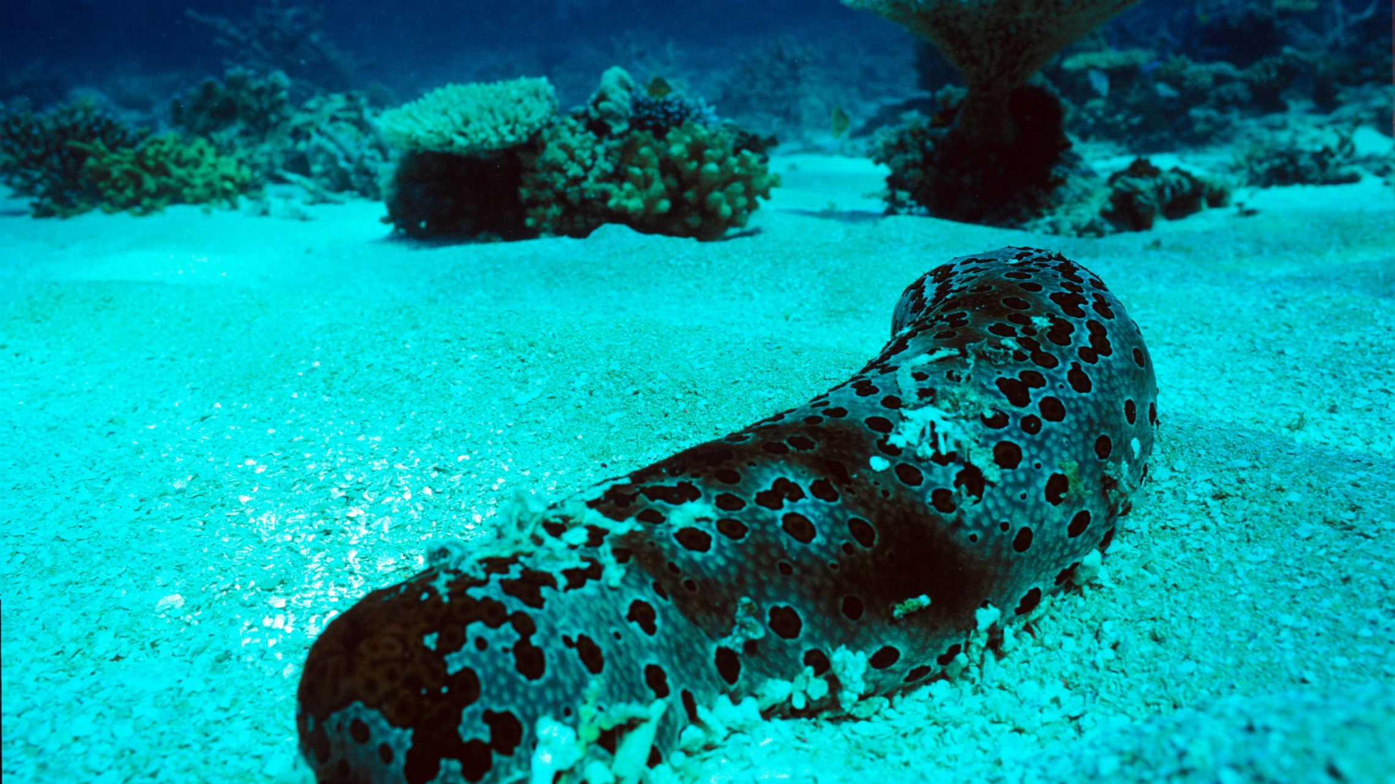
Hint: Sea cucumbers are the
vacuum cleaners of the sea.
Notes:
Image: J. Oliver, Copyright Commonwealth of Australia (GBRMPA)

Slide 25
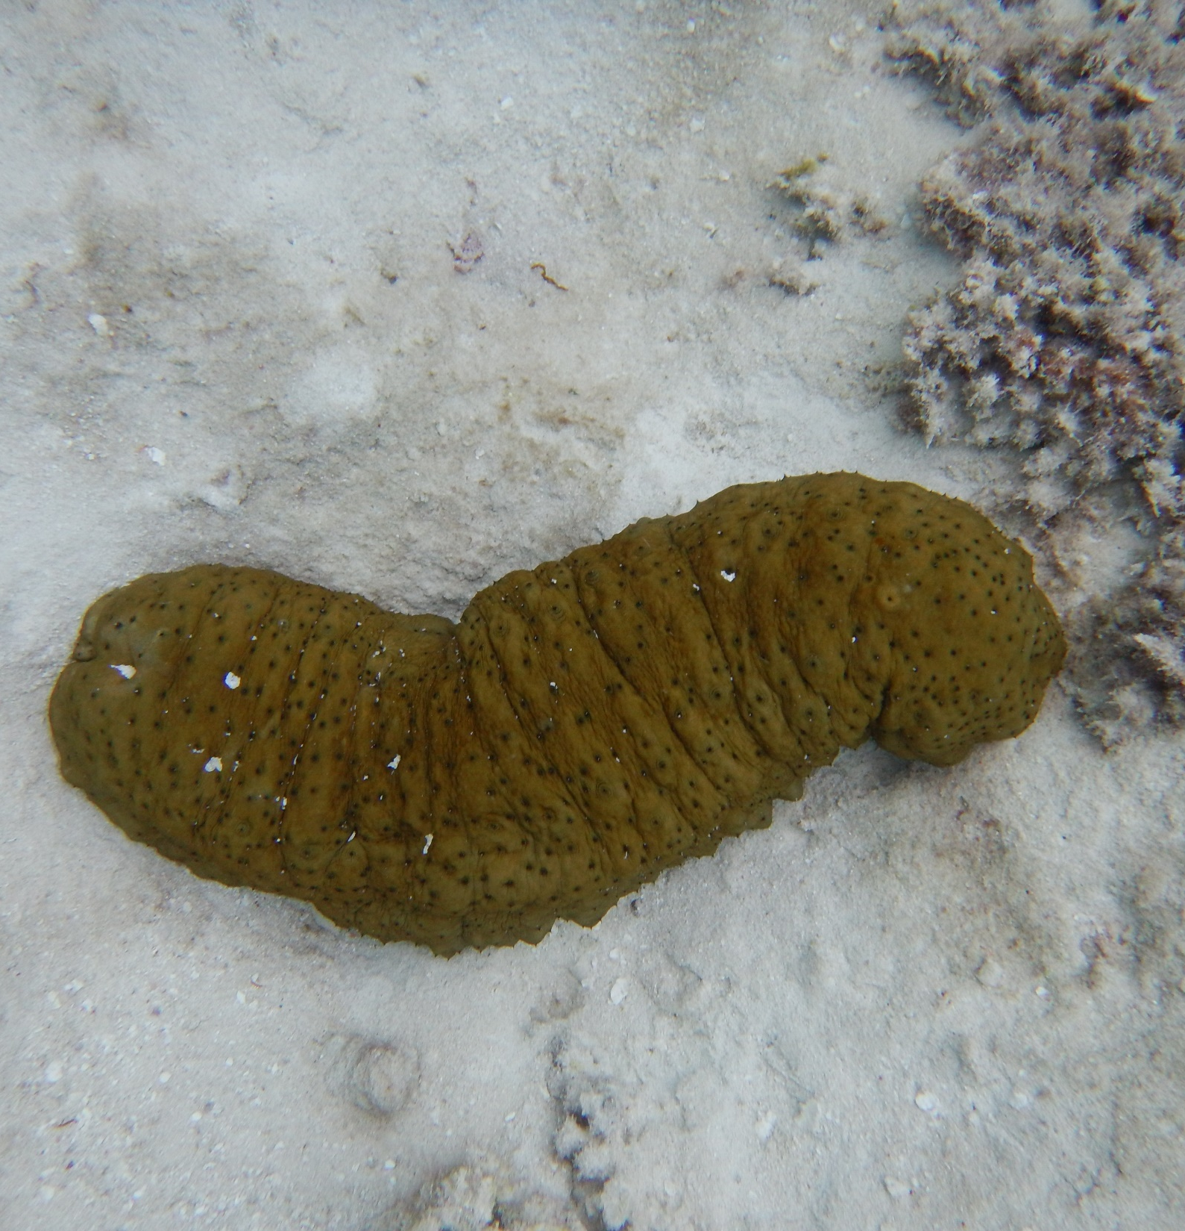
They keep
the sand clean
and filtered.
Notes:
Image: K. Goudkamp, Copyright Commonwealth of Australia (GBRMPA)

Slide 26

Giant clam
VULNERABLE TO EXTINCTION
Notes:
Image: Copyright Commonwealth of Australia (GBRMPA)

Slide 27

How many
holes does the mantle have?
Notes:
Image: C. Jones, Copyright Commonwealth Government of Australia (GBRMPA)

Slide 28
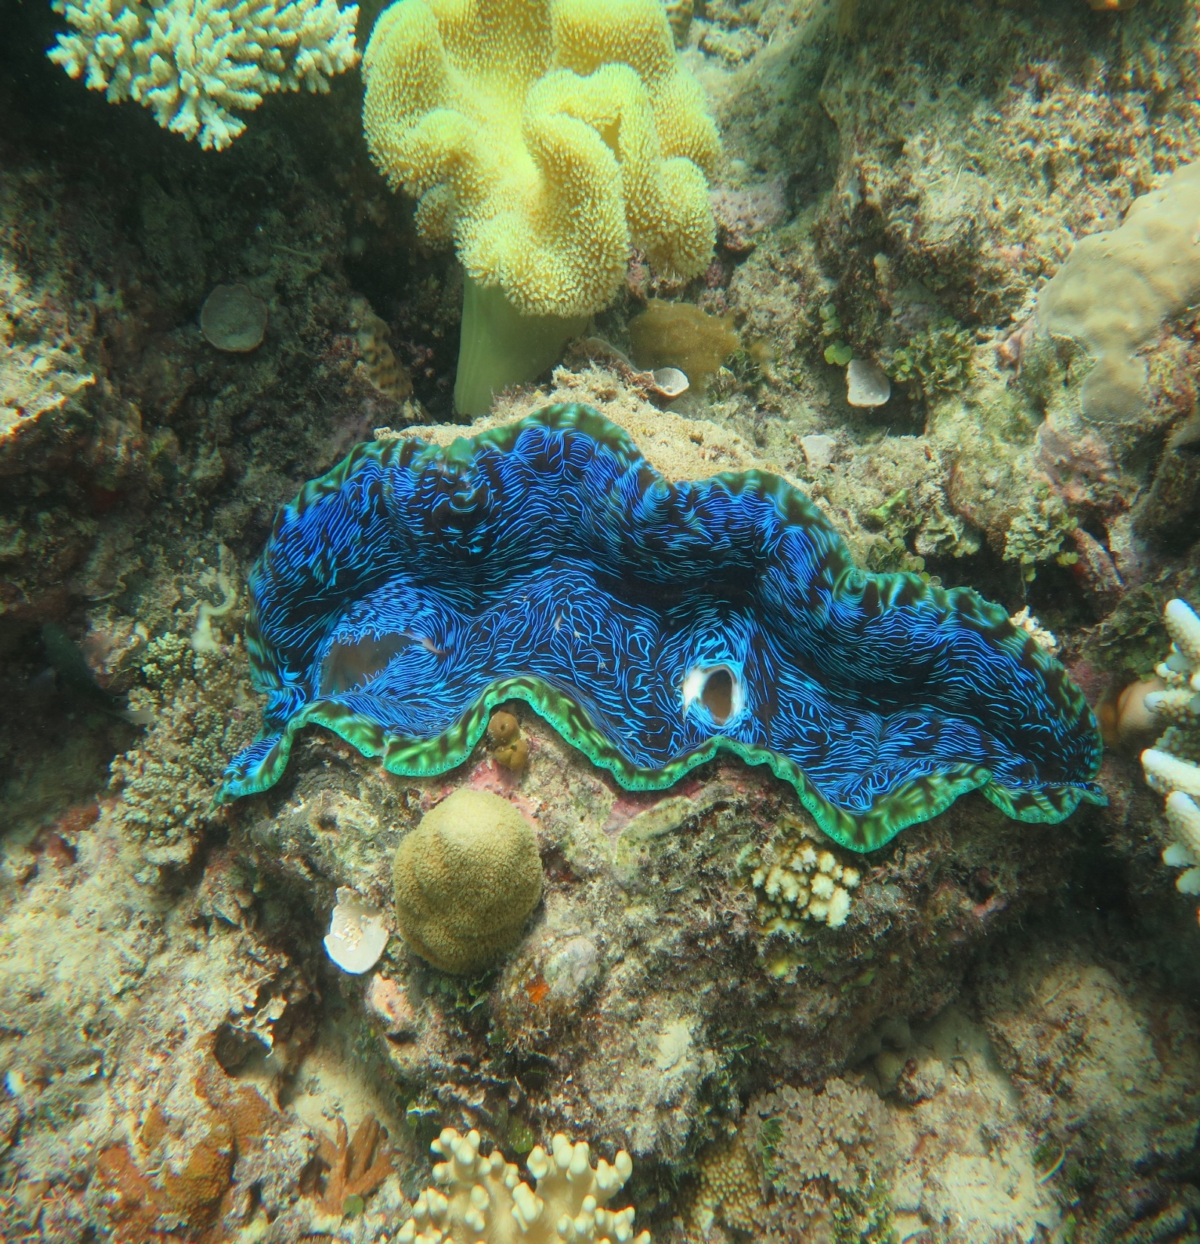
2
Notes:
Image: J. Stella, Copyright Commonwealth of Australia (GBRMPA)

Slide 29
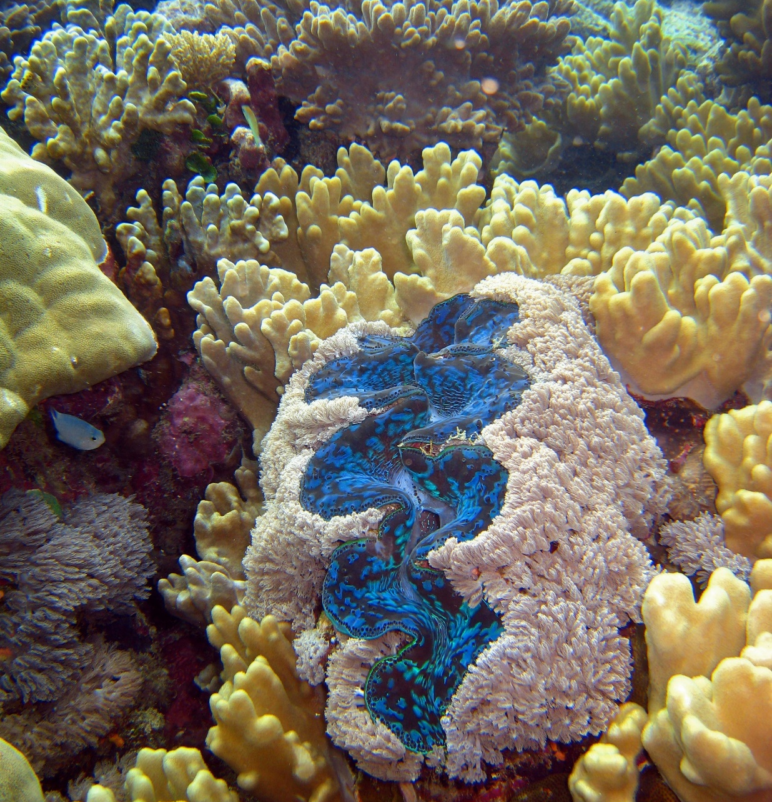
How does the
algae that lives in the mantle help the giant clam?
Notes:
Image: C. Jones, Copyright Commonwealth of Australia (GBRMPA)

Slide 30
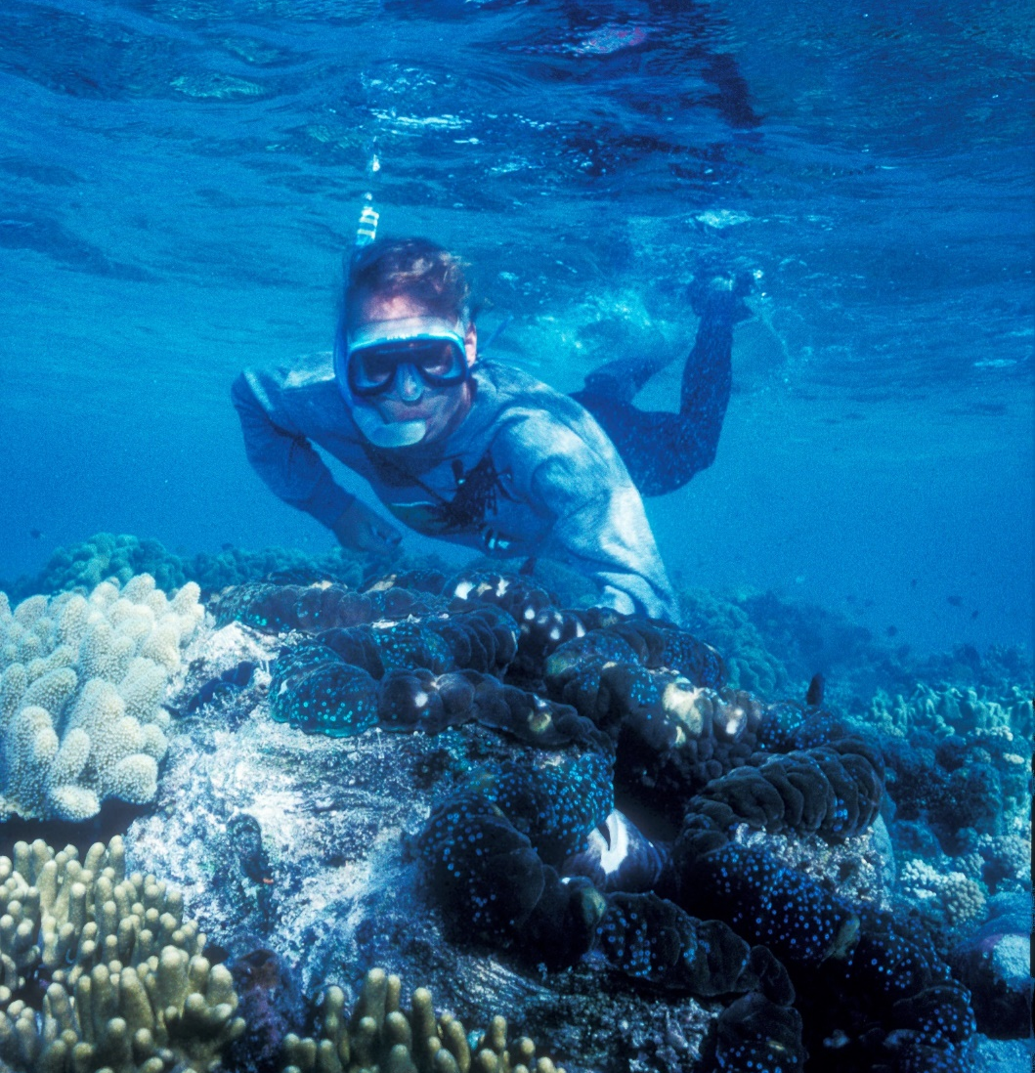
It feeds the clam via photosynthesis, turning sunlight into food and energy.
Notes:
Image: K. Anthony, Copyright Commonwealth of Australia (GBRMPA)

Slide 31
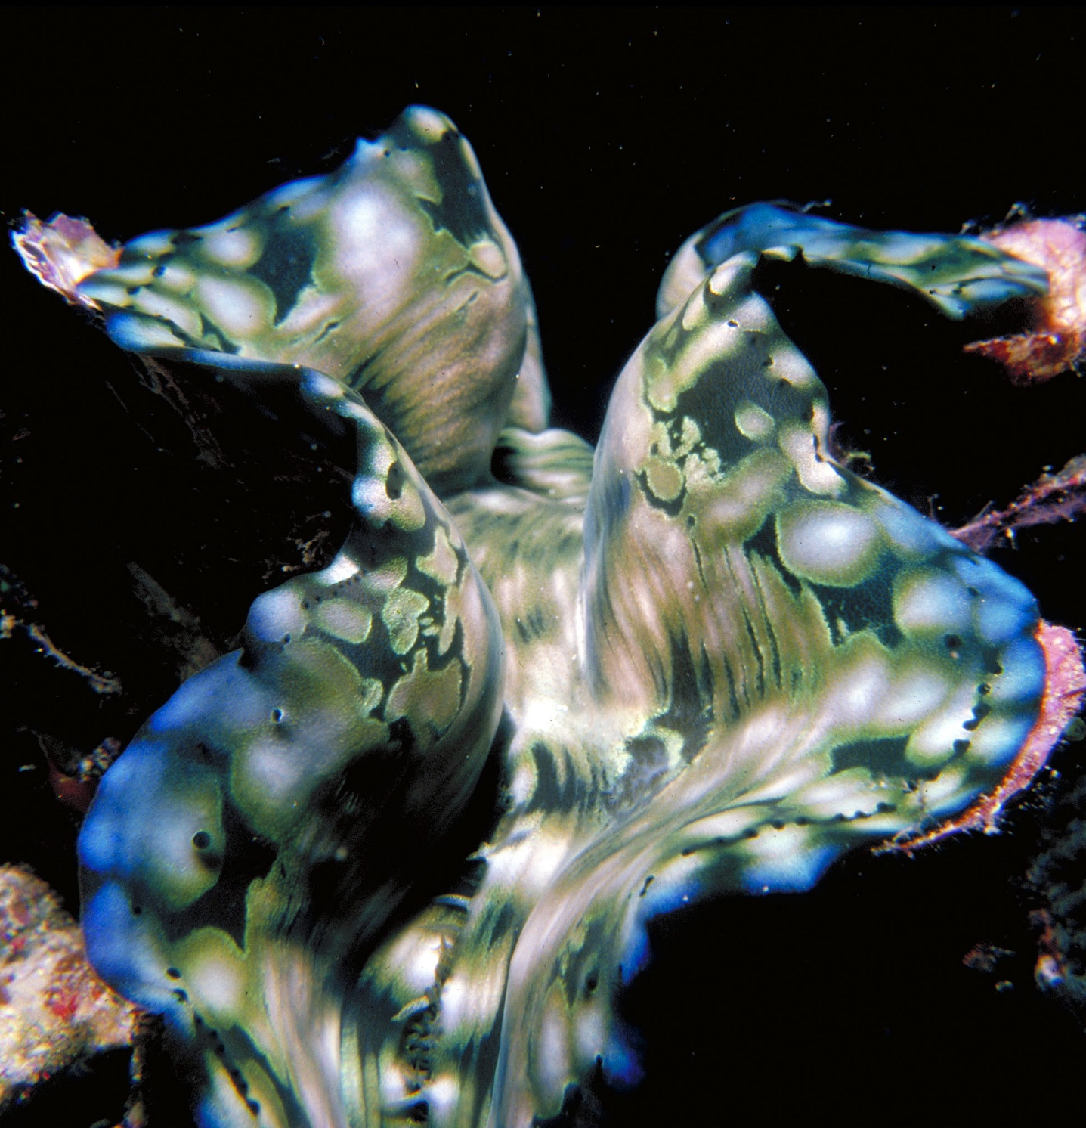
How does the
giant clam help the algae in return?
Notes:
Image: R. Berklemans, Copyright Commonwealth of Australia (GBRMPA)

Slide 32

The algae has a safe place to live.
Notes:
Image: J. Sumerling, Copyright Commonwealth of Australia (GBRMPA)

Slide 33

Anemonefish
Notes:
Image: J. Sumerling, Copyright Commonwealth Government of Australia (GBRMPA)

Slide 34

Why are the anemonefish all different sizes?
Notes:
Image: T. Mayne, Copyright Commonwealth of Australia (GBRMPA)

Slide 35
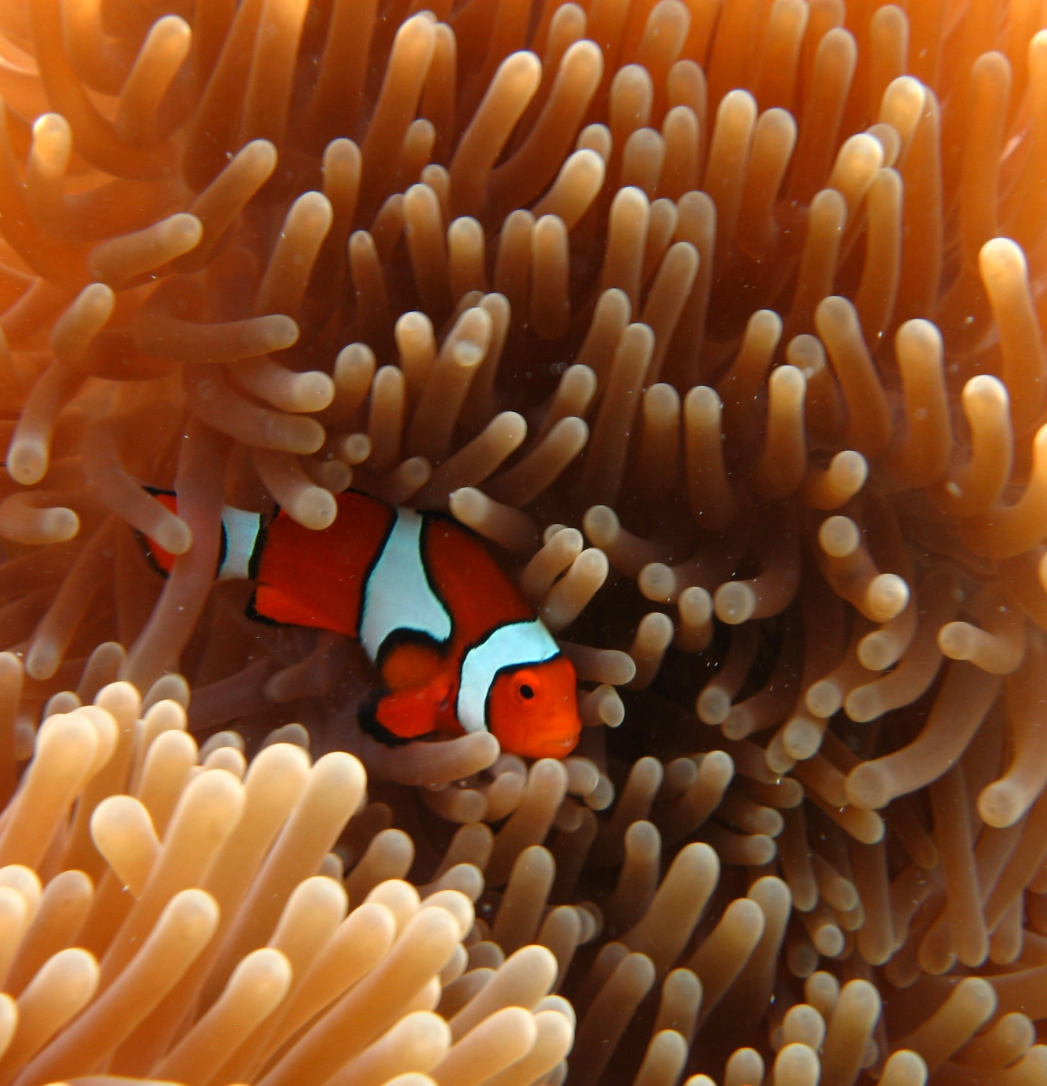
The biggest anemonefish is always the female.
All the others
are male.
Notes:
Image: E. Smart, Copyright Commonwealth Government of Australia (GBRMPA)

Slide 36
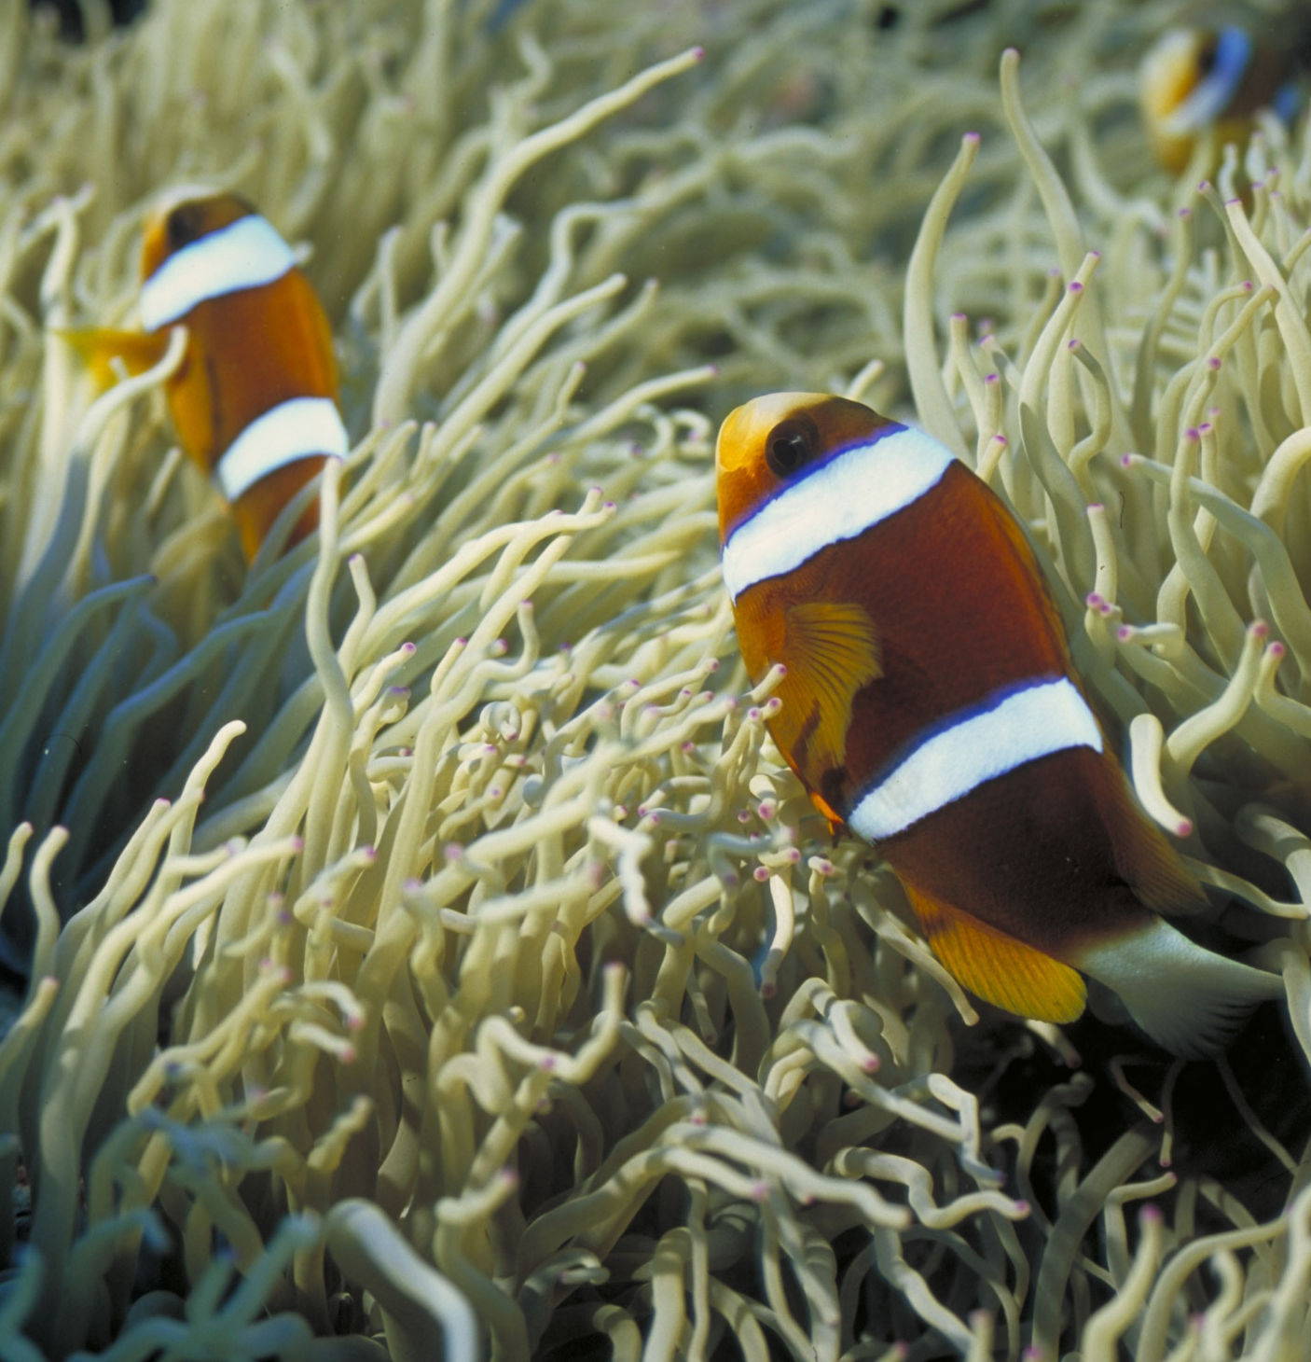
The two largest anemonefish are the
mating pair.
Notes:
Image: D. Wachenfeld, Copyright Commonwealth of Australia (GBRMPA)

Slide 37
When the female dies,
her male partner turns into
a female. Then the next largest male takes his place.
Smaller male
Male
Female
Notes:
Image: D. Wachenfeld, Copyright Commonwealth of Australia (GBRMPA)

Slide 38

Butterflyfish
Bright colours and pretty patterns
Long snout and little mouth for eating coral polyps
Flat body
Notes:
Image: J. Jones, Copyright Commonwealth of Australia (GBRMPA)

Slide 39

Some have a
fake eye spot.
Why?
Notes:
Image: J. Jones, Copyright Commonwealth of Australia (GBRMPA)

Slide 40
To trick their predators.
Notes:
Image: J. Jones, Copyright Commonwealth of Australia (GBRMPA)

Slide 41

Grazing herbivores
Parrotfish / Surgeonfish / Rabbitfish / Unicornfish
Notes:
Image: W. Gladstone, Copyright Commonwealth of Australia (GBRMPA)

Slide 42

Why are grazing herbivores called
the lawnmowers of the Reef?
Notes:
Image: C. Jones, Copyright Commonwealth of Australia (GBRMPA)

Slide 43

Because they graze on so much algae.
Notes:
Image: C. Jones, Copyright Commonwealth of Australia (GBRMPA)

Slide 44
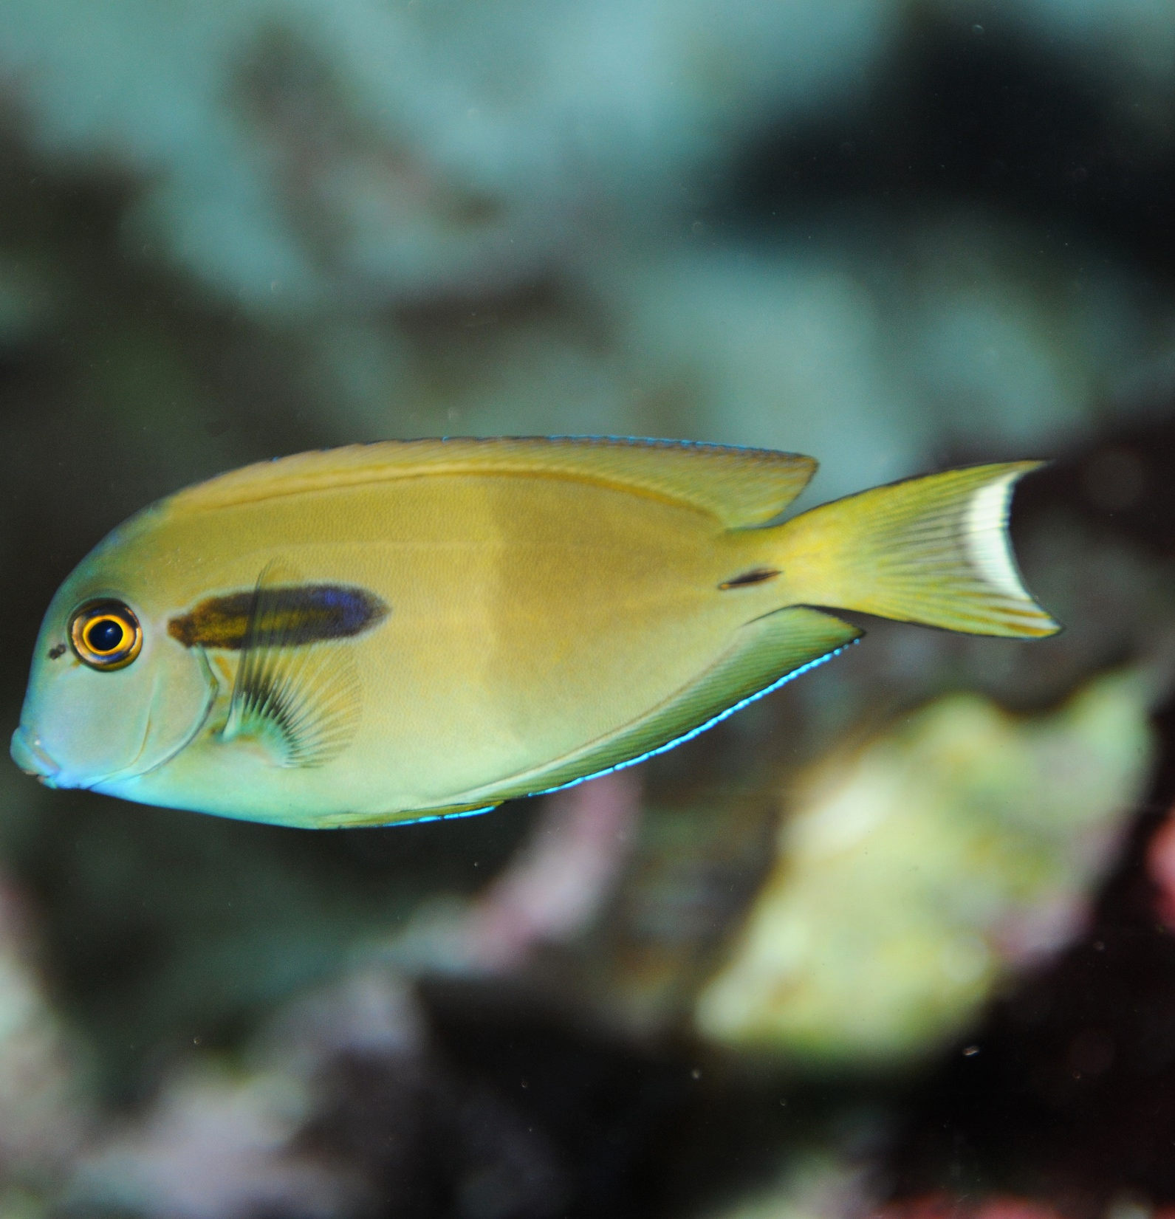
Why are some called surgeonfish?
Notes:
Image: J. Jones, Copyright Commonwealth of Australia (GBRMPA)

Slide 45
Surgeonfish have
a sharp blade, either side of their tail,
like a surgeon
would use.
Notes:
Image: J. Jones, Copyright Commonwealth of Australia (GBRMPA)

Slide 46

Cods and groupers
Pronounced grow-per.
Notes:
Image: J. Hurford, Copyright Commonwealth of Australia (GBRMPA)

Slide 47
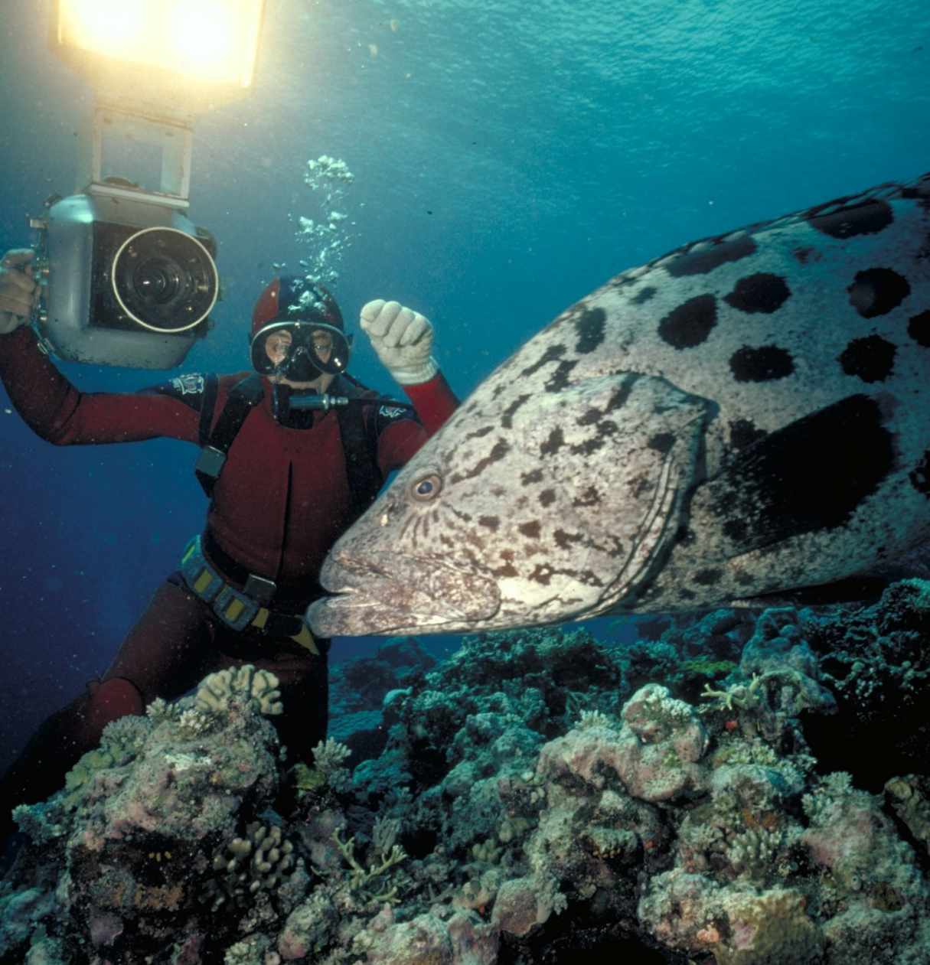
Cods and groupers are solitary animals.
They live alone.
Notes:
Image: Ron & Valerie Taylor, Copyright Commonwealth of Australia (GBRMPA)

Slide 48
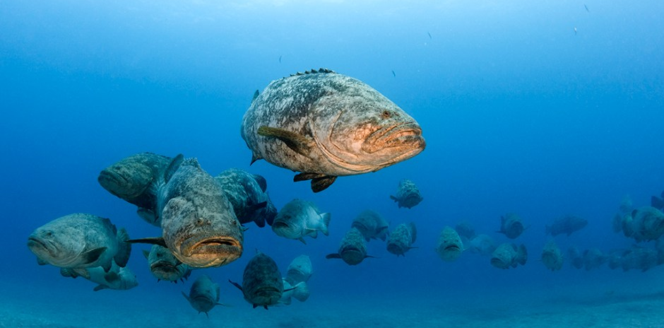
So, what are we looking at here? Why so many?
Image: Walt Sterns Divepbc.com
Notes:
Image: http://divepbc.com/goliath-grouper-spawning-season/
Giant grouper spawning aggregation in the waters off Jupiter Florida

Slide 49
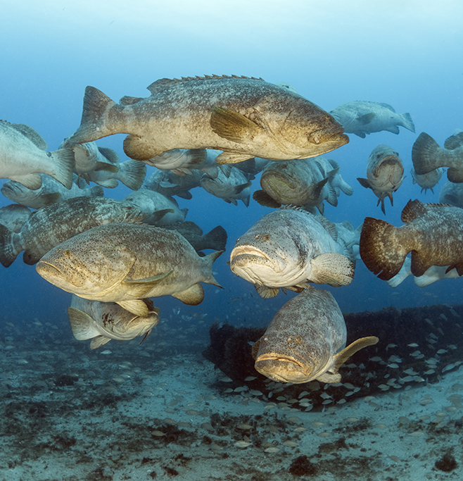
They all gather in one
spot for spawning.
In pairs, they will swim to
the surface to release eggs and sperm in the water.
Notes:
Image: http://divepbc.com/goliath-grouper-spawning-season/
Giant grouper spawning aggregation in the waters off Jupiter Florida

Slide 50
Spawning aggregations are protected
from fishing within the boundaries of
the Great Barrier Reef Marine Park.

Slide 51

Coral trout
Notes:
Image: S. Summerhays, Copyright Commonwealth of Australia (GBRMPA)

Slide 52
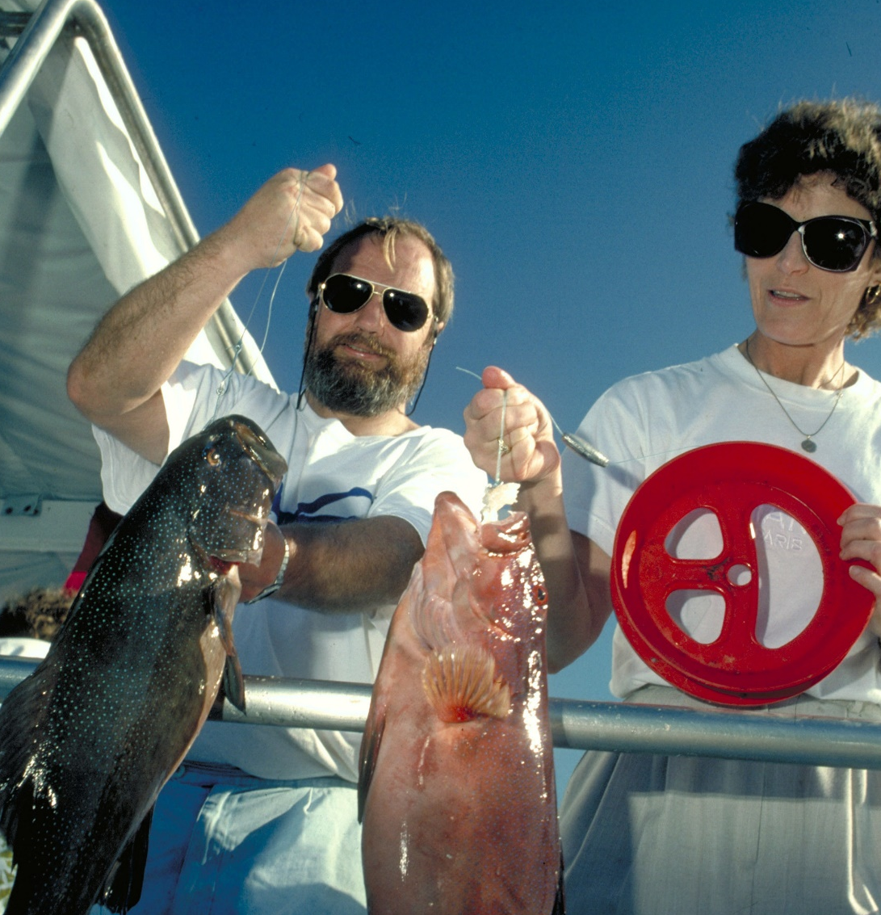
Lots of people
like to eat
coral trout.
What is the
legal size?
Notes:
Image: A. Elliott, Copyright Commonwealth of Australia (GBRMPA)

Slide 53
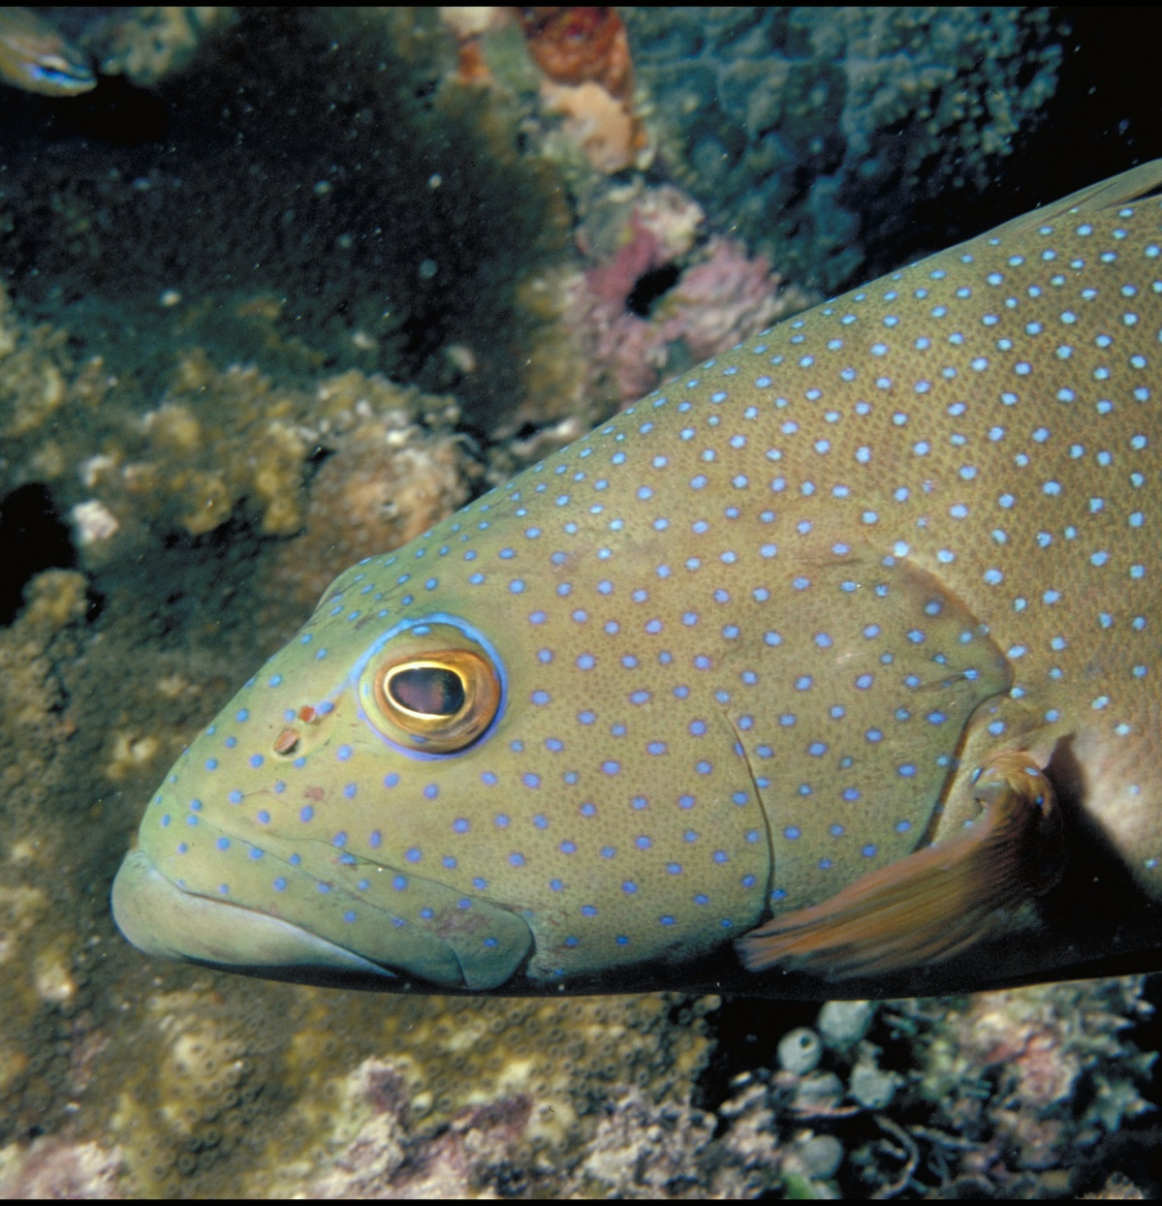
38cm.
Notes:
Image: A. Zell, Copyright Commonwealth of Australia (GBRMPA)

Slide 54

Maori wrasse
also called humphead wrasse or Napoleon wrasse.
Notes:
Image: C. Jones, Copyright Commonwealth of Australia (GBRMPA)

Slide 55
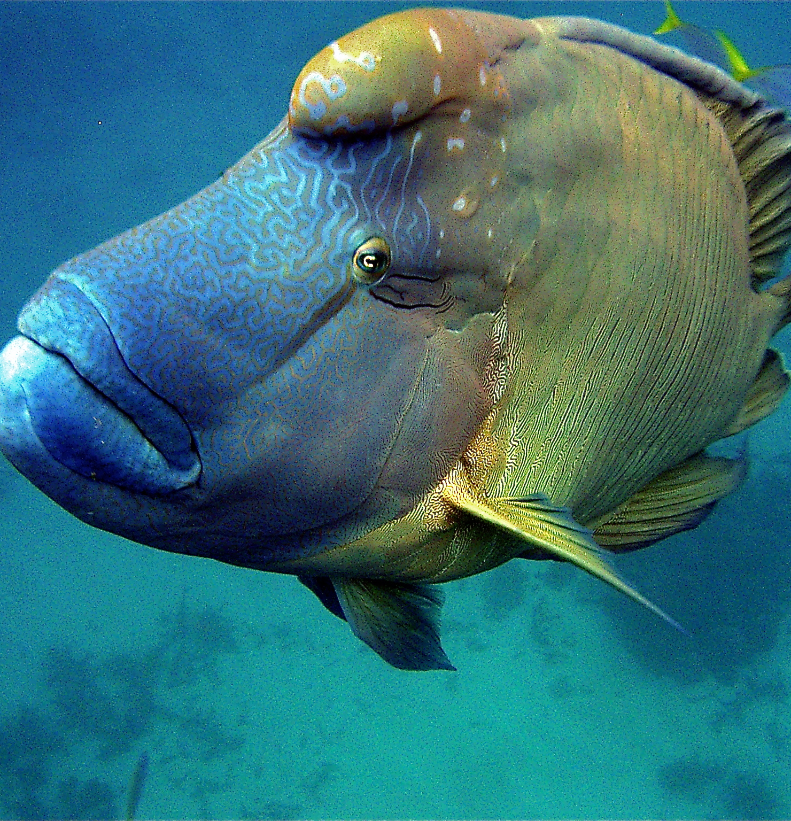
They are the
biggest of all the wrasses, and can become very friendly.
Do not touch!
Notes:
Image: C. Jones, Copyright Commonwealth of Australia (GBRMPA)

Slide 56

What happens if people touch a Maori wrasse?
Notes:
Image: C. Jones Copyright Commonwealth of Australia (GBRMPA)

Slide 57

It removes their protective layer of fish mucus and they can get sick.
Male
Notes:
Image: M. Simmons, Copyright Commonwealth of Australia (GBRMPA)

Slide 58

Sea turtles
Notes:
Image: C. Jones, Copyright Commonwealth of Australia (GBRMPA)

Slide 59
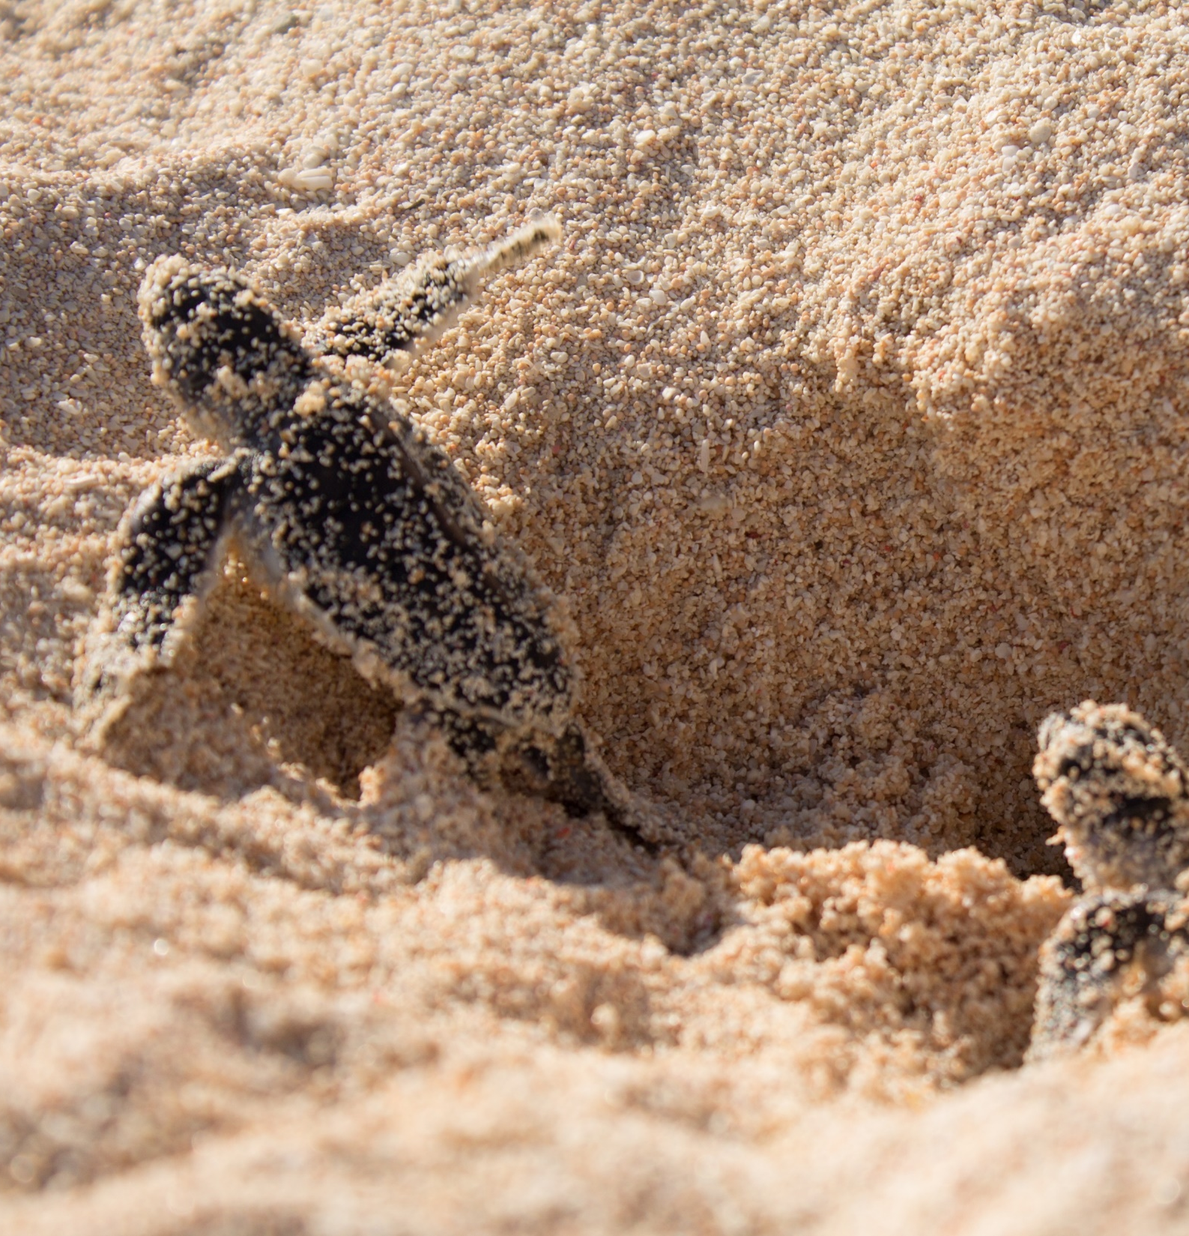
When is turtle breeding season?
Notes:
Image: A. Simmonds, Copyright Commonwealth of Australia (GBRMPA)

Slide 60
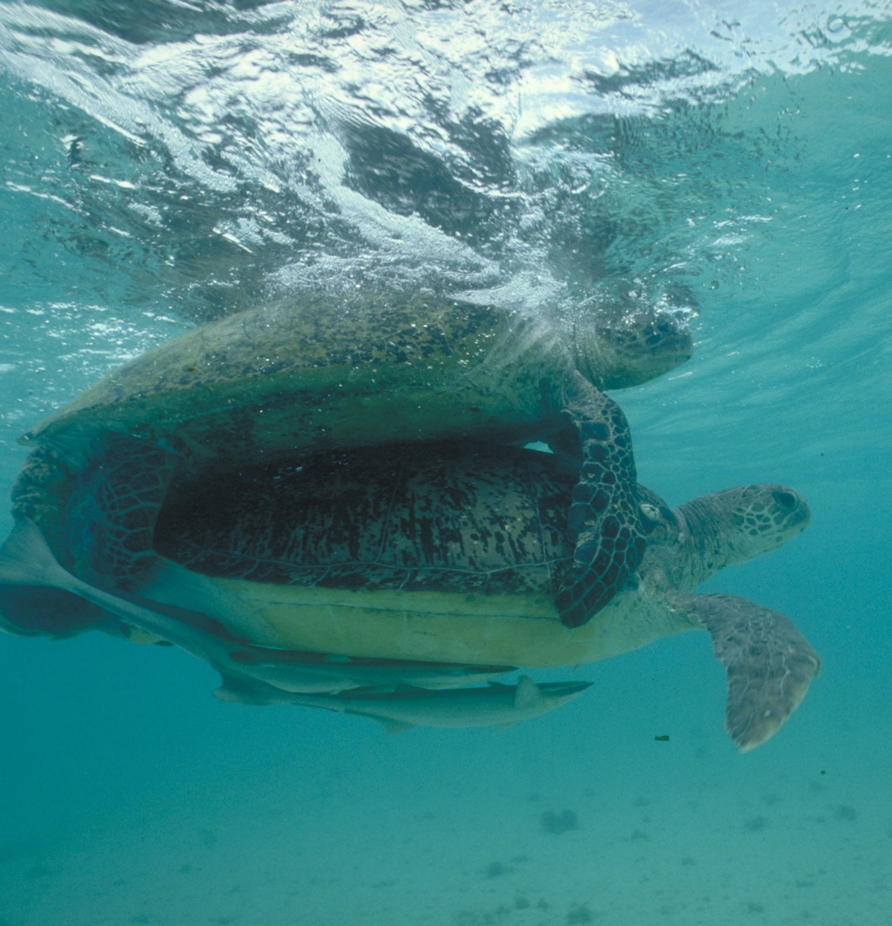
Summer is turtle breeding season!
Notes:
Image: M. Simmons, Copyright Commonwealth of Australia (GBRMPA)

Slide 61
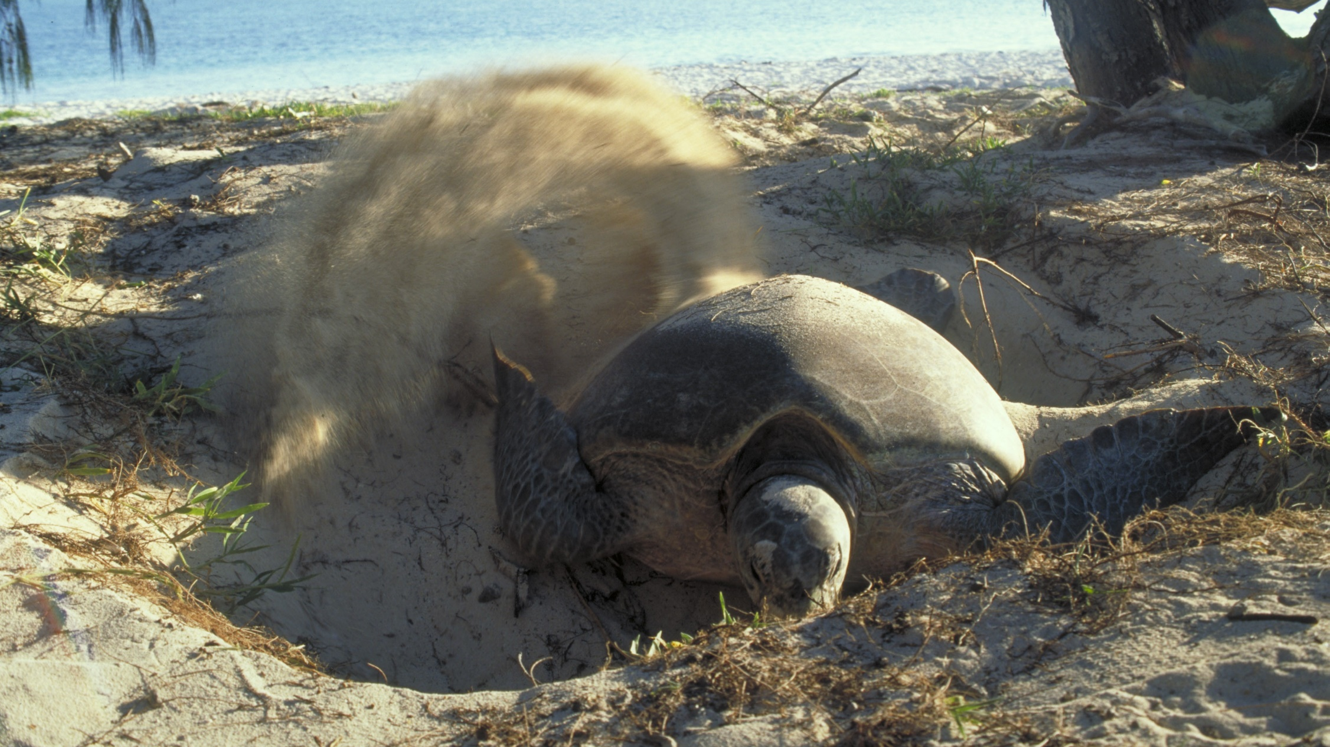
Notes:
They spend their entire lives in the water, except for when they breed. Turtle breeding season is over summer. Turtles do not breed until they are 30 years of age. They swim back to the same place they were born, sometimes 1000s of kilometers away, to find a mate and become pregnant. Image: J. Jones, Copyright Commonwealth of Australia (GBRMPA)

Slide 62
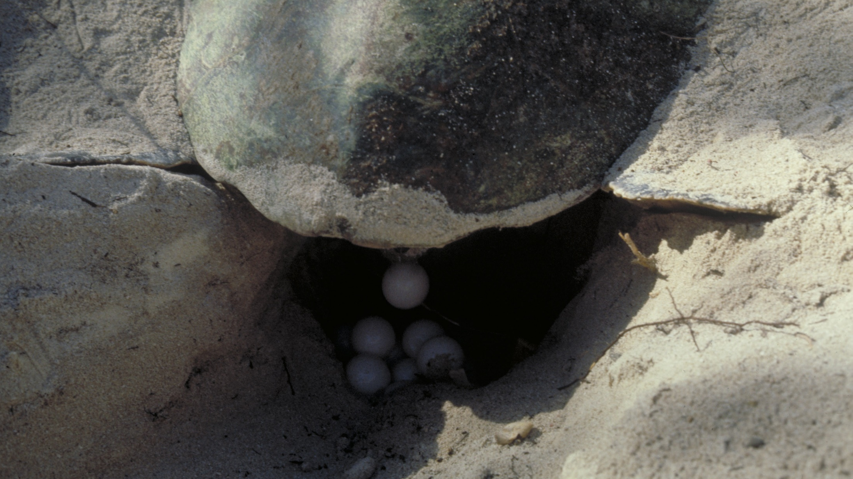
Notes:
After a few weeks of pregnancy, during the night, they climb up on the beach, dig a nest about 1 metre deep, and lay 50-150 eggs that look like ping-pong balls. Image: L. Zell, Copyright Commonwealth of Australia (GBRMPA)

Slide 63
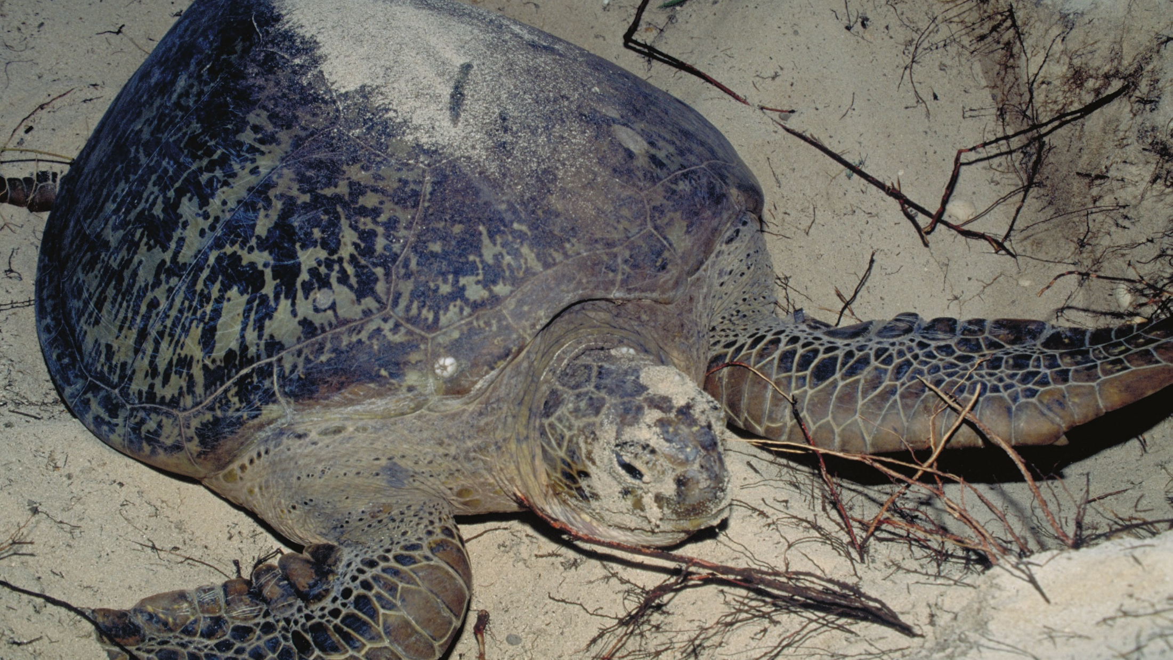
Notes:
She can spend 4 to 6 hours on the beach. It looks exhausting. Image: J. Jones, Copyright Commonwealth of Australia (GBRMPA)

Slide 64
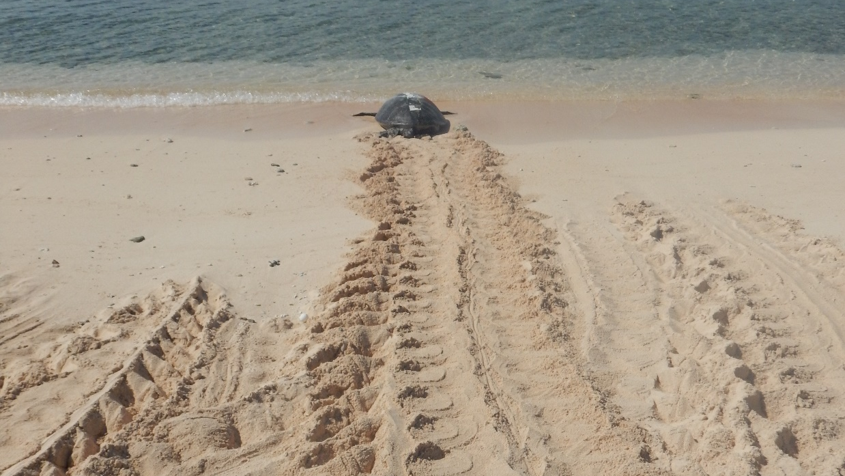
Notes:
Once the eggs are laid, the mother covers the nest and returns to the water. Image: C. Moltzen, Copyright Commonwealth of Australia (GBRMPA)

Slide 65
a few months later…
Warm nests make girl turtles (girls are hot).
Cool nests make boy turtles (boys are cool).

Slide 66
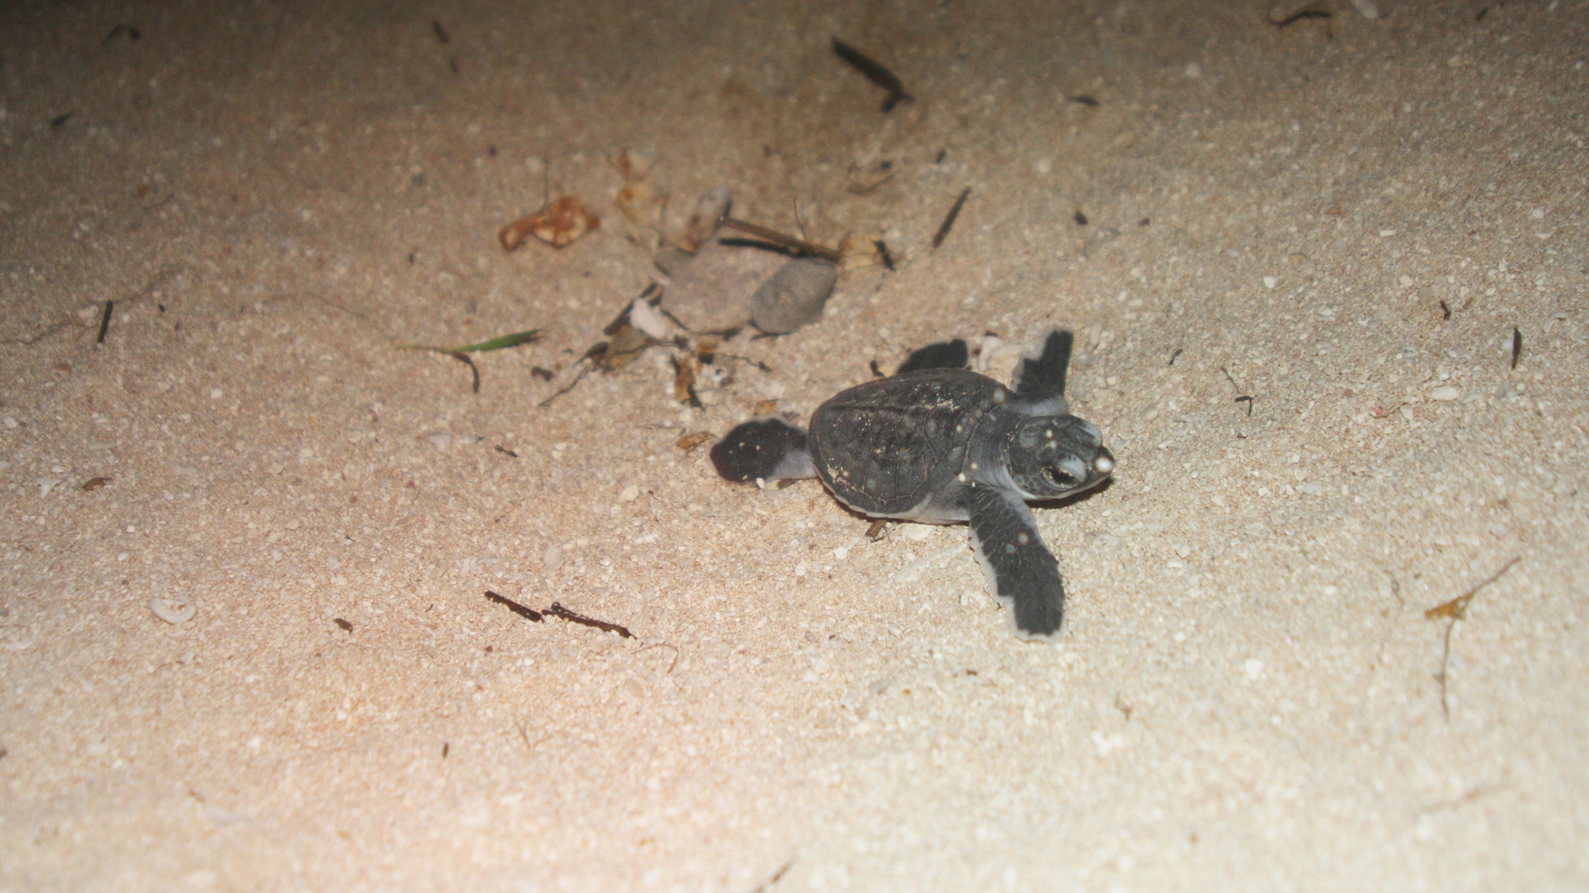
Notes:
Image: M. Turner, Copyright Commonwealth of Australia (GBRMPA)

Slide 67
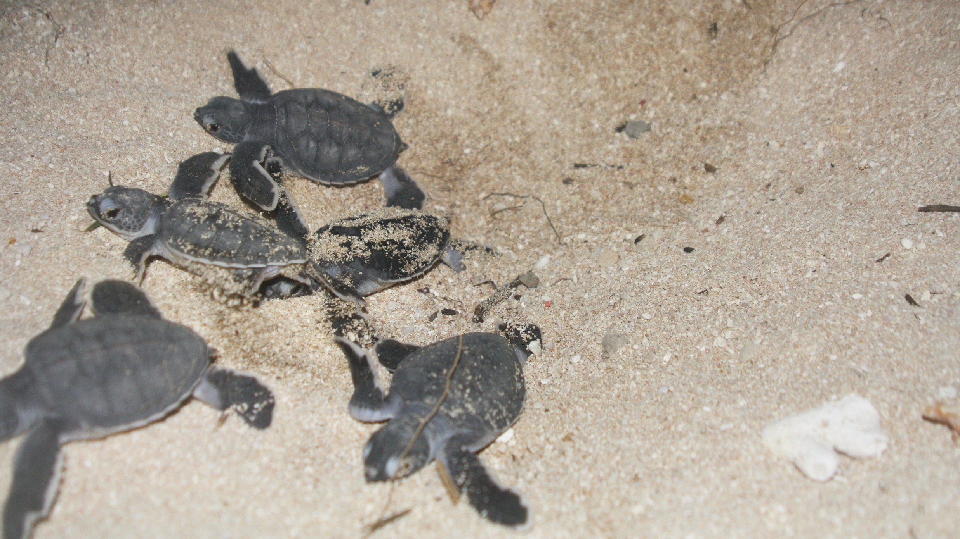
Notes:
Image: M. Turner, Copyright Commonwealth of Australia (GBRMPA)

Slide 68
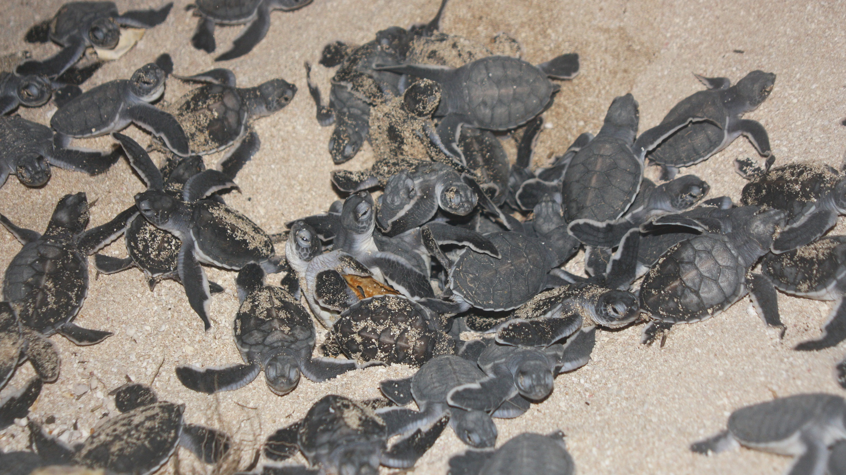
Notes:
Image: M. Turner, Copyright Commonwealth of Australia (GBRMPA)

Slide 69
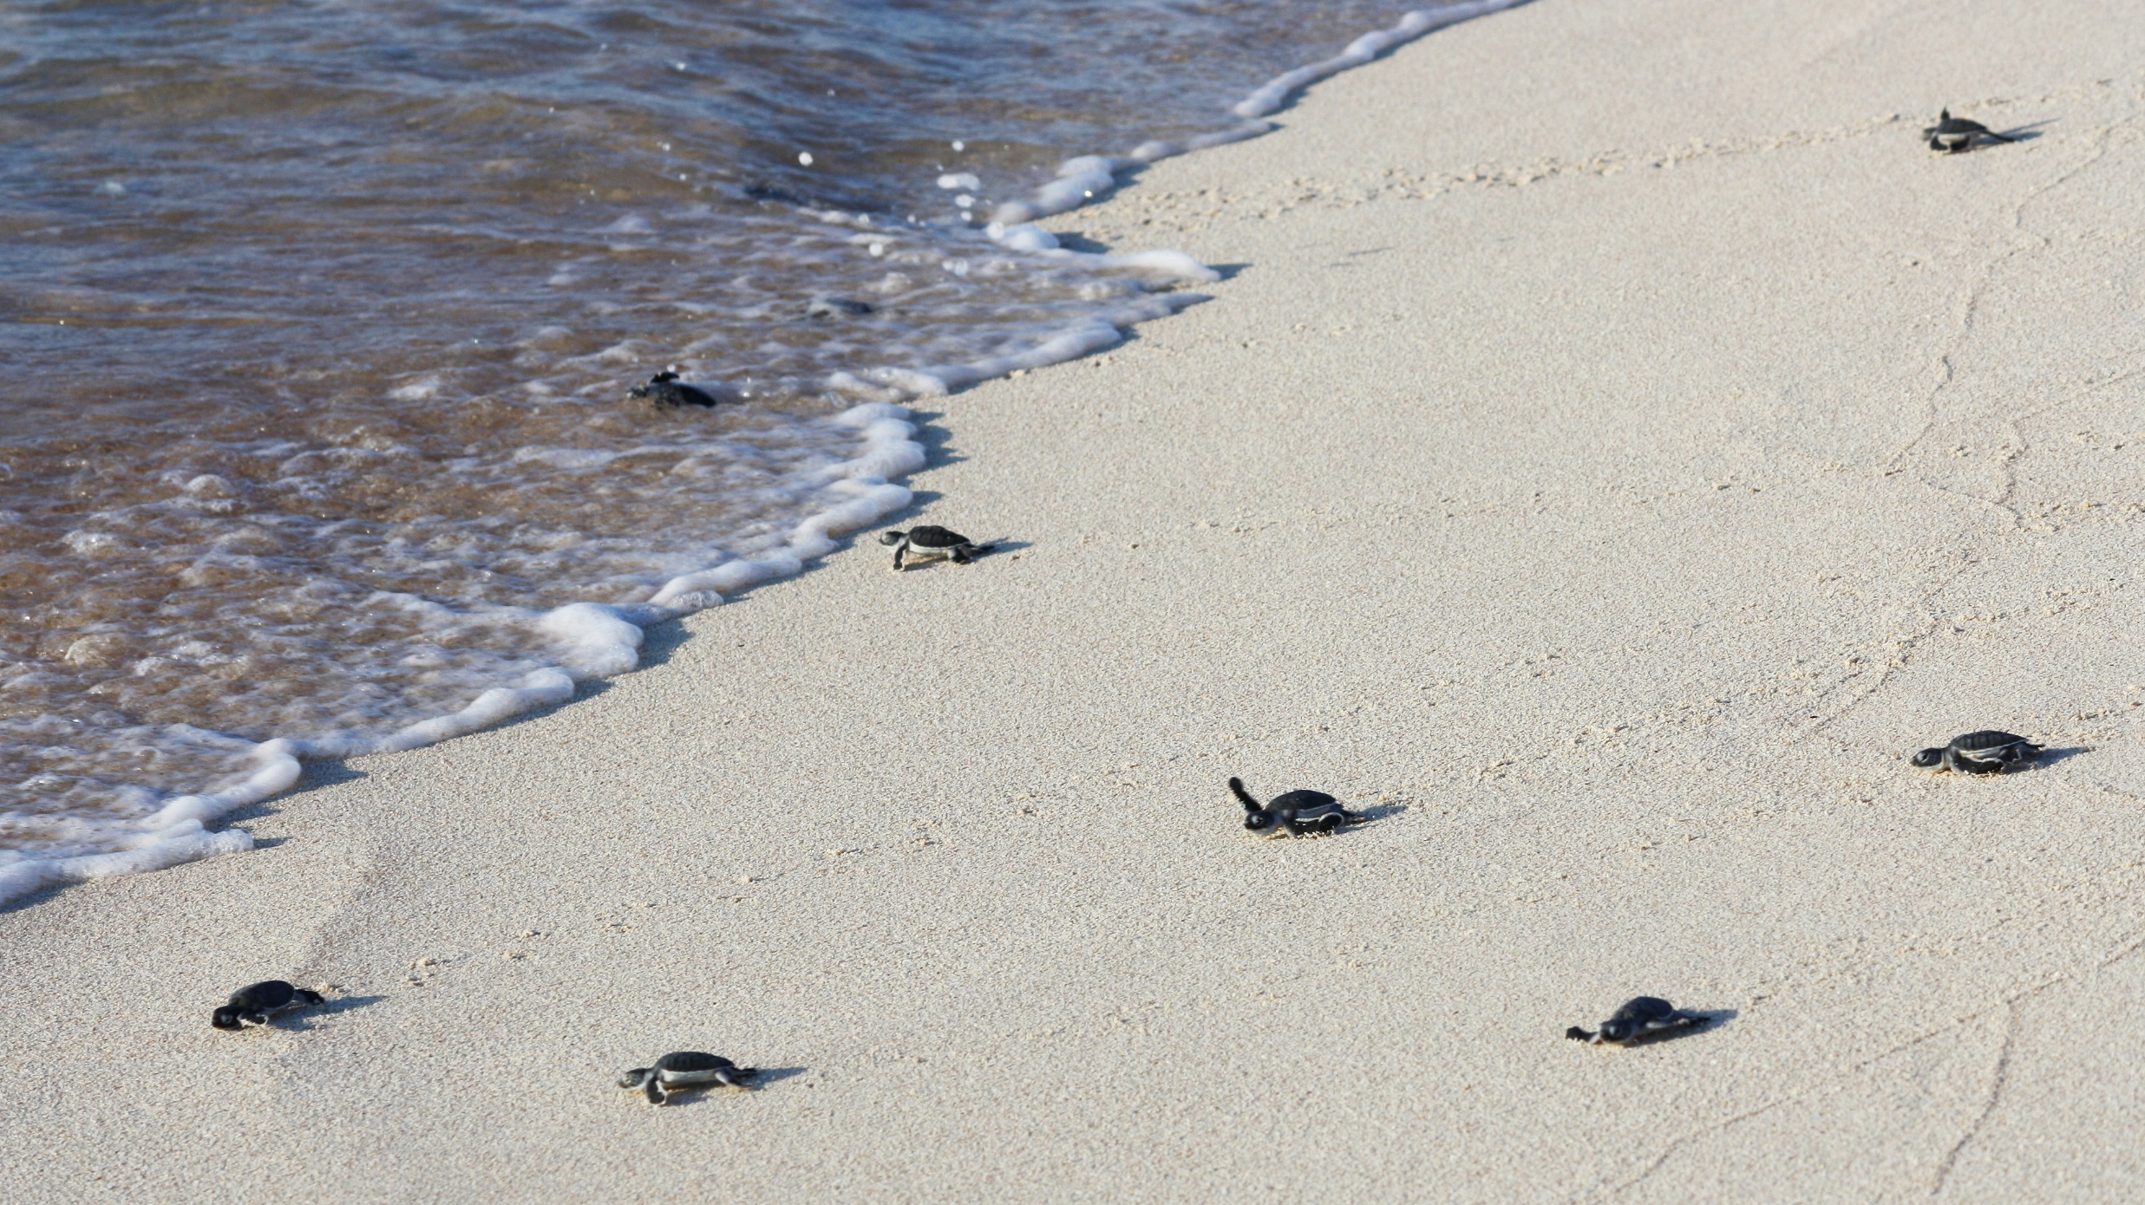
Notes:
Image: M. Turner, Copyright Commonwealth of Australia (GBRMPA)

Slide 70
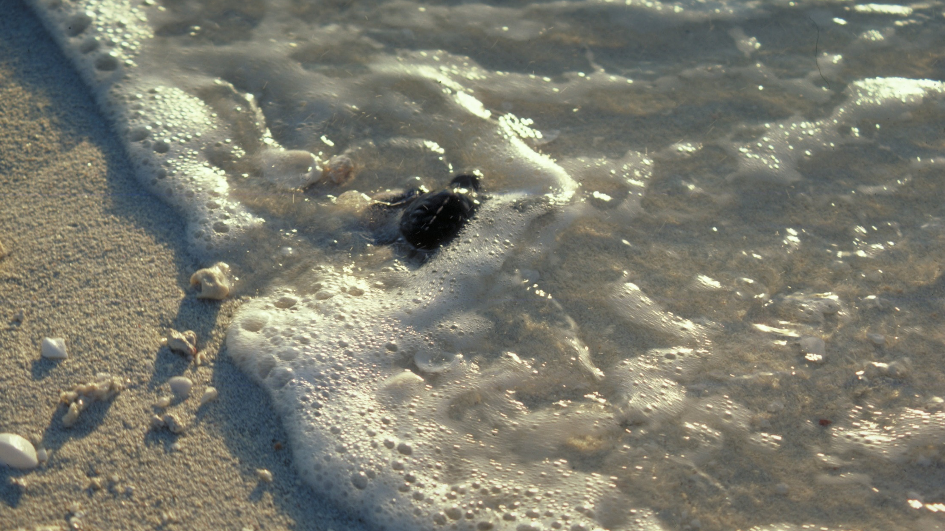
Notes:
Image: L. Zell, Copyright Commonwealth of Australia (GBRMPA)

Slide 71
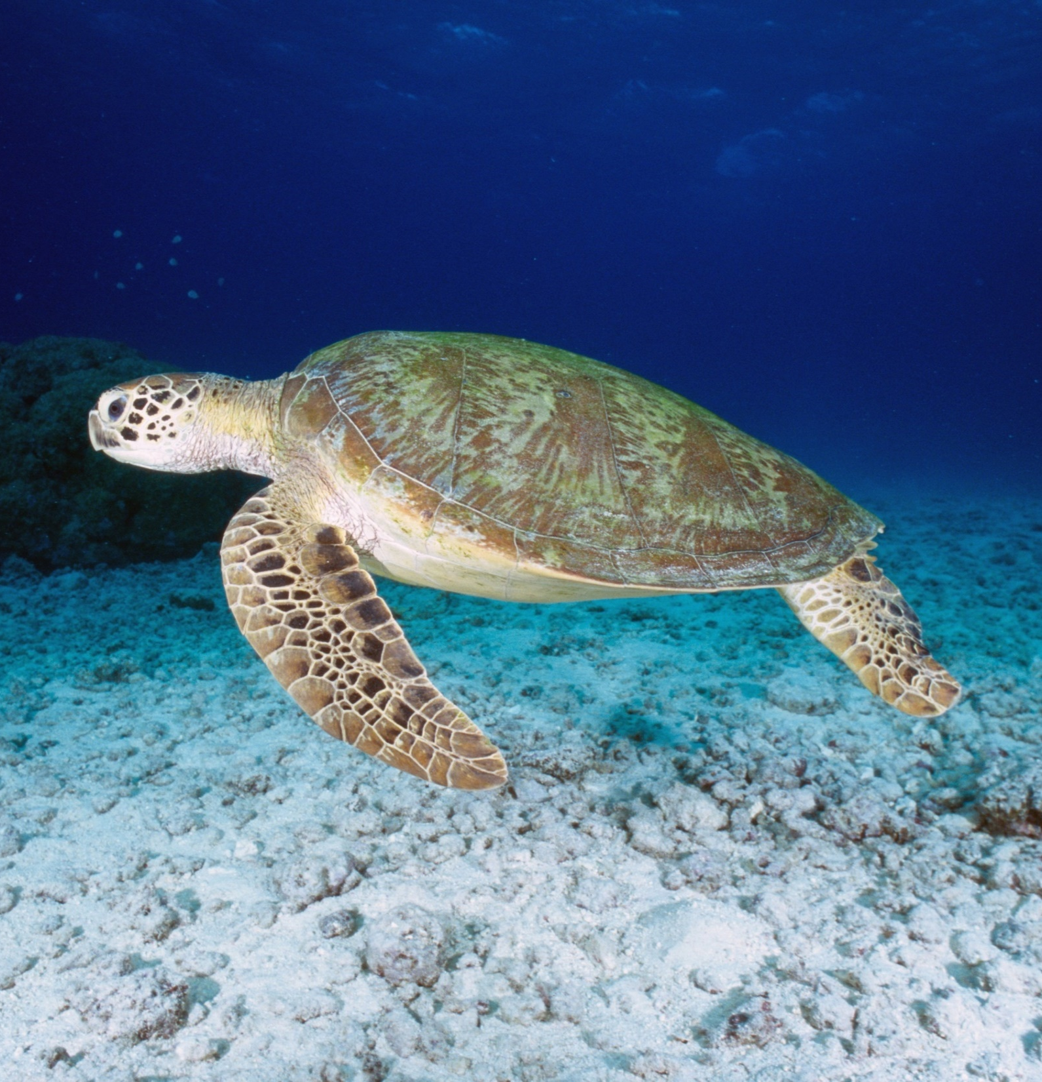
Some turtles migrate long distances, hitch-hiking rides in ocean currents such as the East Australian Current and ocean gyres.
Notes:
Image: K. Hoppen, Copyright Commonwealth of Australia (GBRMPA)

Slide 72
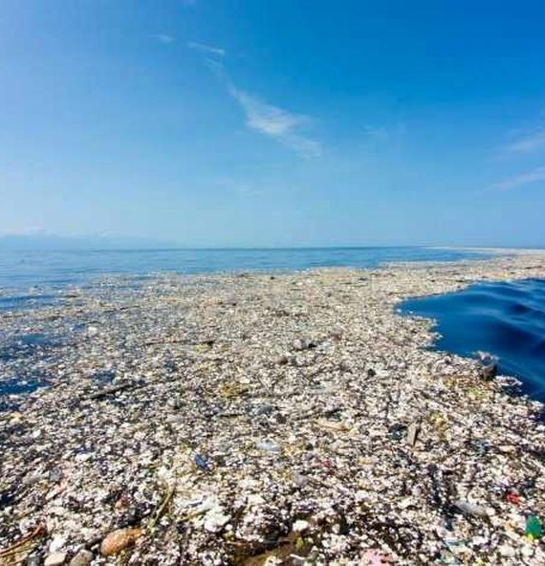
What is the
Great Pacific Garbage Patch?
Notes:
Image: https://theoceancleanup.com/

Slide 73
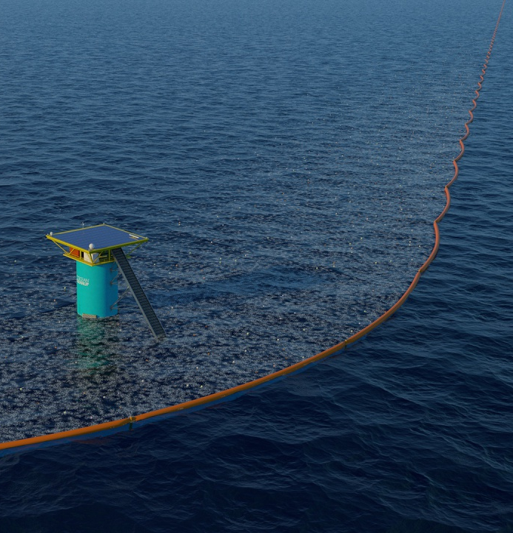
A collection
of marine debris
in the north
Pacific Ocean.
Image: the Ocean Cleanup
Notes:
Image: https://theoceancleanup.com/

Slide 74

How many sea turtles pictured below are threatened with extinction?
Notes:
Image: GBRMPA Image Library

Slide 75
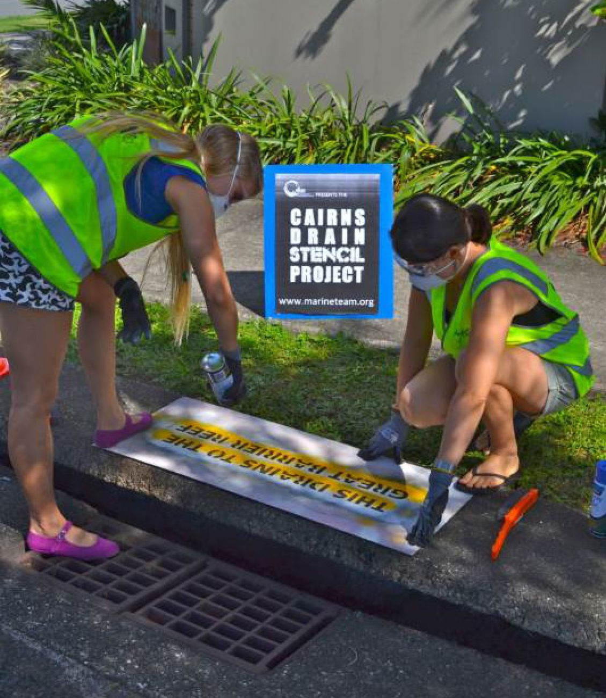
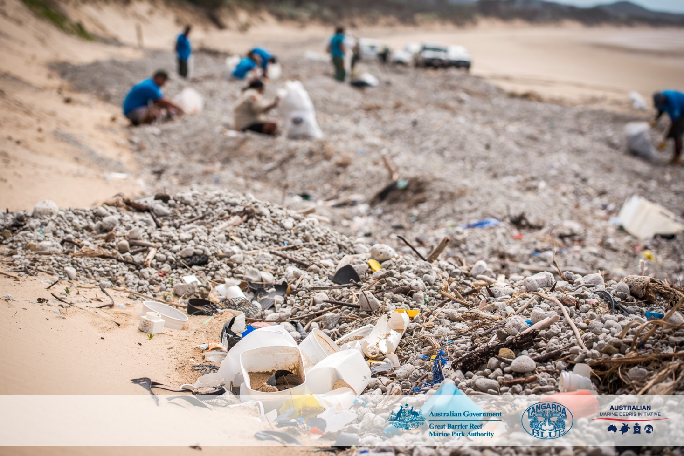
All storm water drains lead to the sea.
How can I help the Great Barrier Reef?
Notes:
Images: (Left) https://www.gbrmpa.gov.au/our-work/threats-to-the-reef/marine-debris; (Right) C. Miller, Copyright Commonwealth of Australia (GBRMPA)

Slide 76

Sharks
Notes:
Image: J. Sumerling, Copyright Commonwealth of Australia (GBRMPA)

Slide 77
A lot of sharks are killed
in shark nets designed to keep swimmers safe.

Slide 78
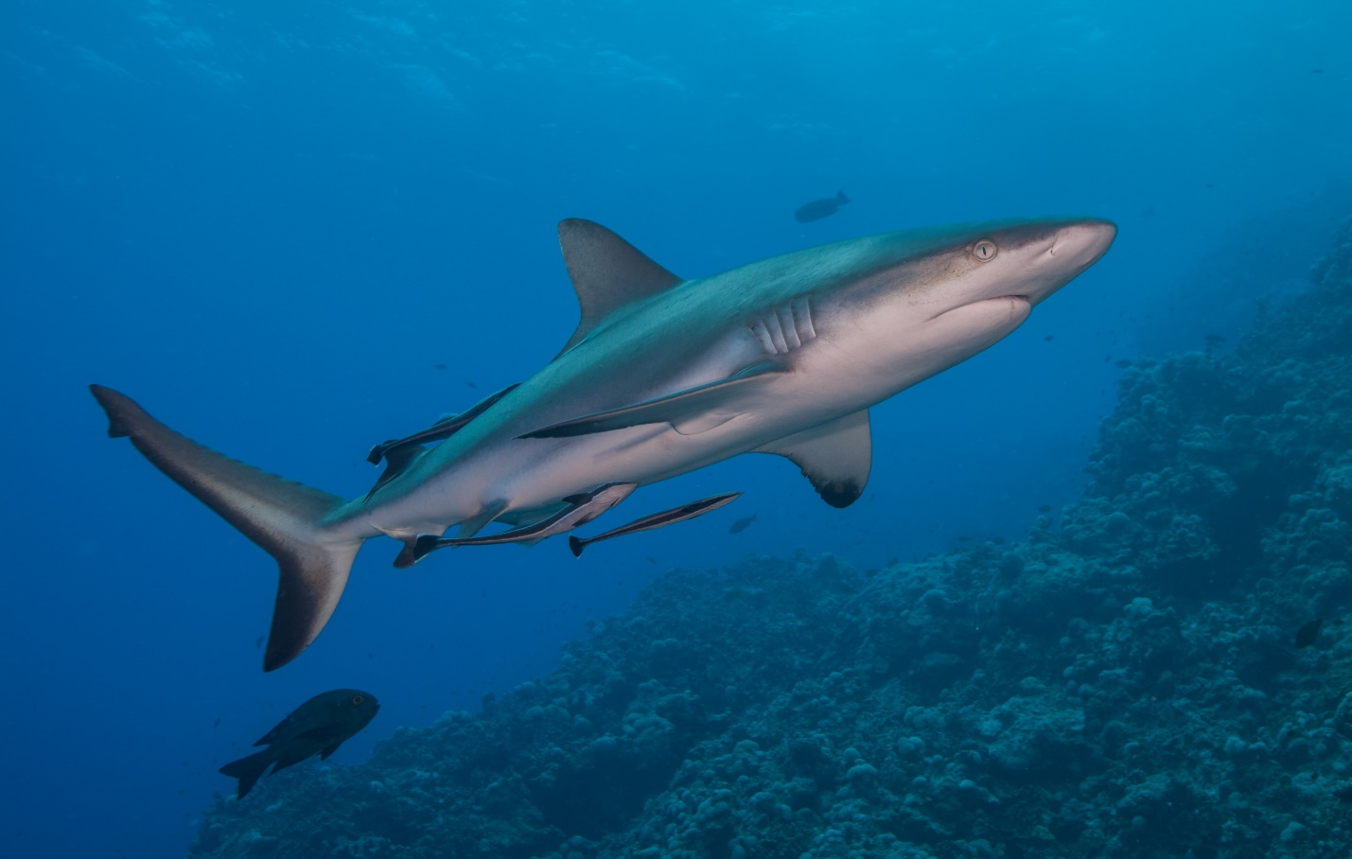

Are all sharks dangerous?
Notes:
Images: (Top) J. Sumerling, Copyright Commonwealth of Australia (GBRMPA); (Bottom) K. Hoppen, Copyright Commonwealth of Australia (GBRMPA)

Slide 79
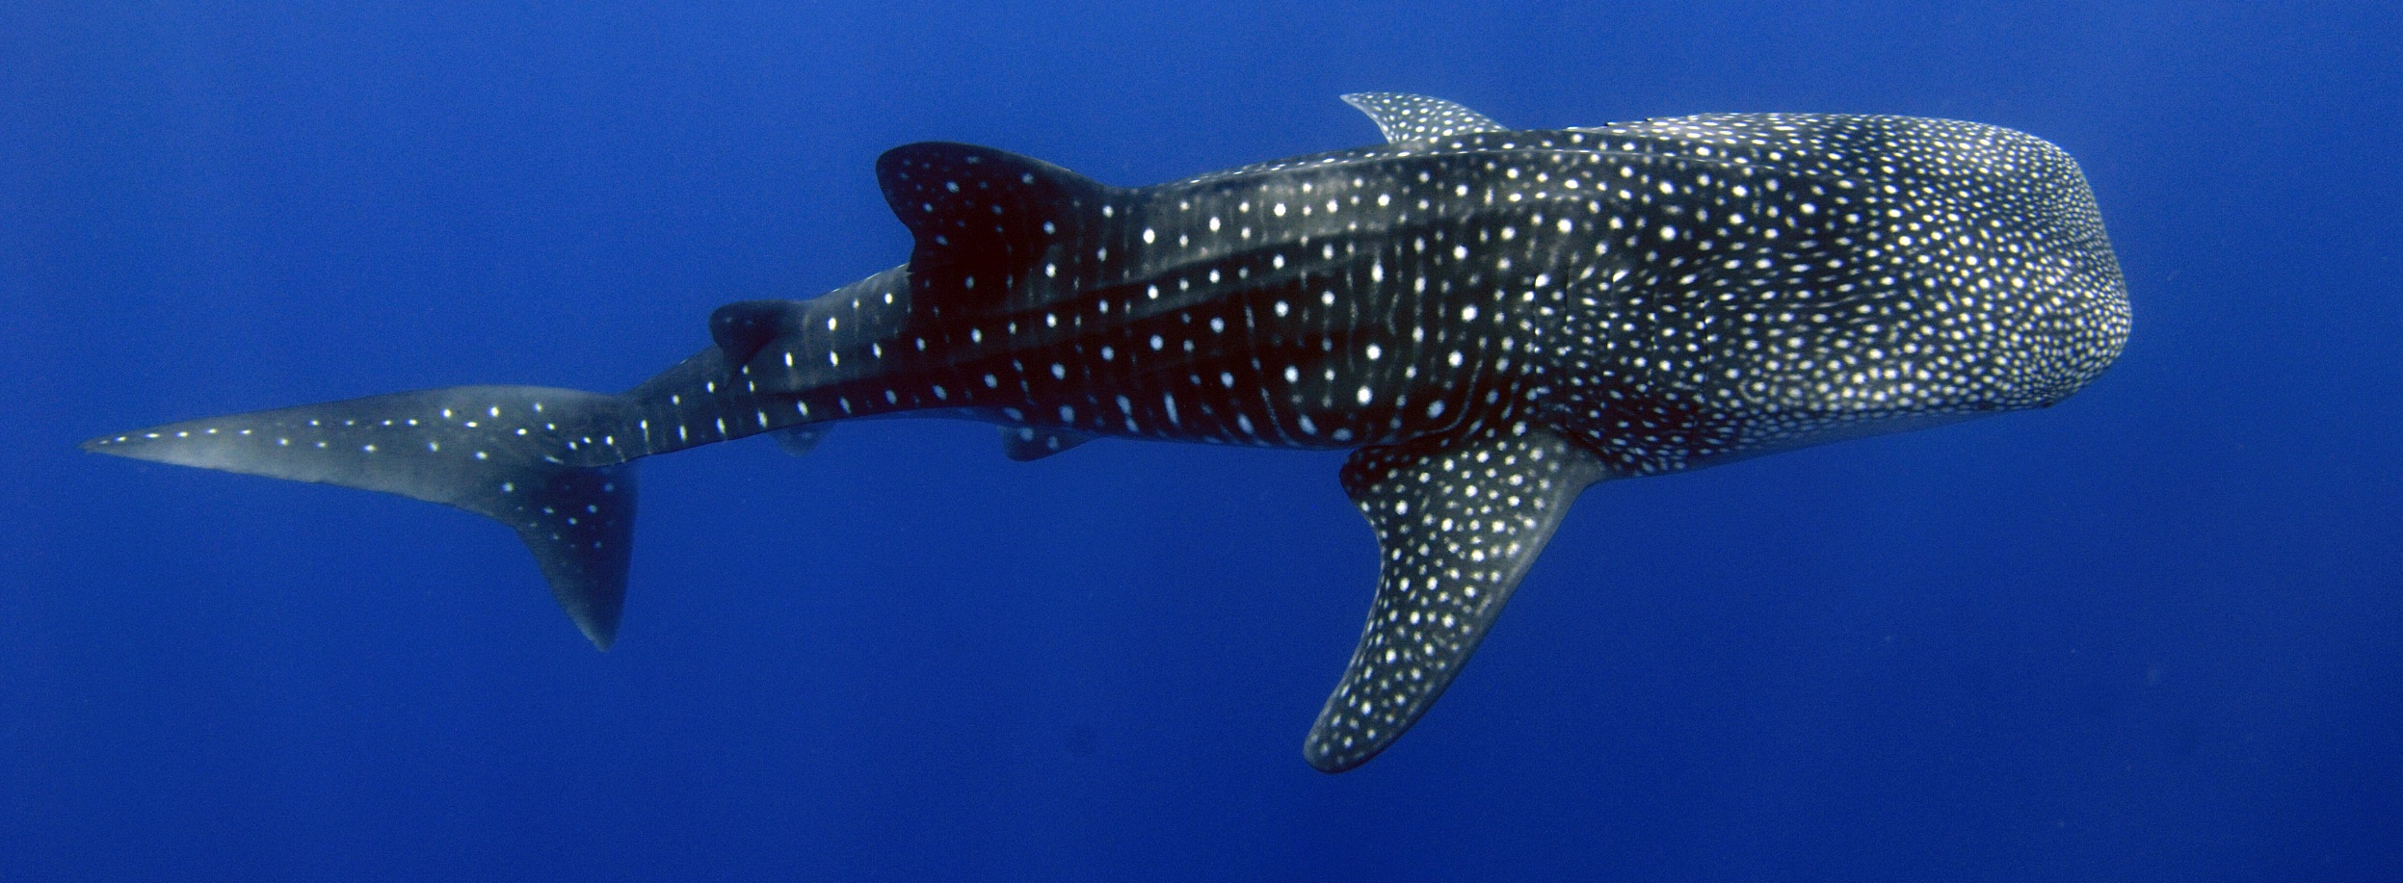
No - Not all sharks are dangerous.
For example, this Whale Shark is the biggest shark alive.
It has small teeth and eats plankton!
ENDANGERED
Notes:
Image: GBRMPA Image Library

Slide 80

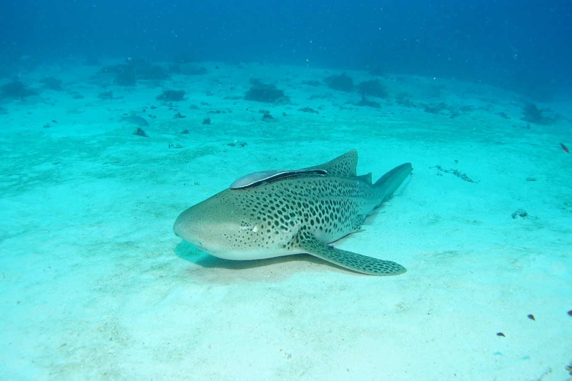
Why count sharks?
Notes:
Images: (Left) J. Sumerling, Copyright Commonwealth of Australia (GBRMPA); (Right) C. Jones, Copyright Commonwealth of Australia (GBRMPA)

Slide 81

Sharks keep
the Reef balanced and healthy.
Notes:
Image: K. Hoppen, Copyright Commonwealth of Australia (GBRMPA)

Slide 82

Many sharks
are threatened
with extinction.
Notes:
Image: C. Jones, Copyright Commonwealth of Australia (GBRMPA)

Slide 83
How did you go?

Slide 84
Now that you have learnt about some of the animals on the Great Barrier Reef, how do you think you can help protect them?

Slide 85

What actions can you take to protect the Great Barrier Reef?

Slide 86

Download
the Eye on the
Reef app.
Notes:
App image: https://www.gbrmpa.gov.au/__data/assets/pdf_file/0020/265430/Eye-on-the-Reef-app-poster.pdf

Slide 87


Press “Sightings” and “Create”.

Slide 88


Press “Wildlife”.

Slide 89


Marine mammals.
Select your animal and press “INFORMATION” to learn more.

Slide 90


Marine reptiles.

Slide 91




Sharks and rays.

Slide 92



Fishes.

Slide 93











Slide 94





Birds.

Slide 95


Invertebrates.

Slide 96










Slide 97
Explore the other tabs too!

Slide 98
Create a poster to answer the question:
How can I help the Great Barrier Reef?
Display it proudly in your classroom.
Notes:
This is the last slide for students to view.

Slide 99
Thank you for helping the Great Barrier Reef!
See the Reef • Love the Reef • Protect the Reef

