Slide 1
Be a Marine
Biologist for a Day
Part 3: Making connections
Year 7
Notes:
Image: L. Zell, Copyright Commonwealth of Australia (GBRMPA)

Slide 2


Thank you for organising your trip to the reef with us.
We had a great time and hope you did too.
This PowerPoint is Part 3 of the Be a Marine Biologist for a Day program designed for year 7 by the Great Barrier Reef Marine Park Authority (GBRMPA).
View this PowerPoint after your excursion, with the accompanying activity book.
This is Part 3: Making connections. This is the last part of the program. This is when your students make connections with all they’ve learned and experienced so far.
On your excursion, you conducted an Eye on the Reef citizen science activity with your reef guide. Now it’s time to upload your data to the GBRMPA website. It’s also time for students to check understanding by answering any questions in Parts 1 and 2.
The Great Barrier Reef Marine Park Authority would like to thank you for uploading your data to their Rapid Monitoring database. We hope to see you again next year!
Licensed by the Commonwealth of Australia for use under a Creative Commons By Attribution 4.0 International licence with the exception of content supplied by third parties and any photographs. http://creativecommons.org/licences/by/4.0

Slide 3

We would like to acknowledge all of the Aboriginal and Torres Straight Islander peoples who have connection to the Great Barrier Reef.
We recognise their continuing connection to land, water and community, and pay our respects to their Elders past, present and emerging.

Slide 4

We would like to acknowledge the (insert name of local Traditional Owner group) peoples as the Traditional Owners of the Land and Sea Country that we visited as part of your excursion.

Slide 5

How can I help the
Great Barrier Reef?
Notes:
This is the overarching inquiry question that encompasses the entire BAMBFAD Program and is the starting slide to this presentation.

Slide 6

Notes:
Image: J. Johnson, Copyright Copyright Commonwealth of Australia (GBRMPA)

Slide 7
Eye on the Reef
Rapid Monitoring survey
10 MINUTE TIMED SWIM

Slide 8
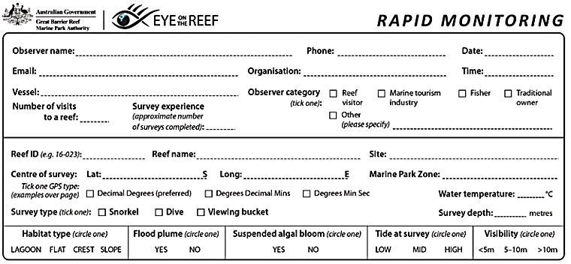
Have you got your data ready?

Slide 9

Because it’s time to upload it to GBRMPA!

Slide 10

This is the website for GBRMPA’s Eye on the Reef.
The link to connect is provided at the end of this presentation.

Slide 11

Login.

Slide 12

Select ‘Rapid Monitoring Survey’ tab.

Slide 13


Enter your data.

Slide 14

If you also completed the (more advanced) 360°survey, complete all questions. Otherwise, leave blank.

Slide 15

Save!
Scroll down to the bottom of the page to ‘Save’.

Slide 16
Are you ready?
Click on the image below to connect.
Notes:
www.gbrmpa.gov.au/our-work/eye-on-the-reef

Slide 17

Thank
you
Male Maori wrasse
Notes:
Image: C. Jones, Copyright Copyright Commonwealth of Australia (GBRMPA)

Slide 18
Check understanding.
Next, is what you’ve all been waiting for.
The answers to questions asked in Part 1 (before the excursion) and/or Part 2 (on the excursion).
Let’s check how you went!
Notes:
The following questions are straight from the Rapid Monitoring Survey course exam questions.

Slide 19


Sea cucumber
Notes:
Image: Copyright Commonwealth of Australia (GBRMPA)

Slide 20

What animals eat sea cucumbers?
Notes:
Image: Copyright Commonwealth of Australia (GBRMPA)

Slide 21
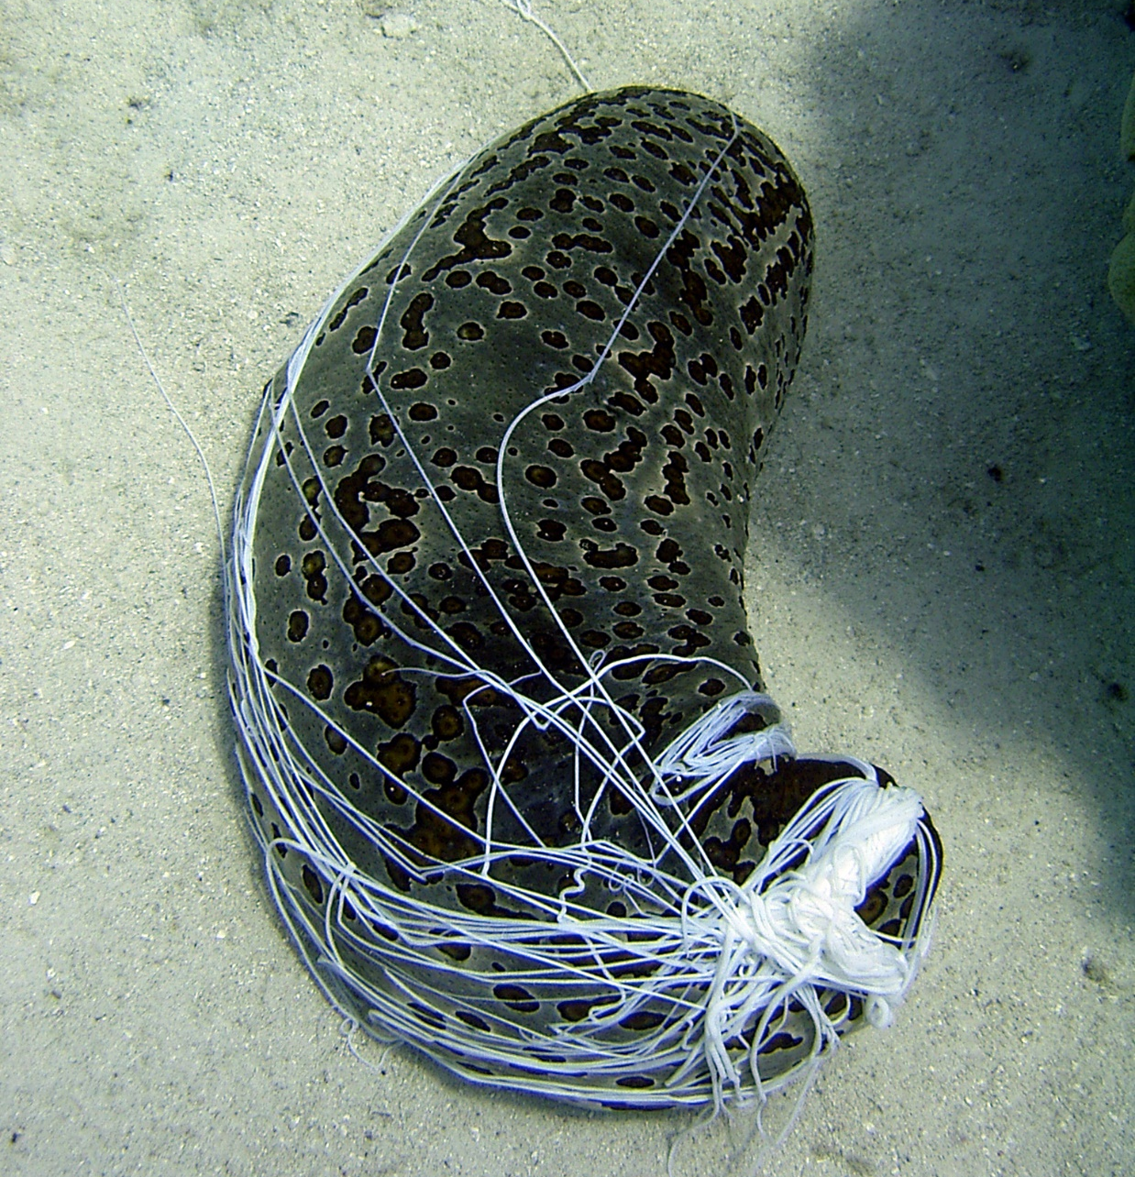
Humans!
Sold as trepang or
beche de mer.
Other predators include some fish and sea turtles.
Some eject their internal organs when threatened.
Notes:
Image: C. Jones, Copyright Commonwealth of Australia (GBRMPA)

Slide 22

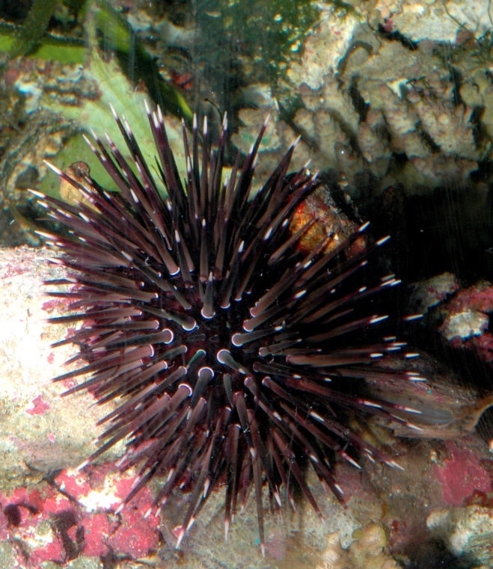
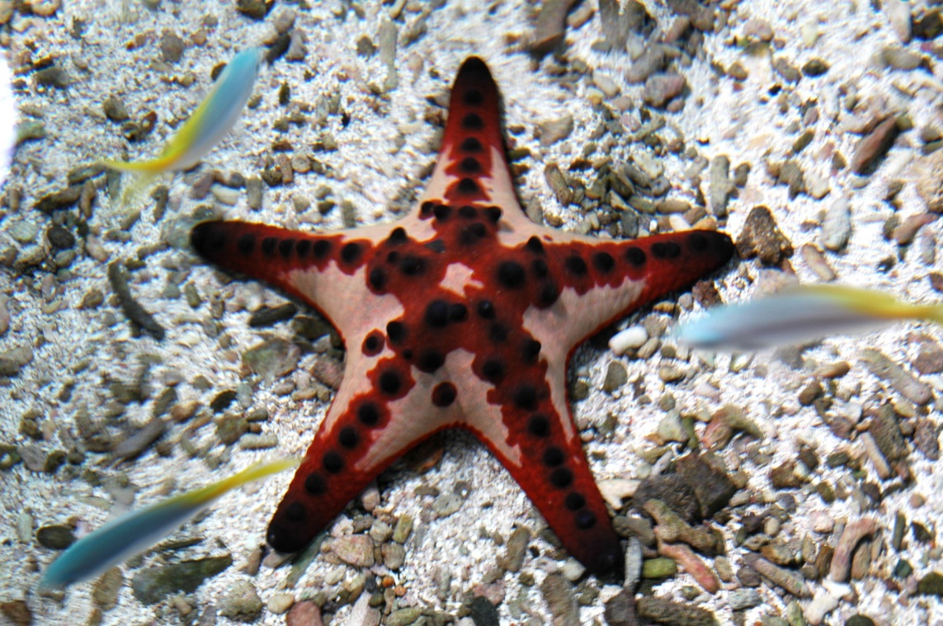
The phylum Echinodermata also includes sea stars and sea urchins. What do all echinoderms have in common?
Notes:
Images: (Left) J. Jones, Copyright Commonwealth of Australia (GBRMPA); (Middle) Copyright Commonwealth of Australia; (Right) Copyright Commonwealth of Australia

Slide 23
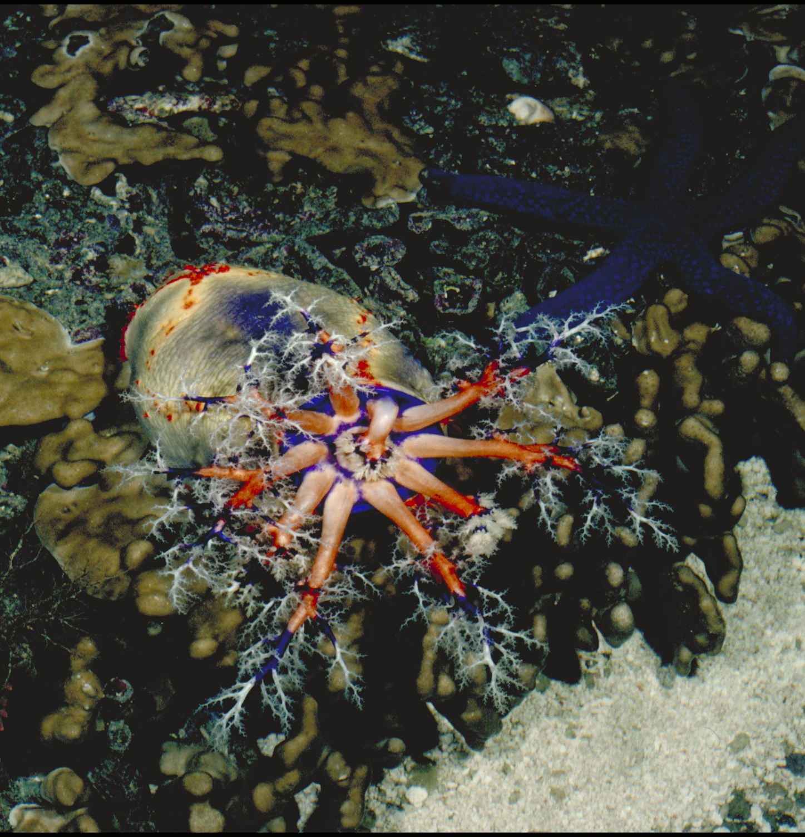
Echinoderms have radial symmetry.
Their body parts
are arranged like the
spokes of a wheel.
Notes:
Image: A. Elliott, Copyright Commonwealth of Australia (GBRMPA)

Slide 24
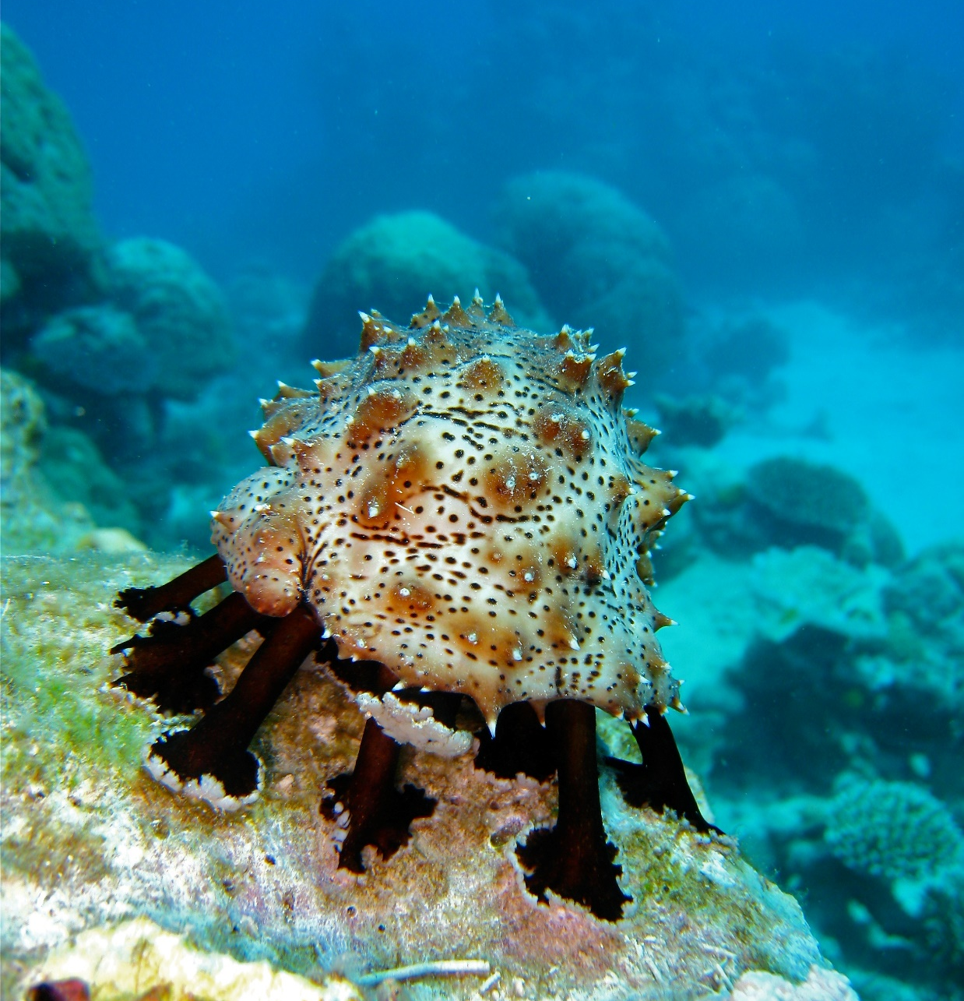
Echinoderms
have tube feet.
Notes:
Image: C. Jones, Copyright Commonwealth of Australia (GBRMPA)

Slide 25
Echinoderms have amazing powers of regeneration.
They can regrow lost body parts, including internal organs that are ejected when threatened.
Notes:
Image: C. Jones, Copyright Commonwealth of Australia (GBRMPA)

Slide 26
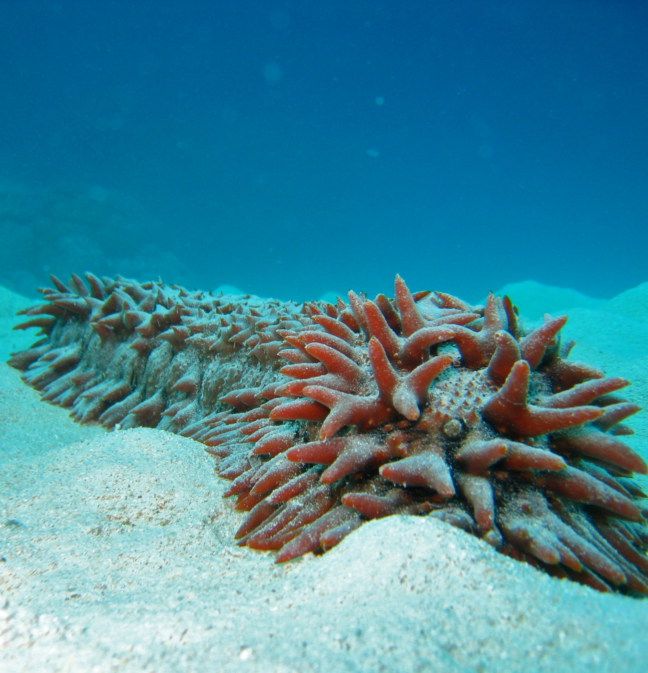
What and how
does a sea cucumber eat?
Notes:
Image: C. Jones, Copyright Commonwealth of Australia (GBRMPA)

Slide 27
Some eat food on
the seafloor.
Others eat food in the water.
They gather food using branching tentacles that surround their mouth.
Branched feeding tentacles.
Notes:
Image: C. Jones, Copyright Commonwealth of Australia (GBRMPA)

Slide 28

Giant clam
VULNERABLE TO EXTINCTION
Notes:
Image: Copyright Commonwealth of Australia (GBRMPA)

Slide 29

Why does algae (zooxanthellae) live in the mantle of a giant clam?
Notes:
Image: J. Sumerling, Copyright Commonwealth of Australia (GBRMPA)

Slide 30
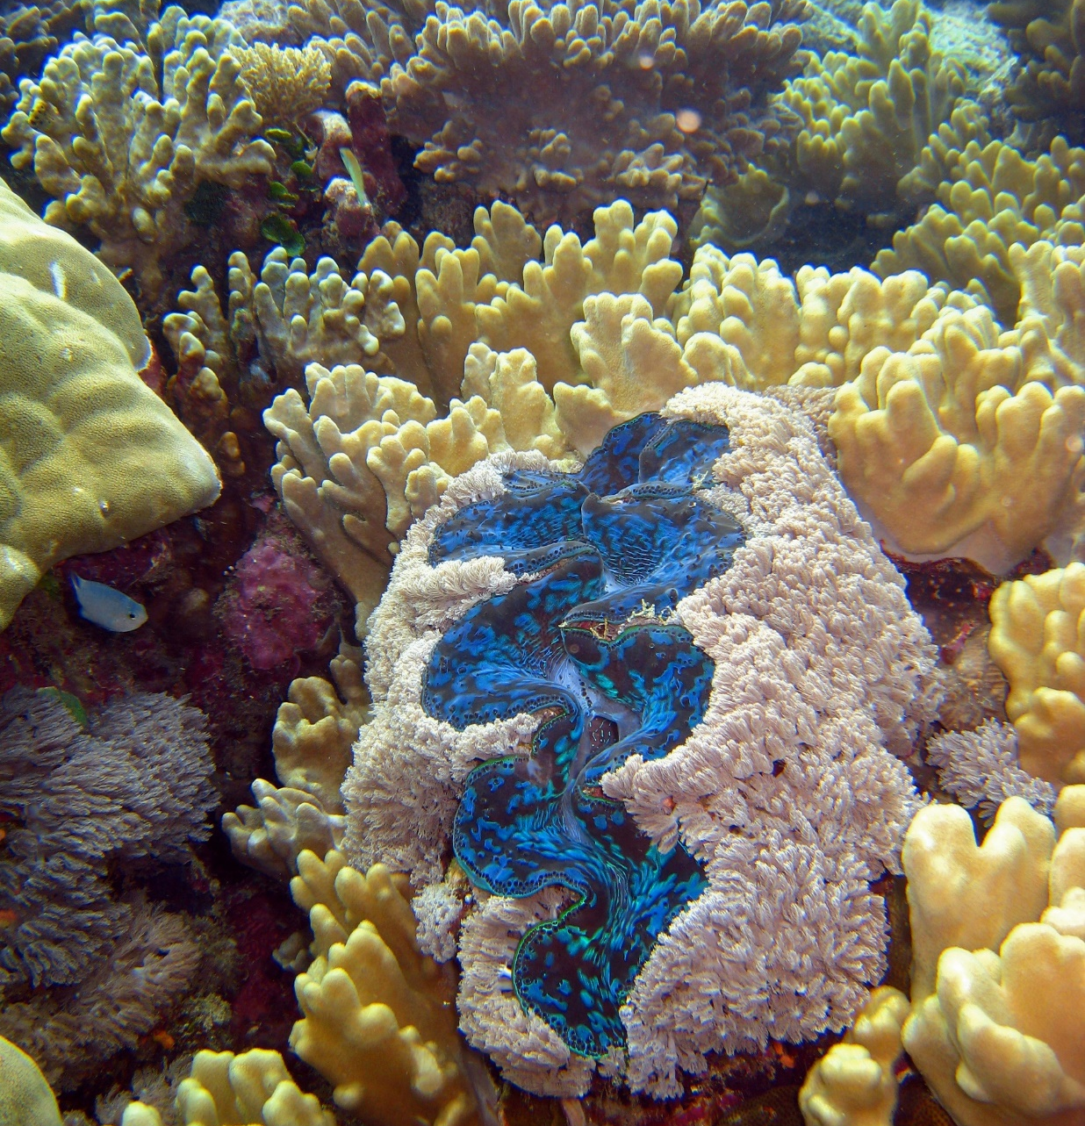
It feeds the clam in exchange for a safe place to live.
The algae (zooxanthellae) turns sunlight into energy via photosynthesis.
That’s why the giant clam is always open.
So their algae can access lots of sunlight.
Notes:
Image: C. Jones, Copyright Commonwealth of Australia (GBRMPA)

Slide 31

Anemonefish
Notes:
Image: J. Sumerling, Copyright Commonwealth Government of Australia (GBRMPA)

Slide 32
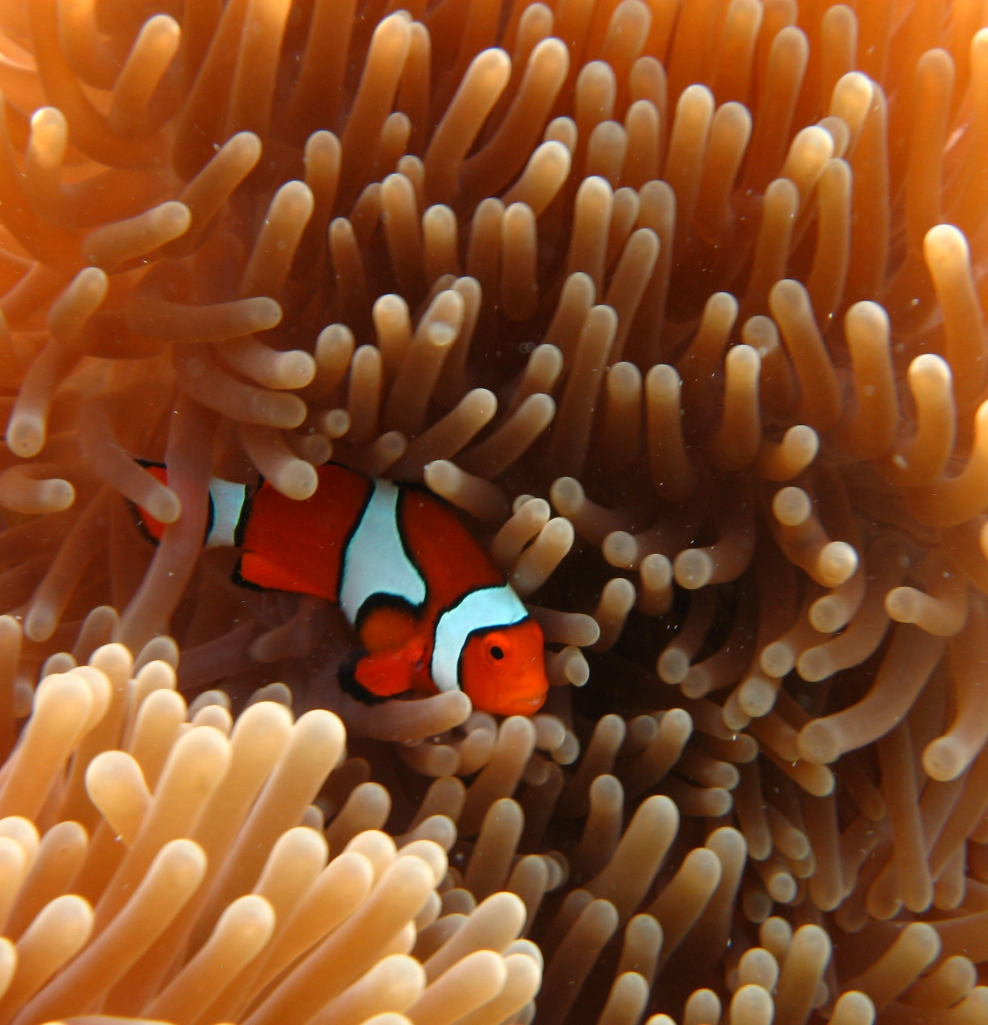
If anemones and jellyfish are both cnidarians, what do they have in common?
Notes:
Image: E. Smart, Copyright Commonwealth Government of Australia (GBRMPA)

Slide 33

Stinging cells on
their tentacles
(called nematocysts).
The anemonefish has a protective layer of mucus that stops it from getting stung.
Notes:
Image: T. Mayne, Copyright Commonwealth of Australia (GBRMPA)

Slide 34

Butterflyfish
Bright colours and pretty patterns
Long snout and little mouth for eating coral polyps
Flat body
Notes:
Image: J. Jones, Copyright Commonwealth of Australia (GBRMPA)

Slide 35

Did you see any butterflyfish with a fake eye spot?
What is the
reason for the
fake eye spot?
Notes:
Image: J. Jones, Copyright Commonwealth of Australia (GBRMPA)

Slide 36
To avoid
predation.
Designed to trick
their predators about the location of their head.
Notes:
Image: J. Jones, Copyright Commonwealth of Australia (GBRMPA)

Slide 37

Did you see what the butterflyfish
were eating?
Notes:
Image: R. Berkelmans, Copyright Commonwealth of Australia (GBRMPA)

Slide 38
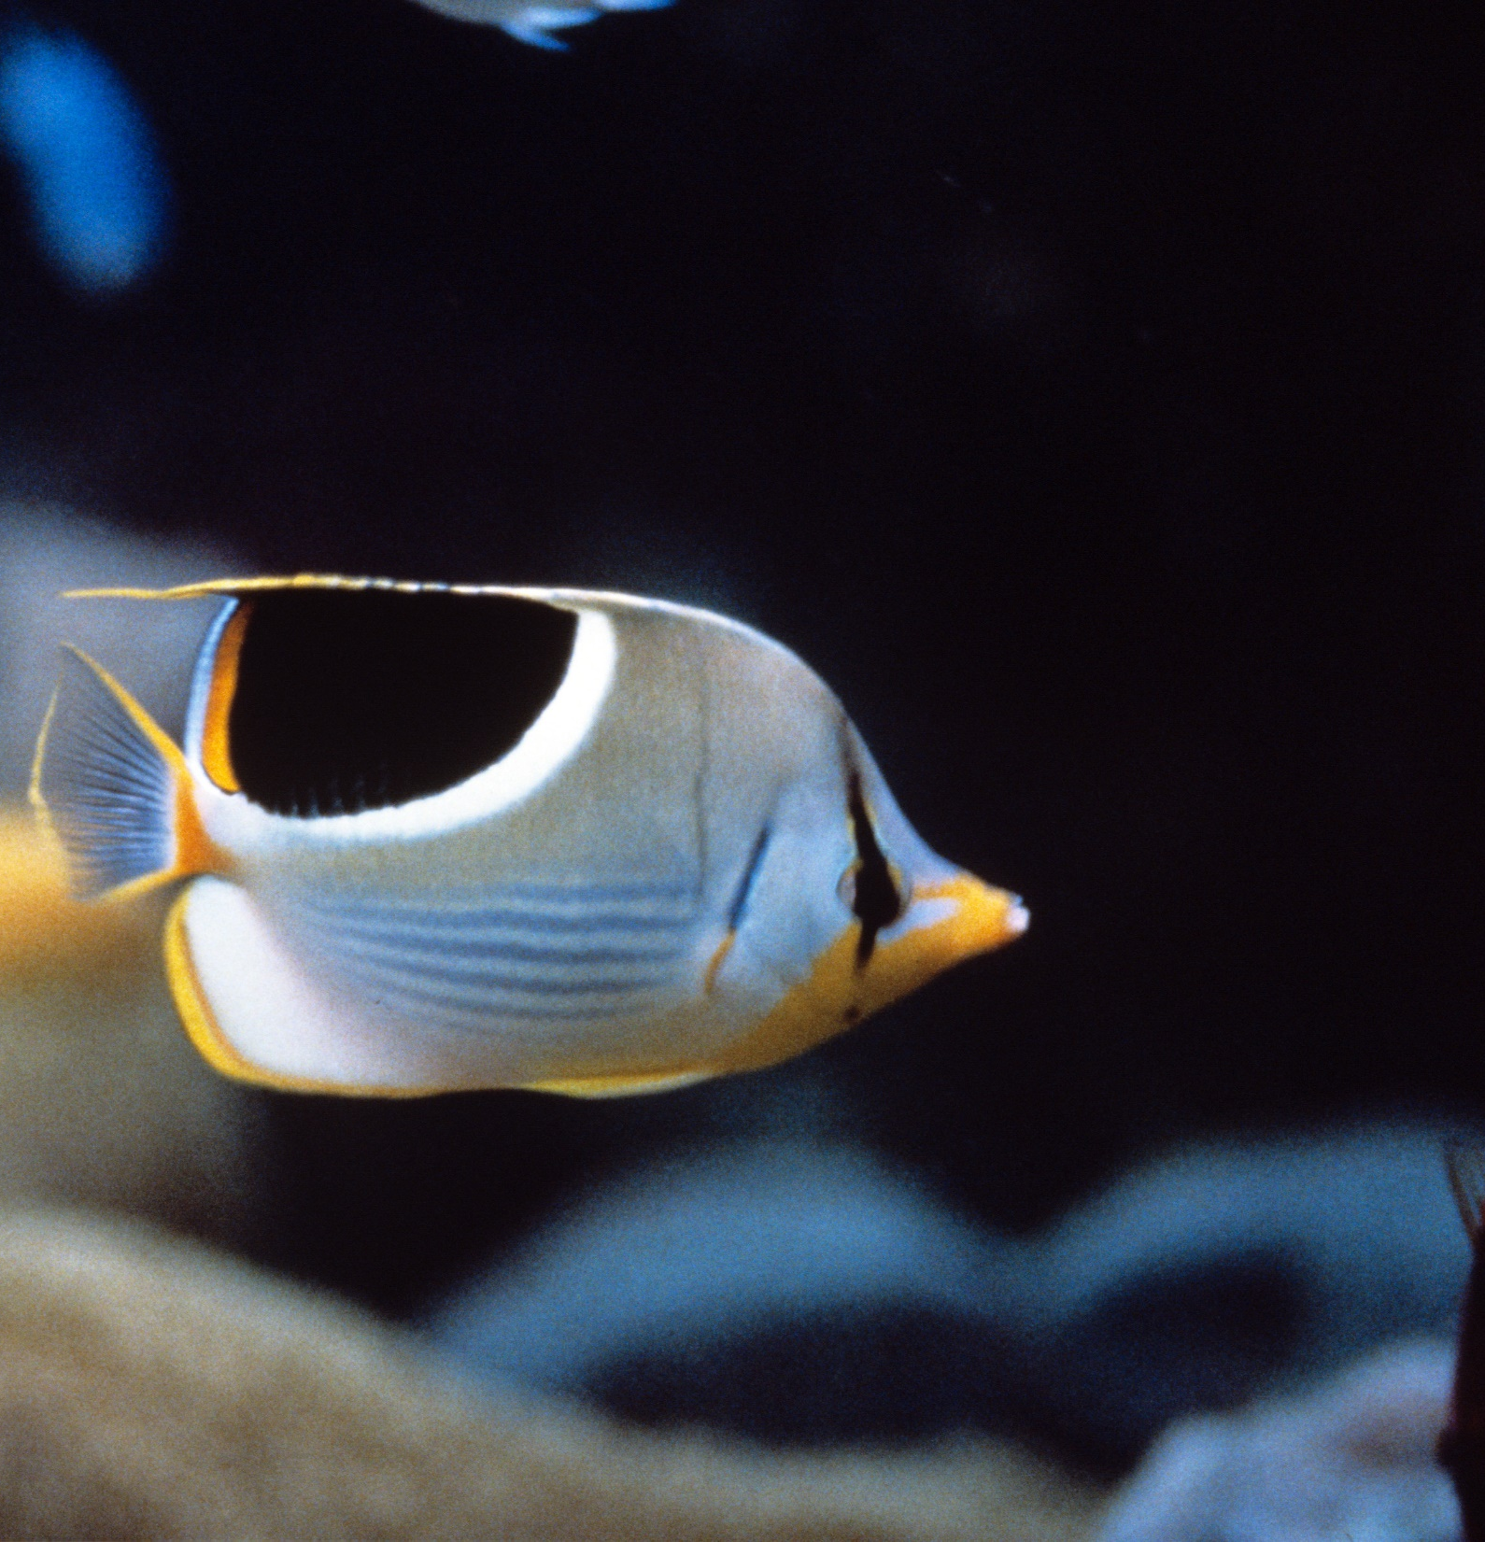
Some eat tiny invertebrates.
Or pluck off bits of larger organisms, such as the
tube feet of echinoderms.
Notes:
Image: R. Walls, Copyright Commonwealth of Australia (GBRMPA)

Slide 39

Most feed
directly on living coral polyps.
Notes:
Image: L. Zell, Copyright Commonwealth of Australia (GBRMPA)

Slide 40

Grazing herbivores
Parrotfish / Surgeonfish / Rabbitfish / Unicornfish
Notes:
Image: W. Gladstone, Copyright Commonwealth of Australia (GBRMPA)

Slide 41

Why are grazing herbivores called
the lawnmowers of the Reef?
Notes:
Image: C. Jones, Copyright Commonwealth of Australia (GBRMPA)

Slide 42

Because they graze on so much algae.
Notes:
Image: C. Jones, Copyright Commonwealth of Australia (GBRMPA)

Slide 43

Cods and groupers
Notes:
Image: J. Hurford, Copyright Commonwealth of Australia (GBRMPA)

Slide 44
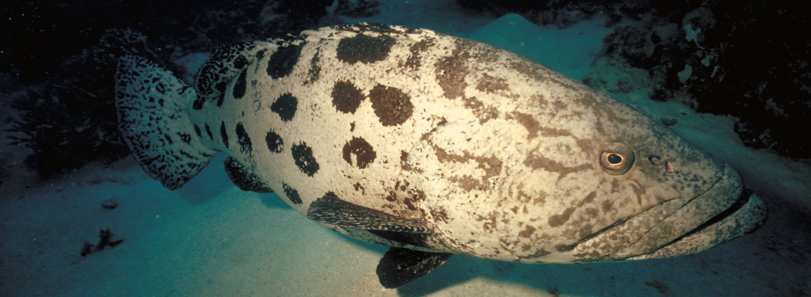
What is the name of this fish?
Paddle-like tail
Potato-like markings
Notes:
Image: P. McGinnity, Copyright Commonwealth of Australia (GBRMPA)

Slide 45
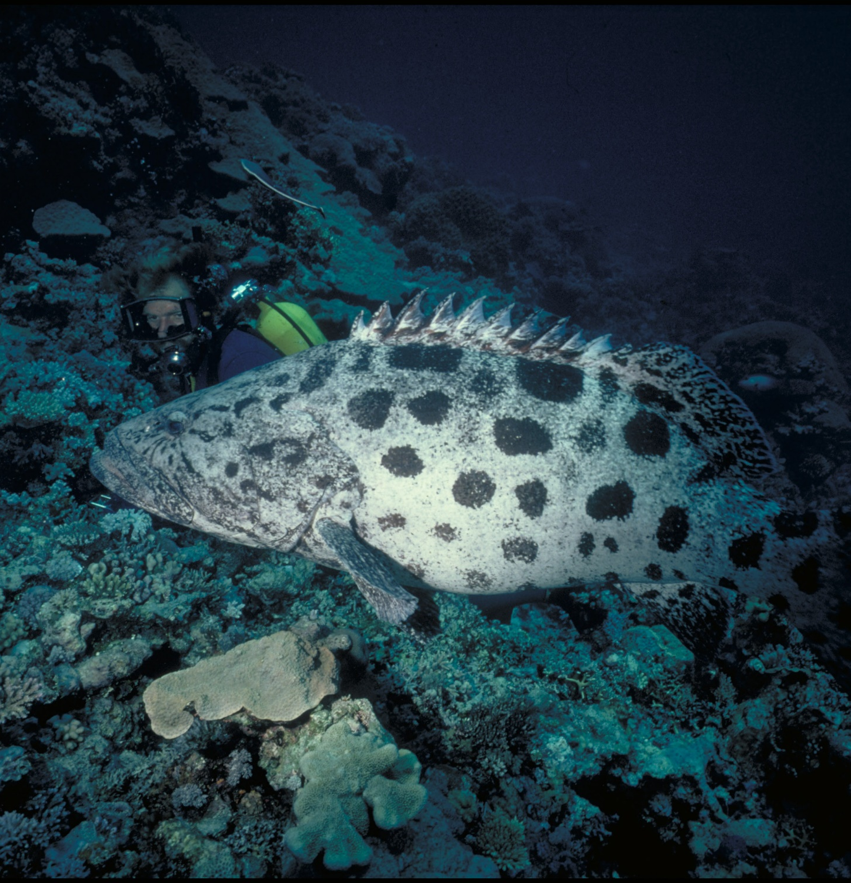
Potato cod
Epinephelus tukula
Why does it have a common name and a scientific name?
Notes:
Image: Ron & Valerie Taylor, Copyright Commonwealth of Australia (GBRMPA)

Slide 46
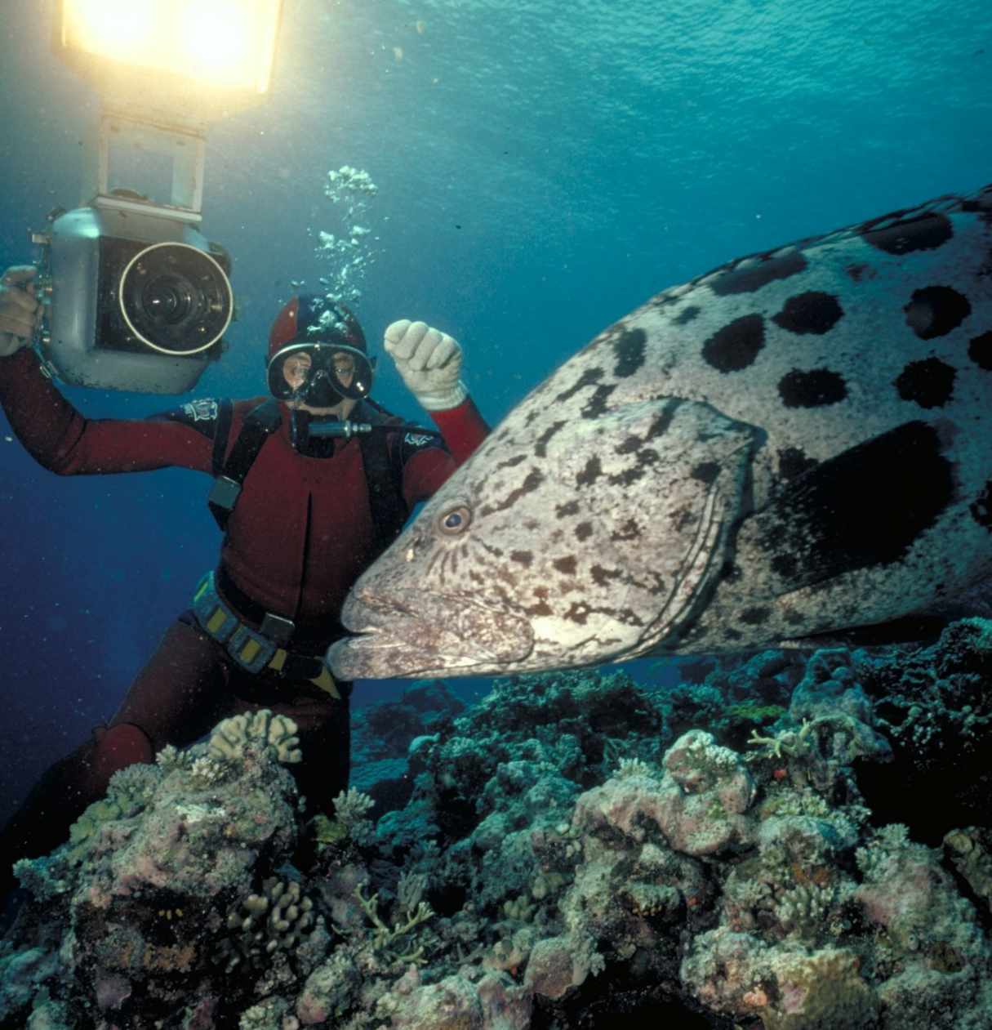
Common names are nicknames, so they can
vary, but are easy
to remember.
Scientific names
are more exact.
Notes:
Image: Ron & Valerie Taylor, Copyright Commonwealth of Australia (GBRMPA)

Slide 47
How do cods and groupers hunt?
Notes:
Image: J. Hurford, Copyright Commonwealth of Australia (GBRMPA)

Slide 48
They are opportunistic ambush predators.
They sit still and wait.
Then, pounce, suck in, and swallow their prey whole.
Notes:
Image: Ron & Valerie Taylor, Copyright Commonwealth of Australia (GBRMPA)

Slide 49

Coral trout
Notes:
Image: S. Summerhays, Copyright Commonwealth of Australia (GBRMPA)

Slide 50
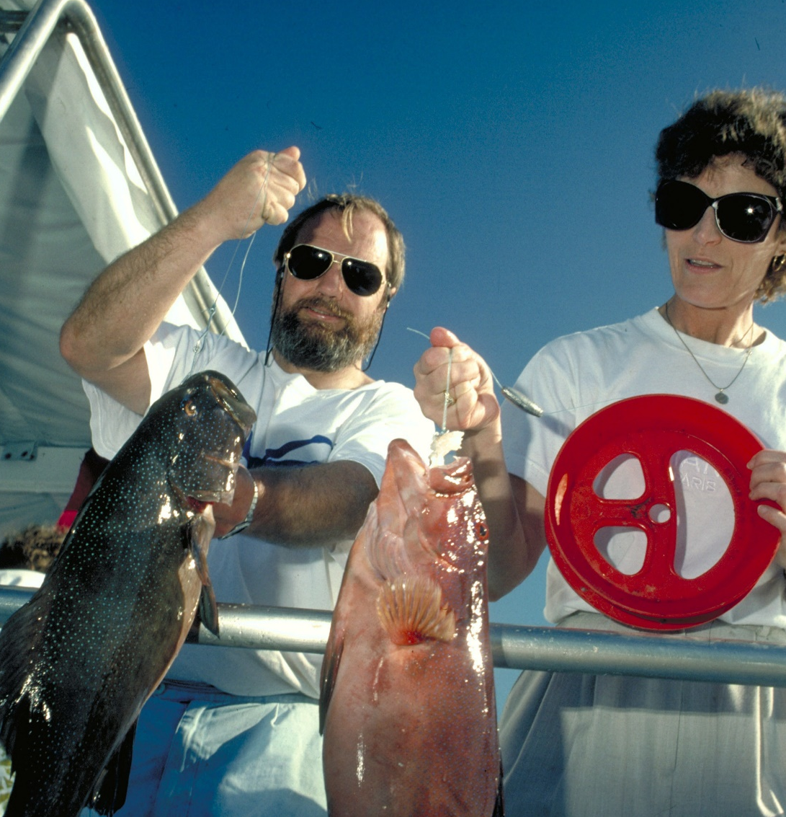
Lots of people like
to eat coral trout.
What is the
legal size of a
coral trout?
Notes:
Image: A. Elliott, Copyright Commonwealth of Australia (GBRMPA)

Slide 51
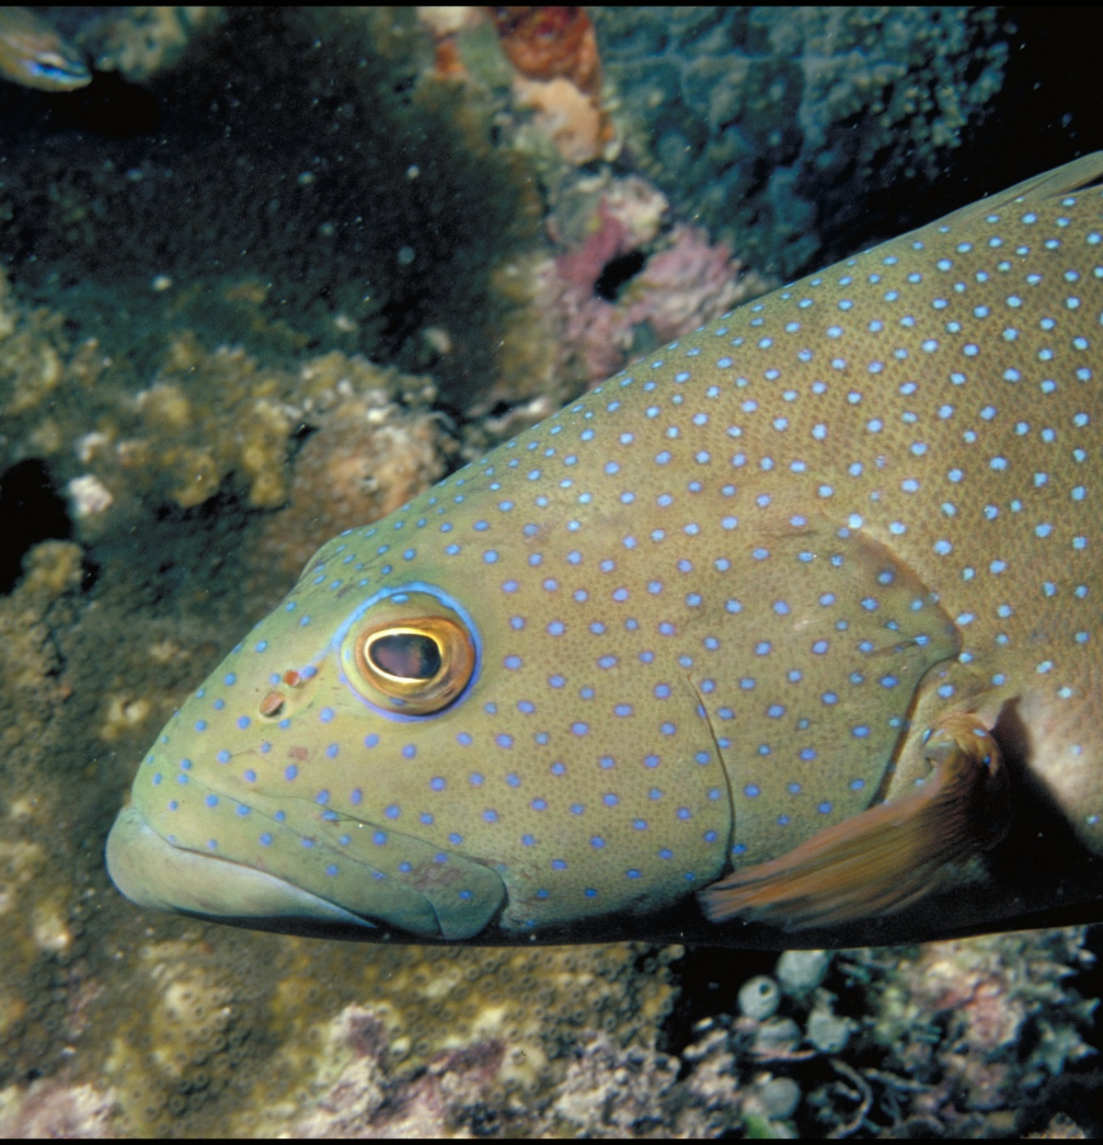
38cm.
Notes:
Image: A. Zell, Copyright Commonwealth of Australia (GBRMPA)

Slide 52

Maori wrasse
also called humphead wrasse or Napoleon wrasse.
Notes:
Image: C. Jones, Copyright Commonwealth of Australia (GBRMPA)

Slide 53
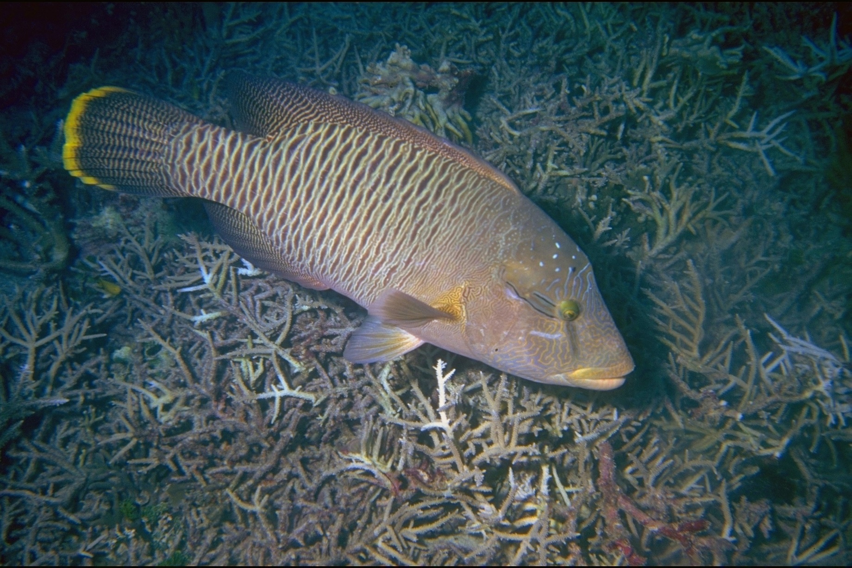

Are these two fish the same species?
Notes:
Images: (Left) U. Engelhardt, Copyright Commonwealth of Australia (GBRMPA); (Right) M. Simmons, Copyright Commonwealth of Australia (GBRMPA)

Slide 54
Yes!
Female
Male
Notes:
Images: (Left) U. Engelhardt, Copyright Commonwealth of Australia (GBRMPA); (Right) M. Simmons, Copyright Commonwealth of Australia (GBRMPA)

Slide 55


Maori wrasse are ENDANGERED.
Why?
Notes:
Image: C. Jones, Copyright Commonwealth of Australia (GBRMPA)

Slide 56
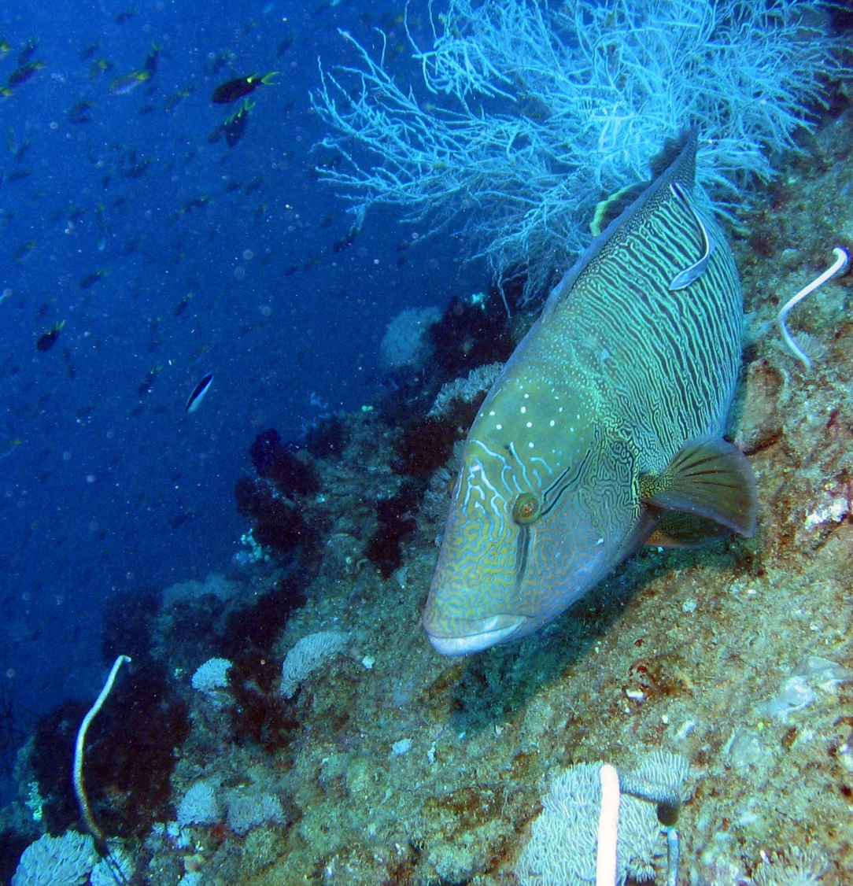
Mostly because they are a highly valued fish on the luxury live reef fish trade.
Notes:
Image: J. Monkivitch, Copyright Commonwealth of Australia (GBRMPA)

Slide 57

Sea turtles
Notes:
Image: C. Jones, Copyright Commonwealth of Australia (GBRMPA)

Slide 58

How many sea turtles pictured below are threatened with extinction?
Notes:
Image: GBRMPA Image Library

Slide 59
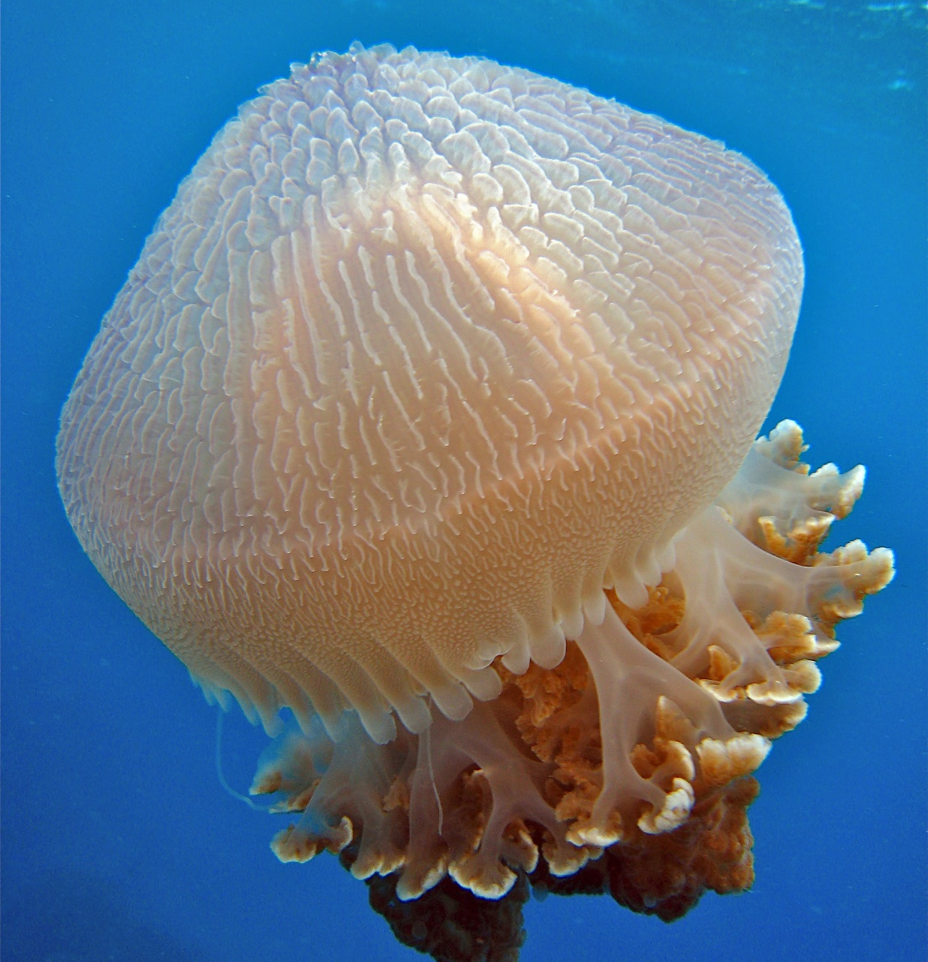
What do sea
turtles eat that look like jellyfish?
Notes:
Image: C. Jones, Copyright Commonwealth of Australia (GBRMPA)

Slide 60
Plastic
bags.
Notes:
Image: C. Jones, Copyright Commonwealth of Australia (GBRMPA)

Slide 61
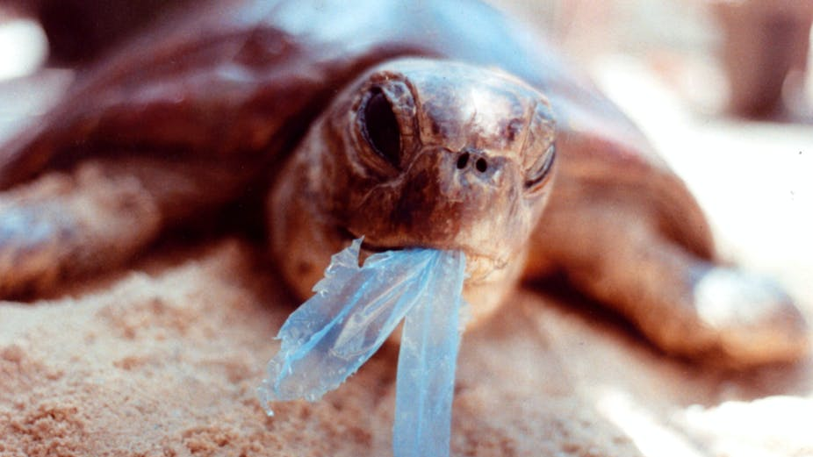
AAP Image/Department of the Environment and Heritage/Melbourne Zoo
Notes:
Image: https://theconversation.com/ghostnets-fish-on-marine-rubbish-threatens-northern-australian-turtles-11585

Slide 62
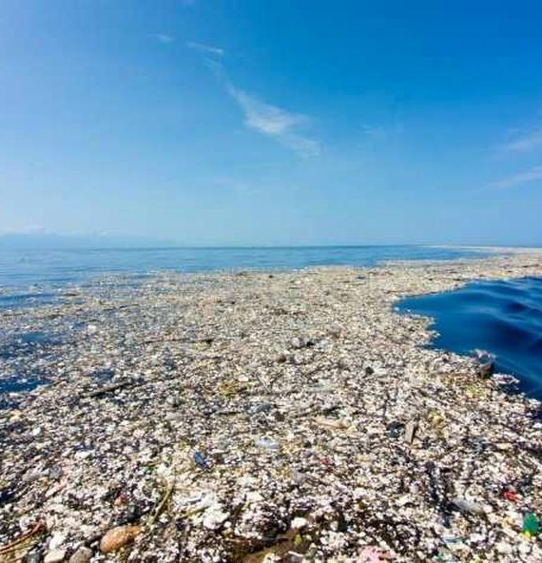
For every kilogram of plankton in the Great Pacific Garbage Patch,
how many kilograms is plastic?
Notes:
Image: https://theoceancleanup.com/

Slide 63
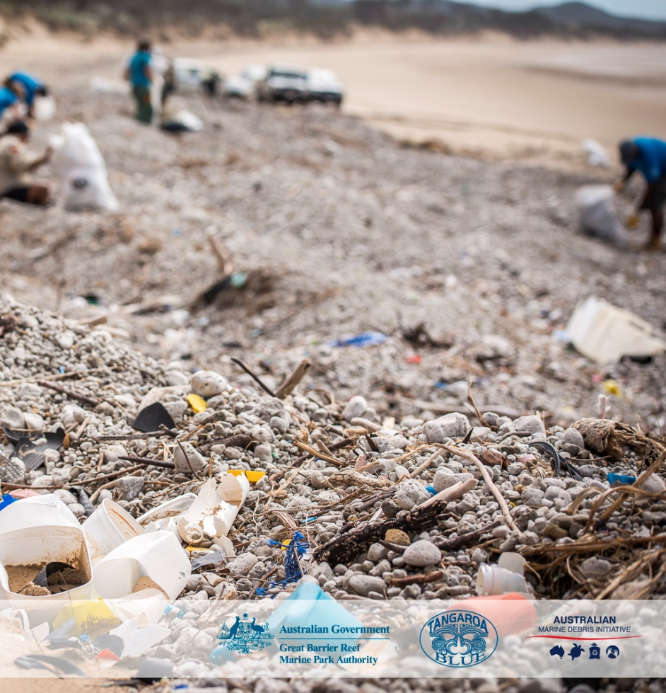
6kg
Notes:
Image: C. Miller, Copyright Commonwealth of Australia (GBRMPA)

Slide 64

Sharks
Notes:
Image: J. Sumerling, Copyright Commonwealth of Australia (GBRMPA)

Slide 65

Where are sharks positioned in the food chain?
Notes:
Image: K. Hoppen, Copyright Commonwealth of Australia (GBRMPA)

Slide 66
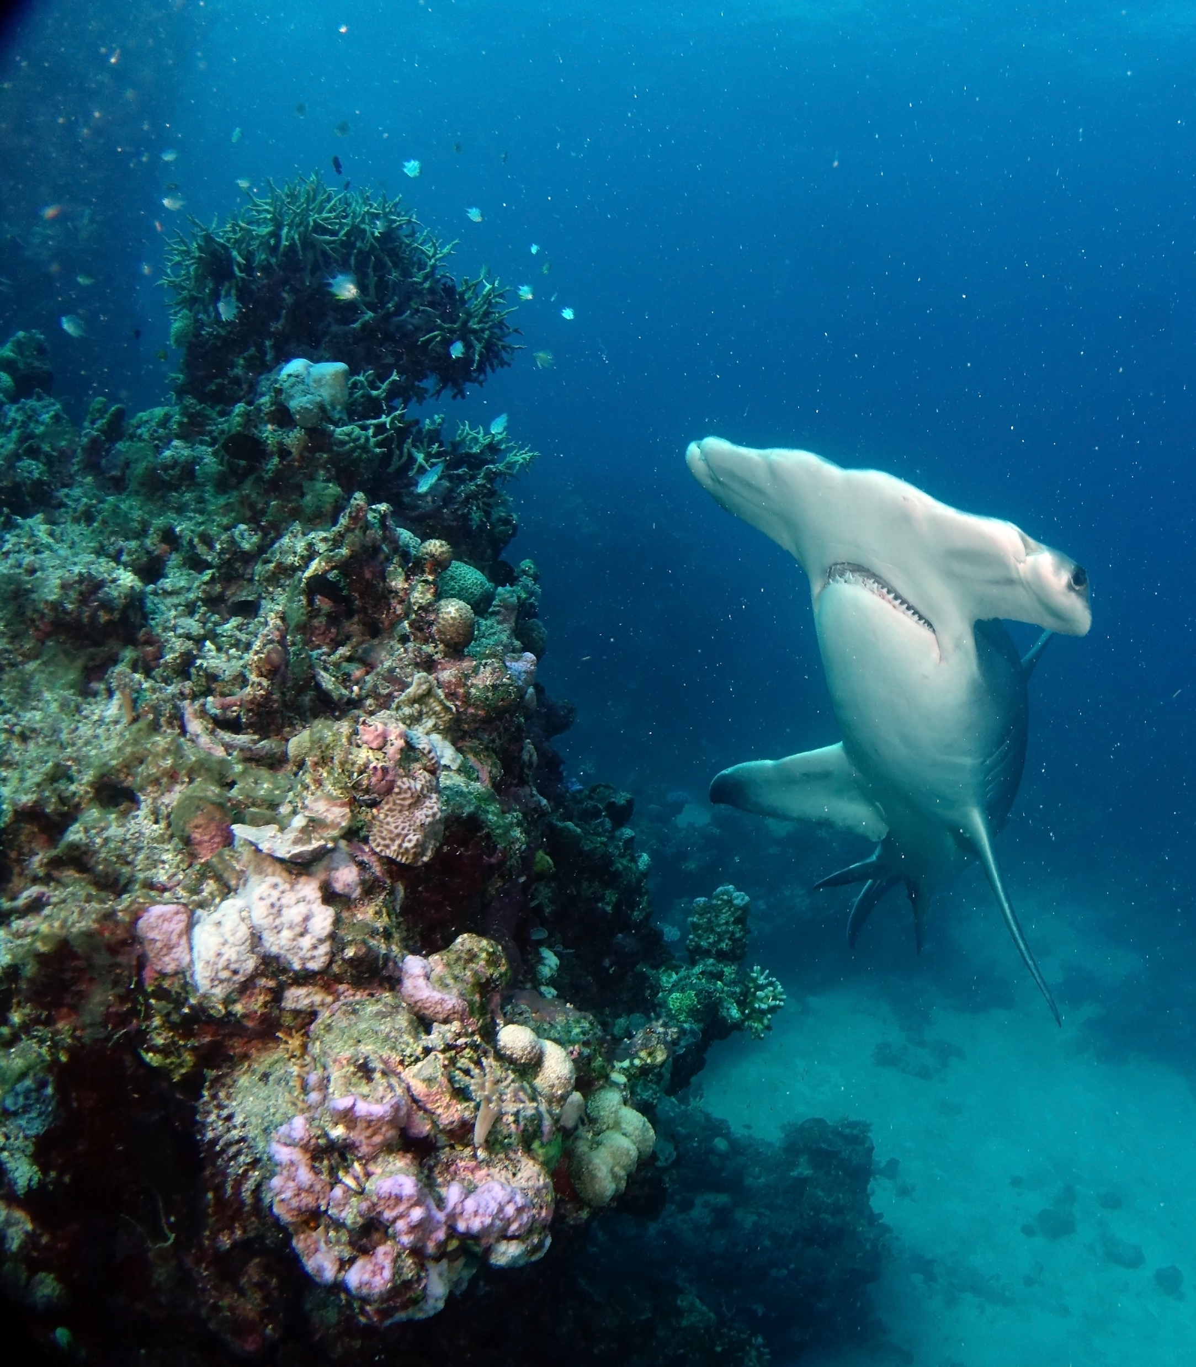
Sharks are apex predators at the top of the food chain.
They help regulate the number of prey species and maintain ecological balance.
Notes:
Image: C. Jones, Copyright Commonwealth of Australia (GBRMPA)

Slide 67
Quiz time!
30 questions. Answers are
provided at the end.
Notes:
The following questions are straight from the Rapid Monitoring Survey course exam questions.

Slide 68
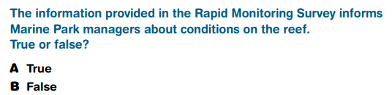
Question 1.

Slide 69
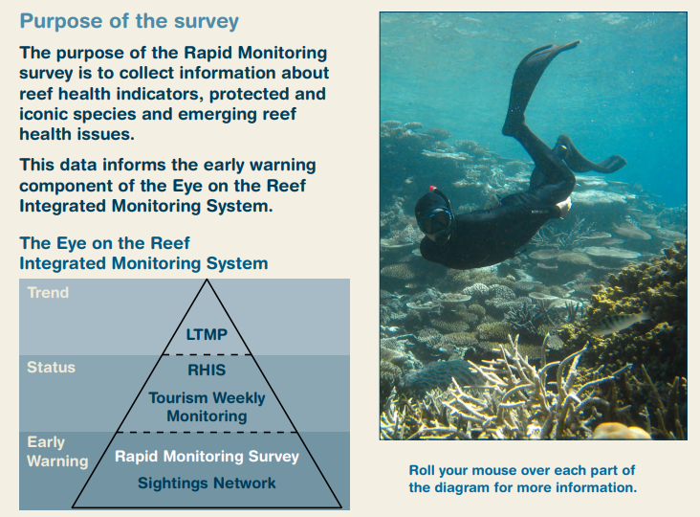
Read to answer the next question.

Slide 70
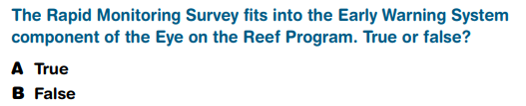
Question 2.

Slide 71
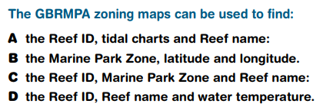
Question 3.

Slide 72
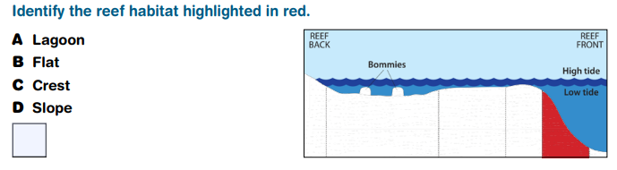
Question 4.

Slide 73
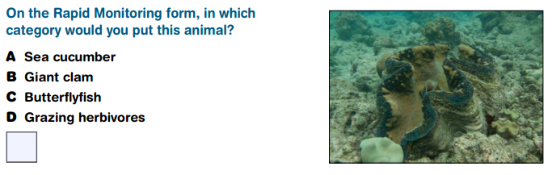
Question 5.

Slide 74
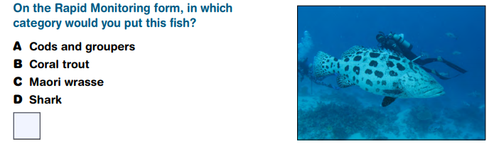
Question 6.

Slide 75
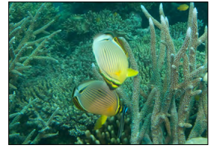
Question 7.

Slide 76
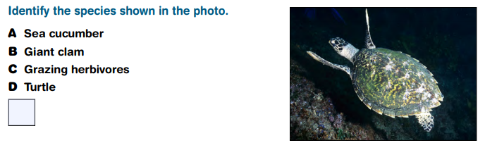
Question 8.
Hawksbill turtle

Slide 77
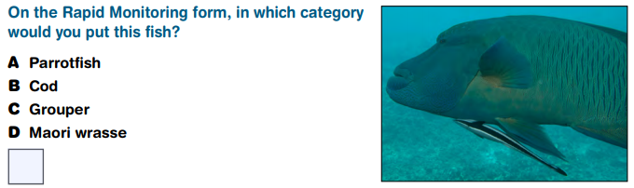
Question 9.

Slide 78
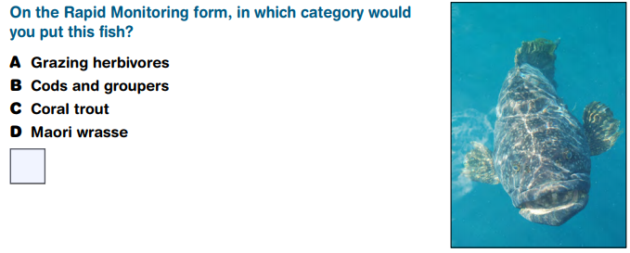
Question 10.

Slide 79
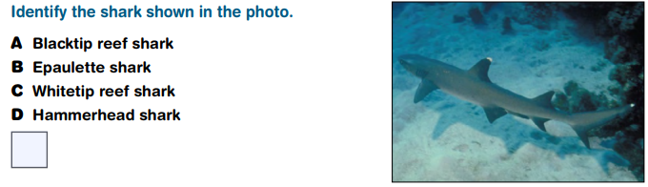
Question 11.

Slide 80
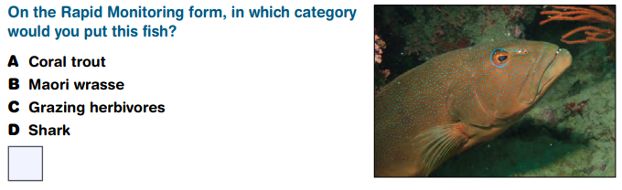
Question 12.

Slide 81
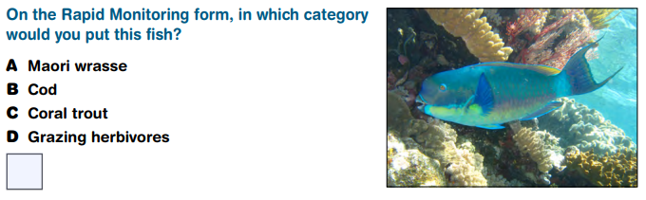
Question 13.

Slide 82
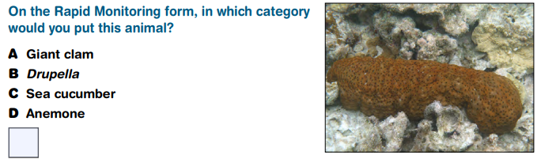
Question 14.

Slide 83
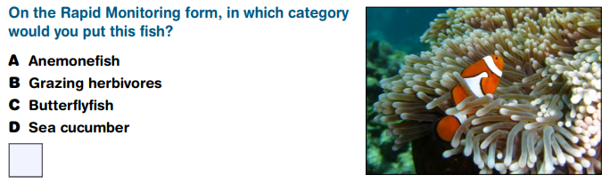
Question 15.

Slide 84
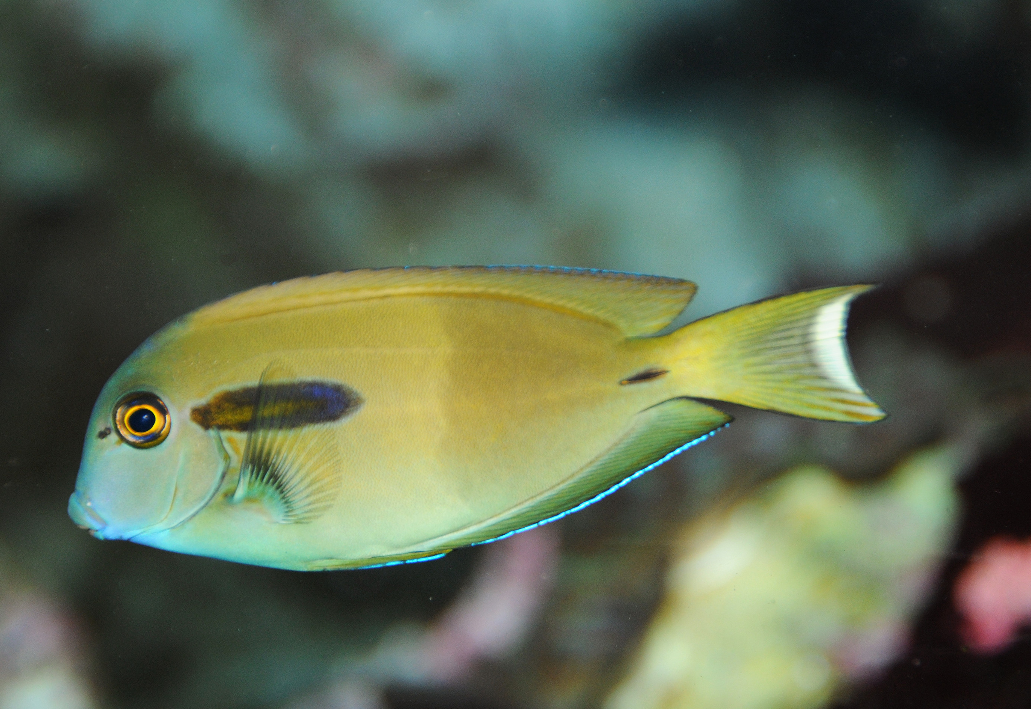
Question 16.

Slide 85
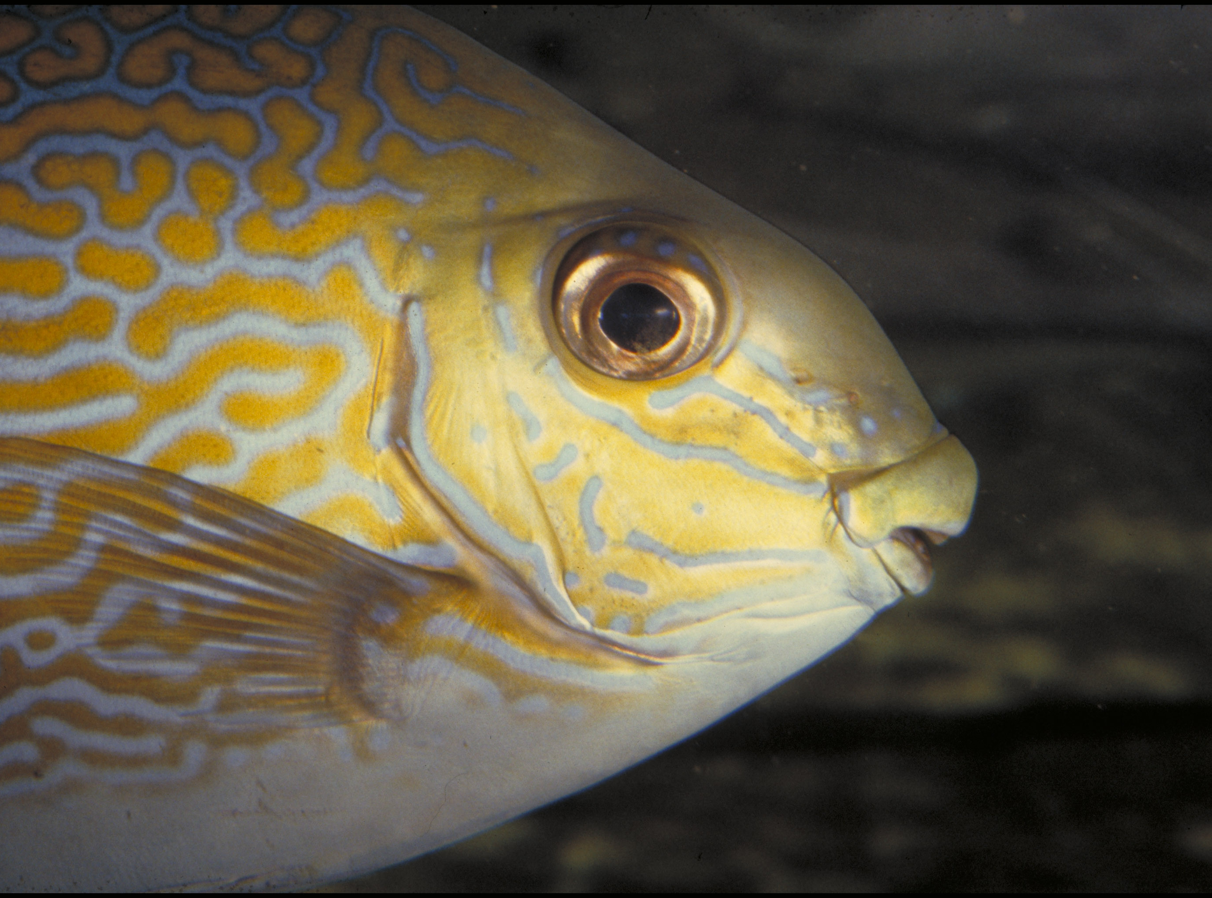
Question 17.

Slide 86
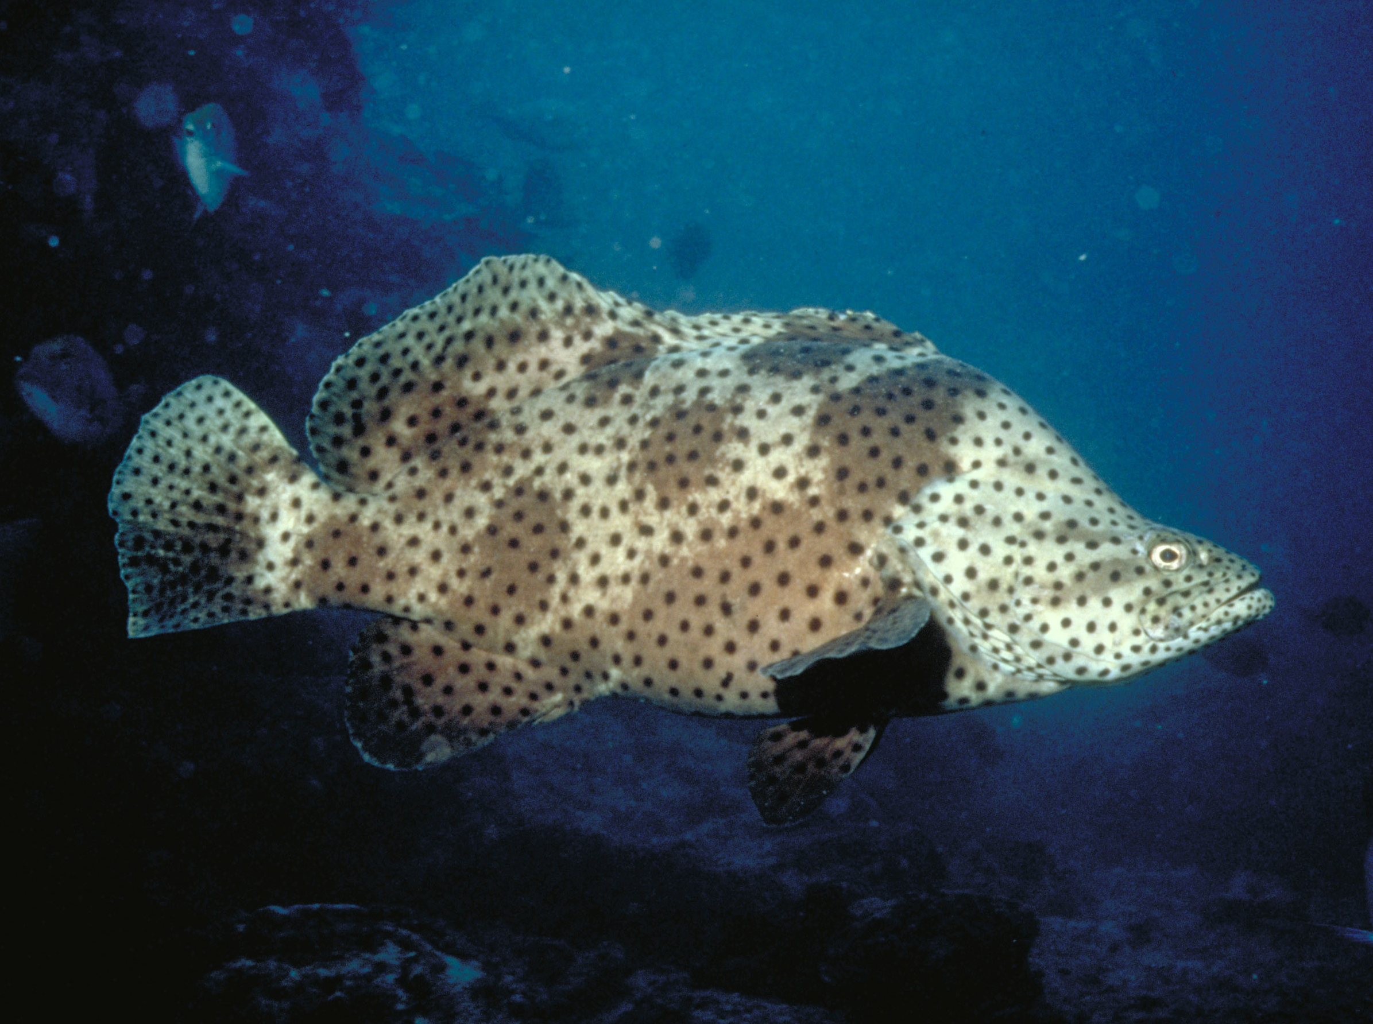
Question 18.

Slide 87

Question 19.
FEMALE

Slide 88
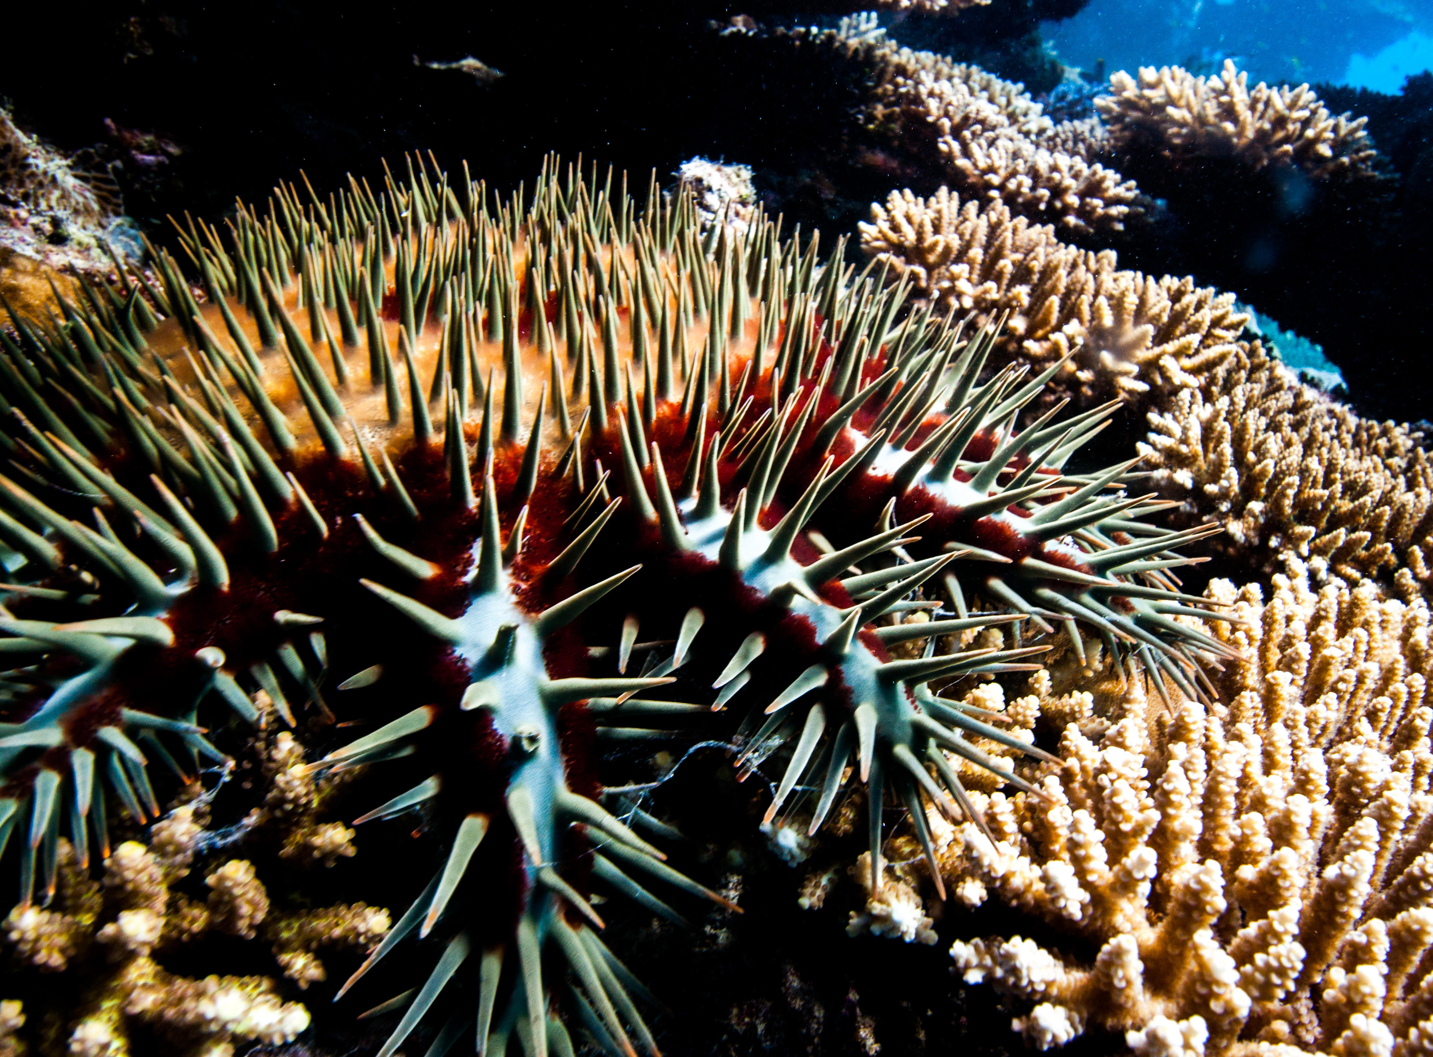
Question 20.
On the Rapid Monitoring form, in which category would you put this animal?
Crown-of-thorns starfish

Slide 89

Question 21.
Sea cucumbers are Echinoderms are related to sea stars and sea urchins. What do these animals all have in common?
A Radial symmetry
B Tube feet
C Powers of regeneration
D All the above
Notes:
These are questions from the pre-snorkel brief on the excursion. Repeating information helps with long term memory retention and builds confidence.

Slide 90
Question 22.
A giant clam stays open to provide enough sunlight for which guest to carry out photosynthesis in its mantle?
A Protist
B Zooxanthellae algae
C Dinoflagellate
D Cilia
Notes:
These are questions from the pre-snorkel brief on the excursion. Repeating information helps with long term memory retention and builds confidence.

Slide 91
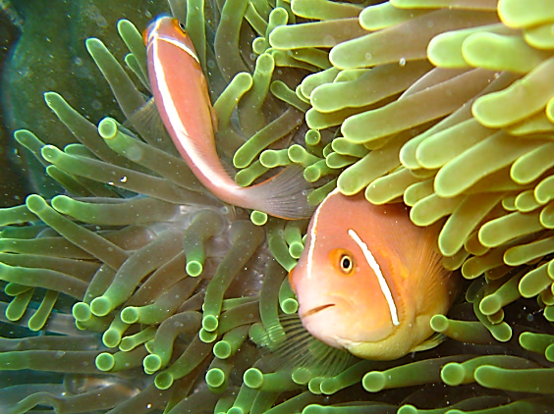
Question 23.
If anemones and jellyfish are both Cnidarians, what do they have in common?
A Stinging cells (nematocysts)
B Anemonefish
C Same colour
D Same size
Notes:
These are questions from the pre-snorkel brief on the excursion. Repeating information helps with long term memory retention and builds confidence.

Slide 92
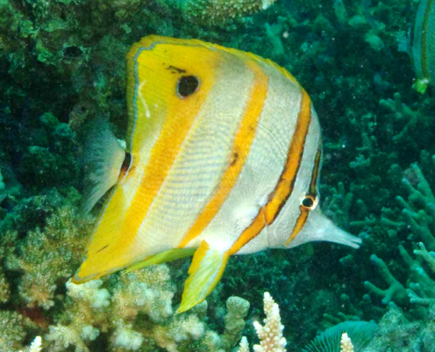
Question 24.
What do butterflyfish eat?
A Coral polyps
B Anemones
C Small invertebrates
D All the above
Notes:
These are questions from the pre-snorkel brief on the excursion. Repeating information helps with long term memory retention and builds confidence.

Slide 93

Question 25.
Why are grazing herbivores called the lawnmowers of the Reef?
A Because they graze on so much algae
B Because they sound like lawnmowers
C Because they look like lawnmowers
D None of the above
Notes:
These are questions from the pre-snorkel brief on the excursion. Repeating information helps with long term memory retention and builds confidence.

Slide 94

Question 26.
How do cod and grouper hunt?
A They actively chase their prey
B They hunt in groups
C They sit and wait to ambush
their prey
D They wobble their lips
Notes:
These are questions from the pre-snorkel brief on the excursion. Repeating information helps with long term memory retention and builds confidence.

Slide 95

Question 27.
Lots of people like to eat coral trout. What size coral trout can people legally catch and keep?
A 30cm
B 35cm
C 38cm
D 42cm
Notes:
These are questions from the pre-snorkel brief on the excursion. Repeating information helps with long term memory retention and builds confidence.

Slide 96

Question 28.
What do sea turtles eat that look like jellyfish?
A Fruit cups
B Plastic bags
C Fishing line
D Mops
Notes:
These are questions from the pre-snorkel brief on the excursion. Repeating information helps with long term memory retention and builds confidence.

Slide 97
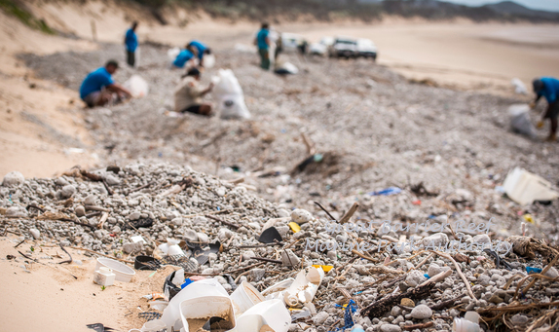
Question 29.
Researchers have estimated that for every 1 kilogram of plankton in the Great Pacific Garbage Patch, there are how many kilograms of plastic?
A 1
B 2
C 3
D 6
Notes:
These are questions from the pre-snorkel brief on the excursion. Repeating information helps with long term memory retention and builds confidence.

Slide 98

Question 30.
Where are sharks positioned in the food chain?
A At the bottom
B In the middle
C At the top
D None of the above
Notes:
These are questions from the pre-snorkel brief on the excursion. Repeating information helps with long term memory retention and builds confidence.

Slide 99
Answers
Notes:
The following questions are straight from the Rapid Monitoring Survey course exam questions.

Slide 100
Question 1.

Slide 101
Read to answer the next question.

Slide 102
Question 2.

Slide 103
Question 3.

Slide 104
Question 4.
D

Slide 105
Question 5.
B

Slide 106
Question 6.
A

Slide 107
Question 7.
C

Slide 108
Question 8.
Hawksbill turtle
D

Slide 109
Question 9.
D

Slide 110
Question 10.
B

Slide 111
Question 11.
C

Slide 112
Question 12.
A

Slide 113
Question 13.
D

Slide 114
Question 14.
C

Slide 115
Question 15.
A

Slide 116
Question 16.
B

Slide 117
Question 17.
B

Slide 118
Question 18.
B

Slide 119
Question 19.
B
FEMALE

Slide 120
Question 20.
On the Rapid Monitoring form, in which category would you put this animal?
Crown-of-thorns starfish
B

Slide 121
Question 21.
Sea cucumbers are Echinoderms and are related to sea stars and sea urchins. What do these animals all have in common?
A Radial symmetry
B Tube feet
C Powers of regeneration
D All the above
D
Notes:
These are questions from the pre-snorkel brief on the excursion. Repeating information helps with long term memory retention and builds confidence.

Slide 122
Question 22.
A giant clam stays open to provide enough sunlight for which guest to carry out photosynthesis in its mantle?
A Protist
B Zooxanthellae algae
C Dinoflagellate
D Cilia
B
Notes:
These are questions from the pre-snorkel brief on the excursion. Repeating information helps with long term memory retention and builds confidence.

Slide 123
Question 23.
If anemones and jellyfish are both Cnidarians, what do they have in common?
A Stinging cells (nematocysts)
B Anemonefish
C Same colour
D Same size
A
Notes:
These are questions from the pre-snorkel brief on the excursion. Repeating information helps with long term memory retention and builds confidence.

Slide 124
Question 24.
What do butterflyfish eat?
A Coral polyps
B Anemones
C Small invertebrates
D All the above
D
Notes:
These are questions from the pre-snorkel brief on the excursion. Repeating information helps with long term memory retention and builds confidence.

Slide 125
Question 25.
Why are grazing herbivores called the lawnmowers of the Reef?
A Because they graze on so much algae
B Because they sound like lawnmowers
C Because they look like lawnmowers
D None of the above
A
Notes:
These are questions from the pre-snorkel brief on the excursion. Repeating information helps with long term memory retention and builds confidence.

Slide 126
Question 26.
How do cod and grouper hunt?
A They actively chase their prey
B They hunt in groups
C They sit and wait to ambush their prey
D They wobble their lips
C
Notes:
These are questions from the pre-snorkel brief on the excursion. Repeating information helps with long term memory retention and builds confidence.

Slide 127
Question 27.
Lots of people like to eat coral trout. What size coral trout can people legally catch and keep?
A 30cm
B 35cm
C 38cm
D 42cm
C
Notes:
These are questions from the pre-snorkel brief on the excursion. Repeating information helps with long term memory retention and builds confidence.

Slide 128
Question 28.
What do sea turtles eat that look like jellyfish?
A Fruit cups
B Plastic bags
C Fishing line
D Mops
B
Notes:
These are questions from the pre-snorkel brief on the excursion. Repeating information helps with long term memory retention and builds confidence.

Slide 129
Question 29.
Researchers have estimated that for every 1 kilogram of plankton in the Great Pacific Garbage Patch, there are how many kilograms of plastic?
A 1
B 2
C 3
D 6
D
Notes:
These are questions from the pre-snorkel brief on the excursion. Repeating information helps with long term memory retention and builds confidence.

Slide 130
Question 30.
Where are sharks positioned in the food chain?
A At the bottom
B In the middle
C At the top
D None of the above
C
Notes:
These are questions from the pre-snorkel brief on the excursion. Repeating information helps with long term memory retention and builds confidence.

Slide 131
How did you go?

Slide 132
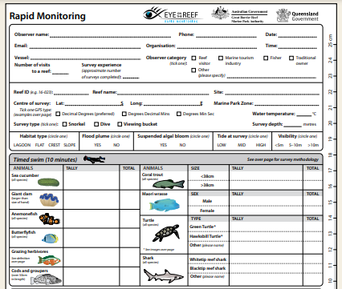
Do you think next time, you could count all the animals yourself?

Slide 133
You’ve now learnt that the Great Barrier Reef is one of the world’s most biodiverse ecosystems.

Slide 134
Coral reefs are dependent on many factors. They are highly interconnected ecosystems.

Slide 135
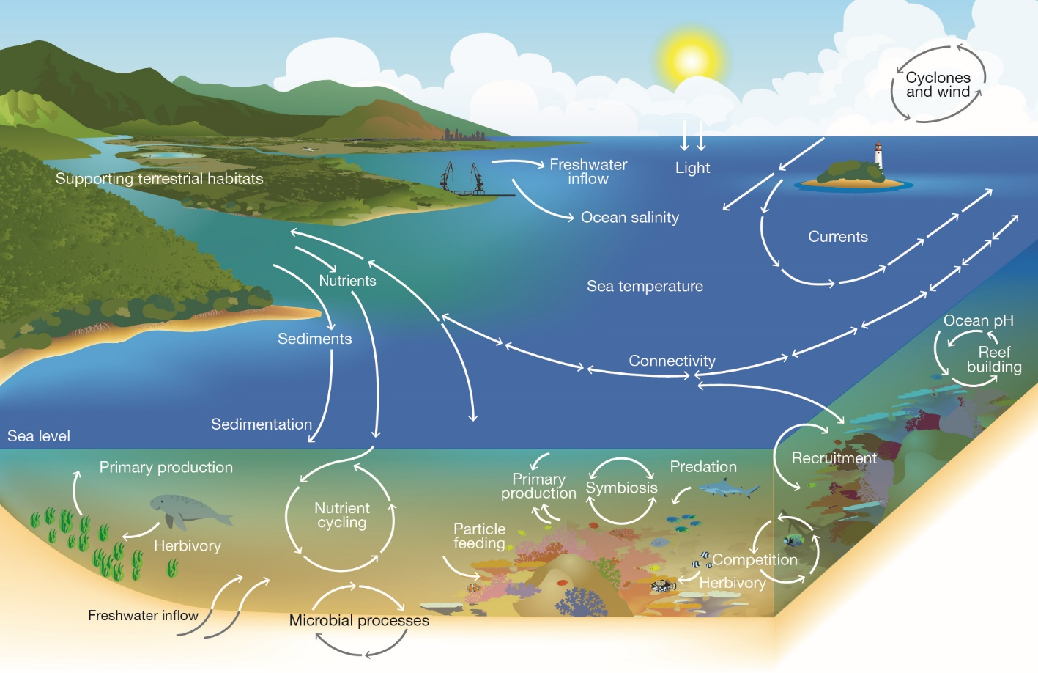
Notes:
Image: Copyright Commonwealth of Australia (GBRMPA)

Slide 136
The Great Barrier Reef faces many threats that impact on its health and resilience.

Slide 137
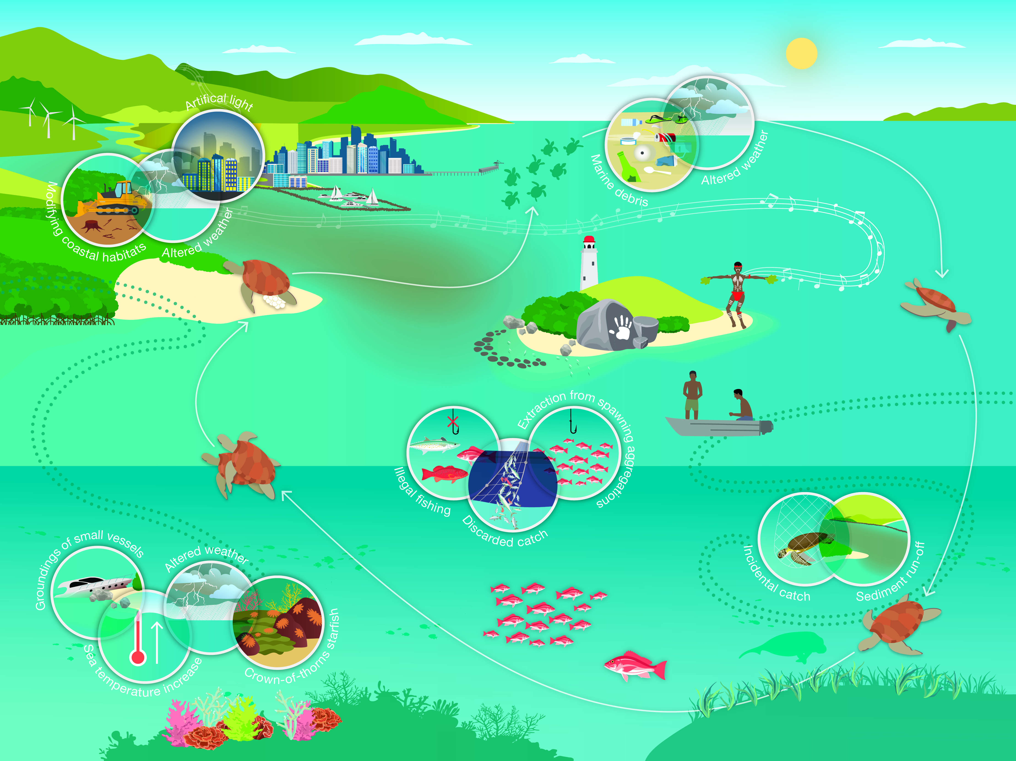
Notes:
Image: Copyright Commonwealth of Australia (GBRMPA)

Slide 138

What actions can you take to protect the Great Barrier Reef?

Slide 139
Remember, the Great Barrier
Reef Marine Park Authority also
has an Eye on the Reef app.
Do you remember this from your excursion?
It’s also a great tool for learning more about the
animals you saw!
Do you recognize any wildlife in the app?

Slide 140

Download
the Eye on the
Reef app.
Notes:
App image: https://www.gbrmpa.gov.au/__data/assets/pdf_file/0020/265430/Eye-on-the-Reef-app-poster.pdf

Slide 141


Press “Sightings” and “Create”.

Slide 142


Press “Wildlife”.

Slide 143


Marine mammals.
Select your animal and press “INFORMATION” to learn more.

Slide 144


Marine reptiles.

Slide 145




Sharks and rays.

Slide 146



Fishes.

Slide 147











Slide 148





Birds.

Slide 149


Invertebrates.

Slide 150










Slide 151
Explore the other tabs too!

Slide 152
Create a poster to answer the question:
How can I help the Great Barrier Reef?
Display it proudly in your classroom.
Notes:
This is the last slide for students to view. The remaining slides are for the teachers.

Slide 153
Thank you for helping the Great Barrier Reef!
See the Reef • Love the Reef • Protect the Reef

