Slide 1
Be a Marine
Biologist for a Day
Part 3: Making connections
Senior School
Notes:
Image: C. Golino, Copyright Commonwealth of Australia (GBRMPA)

Slide 2


Thank you for organising your trip to the reef with us.
We had a great time and hope you did too.
This PowerPoint is Part 3 of the Be a Marine Biologist for a Day program designed for senior school by the Great Barrier Reef Marine Park Authority (GBRMPA).
View this PowerPoint after your excursion, with the accompanying activity book.
This is Part 3: Making connections. This is the last part of the program. This is when your students make connections with all they’ve learned and experienced so far.
On your excursion, you conducted an Eye on the Reef citizen science activity with your reef guide. Now it’s time to upload your data to the GBRMPA website.
The Great Barrier Reef Marine Park Authority would like to thank you for uploading your data to their Rapid Monitoring database. We hope to see you again next year!
Licensed by the Commonwealth of Australia for use under a Creative Commons By Attribution 4.0 International licence with the exception of content supplied by third parties and any photographs. http://creativecommons.org/licences/by/4.0

Slide 3

We would like to acknowledge all of the Aboriginal and Torres Straight Islander peoples who have connection to the Great Barrier Reef.
We recognise their continuing connection to land, water and community, and pay our respects to their Elders past, present and emerging.

Slide 4

We would like to acknowledge the (insert name of local Traditional Owner group) peoples as the Traditional Owners of the Land and Sea Country that we visited as part of your excursion.

Slide 5

How can I help the
Great Barrier Reef?
Notes:
This is the overarching inquiry question that encompasses the entire BAMBFAD Program and is the starting slide to this presentation.

Slide 6

Notes:
Image: J. Johnson, Copyright Copyright Commonwealth of Australia (GBRMPA)

Slide 7
Eye on the Reef
Rapid Monitoring survey
10 MINUTE TIMED SWIM

Slide 8
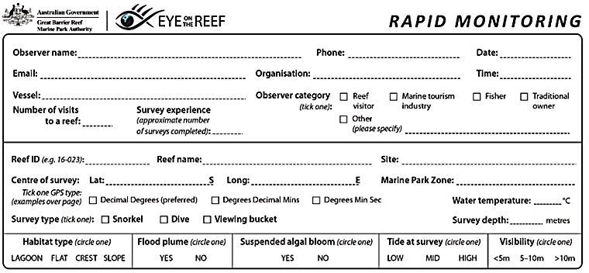
Have you got your data ready?

Slide 9

Because it’s time to upload it to GBRMPA!

Slide 10

This is the website for GBRMPA’s Eye on the Reef.
The link to connect is provided at the end of this presentation.

Slide 11

Login.

Slide 12

Select ‘Rapid Monitoring Survey’ tab.

Slide 13


Enter your data.

Slide 14

If you also completed the (more advanced) 360°survey, complete all questions. Otherwise, leave blank.

Slide 15

Save!
Scroll down to the bottom of the page to ‘Save’.

Slide 16
Are you ready?
Click on the image below to connect.
Notes:
www.gbrmpa.gov.au/our-work/eye-on-the-reef

Slide 17

Thank
you
Male Maori wrasse
Notes:
Image: C. Jones, Copyright Copyright Commonwealth of Australia (GBRMPA)

Slide 18
Check understanding.
Next, is what you’ve all been waiting for.
The answers to questions asked in Part 1 (before the excursion) and/or Part 2 (on the excursion).
Let’s check how you went!
Notes:
The following questions are straight from the Rapid Monitoring Survey course exam questions.

Slide 19


Sea cucumber
Notes:
Image: Copyright Commonwealth of Australia (GBRMPA)

Slide 20
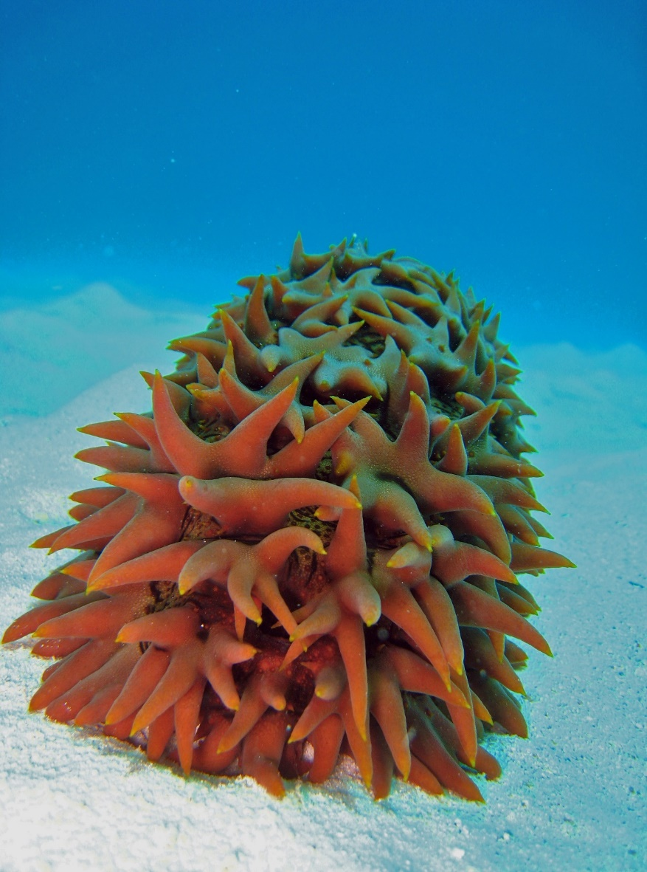
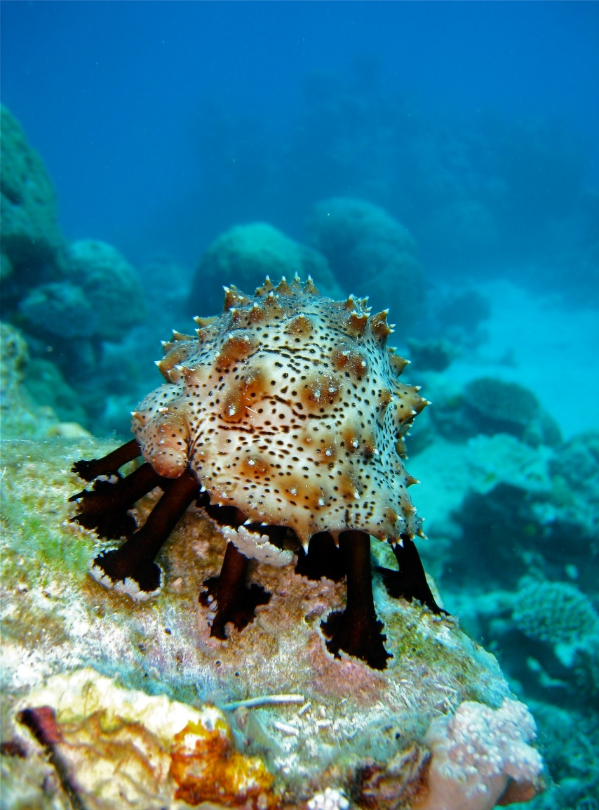

Why count sea cucumbers?
What is their functional role?
Notes:
Images: (Left) C. Jones, Copyright Copyright Commonwealth of Australia (GBRMPA); (Middle) C. Jones, Copyright Copyright Commonwealth of Australia (GBRMPA); (Right) J. Jones, Copyright Copyright Commonwealth of Australia (GBRMPA)

Slide 21
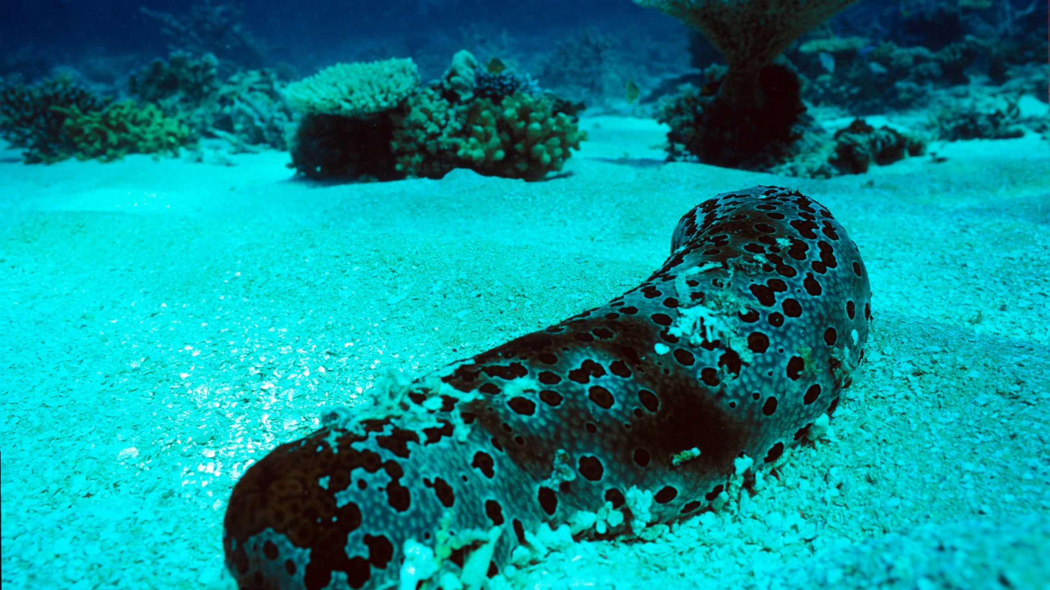
Hint: Sea cucumbers are the
vacuum cleaners of the sea.
Notes:
Image: J. Oliver, Copyright Commonwealth of Australia (GBRMPA)

Slide 22
Sea cucumbers
= clean sand
= healthy reef ☺

Slide 23

Giant clam
VULNERABLE TO EXTINCTION
Notes:
Image: Copyright Commonwealth of Australia (GBRMPA)

Slide 24
Giant clams, like corals, are susceptible to bleaching.
What causes giant clams
to bleach?

Slide 25

Giant clams share a mutualistic symbiotic relationship with an algae called zooxanthellae.
Notes:
Image: C. Jones, Copyright Commonwealth of Australia (GBRMPA)

Slide 26
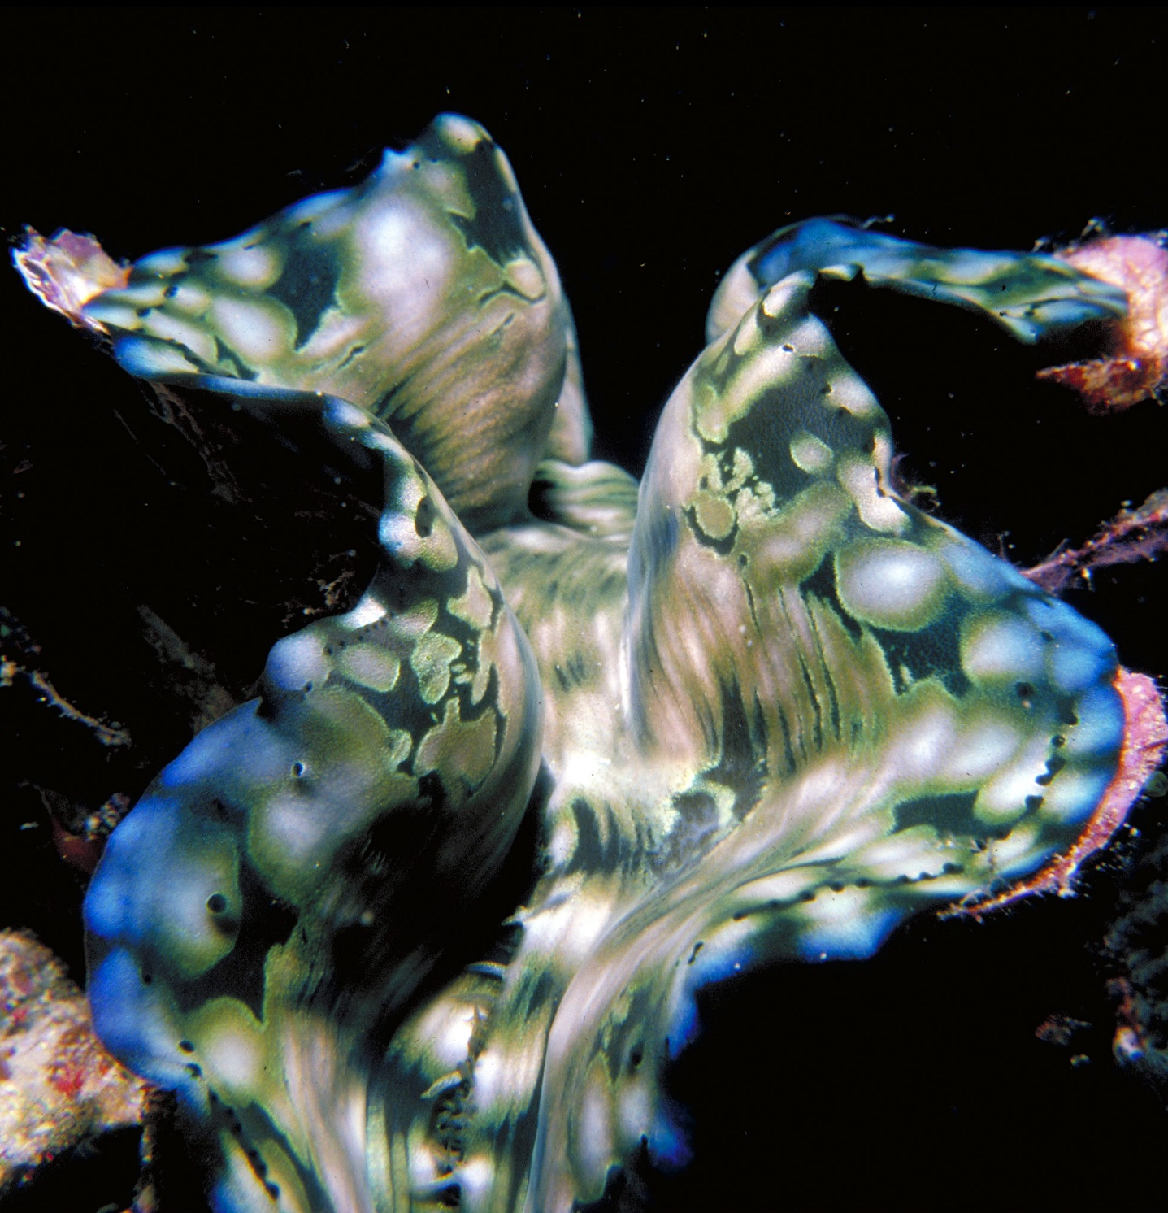
The algae live in the mantle and carry out photosynthesis.
Oxygen is a byproduct of photosynthesis.
Notes:
Image: R. Berklemans, Copyright Commonwealth of Australia (GBRMPA)
Ans. oxygen

Slide 27
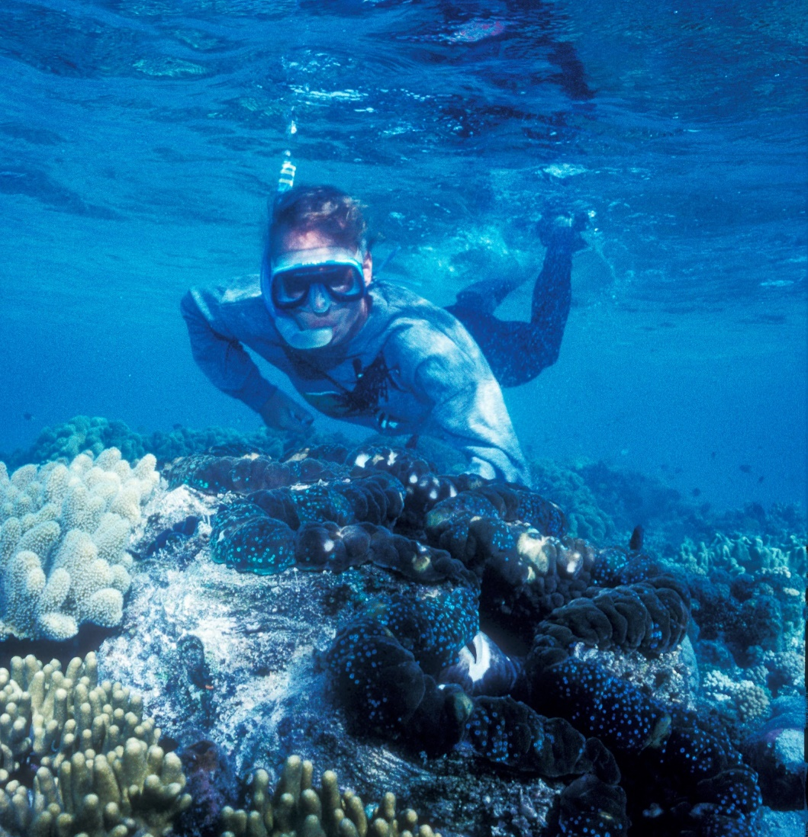
A stress event, such as a heat wave, causes the zooxanthellae to produce toxic levels of oxygen.
Notes:
Image: K. Anthony, Copyright Commonwealth of Australia (GBRMPA)

Slide 28
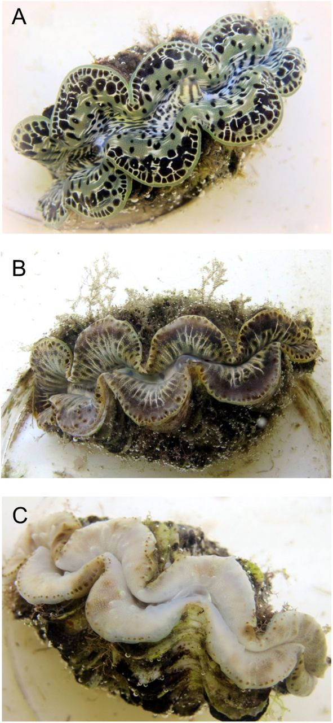
The clam does not like this and, as a result, expels its zooxanthellae. The clam bleaches white.
(A) Non-bleached specimen exposed to 29.2°C 430 µatm of CO₂, (B) partially bleached and
(C) completely bleached specimens exposed to 30.7°C 1212 µatm of CO₂
Chloé Brahmi et al., (2019). Effects of temperature and pCO2 on the respiration, biomineralization and photophysiology of the giant clam Tridacna maxima. Biorxiv. DOI: https://doi.org/10.1101/672907
Notes:
Image: https://www.biorxiv.org/content/10.1101/672907v1.full

Slide 29
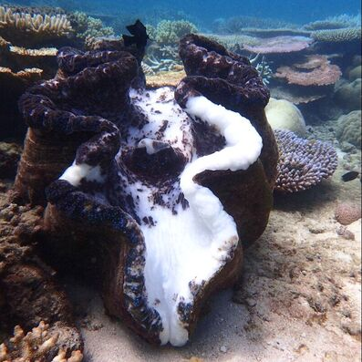
Like coral bleaching, except in clams.
https://missionbeachislandreefadventures.com.au/giant-clams.html
Notes:
Image: https://missionbeachislandreefadventures.com.au/giant-clams.html

Slide 30
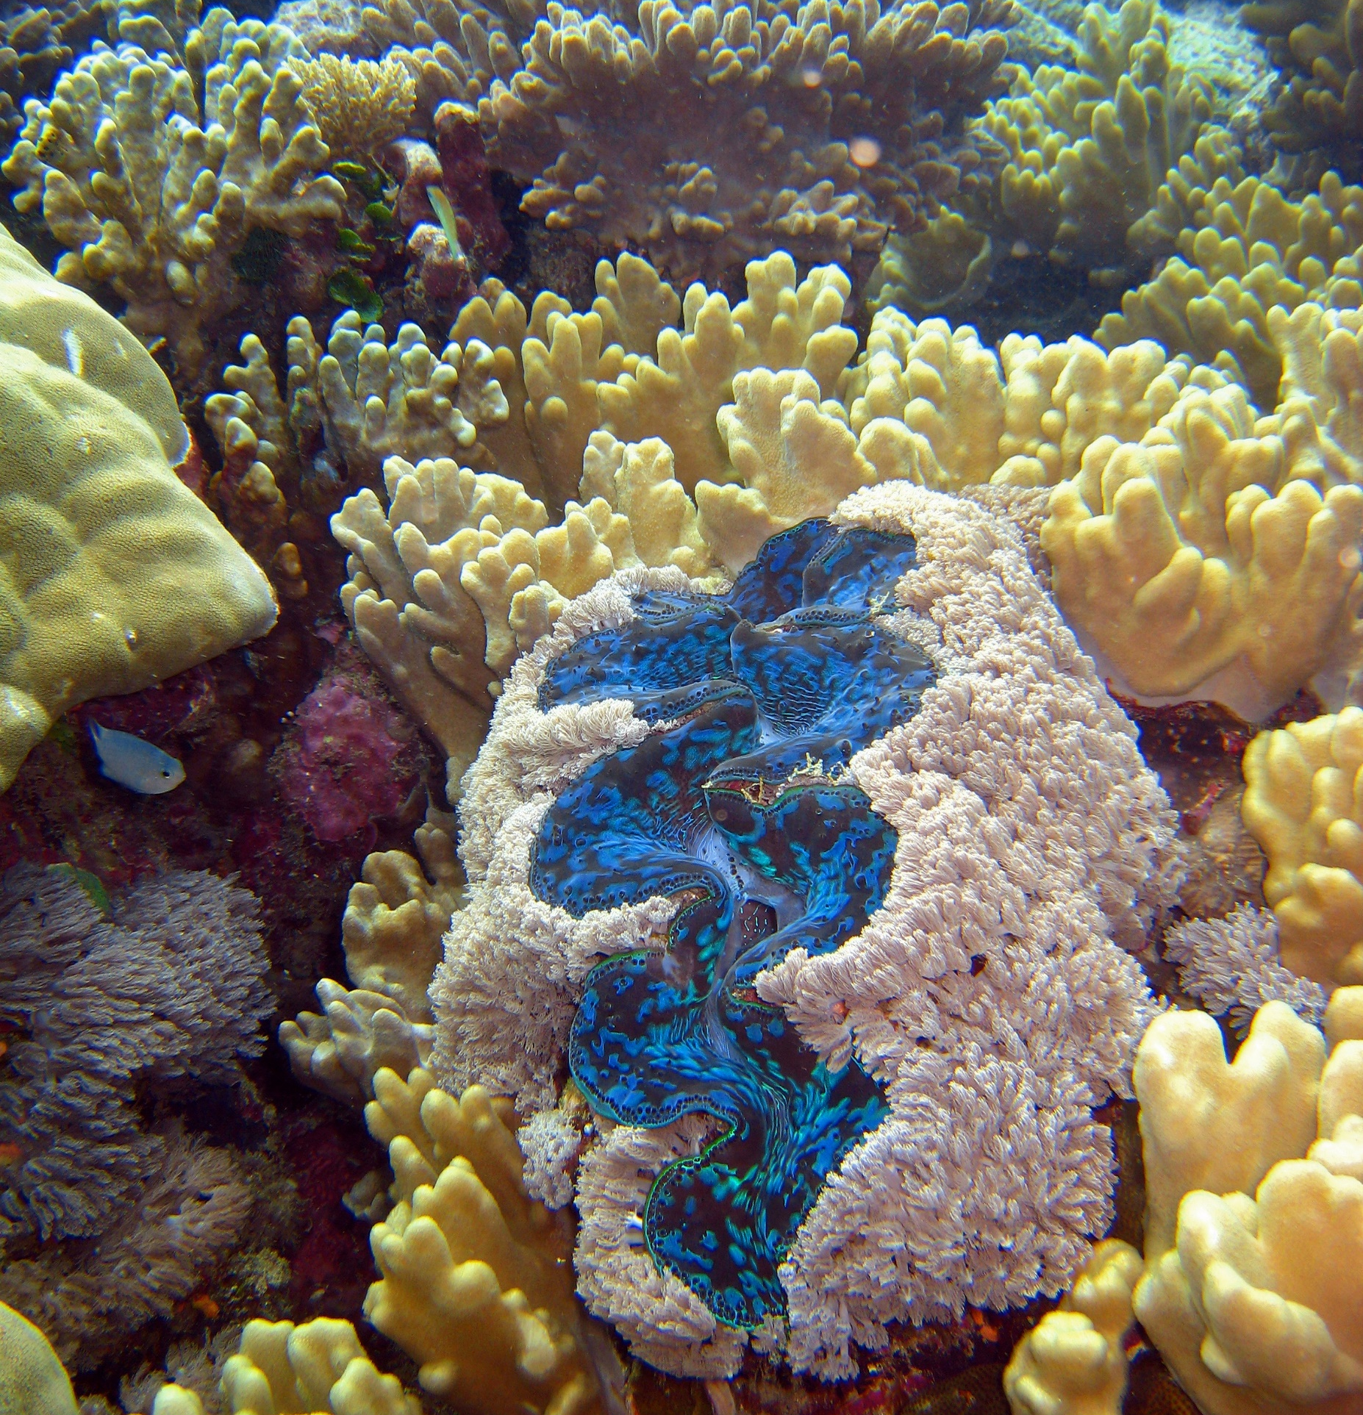
If the temperature cools, and the clam is still alive, the zooxanthellae returns ☺.
Notes:
Image: C. Jones, Copyright Commonwealth of Australia (GBRMPA)

Slide 31

Anemonefish
Notes:
Image: J. Sumerling, Copyright Commonwealth Government of Australia (GBRMPA)

Slide 32

Anemonefish are hermaphrodites.
What does this mean?
Notes:
Image: T. Mayne, Copyright Commonwealth of Australia (GBRMPA)

Slide 33
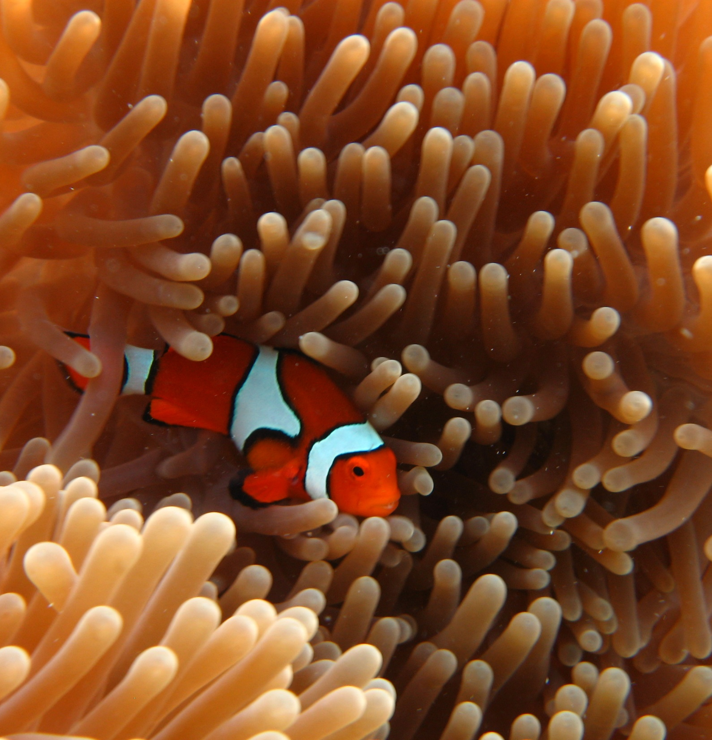
It means they produce both male and female gametes (at different stages in their life).
Notes:
Image: E. Smart, Copyright Commonwealth of Australia (GBRMPA)

Slide 34
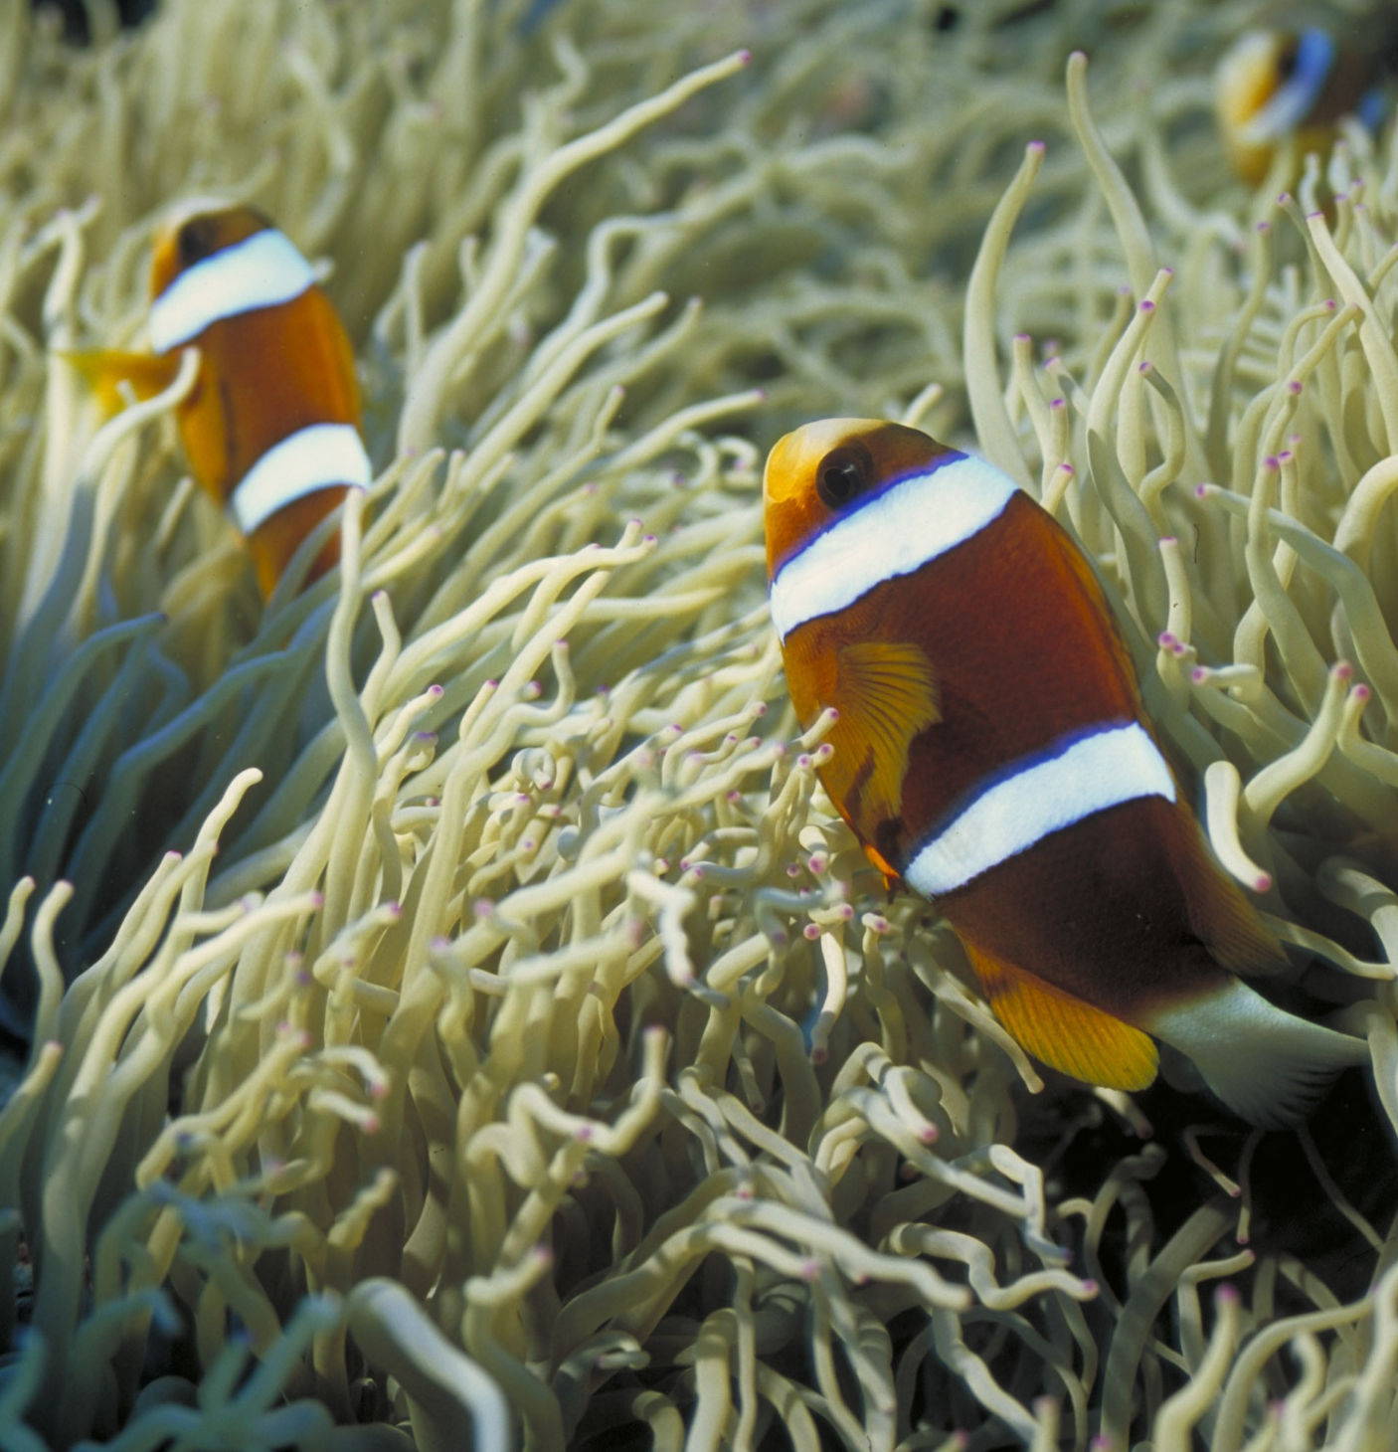
The biggest anemonefish
is always the female, and the second largest is the breeding male.
All of the other fish are subordinate males (these don’t breed).
Subordinate male
Male
Female
Notes:
Image: D. Wachenfeld, Copyright Commonwealth of Australia (GBRMPA)

Slide 35
When the female dies,
her male partner turns into
a female, and the next largest male becomes the breeding male.
Subordinate male
Male
Female
Notes:
Image: D. Wachenfeld, Copyright Commonwealth of Australia (GBRMPA)

Slide 36

Butterflyfish
Bright colours and pretty patterns
Long snout and little mouth for eating coral polyps
Flat body
Notes:
Image: J. Jones, Copyright Commonwealth of Australia (GBRMPA)

Slide 37

How do butterflyfish amplify sounds?
Notes:
Image: R. Berkelmans, Copyright Commonwealth of Australia (GBRMPA)

Slide 38

Their swim bladder is linked to their lateral line.
Notes:
Image: L. Zell, Copyright Commonwealth of Australia (GBRMPA)

Slide 39

Grazing herbivores
Parrotfish / Surgeonfish / Rabbitfish / Unicornfish
Notes:
Image: W. Gladstone, Copyright Commonwealth of Australia (GBRMPA)

Slide 40

Why is it important to have grazing herbivores?
Notes:
Image: C. Jones, Copyright Commonwealth of Australia (GBRMPA)

Slide 41

Grazing herbivores are like the lawnmowers on
the Reef.
Notes:
Image: C. Jones, Copyright Commonwealth of Australia (GBRMPA)

Slide 42
They play a very important role.
They eat algae that
competes with coral for space.
By limiting the growth and spread of algae, coral reefs stay healthy and resilient.

Slide 43
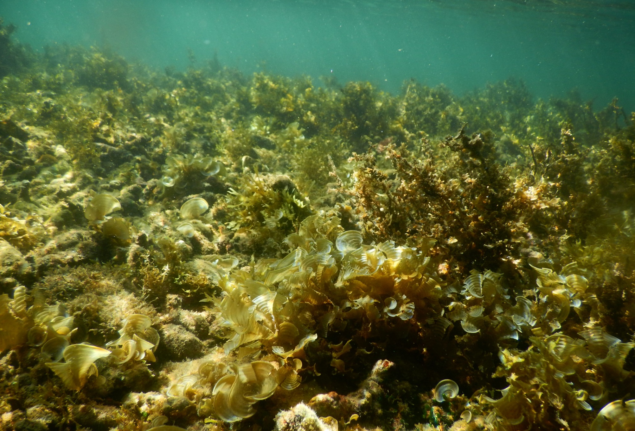
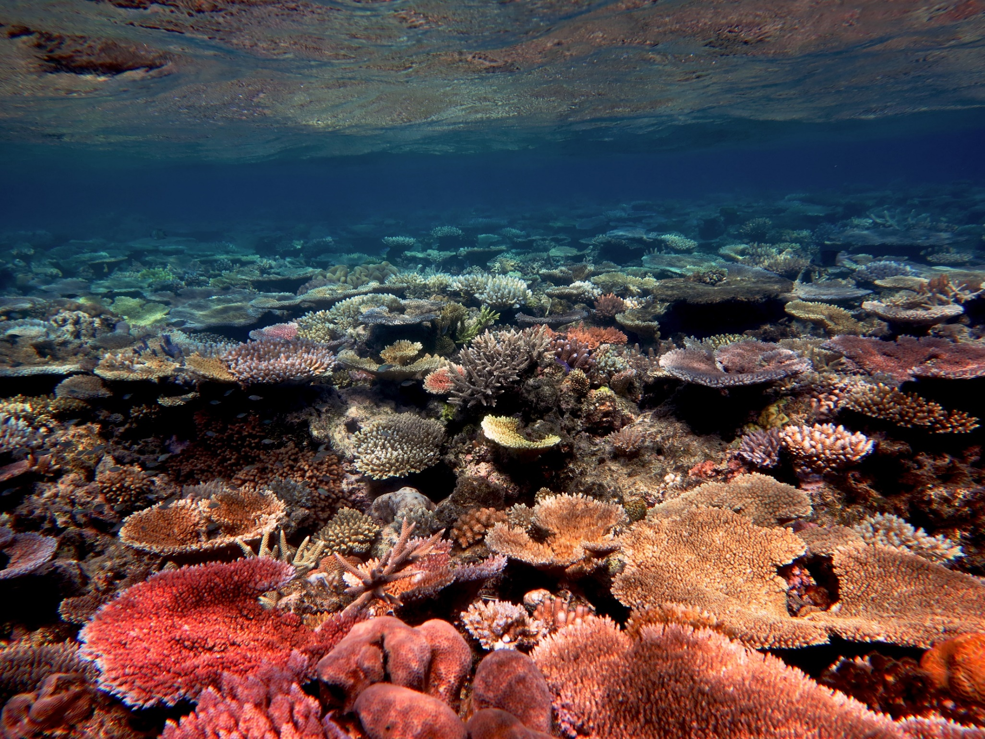
Algae-dominated reef vs coral-dominated reef.
Notes:
Images: (Left) N. Mattocks, Copyright Commonwealth of Australia (GBRMPA); (Right) R. Ramasamy, Copyright Commonwealth of Australia (GBRMPA)

Slide 44

Cods and groupers
Pronounced grow-per.
Notes:
Image: J. Hurford, Copyright Commonwealth of Australia (GBRMPA)

Slide 45
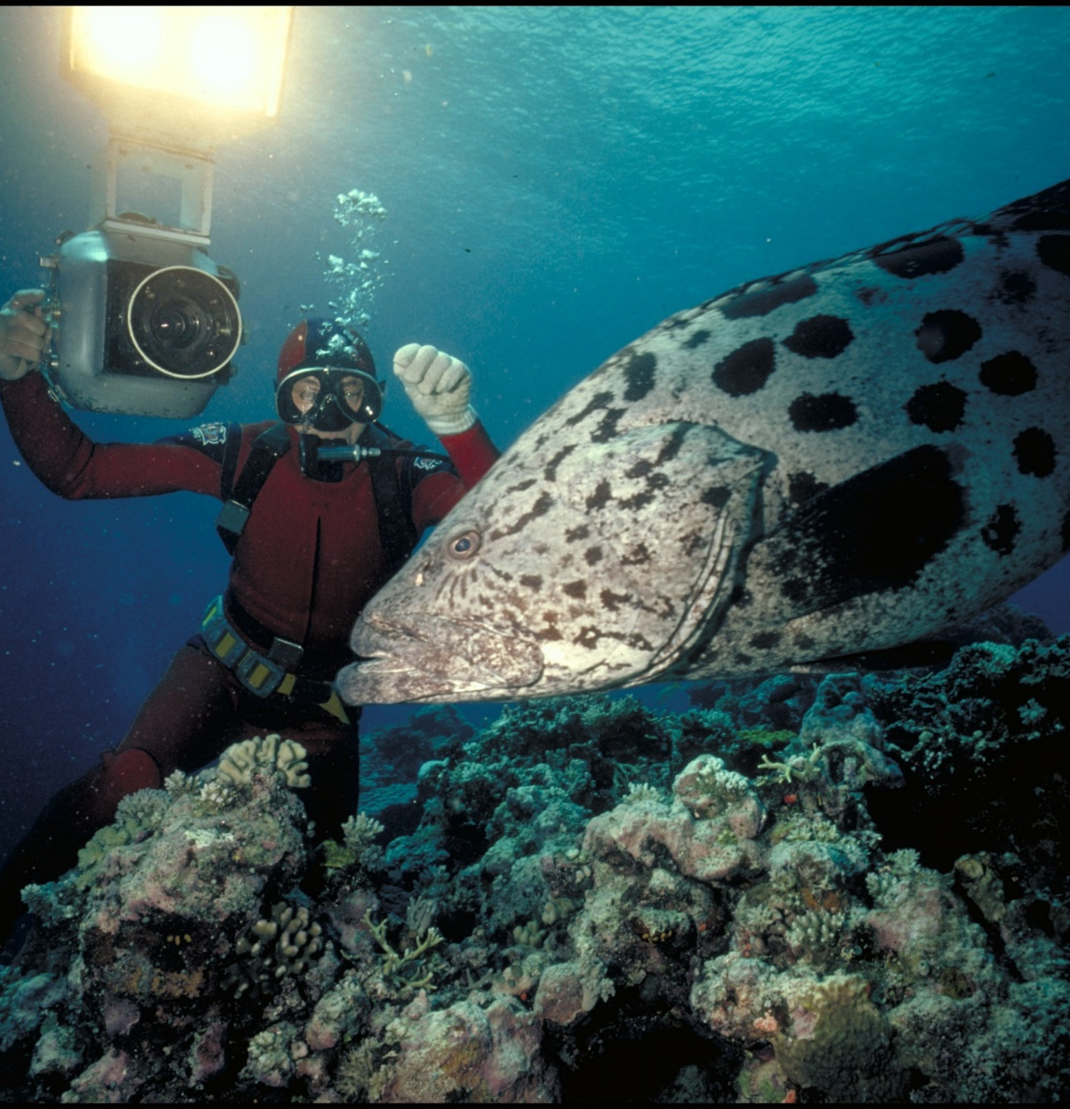
Are Queensland grouper, potato cod and barramundi cod protected in the Great Barrier Reef Marine Park?
Notes:
Image: Ron & Valerie Taylor, Copyright Commonwealth of Australia (GBRMPA)

Slide 46
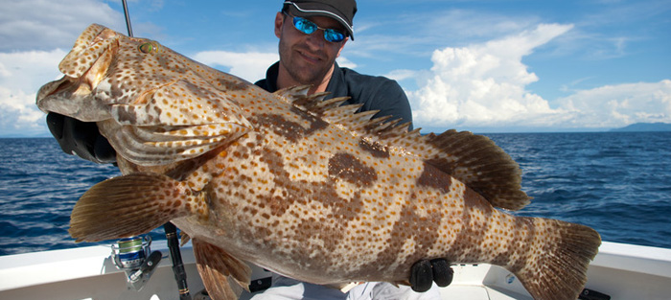
What should you do if you catch one? Use best practice methods to release it. E.g. avoid lifting into the boat
Not this!
Notes:
Image: https://www.reelpursuits.com/7-tips-on-how-to-catch-big-grouper/

Slide 47

Coral trout
Notes:
Image: S. Summerhays, Copyright Commonwealth of Australia (GBRMPA)

Slide 48
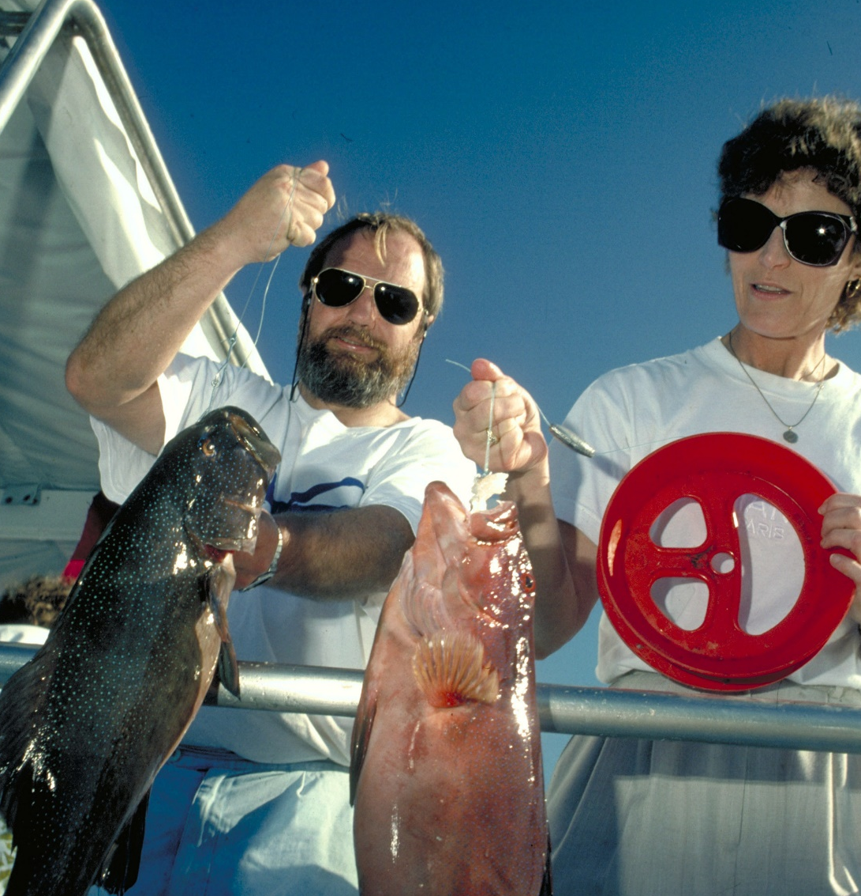
Lots of people like
to eat coral trout.
The legal size is 38cm.
Penalties for keeping undersize fish are hundreds to thousands of dollars.
Notes:
Image: A. Elliott, Copyright Commonwealth of Australia (GBRMPA)

Slide 49

If you eat really
big reef fish, you
risk getting ciguatera poisoning.
Large fish, including coral trout (>6kg) bioaccumulate a toxin from eating lots of smaller contaminated fish.
Eat it and you get very sick.
Notes:
The toxin is a marine algae called Gambierdiscus toxicus.
Image: T. Mayne, Copyright Commonwealth of Australia (GBRMPA)

Slide 50

Maori wrasse
also called humphead wrasse or Napoleon wrasse.
Notes:
Image: C. Jones, Copyright Commonwealth of Australia (GBRMPA)

Slide 51

Maori wrasse live
on the Reef and occupy limited
home ranges.
Male
Notes:
Image: M. Simmons, Copyright Commonwealth of Australia (GBRMPA)

Slide 52
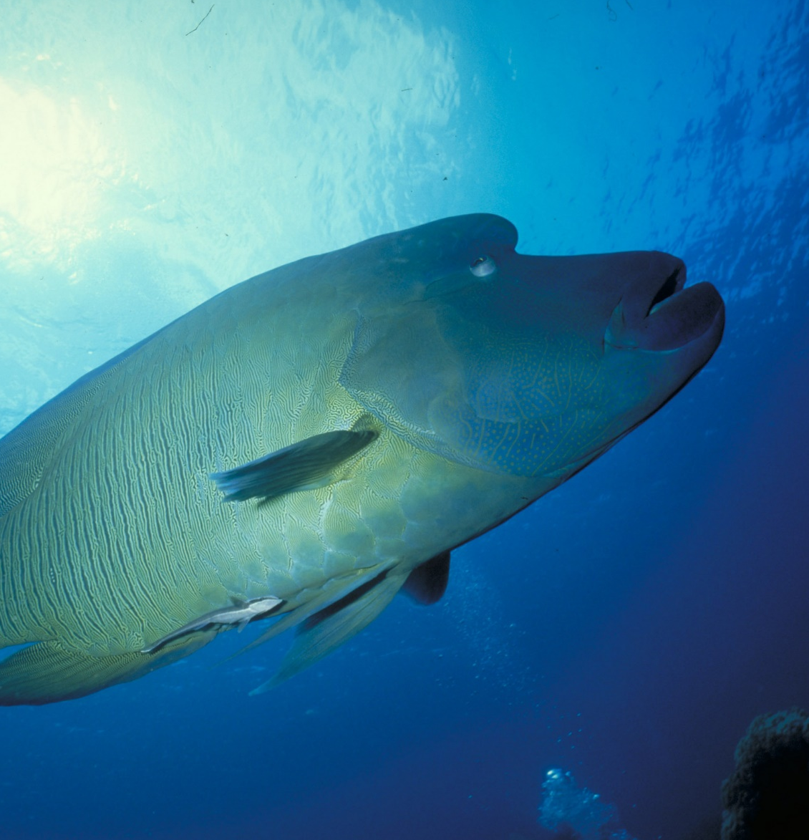
Adults swim across the reefs during the day, resting at night in caves and under coral ledges.
Male
Notes:
Image: M. Simmons, Copyright Commonwealth of Australia (GBRMPA)

Slide 53

Sea turtles
Notes:
Image: C. Jones, Copyright Commonwealth of Australia (GBRMPA)

Slide 54
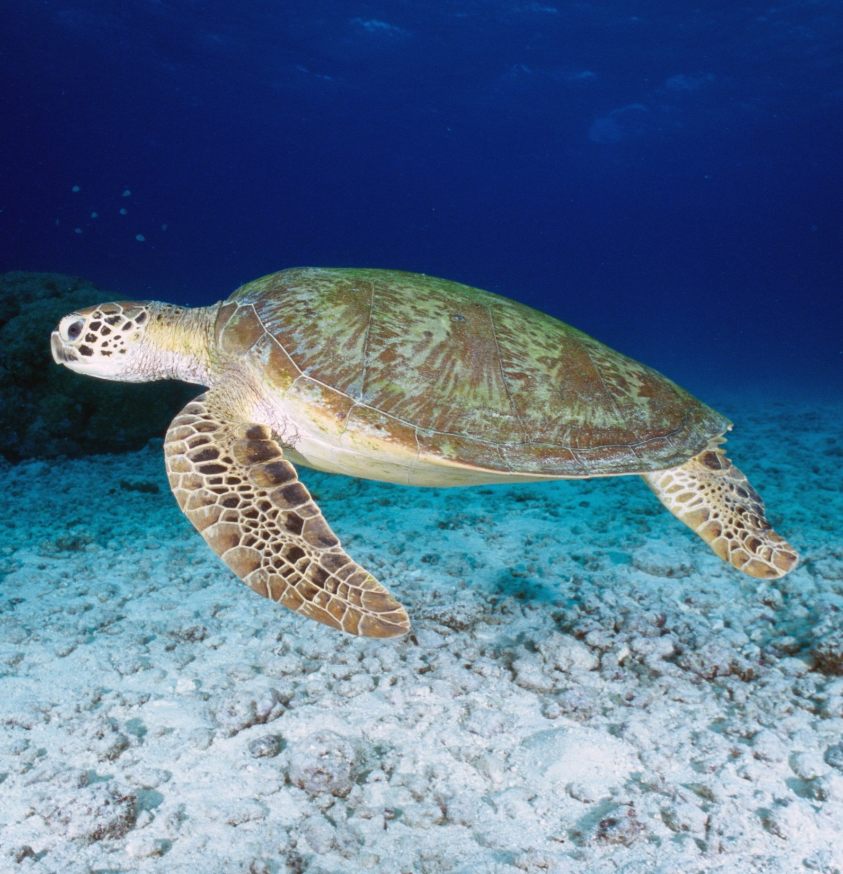
Green turtle
(Chelonia mydas)
Small head.
High domed carapace (shell).
Carapace colour – cream and rusty brown to grey.
4 pairs of costal scutes (side scales) on carapace.
ENDANGERED
1
2
3
4
Notes:
Image: K. Hoppen, Copyright Commonwealth of Australia (GBRMPA)

Slide 55
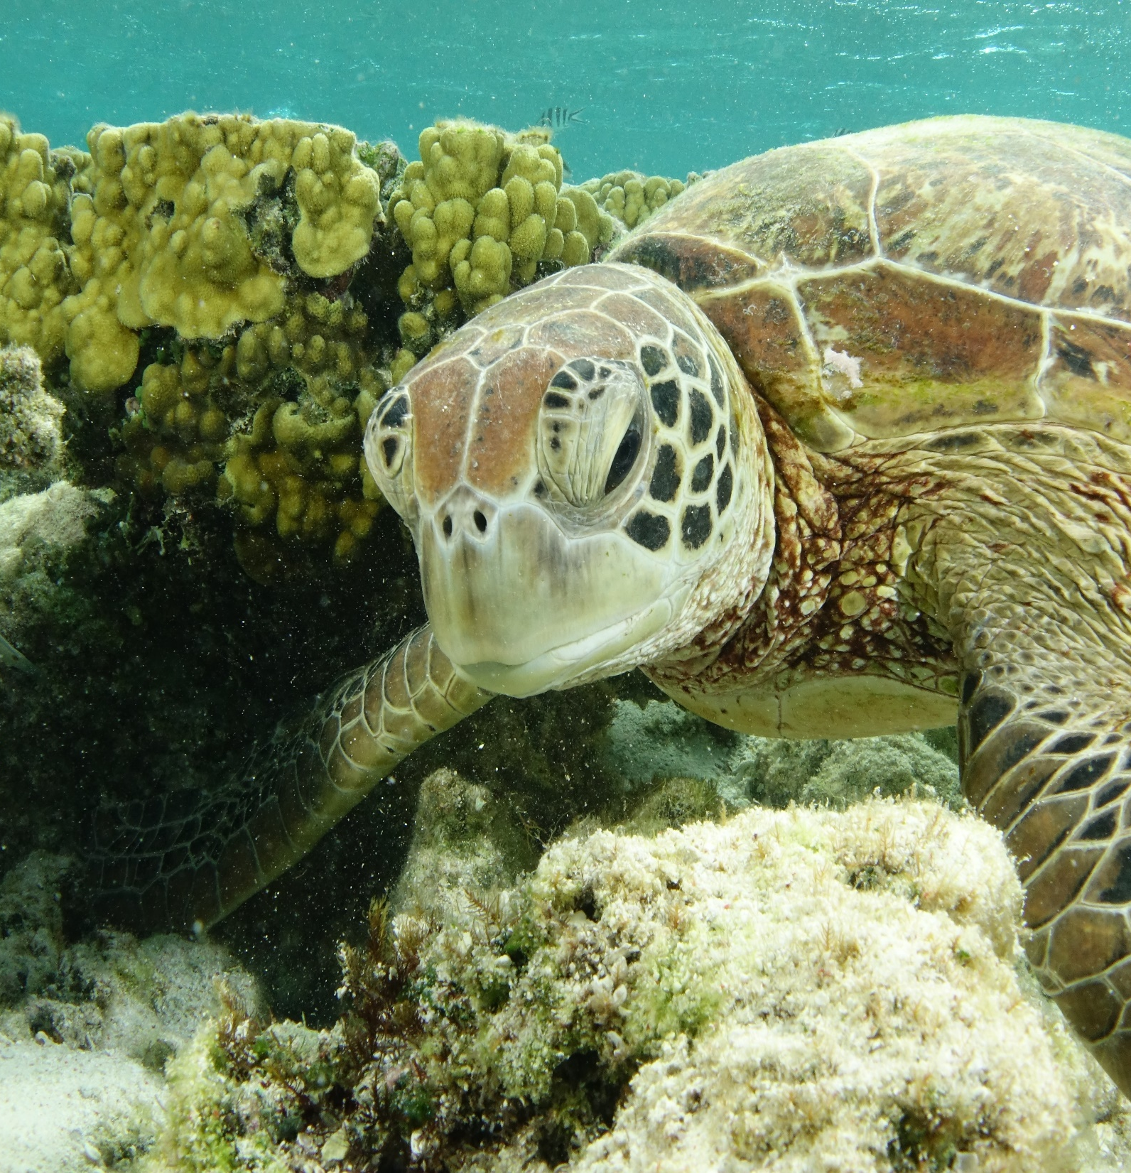
1 pair of
pre-frontal scales above beak.
ENDANGERED
1 pair
Notes:
Image: C. Jones, Copyright Commonwealth of Australia (GBRMPA)

Slide 56
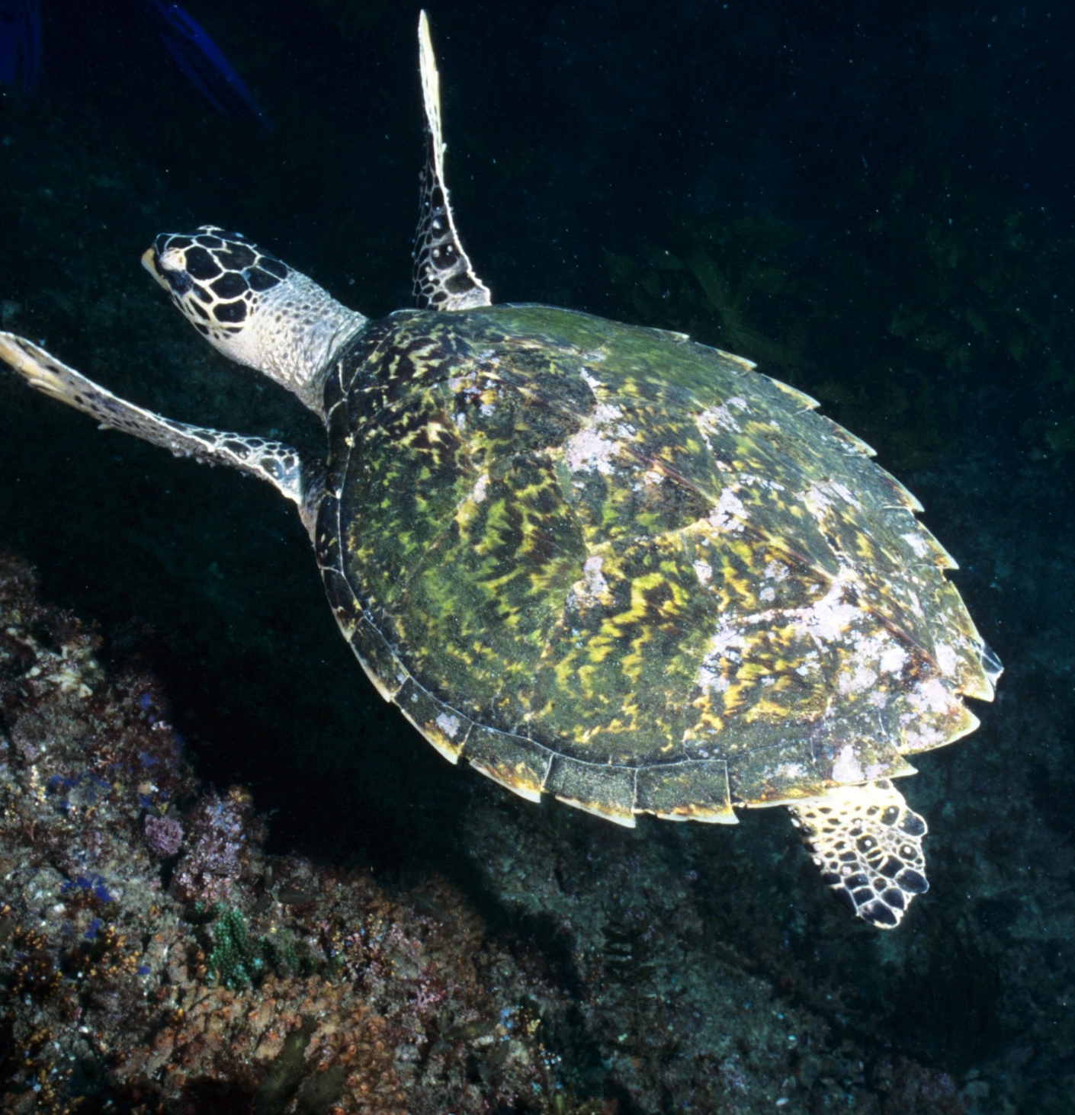
Hawksbill turtle
(Eretmochelys imbricata)
Small head.
Black scales on head and flippers.
Carapace with serrated edges (smaller turtles only).
4 pairs of costal scutes.
Overlapping scutes (like fish scales).
CRITICALLY ENDANGERED
1
2
3
4
Serrated edges
Notes:
Image: K. Hoppen, Copyright Commonwealth of Australia (GBRMPA)

Slide 57
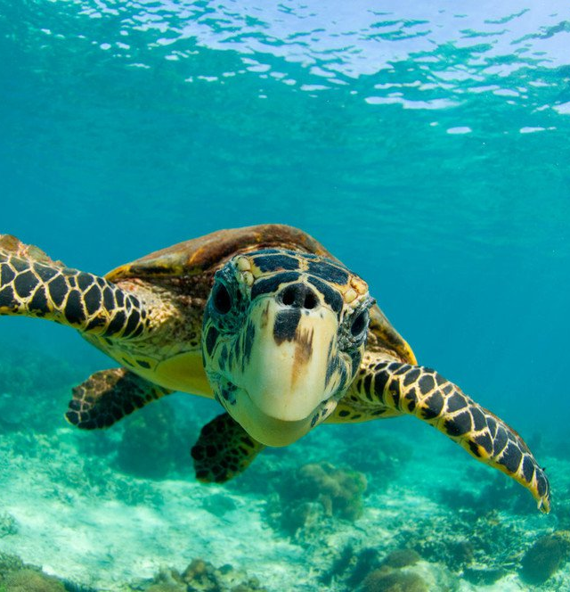
2 pairs of
pre-frontal scales.
Hawk-like beak.
CRITICALLY ENDANGERED
1st pair
2nd pair
Hawk-like beak
© naturepl.com / Inaki Relanzon / WWF
Notes:
Image: Hawksbill turtle (Eretmochelys imbricata) swimming underwater, Nosy Be, North Madagascar. Image: naturepl.com / Inaki Relanzon / WWF
© naturepl.com / Inaki Relanzon / WWF Source: https://australian.museum/learn/animals/reptiles/hawksbill-sea-turtle/

Slide 58
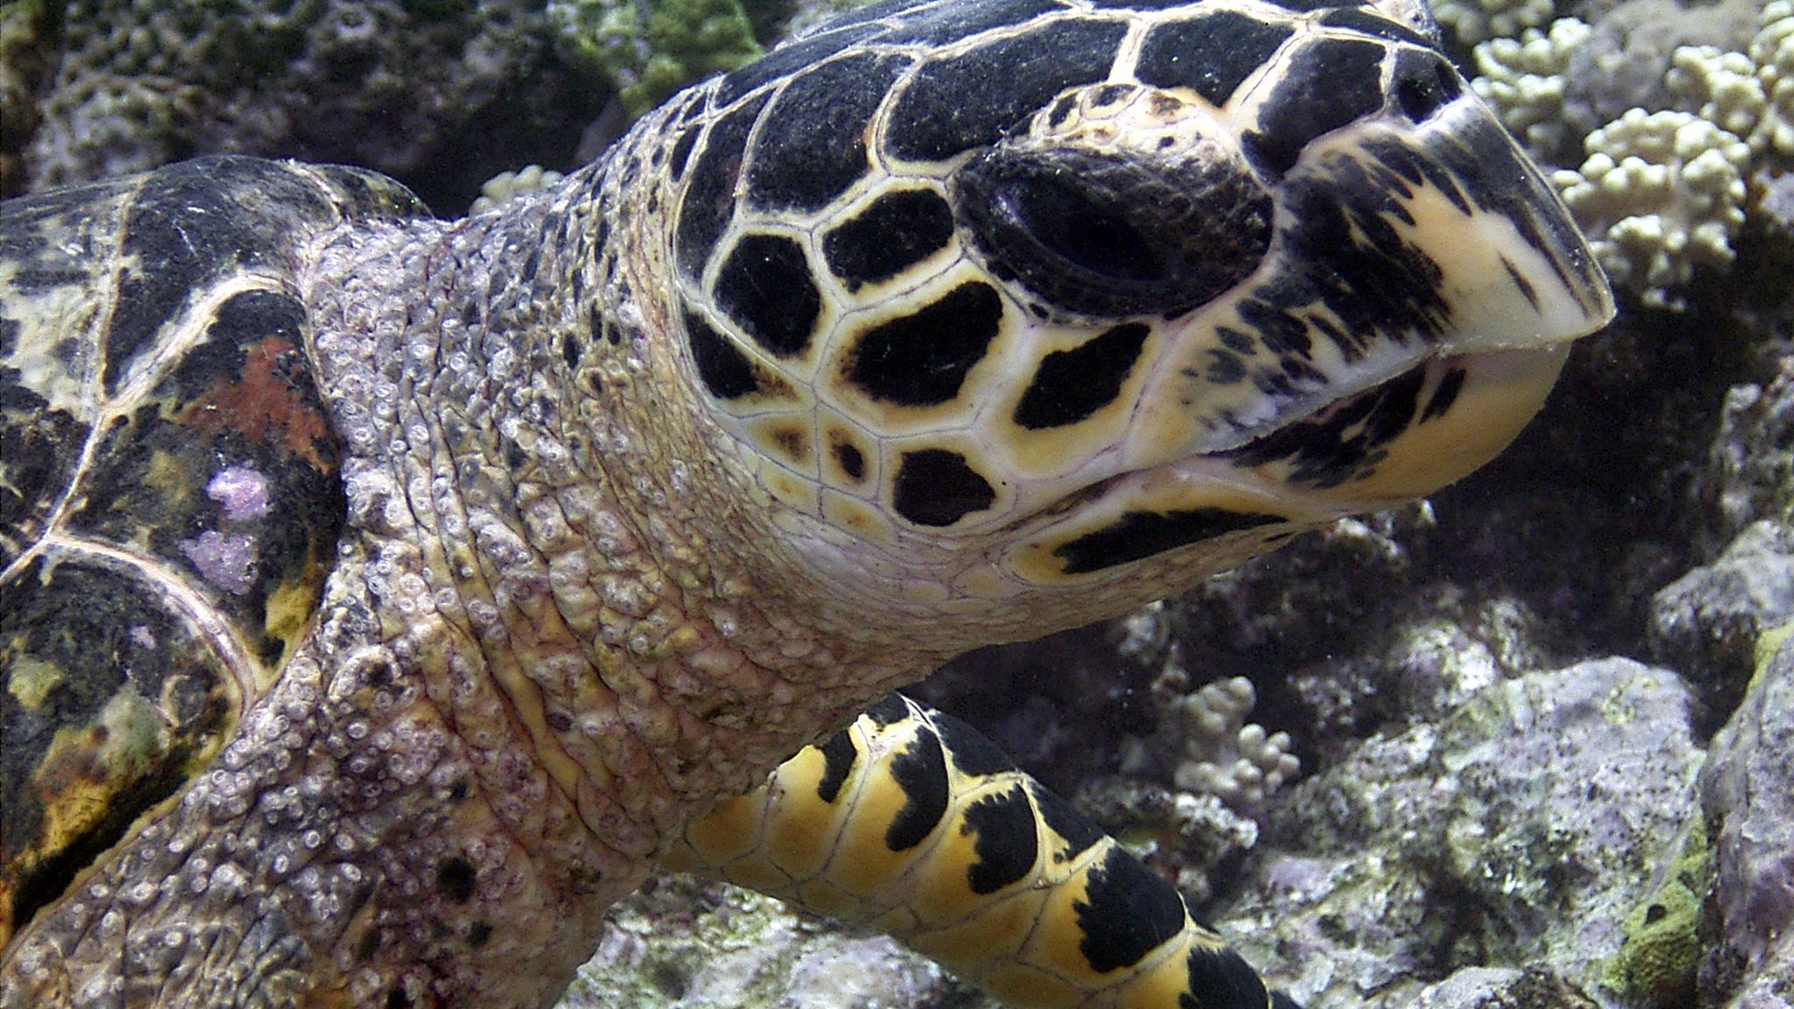
CRITICALLY ENDANGERED
nostril
Notes:
Image: C. Jones, Copyright Commonwealth of Australia (GBRMPA)

Slide 59

Sharks
Notes:
Image: J. Sumerling, Copyright Commonwealth of Australia (GBRMPA)

Slide 60
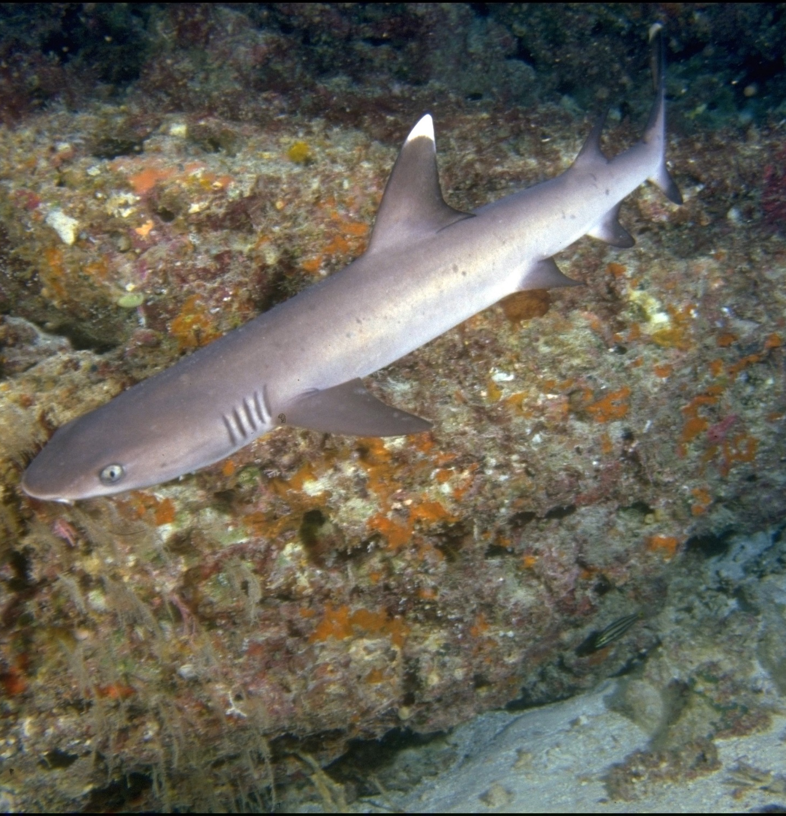
Whitetip reef
shark
VULNERABLE TO EXTINCTION
White tip on dorsal fin
Notes:
Image: T. Mayne, Copyright Commonwealth of Australia (GBRMPA)

Slide 61

Blacktip reef
shark
VULNERABLE TO EXTINCTION
Black tip on dorsal fin
Notes:
Image: K. Hoppen, Copyright Commonwealth of Australia (GBRMPA)

Slide 62
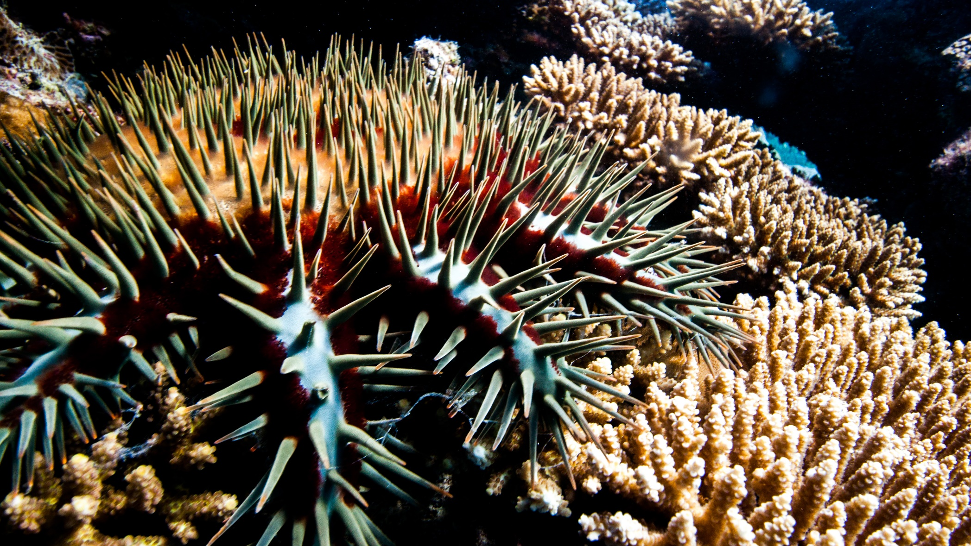

Crown-of-Thorns Starfish (COTS)
Notes:
Image: J. Hurford, Copyright Commonwealth of Australia (GBRMPA)

Slide 63
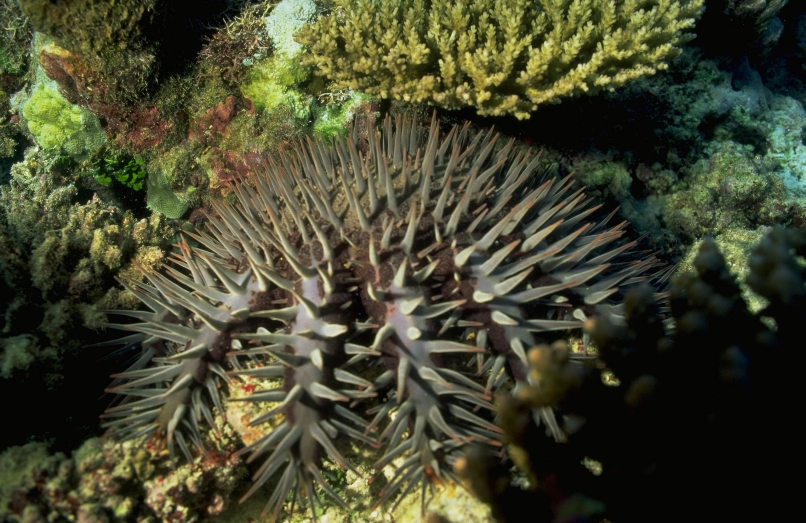
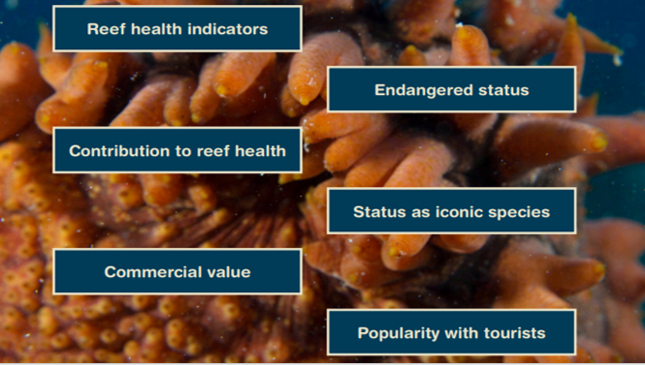
Why count crown-of-thorns starfish?
Notes:
Image: D. Wachenfeld, Copyright Commonwealth of Australia (GBRMPA)

Slide 64
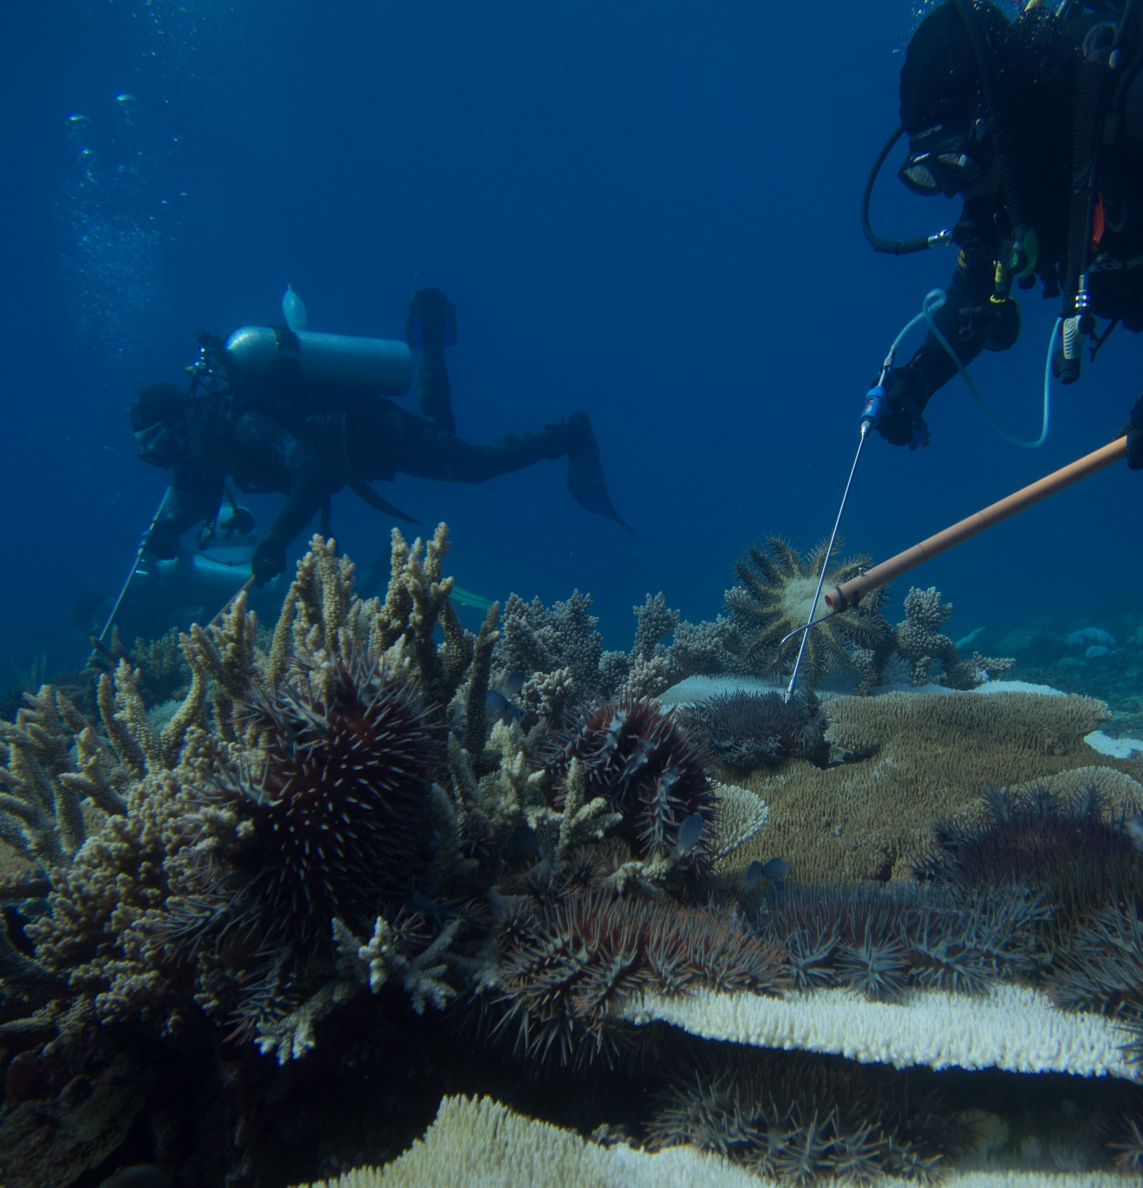
To prevent an outbreak, report
all sightings!
Notes:
Image: D. Shultz, Copyright Commonwealth of Australia (GBRMPA)

Slide 65
How are coral reefs so biodiverse and interconnected?

Slide 66
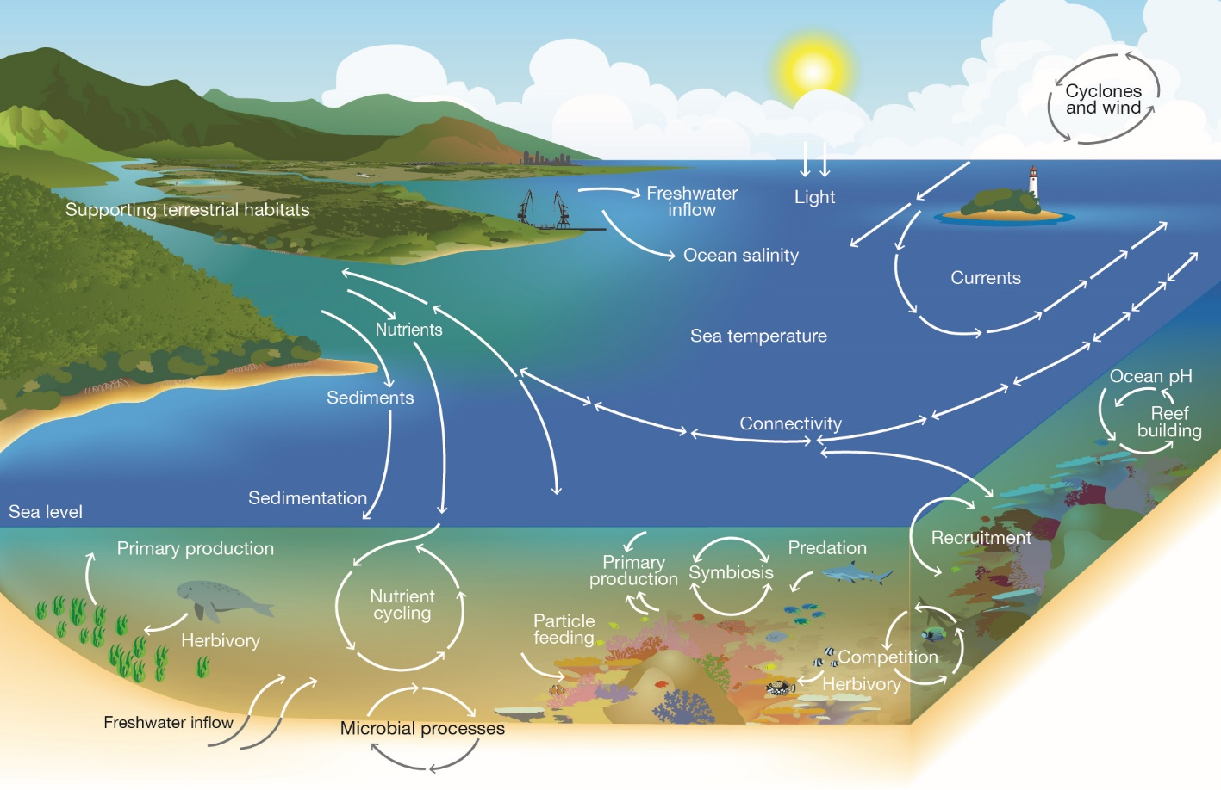

Slide 67
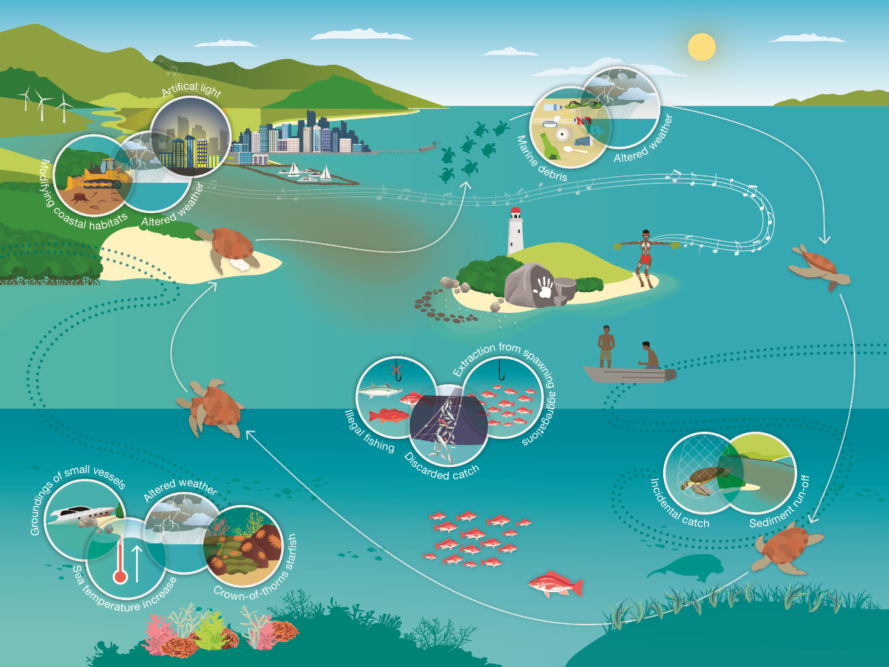
What threats impact on the Great Barrier Reef?

Slide 68

What actions can you take to protect the Great Barrier Reef?

Slide 69
Remember, the Great Barrier Reef
Marine Park Authority also has an Eye on the Reef app.
Do you remember this from your excursion?
It’s also a wonderful animal I.D. tool.
Do you recognize any wildlife in the app?

Slide 70

Download
the Eye on the
Reef app.
Notes:
App image: https://www.gbrmpa.gov.au/__data/assets/pdf_file/0020/265430/Eye-on-the-Reef-app-poster.pdf

Slide 71


Press “Sightings” and “Create”.

Slide 72


Press “Wildlife”.

Slide 73


Marine mammals.
Select your animal and press “INFORMATION” to learn more.

Slide 74


Marine reptiles.

Slide 75




Sharks and rays.

Slide 76



Fishes.

Slide 77











Slide 78





Birds.

Slide 79


Invertebrates.

Slide 80










Slide 81
Explore the other tabs too!

Slide 82
Create a poster to answer the question:
How can I help the Great Barrier Reef?
Display it proudly in your classroom.
Notes:
This is the last slide for students to view. The remaining slides are for the teachers.

Slide 83
Thank you for helping the Great Barrier Reef!
See the Reef • Love the Reef • Protect the Reef

