Slide 1
Be a Marine
Biologist for a Day
Part 3: Making connections
Year 8
Notes:
Image: L. Zell, Copyright Commonwealth of Australia (GBRMPA)

Slide 2


Thank you for organising your trip to the reef with us.
We had a great time and hope you did too.
This PowerPoint is Part 3 of the Be a Marine Biologist for a Day program designed for year 8 by the Great Barrier Reef Marine Park Authority (GBRMPA).
View this PowerPoint after your excursion, with the accompanying activity book.
This is Part 3: Making connections. This is the last part of the program. This is when your students make connections with all they’ve learned and experienced so far.
On your excursion, you conducted an Eye on the Reef citizen science activity with your reef guide. Now it’s time to upload your data to the GBRMPA website. It’s also time for students to check understanding by answering any questions in Parts 1 and 2.
The Great Barrier Reef Marine Park Authority would like to thank you for uploading your data to their Rapid Monitoring database. We hope to see you again next year!
Licensed by the Commonwealth of Australia for use under a Creative Commons By Attribution 4.0 International licence with the exception of content supplied by third parties and any photographs. http://creativecommons.org/licences/by/4.0

Slide 3

We would like to acknowledge all of the Aboriginal and Torres Straight Islander peoples who have connection to the Great Barrier Reef.
We recognise their continuing connection to land, water and community, and pay our respects to their Elders past, present and emerging.

Slide 4

We would like to acknowledge the (insert name of local Traditional Owner group) peoples as the Traditional Owners of the Land and Sea Country that we visited as part of your excursion.

Slide 5

How can I help the
Great Barrier Reef?
Notes:
This is the overarching inquiry question that encompasses the entire BAMBFAD Program and is the starting slide to this presentation.

Slide 6

Notes:
Image: J. Johnson, Copyright Copyright Commonwealth of Australia (GBRMPA)

Slide 7
Eye on the Reef
Rapid Monitoring survey
10 MINUTE TIMED SWIM

Slide 8
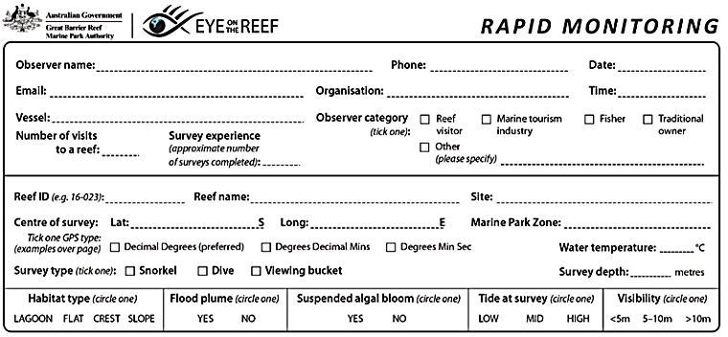
Have you got your data ready?

Slide 9

Because it’s time to upload it to GBRMPA!

Slide 10

This is the website for GBRMPA’s Eye on the Reef.
The link to connect is provided at the end of this presentation.

Slide 11

Login.

Slide 12

Select ‘Rapid Monitoring Survey’ tab.

Slide 13


Enter your data.

Slide 14

If you also completed the (more advanced) 360°survey, complete all questions. Otherwise, leave blank.

Slide 15

Save!
Scroll down to the bottom of the page to ‘Save’.

Slide 16
Are you ready?
Click on the image below to connect.
Notes:
www.gbrmpa.gov.au/our-work/eye-on-the-reef

Slide 17

Thank
you
Male Maori wrasse
Notes:
Image: C. Jones, Copyright Copyright Commonwealth of Australia (GBRMPA)

Slide 18
Check understanding.
Next, is what you’ve all been waiting for.
The answers to questions asked in Part 1 (before the excursion) and/or Part 2 (on the excursion).
Let’s check how you went!
Notes:
The following questions are straight from the Rapid Monitoring Survey course exam questions.

Slide 19


Sea cucumber
Notes:
Image: Copyright Commonwealth of Australia (GBRMPA)

Slide 20
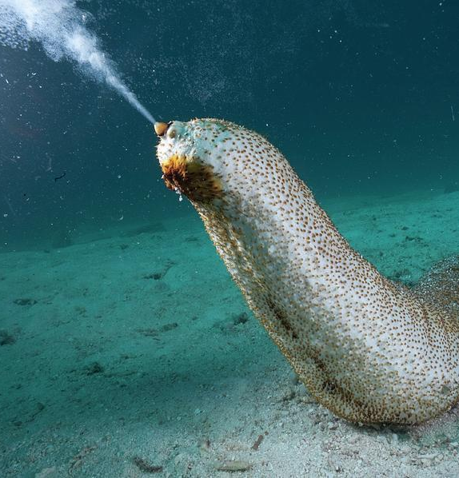
How does
a sea cucumber reproduce?
Image: https://fineartamerica.com/featured/a-sea-cucumber-spawning-in-challenger-david-doubilet.html
Notes:
Image: https://fineartamerica.com/featured/a-sea-cucumber-spawning-in-challenger-david-doubilet.html

Slide 21
They lift their head, high above the seafloor, and spawn eggs or sperm into the water.
Image: https://fineartamerica.com/featured/a-sea-cucumber-spawning-in-challenger-david-doubilet.html
Notes:
Image: https://fineartamerica.com/featured/a-sea-cucumber-spawning-in-challenger-david-doubilet.html

Slide 22

Giant clam
VULNERABLE TO EXTINCTION
Notes:
Image: Copyright Commonwealth of Australia (GBRMPA)

Slide 23
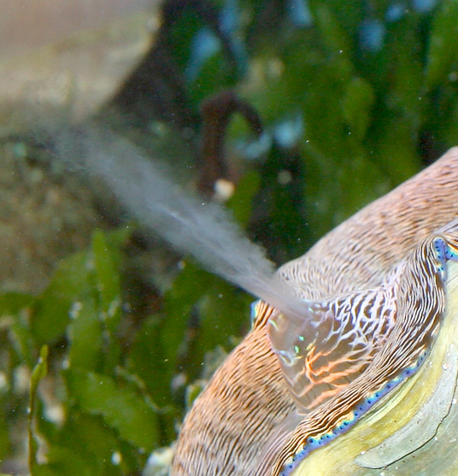
How do giant clams reproduce?
Particularly when they are stationary?
Notes:
Image: https://reefs.com/magazine/aquarium-invertebrates-a-look-at-giant-clam-spawning-in-aquaria/

Slide 24
They eject eggs and sperm into the water.
Usually when other clams are spawning too.
Chemical signals initiate spawning.
Image: https://reefs.com/magazine/aquarium-invertebrates-a-look-at-giant-clam-spawning-in-aquaria/
Notes:
Image: https://reefs.com/magazine/aquarium-invertebrates-a-look-at-giant-clam-spawning-in-aquaria/

Slide 25

Can giant
clams see?
Notes:
Image: J. Sumerling, Copyright Commonwealth of Australia (GBRMPA)

Slide 26

Yes.
With hundreds of
pin-hole eyespots that respond to light and dark.
Notes:
Image: C. Jones, Copyright Commonwealth of Australia (GBRMPA)

Slide 27
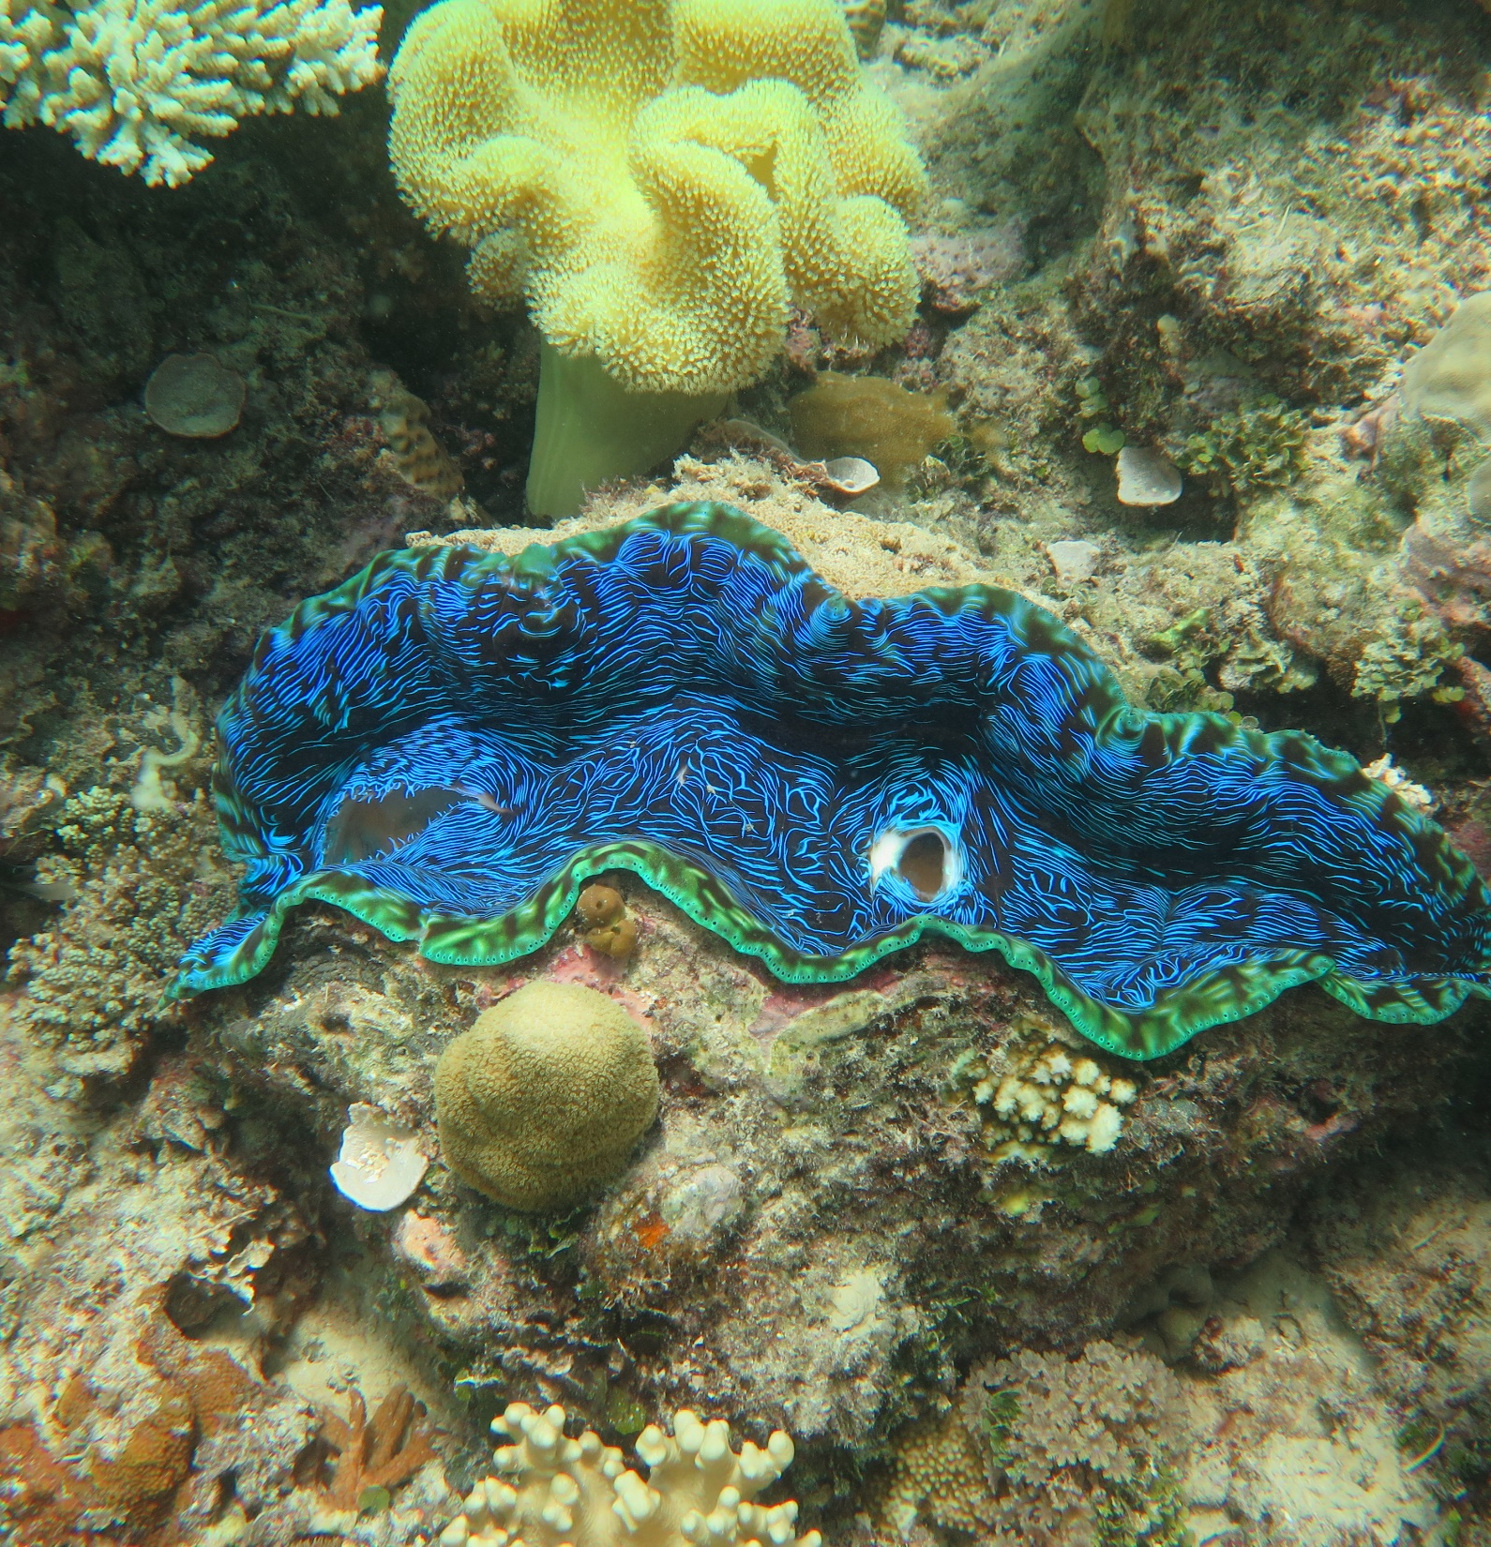
How many
holes (siphons)
are there in the mantle?
Notes:
Image: J. Stella, Copyright Commonwealth of Australia (GBRMPA)

Slide 28
2
Water goes in one hole
(it filter feeds) and comes out the other.
Notes:
Image: J. Stella, Copyright Commonwealth of Australia (GBRMPA)

Slide 29

Anemonefish
Notes:
Image: J. Sumerling, Copyright Commonwealth Government of Australia (GBRMPA)

Slide 30
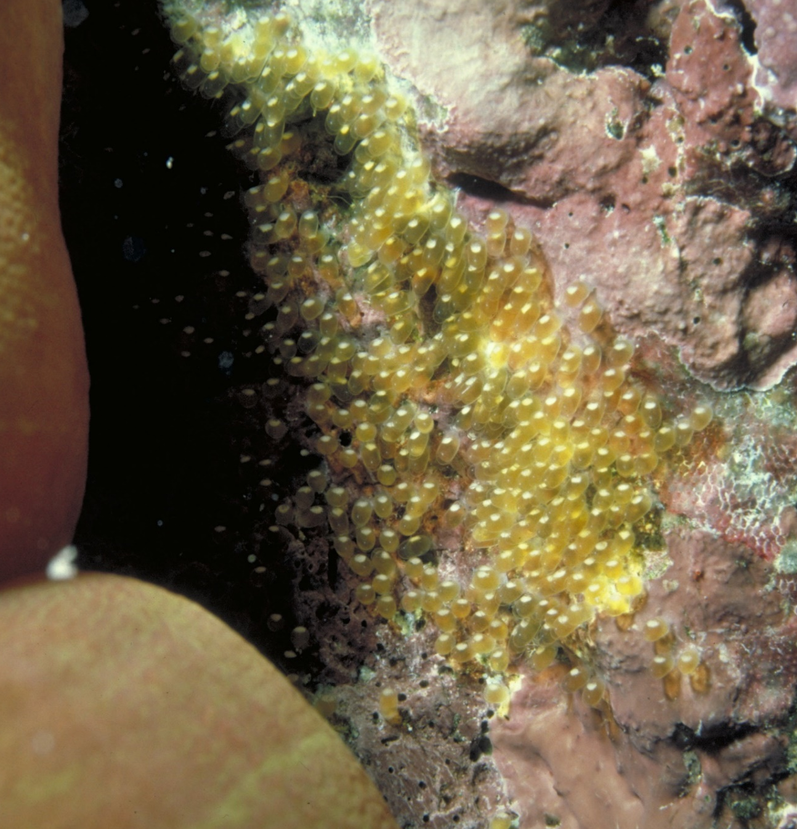
How do anemonefish reproduce?
Notes:
Image: L. Zell, Copyright Commonwealth of Australia (GBRMPA)

Slide 31
The female attaches her eggs to the reef substrate and the male fertilizes them.
Baby anemonefish can
swim very fast soon
after hatching.
Notes:
Image: L. Zell, Copyright Commonwealth of Australia (GBRMPA)

Slide 32

Butterflyfish
Bright colours and pretty patterns
Long snout and little mouth for eating coral polyps
Flat body
Notes:
Image: J. Jones, Copyright Commonwealth of Australia (GBRMPA)

Slide 33

Do all butterflyfish form pairs?
Notes:
Image: L. Zell, Copyright Commonwealth of Australia (GBRMPA)

Slide 34
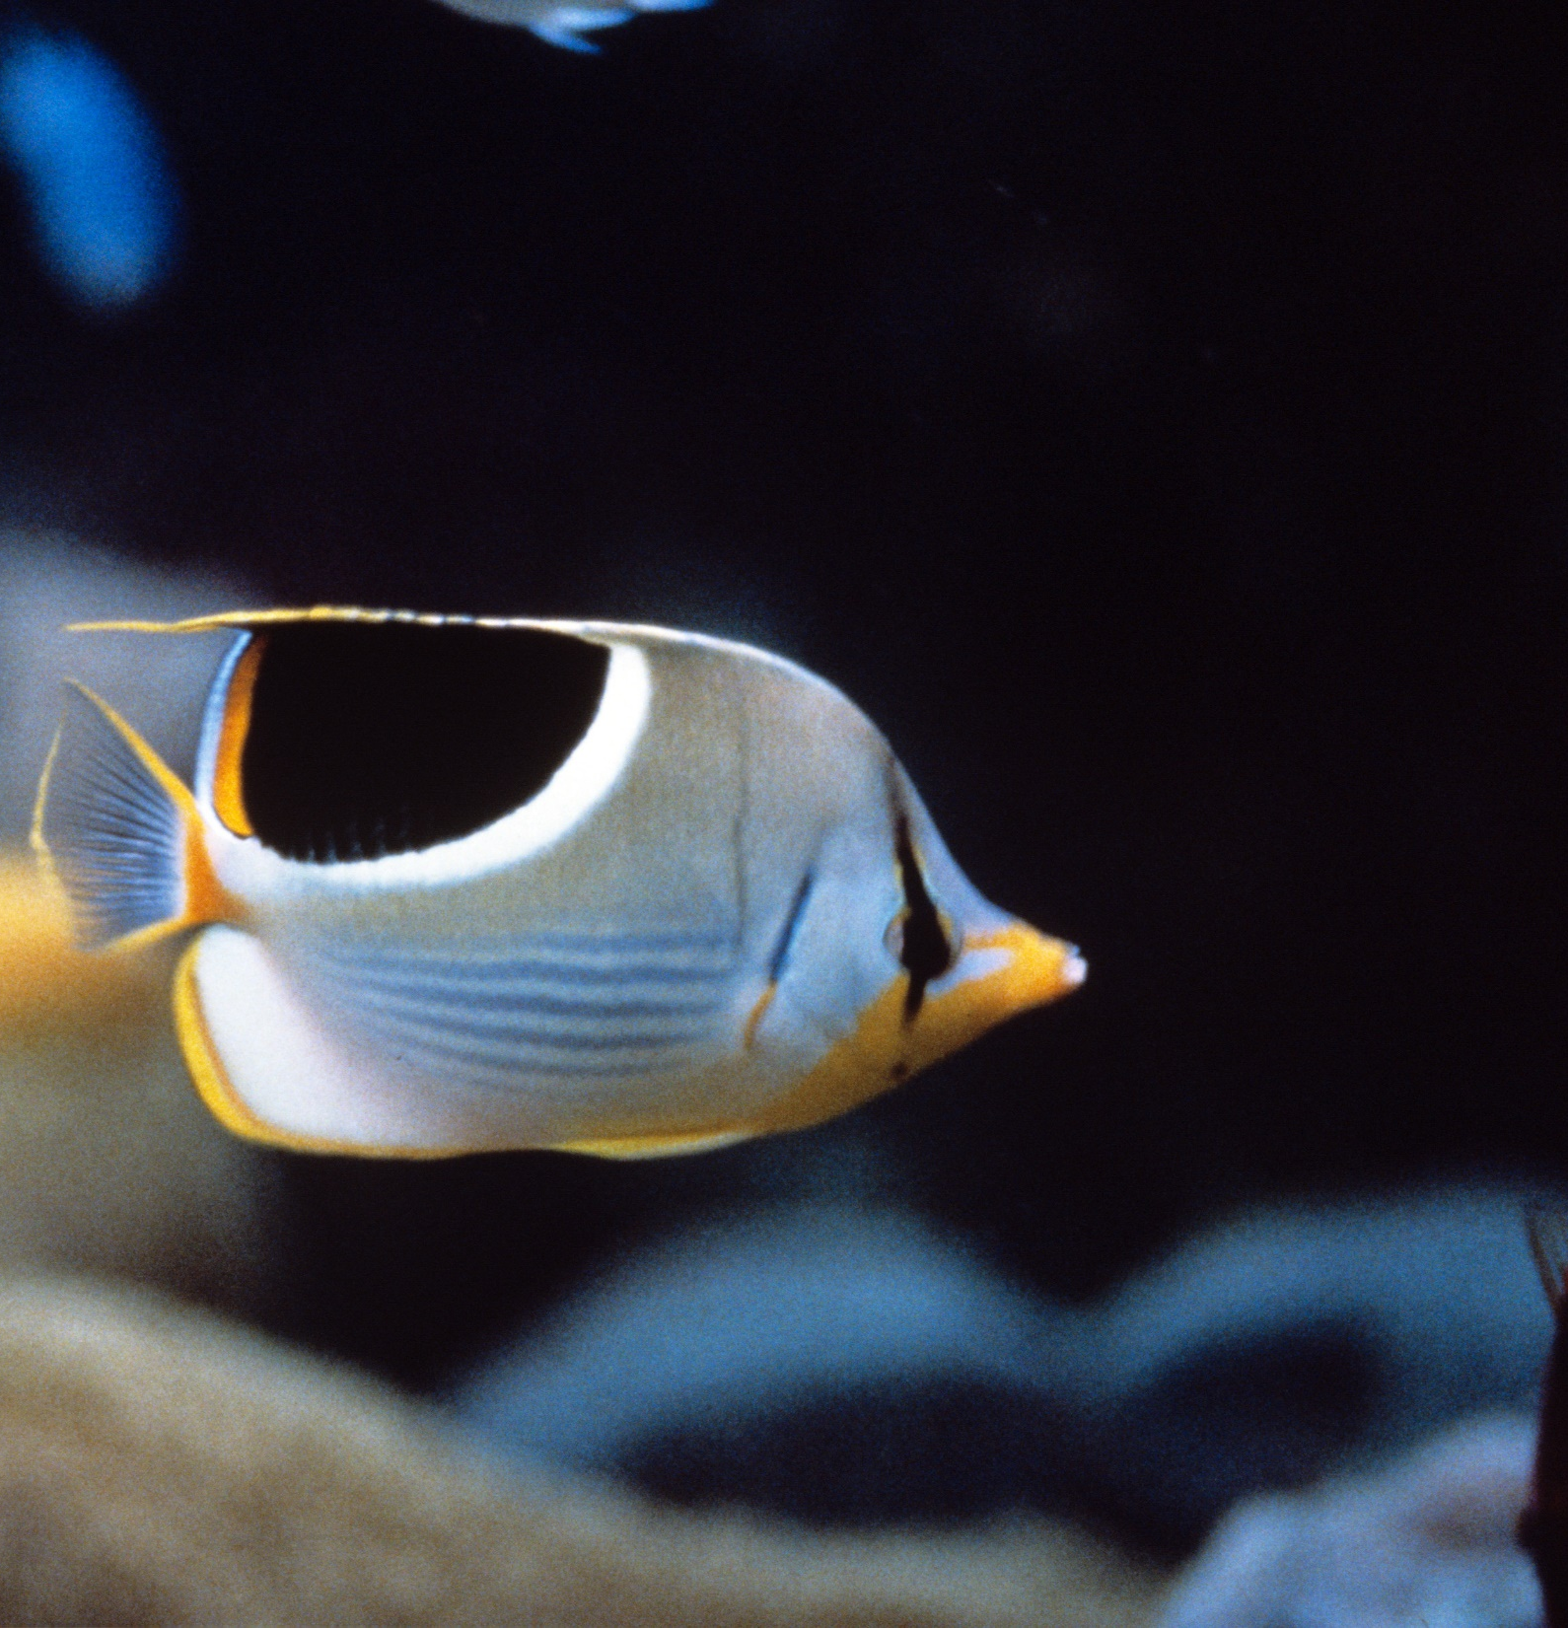
No.
But pairs of
butterflyfish are
very common.
Notes:
Image: R. Walls, Copyright Commonwealth of Australia (GBRMPA)

Slide 35

Did you see
any pairs of
butterflyfish?
Notes:
Image: R. Berkelmans, Copyright Commonwealth of Australia (GBRMPA)

Slide 36
How do
butterflyfish reproduce?
Notes:
Image: R. Berkelmans, Copyright Commonwealth of Australia (GBRMPA)

Slide 37
A pair will swim to the surface and release sperm and eggs.
Sometimes other males follow the pair upwards and shed their sperm moments after the initial gametes were released.
Notes:
Image: R. Berkelmans, Copyright Commonwealth of Australia (GBRMPA)

Slide 38
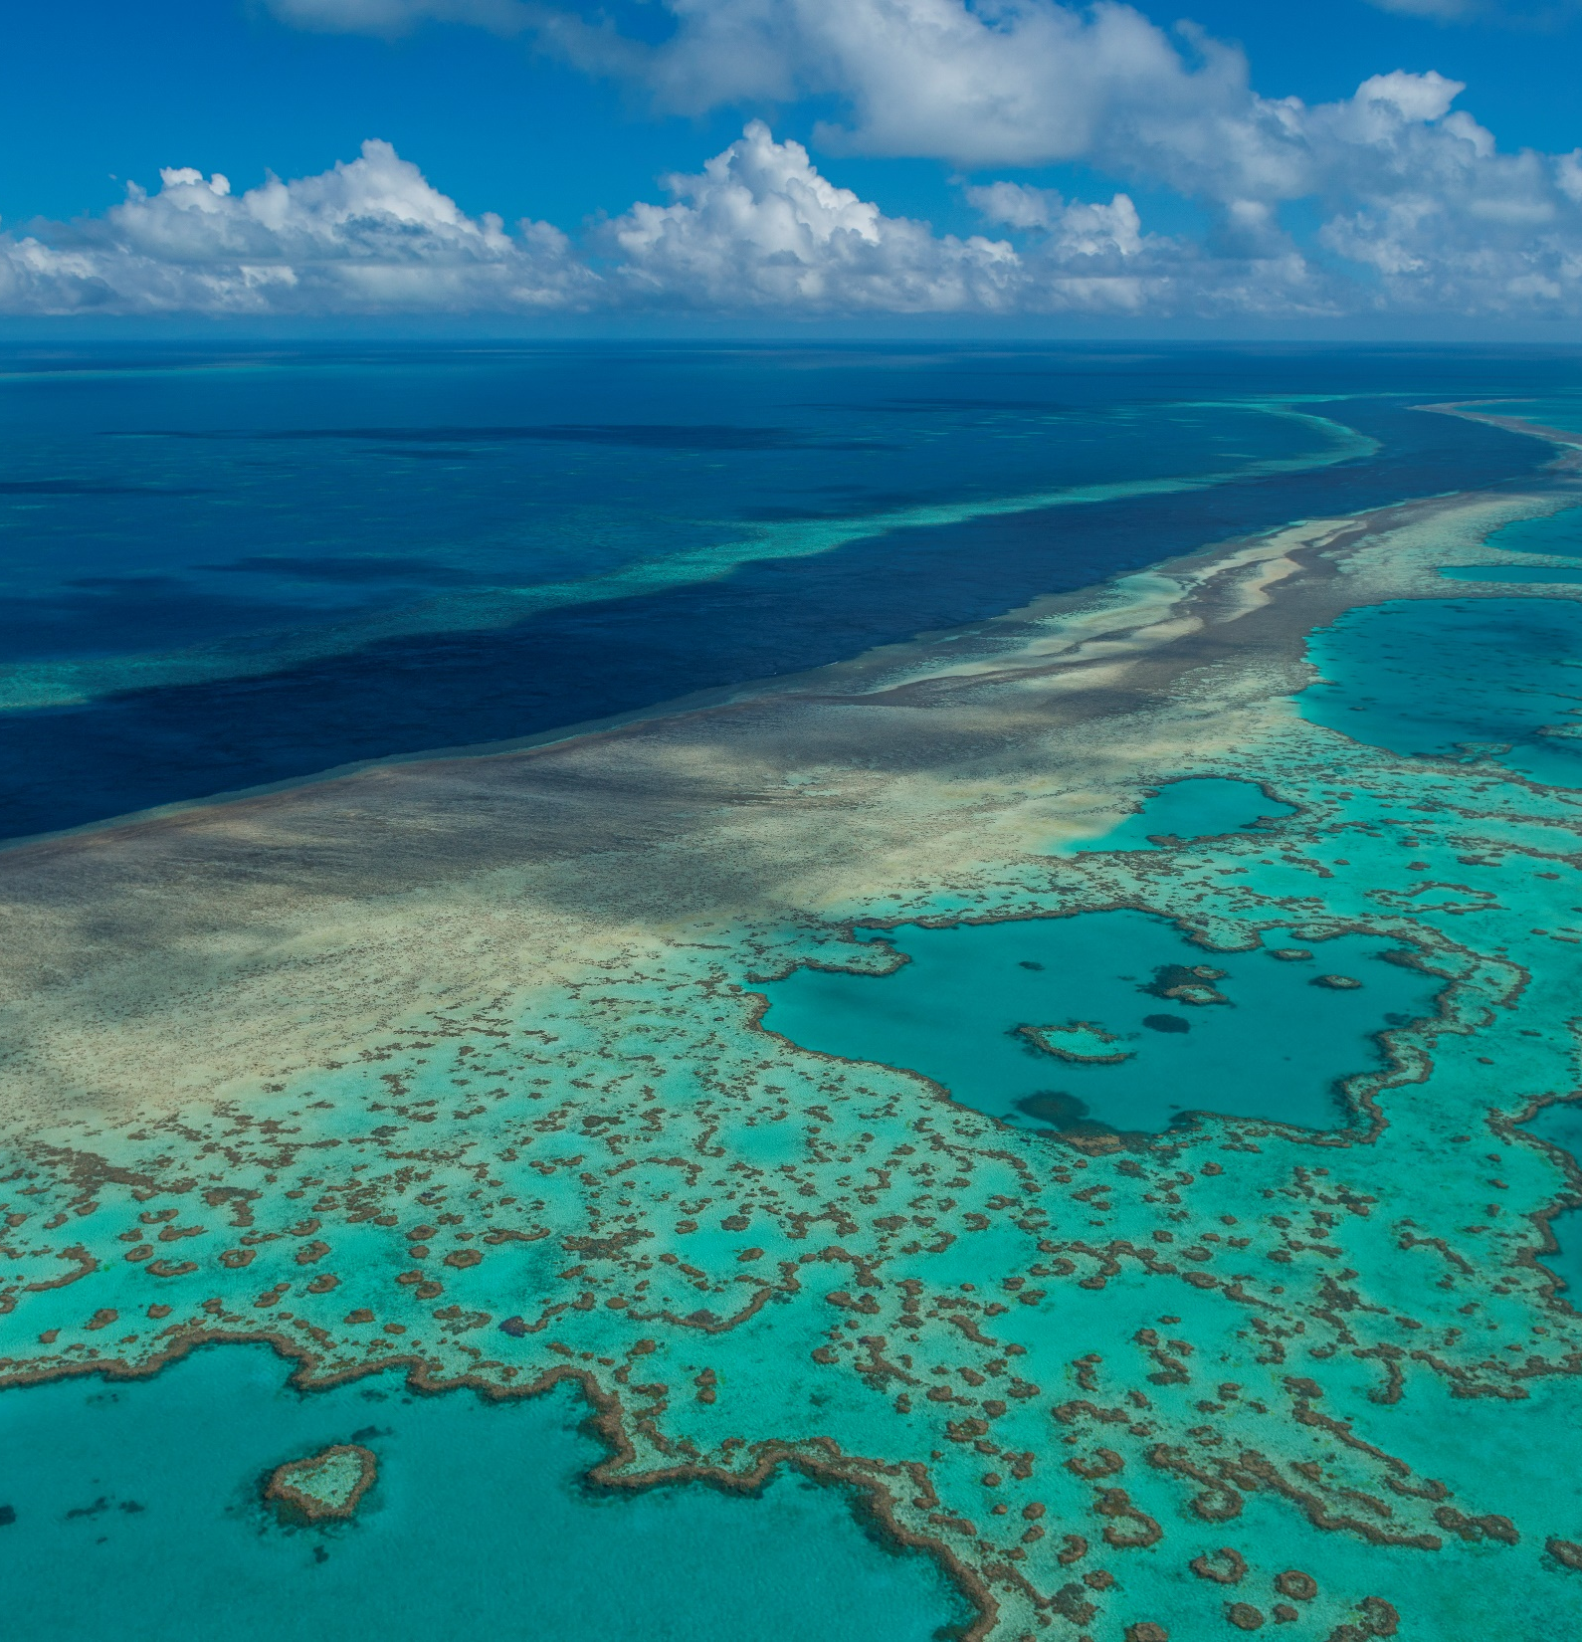
After the
eggs fertilize,
how long do the larvae drift?
Notes:
Image: Copyright Commonwealth of Australia (GBRMPA)

Slide 39
Approximately
1 month
(varies depending on species).
Notes:
Image: Copyright Commonwealth of Australia (GBRMPA)

Slide 40

Grazing herbivores
Parrotfish / Surgeonfish / Rabbitfish / Unicornfish
Notes:
Image: W. Gladstone, Copyright Commonwealth of Australia (GBRMPA)

Slide 41

Why are grazing herbivores called
the lawnmowers of the Reef?
Notes:
Image: C. Jones, Copyright Commonwealth of Australia (GBRMPA)

Slide 42

Because they graze on so much algae.
Notes:
Image: C. Jones, Copyright Commonwealth of Australia (GBRMPA)

Slide 43

Cods and groupers
Notes:
Image: J. Hurford, Copyright Commonwealth of Australia (GBRMPA)

Slide 44
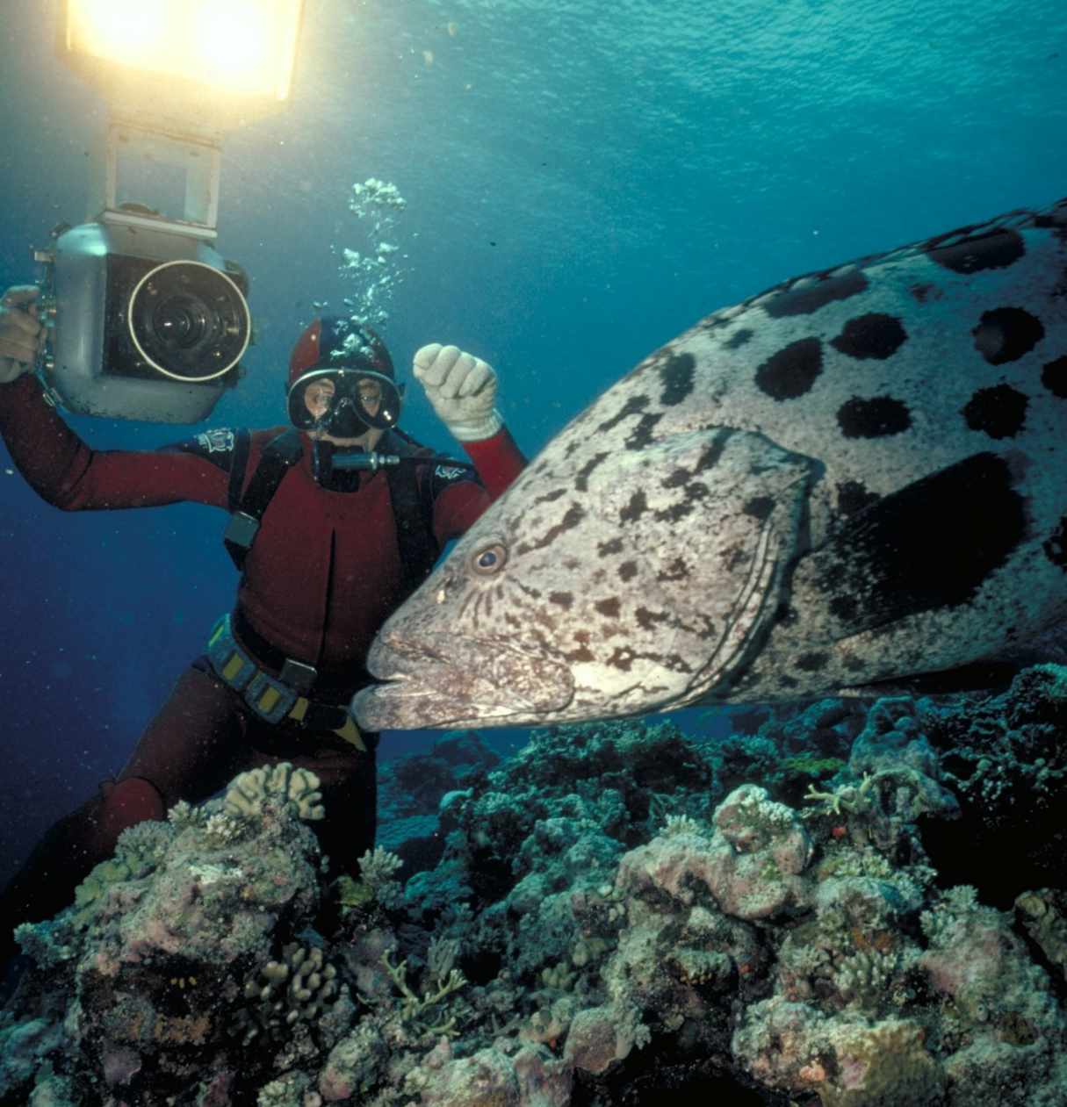
Cods and groupers
are solitary animals.
They live alone.
How do they find a mate
to reproduce?
Notes:
Image: Ron & Valerie Taylor, Copyright Commonwealth of Australia (GBRMPA)

Slide 45
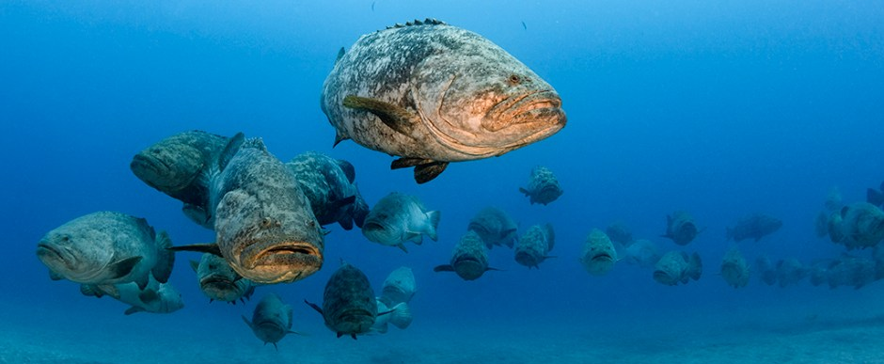
At spawning aggregations. They all gather in one spot and, in pairs, simultaneously release eggs and sperm in the water.
Image: Walt Sterns Divepbc.com
Notes:
Image: http://divepbc.com/goliath-grouper-spawning-season/
Giant grouper spawning aggregation in the waters off Jupiter Florida

Slide 46
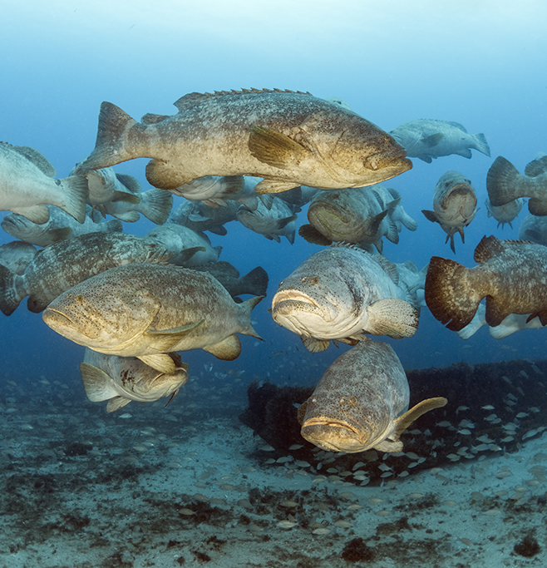
After spawning one or
more times as females,
they change sex and become a male.
Notes:
Image: http://divepbc.com/goliath-grouper-spawning-season/
Giant grouper spawning aggregation in the waters off Jupiter Florida

Slide 47

Coral trout
Notes:
Image: S. Summerhays, Copyright Commonwealth of Australia (GBRMPA)

Slide 48

What size do coral trout change from female to male?
Notes:
Image: T. Mayne, Copyright Commonwealth of Australia (GBRMPA)

Slide 49
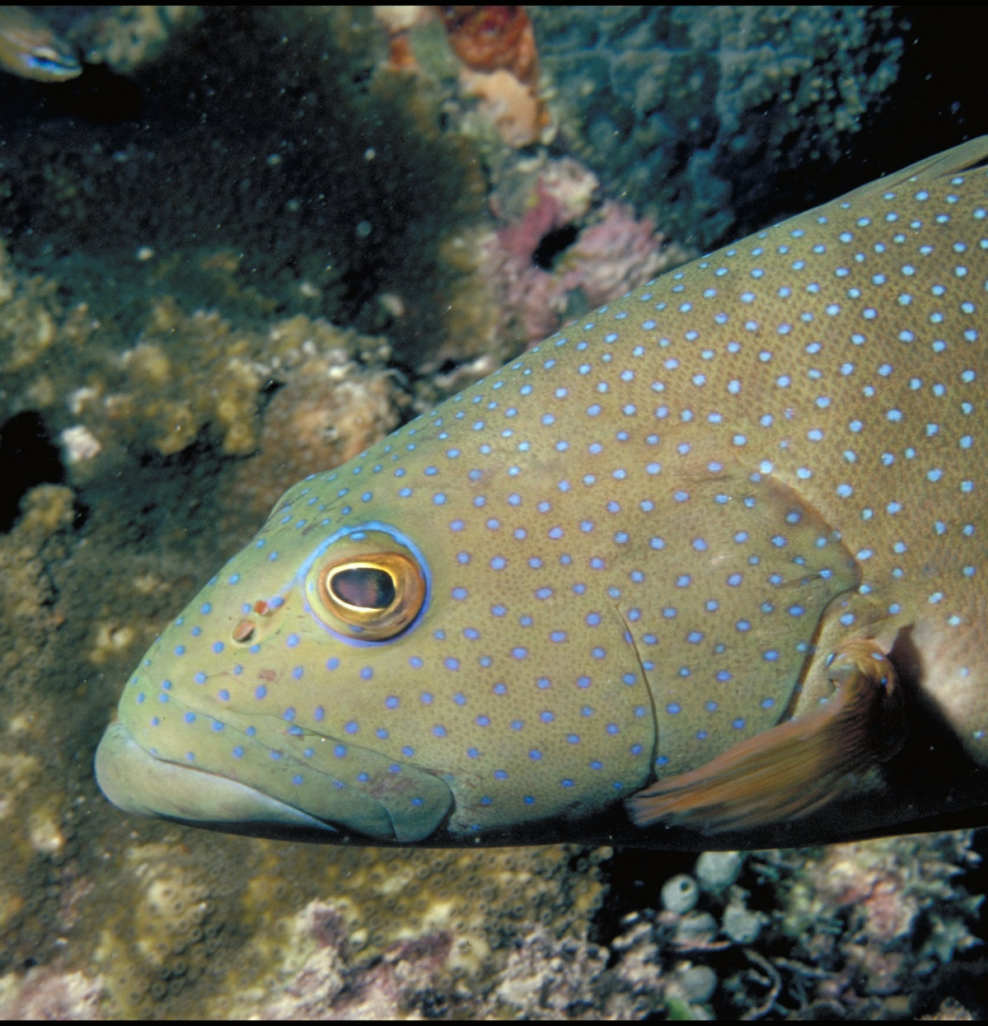
Approximately 42cm.
Notes:
Image: A. Zell, Copyright Commonwealth of Australia (GBRMPA)

Slide 50

Maori wrasse
also called humphead wrasse or Napoleon wrasse.
Notes:
Image: C. Jones, Copyright Commonwealth of Australia (GBRMPA)

Slide 51
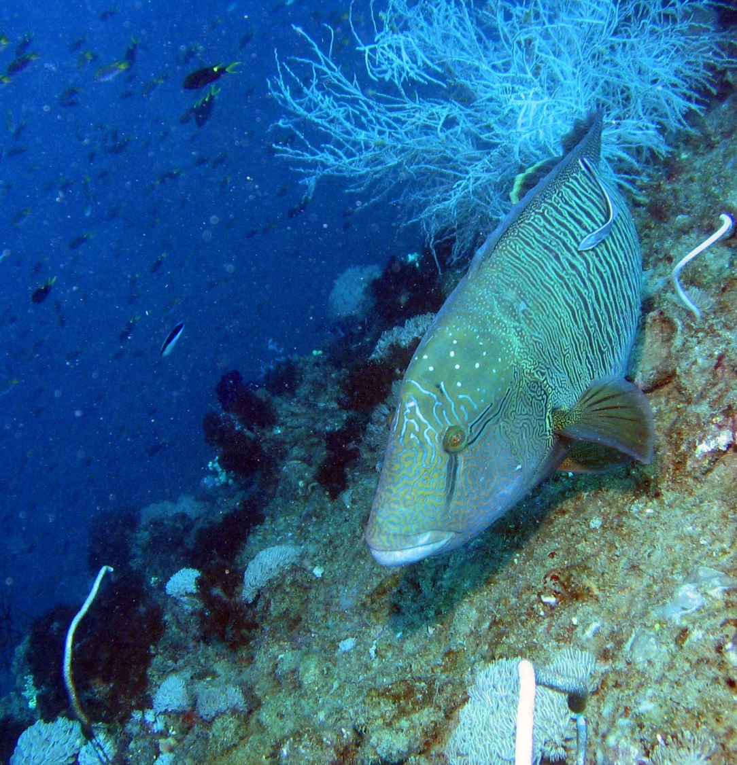
Where do Maori wrasse live?
Notes:
Image: J. Monkivitch, Copyright Commonwealth of Australia (GBRMPA)

Slide 52

Maori wrasse live
on the Reef and occupy limited
home ranges.
Male
Notes:
Image: M. Simmons, Copyright Commonwealth of Australia (GBRMPA)

Slide 53
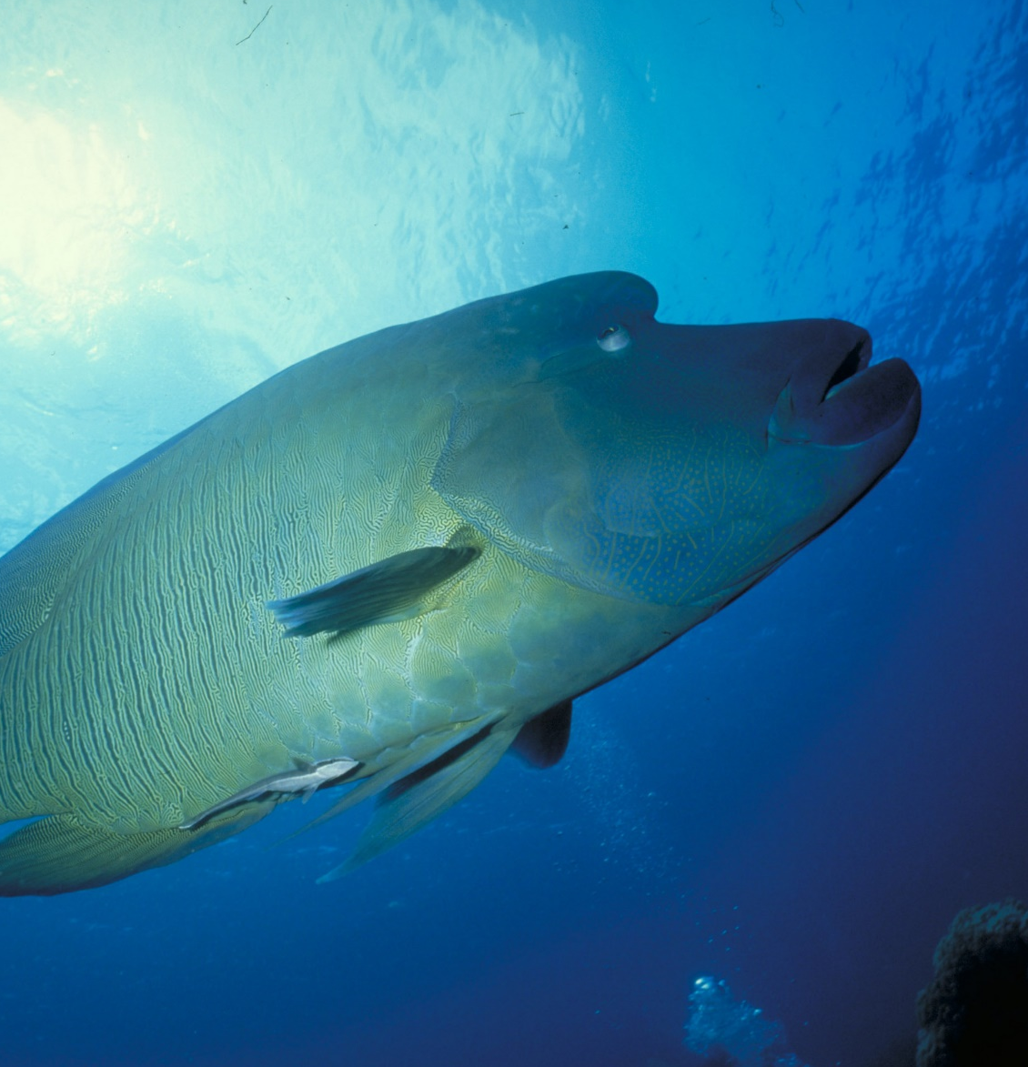
Adults swim across the reefs during the day, resting at night in caves and under coral ledges.
Male
Notes:
Image: M. Simmons, Copyright Commonwealth of Australia (GBRMPA)

Slide 54

What happens
if people touch
a Maori wrasse
and remove its protective coating
of fish mucus?
Notes:
Image: C. Jones Copyright Commonwealth of Australia (GBRMPA)

Slide 55
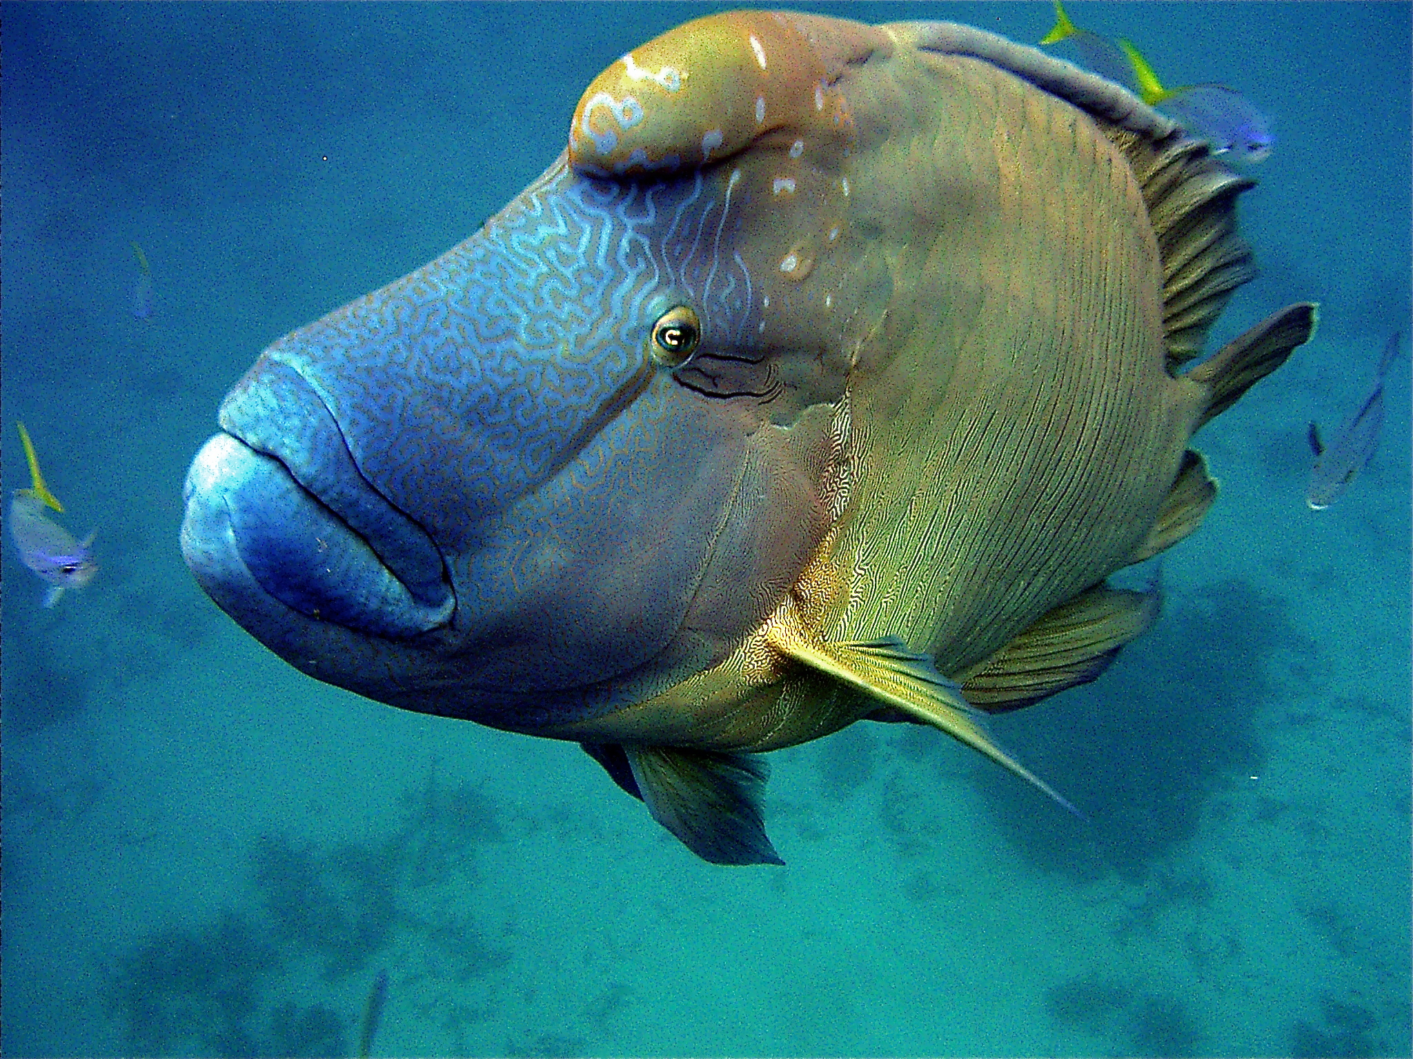
They can
get sick.
Notes:
Image: C. Jones, Copyright Commonwealth of Australia (GBRMPA)

Slide 56

Sea turtles
Notes:
Image: C. Jones, Copyright Commonwealth of Australia (GBRMPA)

Slide 57
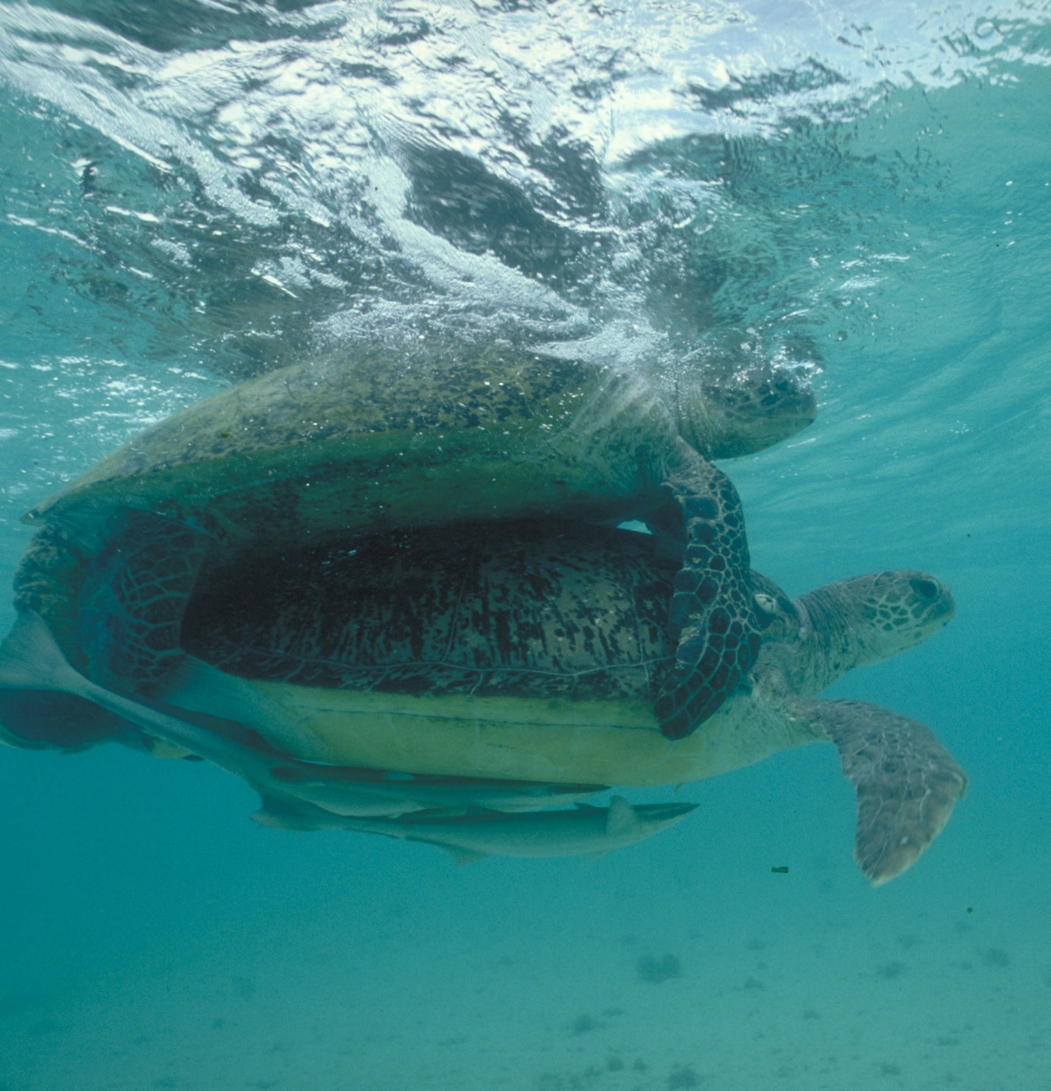
When is turtle breeding season?
Notes:
Image: M. Simmons, Copyright Commonwealth of Australia (GBRMPA)

Slide 58
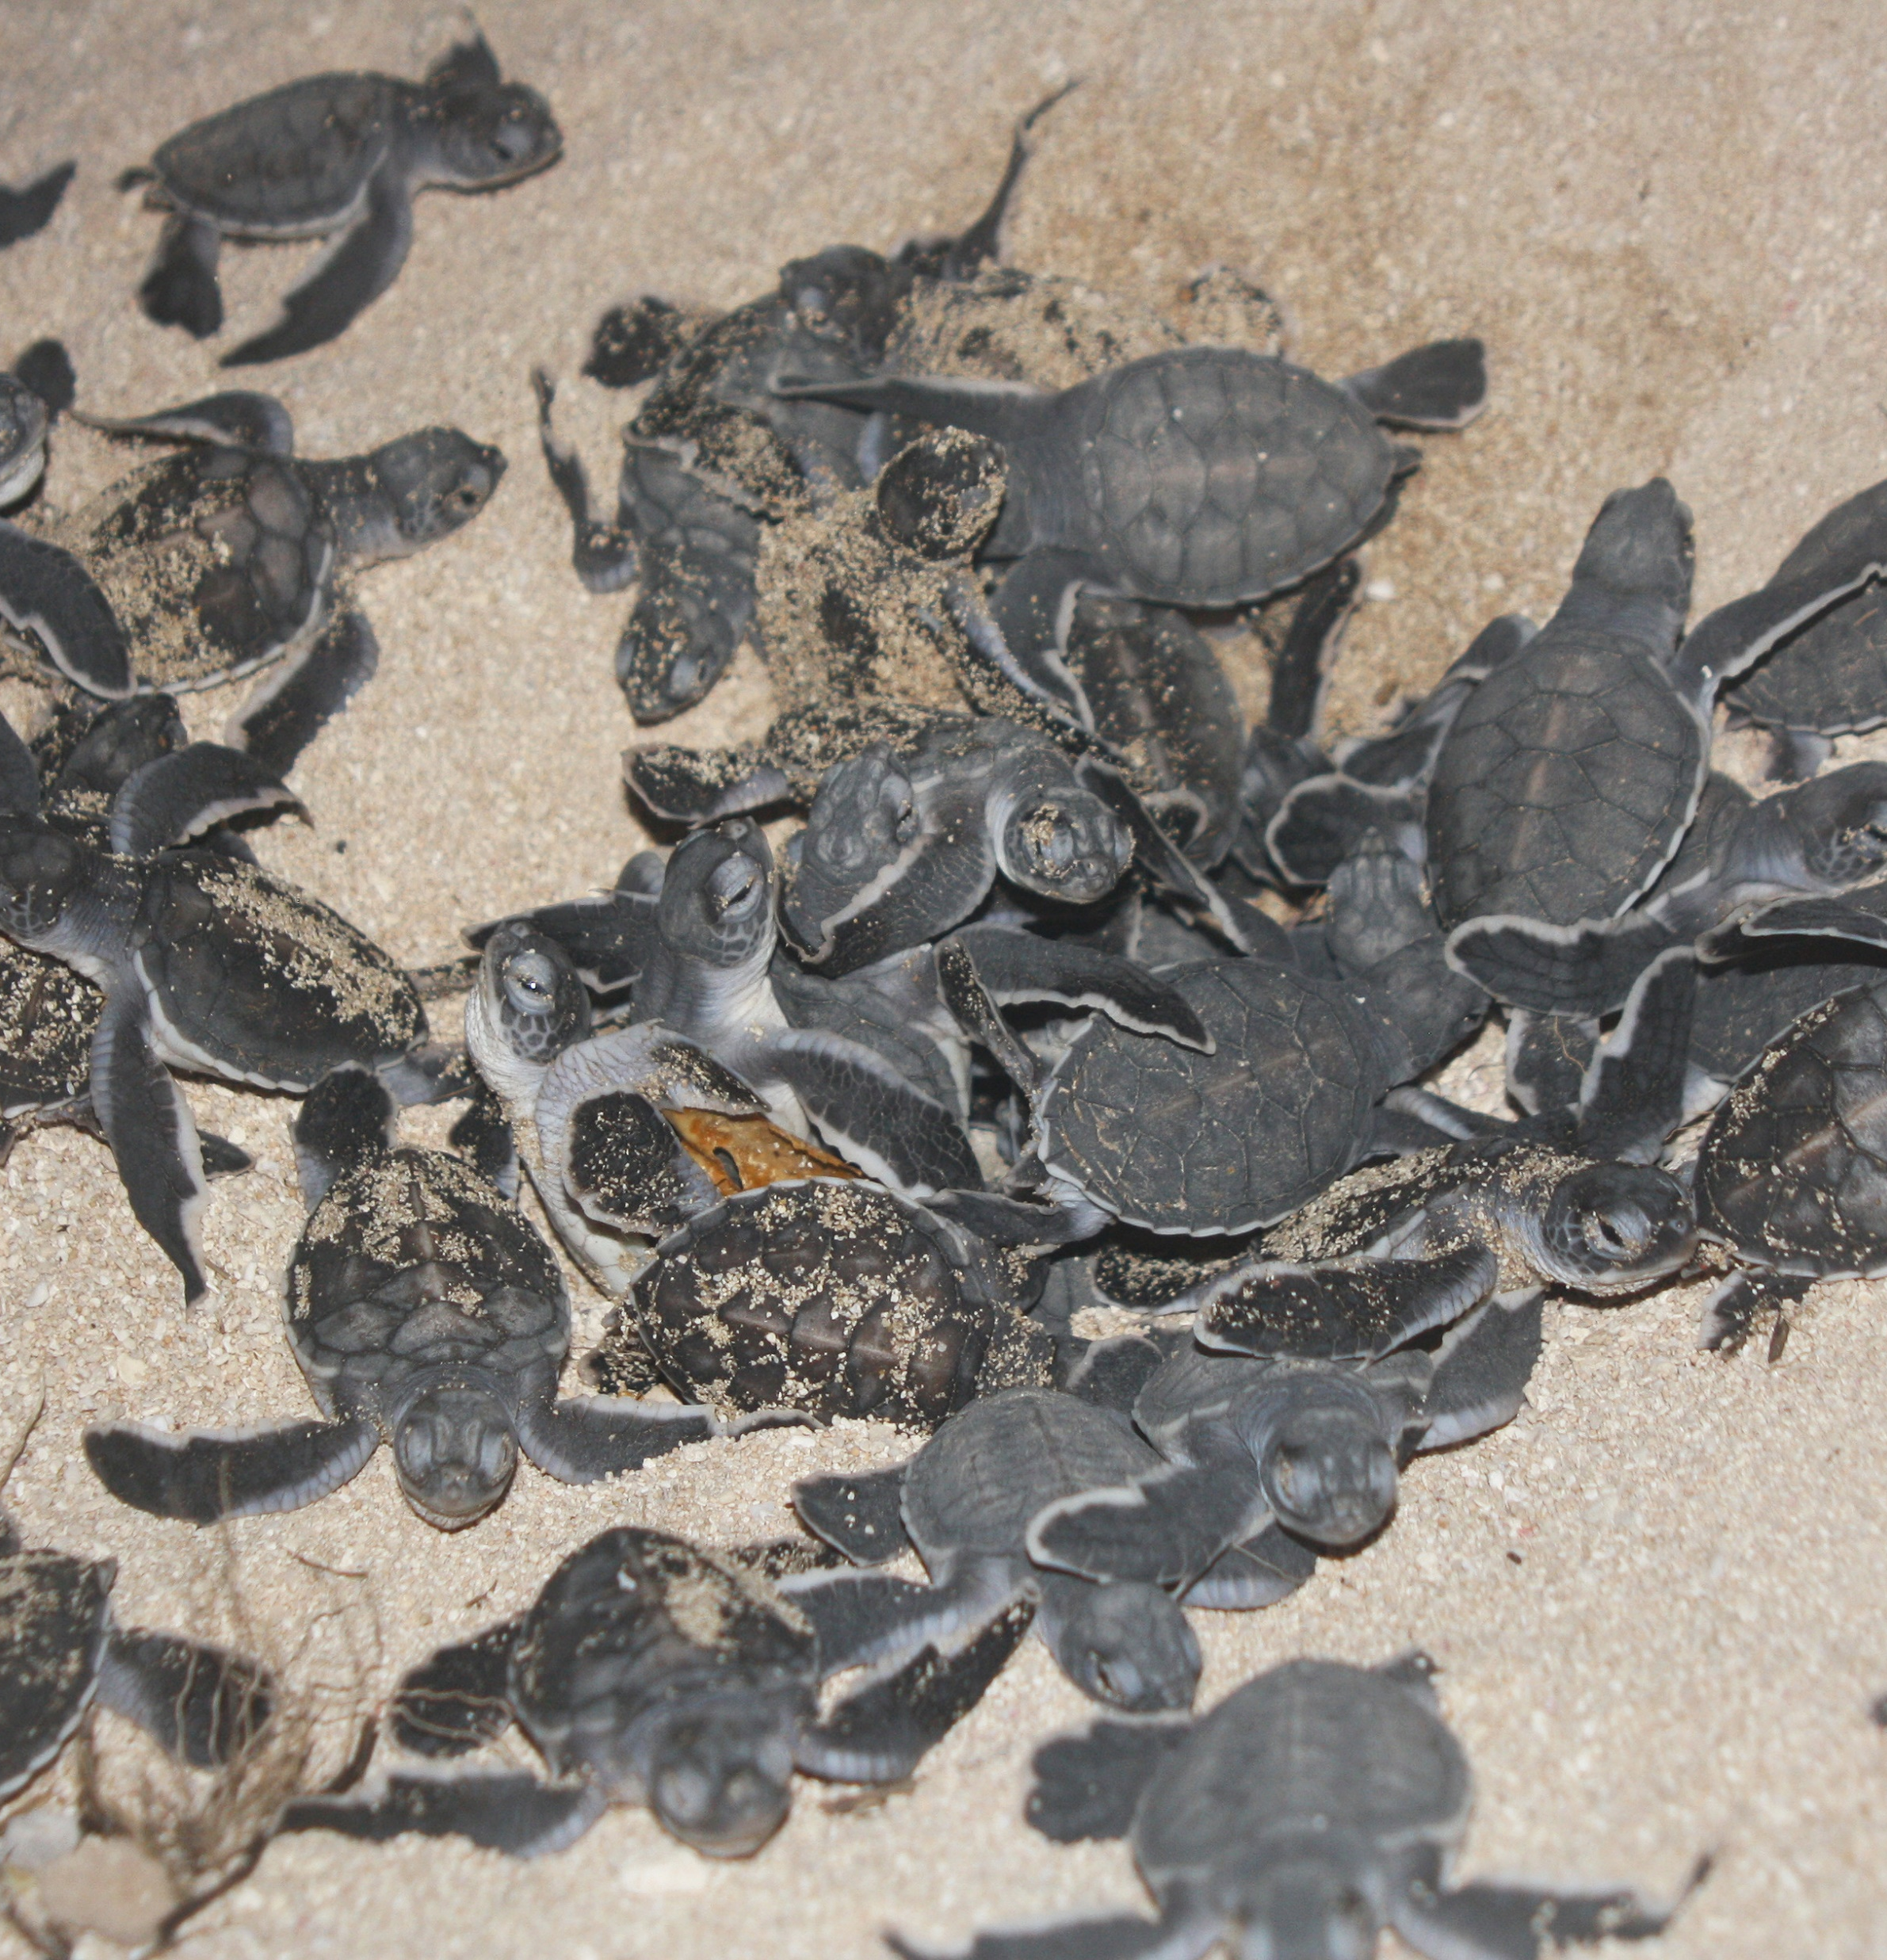
Summer!
Cool nests produce
male turtles.
Warm nests produce
female turtles.
Boys are cool.
Girls are hot.
Notes:
Image: M. Turner, Copyright Commonwealth of Australia (GBRMPA)

Slide 59

How many sea turtles pictured below are threatened with extinction?
Notes:
Image: GBRMPA Image Library

Slide 60
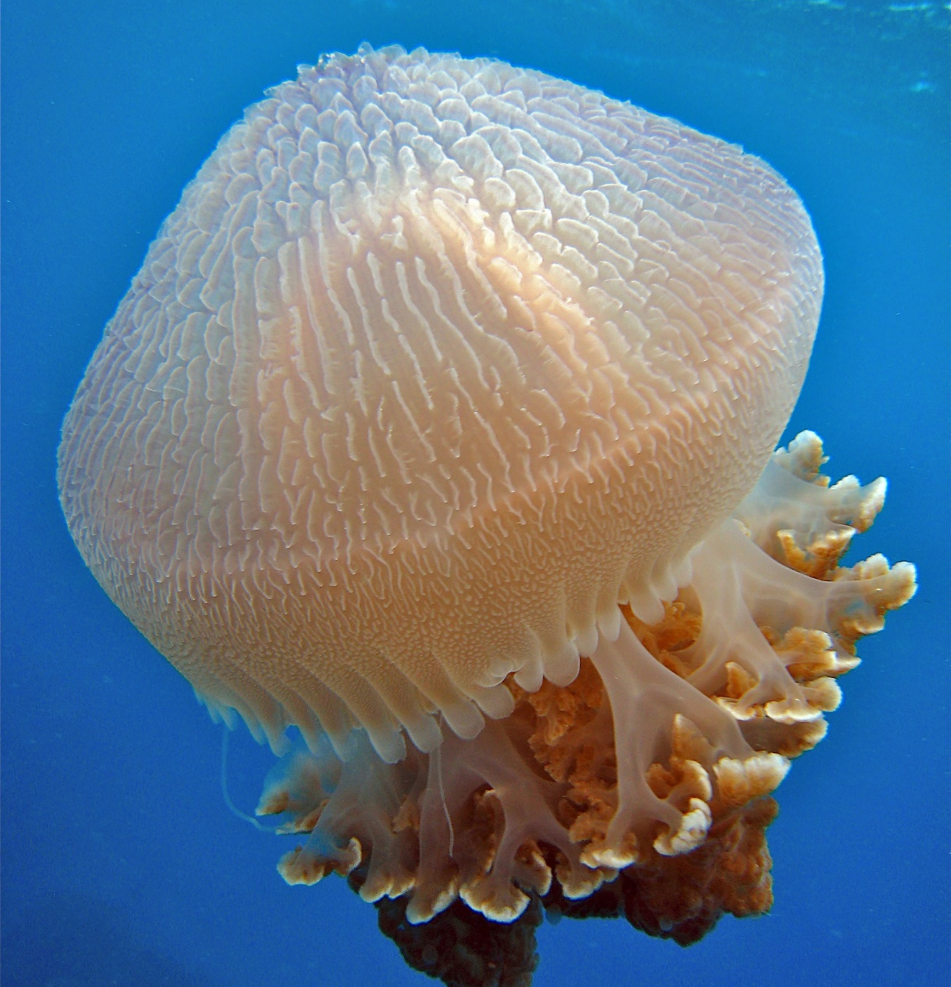
What do sea
turtles eat that look like jellyfish?
Notes:
Image: C. Jones, Copyright Commonwealth of Australia (GBRMPA)

Slide 61
Plastic
bags.
Notes:
Image: C. Jones, Copyright Commonwealth of Australia (GBRMPA)

Slide 62
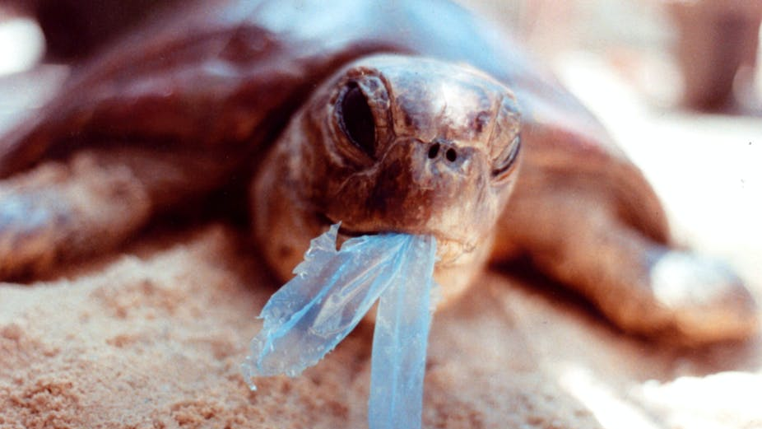
AAP Image/Department of the Environment and Heritage/Melbourne Zoo
Notes:
Image: https://theconversation.com/ghostnets-fish-on-marine-rubbish-threatens-northern-australian-turtles-11585

Slide 63

Sharks
Notes:
Image: J. Sumerling, Copyright Commonwealth of Australia (GBRMPA)

Slide 64

How do you tell
the difference between a male and female shark?
Notes:
Image: K. Hoppen, Copyright Commonwealth of Australia (GBRMPA)

Slide 65
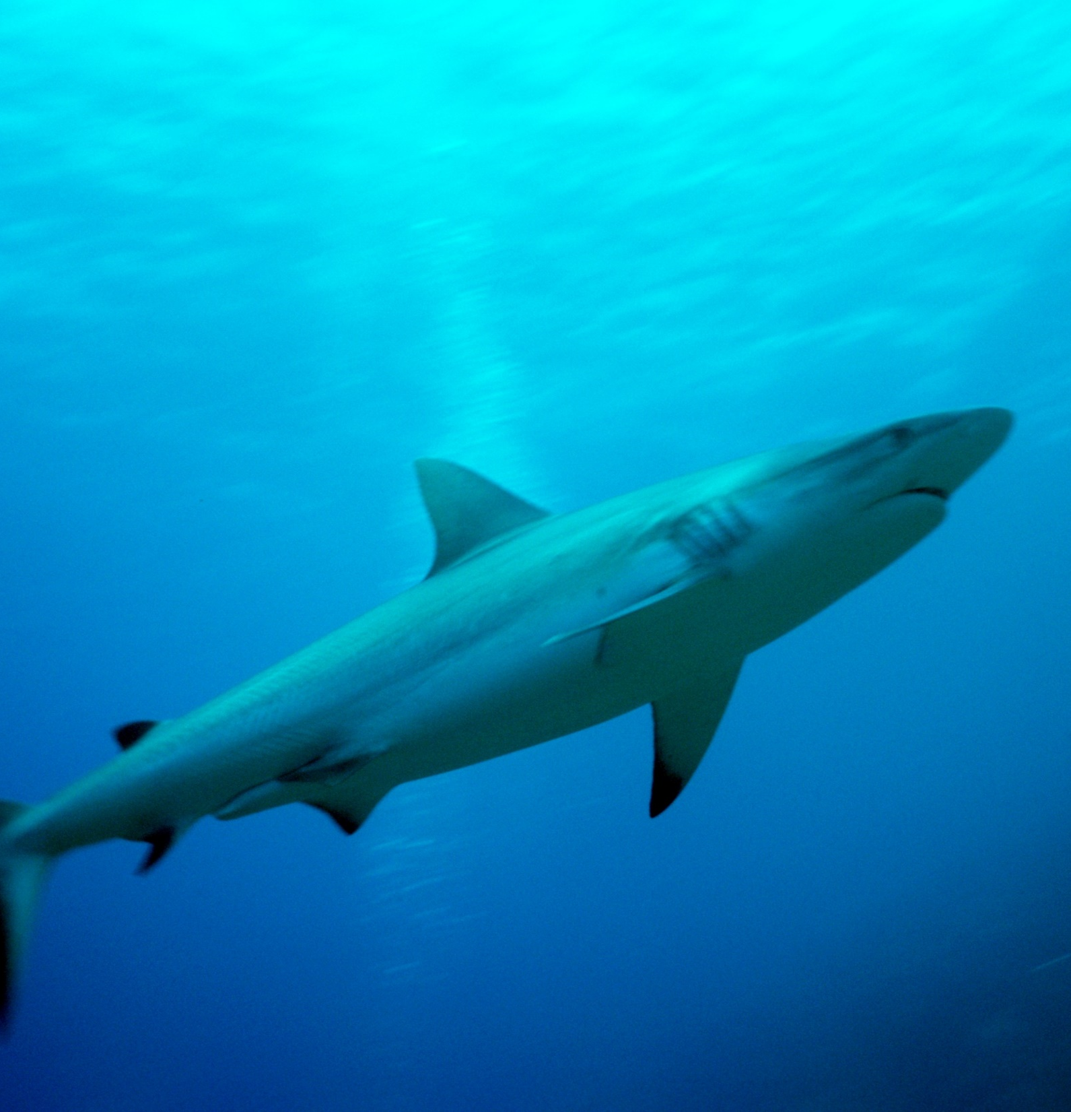
Males have
2 claspers.
Put your hands side by
side, fingers together. Push the thumbs outwards to model the claspers.
Notes:
Image: K. Hoppen, Copyright Commonwealth of Australia (GBRMPA)

Slide 66
Quiz time!
30 questions. Answers are
provided at the end.
Notes:
The following questions are straight from the Rapid Monitoring Survey course exam questions.

Slide 67
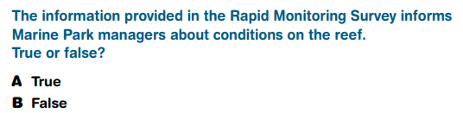
Question 1.

Slide 68
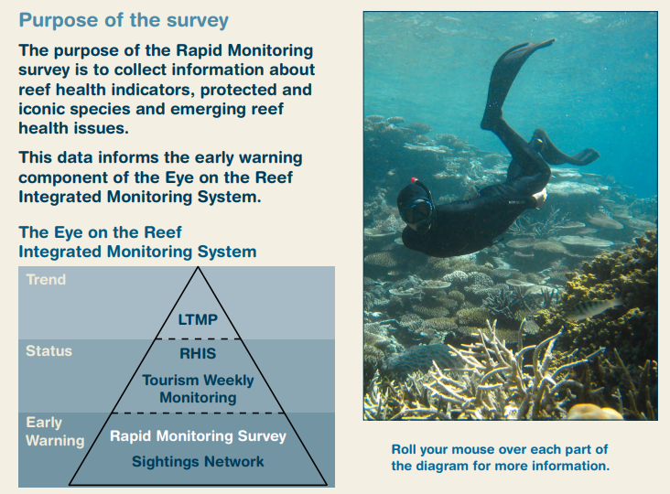
Read to answer the next question.

Slide 69
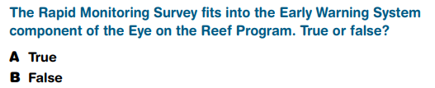
Question 2.

Slide 70
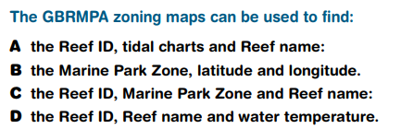
Question 3.

Slide 71
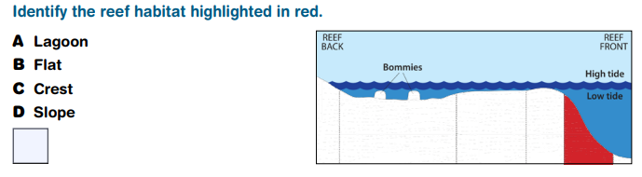
Question 4.

Slide 72
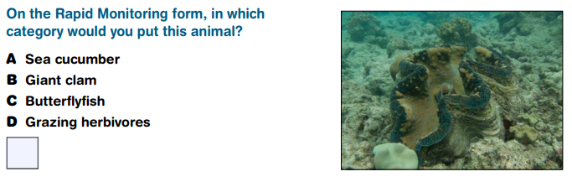
Question 5.

Slide 73
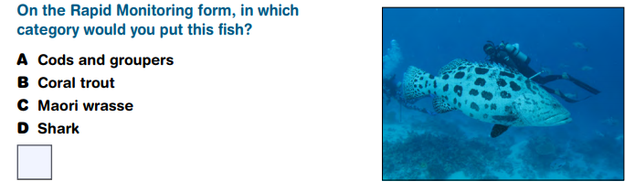
Question 6.

Slide 74
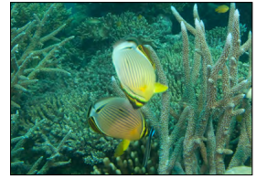
Question 7.

Slide 75
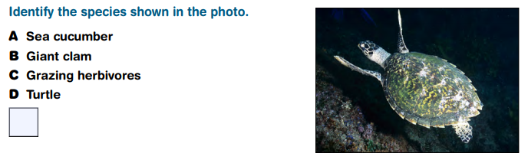
Question 8.
Hawksbill turtle

Slide 76
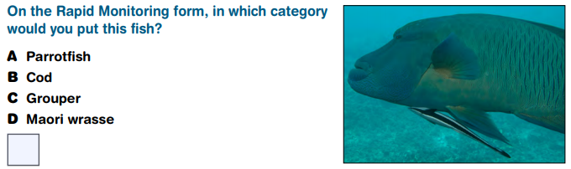
Question 9.

Slide 77
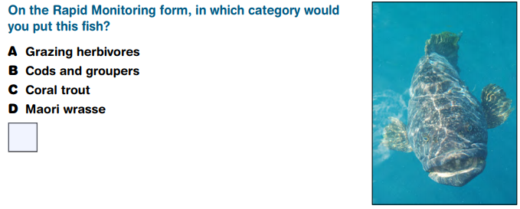
Question 10.

Slide 78
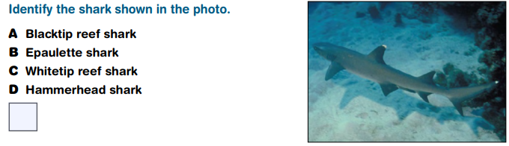
Question 11.

Slide 79
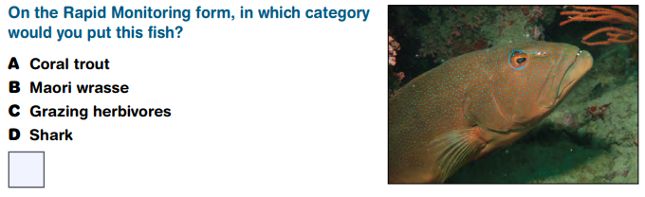
Question 12.

Slide 80
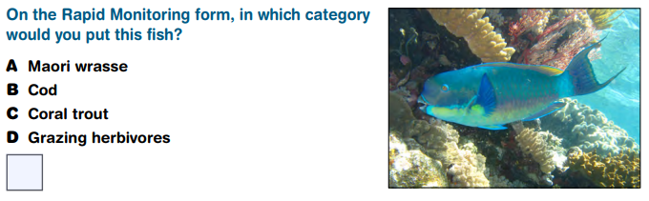
Question 13.

Slide 81
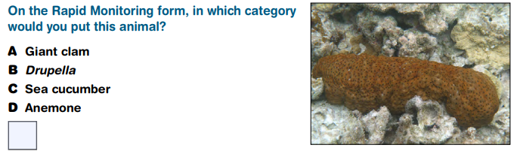
Question 14.

Slide 82
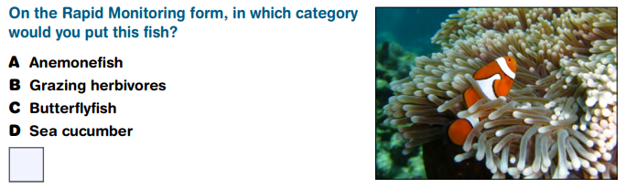
Question 15.

Slide 83
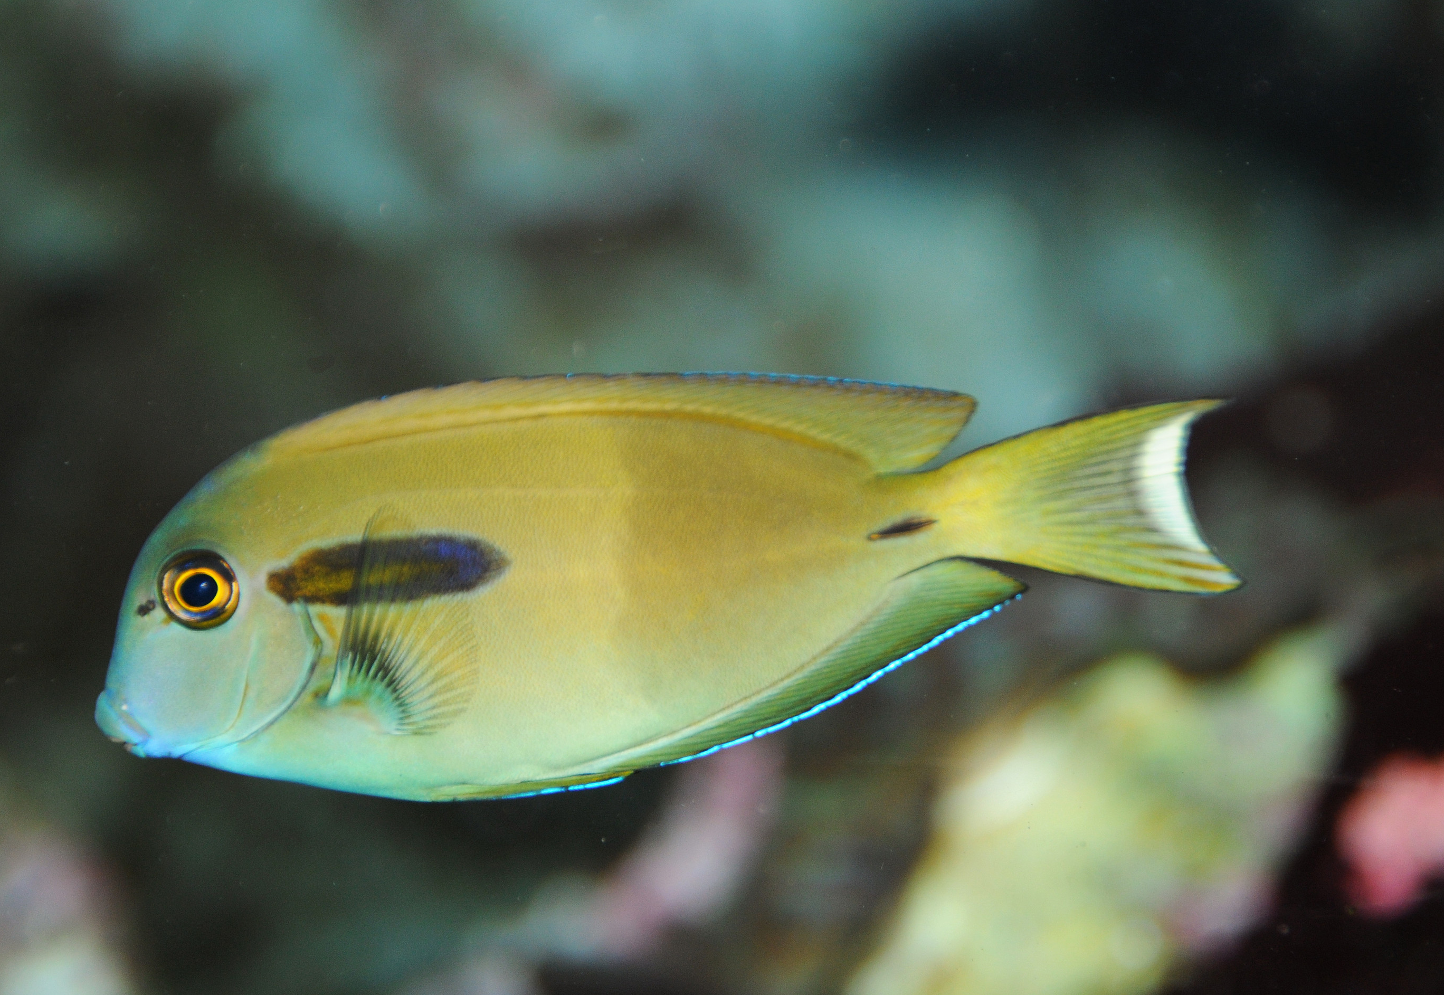
Question 16.

Slide 84
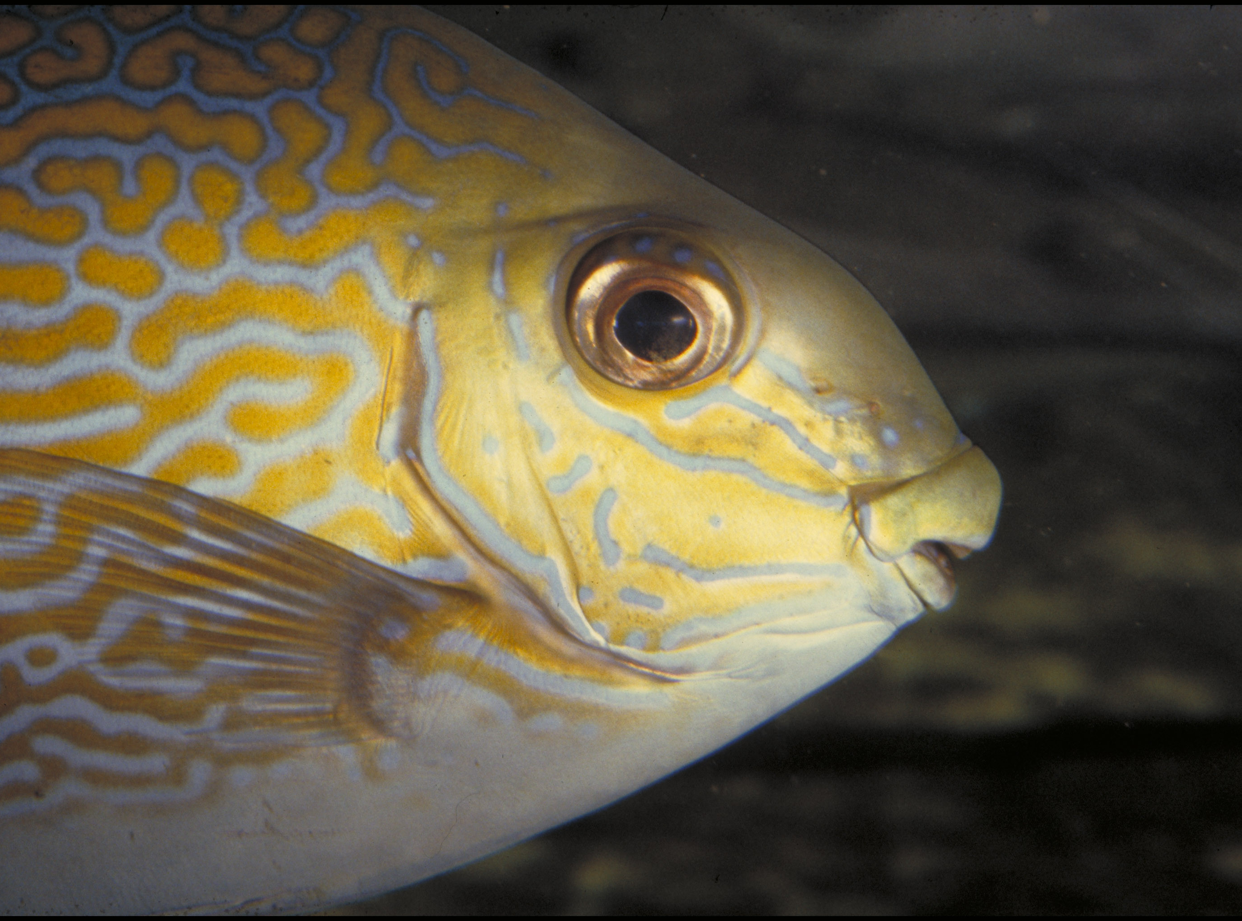
Question 17.

Slide 85
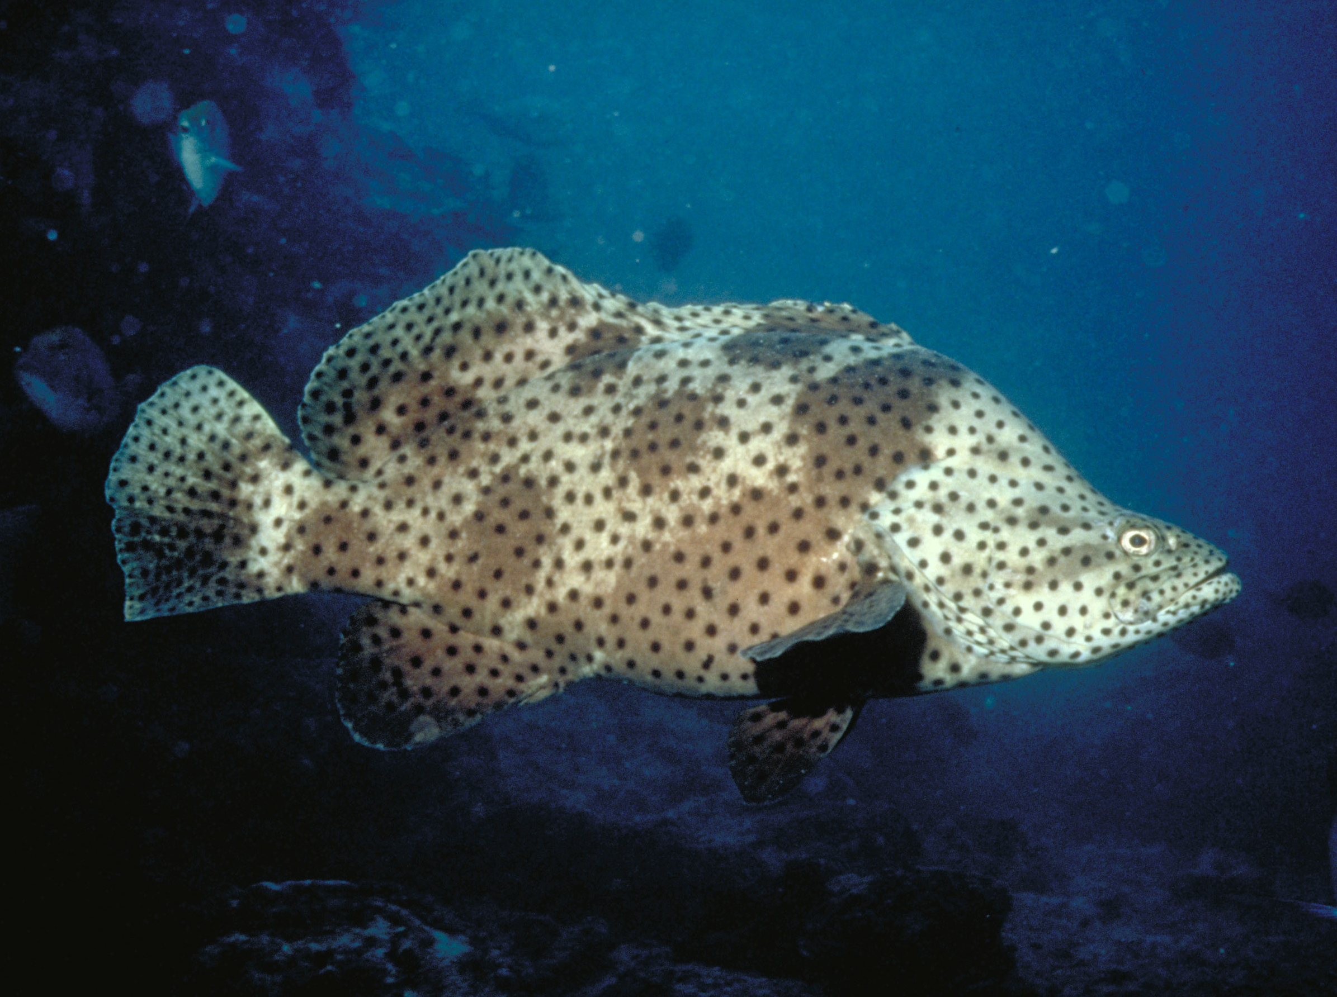
Question 18.

Slide 86
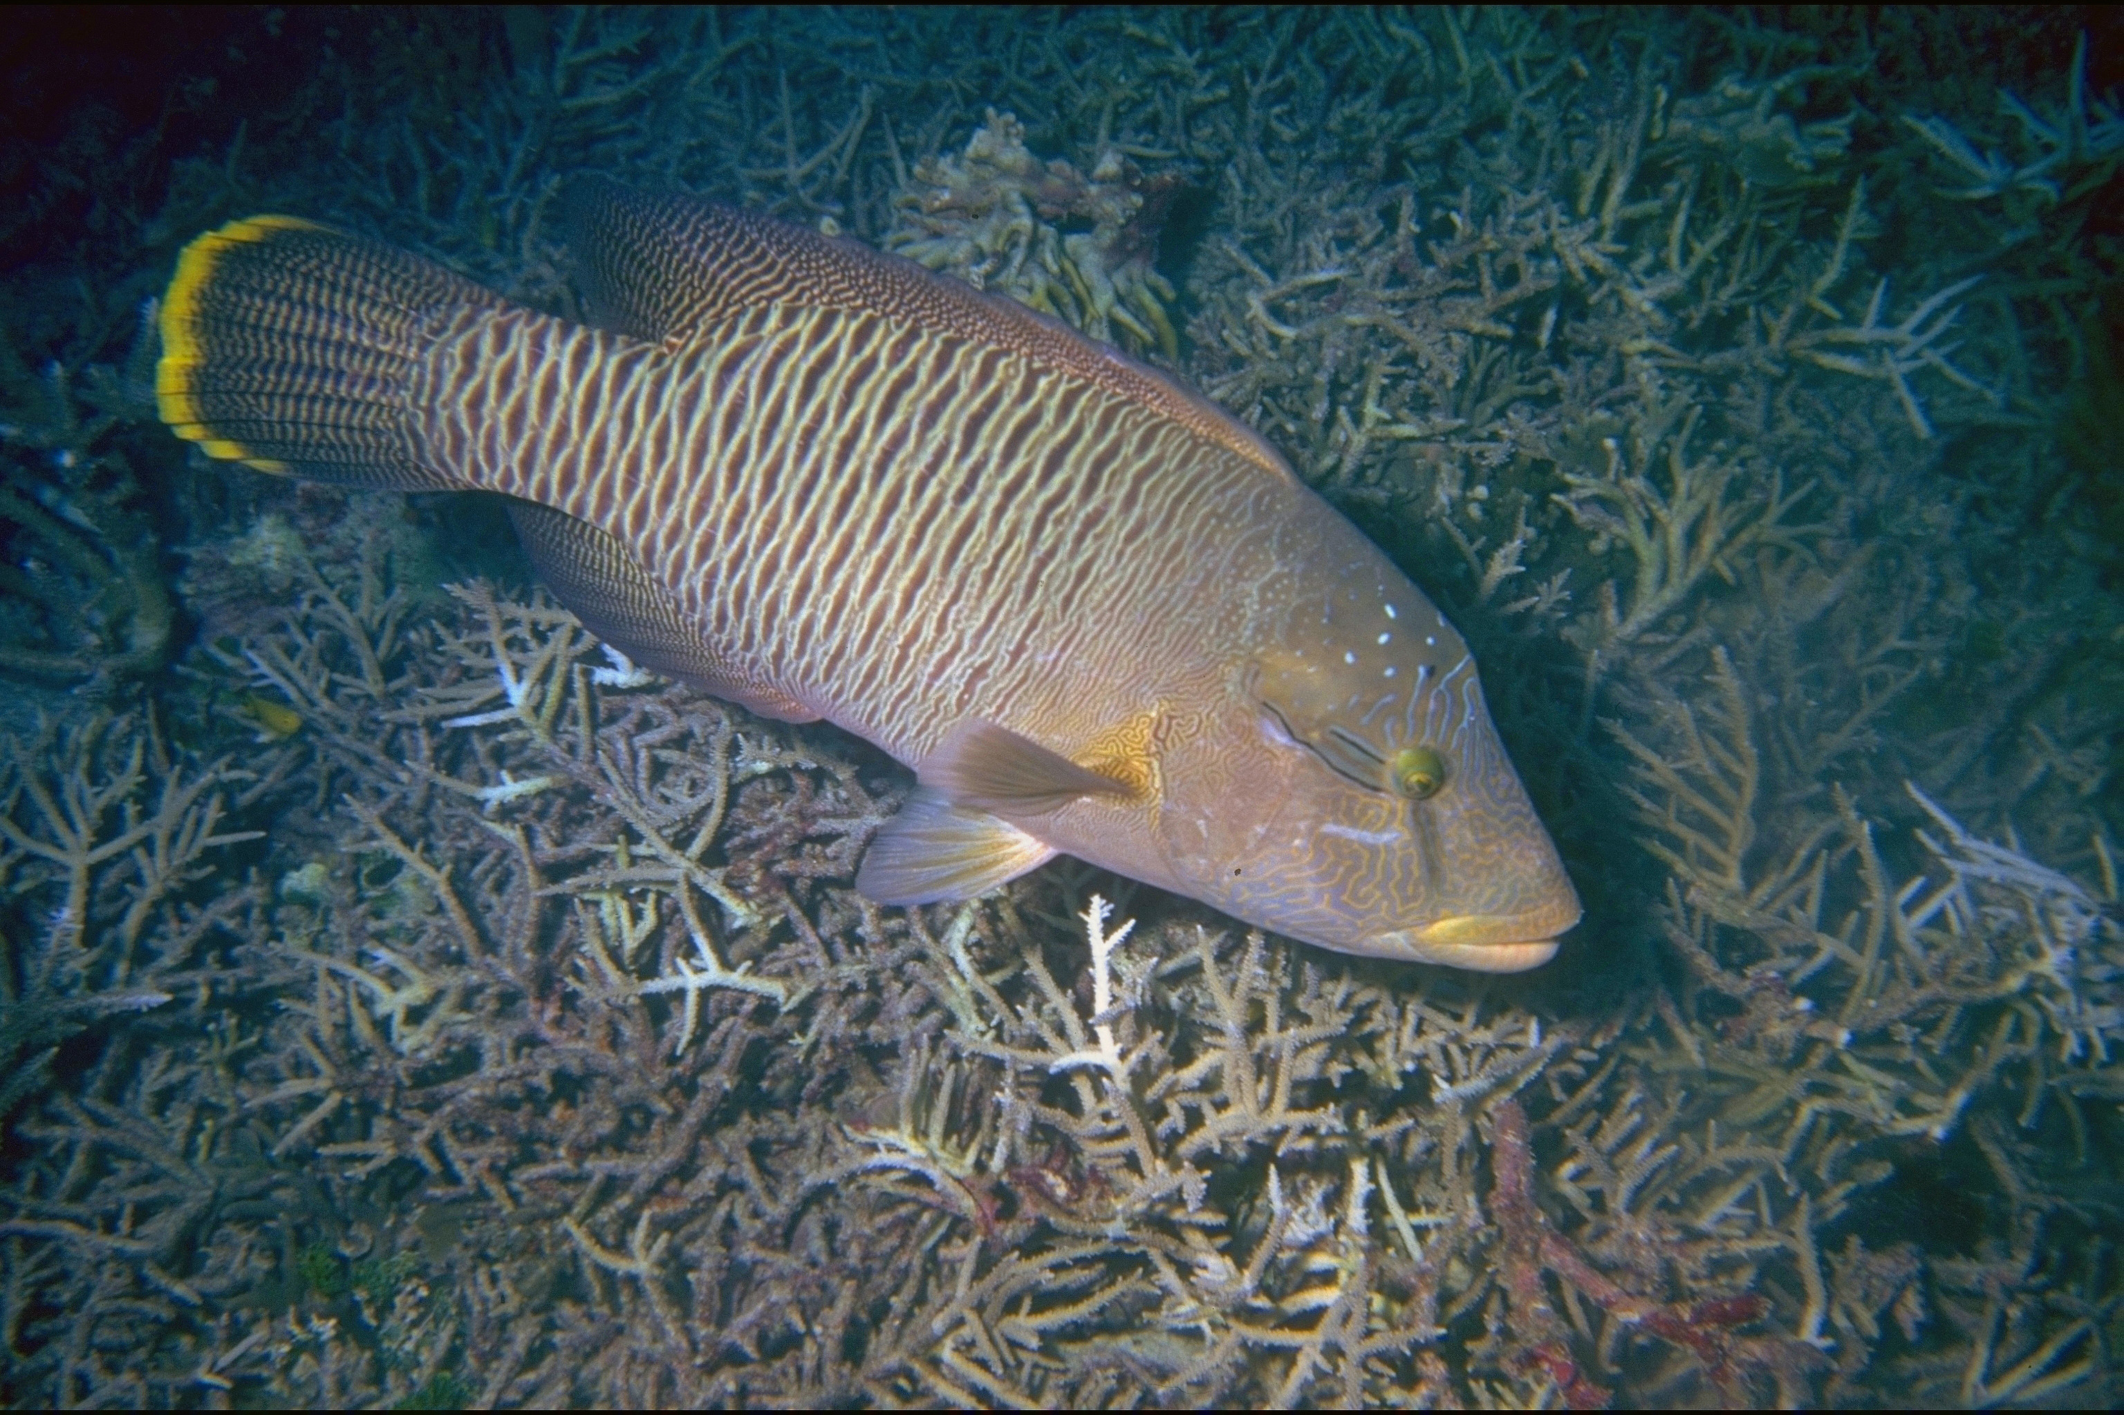
Question 19.
FEMALE

Slide 87
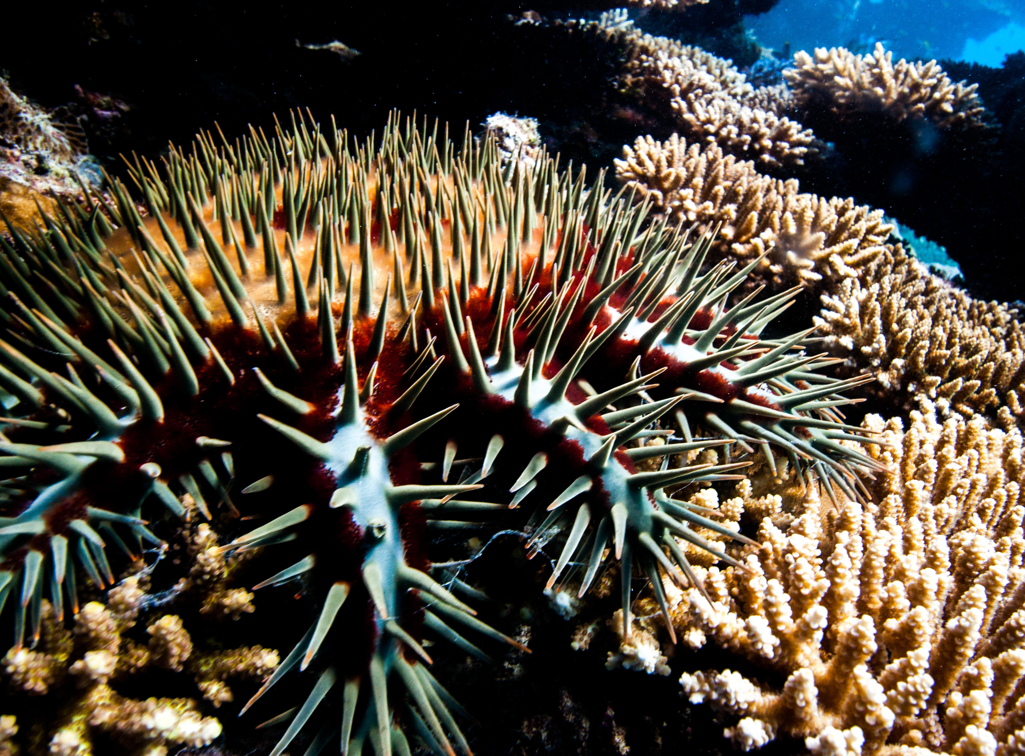
Question 20.
On the Rapid Monitoring form, in which category would you put this animal?
A Anemonefish
B Crown-of-thorns starfish
C Butterflyfish
D Sea cucumber

Slide 88

Question 21.
If sea cucumbers don’t have a heart and blood, what is their circulatory system made of?
A Catalysts
B Water vascular system
C Digestive fluids
D Central nervous system
Notes:
These are questions from the pre-snorkel brief on the excursion. Repeating information helps with long term memory retention and builds confidence.

Slide 89
Question 22.
How does a giant clam manage to
reproduce when stationary?
A It spawns when others spawn too
B Chemical signals initiate spawning
C The release of eggs and sperm
D All the above
Notes:
These are questions from the pre-snorkel brief on the excursion. Repeating information helps with long term memory retention and builds confidence.

Slide 90
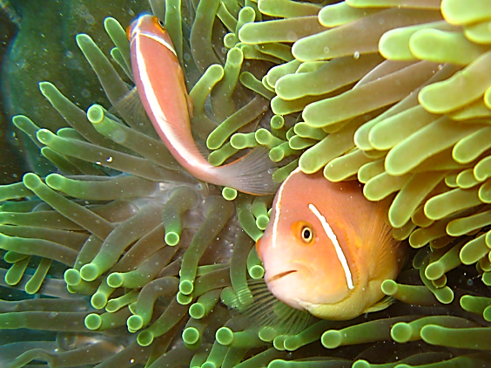
Question 23.
Can an anemonefish change sex from male to female?
Yes
No
Notes:
These are questions from the pre-snorkel brief on the excursion. Repeating information helps with long term memory retention and builds confidence.

Slide 91
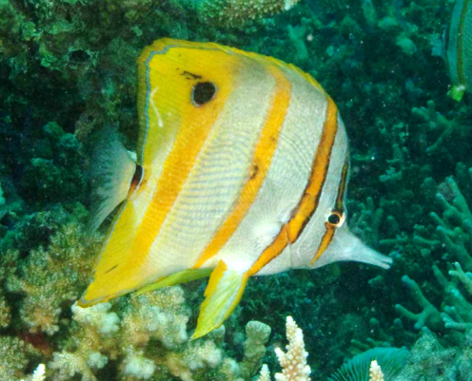
Question 24.
Butterflyfish often mate for life. They stay in pairs. What is the reproductive benefit of having a mate for life?
A Guarantees a mate for reproduction
B Someone to hang out with
C Protection from predatory attack
D Genetic diversity
Notes:
These are questions from the pre-snorkel brief on the excursion. Repeating information helps with long term memory retention and builds confidence.

Slide 92

Question 25.
How is the digestive system in a herbivore different to a carnivore?
A Herbivores have molar-like teeth
B Herbivores have smaller mouths
C Herbivores have longer intestines
D All the above
Notes:
These are questions from the pre-snorkel brief on the excursion. Repeating information helps with long term memory retention and builds confidence.

Slide 93

Question 26.
Coral trout change from female to male. What size do they change gender?
Note: legal catch size is 38cm.
A 36cm
B 36cm
C 40cm
D 42cm
Notes:
These are questions from the pre-snorkel brief on the excursion. Repeating information helps with long term memory retention and builds confidence.

Slide 94
Question 27.
Maori wrasse, like all fish, have a protective layer of mucous coating their body. Why is it so important not to touch the animals, including this friendly fish?
A They can get sick.
B You can get sick.
C They will attack you.
D It scares them away.
Notes:
These are questions from the pre-snorkel brief on the excursion. Repeating information helps with long term memory retention and builds confidence.

Slide 95
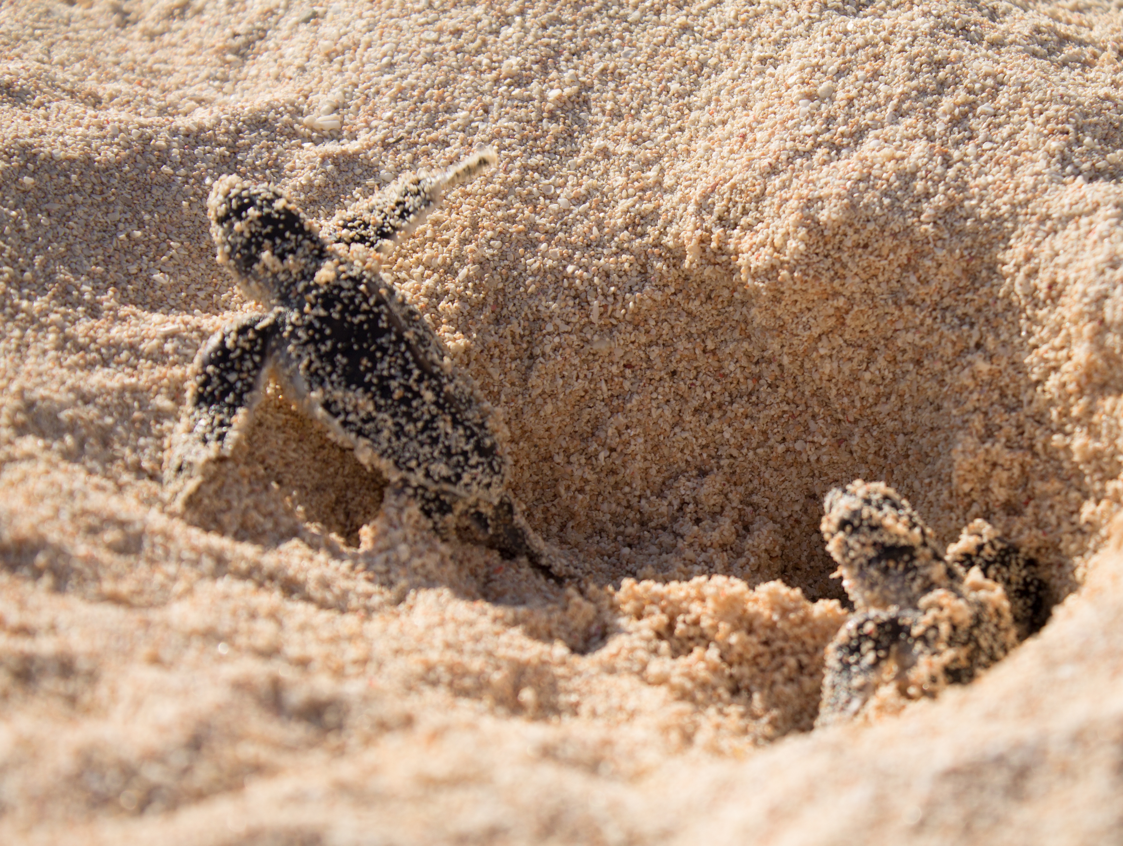
Question 28.
When is turtle breeding season?
A Spring
B Summer
C Winter
D Autumn
Notes:
These are questions from the pre-snorkel brief on the excursion. Repeating information helps with long term memory retention and builds confidence.

Slide 96

Question 29.
How do you tell the difference between a male and female shark?
Males have one clasper
Males have two claspers
Males have three claspers
You can’t tell
Notes:
These are questions from the pre-snorkel brief on the excursion. Repeating information helps with long term memory retention and builds confidence.

Slide 97
Question 30.
True or False?
Crown-of-thorns starfish eat coral.
Notes:
These are questions from the pre-snorkel brief on the excursion. Repeating information helps with long term memory retention and builds confidence.

Slide 98
Answers
Notes:
The following questions are straight from the Rapid Monitoring Survey course exam questions.

Slide 99
Question 1.

Slide 100
Read to answer the next question.

Slide 101
Question 2.

Slide 102
Question 3.

Slide 103
Question 4.
D

Slide 104
Question 5.
B

Slide 105
Question 6.
A

Slide 106
Question 7.
C

Slide 107
Question 8.
Hawksbill turtle
D

Slide 108
Question 9.
D

Slide 109
Question 10.
B

Slide 110
Question 11.
C

Slide 111
Question 12.
A

Slide 112
Question 13.
D

Slide 113
Question 14.
C

Slide 114
Question 15.
A

Slide 115
Question 16.
B

Slide 116
Question 17.
B

Slide 117
Question 18.
B

Slide 118
Question 19.
B
FEMALE

Slide 119

Question 20.
On the Rapid Monitoring form, in which category would you put this animal?
A Anemonefish
B Crown-of-thorns starfish
C Butterflyfish
D Sea cucumber
B

Slide 120
Question 21.
If sea cucumbers don’t have a heart and blood, what is their circulatory system made of?
A Catalysts
B Water vascular system
C Digestive fluids
D Central nervous system
B
Notes:
These are questions from the pre-snorkel brief on the excursion. Repeating information helps with long term memory retention and builds confidence.

Slide 121
Question 22.
How does a giant clam manage to
reproduce when stationary?
A It spawns when others spawn too
B Chemical signals initiate spawning
C The release of eggs and sperm
D All the above
D
Notes:
These are questions from the pre-snorkel brief on the excursion. Repeating information helps with long term memory retention and builds confidence.

Slide 122
Question 23.
Can an anemonefish change sex from male to female?
Yes
No
Yes
Notes:
These are questions from the pre-snorkel brief on the excursion. Repeating information helps with long term memory retention and builds confidence.

Slide 123
Question 24.
Butterflyfish often mate for life. They stay in pairs. What is the reproductive benefit of having a mate for life?
A Guarantees a mate for reproduction
B Someone to hang out with
C Protection from predatory attack
D Genetic diversity
A
Notes:
These are questions from the pre-snorkel brief on the excursion. Repeating information helps with long term memory retention and builds confidence.

Slide 124
Question 25.
How is the digestive system in a herbivore different to a carnivore?
A Herbivores have molar-like teeth
B Herbivores have smaller mouths
C Herbivores have longer intestines
D All the above
D
Notes:
These are questions from the pre-snorkel brief on the excursion. Repeating information helps with long term memory retention and builds confidence.

Slide 125
Question 26.
Coral trout change from female to male. What size do they change gender?
Note: legal catch size is 38cm.
A 36cm
B 36cm
C 40cm
D 42cm
D
Notes:
These are questions from the pre-snorkel brief on the excursion. Repeating information helps with long term memory retention and builds confidence.

Slide 126
Question 27.
Maori wrasse, like all fish, have a protective layer of mucous coating their body. Why is it so important not to touch the animals, including this friendly fish?
A They can get sick.
B You can get sick.
C They will attack you.
D It scares them away.
A
Notes:
These are questions from the pre-snorkel brief on the excursion. Repeating information helps with long term memory retention and builds confidence.

Slide 127
Question 28.
When is turtle breeding season?
A Spring
B Summer
C Winter
D Autumn
C
Notes:
These are questions from the pre-snorkel brief on the excursion. Repeating information helps with long term memory retention and builds confidence.

Slide 128
Question 29.
How do you tell the difference between a male and female shark?
Males have one clasper
Males have two claspers
Males have three claspers
You can’t tell
B
Notes:
These are questions from the pre-snorkel brief on the excursion. Repeating information helps with long term memory retention and builds confidence.

Slide 129
Question 30.
True or False?
Crown-of-thorns starfish eat coral.
True
Notes:
These are questions from the pre-snorkel brief on the excursion. Repeating information helps with long term memory retention and builds confidence.

Slide 130
How did you go?

Slide 131
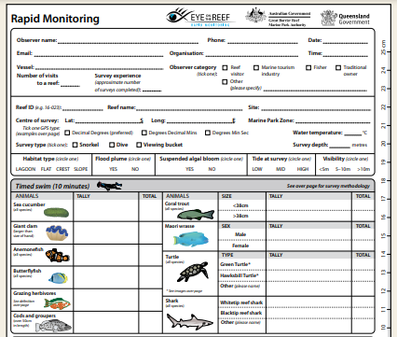
Do you think next time, you could count all the animals yourself?

Slide 132
You’ve now learnt that the Great Barrier Reef is one of the world’s most biodiverse ecosystems.

Slide 133
Coral reefs are dependent on many factors. They are highly interconnected ecosystems.

Slide 134
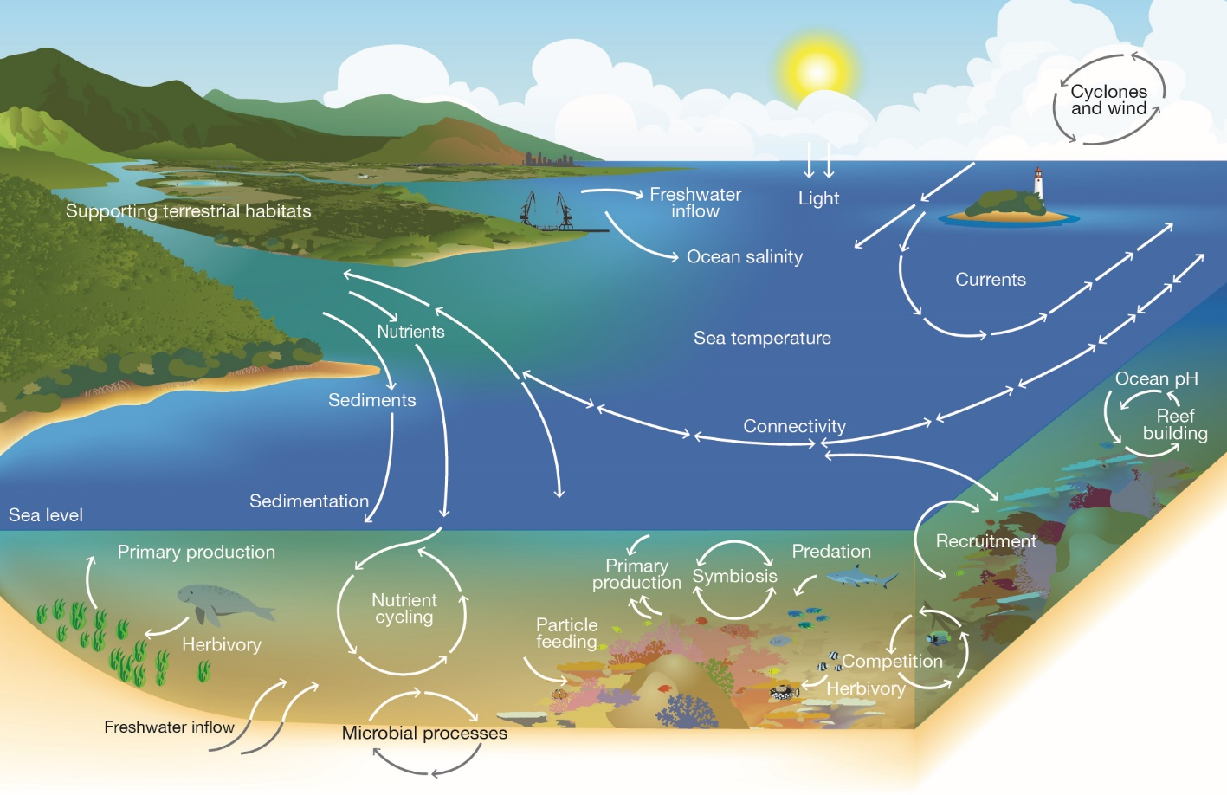
Notes:
Image: Copyright Commonwealth of Australia (GBRMPA)

Slide 135
The Great Barrier Reef faces many threats that impact on its health and resilience.

Slide 136
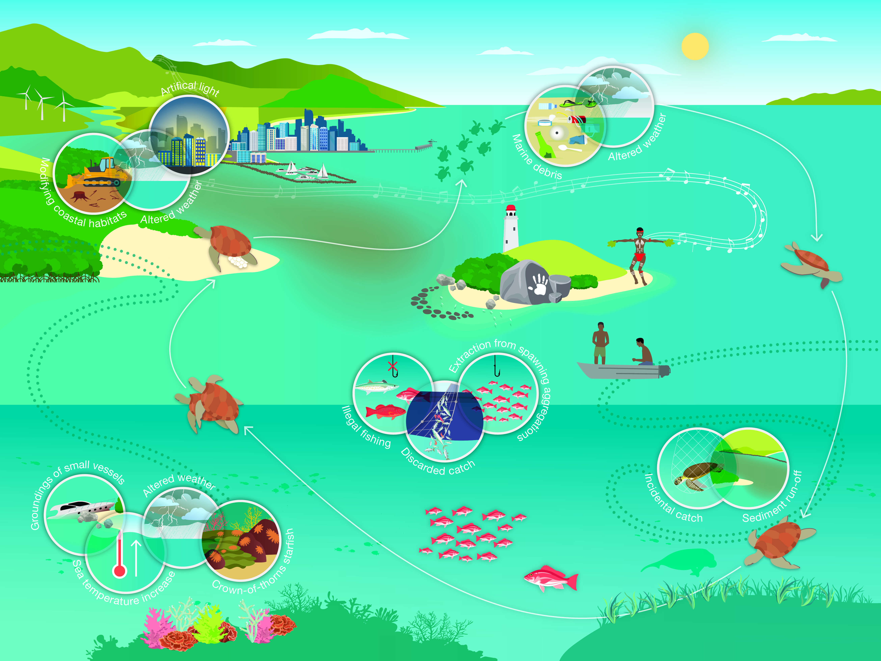
Notes:
Image: Copyright Commonwealth of Australia (GBRMPA)

Slide 137

What actions can you take to protect the Great Barrier Reef?

Slide 138
Remember, the Great Barrier
Reef Marine Park Authority also
has an Eye on the Reef app.
Do you remember this from your excursion?
It’s also a great tool for learning more about the
animals you saw!
Do you recognize any wildlife in the app?

Slide 139

Download
the Eye on the
Reef app.
Notes:
App image: https://www.gbrmpa.gov.au/__data/assets/pdf_file/0020/265430/Eye-on-the-Reef-app-poster.pdf

Slide 140


Press “Sightings” and “Create”.

Slide 141


Press “Wildlife”.

Slide 142


Marine mammals.
Select your animal and press “INFORMATION” to learn more.

Slide 143


Marine reptiles.

Slide 144




Sharks and rays.

Slide 145



Fishes.

Slide 146











Slide 147





Birds.

Slide 148


Invertebrates.

Slide 149










Slide 150
Explore the other tabs too!

Slide 151
Create a poster to answer the question:
How can I help the Great Barrier Reef?
Display it proudly in your classroom.
Notes:
This is the last slide for students to view. The remaining slides are for the teachers.

Slide 152
Thank you for helping the Great Barrier Reef!
See the Reef • Love the Reef • Protect the Reef

