Slide 1


AQUATIC PRACTICES
ASSESSMENT TASK
Answer the question:
How did I help
the Great Barrier Reef?
Multi-modal presentation
Length: 2-4 minutes (year 11) or 3-6 minutes (year 12).
+ Written component: activity book,
+ Performance component: demonstration of snorkelling.
Draft due date:
Final due date:
Teacher nominated presentations will be sent to GBRMPA for publication.
Notes:
CAN GBRMPA PUBLISH THESE? It would be great marketing???!!! Could make it some sort of competition perhaps???

Slide 2
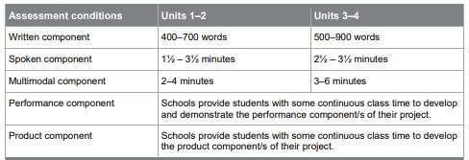
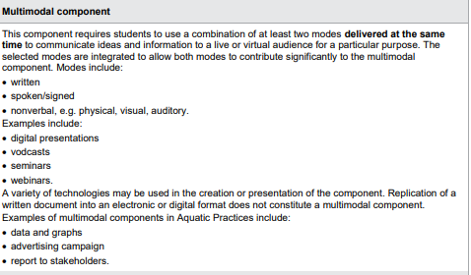
Aquatic Practices: project.
Written component: activity book.
Multi-modal component: presentation about excursion outcomes.
Performance component: demonstration of snorkelling.

Slide 3
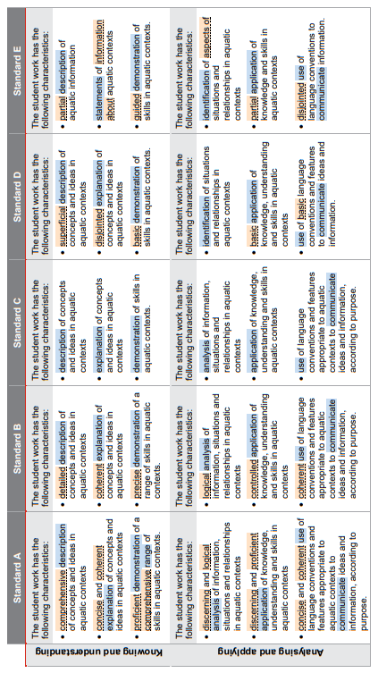
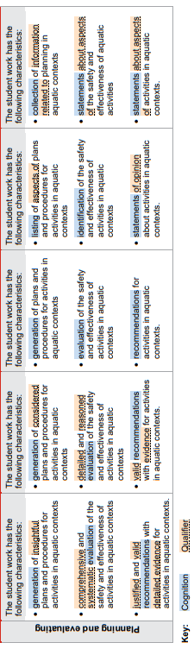
Name:
Teacher comments:
Notes:
https://www.qcaa.qld.edu.au/downloads/senior-qce/sciences/snr_aquatic_19_app_highlighted_standards.pdf

