Slide 1
Be a Marine
Biologist for a Day
Part 3: Making connections
Year 9
Notes:
Image: L. Zell, Copyright Commonwealth of Australia (GBRMPA)

Slide 2


Thank you for organising your trip to the reef with us.
We had a great time and hope you did too.
This PowerPoint is Part 3 of the Be a Marine Biologist for a Day program designed for year 9 by the Great Barrier Reef Marine Park Authority (GBRMPA).
View this PowerPoint after your excursion, with the accompanying activity book.
This is Part 3: Making connections. This is the last part of the program. This is when your students make connections with all they’ve learned and experienced so far.
On your excursion, you conducted an Eye on the Reef citizen science activity with your reef guide. Now it’s time to upload your data to the GBRMPA website. It’s also time for students to check understanding by answering any questions in Parts 1 and 2.
The Great Barrier Reef Marine Park Authority would like to thank you for uploading your data to their Rapid Monitoring database. We hope to see you again next year!
Licensed by the Commonwealth of Australia for use under a Creative Commons By Attribution 4.0 International licence with the exception of content supplied by third parties and any photographs. http://creativecommons.org/licences/by/4.0

Slide 3

We would like to acknowledge all of the Aboriginal and Torres Straight Islander peoples who have connection to the Great Barrier Reef.
We recognise their continuing connection to land, water and community, and pay our respects to their Elders past, present and emerging.

Slide 4

We would like to acknowledge the (insert name of local Traditional Owner group) peoples as the Traditional Owners of the Land and Sea Country that we visited as part of your excursion.

Slide 5

How can I help the
Great Barrier Reef?
Notes:
This is the overarching inquiry question that encompasses the entire BAMBFAD Program and is the starting slide to this presentation.

Slide 6

Notes:
Image: J. Johnson, Copyright Copyright Commonwealth of Australia (GBRMPA)

Slide 7
Eye on the Reef
Rapid Monitoring survey
10 MINUTE TIMED SWIM

Slide 8
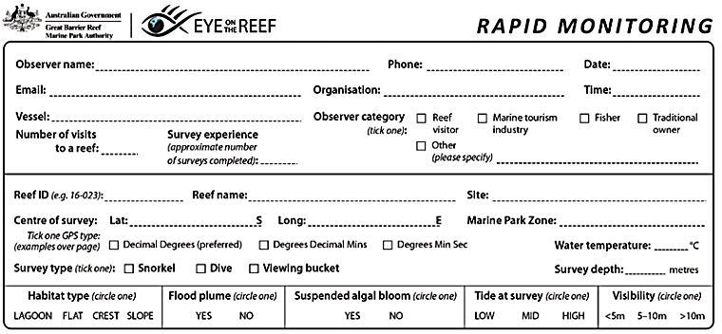
Have you got your data ready?

Slide 9

Because it’s time to upload it to GBRMPA!

Slide 10

This is the website for GBRMPA’s Eye on the Reef.
The link to connect is provided at the end of this presentation.

Slide 11

Login.

Slide 12

Select ‘Rapid Monitoring Survey’ tab.

Slide 13


Enter your data.

Slide 14

If you also completed the (more advanced) 360°survey, complete all questions. Otherwise, leave blank.

Slide 15

Save!
Scroll down to the bottom of the page to ‘Save’.

Slide 16
Are you ready?
Click on the image below to connect.
Notes:
www.gbrmpa.gov.au/our-work/eye-on-the-reef

Slide 17

Thank
you
Male Maori wrasse
Notes:
Image: C. Jones, Copyright Copyright Commonwealth of Australia (GBRMPA)

Slide 18
Check understanding.
Next, is what you’ve all been waiting for.
The answers to questions asked in Part 1 (before the excursion) and/or Part 2 (on the excursion).
Let’s check how you went!
Notes:
The following questions are straight from the Rapid Monitoring Survey course exam questions.

Slide 19


Sea cucumber
Notes:
Image: Copyright Commonwealth of Australia (GBRMPA)

Slide 20
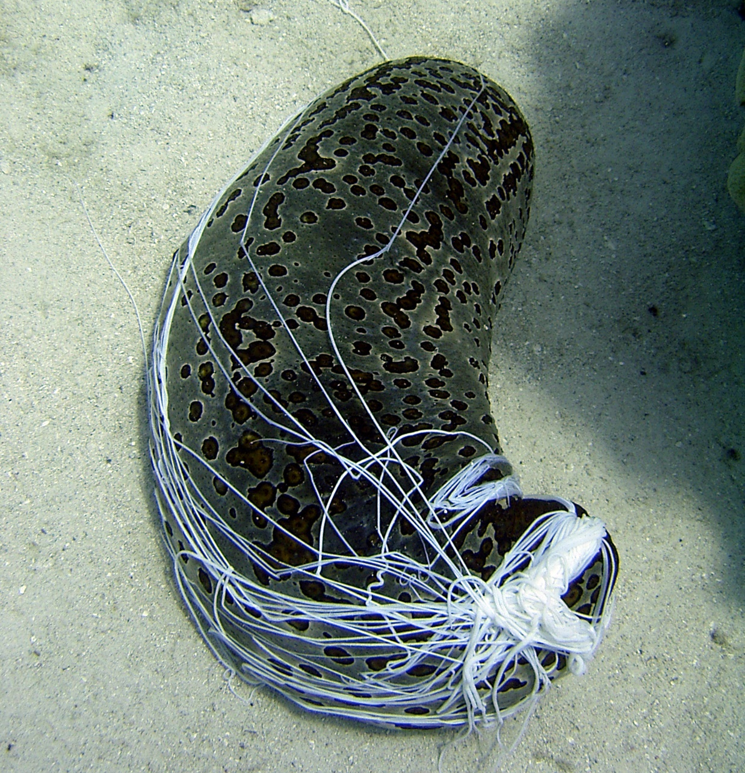
How does a sea cucumber defend itself when threatened?
Some eject their internal organs when threatened.
Notes:
Image: C. Jones, Copyright Commonwealth of Australia (GBRMPA)

Slide 21
Some species eject their internal organs.
Why?
Some internal organs
are very sticky. Predators risk entanglement.
Sticky internal organs.
Notes:
Image: C. Jones, Copyright Commonwealth of Australia (GBRMPA)

Slide 22
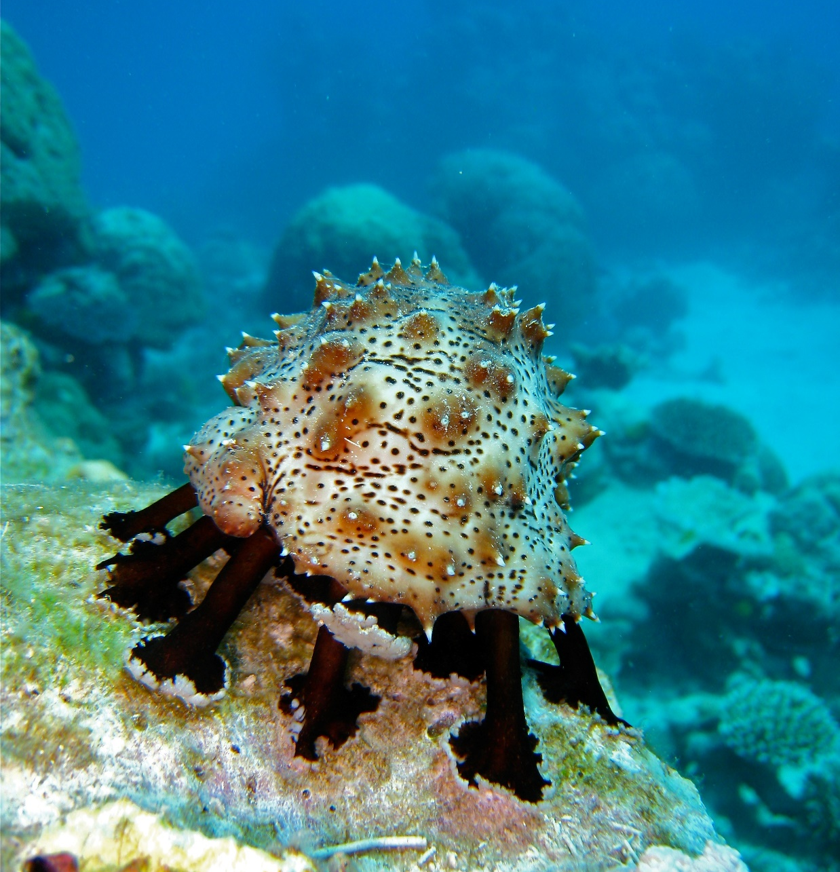
What, and how, does a sea cucumber eat?
Notes:
Image: C. Jones, Copyright Commonwealth of Australia (GBRMPA)

Slide 23
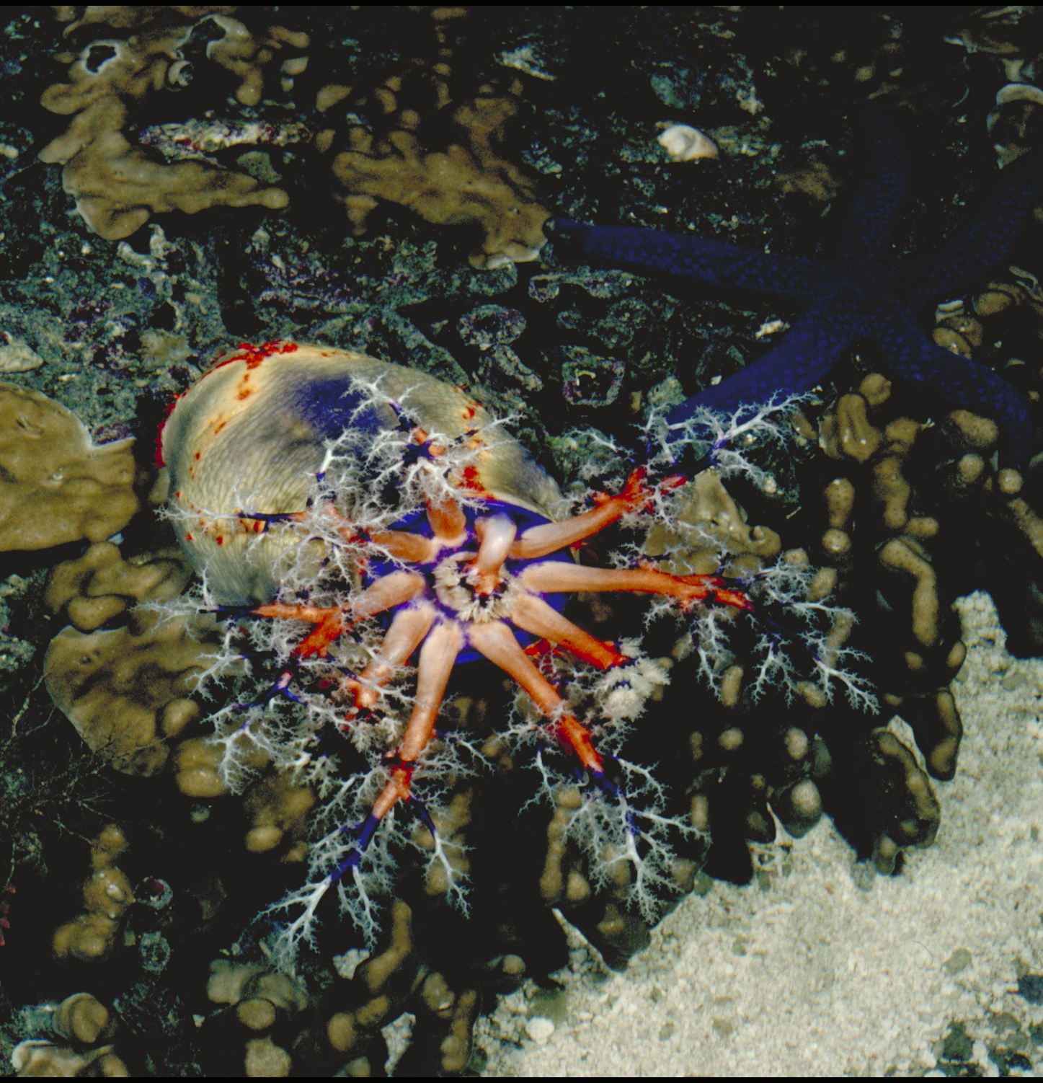
Some eat food on
the seafloor.
Others eat food in the water.
They eat using
branching feeding tentacles to capture food and transfer it to their mouth.
Branching tentacles around the mouth.
Notes:
Image: A. Elliott, Copyright Commonwealth of Australia (GBRMPA)

Slide 24

Giant clam
VULNERABLE TO EXTINCTION
Notes:
Image: Copyright Commonwealth of Australia (GBRMPA)

Slide 25

Can giant
clams see?
Notes:
Image: J. Sumerling, Copyright Commonwealth of Australia (GBRMPA)

Slide 26

Yes.
With hundreds of
pin-hole eyespots that respond to light and dark.
Notes:
Image: C. Jones, Copyright Commonwealth of Australia (GBRMPA)

Slide 27
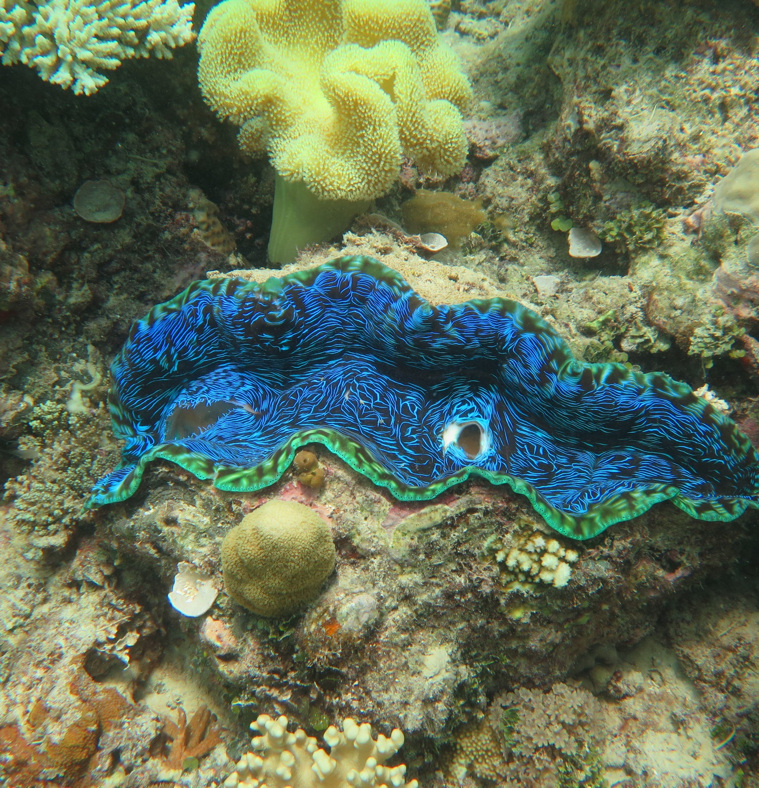
How many
holes (siphons)
are there in the mantle?
Notes:
Image: J. Stella, Copyright Commonwealth of Australia (GBRMPA)

Slide 28
2
Water goes in one hole
(it filter feeds) and comes out the other.
Notes:
Image: J. Stella, Copyright Commonwealth of Australia (GBRMPA)

Slide 29

Anemonefish
Notes:
Image: J. Sumerling, Copyright Commonwealth Government of Australia (GBRMPA)

Slide 30

Is the biggest anemonefish male
or female?
Notes:
Image: T. Mayne, Copyright Commonwealth of Australia (GBRMPA)

Slide 31
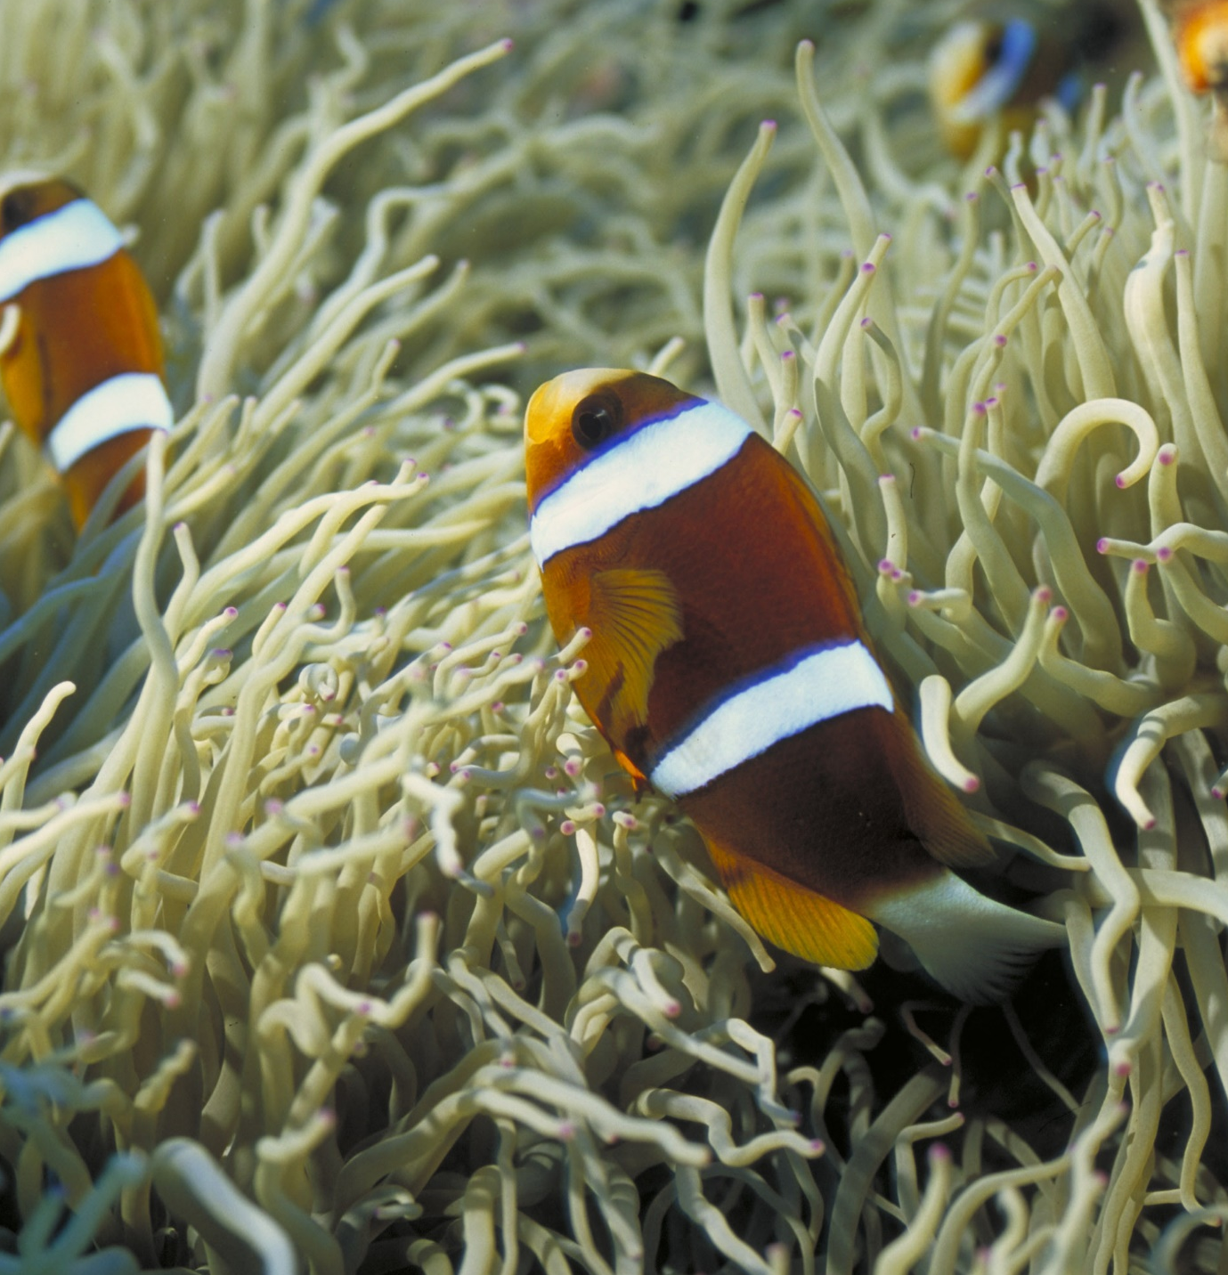
Female.
When she leaves or dies, her male partner will turn into the dominant female.
Notes:
Image: D. Wachenfeld, Copyright Commonwealth of Australia (GBRMPA)

Slide 32

Butterflyfish
Bright colours and pretty patterns
Long snout and little mouth for eating coral polyps
Flat body
Notes:
Image: J. Jones, Copyright Commonwealth of Australia (GBRMPA)

Slide 33

Did you put your ears in the water to hear how loud the reef sounds?
How do butterflyfish amplify the sounds they make and hear?
Notes:
Image: R. Berkelmans, Copyright Commonwealth of Australia (GBRMPA)

Slide 34

Butterflyfish
have linked their lateral line to their swim bladder.
Notes:
Image: L. Zell, Copyright Commonwealth of Australia (GBRMPA)

Slide 35

Grazing herbivores
Parrotfish / Surgeonfish / Rabbitfish / Unicornfish
Notes:
Image: W. Gladstone, Copyright Commonwealth of Australia (GBRMPA)

Slide 36

Why are grazing herbivores called
the lawnmowers of the Reef?
Notes:
Image: C. Jones, Copyright Commonwealth of Australia (GBRMPA)

Slide 37

Because they graze on so much algae.
Notes:
Image: C. Jones, Copyright Commonwealth of Australia (GBRMPA)

Slide 38
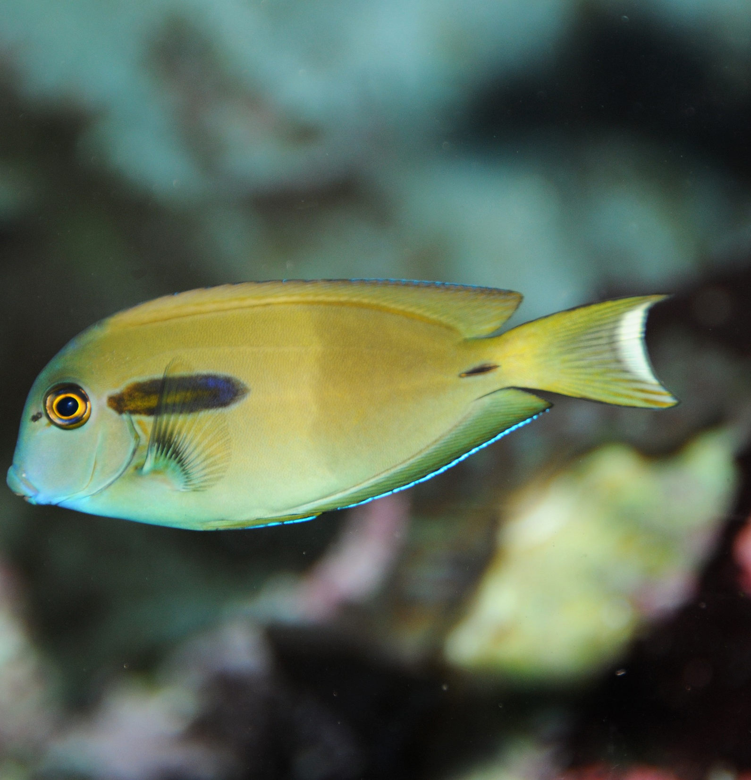
This is a surgeonfish.
Why is it called a surgeonfish?
Notes:
Image: J. Jones, Copyright Commonwealth of Australia (GBRMPA)

Slide 39
They have a scalpel-like blade near the tail used
for fighting and
self-defence.
Notes:
Image: J. Jones, Copyright Commonwealth of Australia (GBRMPA)

Slide 40

Cods and groupers
Notes:
Image: J. Hurford, Copyright Commonwealth of Australia (GBRMPA)

Slide 41
What are some territorial behaviours of the Queensland grouper?
Notes:
Image: J. Hurford, Copyright Commonwealth of Australia (GBRMPA)

Slide 42
They threaten intruders
by shaking the body, opening the mouth or using the swim bladder to make a loud booming noise.
Notes:
Image: J. Hurford, Copyright Commonwealth of Australia (GBRMPA)

Slide 43

Coral trout
Notes:
Image: S. Summerhays, Copyright Commonwealth of Australia (GBRMPA)

Slide 44

Why is it bad
to eat extra-large reef fish?
Notes:
Image: T. Mayne, Copyright Commonwealth of Australia (GBRMPA)

Slide 45
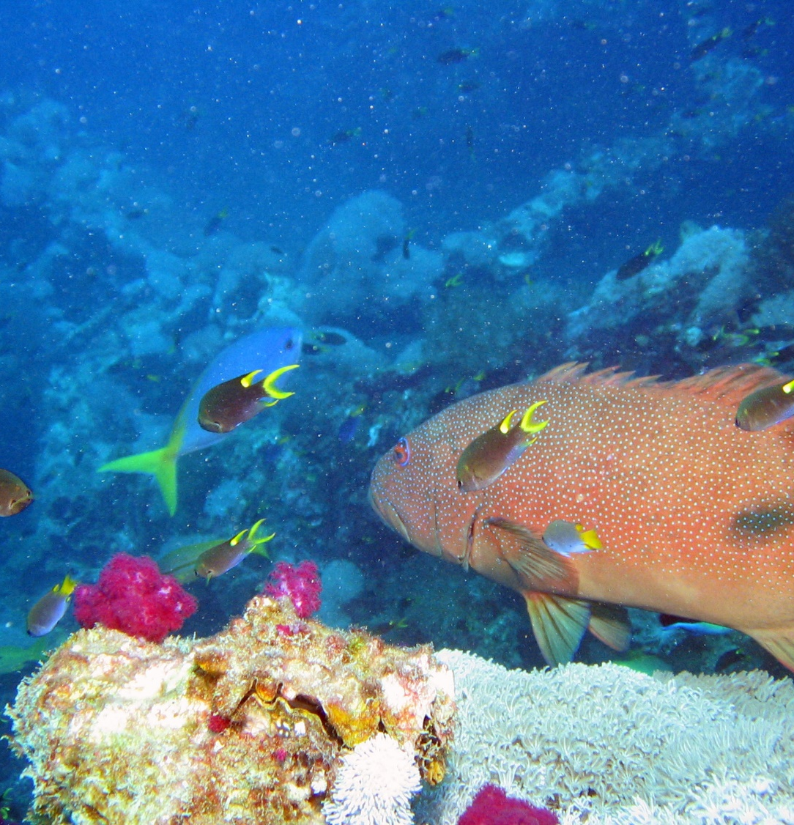
You risk getting very sick with ciguatera poisoning.
Notes:
The toxin is a marine algae called Gambierdiscus toxicus.
Image: J. Mokivitch, Copyright Commonwealth of Australia (GBRMPA)

Slide 46

Maori wrasse
also called humphead wrasse or Napoleon wrasse.
Notes:
Image: C. Jones, Copyright Commonwealth of Australia (GBRMPA)

Slide 47
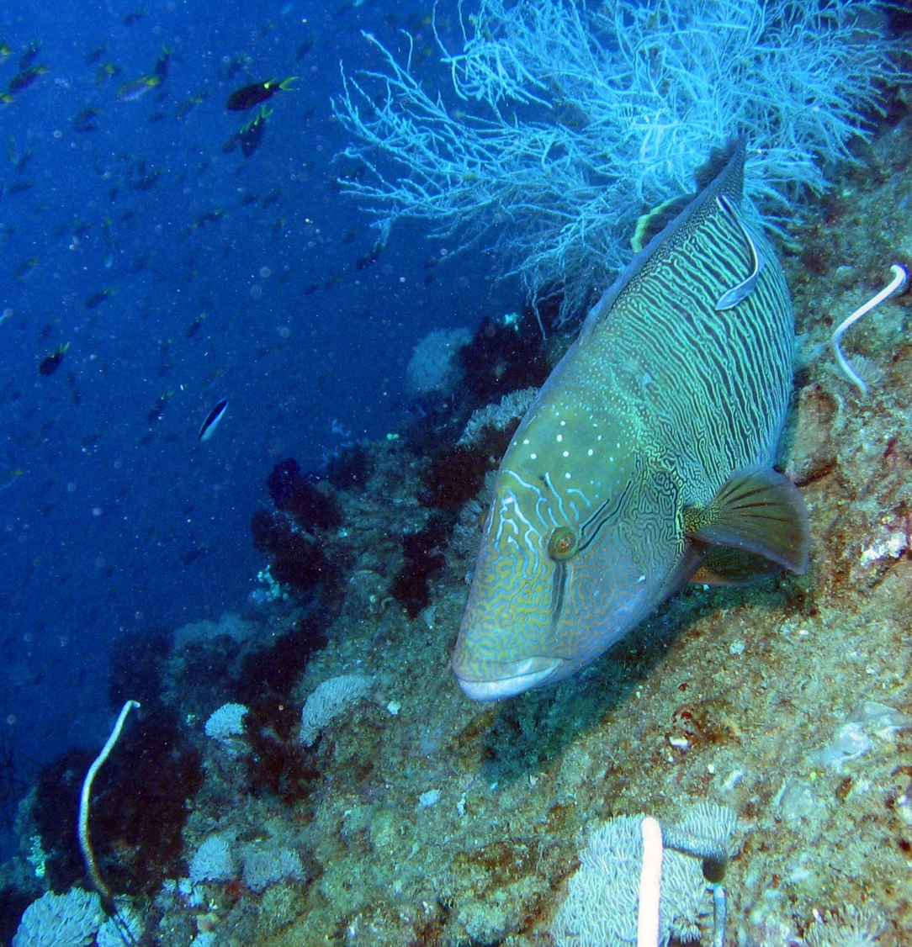
Where do Maori wrasse live?
Notes:
Image: J. Monkivitch, Copyright Commonwealth of Australia (GBRMPA)

Slide 48

Maori wrasse live
on the Reef and occupy limited
home ranges.
Male
Notes:
Image: M. Simmons, Copyright Commonwealth of Australia (GBRMPA)

Slide 49
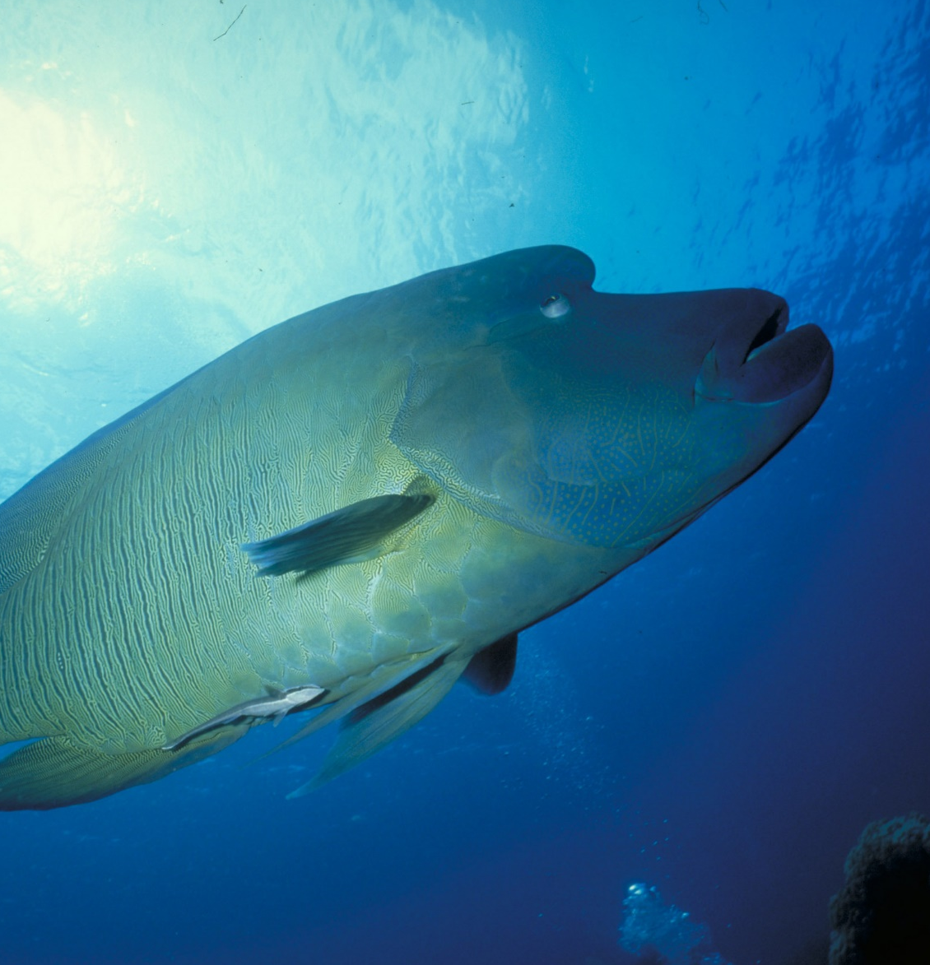
Adults swim across the reefs during the day, resting at night in caves and under coral ledges.
Male
Notes:
Image: M. Simmons, Copyright Commonwealth of Australia (GBRMPA)

Slide 50

What happens
if people touch
a Maori wrasse
and remove its protective coating
of fish mucus?
Notes:
Image: C. Jones Copyright Commonwealth of Australia (GBRMPA)

Slide 51
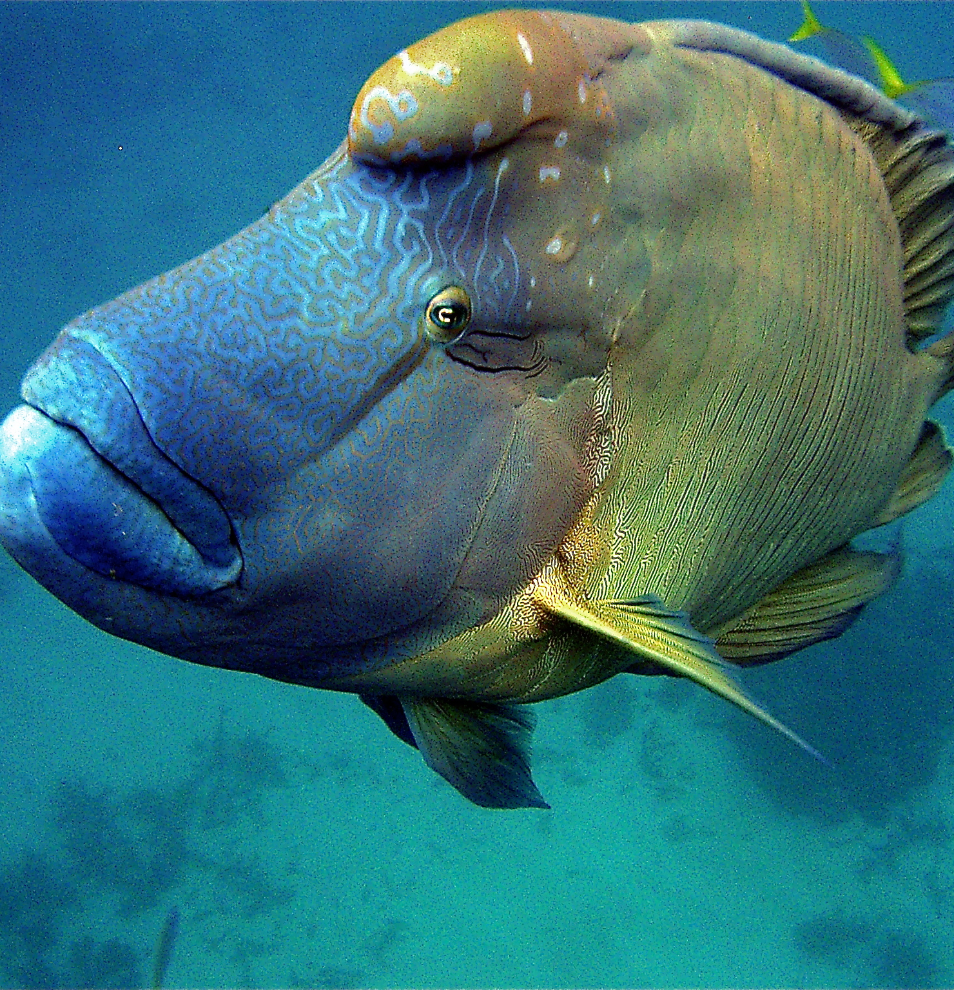
They can
get sick.
Notes:
Image: C. Jones, Copyright Commonwealth of Australia (GBRMPA)

Slide 52

Sea turtles
Notes:
Image: C. Jones, Copyright Commonwealth of Australia (GBRMPA)

Slide 53

How many sea turtles pictured below are threatened with extinction?
Notes:
Image: GBRMPA Image Library

Slide 54
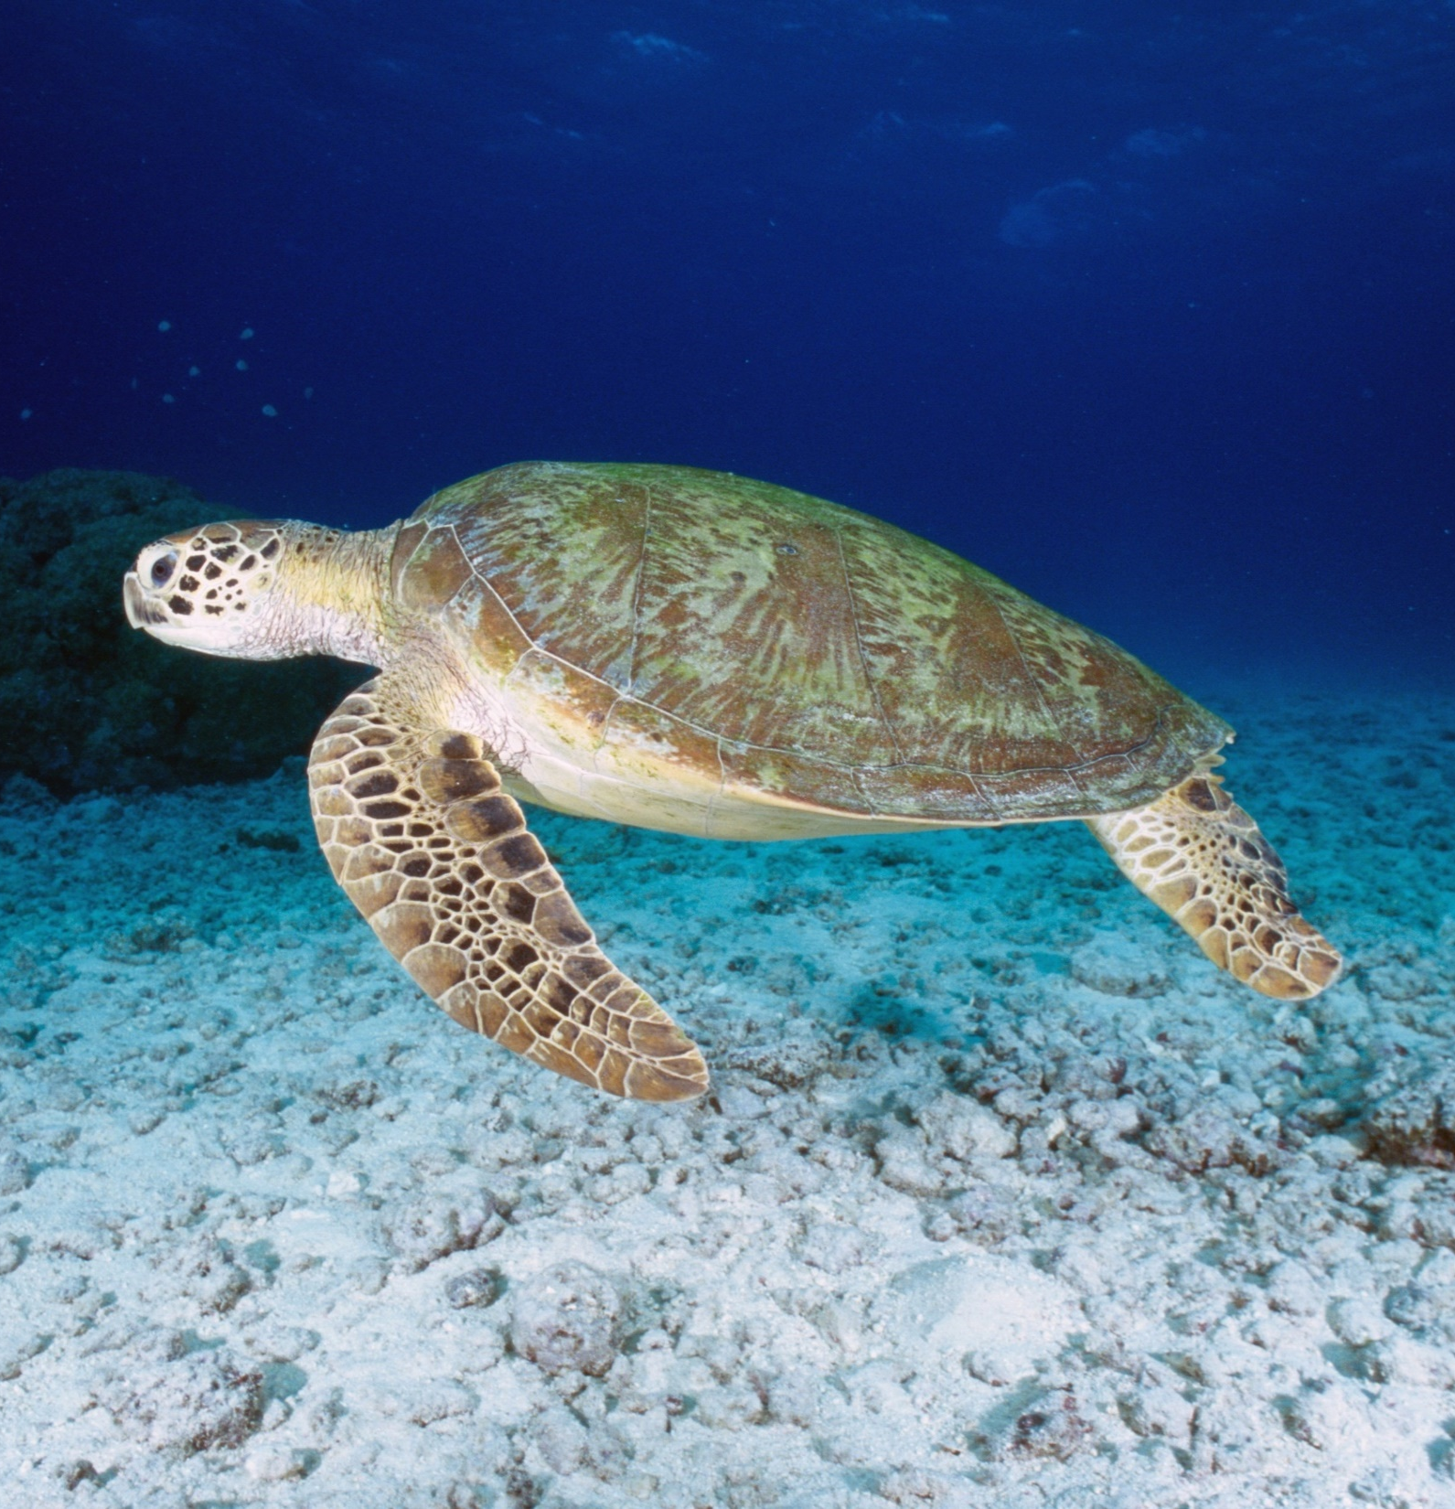
Some turtles travel long distances, hitch-hiking rides in ocean currents such as the East Australian Current and ocean gyres.
Notes:
Image: K. Hoppen, Copyright Commonwealth of Australia (GBRMPA)

Slide 55
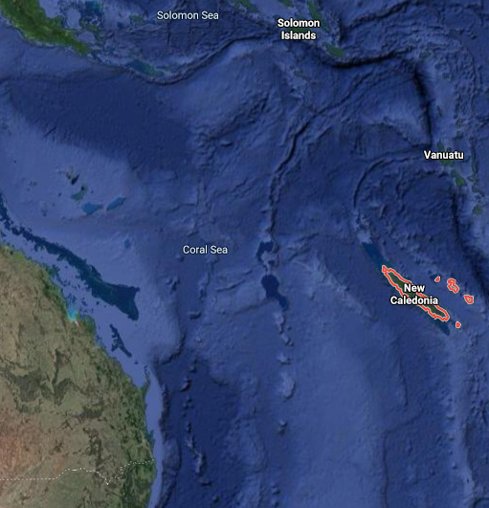
For example, turtles nesting in New Caledonia were found feeding on Heron Island, and turtles nesting on Heron Island were found feeding in New Caledonia!
Notes:
Fun Fact Source: https://parksaustralia.gov.au/marine/parks/coral-sea/explore/sea-turtles/

Slide 56
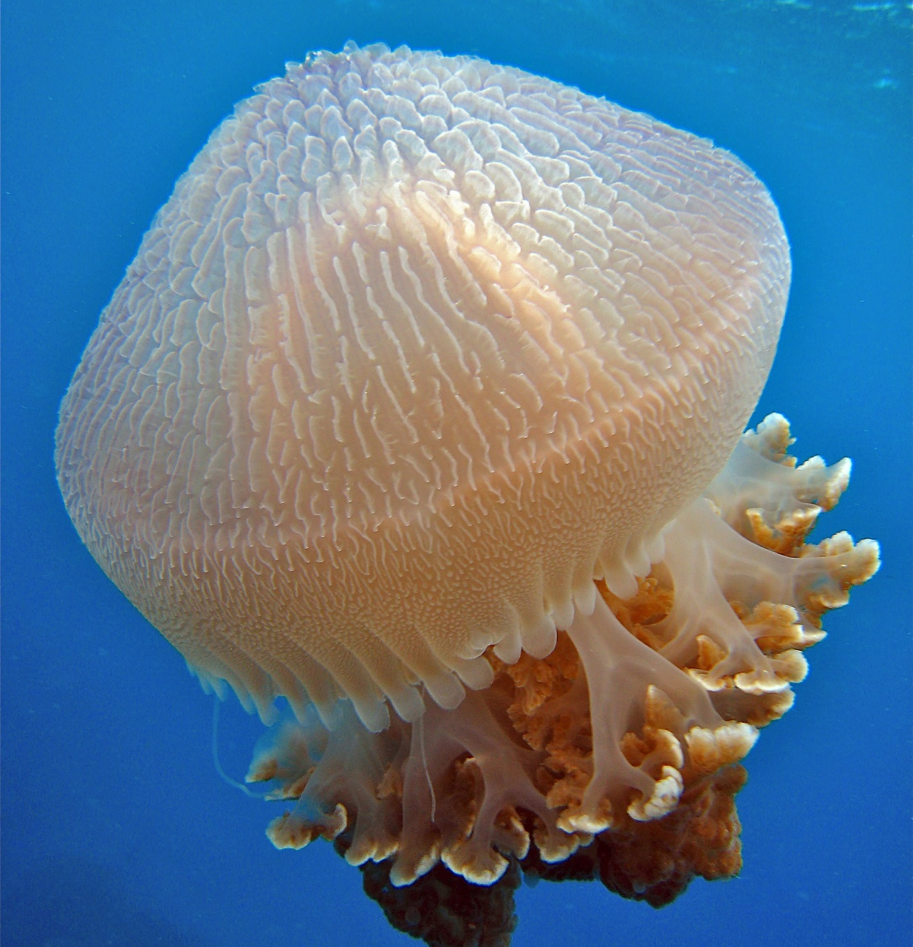
What do sea
turtles eat that look like jellyfish?
Notes:
Image: C. Jones, Copyright Commonwealth of Australia (GBRMPA)

Slide 57
Plastic
bags.
Notes:
Image: C. Jones, Copyright Commonwealth of Australia (GBRMPA)

Slide 58
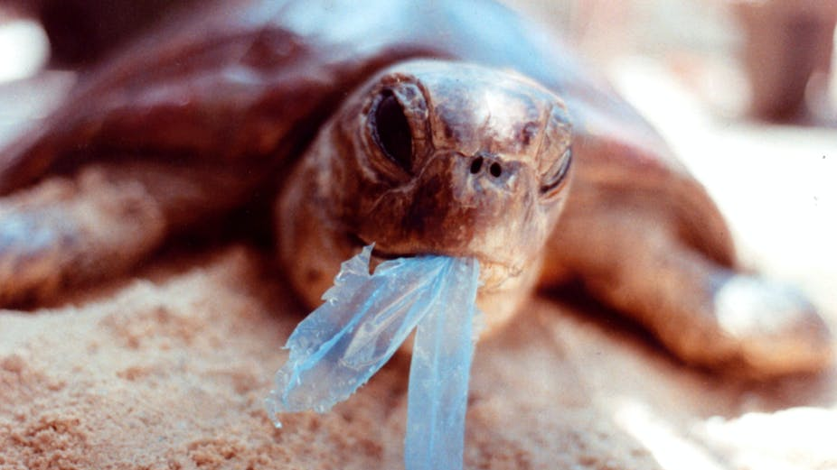
AAP Image/Department of the Environment and Heritage/Melbourne Zoo
Notes:
Image: https://theconversation.com/ghostnets-fish-on-marine-rubbish-threatens-northern-australian-turtles-11585

Slide 59
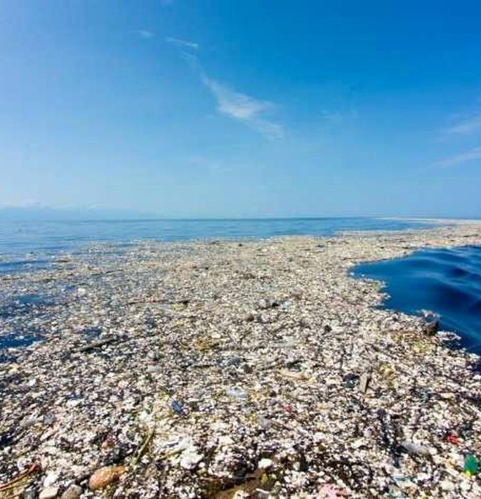
How many
kilograms of plastic are there for every kilogram of plankton in the Great Pacific Garbage Patch?
Notes:
Image: https://theoceancleanup.com/

Slide 60
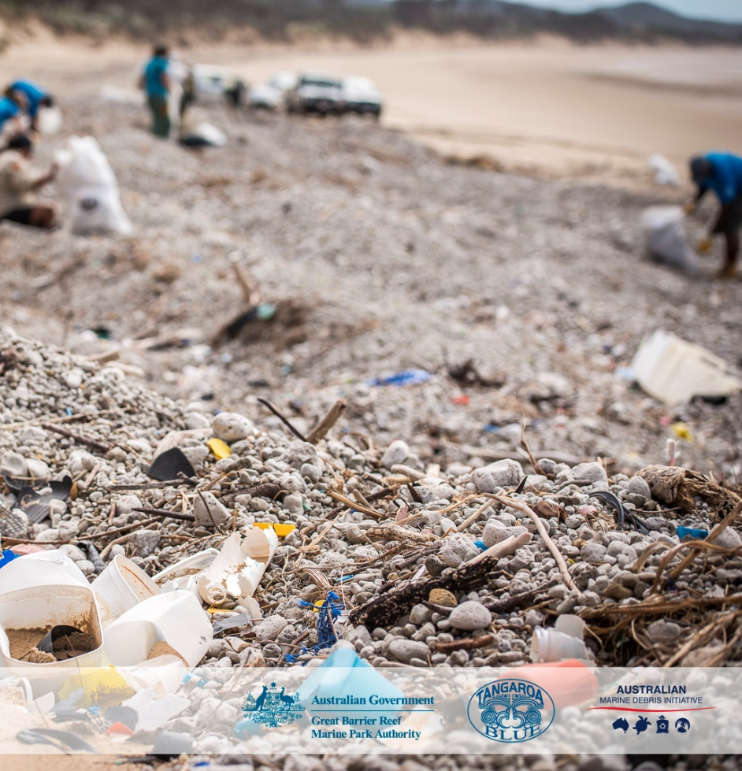
6kg
Notes:
Image: C. Miller, Copyright Commonwealth of Australia (GBRMPA)

Slide 61

Sharks
Notes:
Image: J. Sumerling, Copyright Commonwealth of Australia (GBRMPA)

Slide 62
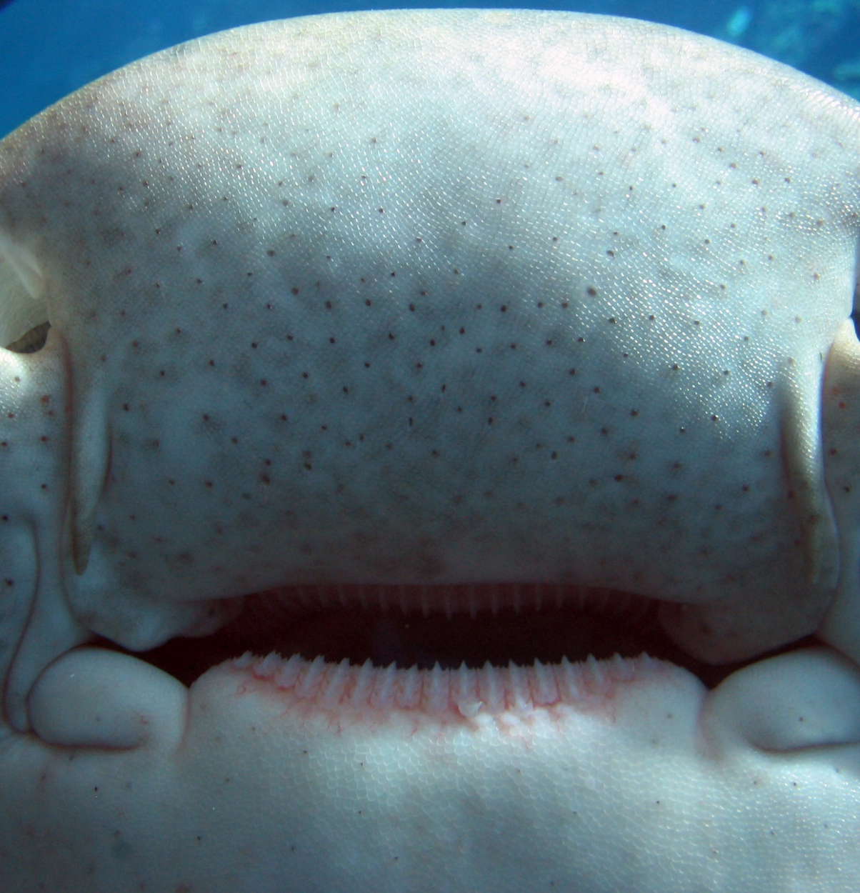
What are the tiny black dots around the nose and mouth of a shark?
Leopard shark
Notes:
Image: C. McGrogan, Copyright Commonwealth of Australia (GBRMPA)

Slide 63
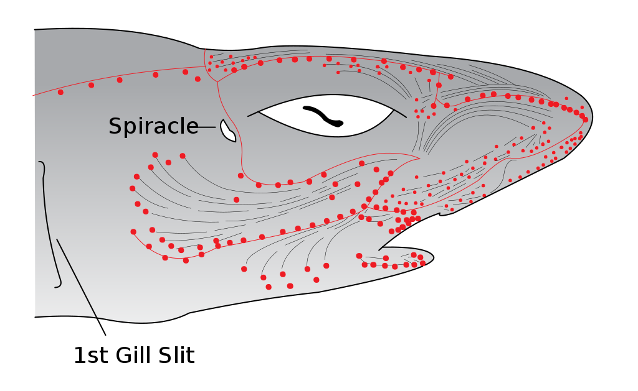
Electroreceptors that sense electricity and vibrations in the water, also called Ampullae of Lorenzini.
Image: Wikipedia by Chris Huh.
Notes:
Image: https://en.wikipedia.org/wiki/Ampullae_of_Lorenzini#/media/File:Electroreceptors_in_a_sharks_head.svg
By Chris_huh - Own work, Public Domain, https://commons.wikimedia.org/w/index.php?curid=1749294

Slide 64
Quiz time!
30 questions. Answers are
provided at the end.
Notes:
The following questions are straight from the Rapid Monitoring Survey course exam questions.

Slide 65
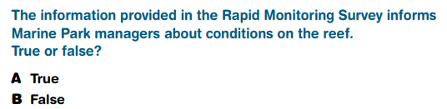
Question 1.

Slide 66
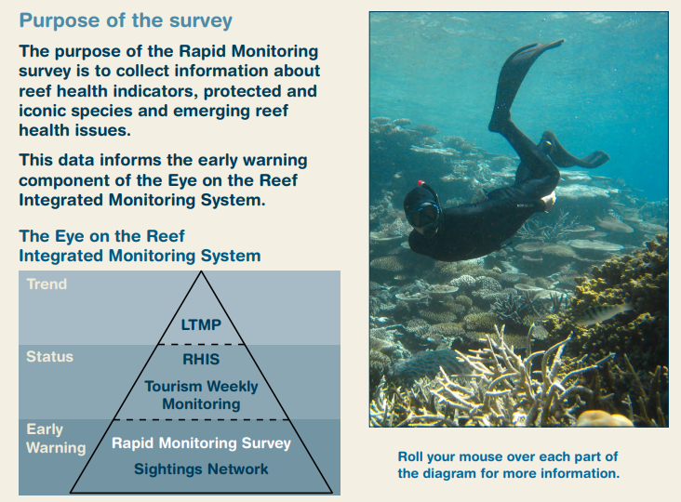
Read to answer the next question.

Slide 67
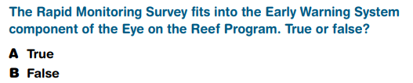
Question 2.

Slide 68
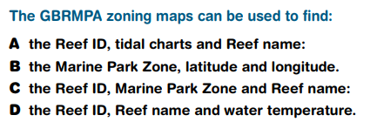
Question 3.

Slide 69
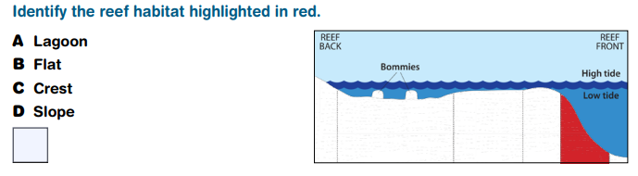
Question 4.

Slide 70
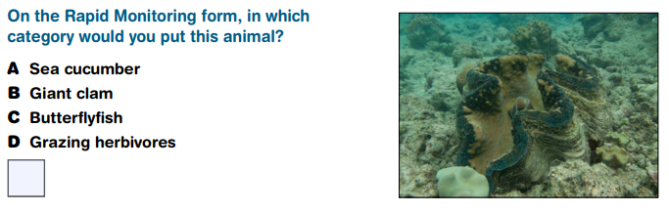
Question 5.

Slide 71
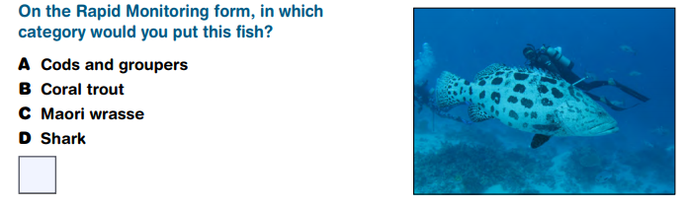
Question 6.

Slide 72
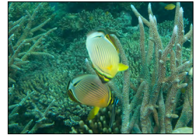
Question 7.

Slide 73
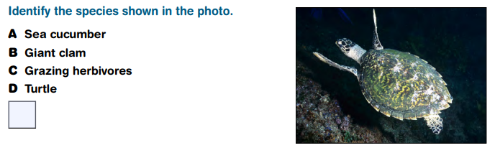
Question 8.
Hawksbill turtle

Slide 74
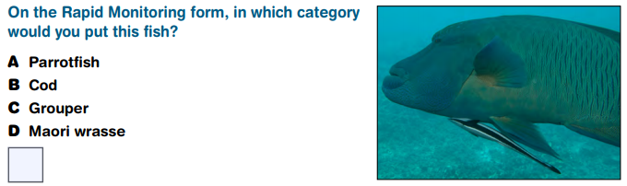
Question 9.

Slide 75
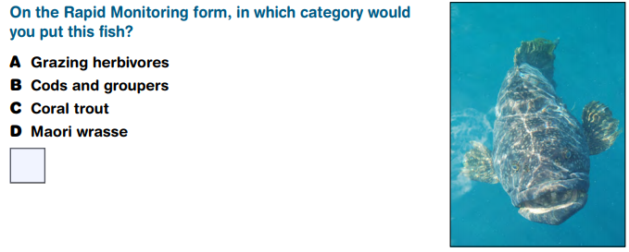
Question 10.

Slide 76
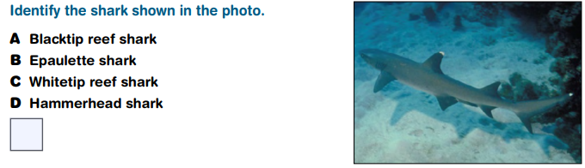
Question 11.

Slide 77
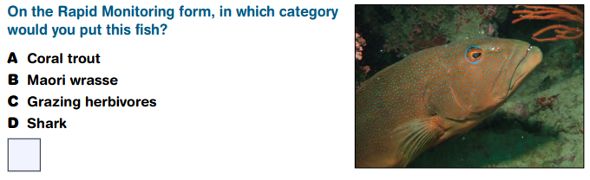
Question 12.

Slide 78
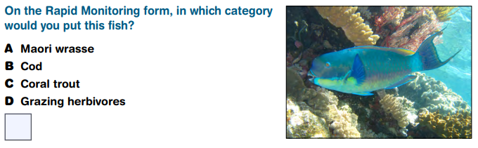
Question 13.

Slide 79
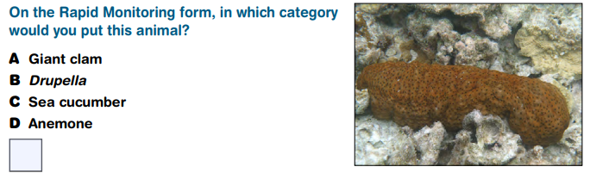
Question 14.

Slide 80
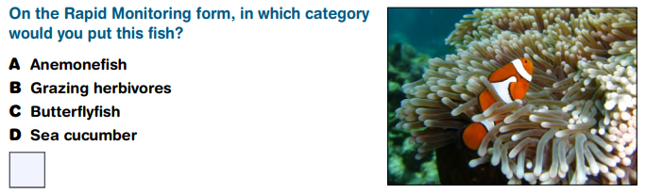
Question 15.

Slide 81

Question 16.

Slide 82
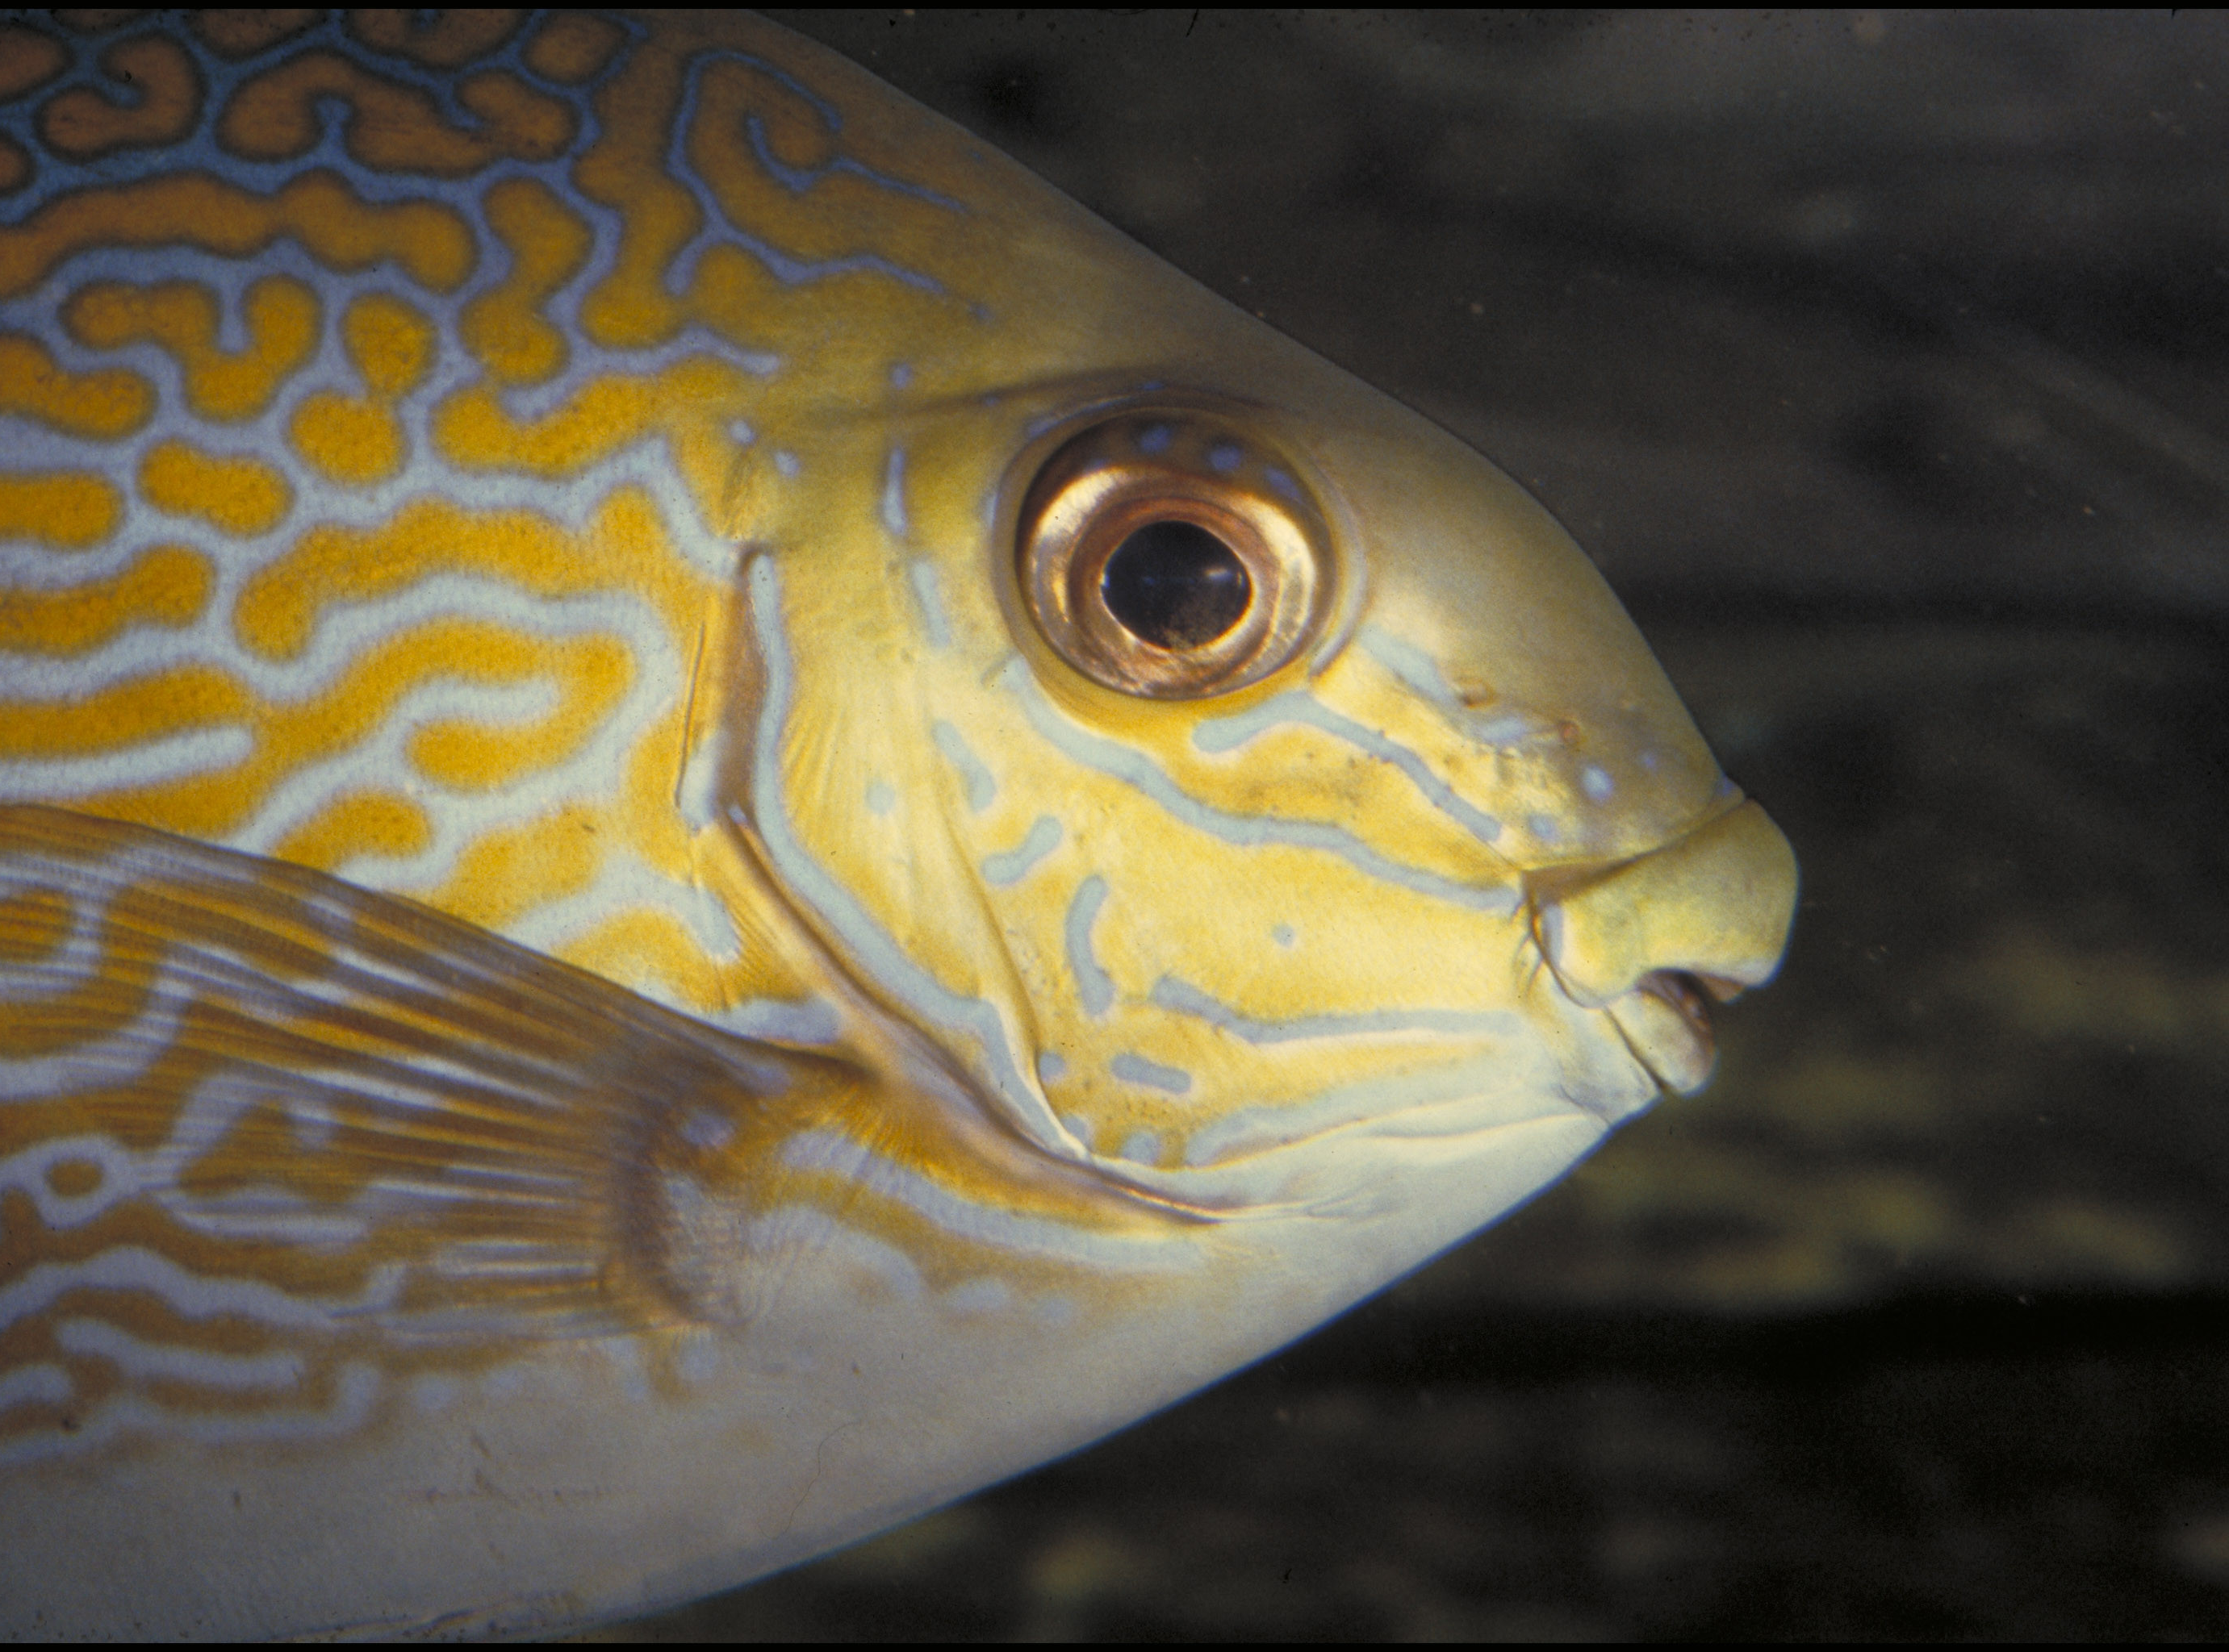
Question 17.

Slide 83
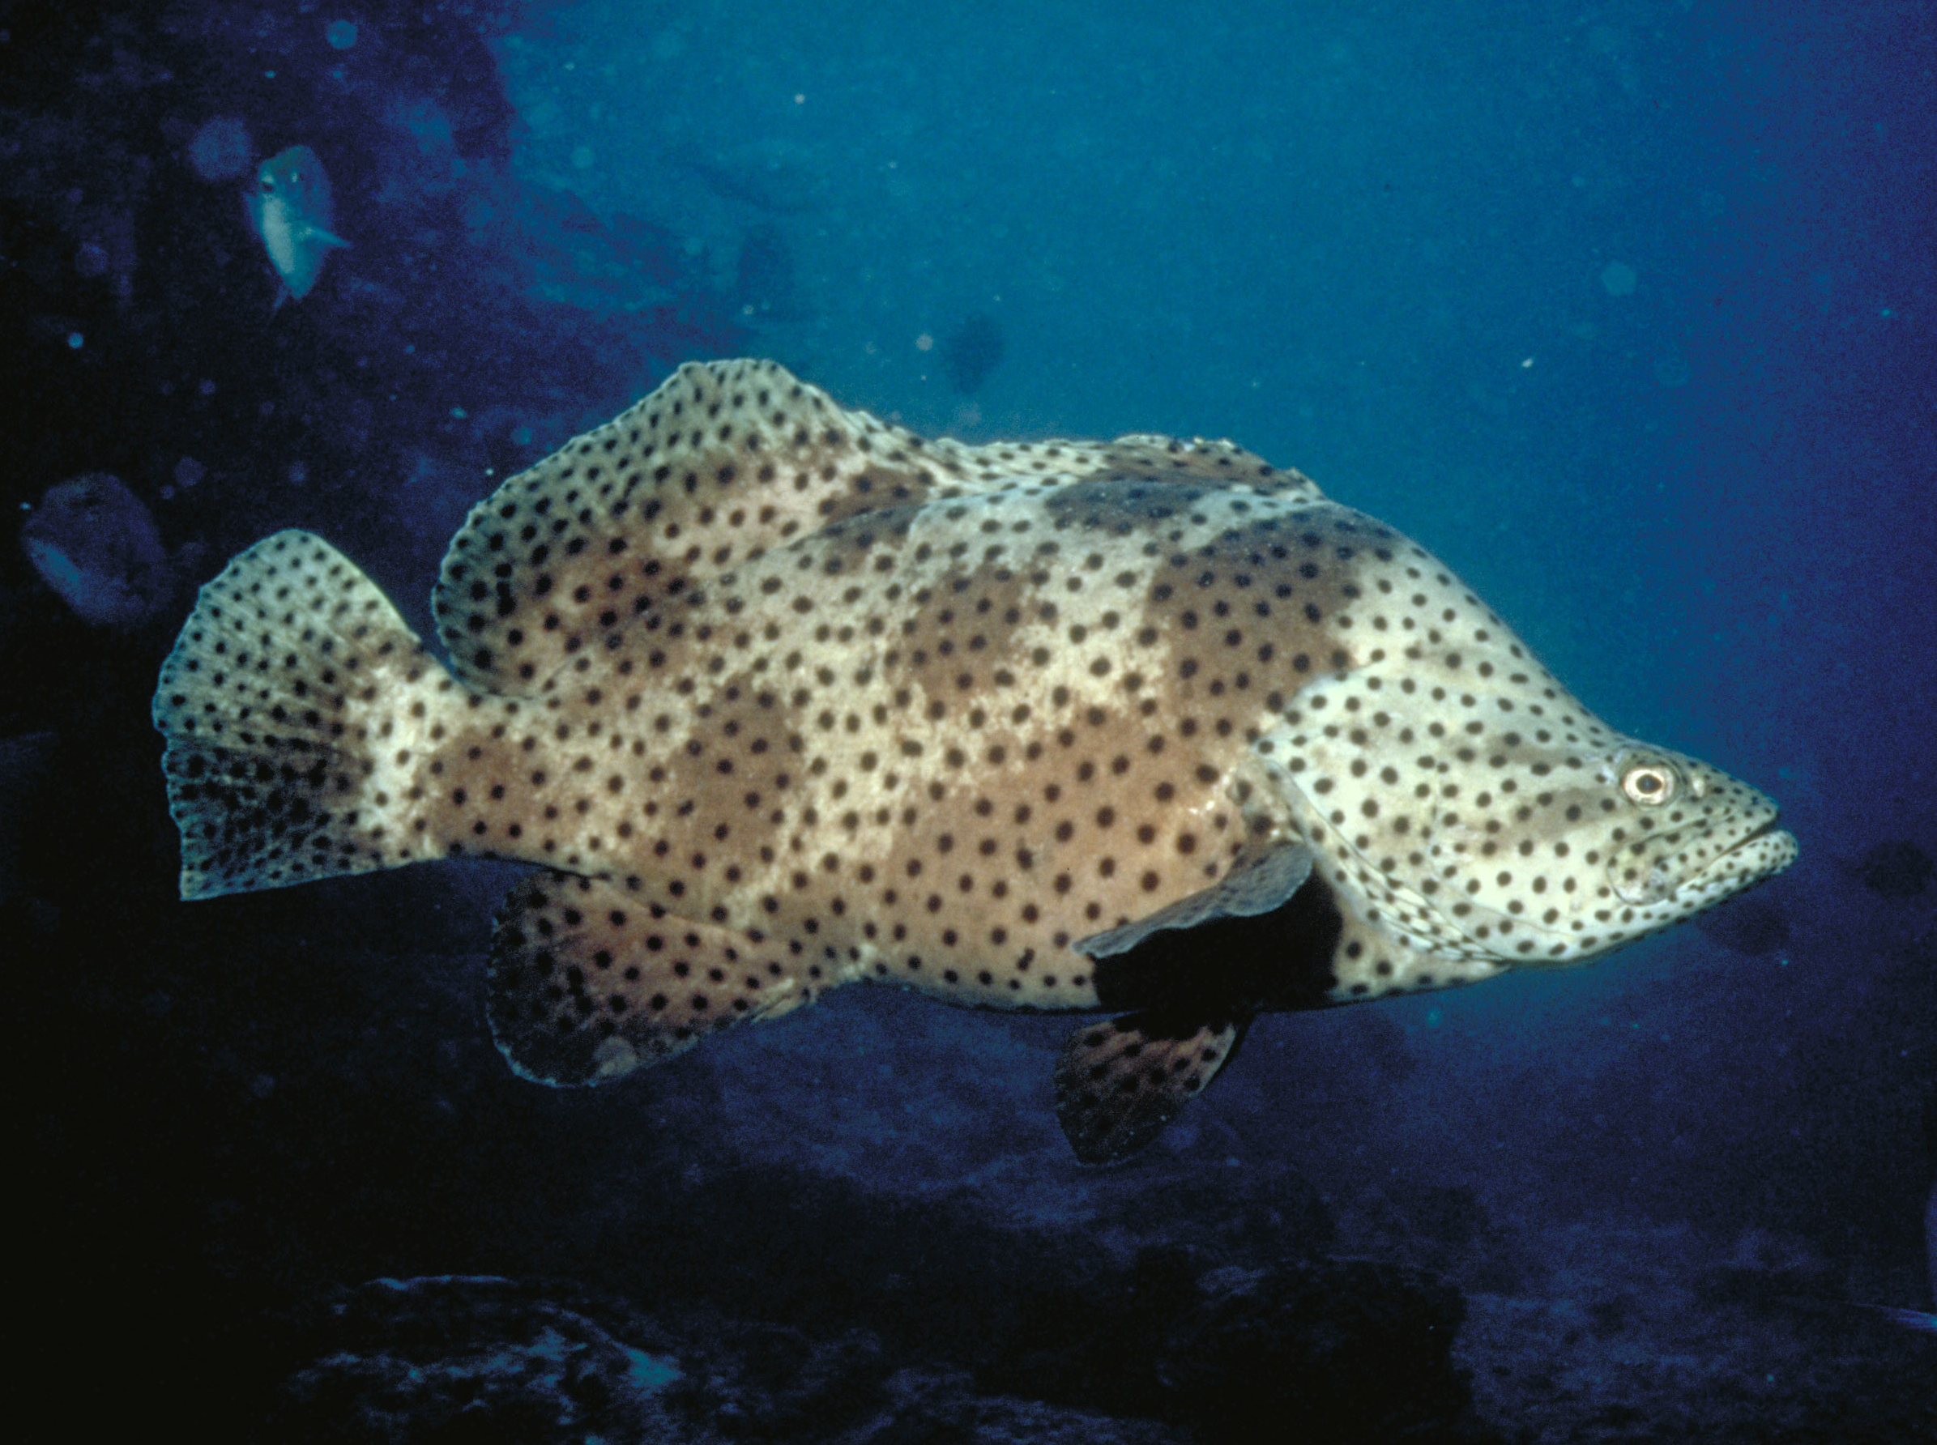
Question 18.

Slide 84
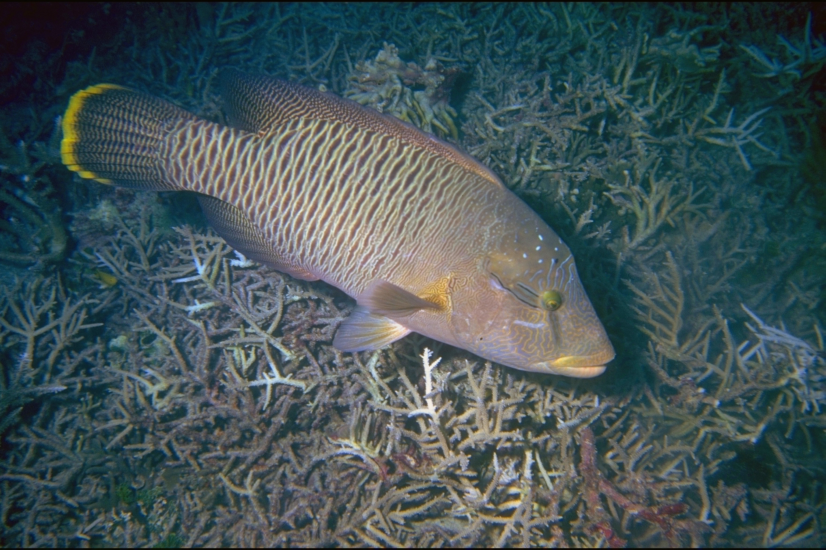
Question 19.
FEMALE

Slide 85
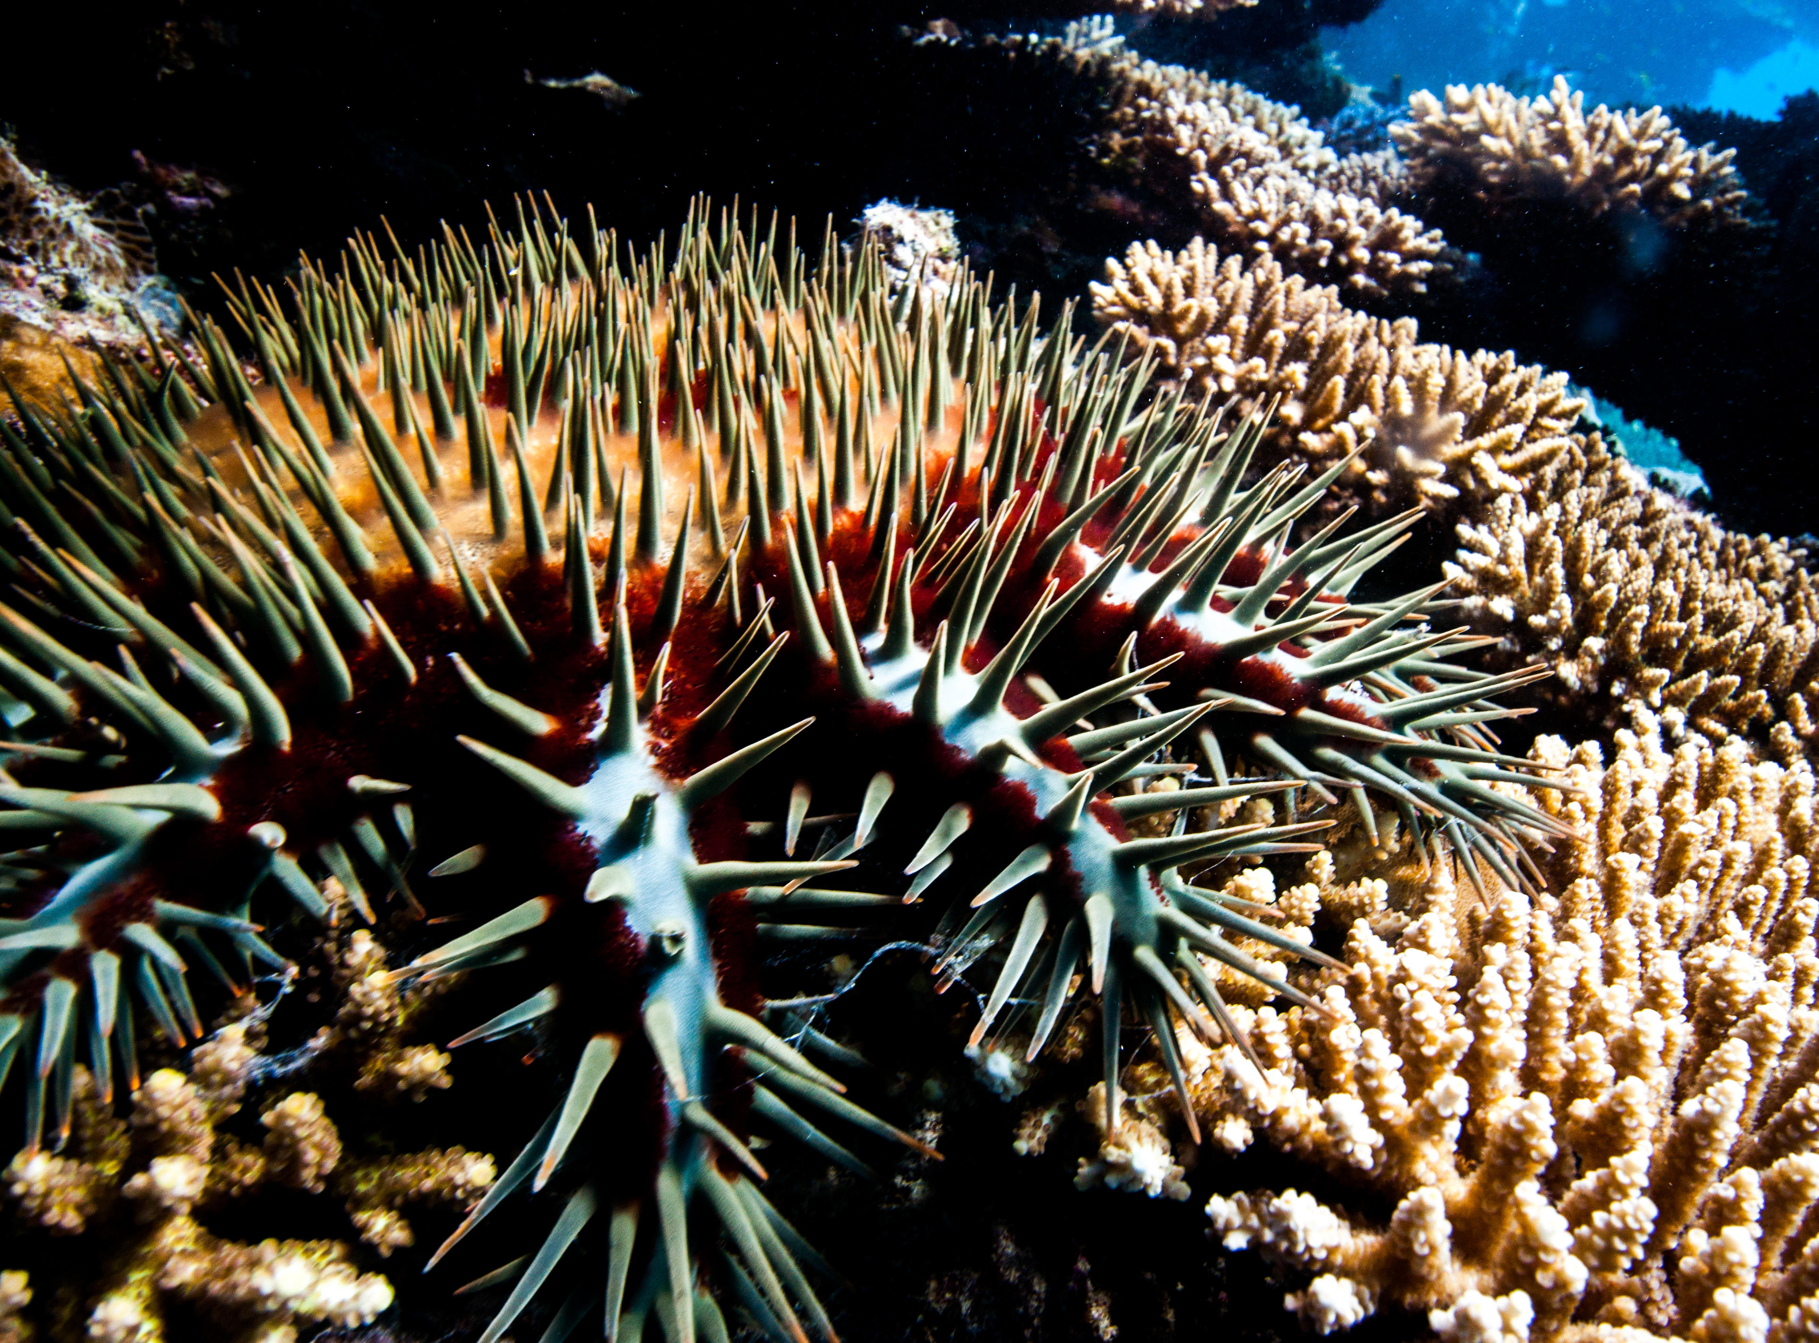
Question 20.
On the Rapid Monitoring form, in which category would you put this animal?
Crown-of-thorns starfish

Slide 86

Question 21.
Some sea cucumbers respond to threats by ejecting their internal organs. Why?
A Some internal organs are very sticky
B To entangle predators
C As a sacrifice, they grow back in 2-3 weeks
D All the above
Notes:
These are questions from the pre-snorkel brief on the excursion. Repeating information helps with long term memory retention and builds confidence.

Slide 87
Question 22.
What does a giant clam
do when threatened?
A Nothing
B Tries to close its shell
C Releases toxic chemicals
D Changes colour
Notes:
These are questions from the pre-snorkel brief on the excursion. Repeating information helps with long term memory retention and builds confidence.

Slide 88
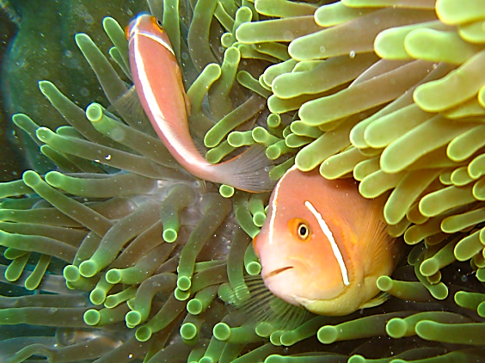
Question 23.
What is the cue for the dominant male anemonefish to change sex to a female?
A When his female partner dies
B When he is 9 years old
C An environmental cue
D When he is approximately 15cm
Notes:
These are questions from the pre-snorkel brief on the excursion. Repeating information helps with long term memory retention and builds confidence.

Slide 89
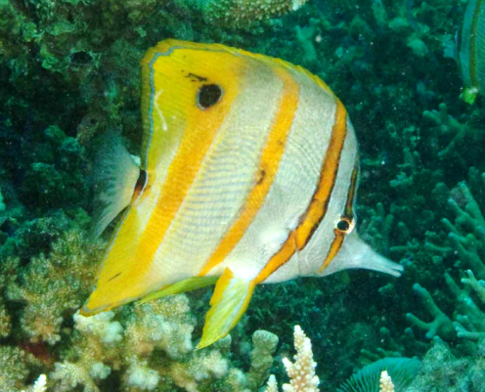
Question 24.
Butterflyfish linked their lateral line to their swim bladder. Why?
A For advanced buoyancy control
B To see better
C To detect and amplify sounds
D To swim better
Notes:
These are questions from the pre-snorkel brief on the excursion. Repeating information helps with long term memory retention and builds confidence.

Slide 90

Question 25.
Surgeonfish have a scalpel-like blade between their body and tail. Why?
A It looks attractive
B For fighting and self defence
C For cutting up algae
D To warn predators
Notes:
These are questions from the pre-snorkel brief on the excursion. Repeating information helps with long term memory retention and builds confidence.

Slide 91

Question 26.
What territorial behaviour does a Queensland grouper exhibit to threaten intruders?
A Shakes the body
B Opens the mouth
C Uses the swim bladder to make a loud booming
noise
D All of the above
Notes:
These are questions from the pre-snorkel brief on the excursion. Repeating information helps with long term memory retention and builds confidence.

Slide 92

Question 27.
What is ciguatera poisoning?
A When you get stung by jellyfish
B When you get sick from swimming in
poor water quality
C When you get sick from eating very
small reef fish
D When you get sick from eating very big
reef fish
Notes:
These are questions from the pre-snorkel brief on the excursion. Repeating information helps with long term memory retention and builds confidence.

Slide 93
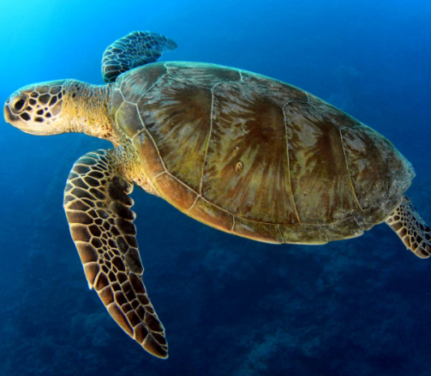
Question 28.
Is it possible that a large turtle on the Great Barrier Reef has travelled to South America and back?
Yes
No
Notes:
These are questions from the pre-snorkel brief on the excursion. Repeating information helps with long term memory retention and builds confidence.

Slide 94
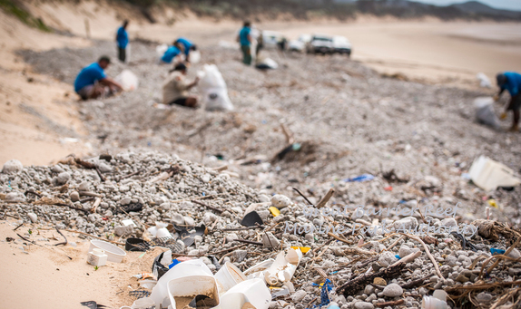
Question 29.
Researchers have estimated that for every 1 kilogram of plankton in the Great Pacific Garbage Patch, there are how many kilograms of plastic?
A 1
B 2
C 3
D 6
Notes:
These are questions from the pre-snorkel brief on the excursion. Repeating information helps with long term memory retention and builds confidence.

Slide 95

Question 30.
What do sharks use to sense electricity and vibrations in the water?
A Ampullae of Lorenzini
B Electroreceptors
C Tiny black dots around their mouth
and nose
D All the above
Notes:
These are questions from the pre-snorkel brief on the excursion. Repeating information helps with long term memory retention and builds confidence.

Slide 96
Answers
Notes:
The following questions are straight from the Rapid Monitoring Survey course exam questions.

Slide 97
Question 1.

Slide 98
Read to answer the next question.

Slide 99
Question 2.

Slide 100
Question 3.

Slide 101
Question 4.
D

Slide 102
Question 5.
B

Slide 103
Question 6.
A

Slide 104
Question 7.
C

Slide 105
Question 8.
Hawksbill turtle
D

Slide 106
Question 9.
D

Slide 107
Question 10.
B

Slide 108
Question 11.
C

Slide 109
Question 12.
A

Slide 110
Question 13.
D

Slide 111
Question 14.
C

Slide 112
Question 15.
A

Slide 113
Question 16.
B

Slide 114
Question 17.
B

Slide 115
Question 18.
B

Slide 116
Question 19.
B
FEMALE

Slide 117
Question 20.
On the Rapid Monitoring form, in which category would you put this animal?
Crown-of-thorns starfish
B

Slide 118
Question 21.
Some sea cucumbers respond to threats by ejecting their internal organs. Why?
A Some internal organs are very sticky
B To entangle predators
C As a sacrifice, they grow back in 2-3 weeks
D All the above
D
Notes:
These are questions from the pre-snorkel brief on the excursion. Repeating information helps with long term memory retention and builds confidence.

Slide 119
Question 22.
What does a giant clam
do when threatened?
A Nothing
B Tries to close its shell
C Releases toxic chemicals
D Changes colour
B
Notes:
These are questions from the pre-snorkel brief on the excursion. Repeating information helps with long term memory retention and builds confidence.

Slide 120
Question 23.
What is the cue for the dominant male anemonefish to change sex to a female?
A When his female partner dies
B When he is 9 years old
C An environmental cue
D When he is approximately 15cm
A
Notes:
These are questions from the pre-snorkel brief on the excursion. Repeating information helps with long term memory retention and builds confidence.

Slide 121
Question 24.
Butterflyfish linked their lateral line to their swim bladder. Why?
A For advanced buoyancy control
B To see better
C To detect and amplify sounds
D To swim better
C
Notes:
These are questions from the pre-snorkel brief on the excursion. Repeating information helps with long term memory retention and builds confidence.

Slide 122
Question 25.
Surgeonfish have a scalpel-like blade between their body and tail. Why?
A It looks attractive
B For fighting and self defence
C For cutting up algae
D To warn predators
B
Notes:
These are questions from the pre-snorkel brief on the excursion. Repeating information helps with long term memory retention and builds confidence.

Slide 123
Question 26.
What territorial behaviour does a Queensland grouper exhibit to threaten intruders?
A Shakes the body
B Opens the mouth
C Uses the swim bladder to make a loud booming
noise
D All of the above
D
Notes:
These are questions from the pre-snorkel brief on the excursion. Repeating information helps with long term memory retention and builds confidence.

Slide 124
Question 27.
What is ciguatera poisoning?
A When you get stung by jellyfish
B When you get sick from swimming in
poor water quality
C When you get sick from eating very
small reef fish
D When you get sick from eating very big
reef fish
D
Notes:
These are questions from the pre-snorkel brief on the excursion. Repeating information helps with long term memory retention and builds confidence.

Slide 125
Question 28.
Is it possible that a large turtle on the Great Barrier Reef has travelled to South America and back?
Yes
No
Yes
Notes:
These are questions from the pre-snorkel brief on the excursion. Repeating information helps with long term memory retention and builds confidence.

Slide 126
Question 29.
Researchers have estimated that for every 1 kilogram of plankton in the Great Pacific Garbage Patch, there are how many kilograms of plastic?
A 1
B 2
C 3
D 6
D
Notes:
These are questions from the pre-snorkel brief on the excursion. Repeating information helps with long term memory retention and builds confidence.

Slide 127
Question 30.
What do sharks use to sense electricity and vibrations in the water?
A Ampullae of Lorenzini
B Electroreceptors
C Tiny black dots around their mouth
and nose
D All the above
D
Notes:
These are questions from the pre-snorkel brief on the excursion. Repeating information helps with long term memory retention and builds confidence.

Slide 128
How did you go?

Slide 129
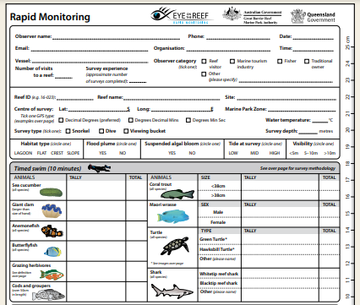
Do you think next time, you could count all the animals yourself?

Slide 130
You’ve now learnt that the Great Barrier Reef is one of the world’s most biodiverse ecosystems.

Slide 131
Coral reefs are dependent on many factors. They are highly interconnected ecosystems.

Slide 132
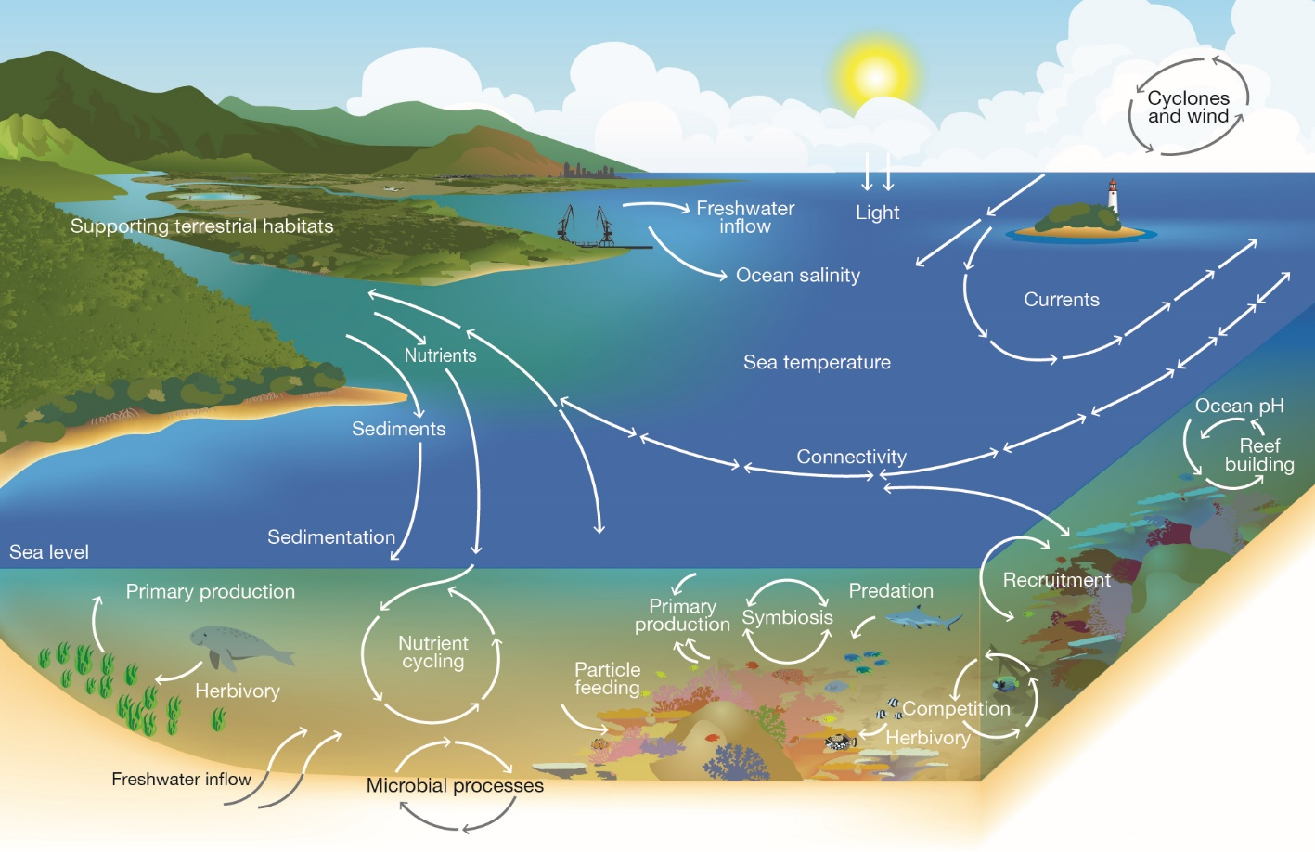
Notes:
Image: Copyright Commonwealth of Australia (GBRMPA)

Slide 133
The Great Barrier Reef faces many threats that impact on its health and resilience.

Slide 134
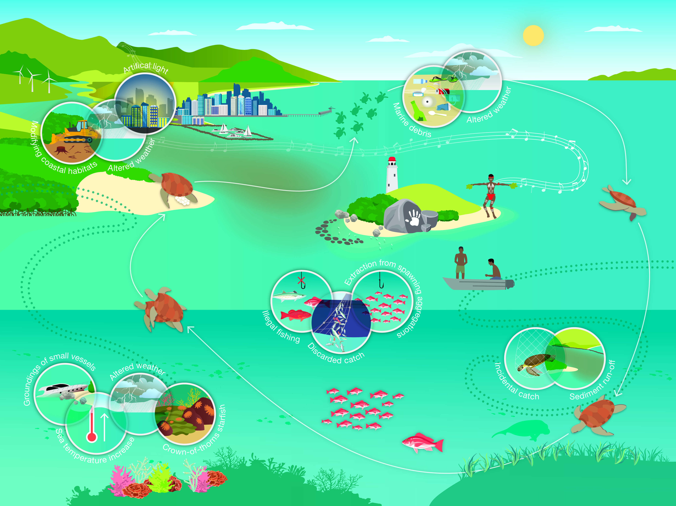
Notes:
Image: Copyright Commonwealth of Australia (GBRMPA)

Slide 135

What actions can you take to protect the Great Barrier Reef?

Slide 136
Remember, the Great Barrier
Reef Marine Park Authority also
has an Eye on the Reef app.
Do you remember this from your excursion?
It’s also a great tool for learning more about the
animals you saw!
Do you recognize any wildlife in the app?

Slide 137

Download
the Eye on the
Reef app.
Notes:
App image: https://www.gbrmpa.gov.au/__data/assets/pdf_file/0020/265430/Eye-on-the-Reef-app-poster.pdf

Slide 138


Press “Sightings” and “Create”.

Slide 139


Press “Wildlife”.

Slide 140


Marine mammals.
Select your animal and press “INFORMATION” to learn more.

Slide 141


Marine reptiles.

Slide 142




Sharks and rays.

Slide 143



Fishes.

Slide 144











Slide 145





Birds.

Slide 146


Invertebrates.

Slide 147










Slide 148
Explore the other tabs too!

Slide 149
Create a poster to answer the question:
How can I help the Great Barrier Reef?
Display it proudly in your classroom.
Notes:
This is the last slide for students to view. The remaining slides are for the teachers.

Slide 150
Thank you for helping the Great Barrier Reef!
See the Reef • Love the Reef • Protect the Reef

