Slide 1
Be a Marine
Biologist for a Day
Part 3: Making connections
Year 5
Notes:
Image: C. Jones, Copyright Commonwealth of Australia (GBRMPA)

Slide 2


Thank you for organising your trip to the reef with us.
We had a great time and hope you did too.
This PowerPoint is Part 3 of the Be a Marine Biologist for a Day program designed for year 5 by the Great Barrier Reef Marine Park Authority (GBRMPA).
View this PowerPoint after your excursion, with the accompanying activity book.
This is Part 3: Making connections. This is the last part of the program. This is when your students make connections with all they’ve learned and experienced so far.
On your excursion, you conducted an Eye on the Reef citizen science activity with your reef guide. Now it’s time to upload your data to the GBRMPA website. It’s also time for students to check understanding by answering any questions in Parts 1 and 2.
The Great Barrier Reef Marine Park Authority would like to thank you for uploading your data to their Rapid Monitoring database. We hope to see you again next year!
Licensed by the Commonwealth of Australia for use under a Creative Commons By Attribution 4.0 International licence with the exception of content supplied by third parties and any photographs. http://creativecommons.org/licences/by/4.0

Slide 3

We would like to acknowledge all of the Aboriginal and Torres Straight Islander peoples who have connection to the Great Barrier Reef.
We recognise their continuing connection to land, water and community, and pay our respects to their Elders past, present and emerging.

Slide 4

We would like to acknowledge the (insert name of local Traditional Owner group) peoples as the Traditional Owners of the Land and Sea Country that we visited as part of your excursion.

Slide 5

How can I help the
Great Barrier Reef?
Notes:
This is the overarching inquiry question that encompasses the entire BAMBFAD Program and is the starting slide to this presentation.

Slide 6

Notes:
Image: J. Johnson, Copyright Copyright Commonwealth of Australia (GBRMPA)

Slide 7
Eye on the Reef
Rapid Monitoring survey
MODIFIED 10 MINUTE TIMED SURVEY

Slide 8

Are you ready to upload your data to GBRMPA?

Slide 9

This is the website for GBRMPA’s Eye on the Reef.
The link to connect is provided at the end of this presentation.

Slide 10

Login.

Slide 11

Select ‘Rapid Monitoring Survey’ tab.

Slide 12


Enter your data.

Slide 13

If you also completed the (more advanced) 360°survey, complete all questions. Otherwise, leave blank.

Slide 14

Save!
Scroll down to the bottom of the page to ‘Save’.

Slide 15
Are you ready?
Click on the image below to connect.
Notes:
www.gbrmpa.gov.au/our-work/eye-on-the-reef

Slide 16

Thank
you
Male Maori wrasse
Notes:
Image: C. Jones, Copyright Copyright Commonwealth of Australia (GBRMPA)

Slide 17
Check understanding.
Next, is what you’ve all been waiting for.
The answers to questions asked in Part 1 (before the excursion) and/or Part 2 (on the excursion).
Let’s check how you went!
Notes:
The following questions are straight from the Rapid Monitoring Survey course exam questions.

Slide 18


Sea cucumber
Notes:
Image: Copyright Commonwealth of Australia (GBRMPA)

Slide 19
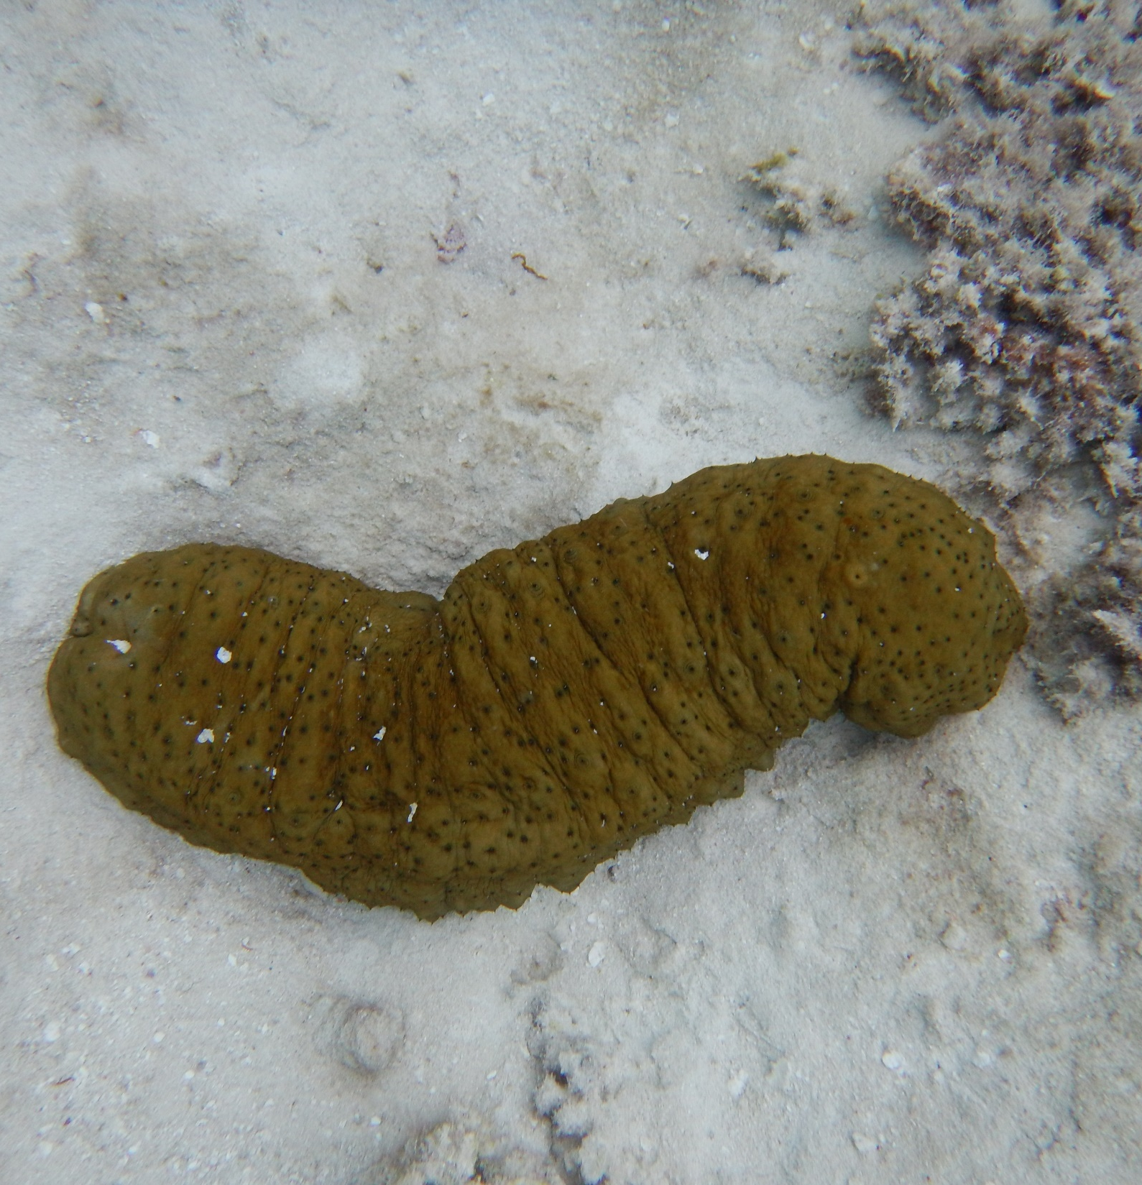
These are sea cucumbers.
How can you tell they’re alive?
Notes:
Image: K. Goudkamp, Copyright Commonwealth of Australia (GBRMPA)

Slide 20
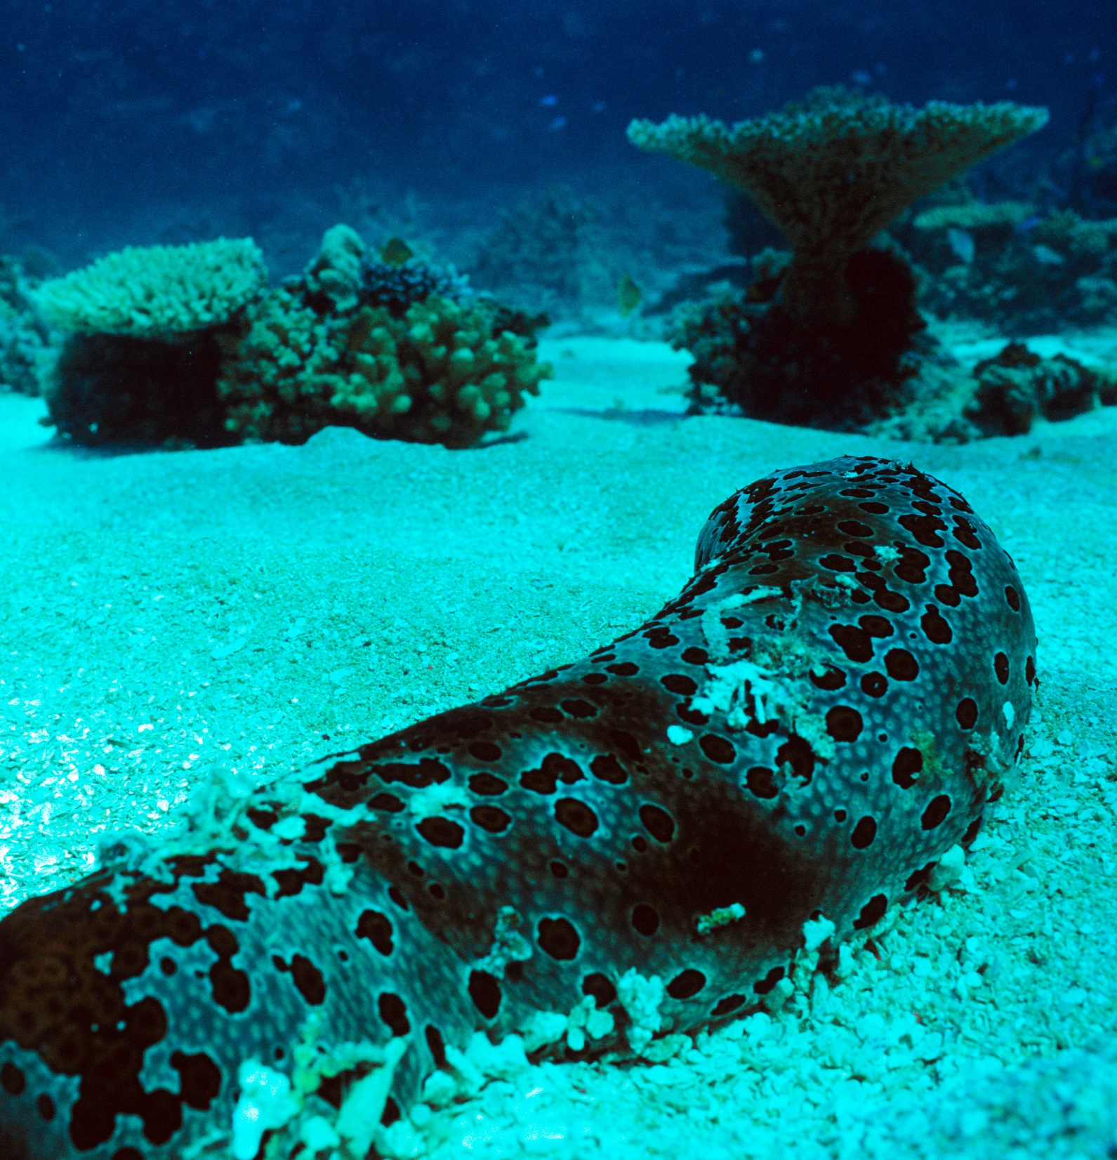
They move slow
and poop lots!
Notes:
Image: J. Oliver, Copyright Commonwealth of Australia (GBRMPA)

Slide 21
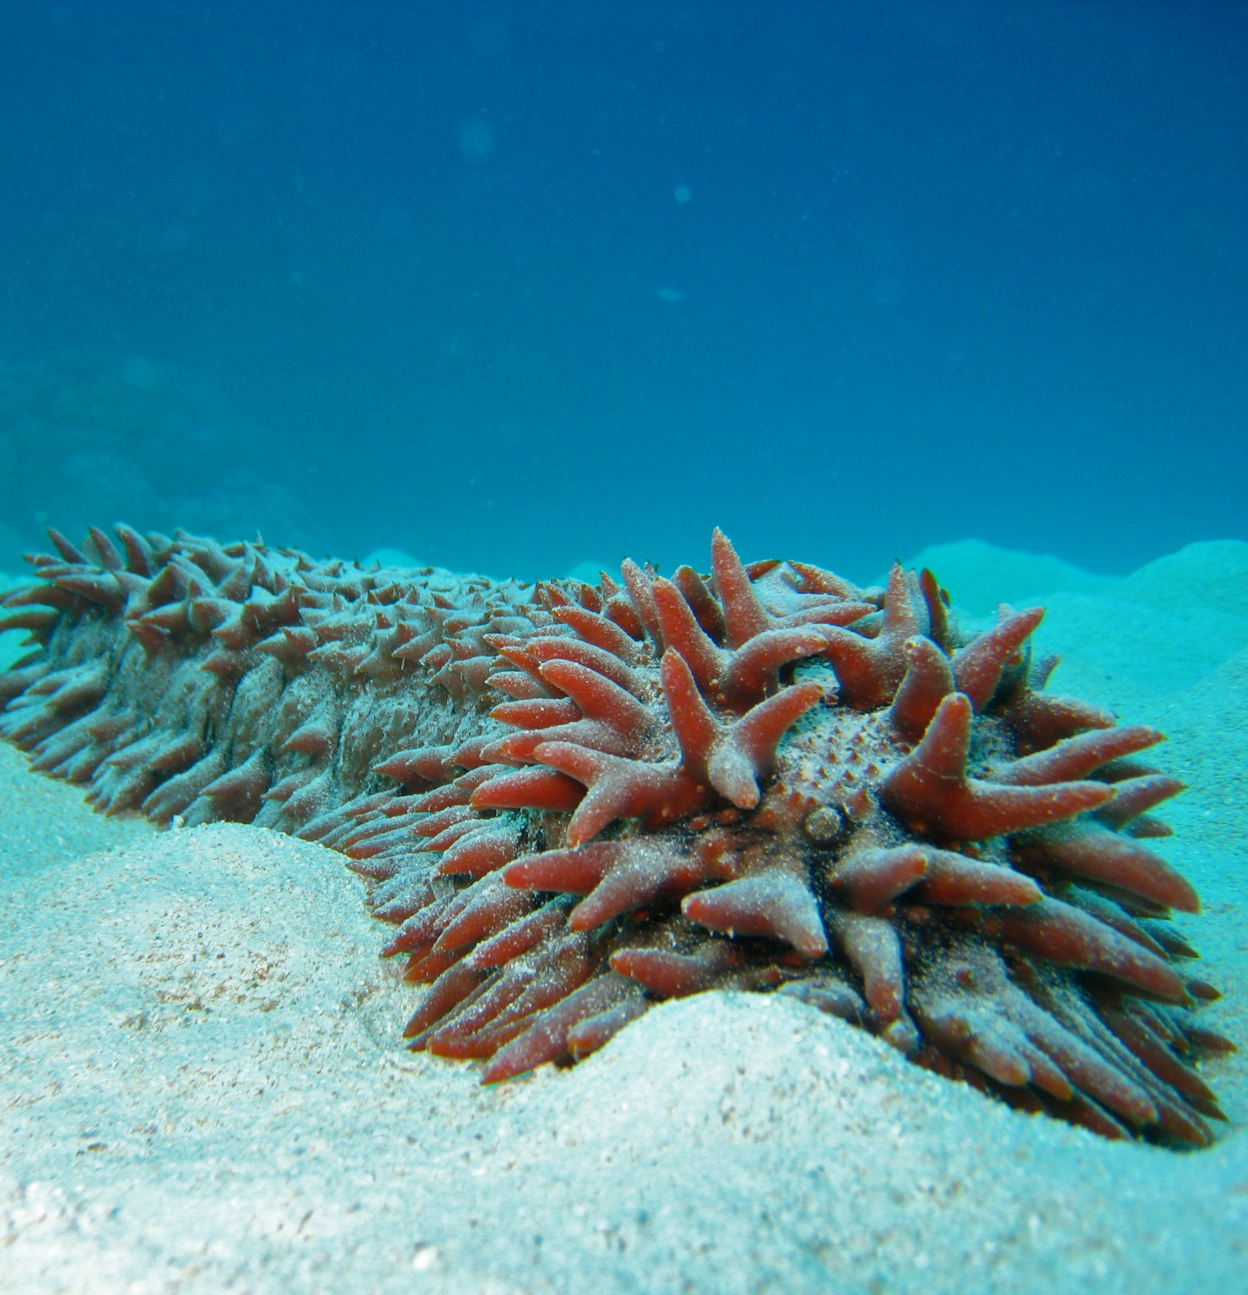
How do
they move?
Notes:
Image: C. Jones, Copyright Commonwealth of Australia (GBRMPA)

Slide 22
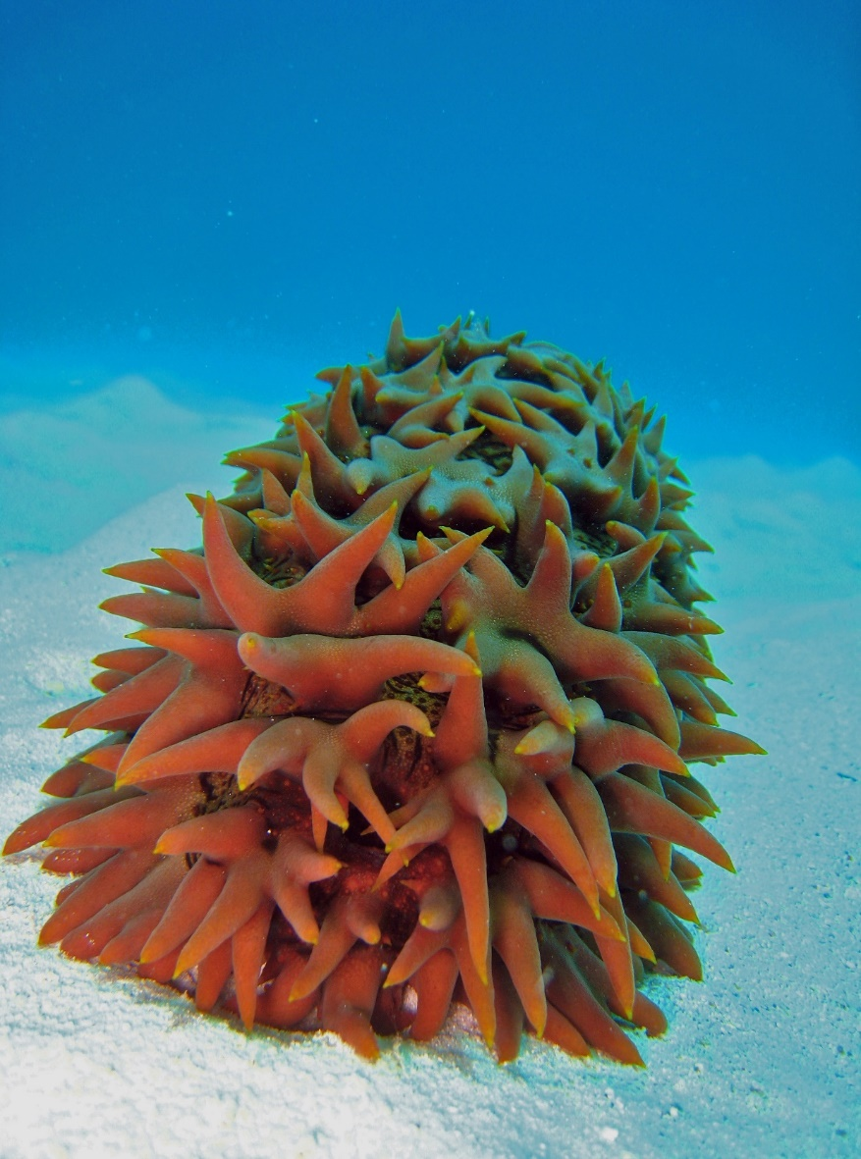
With their tube
feet and rhythmic contractions of
their bodies.
Notes:
Image: C. Jones, Copyright Commonwealth of Australia (GBRMPA)

Slide 23
Why do they have tough skin?
Notes:
Image: C. Jones, Copyright Commonwealth of Australia (GBRMPA)

Slide 24
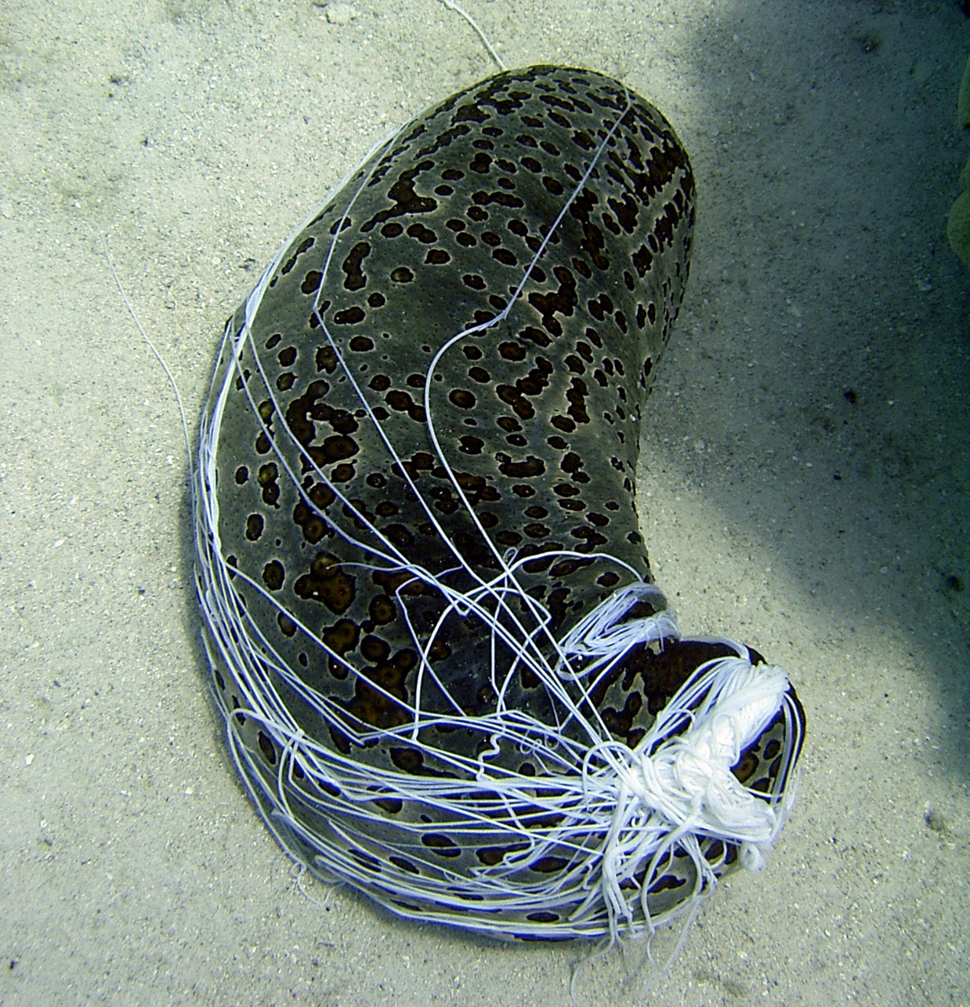
To avoid
being eaten.
Notes:
Image: C. Jones, Copyright Commonwealth of Australia (GBRMPA)

Slide 25
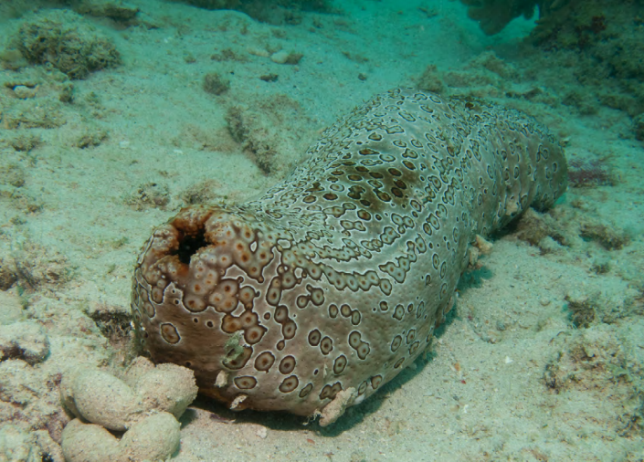
How do they breathe?
Notes:
Image: Copyright Commonwealth of Australia (GBRMPA)

Slide 26
By taking in
water through
their anus!
Mouth
Anus
Notes:
Image: Copyright Commonwealth of Australia (GBRMPA)

Slide 27
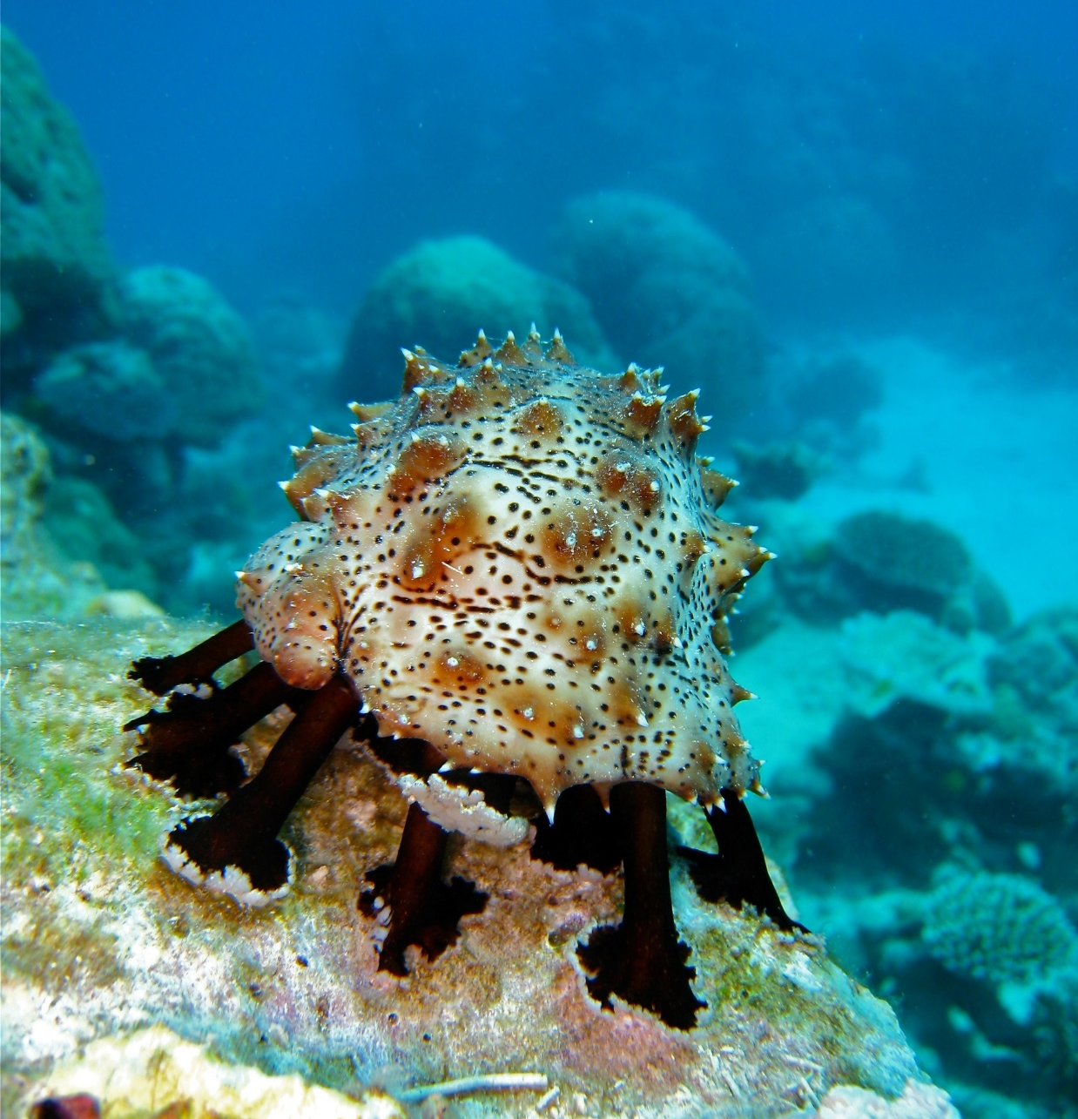
How do they eat?
Do they have teeth?
Notes:
Image: C. Jones, Copyright Commonwealth of Australia (GBRMPA)

Slide 28
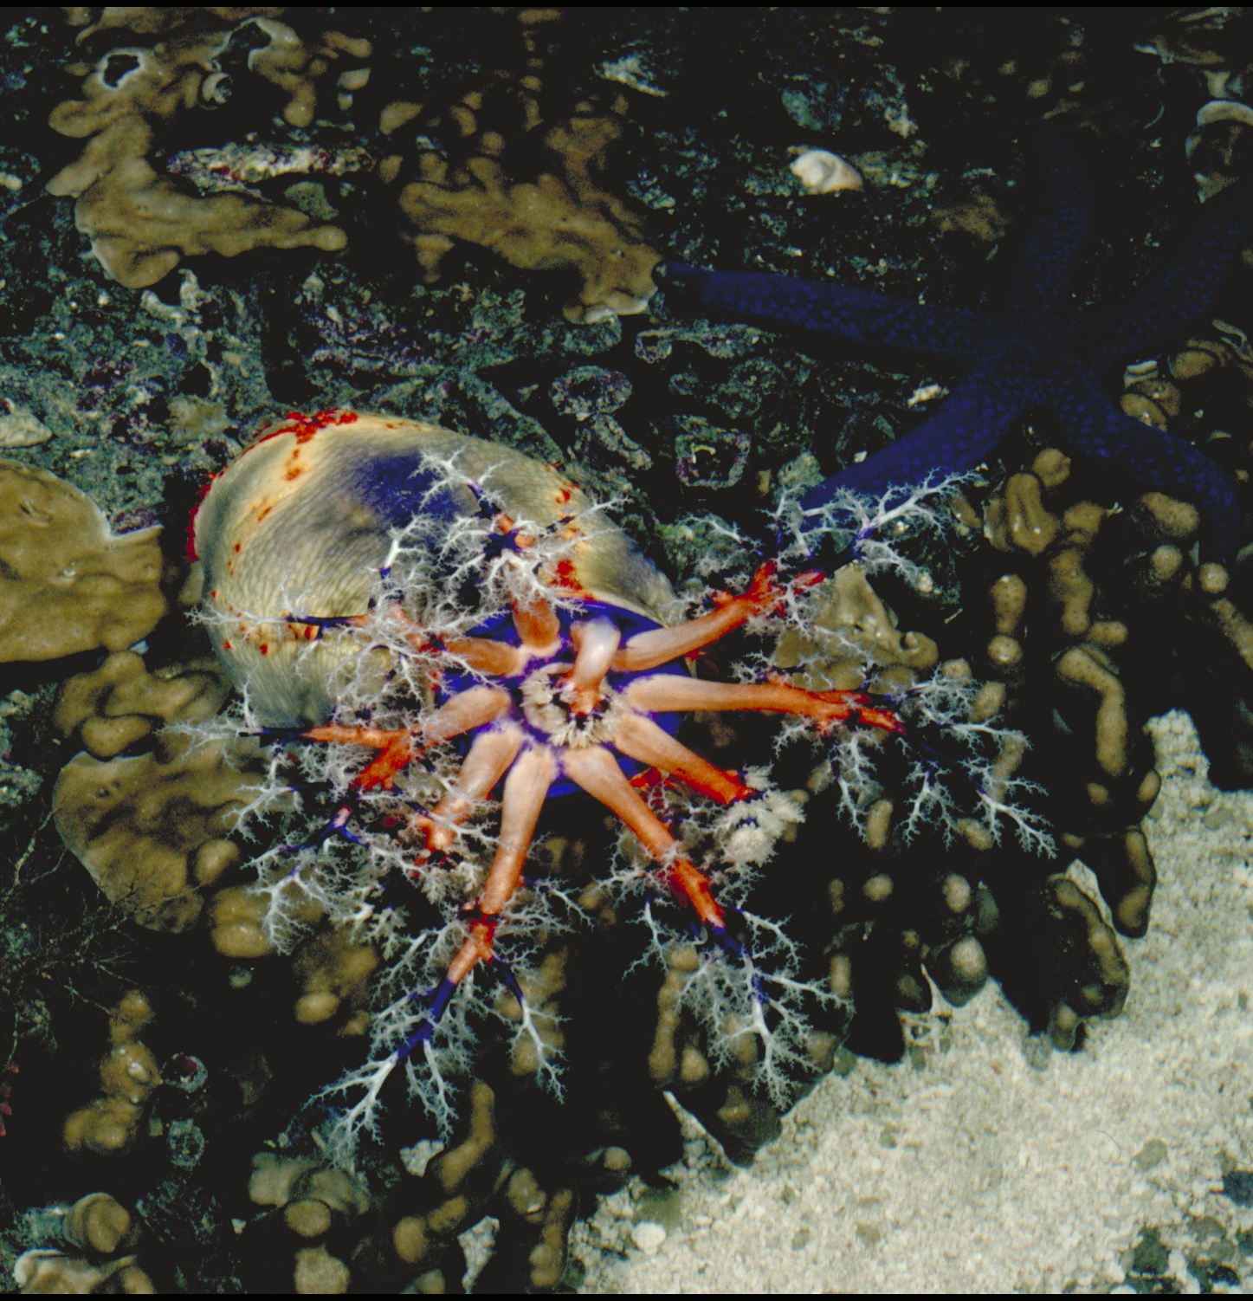
No teeth.
They have
branching tentacles
around the mouth.
Notes:
Image: A. Elliott, Copyright Commonwealth of Australia (GBRMPA)

Slide 29


Why count sea cucumbers?
Notes:
Images: (Left) C. Jones, Copyright Copyright Commonwealth of Australia (GBRMPA); (Middle) C. Jones, Copyright Copyright Commonwealth of Australia (GBRMPA); (Right) J. Jones, Copyright Copyright Commonwealth of Australia (GBRMPA)

Slide 30

Hint: Sea cucumbers are the
vacuum cleaners of the sea.
Notes:
Image: J. Oliver, Copyright Commonwealth of Australia (GBRMPA)

Slide 31
They keep
the sand clean
and filtered.
Notes:
Image: K. Goudkamp, Copyright Commonwealth of Australia (GBRMPA)

Slide 32

Giant clam
VULNERABLE TO EXTINCTION
Notes:
Image: Copyright Commonwealth of Australia (GBRMPA)

Slide 33

How many
holes does the mantle have?
Notes:
Image: C. Jones, Copyright Commonwealth Government of Australia (GBRMPA)

Slide 34
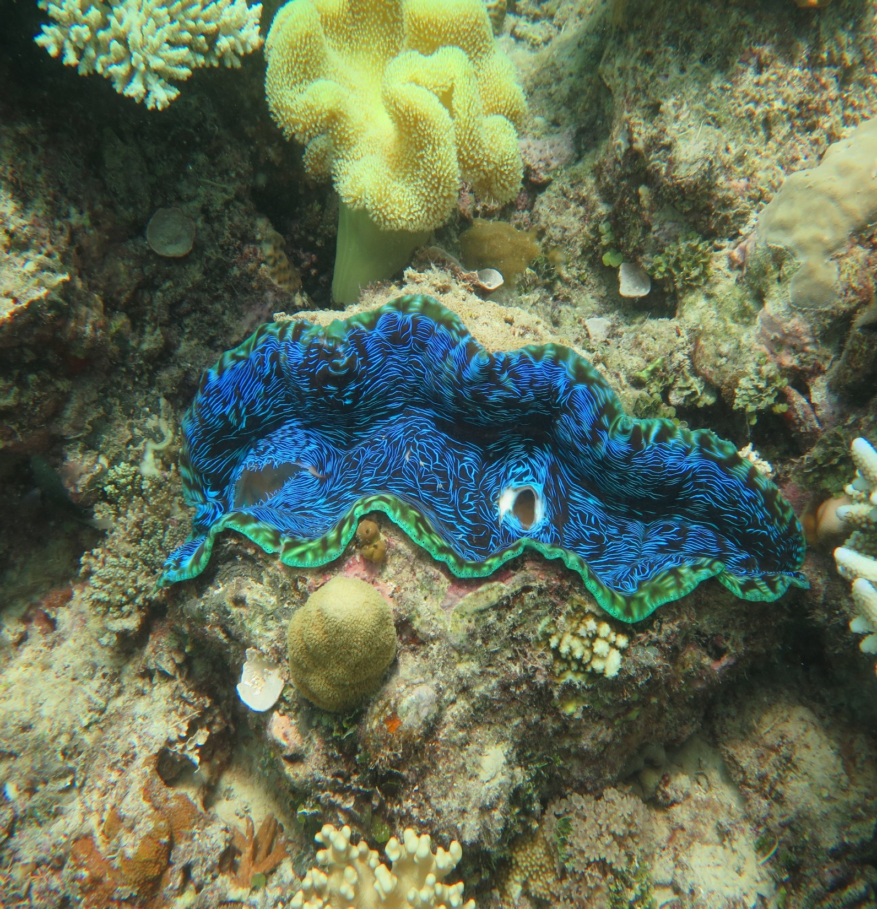
2
Notes:
Image: J. Stella, Copyright Commonwealth of Australia (GBRMPA)

Slide 35
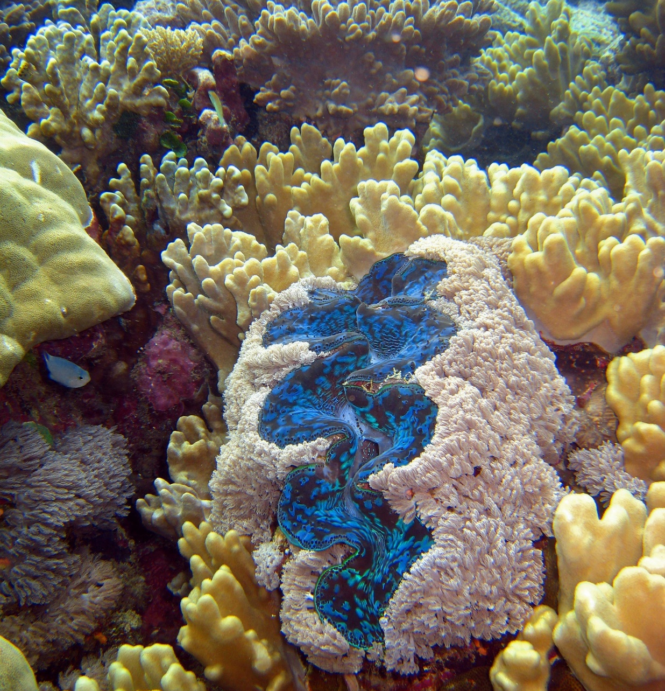
How does the
algae that lives in the mantle help the giant clam?
Notes:
Image: C. Jones, Copyright Commonwealth of Australia (GBRMPA)

Slide 36
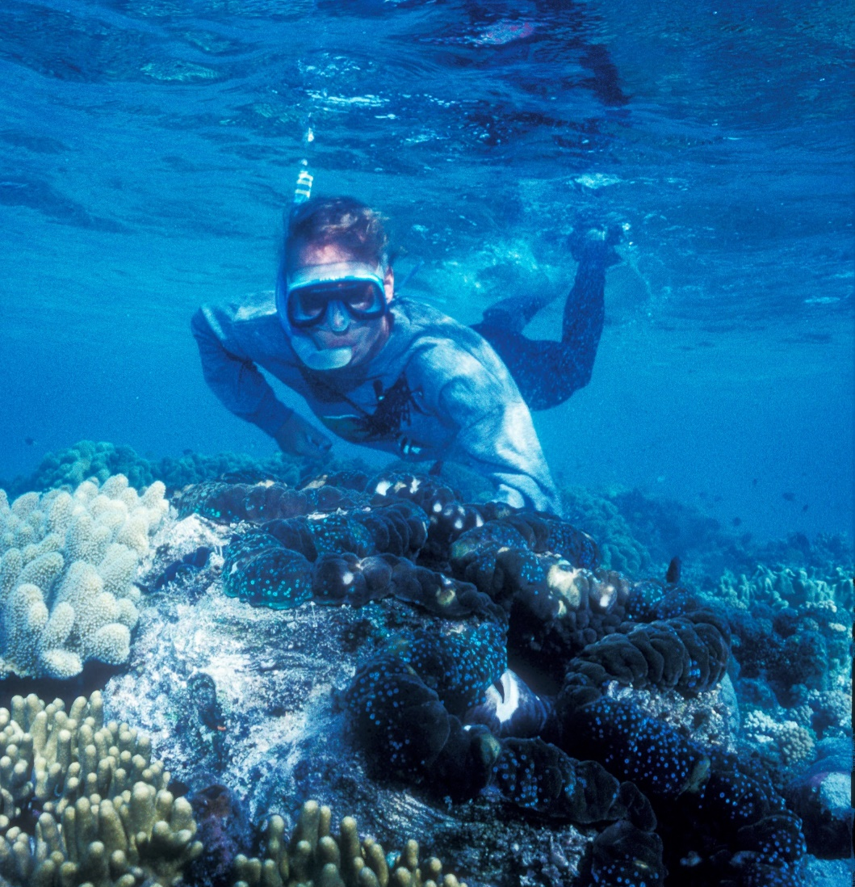
It feeds the clam via photosynthesis, turning sunlight into food and energy.
Notes:
Image: K. Anthony, Copyright Commonwealth of Australia (GBRMPA)

Slide 37
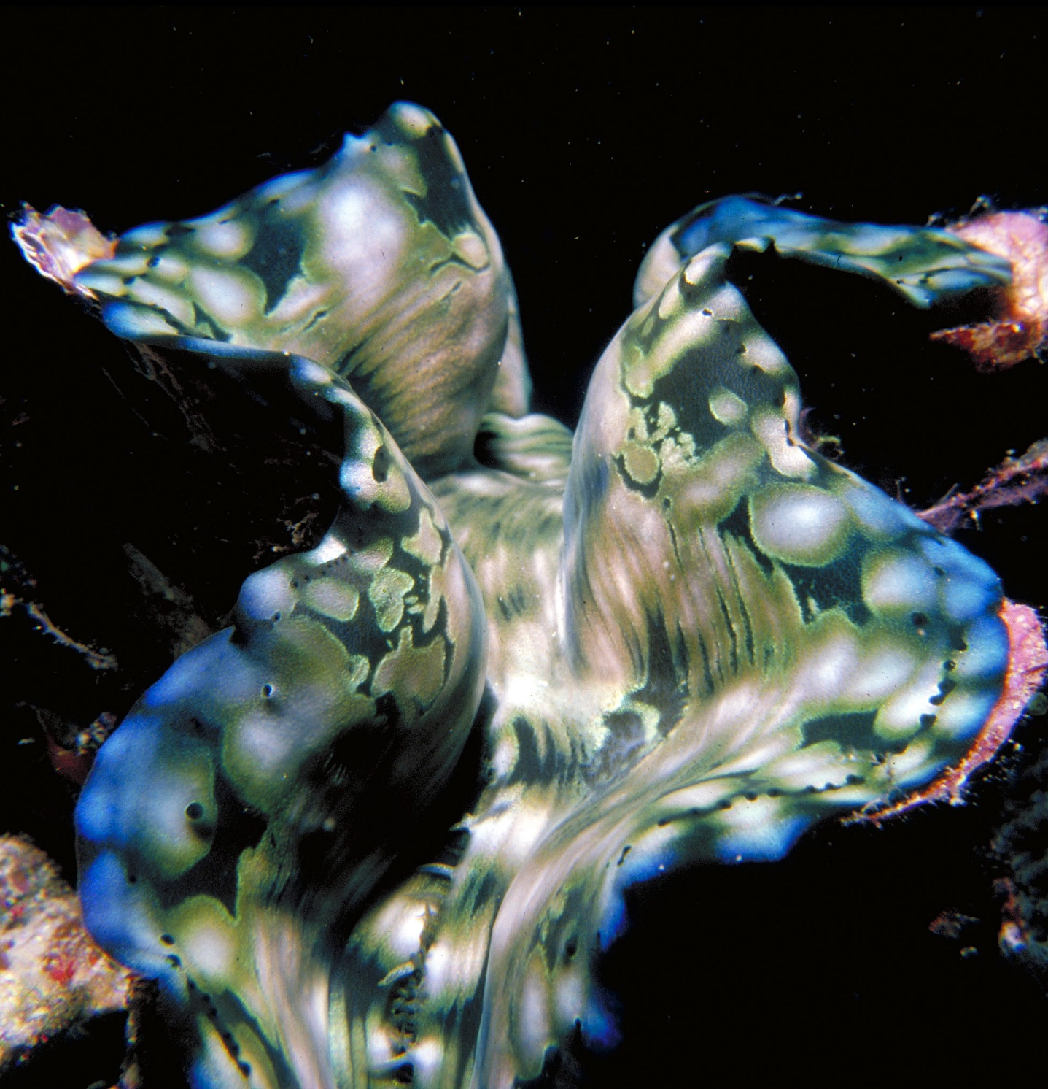
How does the
giant clam help the algae in return?
Notes:
Image: R. Berklemans, Copyright Commonwealth of Australia (GBRMPA)

Slide 38

The algae has a safe place to live.
Notes:
Image: J. Sumerling, Copyright Commonwealth of Australia (GBRMPA)

Slide 39

Anemonefish
Notes:
Image: J. Sumerling, Copyright Commonwealth Government of Australia (GBRMPA)

Slide 40

What is a behavioural adaptation that
stops anemonefish being stung by
their anemone?
Notes:
Image: T. Mayne, Copyright Commonwealth of Australia (GBRMPA)

Slide 41
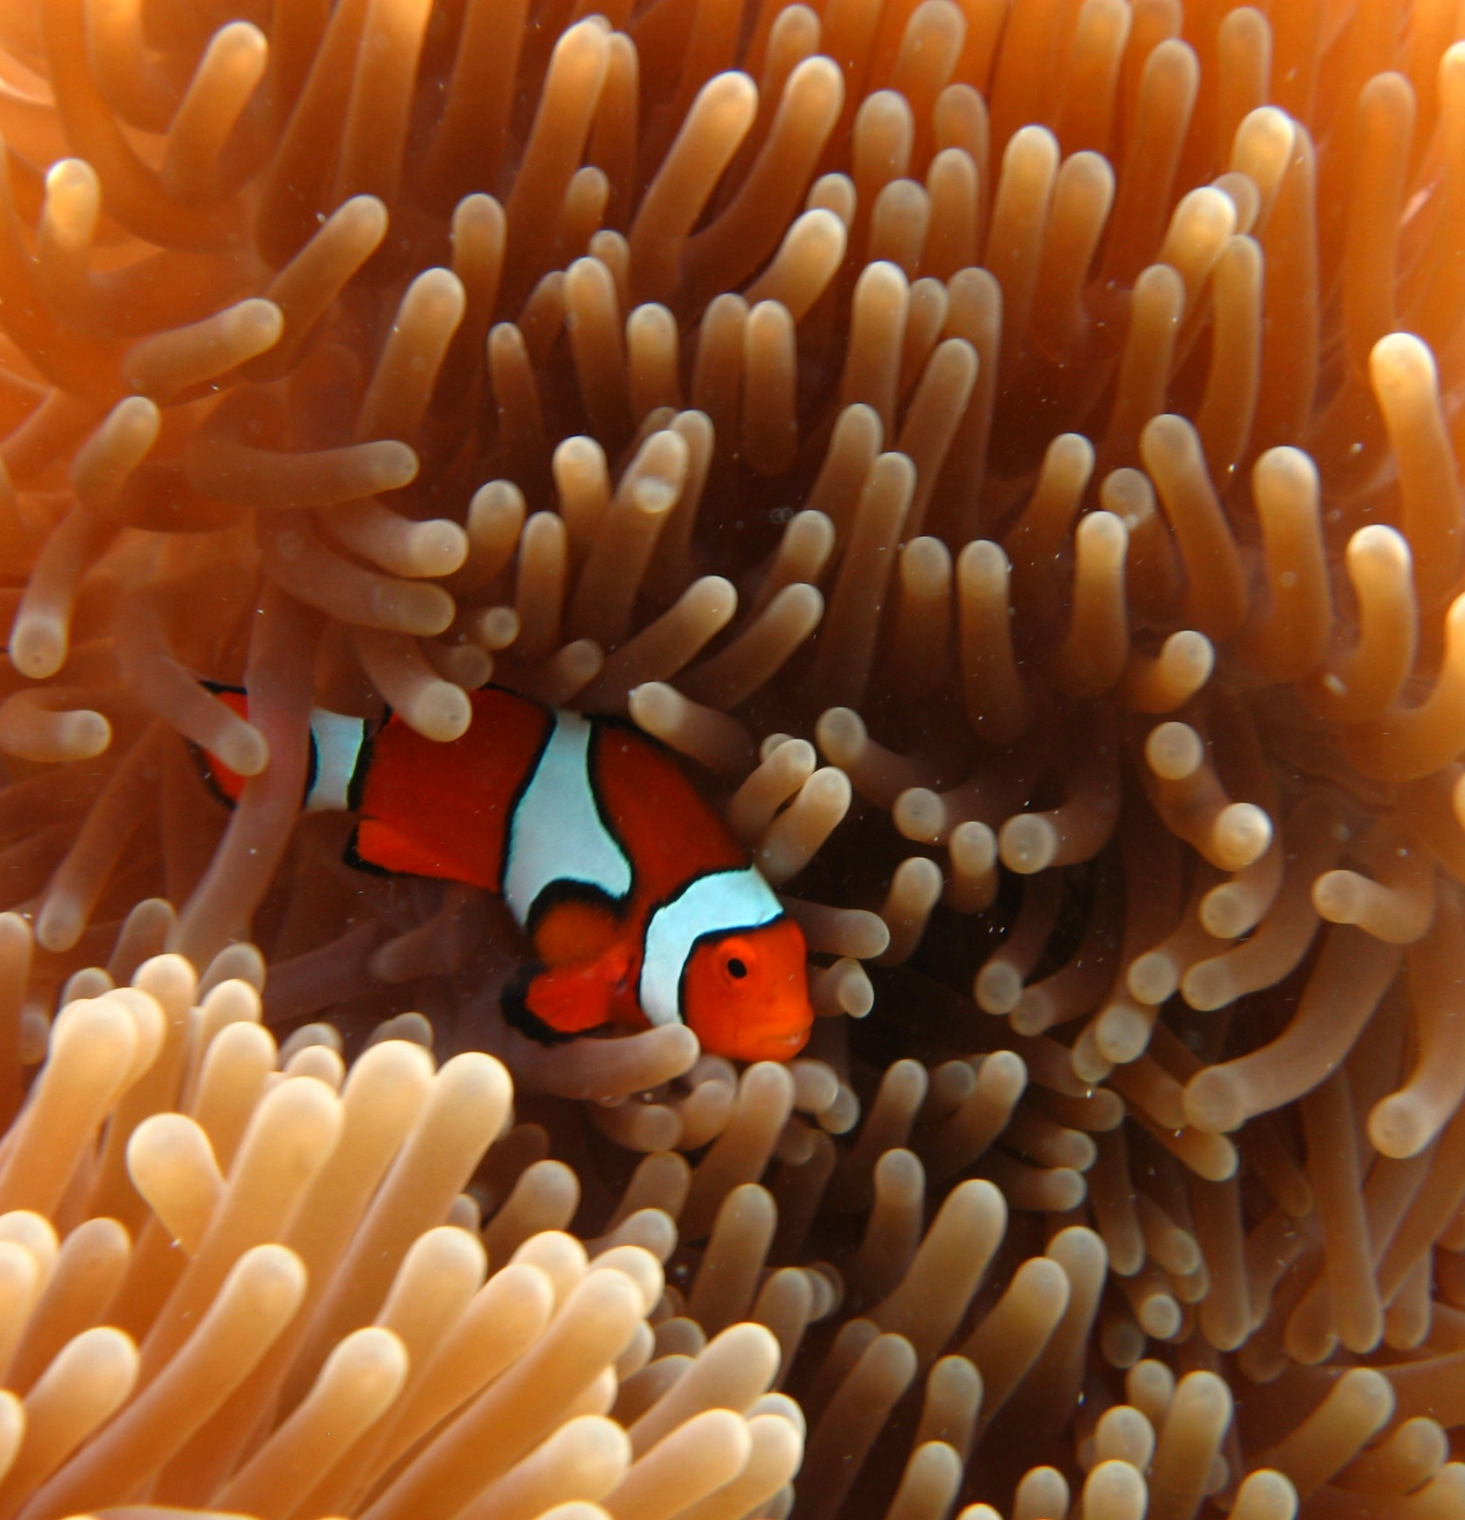
Constantly swimming in the tentacles of their anemone.
Notes:
Image: E. Smart, Copyright Commonwealth Government of Australia (GBRMPA)

Slide 42

Butterflyfish
Bright colours and pretty patterns
Long snout and little mouth for eating coral polyps
Flat body
Notes:
Image: J. Jones, Copyright Commonwealth of Australia (GBRMPA)

Slide 43

Why do butterfly
fish have small compressed bodies?
Notes:
Image: L. Zell, Copyright Commonwealth of Australia (GBRMPA)

Slide 44

To easily maneuver around the corals which they eat.
Notes:
Image: R. Berkelmans, Copyright Commonwealth of Australia (GBRMPA)

Slide 45

Some have a
fake eye spot.
Why?
Notes:
Image: J. Jones, Copyright Commonwealth of Australia (GBRMPA)

Slide 46
To trick their predators.
Notes:
Image: J. Jones, Copyright Commonwealth of Australia (GBRMPA)

Slide 47

Grazing herbivores
Parrotfish / Surgeonfish / Rabbitfish / Unicornfish
Notes:
Image: W. Gladstone, Copyright Commonwealth of Australia (GBRMPA)

Slide 48

Why are grazing herbivores called
the lawnmowers of the Reef?
Notes:
Image: C. Jones, Copyright Commonwealth of Australia (GBRMPA)

Slide 49

Because they graze on so much algae.
Notes:
Image: C. Jones, Copyright Commonwealth of Australia (GBRMPA)

Slide 50
How is the digestive system of a herbivore different
to a carnivore?
Notes:
Image: C. Jones, Copyright Commonwealth of Australia (GBRMPA)

Slide 51
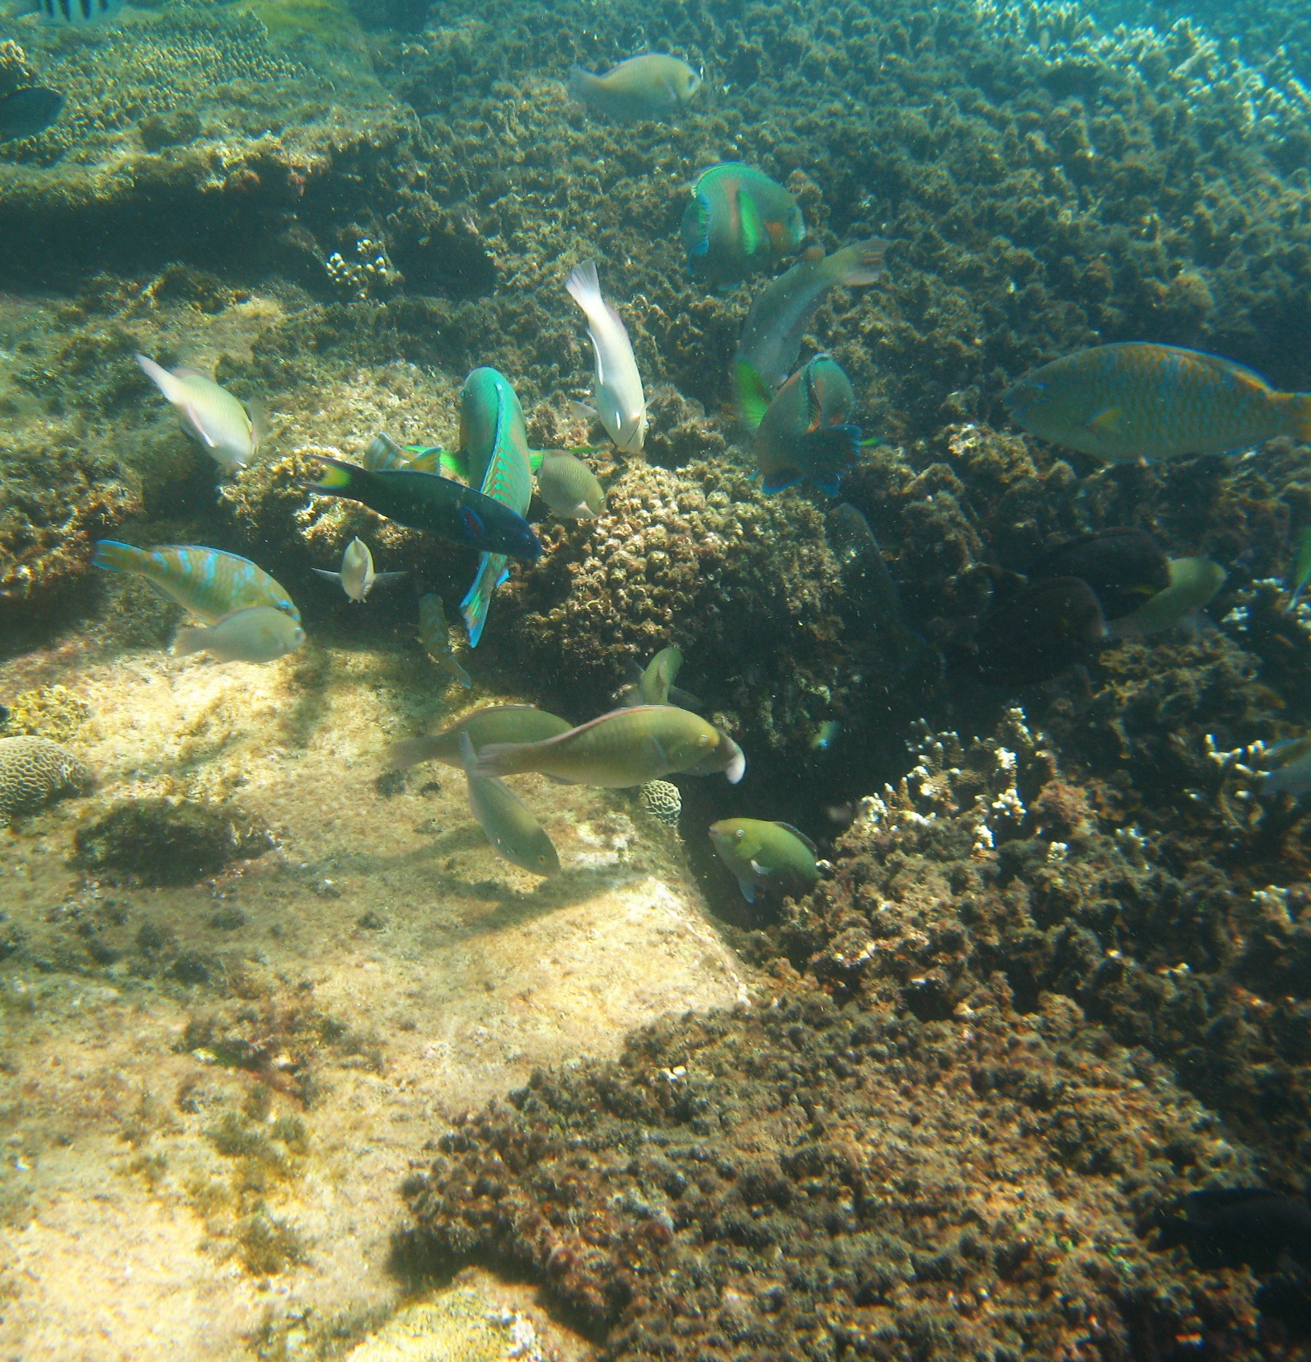
Herbivores have molar-like teeth, smaller mouths, and longer intestines.
Notes:
Image: J. Maynard, Copyright Commonwealth of Australia (GBRMPA)

Slide 52

Cods and groupers
Pronounced grow-per.
Notes:
Image: J. Hurford, Copyright Commonwealth of Australia (GBRMPA)

Slide 53

What is a structural adaptation of a cod or grouper?
Notes:
Image: J. Hurford, Copyright Commonwealth of Australia (GBRMPA)

Slide 54
Large upturned mouth with protruding lower jaw.
Multiple rows of teeth.
Stout, torpedo-shaped body.
Thick and strong caudal peduncle (where the tail attaches to the body).
Notes:
Image: J. Hurford, Copyright Commonwealth of Australia (GBRMPA)

Slide 55

Coral trout
Notes:
Image: S. Summerhays, Copyright Commonwealth of Australia (GBRMPA)

Slide 56
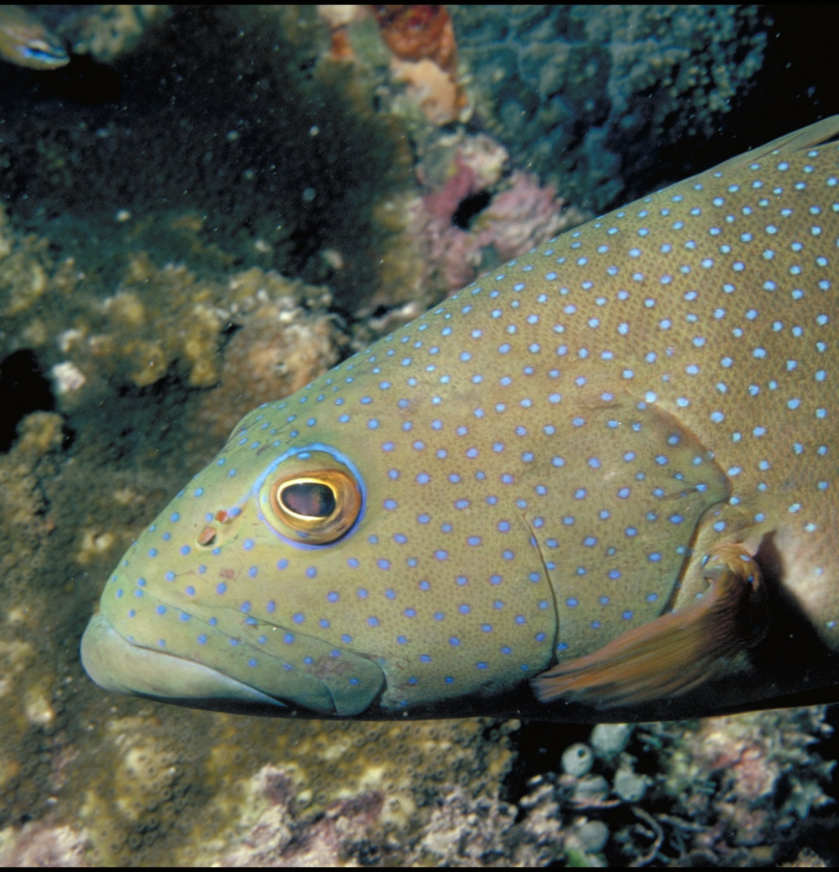
Why do coral
trout change from female to male when approximately 42cm?
Notes:
Image: A. Zell, Copyright Commonwealth of Australia (GBRMPA)

Slide 57

Increased reproductive success.
Large males, because of their
superior competitive ability (in fights and contests with smaller males), are able to monopolize females and prevent smaller males from mating with them.
Notes:
Image: T. Mayne, Copyright Commonwealth of Australia (GBRMPA)

Slide 58

Maori wrasse
also called humphead wrasse or Napoleon wrasse.
Notes:
Image: C. Jones, Copyright Commonwealth of Australia (GBRMPA)

Slide 59
What structural adaptation
does a male Maori wrasse have that a female doesn’t?

Slide 60
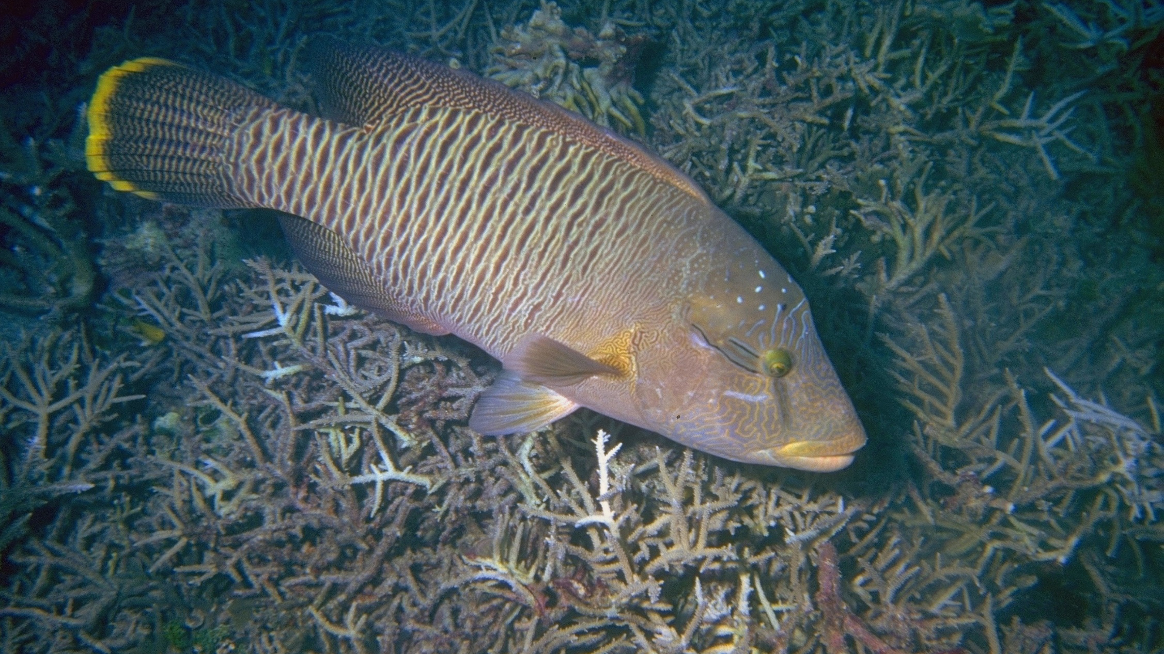
Female
Notes:
Image: U. Englehardt, Copyright Commonwealth of Australia (GBRMPA)

Slide 61

Male
Notes:
Image: M. Simmons, Copyright Commonwealth of Australia (GBRMPA)

Slide 62

Female
Male
Bronze
No hump
Smaller
0–9 years
Blue-green
Hump
Bigger
9–30 years
Notes:
Images: (Left) U. Englehardt, Copyright Commonwealth of Australia (GBRMPA); (Right) M. Simmons, Copyright Commonwealth of Australia (GBRMPA)

Slide 63

Sea turtles
Notes:
Image: C. Jones, Copyright Commonwealth of Australia (GBRMPA)

Slide 64
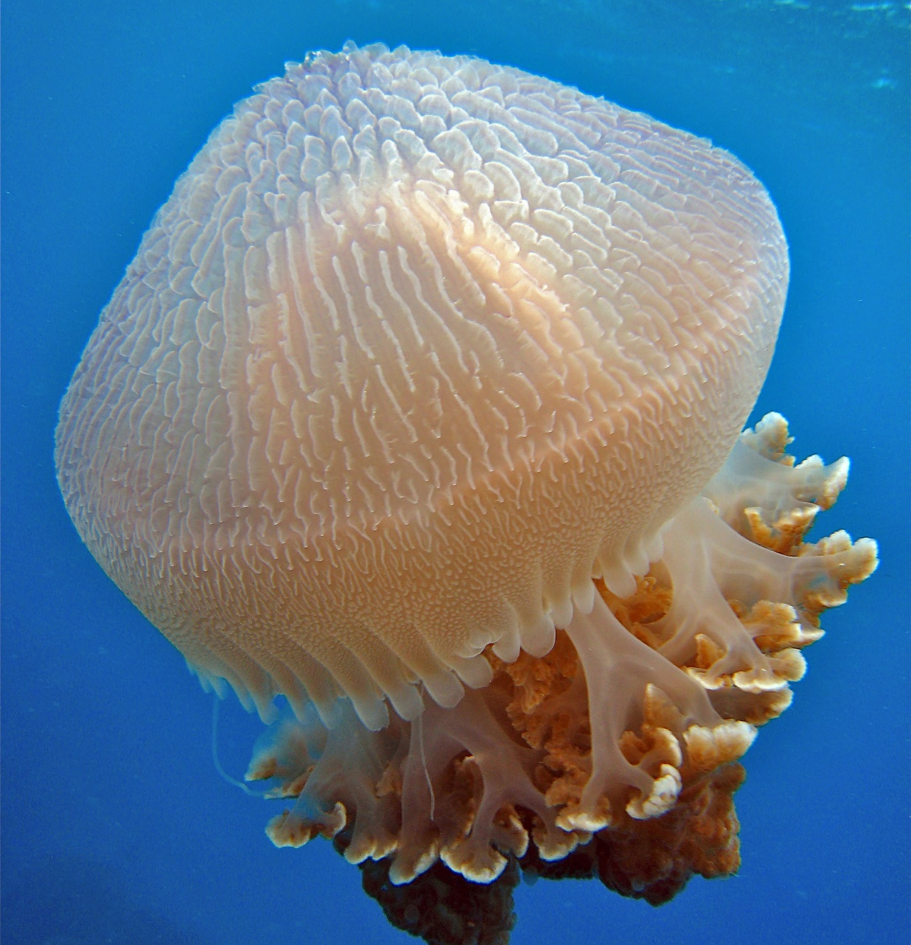
What do sea
turtles eat that look like jellyfish?
Notes:
Image: C. Jones, Copyright Commonwealth of Australia (GBRMPA)

Slide 65
Plastic
bags.
Notes:
Image: C. Jones, Copyright Commonwealth of Australia (GBRMPA)

Slide 66
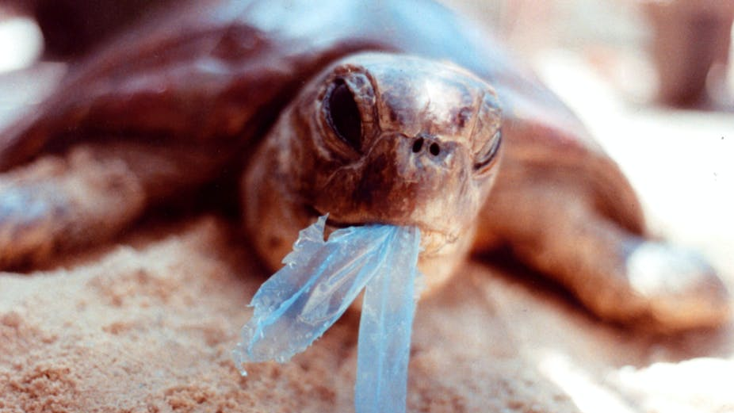
AAP Image/Department of the Environment and Heritage/Melbourne Zoo
Notes:
Image: https://theconversation.com/ghostnets-fish-on-marine-rubbish-threatens-northern-australian-turtles-11585

Slide 67

How many sea turtles pictured below are threatened with extinction?
Notes:
Image: GBRMPA Image Library

Slide 68

Sharks
Notes:
Image: J. Sumerling, Copyright Commonwealth of Australia (GBRMPA)

Slide 69
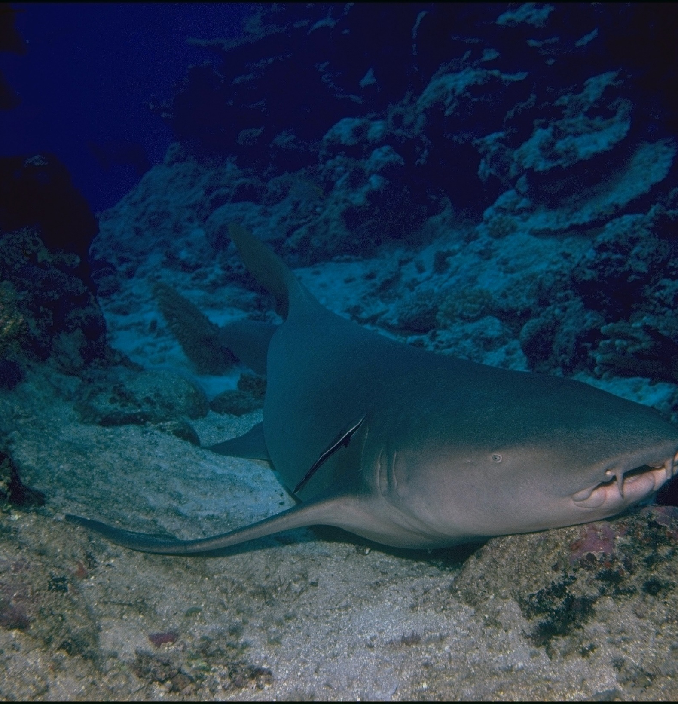
Sharks have all
the senses that
we have.
They can see,
hear, smell, taste and feel.
Tawny nurse shark (harmless)
Notes:
Image: K. Hoppen, Copyright Commonwealth of Australia (GBRMPA)

Slide 70
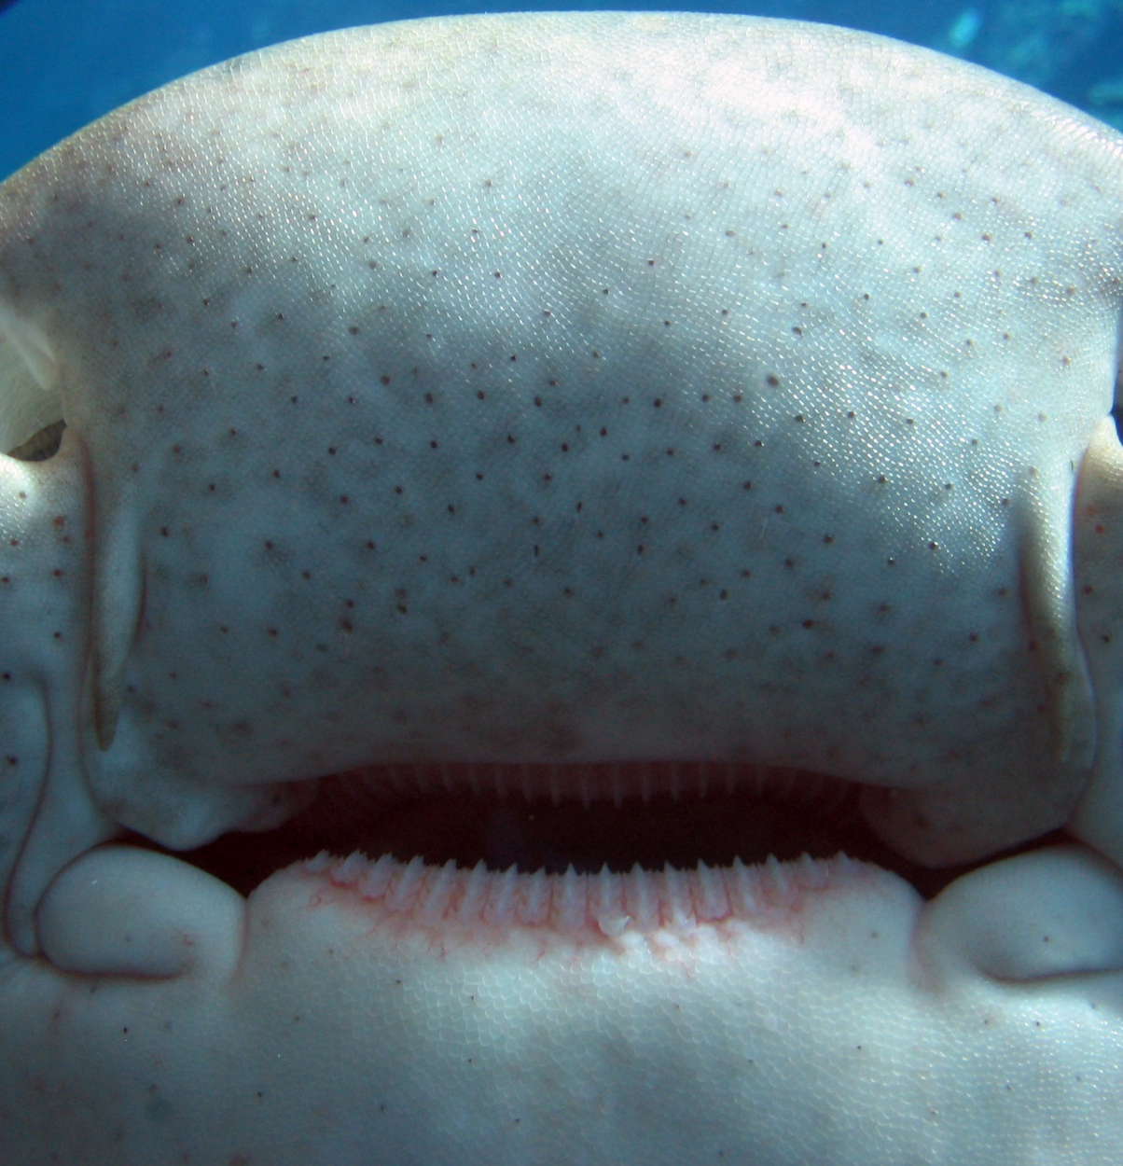
What can
sharks sense that humans can’t?
Leopard shark (harmless)
Notes:
Image: C. McGrogan, Copyright Commonwealth of Australia (GBRMPA)

Slide 71
Electro-receptors (tiny dots) on
a shark’s nose sense electricity
and vibrations to detect prey.
Leopard shark (harmless)
Notes:
Image: C. McGrogan, Copyright Commonwealth of Australia (GBRMPA)

Slide 72

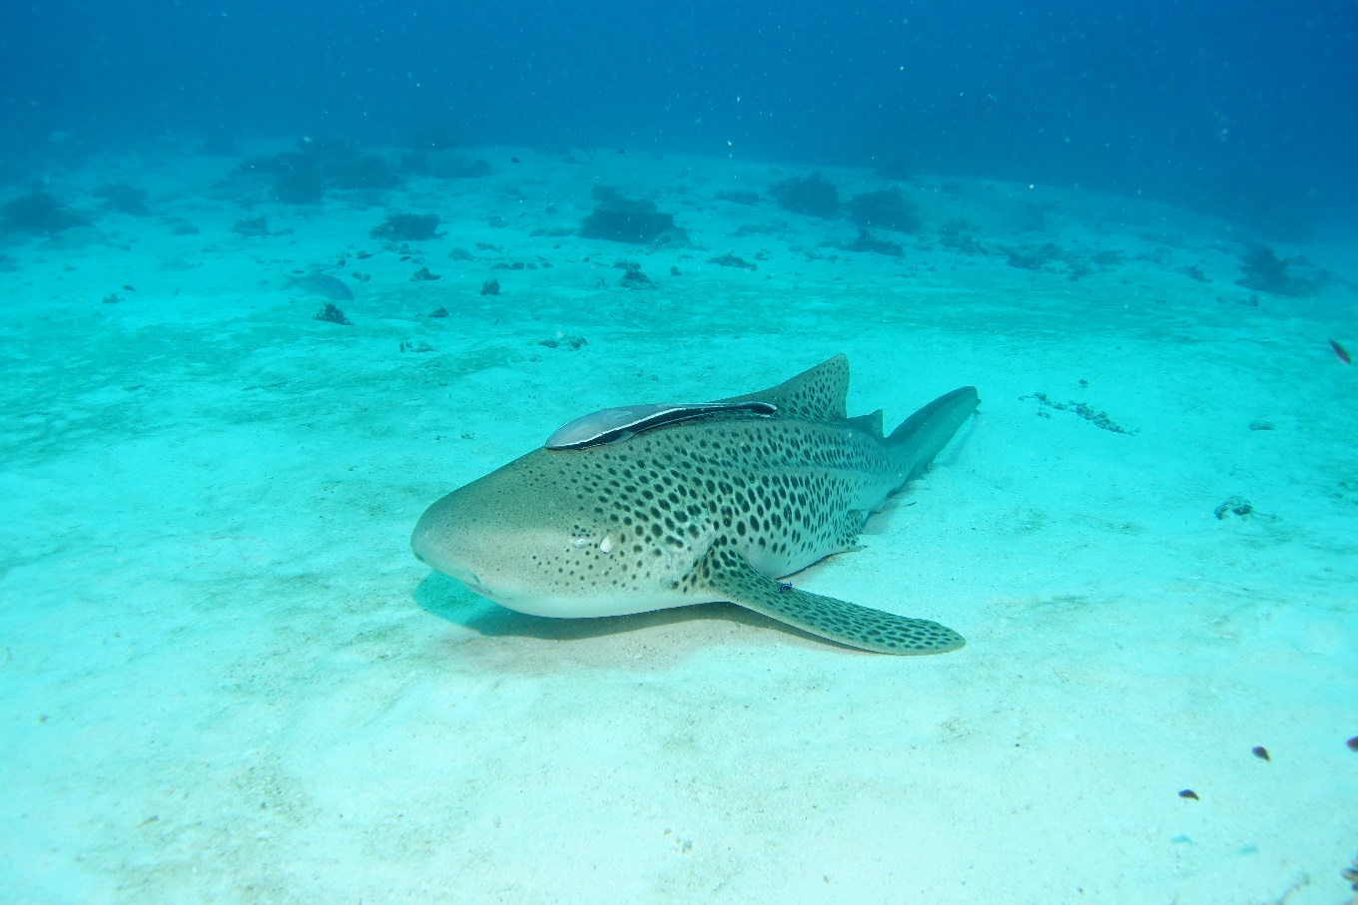
Why count sharks?
Notes:
Images: (Left) J. Sumerling, Copyright Commonwealth of Australia (GBRMPA); (Right) C. Jones, Copyright Commonwealth of Australia (GBRMPA)

Slide 73

Sharks keep
the Reef balanced and healthy.
Notes:
Image: K. Hoppen, Copyright Commonwealth of Australia (GBRMPA)

Slide 74

Many sharks
are threatened
with extinction.
Notes:
Image: C. Jones, Copyright Commonwealth of Australia (GBRMPA)

Slide 75
How did you go?

Slide 76
Now that you have learnt about some of the animals on the Great Barrier Reef, how do you think you can help protect them?

Slide 77

What actions can you take to protect the Great Barrier Reef?

Slide 78

Download
the Eye on the
Reef app.
Notes:
App image: https://www.gbrmpa.gov.au/__data/assets/pdf_file/0020/265430/Eye-on-the-Reef-app-poster.pdf

Slide 79


Press “Sightings” and “Create”.

Slide 80


Press “Wildlife”.

Slide 81


Marine mammals.
Select your animal and press “INFORMATION” to learn more.

Slide 82


Marine reptiles.

Slide 83




Sharks and rays.

Slide 84



Fishes.

Slide 85











Slide 86





Birds.

Slide 87


Invertebrates.

Slide 88










Slide 89
Explore the other tabs too!

Slide 90
Create a poster to answer the question:
How can I help the Great Barrier Reef?
Display it proudly in your classroom.
Notes:
This is the last slide for students to view. The remaining slides are for the teachers.

Slide 91
Thank you for helping the Great Barrier Reef!
See the Reef • Love the Reef • Protect the Reef

