Slide 1
Be a Marine
Biologist for a Day
Part 2: Finding out
Primary School
Post-snorkel presentation for
10 minute timed survey.
Notes:
Image: C. Jones, Copyright Commonwealth of Australia (GBRMPA)

Slide 2

How will I help the
Great Barrier Reef today?
By calculating averages and completing section 1, ready to upload to GBRMPA.

Slide 3

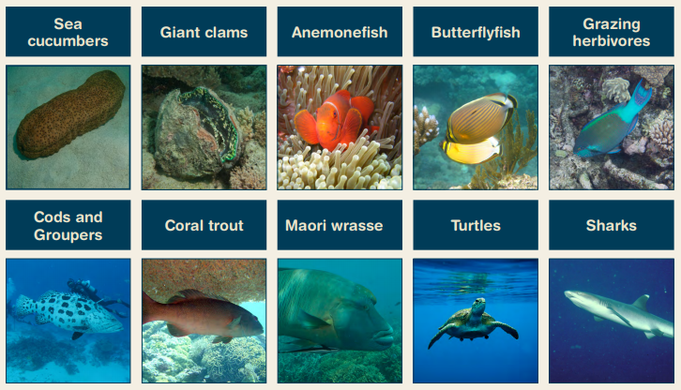
What we counted in 10 minutes.
Notes:
Idea: you could organise a prize for the person with the most correct answers?

Slide 5
“Are you ready to share your data and complete this form?
We will do it together. I will show you how.
Do you have your data sheets and activity books ready?”
Check each student has their activity book that includes their results sheet and a Rapid Monitoring form (only 10 minute part)
or
Check they have their data somewhere and a Rapid Monitoring survey form and a pencil each.
This is a good time to collect any borrowed equipment.

Slide 6
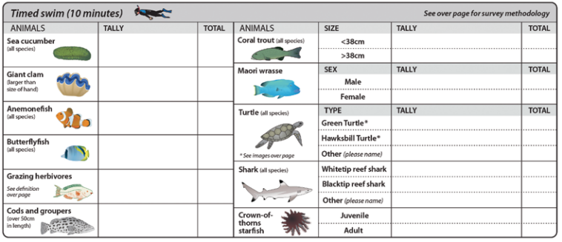
Are you ready to complete this form?
Rapid Monitoring survey form
(in activity book).

Slide 7
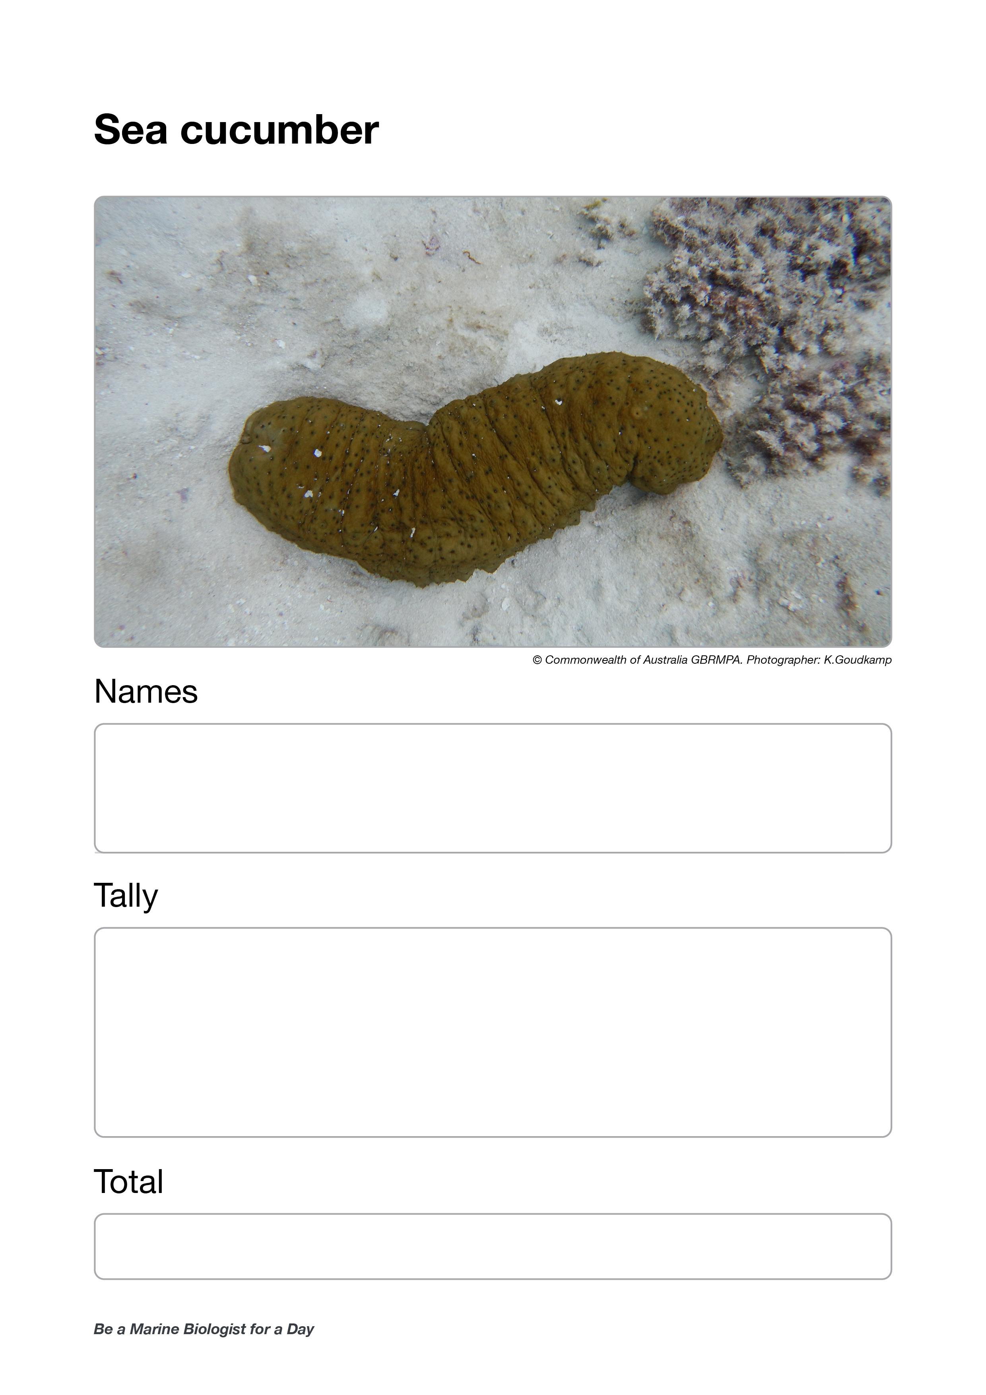
Ask for sea cucumber data.
Ask each buddy pair to read their tally out loud.
If more than one buddy pair counted sea cucumbers,
calculate the average.
Note: students do not learn how to calculate averages until year 8.
Wait for everybody to write it down (flip to next page).
Questions:
Did anyone see a sea cucumber move?
What movements did it make?
Did anyone see it poop?

Slide 8
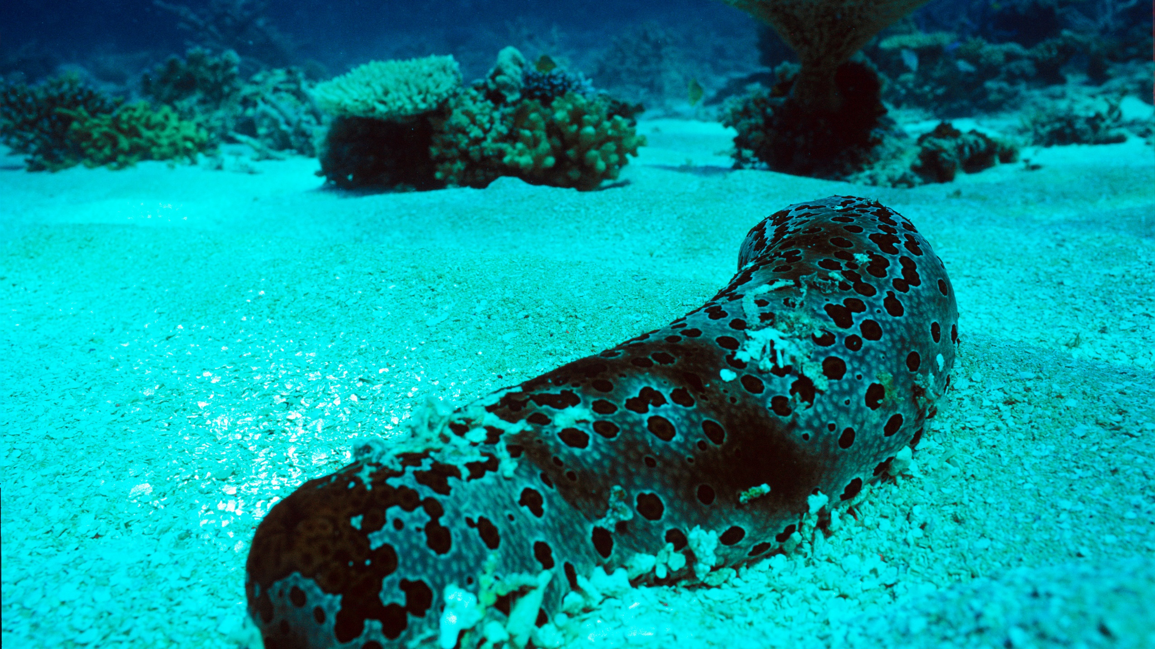

Sea cucumber
Notes:
Image: J. Oliver, Copyright Commonwealth of Australia (GBRMPA)

Slide 9
Write the number of sea cucumbers here.

Slide 10
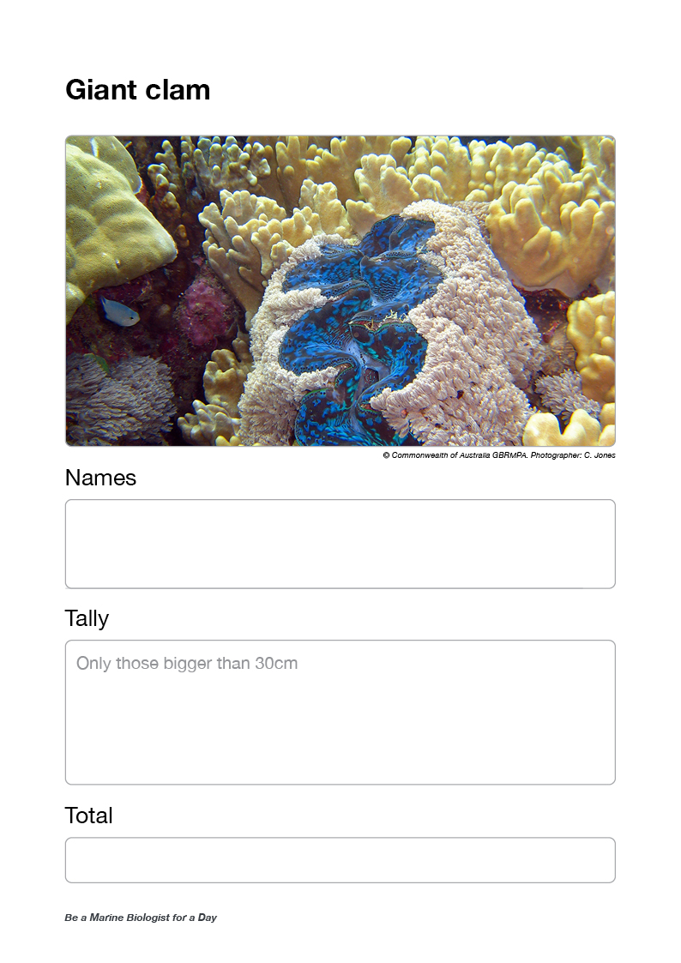
Ask for giant clam data.
Ask each buddy pair to read their tally out loud.
If more than one buddy pair counted giant clams,
calculate the average.
Note: students do not learn how to calculate averages until year 8.
Wait for everybody to write it down (flip to next page).
Questions:
How many holes (siphons) were in the mantle of the giant clam?
Did you work out what the holes were for?

Slide 11
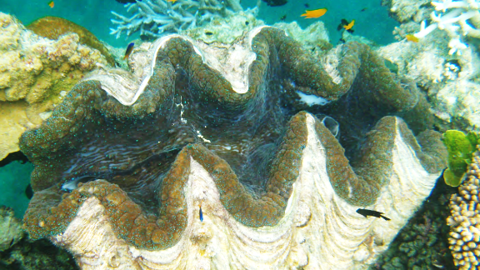
Giant clam
VULNERABLE TO EXTINCTION
Notes:
Image: Copyright Commonwealth of Australia (GBRMPA)

Slide 12
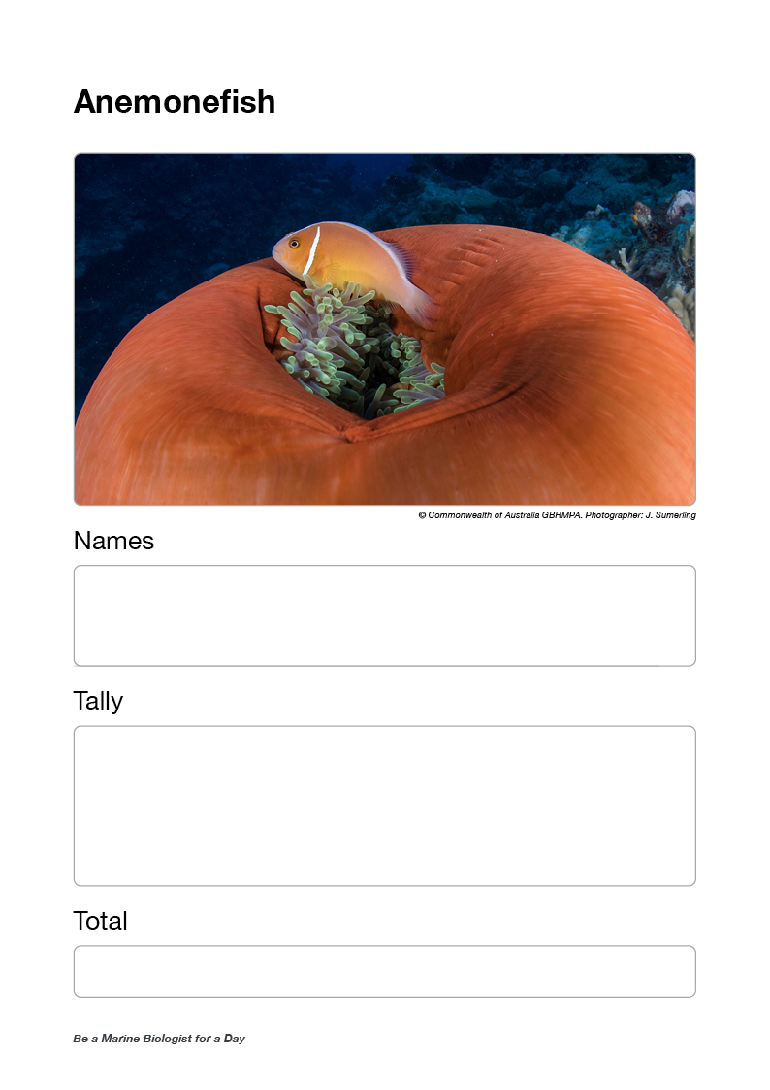
Ask for anemonefish data.
Ask each buddy pair to read their tally out loud.
If more than one buddy pair counted anemonefish,
calculate the average.
Note: students do not learn how to calculate averages until year 8.
Wait for everybody to write it down (flip to next page).
Questions:
Who saw the anemonefish before the anemone?
How many times did the anemonefish go back to its anemone?
Did anyone check to see if there were eggs near the anemone?
Did you happen to notice which one was the female?
Were there different looking anemonefish?

Slide 13
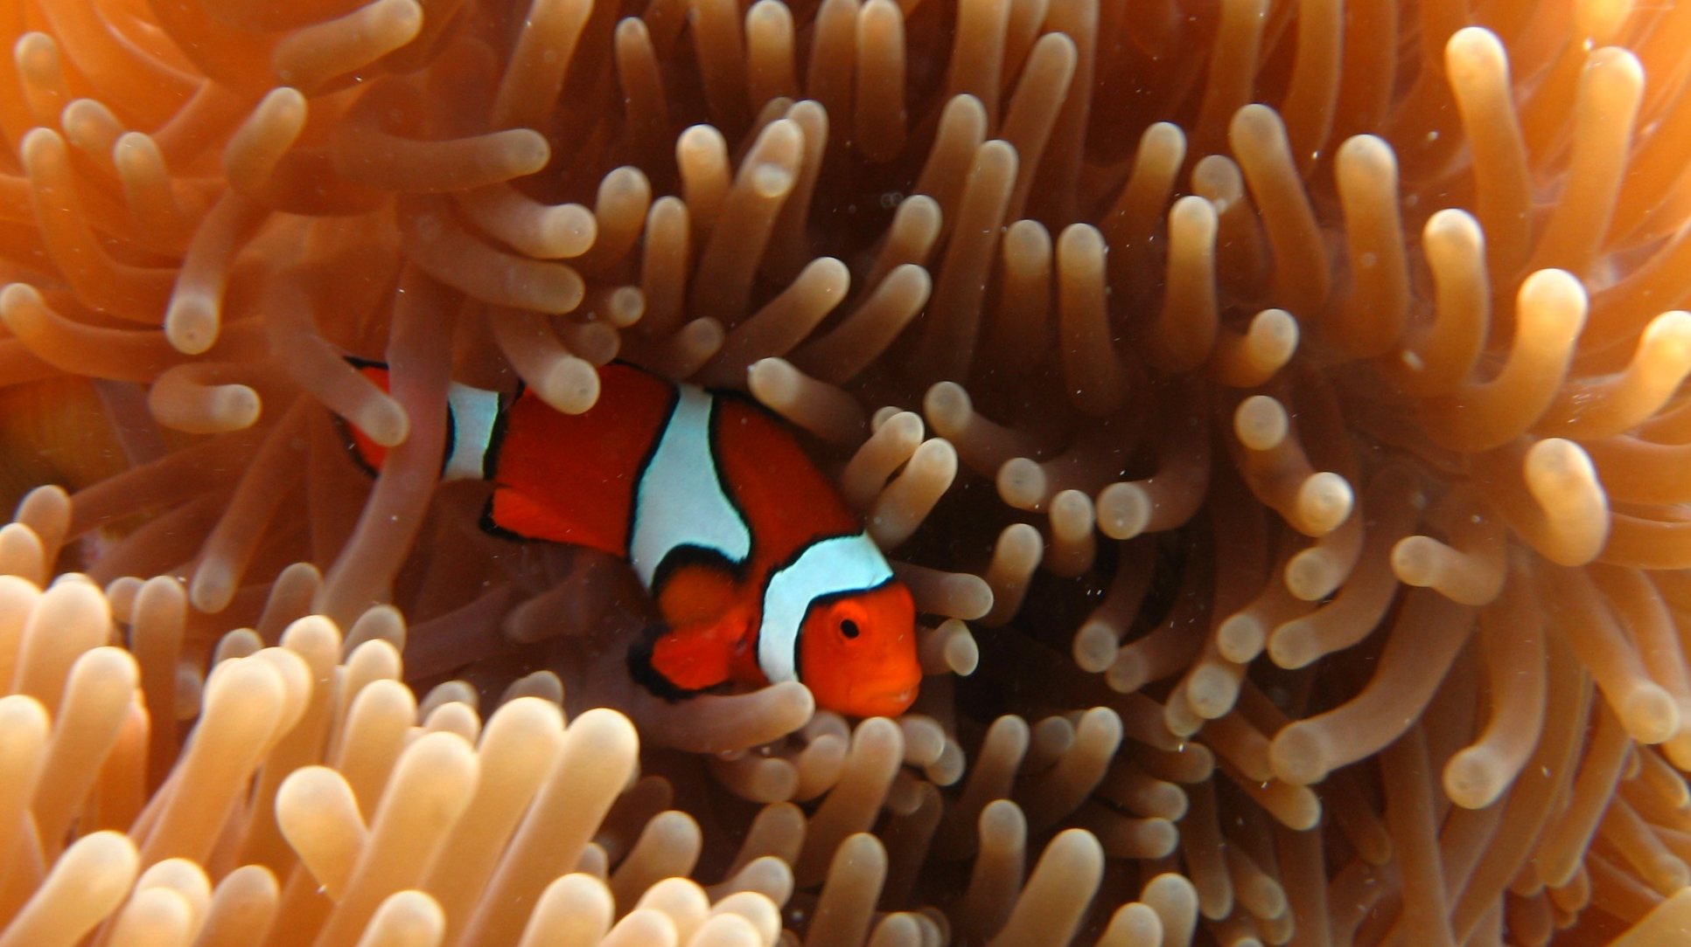
Anemonefish
Notes:
Image: E. Smart, Copyright Commonwealth of Australia (GBRMPA)

Slide 14
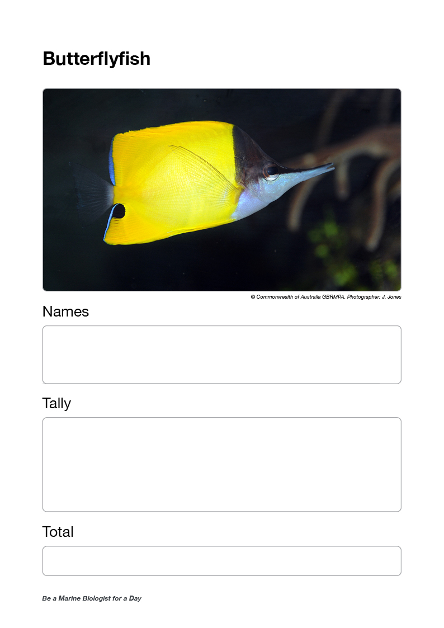
Ask for butterflyfish data.
Ask each buddy pair to read their tally out loud.
If more than one buddy pair counted butterflyfish,
calculate the average.
Note: students do not learn how to calculate averages until year 8.
Wait for everybody to write it down (flip to next page).
Questions:
Did anyone see a butterflyfish with a fake eye spot?
Does anyone know what the fake eye spot is for?
Did anyone notice if they were doing laps around the reef?
Were most of them swimming in pairs?
What were they eating?

Slide 15
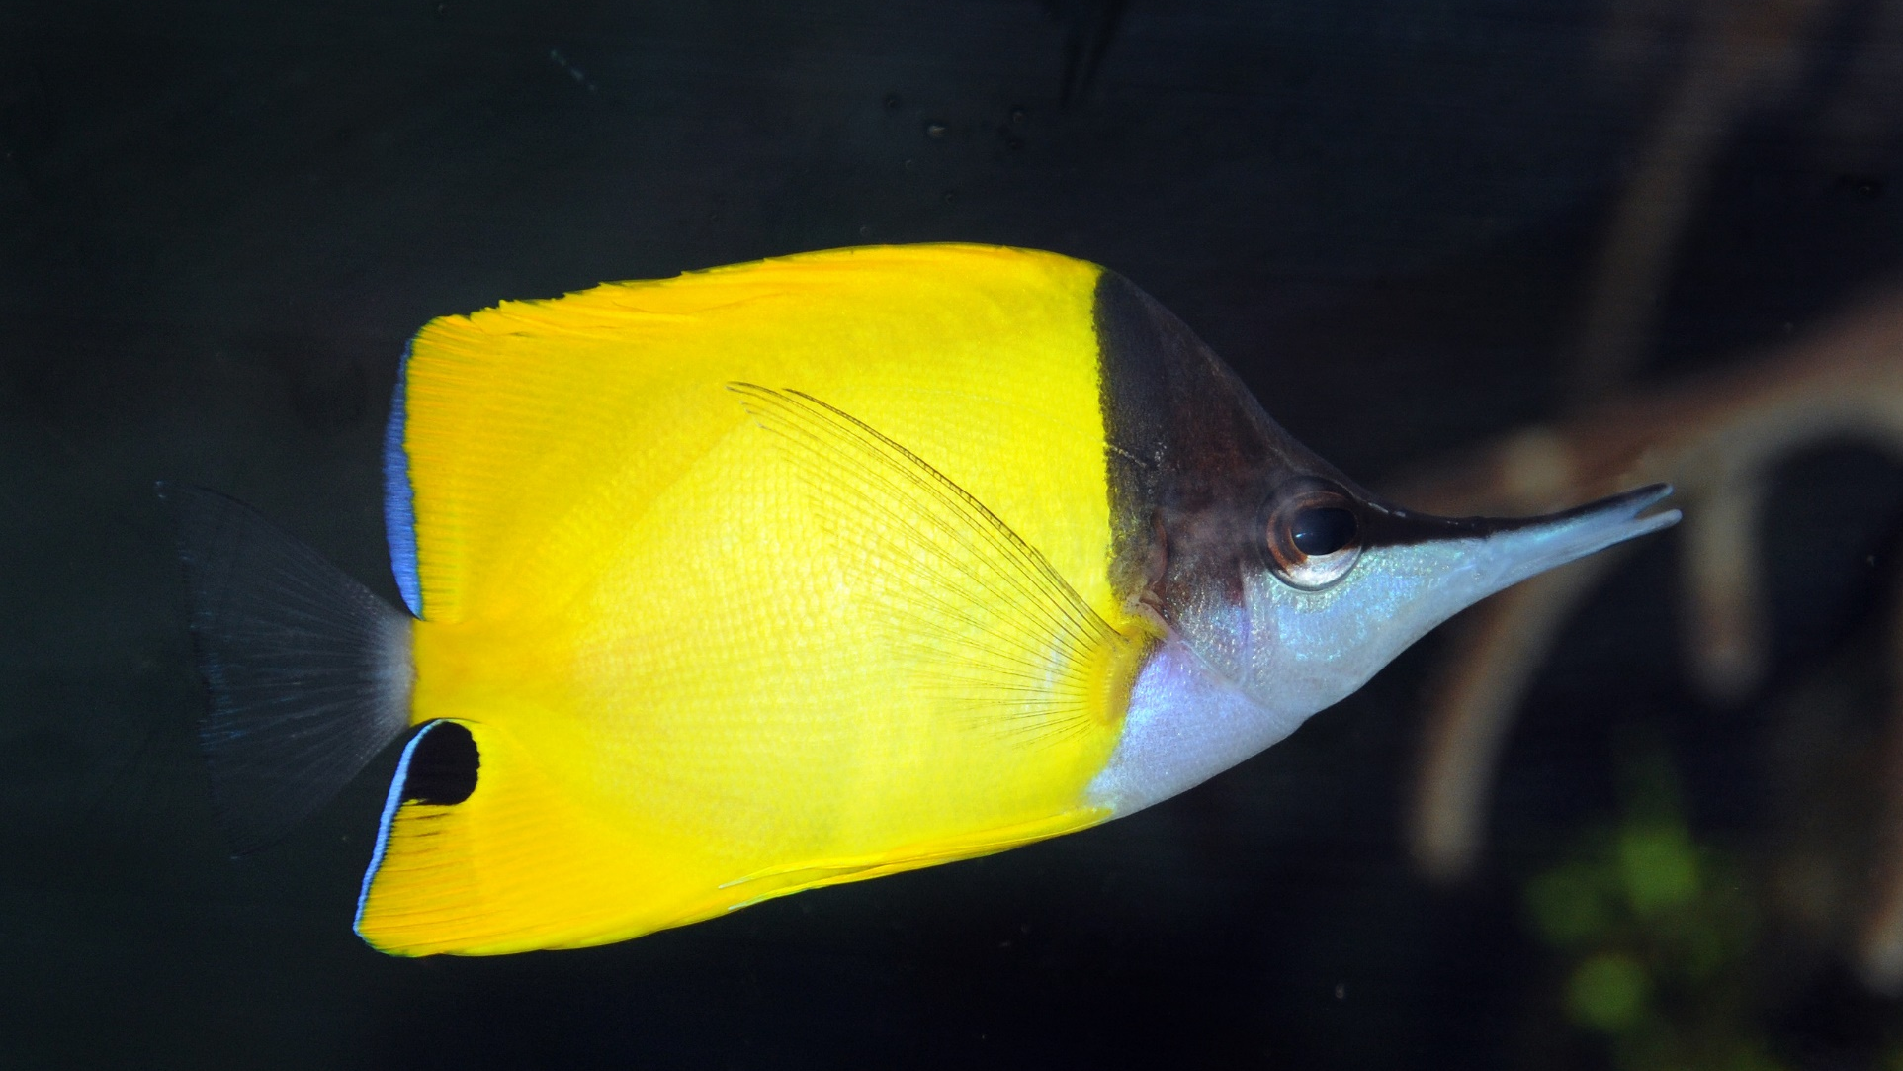
Butterflyfish
Notes:
Image: J. Jones, Copyright Commonwealth of Australia (GBRMPA)

Slide 16
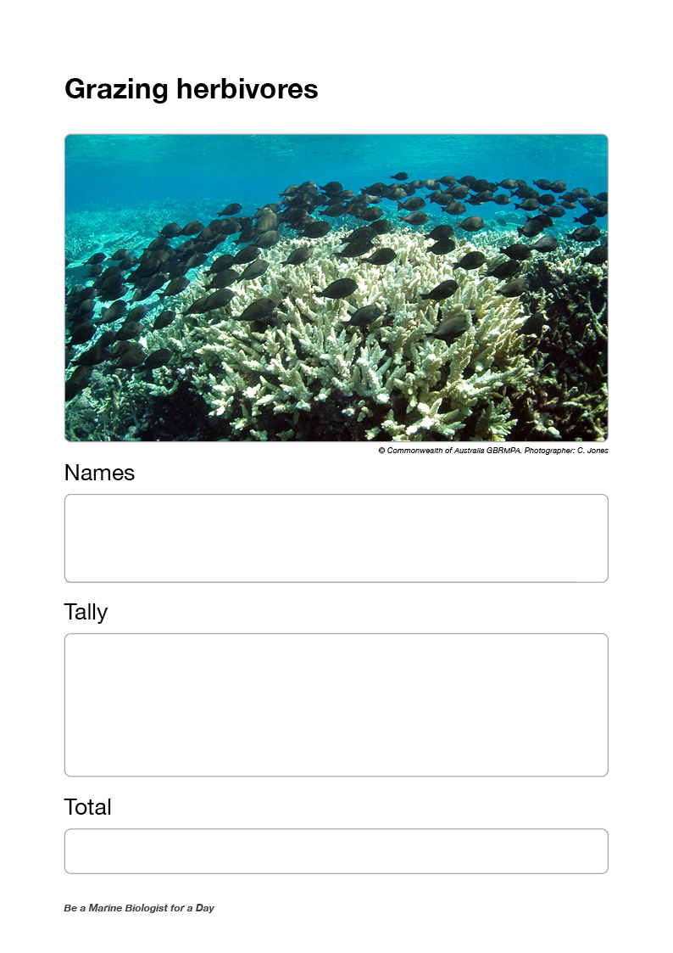
Ask for grazing herbivore data.
Ask each buddy pair to read their tally out loud.
If more than one buddy pair counted grazing herbivores,
calculate the average.
Note: students do not learn how to calculate averages until year 8.
Wait for everybody to write it down (flip to next page).
Questions:
How could you tell if it was a grazing herbivore?
Were the grazing herbivores in a big school, or on their own?
Did anyone see a grazing herbivore poop?
Could anyone hear them eating?
Did anyone pay attention to what it was eating?

Slide 17
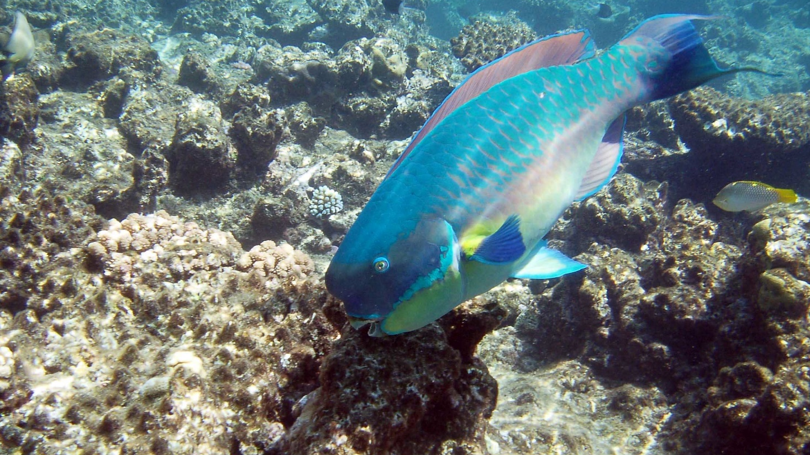
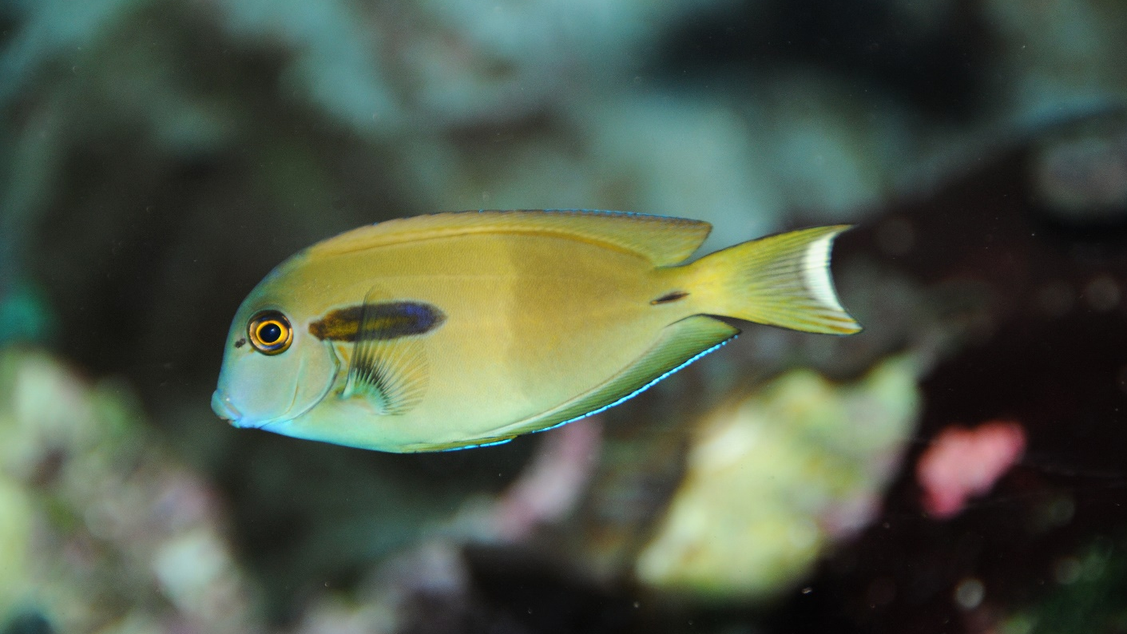
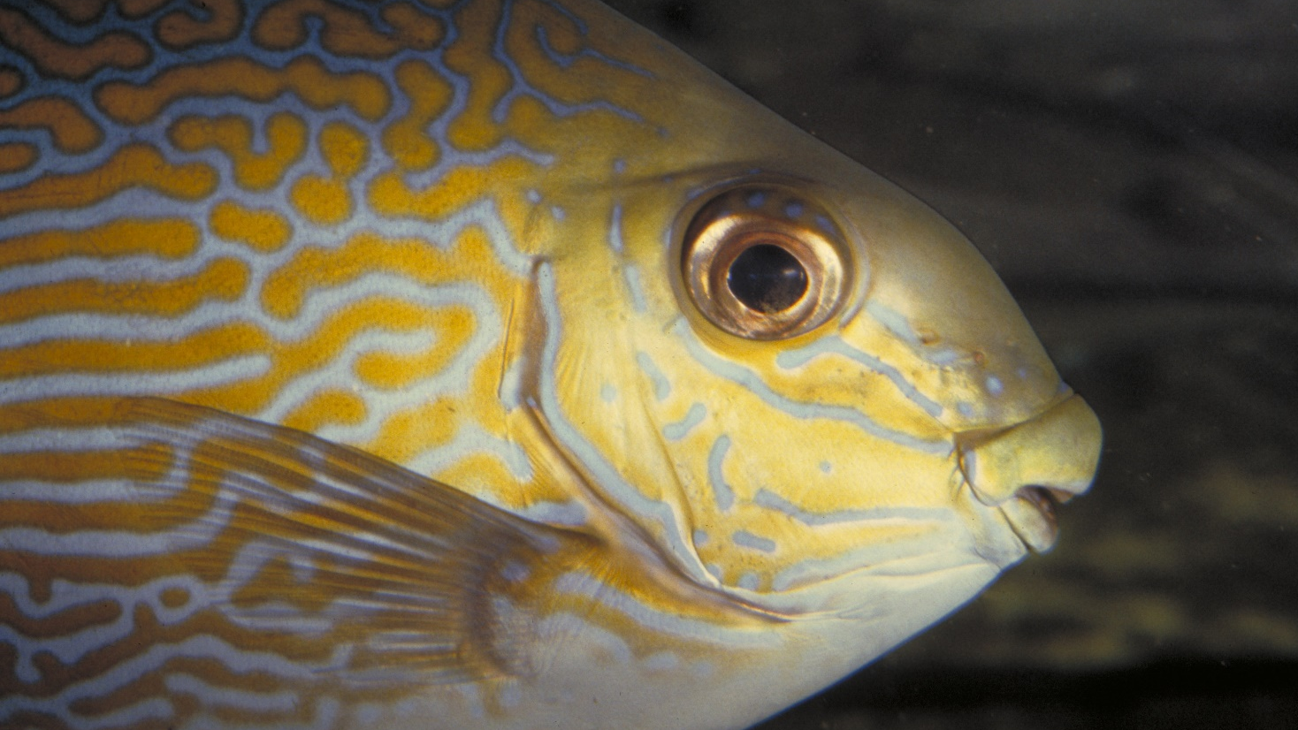
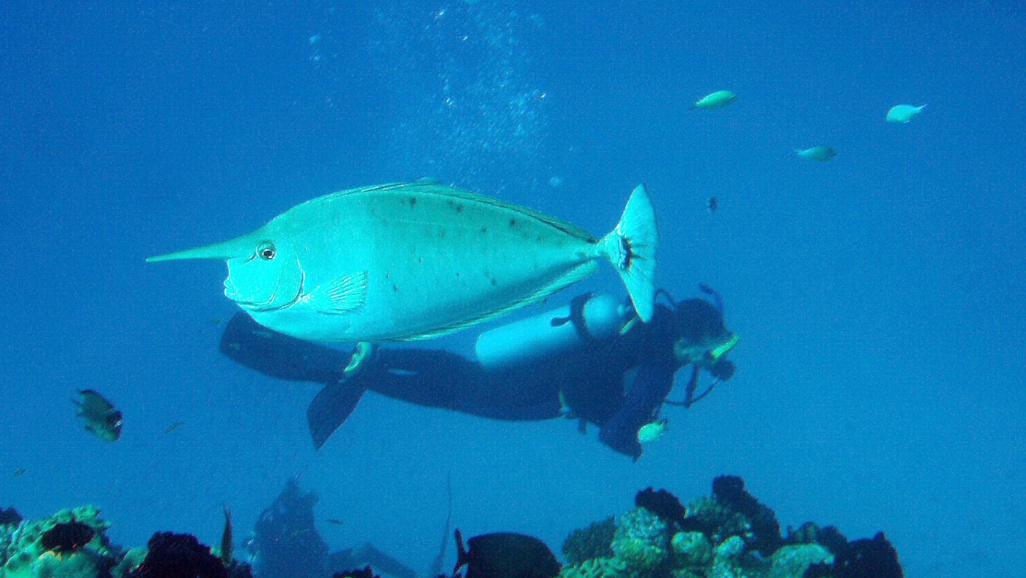
Grazing herbivores
Parrotfish
Surgeonfish
Rabbitfish
Unicornfish
Notes:
Images: (Top Left) C. Jones, Copyright Commonwealth of Australia (GBRMPA); (Top Right) J. Jones, Copyright Commonwealth of Australia (GBRMPA); (Bottom Left) L. Zell, Copyright Commonwealth of Australia (GBRMPA); (Bottom Right) A. Smith, Copyright Commonwealth of Australia (GBRMPA)

Slide 18
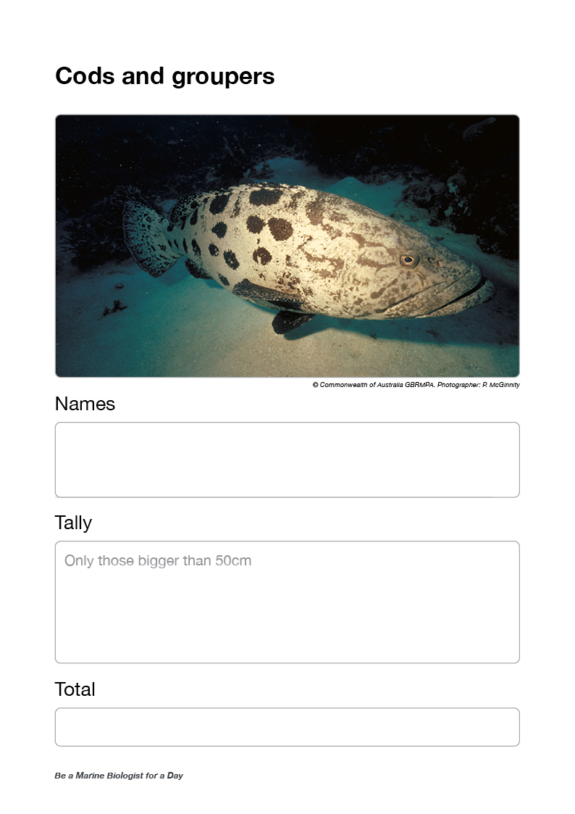
Ask for cods and groupers data.
Ask each buddy pair to read their tally out loud.
If more than one buddy pair counted cods and groupers,
then calculate the average.
Wait for everybody to write it down.
Questions:
Did anyone see a cod or grouper eat something?
How big was it?
Did anyone see it getting cleaned?

Slide 19
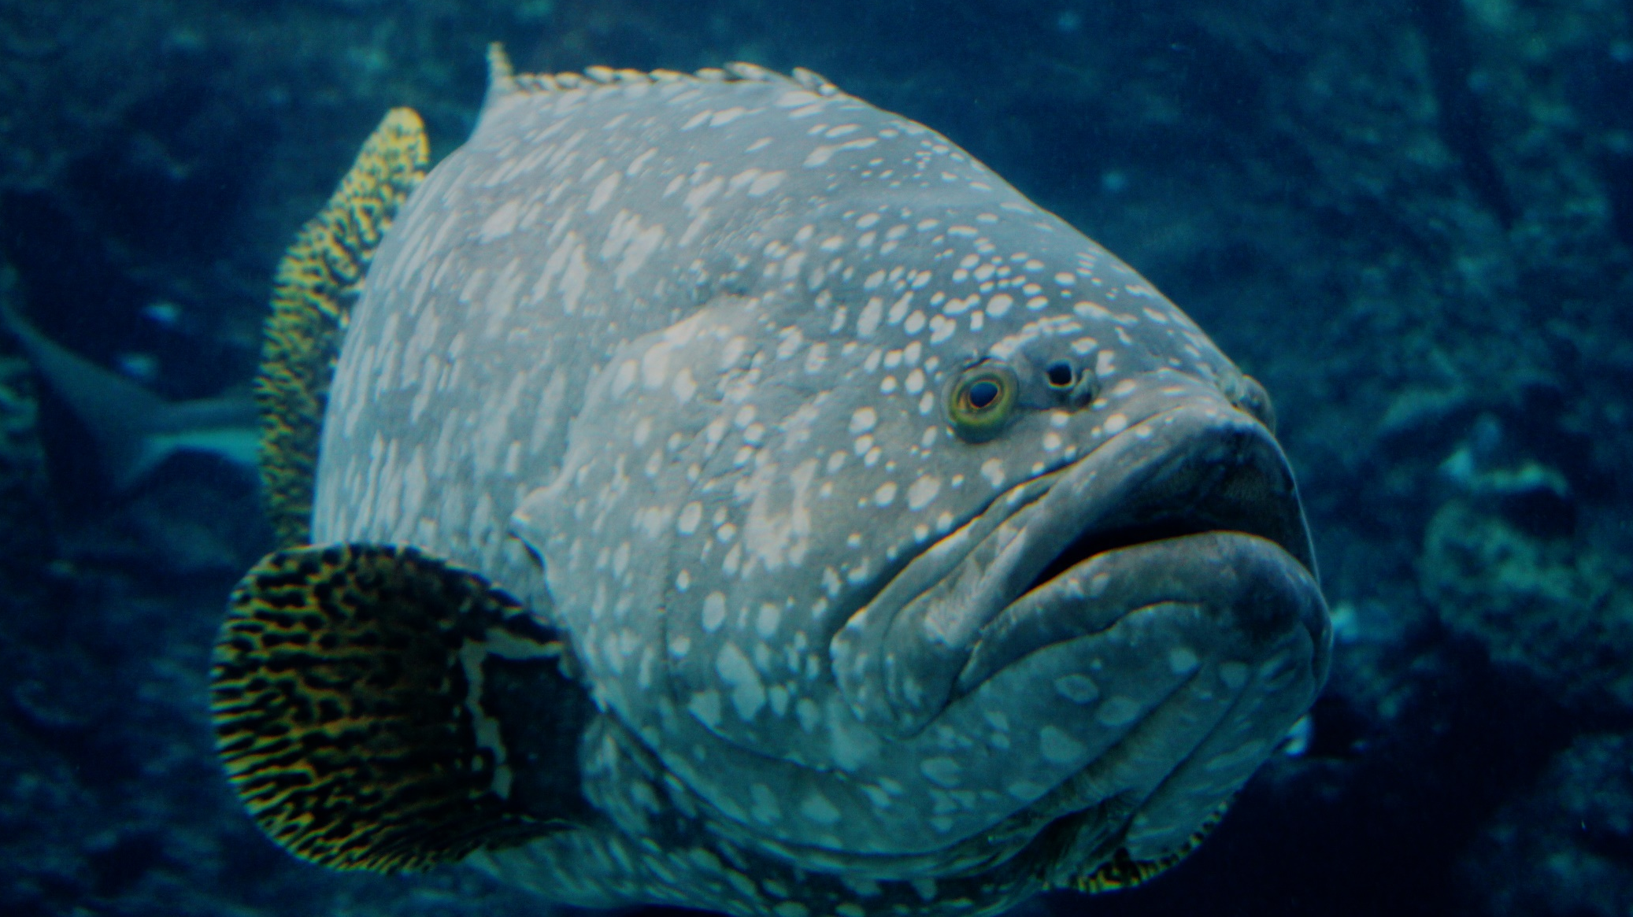
Cods and groupers
>50cm
Notes:
Image: J. Hurford, Copyright Commonwealth of Australia (GBRMPA)

Slide 20
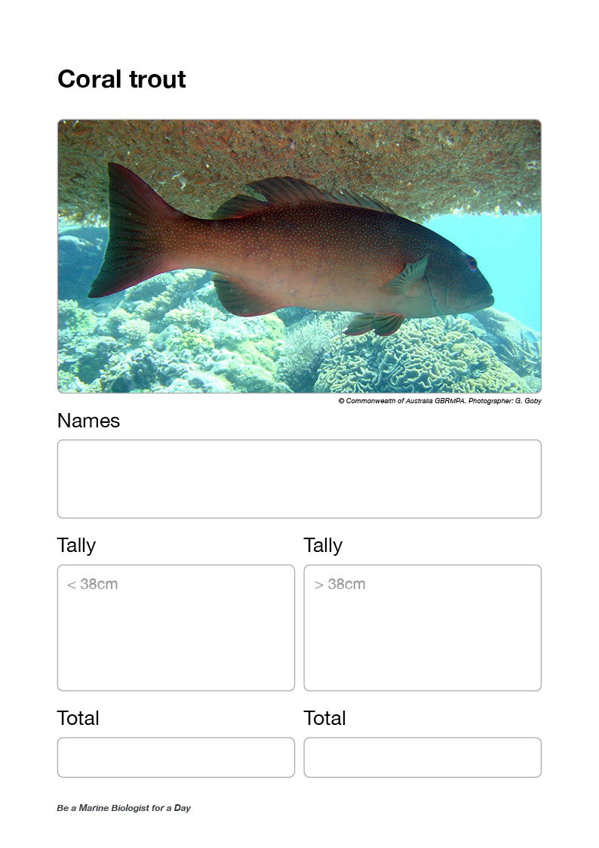
Ask for coral trout data <38cm.
Ask each buddy pair to read their tally out loud.
If more than one buddy pair counted coral trout <38cm,
then calculate the average.
Wait for everybody to write it down.
Ask for coral trout data >38CM.
Ask each buddy pair to read their tally out loud.
If more than one buddy pair counted coral trout >38cm,
then calculate the average.
Wait for everybody to write it down.
Questions:
Did anyone see a really big coral trout?
Do you think it might have been a female?

Slide 21
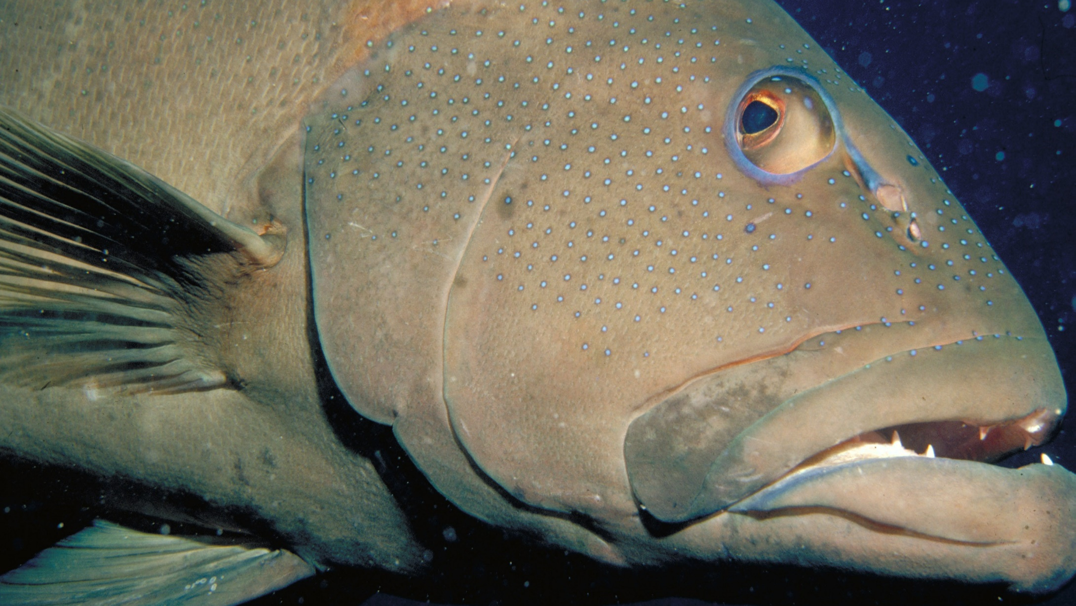
Coral trout
<38cm / >38cm
Notes:
Image: S. Summerhays, Copyright Commonwealth of Australia (GBRMPA)

Slide 22
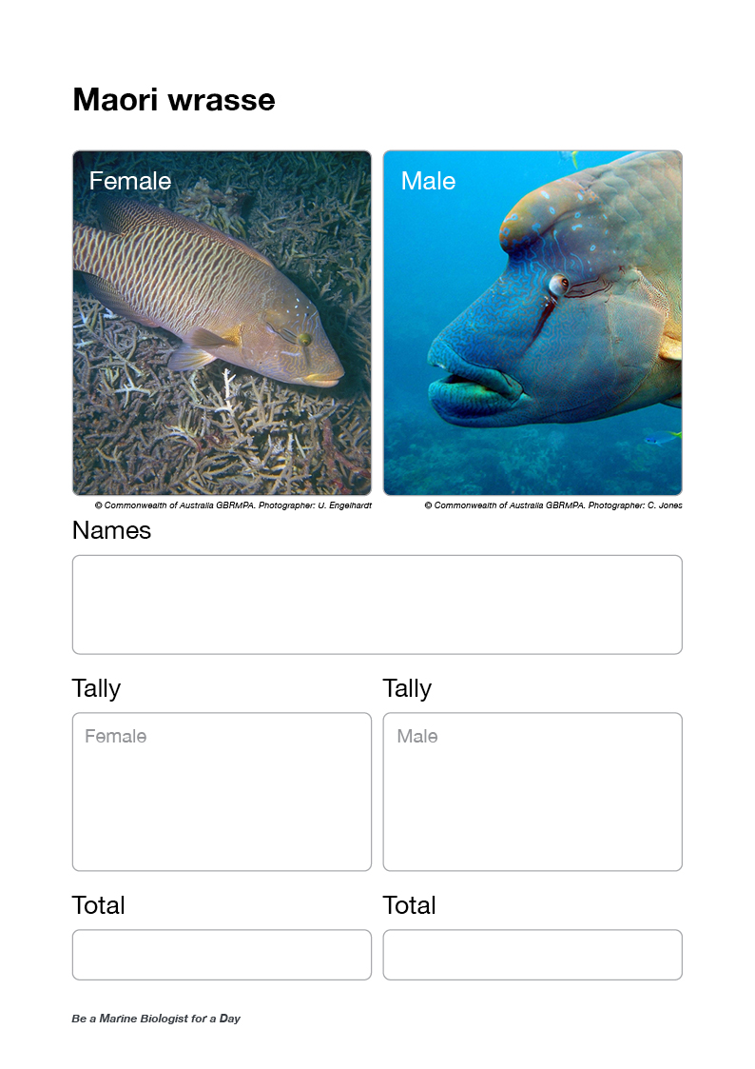
Ask for Maori wrasse data [female].
Ask each buddy pair to read their tally out loud.
If more than one buddy pair counted Maori wrasse [female], calculate the average.
Ask for Maori wrasse data [male].
Ask each buddy pair to read their tally out loud.
If more than one buddy pair counted Maori wrasse [male], calculate the average.
Wait for everybody to write it down (flip to next page).
Questions:
If they saw one, where was it?
Did it move very far?
How big was the hump?
Did it get very close?
Why was it important not to touch it?

Slide 23
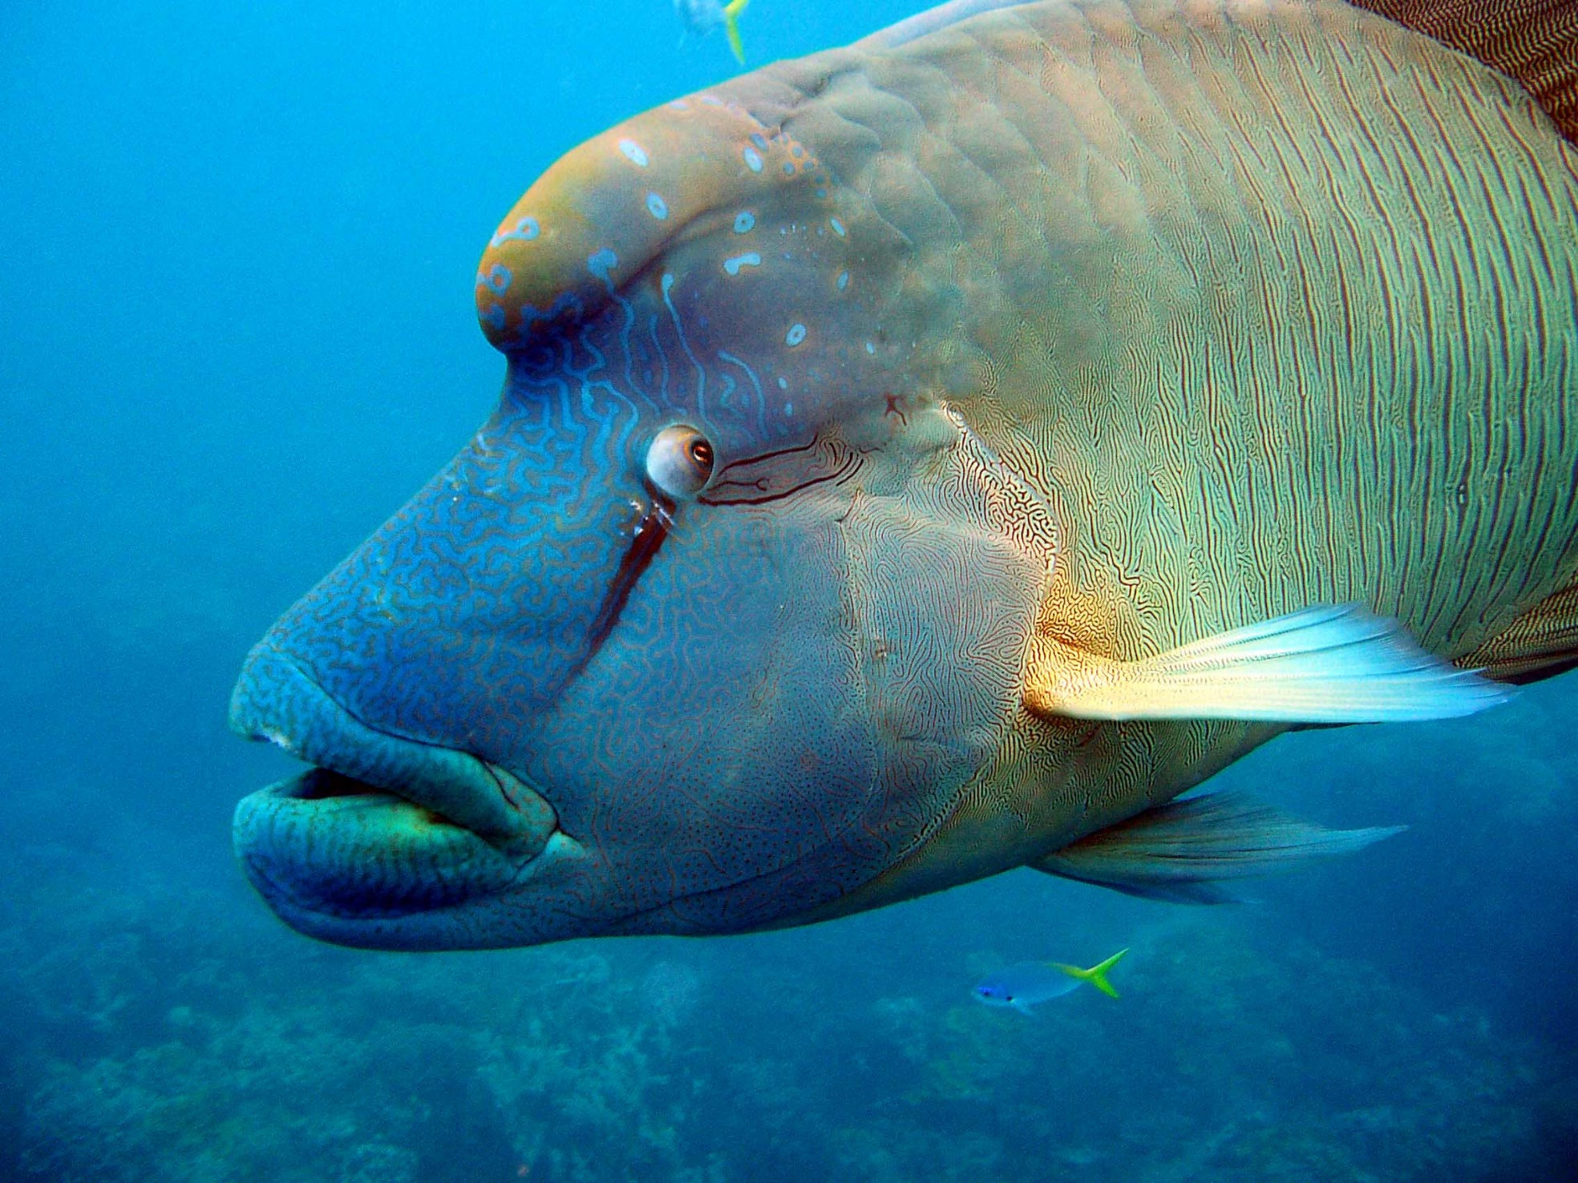
Maori wrasse
Female / Male
Notes:
Image: C. Jones, Copyright Commonwealth of Australia (GBRMPA)

Slide 24
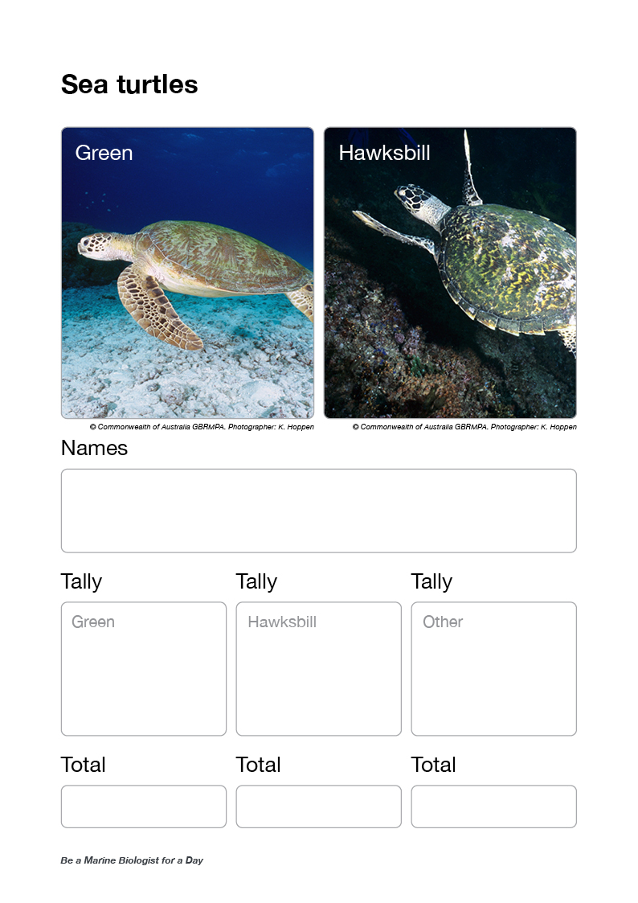
Ask for turtle data [green turtle].
Ask for turtle data [hawksbill turtle].
Ask for turtle data [other].
Ask each buddy pair to read their tally out loud for each species.
If more than one buddy pair counted turtles, then calculate the average.
Wait for everybody to write it down.
Questions:
Did anyone see a tag on its flipper?
How long do you think it can hold its breath for?
Were there any other animals cruising around with it?
Were there any barnacles on its shell (carapace)?
How big was it? How old do you think it might be?

Slide 25
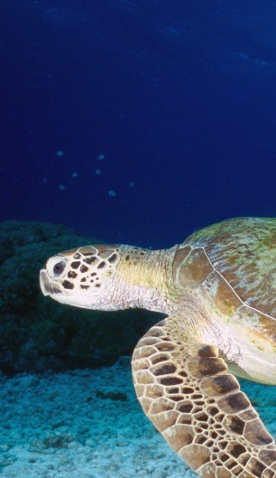
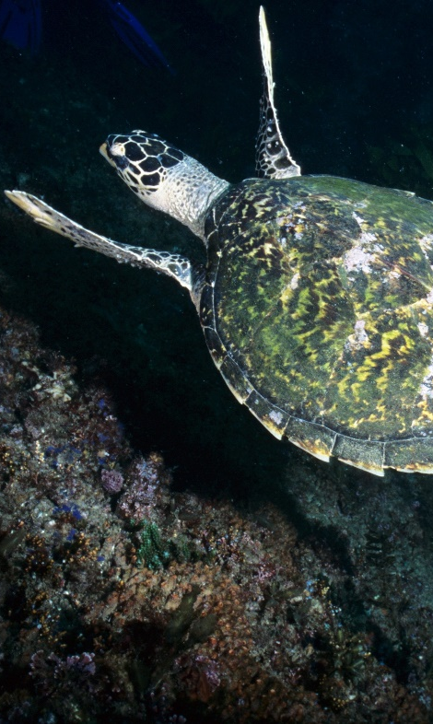
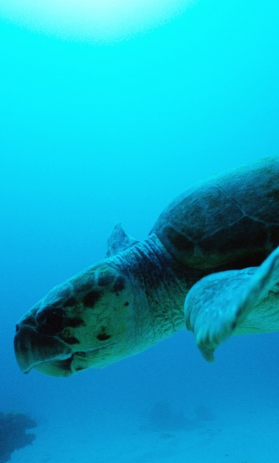
Sea turtles
Green / Hawksbill / other
Green turtle
Hawksbill turtle
Loggerhead turtle
Notes:
Images: (Left) K. Hoppen, Copyright Commonwealth of Australia (GBRMPA); (Middle) K. Hoppen, Copyright Commonwealth of Australia (GBRMPA); (Right) M. Simmons, Copyright Commonwealth of Australia (GBRMPA)

Slide 26
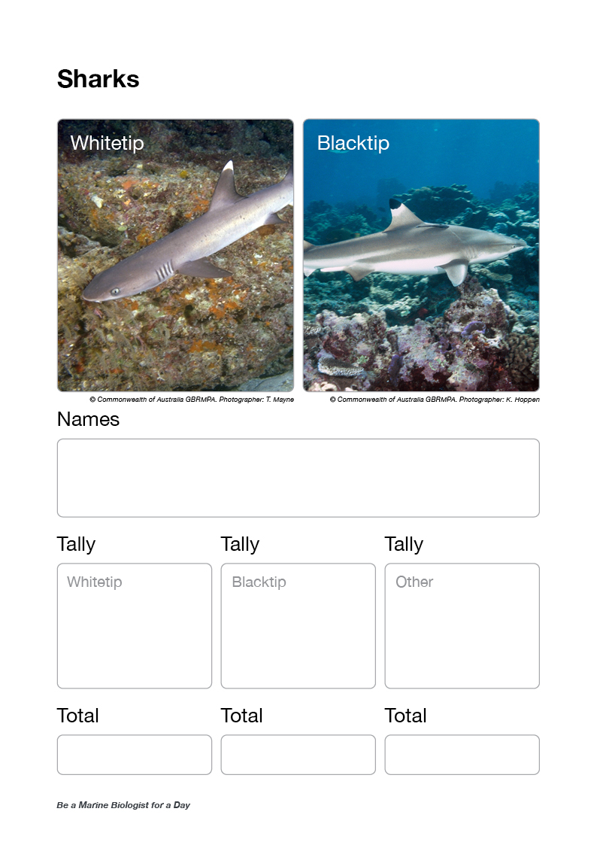
Ask for shark data [whitetip reef shark].
Ask for shark data [blacktip reef shark].
Ask for shark data [other].
Ask each buddy pair to read their tally out loud for each type of shark.
If more than one buddy pair counted other sharks,
then calculate the average.
Wait for everybody to write it down.
Questions:
Could you see if it was a male or female?
Was it swimming, or sitting on the bottom?
Could you see it breathing?
Were you scared?
Has your opinion of sharks changed?

Slide 27
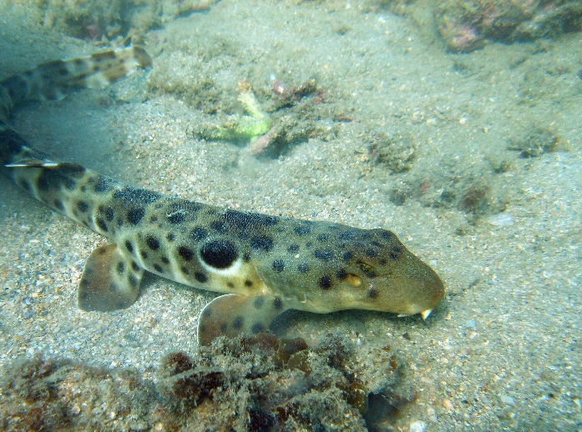
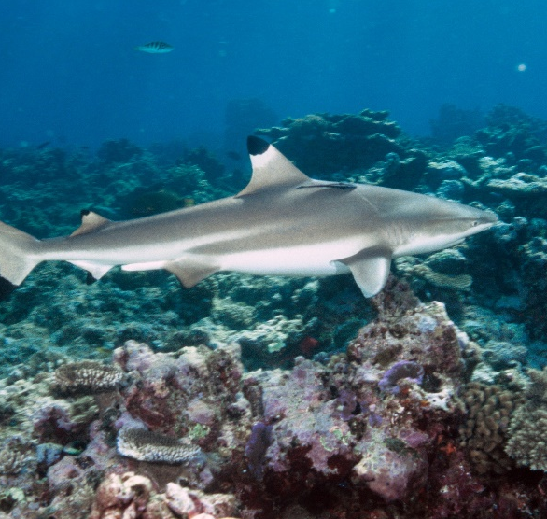
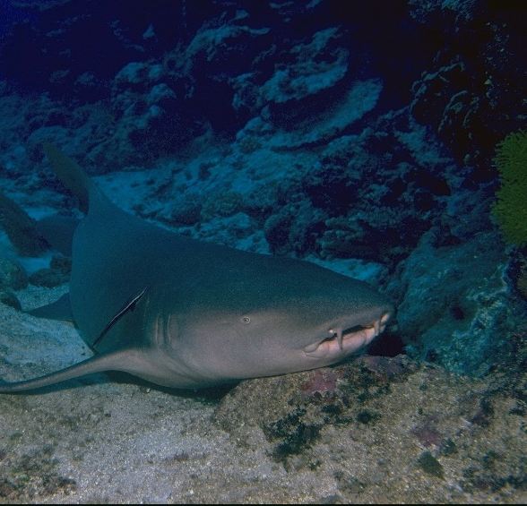
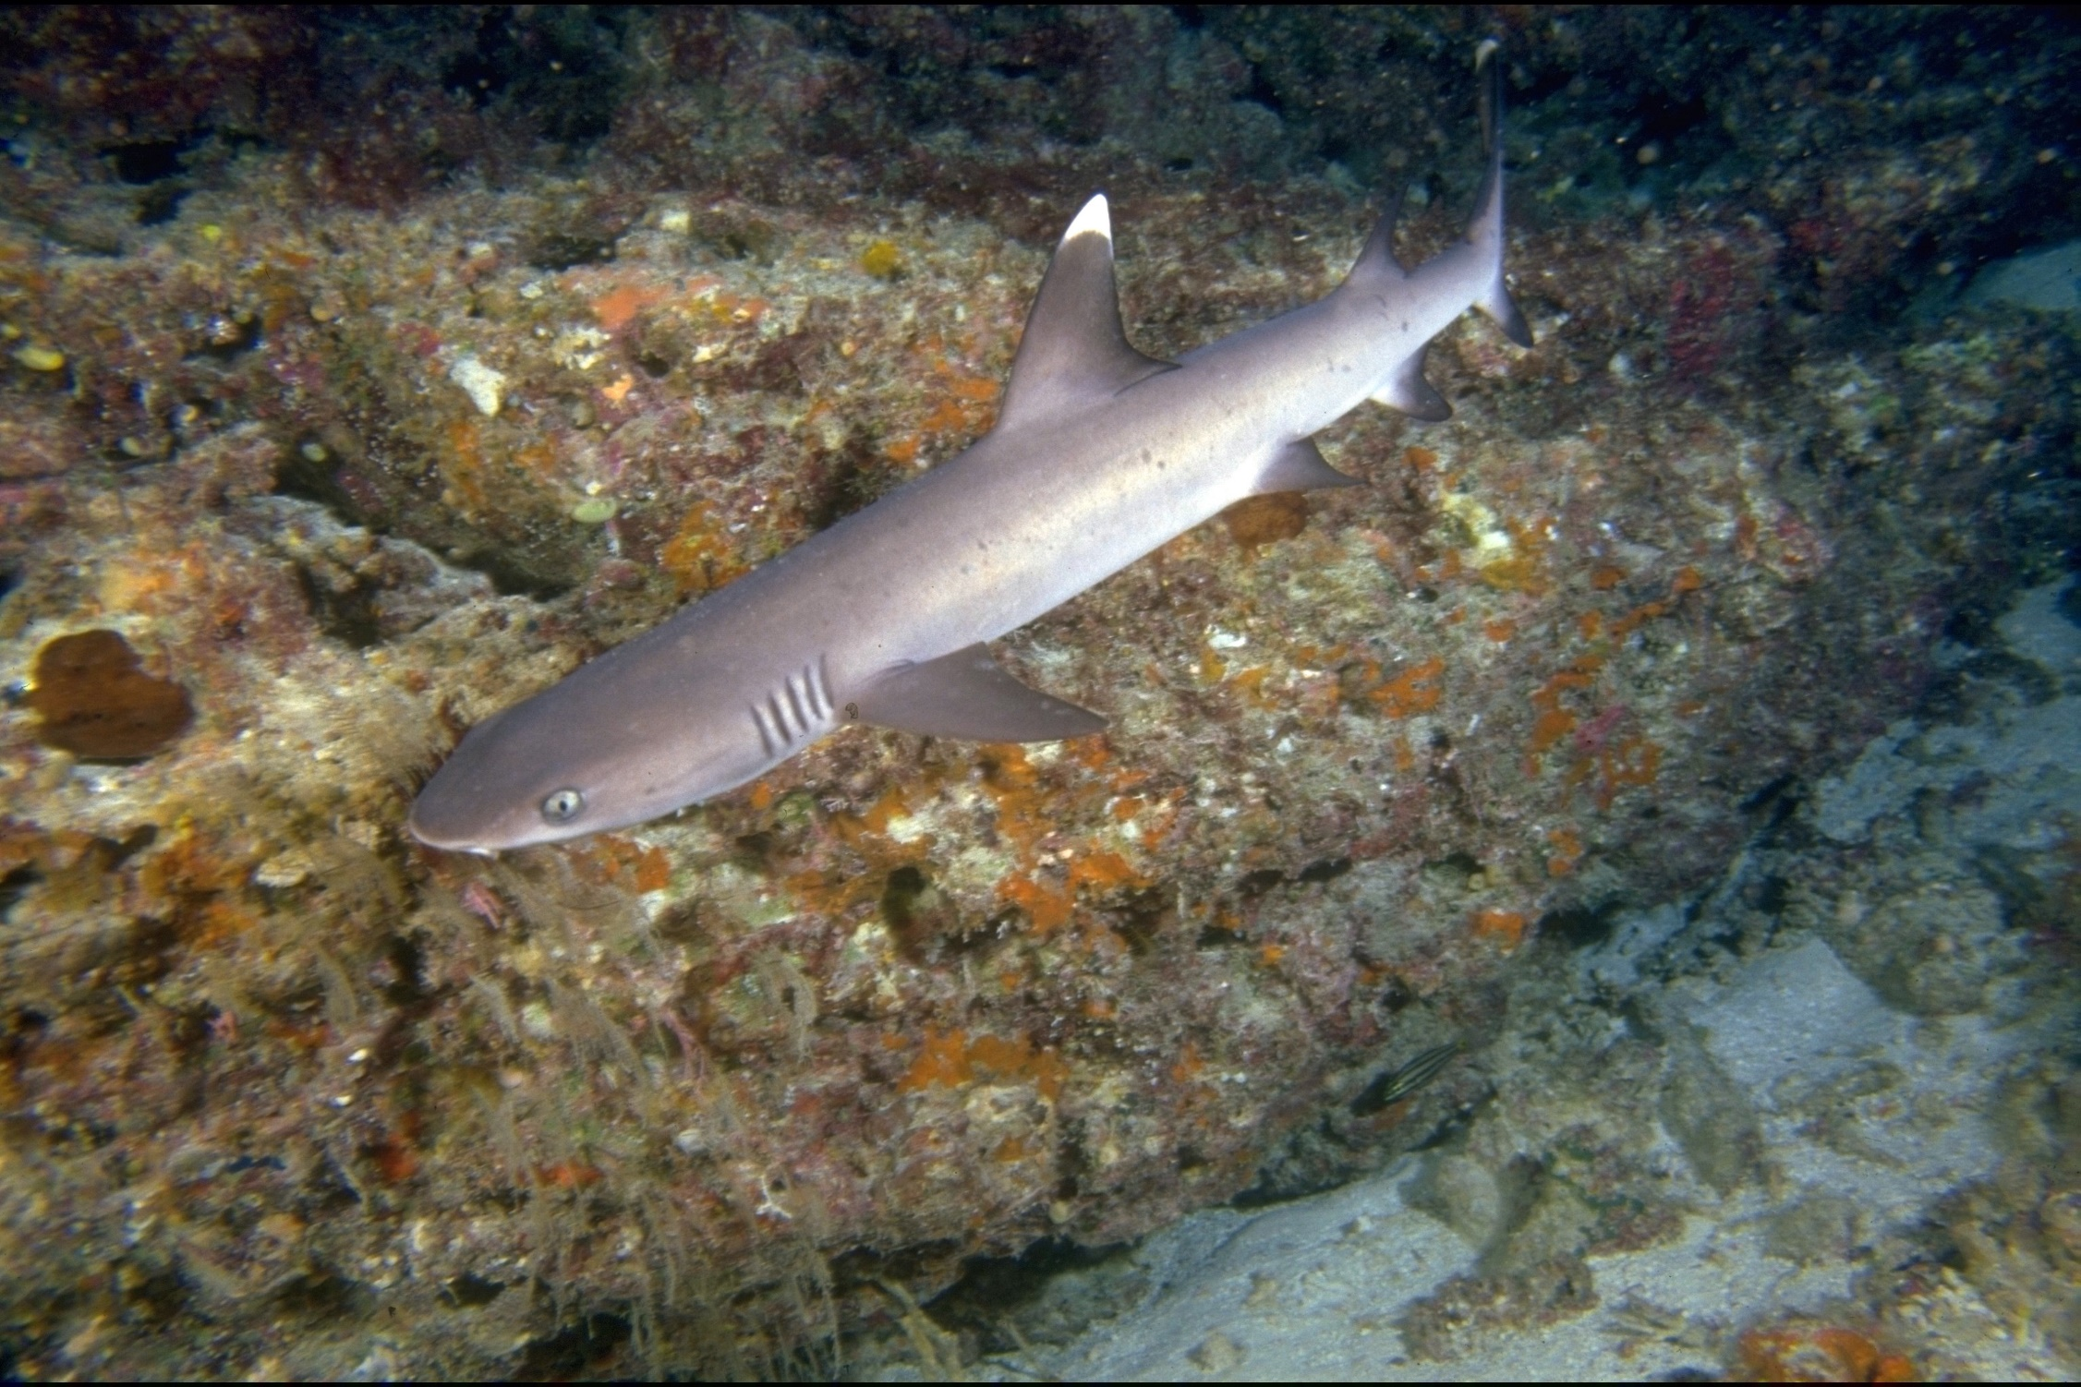
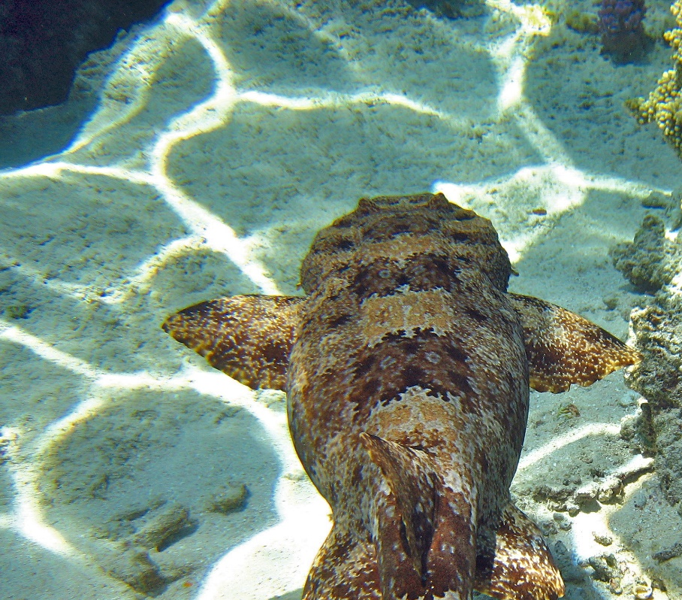
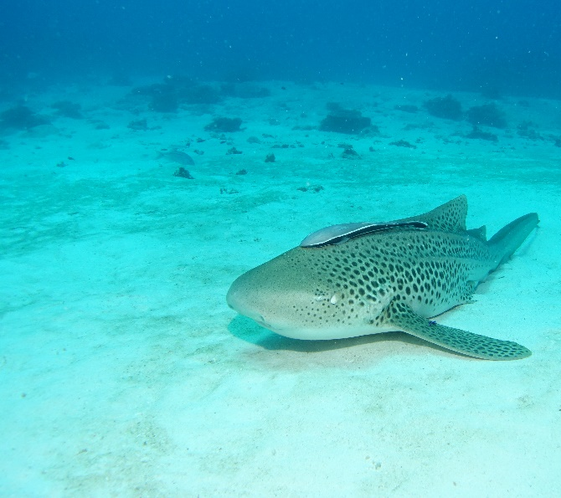
Sharks
Whitetip / Blacktip / other
Epaulette
Blacktip
Tawny nurse
Whitetip
Wobbegong
Leopard
Notes:
Images: (Top Left) C. Jones, Copyright Commonwealth of Australia (GBRMPA); (Bottom Left) T. Mayne, Copyright Commonwealth of Australia (GBRMPA); (Top Middle) K. Hoppen, Copyright Commonwealth of Australia (GBRMPA); (Bottom Middle) C. Jones, Copyright Commonwealth of Australia (GBRMPA); (Top Right) R. Berklemans, Copyright Commonwealth of Australia (GBRMPA); (Bottom Right) C. Jones, Copyright Commonwealth of Australia (GBRMPA)

Slide 28
Ask if anyone saw any COTS [juvenile].
Ask if anyone saw any COTS [adult].
Ask each buddy pair to read their tally out loud.
If more than one buddy pair counted COTS,
then calculate the average.
Wait for everybody to write it down.
Questions:
Was it somewhere out and about and easy to see?
Or, was it underneath something and difficult to spot?
Could you see where it had been?

Slide 29
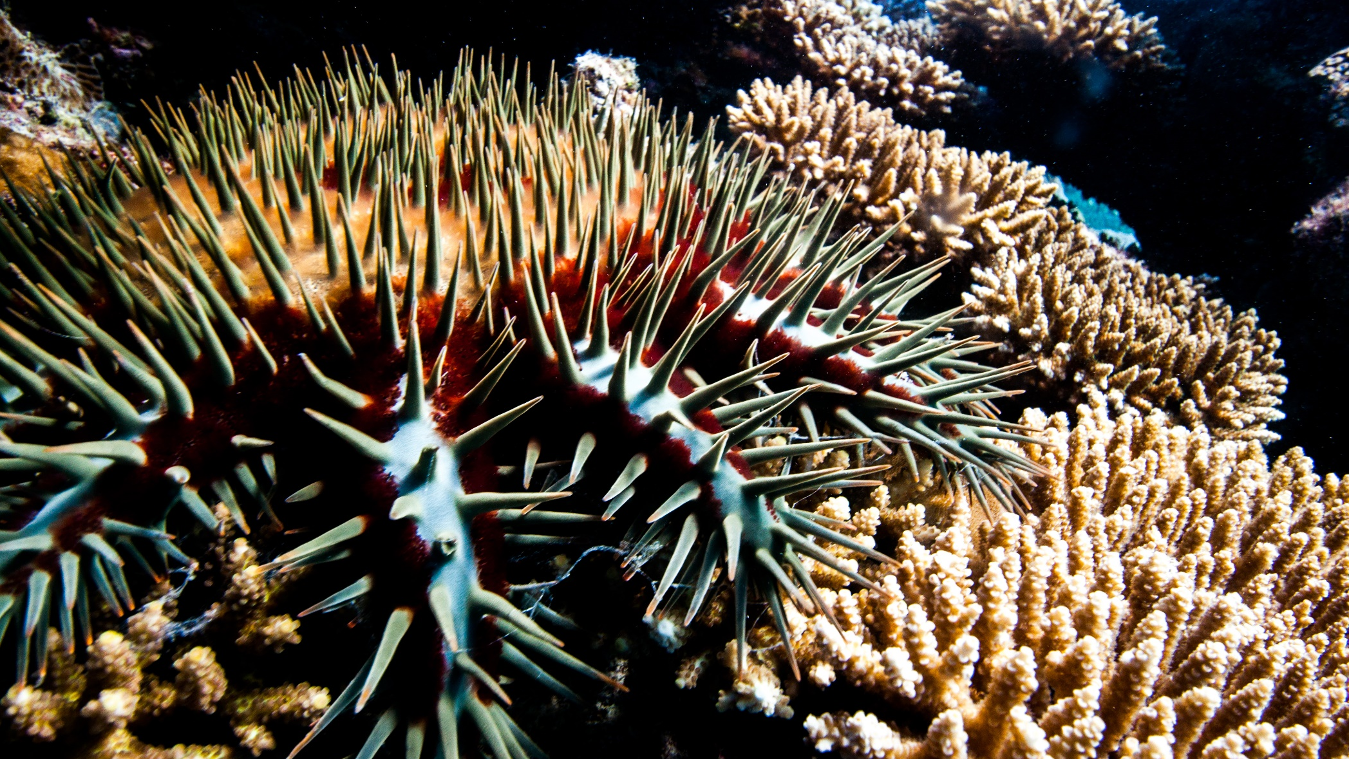
Crown-of-Thorns Starfish (COTS)
Juvenile / Adult
Notes:
Image: J. Hurford, Copyright Commonwealth of Australia (GBRMPA)

Slide 30
Check point.

Slide 31
Ask why it is important to count these animals?
Questions:
What do sea cucumbers and grazing herbivores like to eat? [pause for answer]; What do you think would happen if they were all gone?
What do cods and groupers, coral trout and sharks eat? [pause for answer]; What do you think would happen if they were all gone?
What do Maori wrasse eat? [pause for answer]; What do you think would happen if they were all gone?
What do butterflyfish eat? [pause for answer]; If there are a lot of butterflyfish, that means there is a lot of?
Who really wanted to see an anemonefish or a turtle today? [pause]; Do you think people from all over the world want to see them too?
What would happen to all these animals if the coral reef wasn’t here?

Slide 32
Why is it important to count these animals?

Slide 33
Next step?
Back at school, you will login with your teacher and tell GBRMPA how many you counted!
Schools are shown how to register to Eye on the Reef (Rapid Monitoring and Sightings)
pre-excursion (Part 1) and how to login and upload their data post excursion (Part 3).
Confirm the teacher has registered.

Slide 34
What can I do now?

Slide 35
What can I do now?
You can download the Eye on the Reef app on your smart device to record what you saw today.

Slide 36
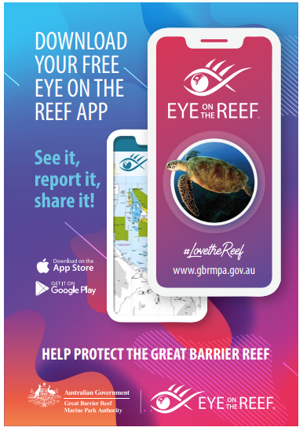
Download the
Eye on the Reef app
to record what you
saw today!
Notes:
App image: https://www.gbrmpa.gov.au/__data/assets/pdf_file/0020/265430/Eye-on-the-Reef-app-poster.pdf

Slide 37
What can I do now?
You can record any animal you saw on your trip today.

Slide 38
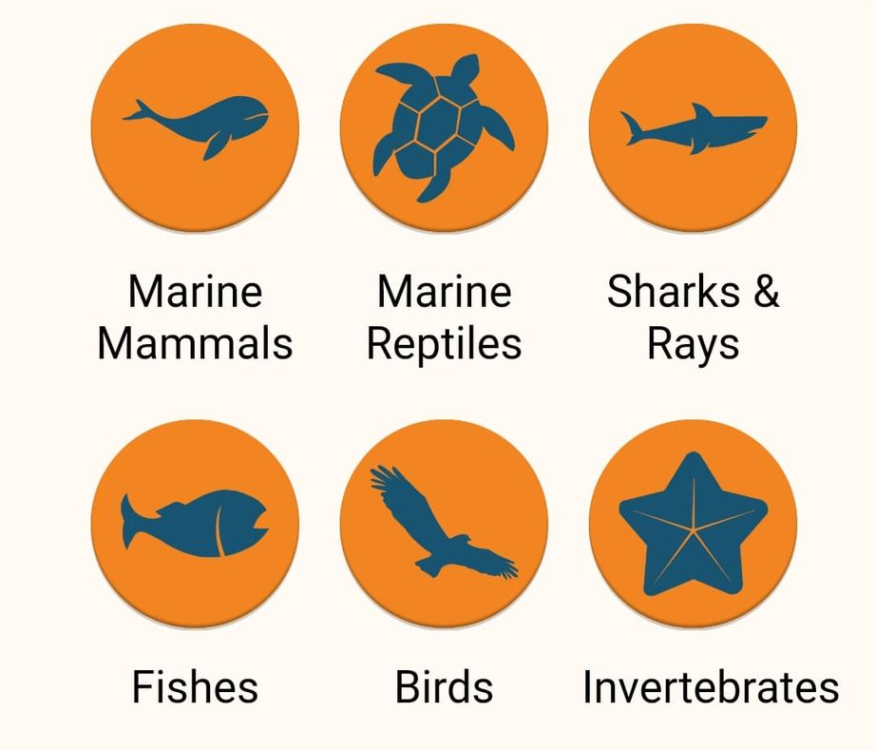
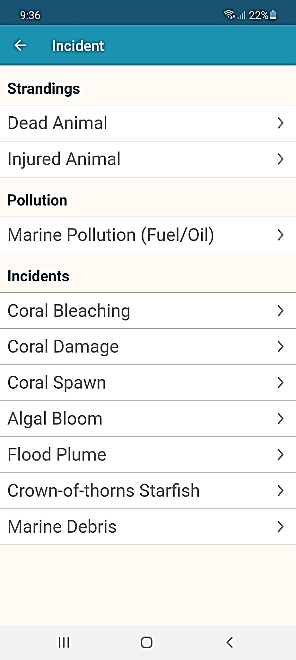
This is what you can record on the app.

Slide 39
What can I do now?
This is the home screen of the Eye on the Reef app.
To create a sighting, ‘click’ on Sightings.

Slide 40
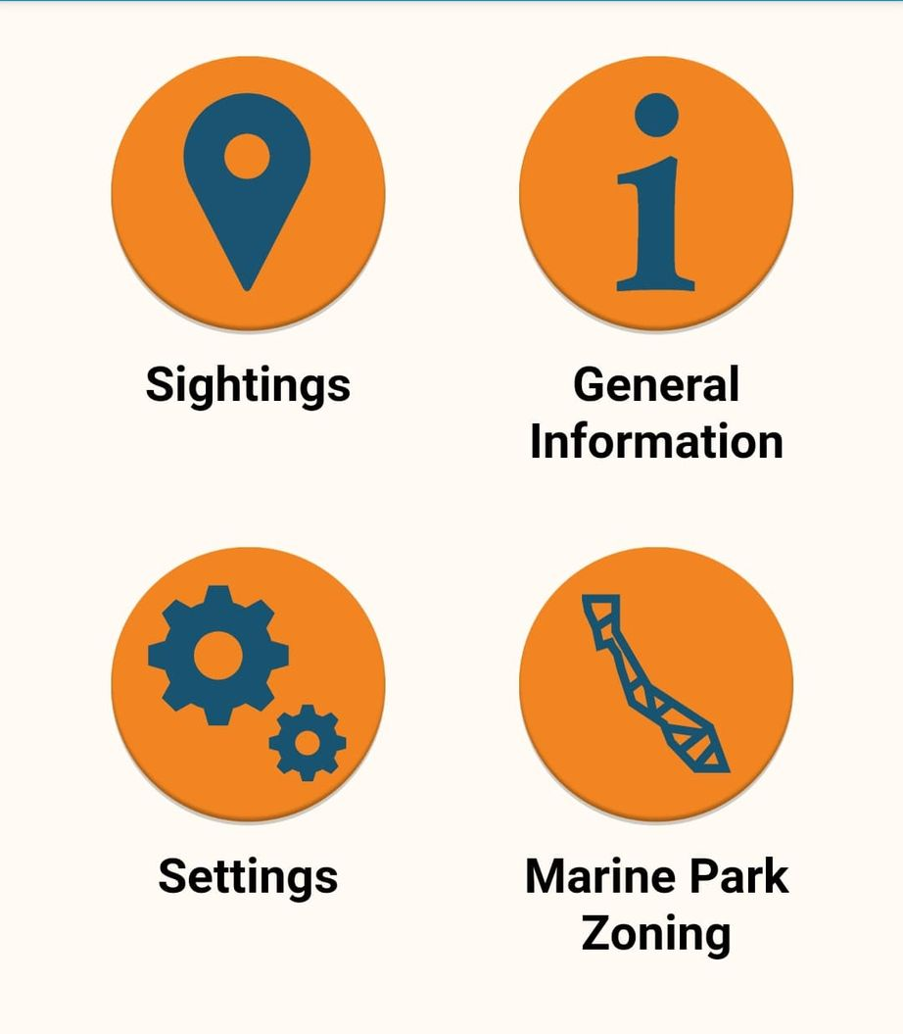
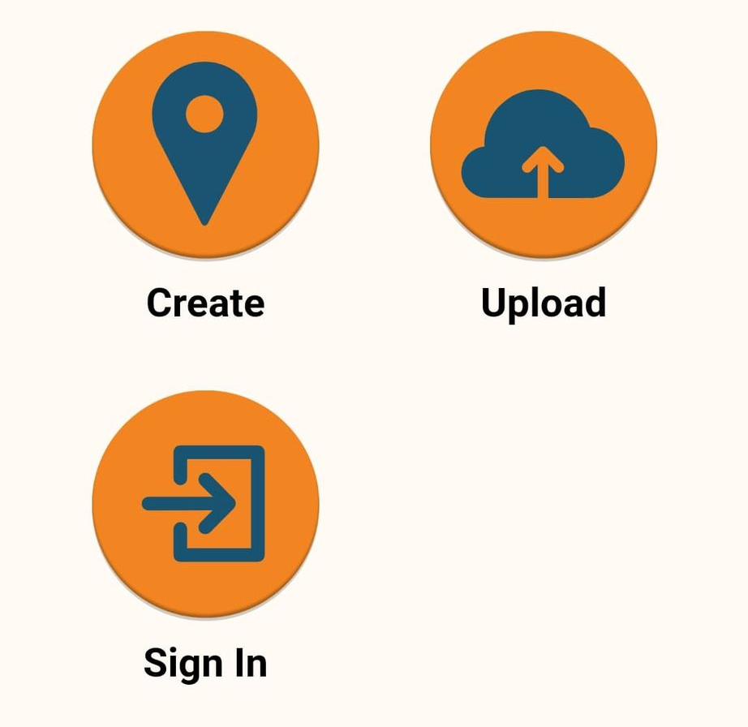

Slide 41
What can I do now?
‘Click’ on Wildlife

Slide 42
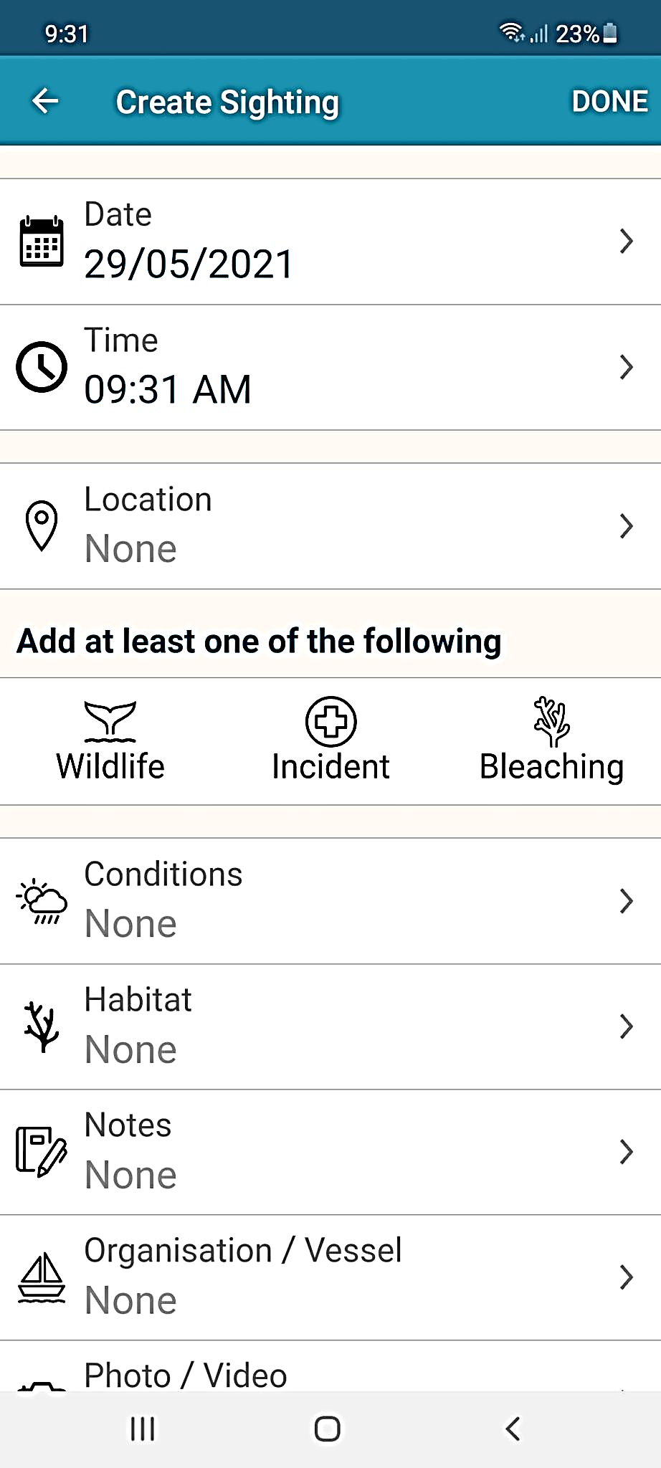
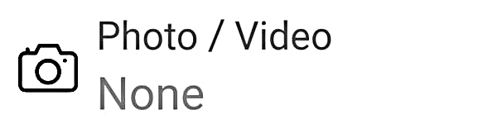

Slide 43
What can I do now?
You can pick the type of animals you saw today.

Slide 44
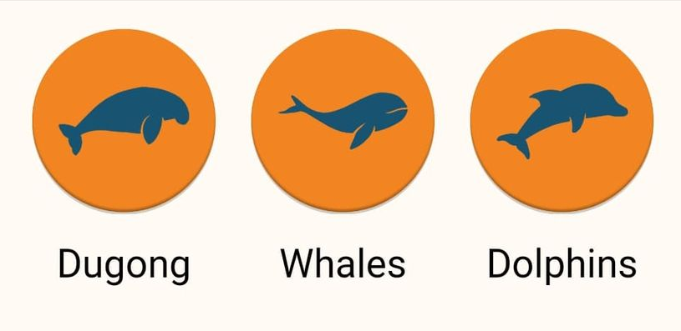
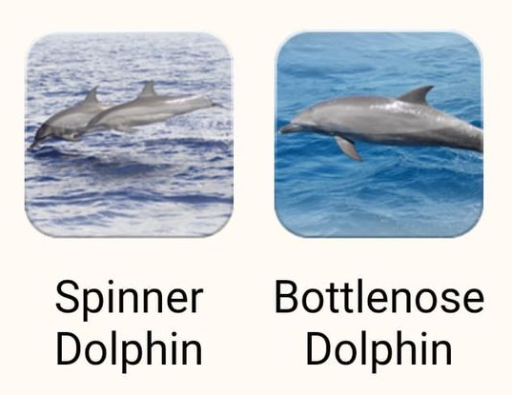
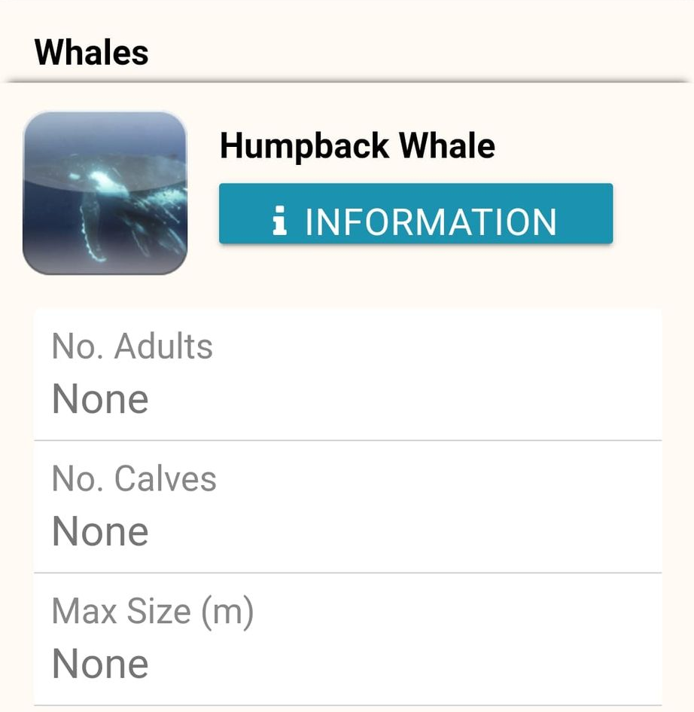
Marine mammals.

Slide 45
What can I do now?
You can pick the type of animals you saw today.

Slide 46
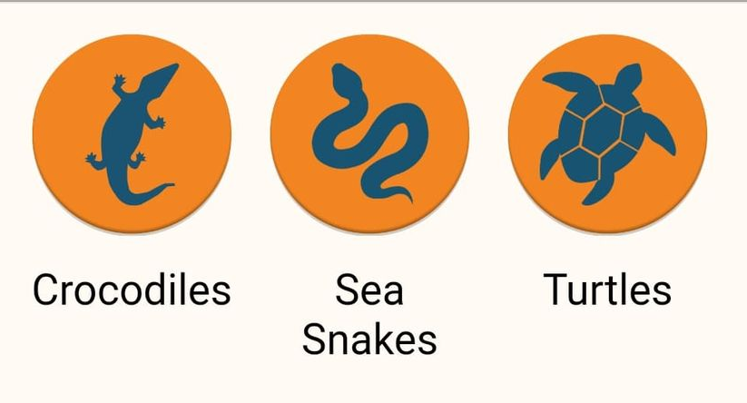
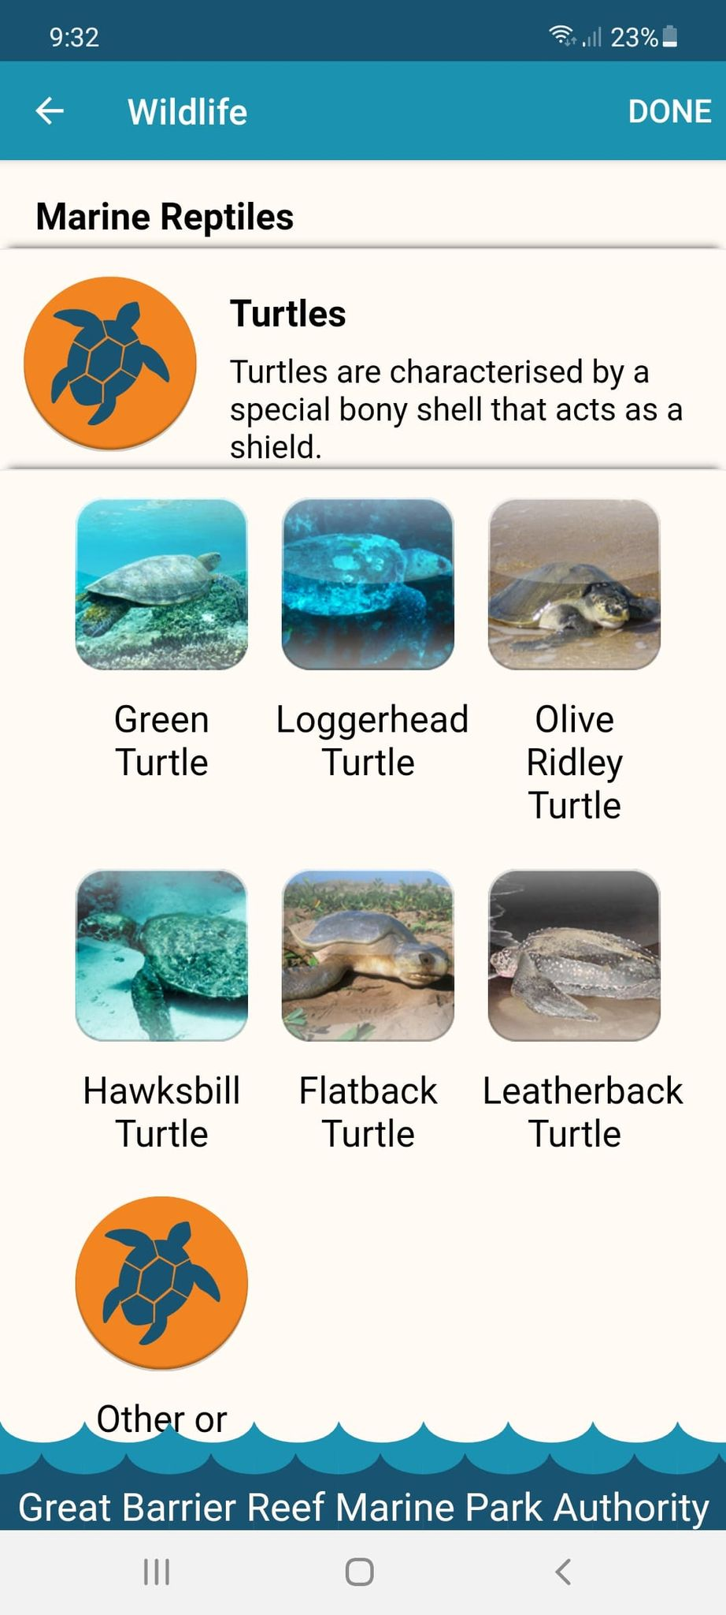
Marine reptiles.

Slide 47
What can I do now?
You can pick the type of animals you saw today.

Slide 48
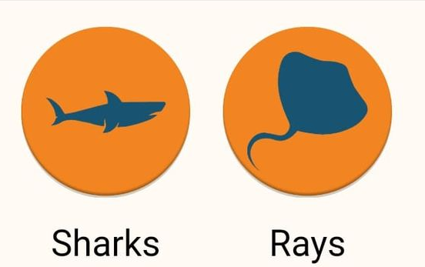
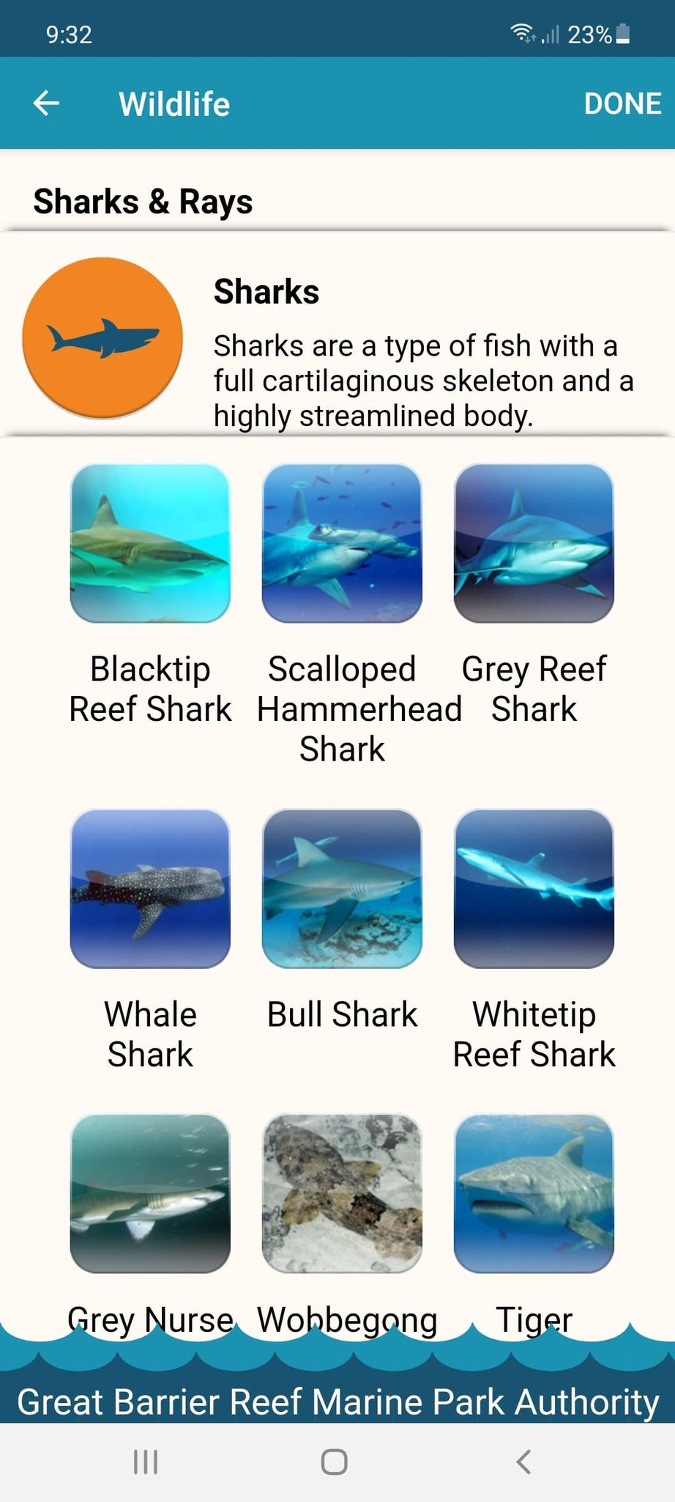
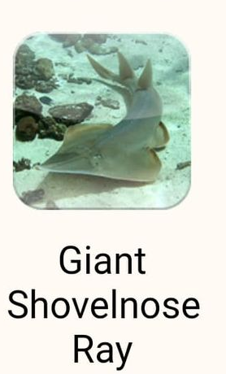
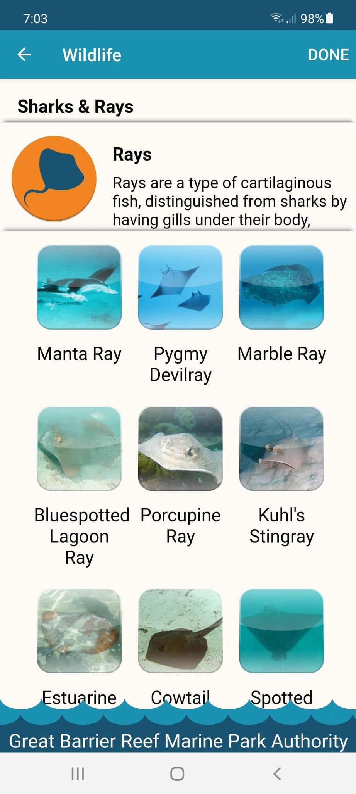
Sharks and rays.

Slide 49
What can I do now?
You can pick the type of animals you saw today.

Slide 50
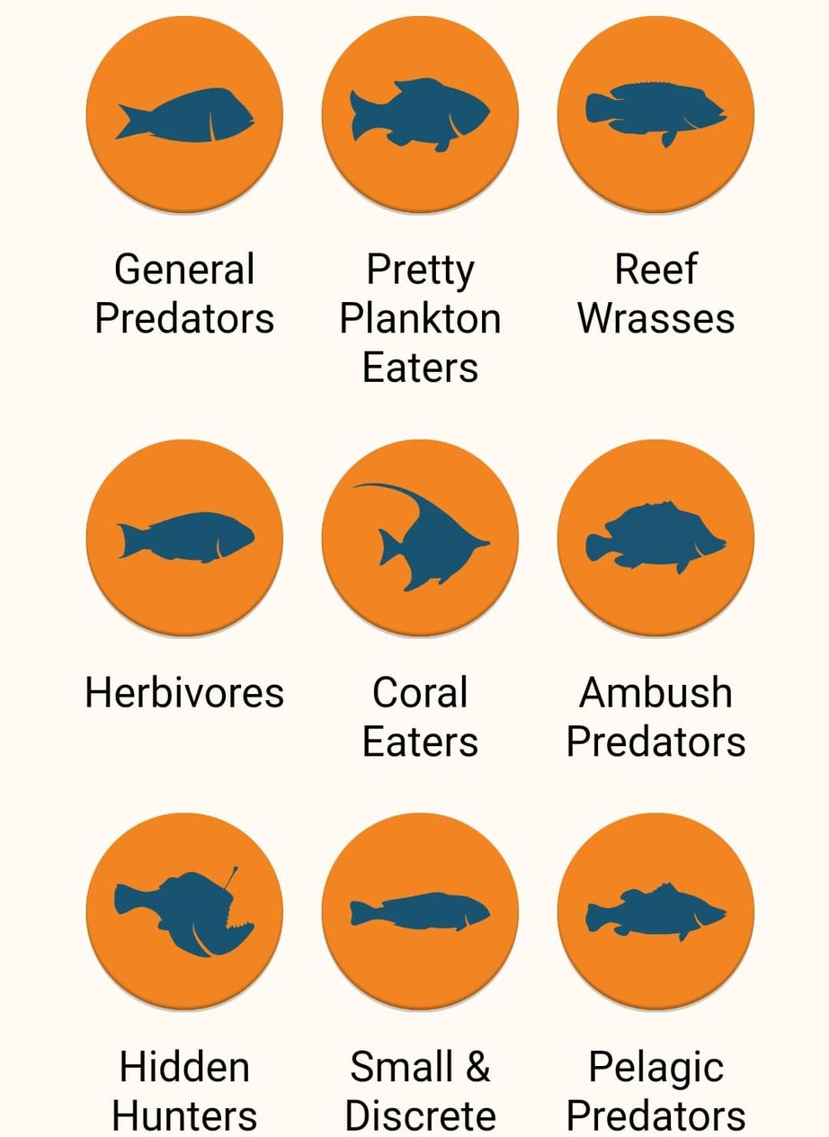


Fishes.

Slide 51
What can I do now?
As you can see, there are many different fish on the Reef. How many did you see?

Slide 52











Slide 53
What can I do now?
You can pick the type of animals you saw today.

Slide 54





Birds.

Slide 55
What can I do now?
You can pick the type of animals you saw today.

Slide 56


Invertebrates.

Slide 57
What can I do now?
As you can see, there are many different invertebrates on the Reef. How many did you see?

Slide 58










Slide 59
What can I do now?
You can pick the type of incidents you saw today (if any).

Slide 61
What can I do now?
You can pick the type of incidents you saw today (if any).

Slide 62

Incident.

Slide 63
What can I do now?
You can pick if you saw any bleaching today.

Slide 65

Bleaching.

Slide 66
Ask What actions can you take to protect what you have seen today?
Link to climate change actions,

Slide 67

What actions can you take to protect what you have seen today?
Notes:
App image: https://www.gbrmpa.gov.au/__data/assets/pdf_file/0020/265430/Eye-on-the-Reef-app-poster.pdf

Slide 68
Check if students have the Rapid Monitoring details correct.

Slide 69

Section 1 details for teacher and any interested students.
Your name
The date
Name of business
am/pm
Name of vessel
Name of school and grade
?
Name of reef
Name of site
Colour of zone
?
?
Notes:
Show the teacher (or interested students) what to write in the sections in red. They WILL NEED IT for part 3 back at school.

Slide 70
We hope you enjoyed you day visiting the Great Barrier Reef!
See the Reef • Love the Reef • Protect the Reef

