Slide 1
Be a Marine
Biologist for a Day
Part 2: Finding out
Senior School
Post-snorkel presentation for
10 minute timed survey.
Notes:
Image: C. Golino, Copyright Commonwealth of Australia (GBRMPA)

Slide 2

How will I help the
Great Barrier Reef today?
By calculating averages and completing section 1, ready to upload to GBRMPA.

Slide 3

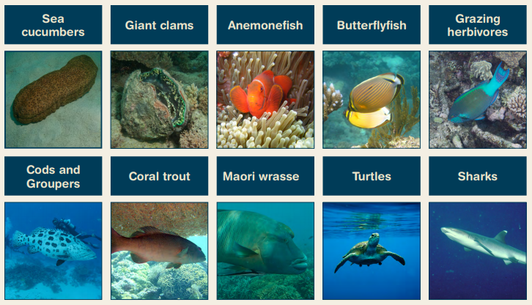
What we counted in 10 minutes.
Notes:
Idea: you could organise a prize for the person with the most correct answers?

Slide 5
“Are you ready to share your data and complete this form?
We will do it together. I will show you how.
Do you have your data sheets and activity books ready?”
Check each student has their data sheets and activity books (and a pencil).
(activity books have a copy of the Rapid Monitoring form)
or
Check they have their data somewhere and a Rapid Monitoring survey form and a pencil each (that they can take home with them).
This is a good time to collect any borrowed equipment.

Slide 6
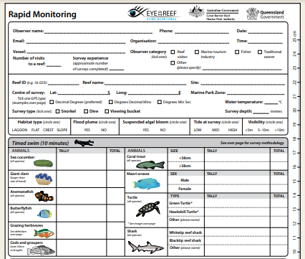
“Are you ready to share your data, and transfer the class data from our slates to a Rapid Monitoring survey form that you can take home with you? There is one in your activity book.”
Rapid Monitoring survey form
(in activity book).

Slide 7
Filling out the form
Walk students through each line:
Observer name
Date
Time

Slide 8
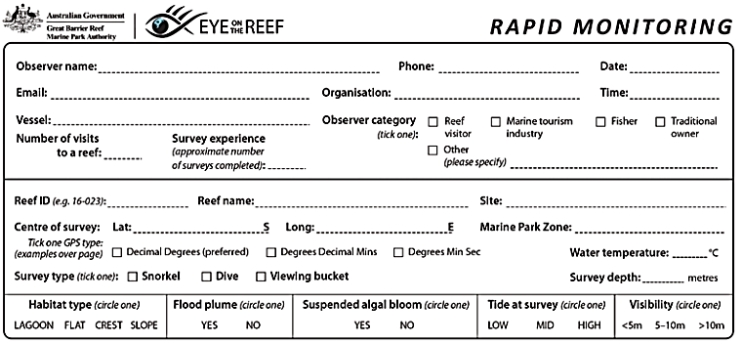
Observer name:
Date:
Time (of snorkel):
Your name
The date
am/pm

Slide 9
Filling out the form
Walk students through each line:
Organisation
Vessel name
Observer category (i.e. name of school and grade)

Slide 10
Organisation: name of the business
Vessel: name of the vessel/s
Observer category: tick Other (name of school)
Name of business
Name of vessel
Name of school and grade

Slide 11
Filling out the form
Walk students through each line:
Reef ID

Slide 12
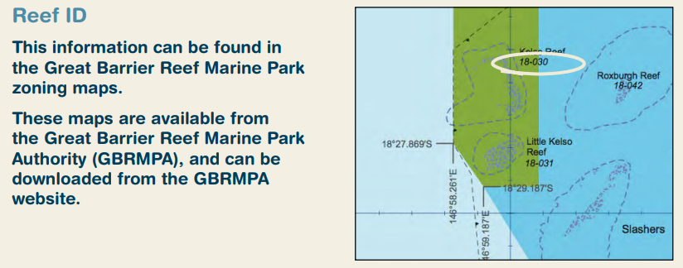
Reef ID: 18-030 (example only).
Notes:
Change the REEF ID number on the slide!!!

Slide 13
Filling out the form
Walk students through each line:
Reef name

Slide 14
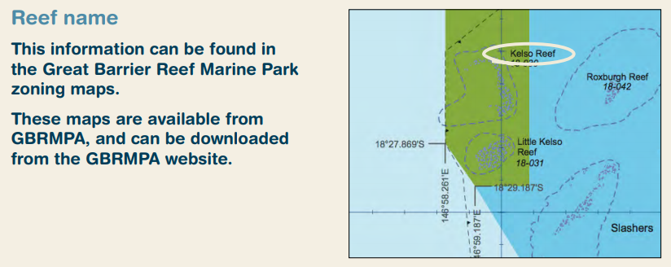
Reef name: Kelso Reef (example only).
Notes:
Change the REEF NAME on the slide!!!

Slide 15
Filling out the form
Walk students through each line:
Name of site

Slide 16
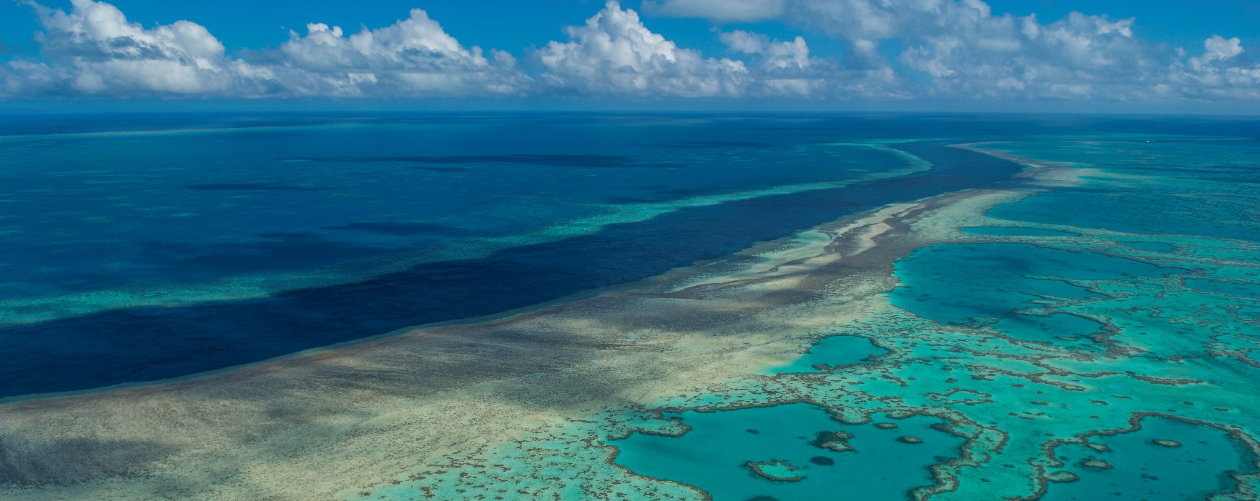
Site: The lagoon (example only).
Notes:
Change the SITE NAME on the slide!! Replace with a photo of YOUR site (same as previous slide)
Image: Copyright Commonwealth of Australia (GBRMPA)

Slide 17
Filling out the form
Walk students through each line:
Colour of marine park zone

Slide 18
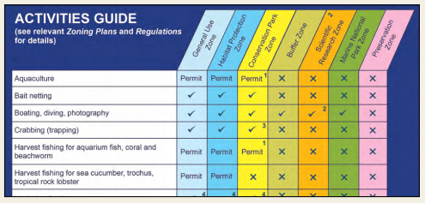
Marine Park Zone: Green (example only).
Notes:
Add the colour of the zone/s that you snorkel

Slide 19
Filling out the form
At this point, check if students have the following filled:
Student’s name
Date
Business name
Time
Observer category (i.e. name of school and grade)
Reef ID
Name of reef
Name of site
Colour of marine park zone

Slide 20
Check point.
Your name
The date
Name of business
am/pm
Name of vessel
Name of school
?
Name of reef
Name of site
Colour of zone

Slide 21
Filling out the form
Walk students through each line:
Lat and Long
Tick decimal degrees

Slide 22
Latitude (Lat):
Longitude (Long):
18.6582°
146.489°

Slide 23
Filling out the form
Walk students through each line:
Tick snorkel
Record water temperature
Record survey depth

Slide 24
Water temperature:
Survey type: tick snorkel
Survey depth:
?
?

Slide 25
Filling out the form
Walk students through each line:
Circle habitat type

Slide 26
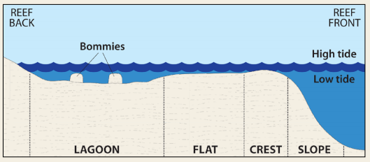
Habitat type.
Notes:
Add the colour of the zone/s that you snorkel

Slide 27
Filling out the form
Walk students through each line:
Circle if flood plume present

Slide 28
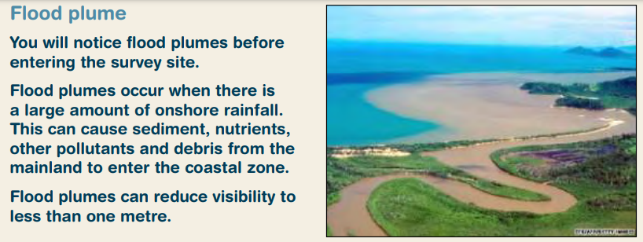
Flood plume.
YES NO
Notes:
Add the colour of the zone/s that you snorkel

Slide 29
Filling out the form
Walk students through each line:
Circle if suspended algal bloom present

Slide 30
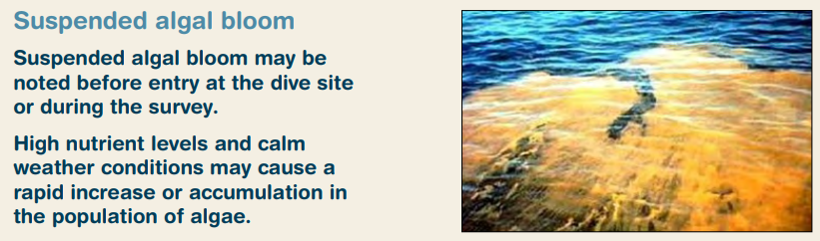
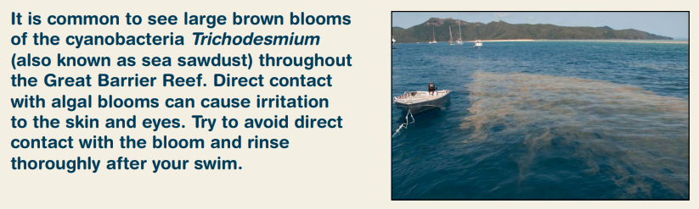
Suspended algal bloom.
YES NO
Notes:
Add the colour of the zone/s that you snorkel

Slide 31
Filling out the form
Walk students through each line:
Circle tide at survey

Slide 32
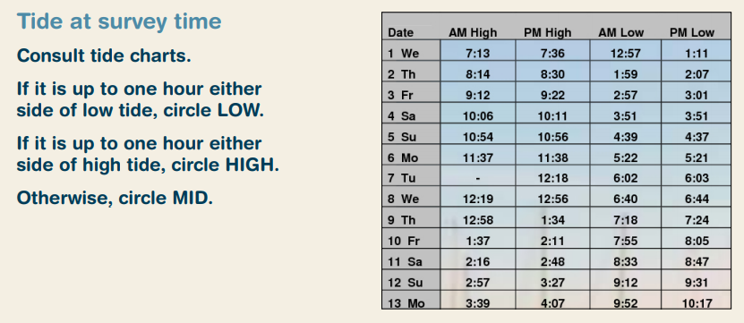
Tide at survey.
LOW MID HIGH
Notes:
Add the colour of the zone/s that you snorkel

Slide 33
Filling out the form
Walk students through each line:
Circle visibility

Slide 34
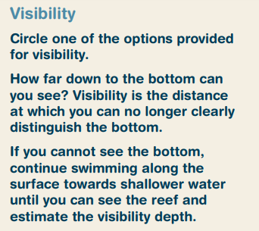
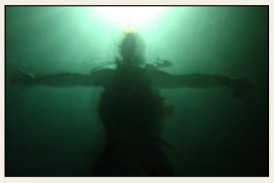
Visibility.
<5m 5-10m >10m
Notes:
Add the colour of the zone/s that you snorkel

Slide 35
Filling out the form
At this point, check if students have the following circled:
Habitat type
Flood plume present
Suspended algal bloom present
Tide at survey
Visibility

Slide 36
Check point.
Your name
The date
Name of business
am/pm
Name of vessel
Name of school and grade
?
Name of reef
Name of site
Colour of zone
?
?

Slide 37
Filling out the form
Check if students are ready to proceed to the next section.

Slide 38
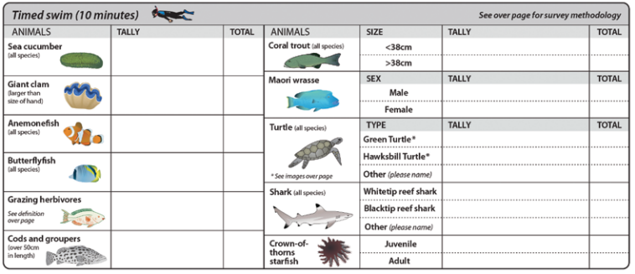
Are you ready to complete the next section?

Slide 39
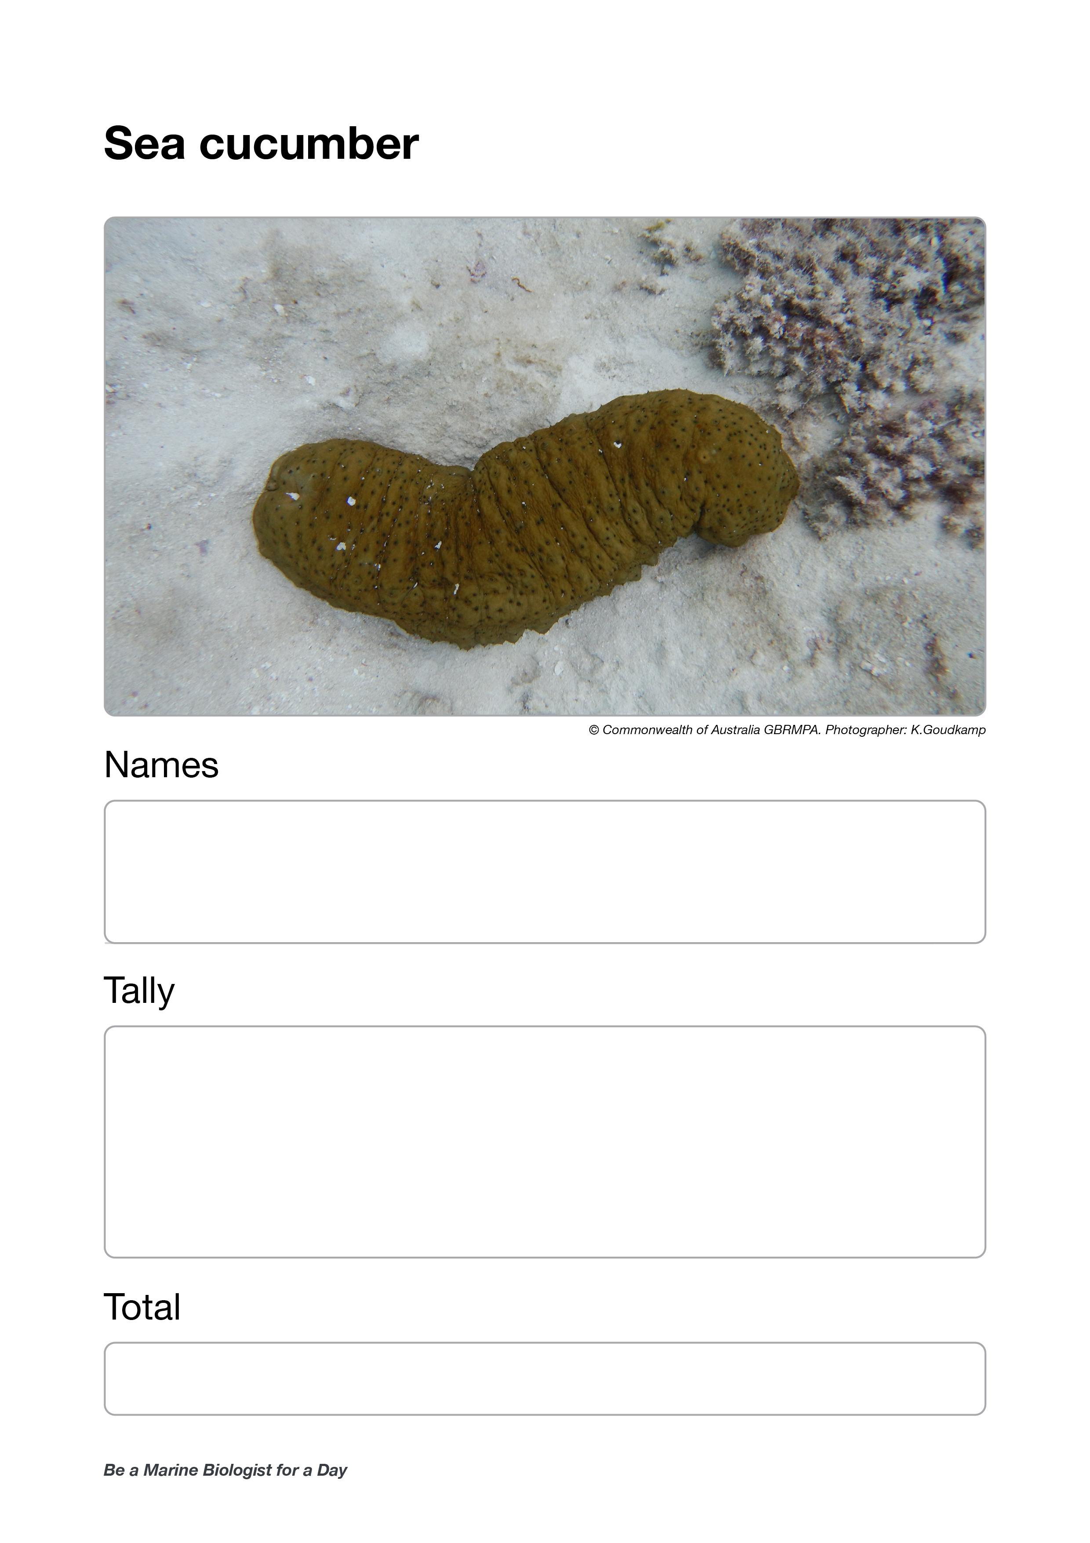
Ask for sea cucumber data.
Calculate the average.
Write it in the total box.

Slide 40
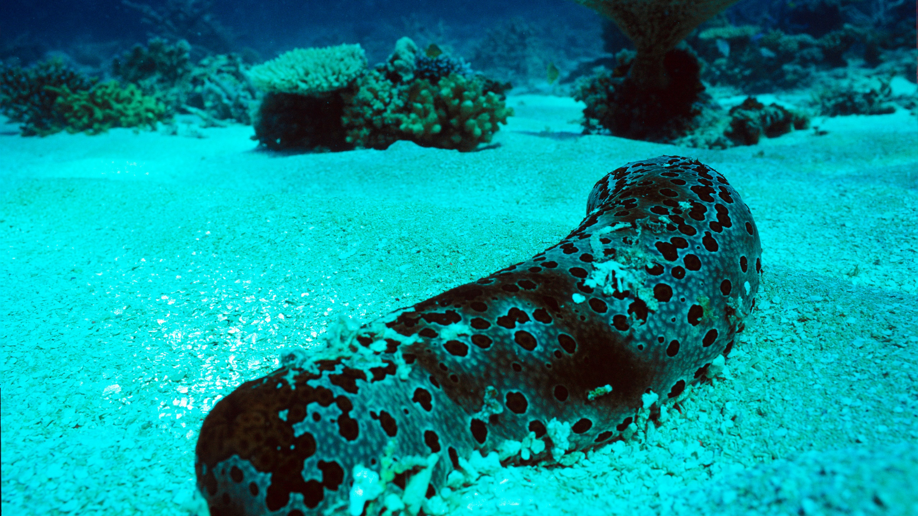

Sea cucumber
Notes:
Image: J. Oliver, Copyright Commonwealth of Australia (GBRMPA)

Slide 41
Write the number of sea cucumbers here.

Slide 42
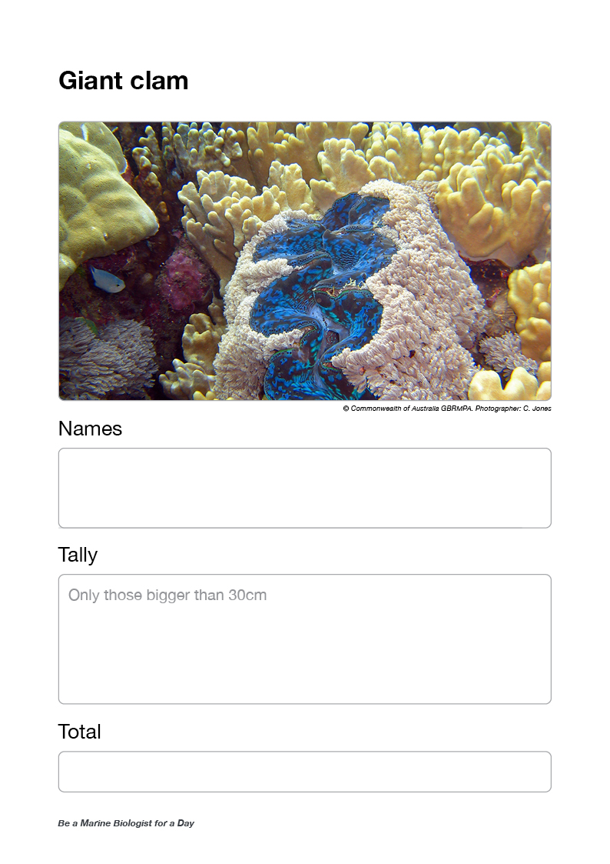
Ask for giant clam data.
Calculate the average.
Write it in the total box.

Slide 43
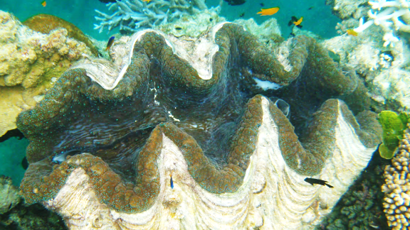
Giant clam
VULNERABLE TO EXTINCTION
Notes:
Image: Copyright Commonwealth of Australia (GBRMPA)

Slide 44
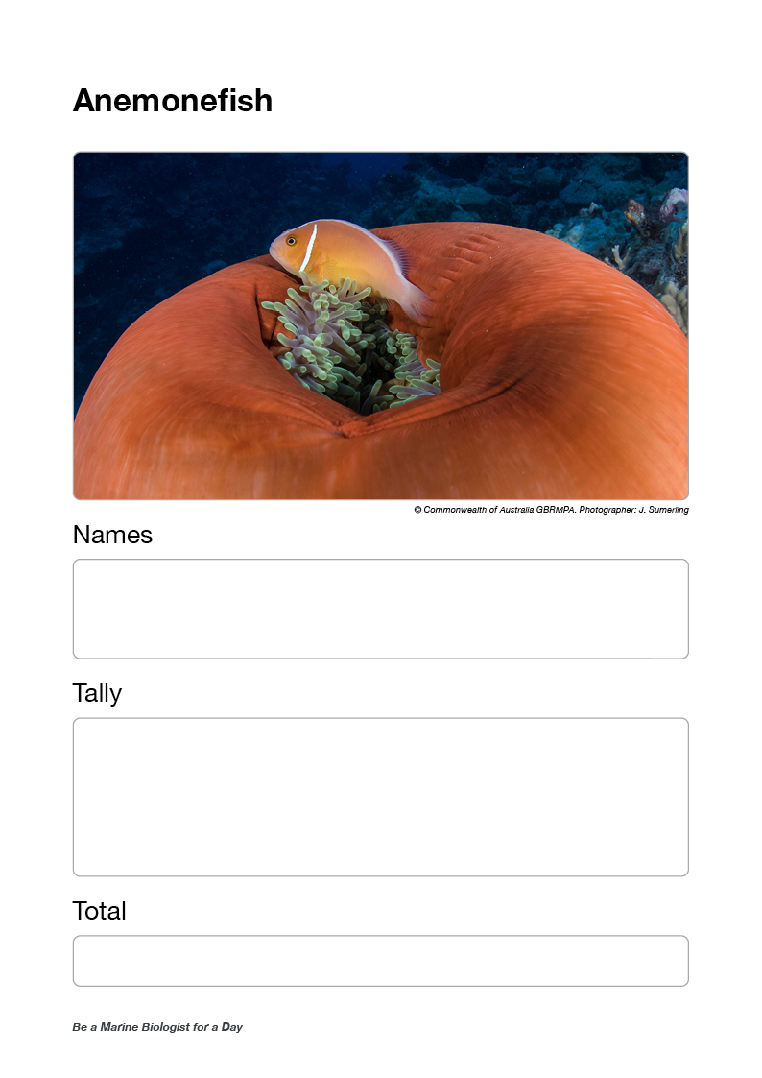
Ask for anemonefish data.
Calculate the average.
Write it in the total box.

Slide 45
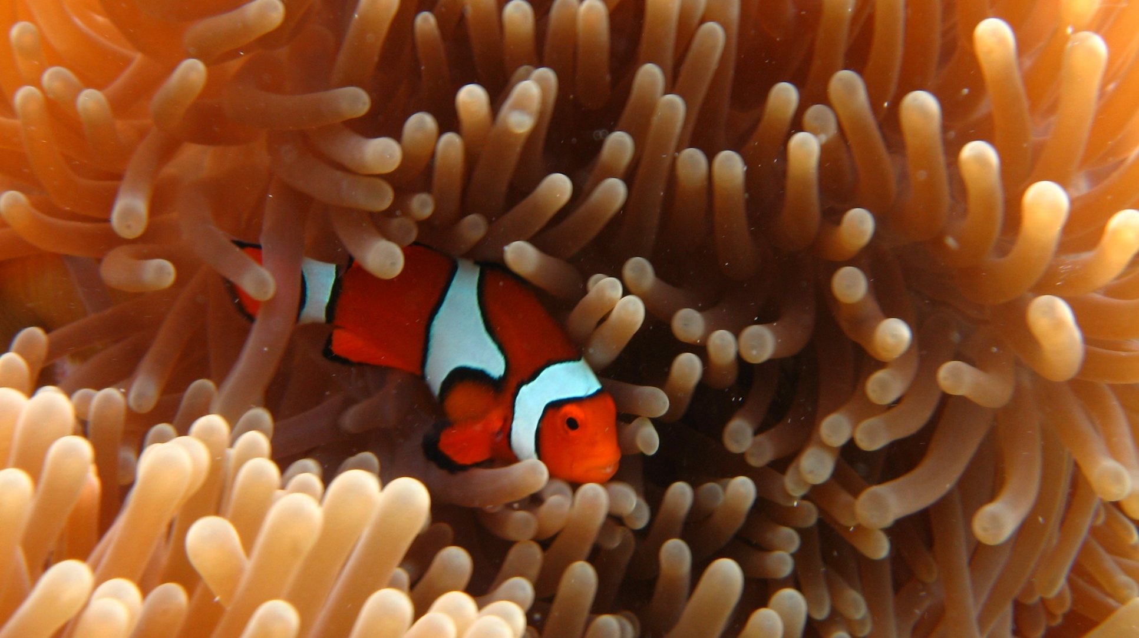
Anemonefish
Notes:
Image: E. Smart, Copyright Commonwealth of Australia (GBRMPA)

Slide 46
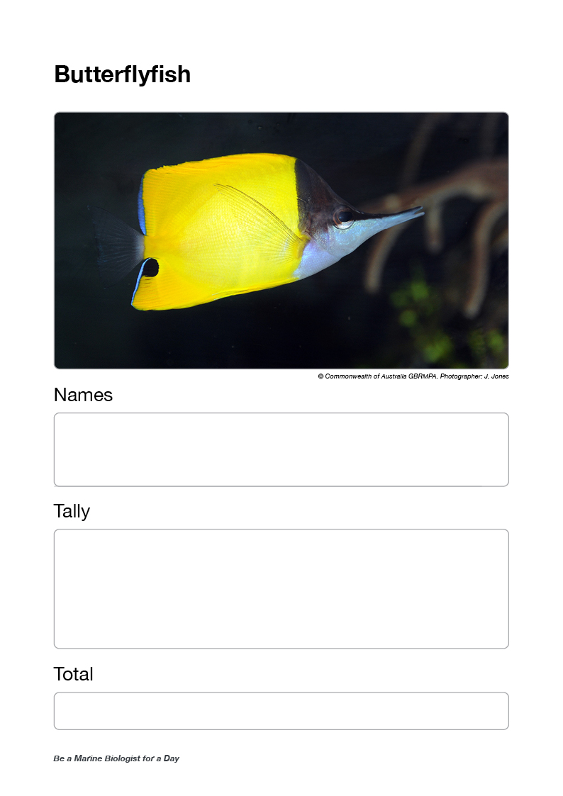
Ask for butterflyfish data.
Calculate the average.
Write it in the total box.
Question:
Did anyone see what they were eating?

Slide 47
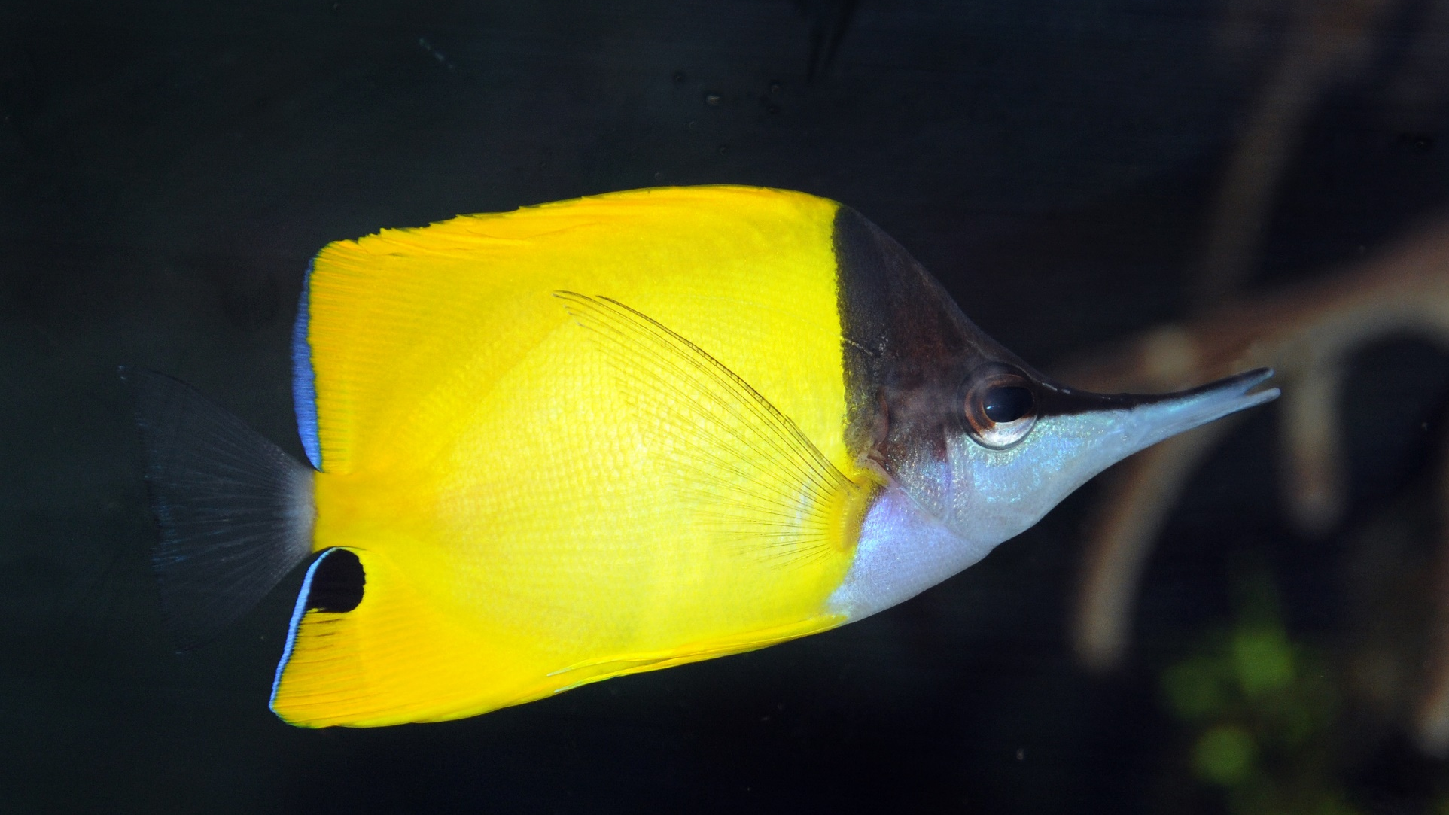
Butterflyfish
Notes:
Image: J. Jones, Copyright Commonwealth of Australia (GBRMPA)

Slide 48
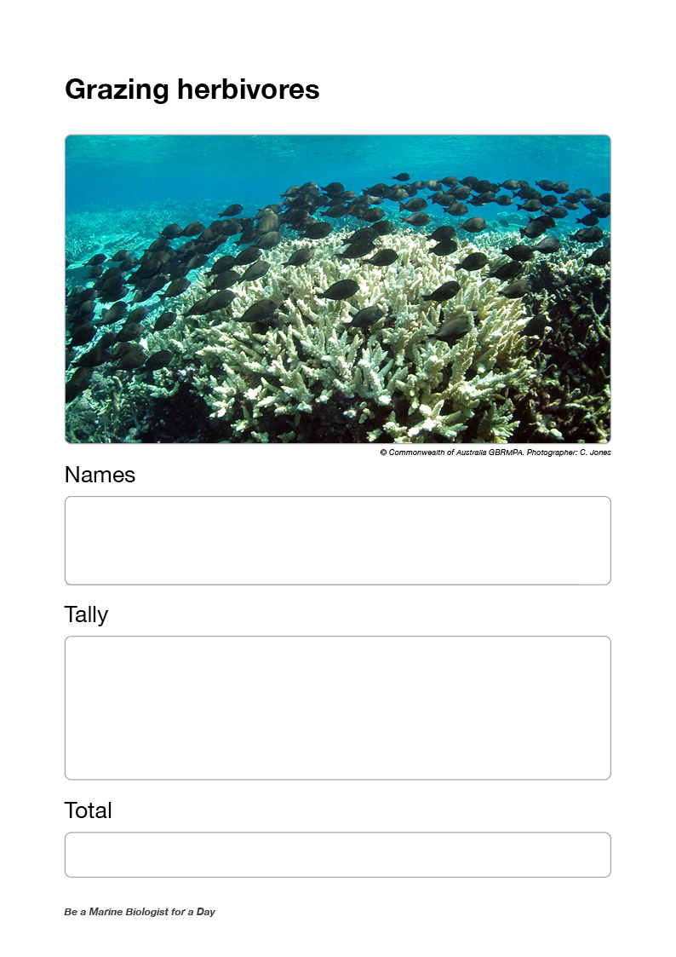
Ask for grazing herbivore data.
Calculate the average.
Write it in the total box.
Questions:
Did anyone see grazing herbivores poop?
Could anyone hear them eating?
Did anyone pay attention to what they were eating?

Slide 49
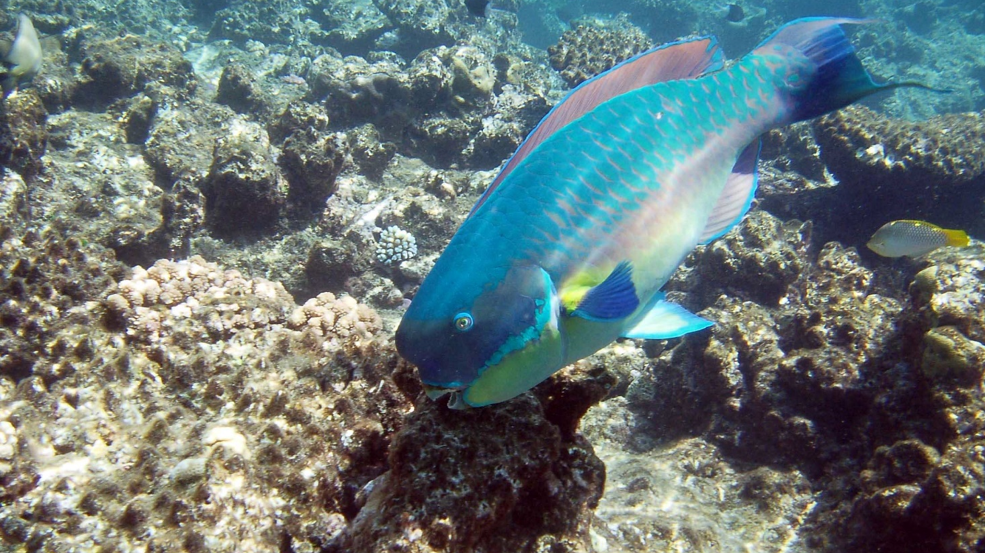
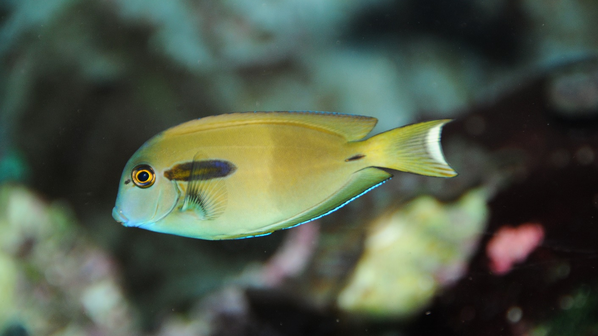
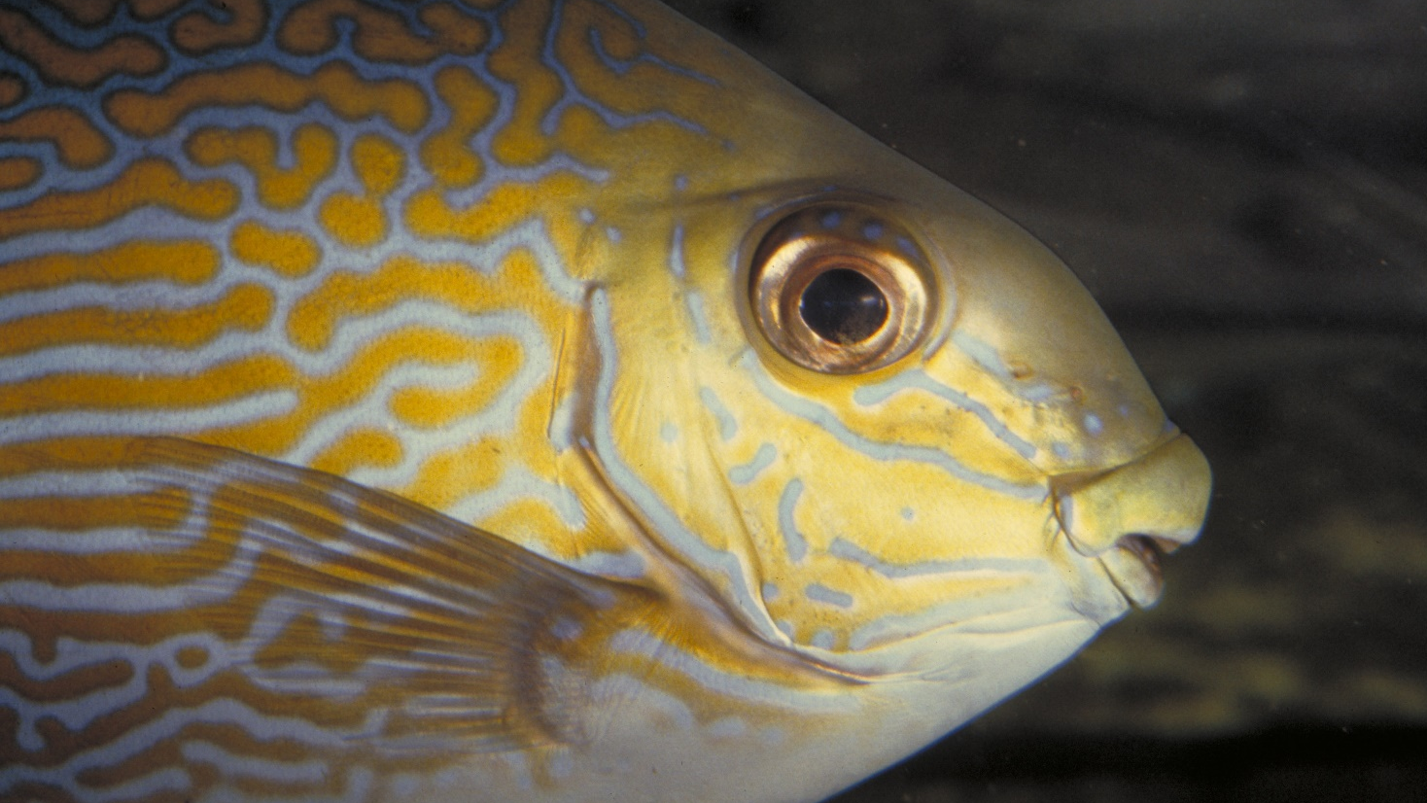
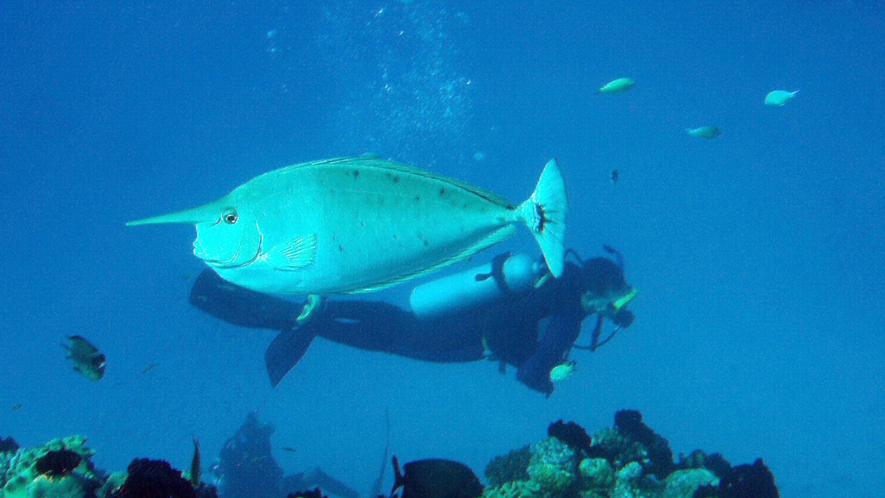
Grazing herbivores
Parrotfish
Surgeonfish
Rabbitfish
Unicornfish
Notes:
Images: (Top Left) C. Jones, Copyright Commonwealth of Australia (GBRMPA); (Top Right) J. Jones, Copyright Commonwealth of Australia (GBRMPA); (Bottom Left) L. Zell, Copyright Commonwealth of Australia (GBRMPA); (Bottom Right) A. Smith, Copyright Commonwealth of Australia (GBRMPA)

Slide 50
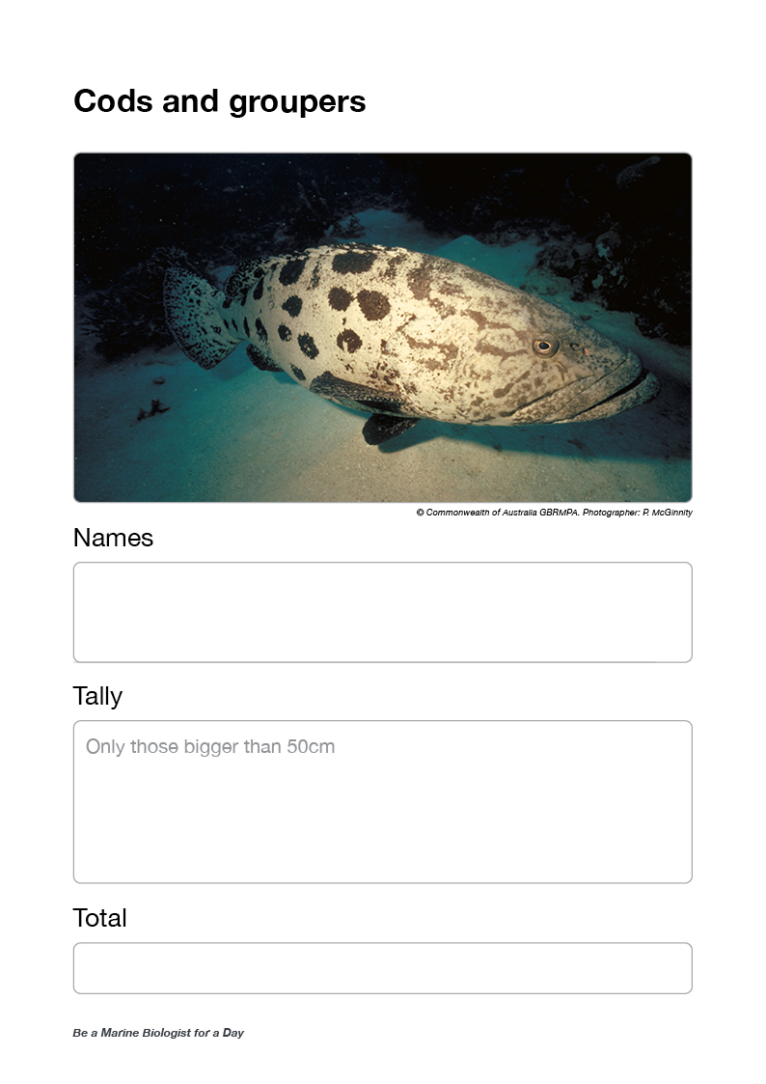
Ask for cods and groupers data.
Calculate the average.
Write it in the total box.

Slide 51
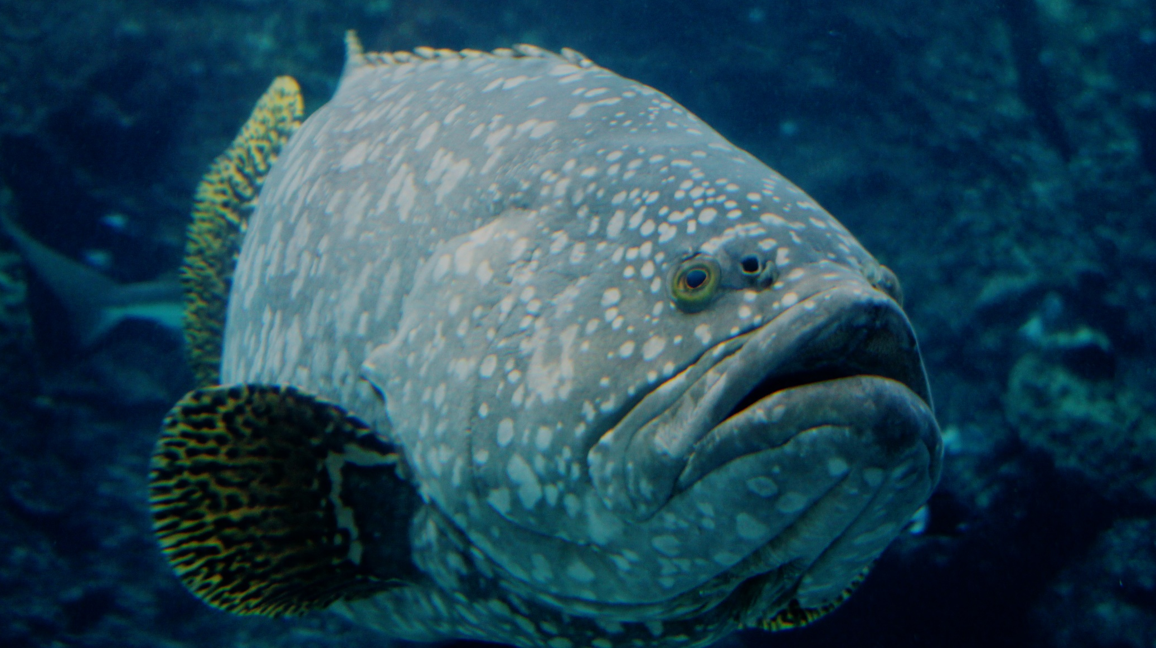
Cods and groupers
>50cm
Notes:
Image: J. Hurford, Copyright Commonwealth of Australia (GBRMPA)

Slide 52
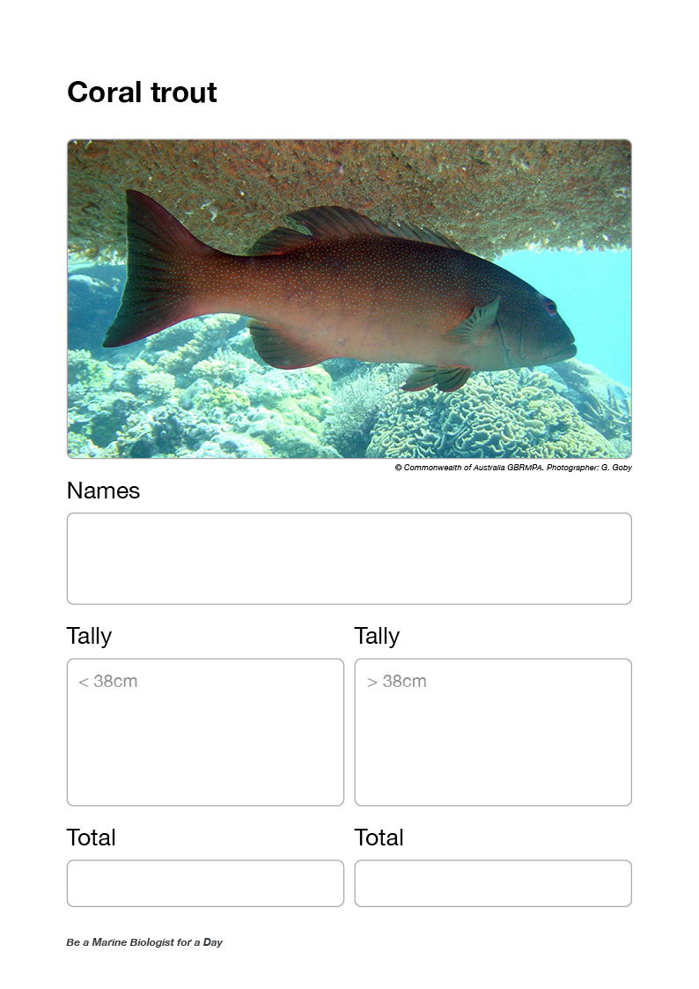
Ask for coral trout data <38cm.
Calculate the average.
Write it in the total box.
Ask for coral trout data >38cm.
Calculate the average.
Write it in the total box.

Slide 53
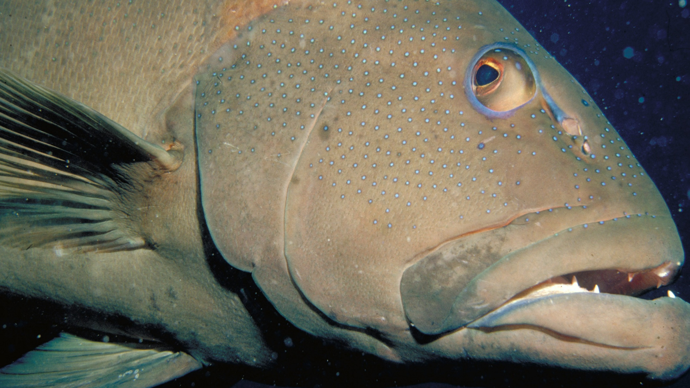
Coral trout
<38cm / >38cm
Notes:
Image: S. Summerhays, Copyright Commonwealth of Australia (GBRMPA)

Slide 54
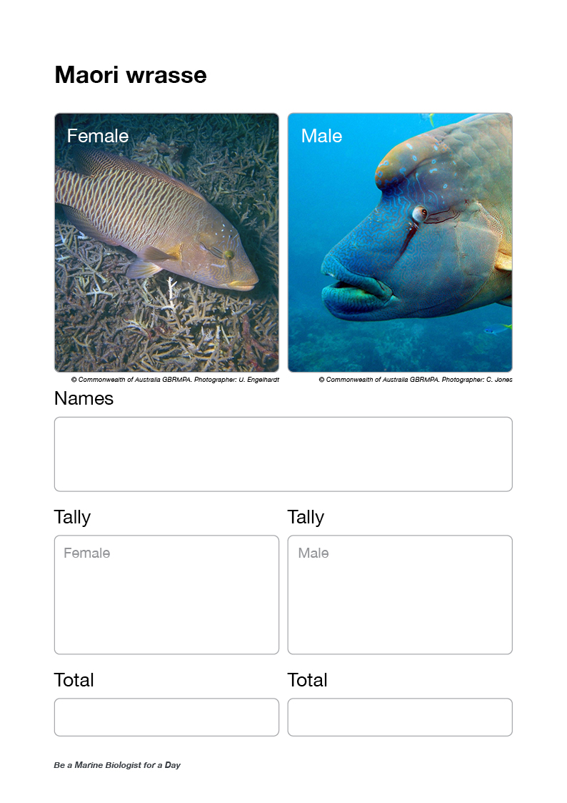
Ask for Maori wrasse data [female].
Calculate the average.
Write it in the total box.
Ask for Maori wrasse data [male].
Calculate the average.
Write it in the total box.

Slide 55
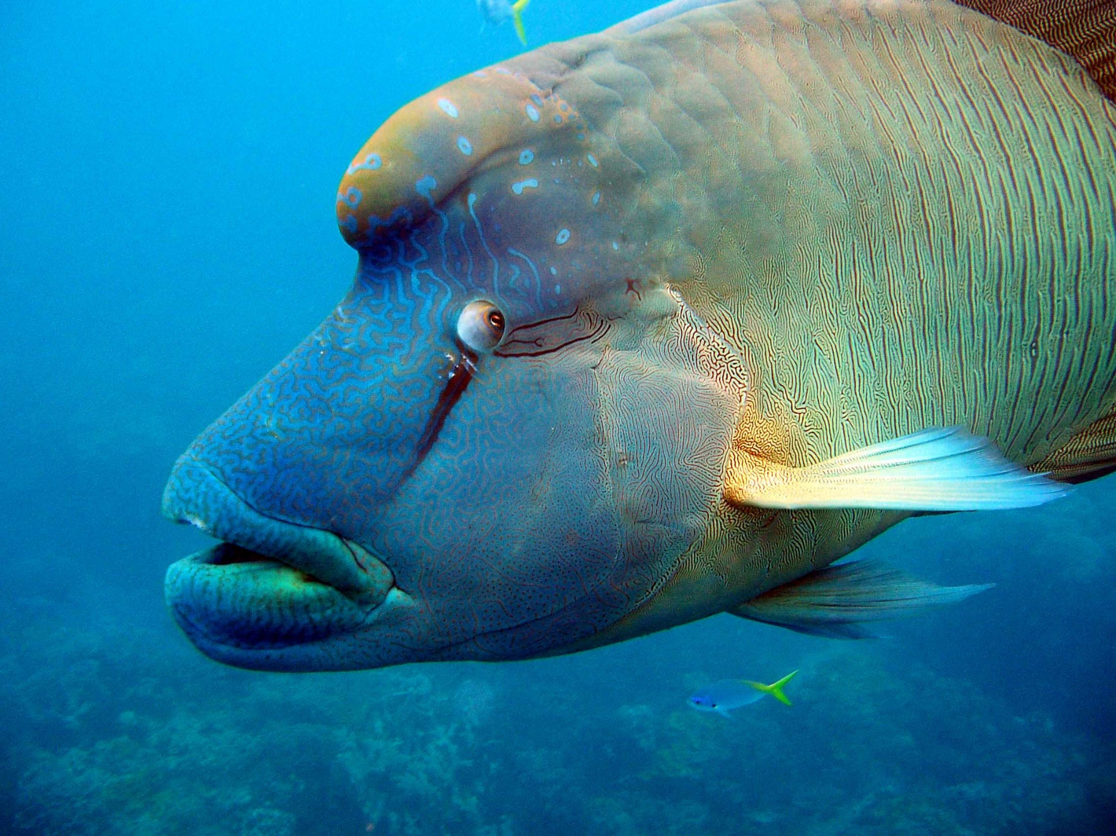
Maori wrasse
Female / Male
Notes:
Image: C. Jones, Copyright Commonwealth of Australia (GBRMPA)

Slide 56
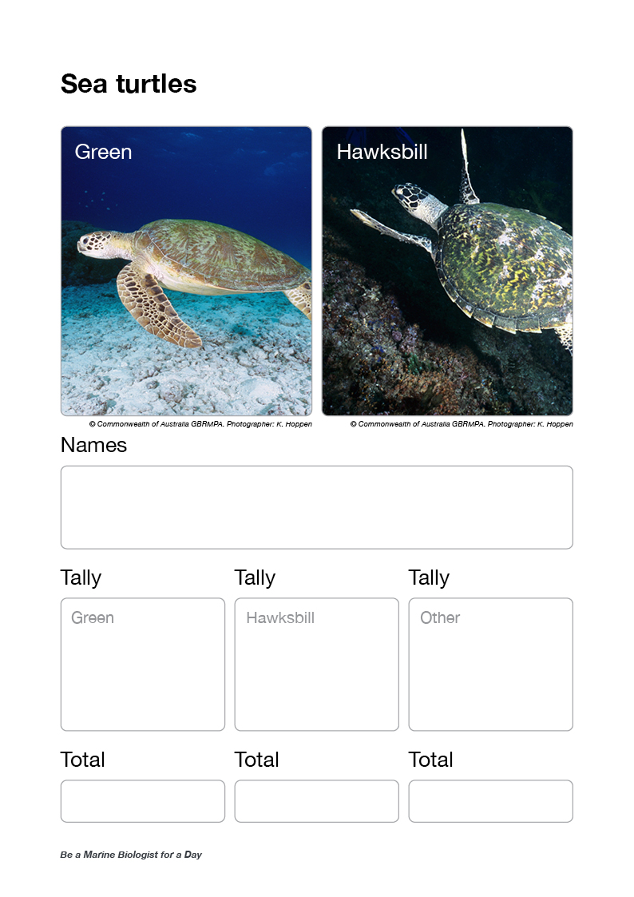
Ask for turtle data [green turtle].
Calculate the average.
Write it in the total box.
Ask for turtle data [hawksbill turtle].
Calculate the average.
Write it in the total box.
Ask for turtle data [other].
Calculate the average.
Write it in the total box.

Slide 57
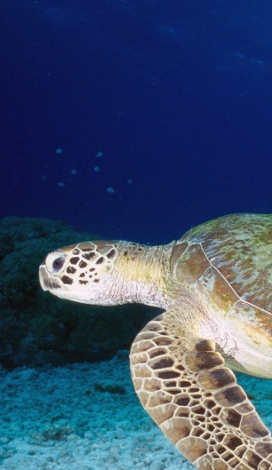
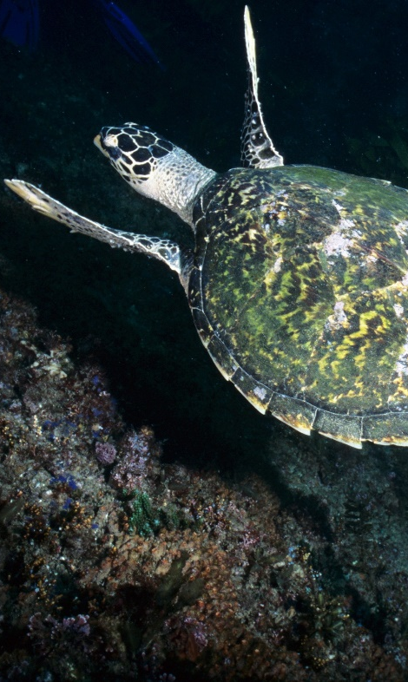
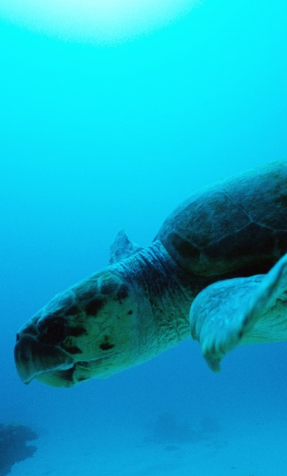
Sea turtles
Green / Hawksbill / other
Green turtle
Hawksbill turtle
Loggerhead turtle
Notes:
Image: (Left) K. Hoppen, Copyright Commonwealth of Australia (GBRMPA); (Middle) K. Hoppen, Copyright Commonwealth of Australia (GBRMPA); (Right) M. Simmons, Copyright Commonwealth of Australia (GBRMPA)

Slide 58
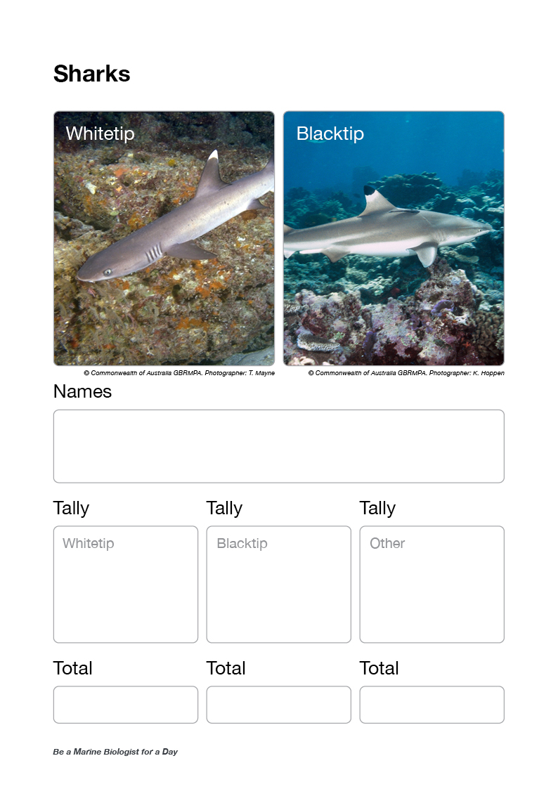
Ask for shark data [whitetip reef shark].
Calculate the average.
Write it in the total box.
Ask for shark data [blacktip reef shark].
Calculate the average.
Write it in the total box.
Ask for shark data [other].
Calculate the average.
Write it in the total box.

Slide 59
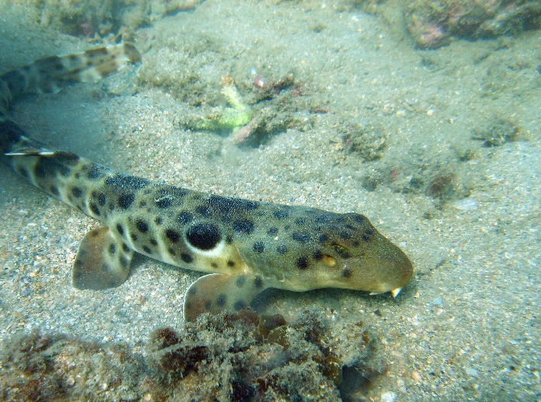
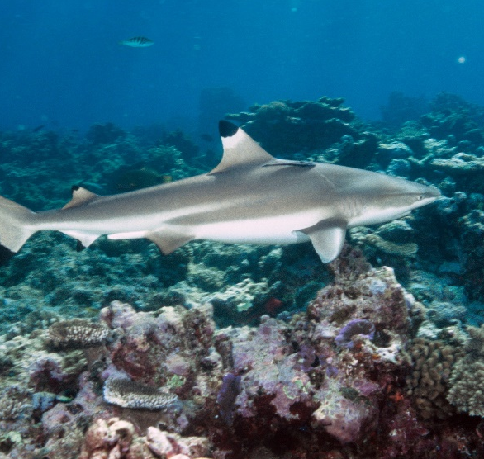
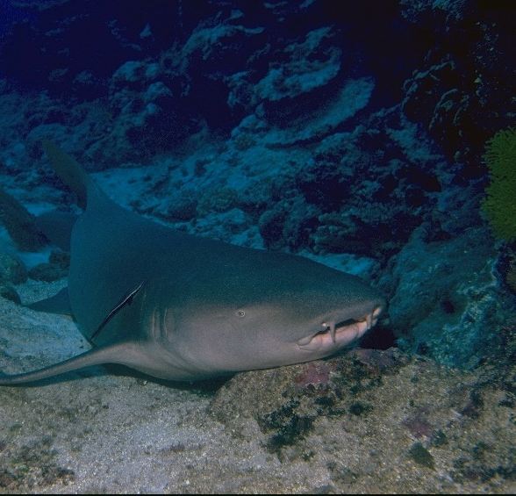
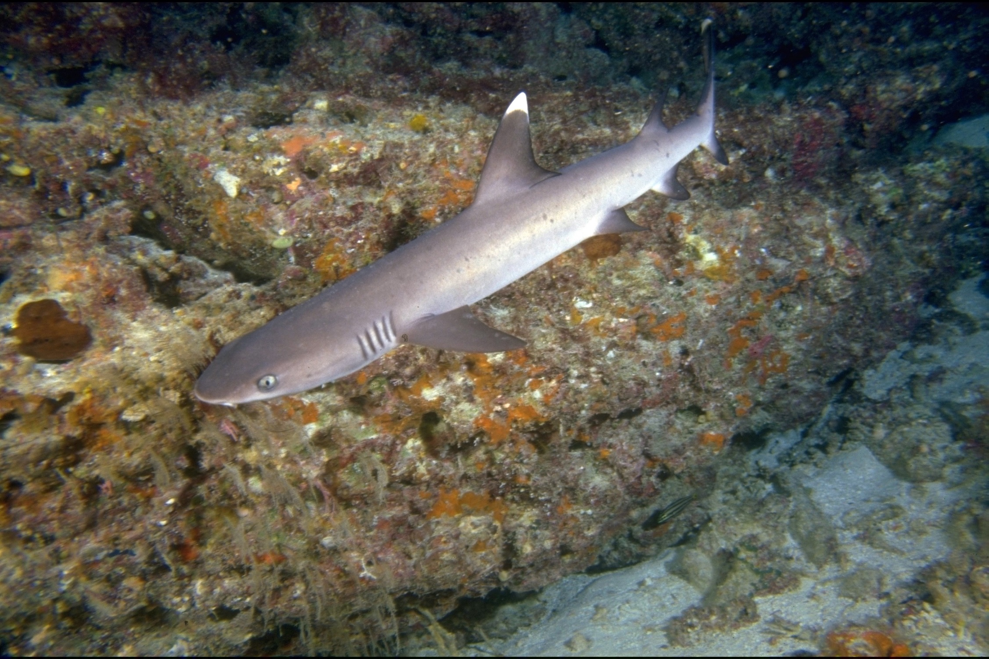
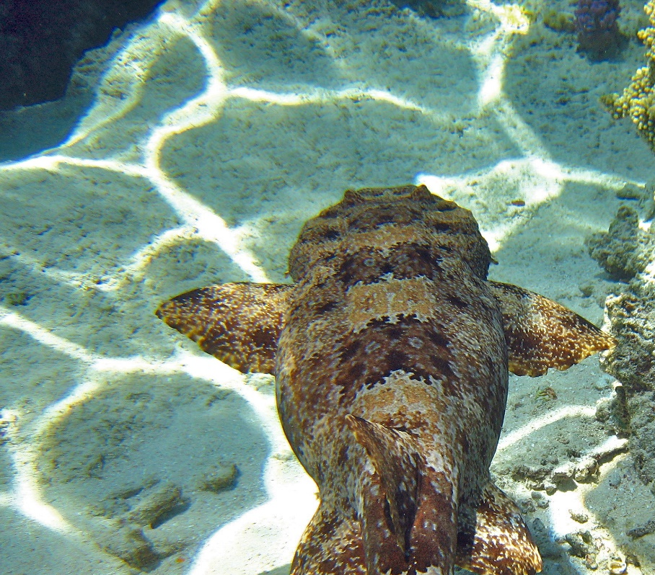
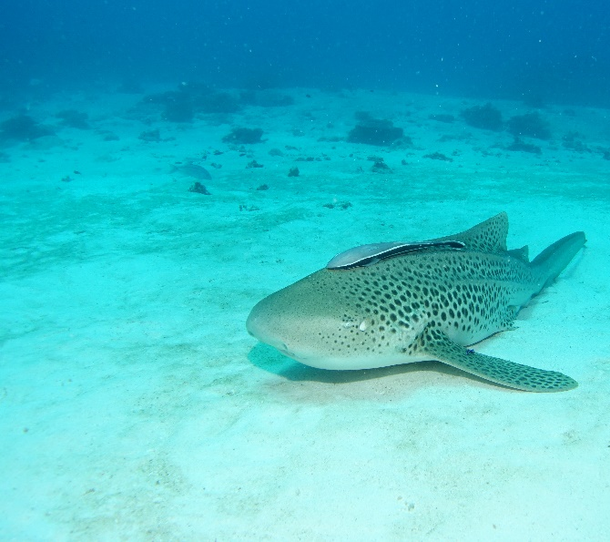
Sharks
Whitetip / Blacktip / other
Epaulette
Blacktip
Tawny nurse
Whitetip
Wobbegong
Leopard
Notes:
Images: (Top Left) C. Jones, Copyright Commonwealth of Australia (GBRMPA); (Bottom Left) T. Mayne, Copyright Commonwealth of Australia (GBRMPA); (Top Middle) K. Hoppen, Copyright Commonwealth of Australia (GBRMPA); (Bottom Middle) C. Jones, Copyright Commonwealth of Australia (GBRMPA); (Top Right) R. Berklemans, Copyright Commonwealth of Australia (GBRMPA); (Bottom Right) C. Jones, Copyright Commonwealth of Australia (GBRMPA)

Slide 60
Ask if anyone saw any COTS [juvenile]?
Calculate the average.
Write it in the total box.
Ask if anyone saw any COTS [adult]?
Calculate the average.
Write it in the total box.
Questions:
Was it somewhere out and about and easy to see,
Was it underneath something and difficult to spot?
Could you recognise where it had been feeding?

Slide 61
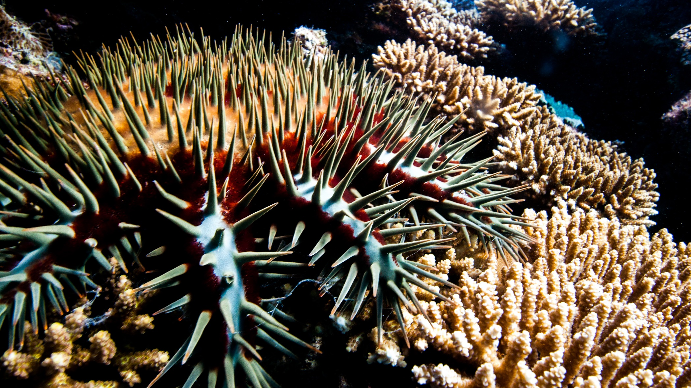
Crown-of-Thorns Starfish (COTS)
Juvenile / Adult
Notes:
Image: J. Hurford, Copyright Commonwealth of Australia (GBRMPA)

Slide 62
Filling out the form
Check if all fields covered have been filled.

Slide 63
Check point.

Slide 64
Ask why it is important to count these animals?
Questions:
What do sea cucumbers and grazing herbivores like to eat? [pause for answer]; What do you think would happen if they were all gone?
What do cods and groupers, coral trout and sharks eat? [pause for answer]; What do you think would happen if they were all gone?
What do Maori wrasse eat? [pause for answer]; What do you think would happen if they were all gone?
What do butterflyfish eat? [pause for answer]; If there are a lot of butterflyfish, that means there is a lot of?
Who really wanted to see an anemonefish or a turtle today? [pause]; Do you think people from all over the world want to see them too?
What would happen to all these animals if the coral reef wasn’t here?

Slide 65
Why is it important to count these animals?

Slide 66
Next step?
Back at school, you will login with your teacher and tell GBRMPA how many you counted!
Schools are shown how to register to Eye on the Reef (Rapid Monitoring and Sightings) pre-excursion (Part 1) and how to login and upload their data post excursion (Part 3).
Confirm the teacher has registered.

Slide 67
What can I do now?
If you also completed the 360 survey,
we will do that next. Otherwise…

Slide 68
What can I do now?
You can download the Eye on the Reef app on your smart device to record what you saw today.

Slide 69
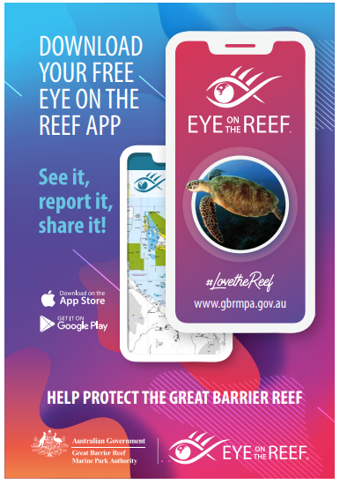
…Download the
Eye on the Reef app
to record what you
saw today!
Notes:
App image: https://www.gbrmpa.gov.au/__data/assets/pdf_file/0020/265430/Eye-on-the-Reef-app-poster.pdf

Slide 70
What can I do now?
You can record any animal you saw on your trip today.

Slide 71
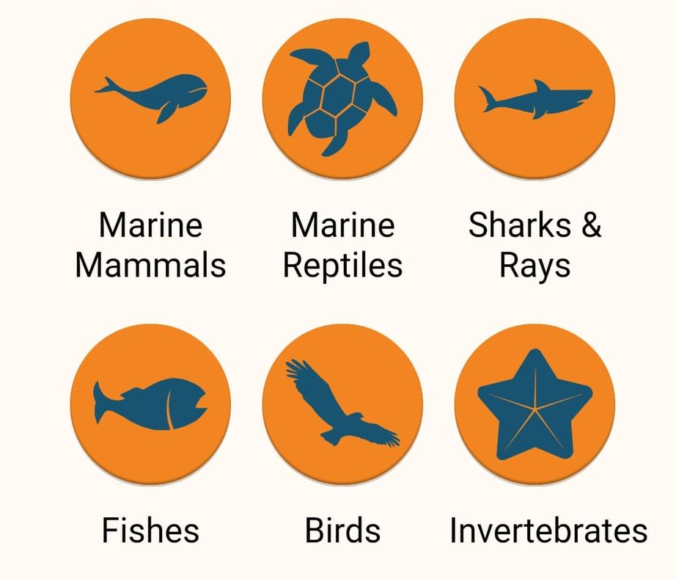
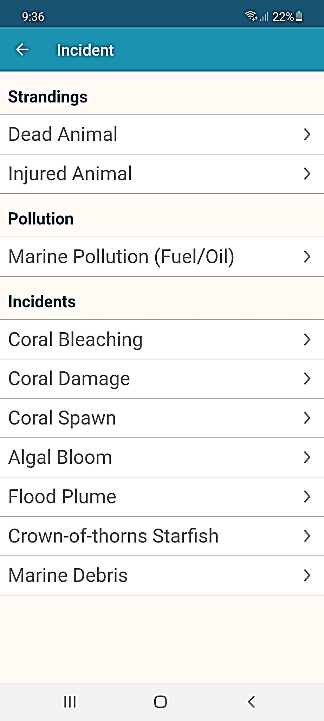
This is what you can record on the app.

Slide 72
What can I do now?
This is the home screen of the Eye on the Reef app.
To create a sighting, ‘click’ on Sightings.

Slide 73
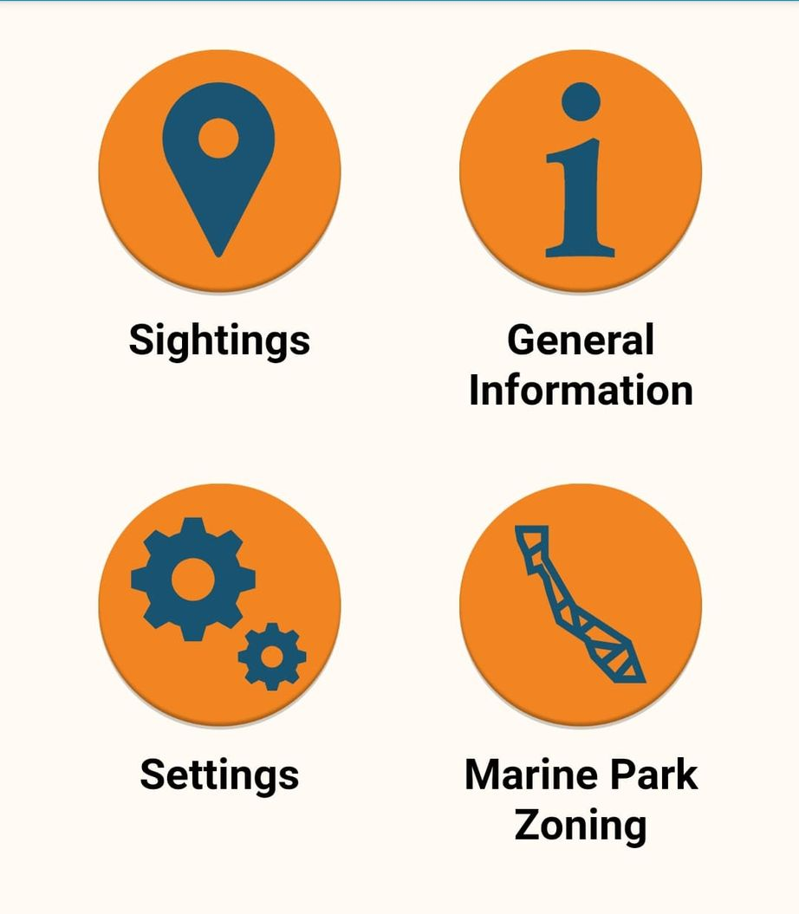


Slide 74
What can I do now?
‘Click’ on Wildlife

Slide 75



Slide 76
What can I do now?
You can pick the type of animals you saw today.

Slide 77



Marine mammals.

Slide 78
What can I do now?
You can pick the type of animals you saw today.

Slide 79


Marine reptiles.

Slide 80
What can I do now?
You can pick the type of animals you saw today.

Slide 81




Sharks and rays.

Slide 82
What can I do now?
You can pick the type of animals you saw today.

Slide 83



Fishes.

Slide 84
What can I do now?
As you can see, there are many different fish on the Reef. How many did you see?

Slide 85











Slide 86
What can I do now?
You can pick the type of animals you saw today.

Slide 87





Birds.

Slide 88
What can I do now?
You can pick the type of animals you saw today.

Slide 89


Invertebrates.

Slide 90
What can I do now?
As you can see, there are many different invertebrates on the Reef. How many did you see?

Slide 91










Slide 92
What can I do now?
You can pick the type of incidents you saw today (if any).

Slide 94
What can I do now?
You can pick the type of incidents you saw today (if any).

Slide 95

Incident.

Slide 96
What can I do now?
You can pick if you saw any bleaching today.

Slide 98
What can I do now?
You can pick if you saw any bleaching today.

Slide 99

Bleaching.

Slide 100
Ask What actions can you take to protect what you have seen today?
Link to climate change actions,

Slide 101

What actions can you take to protect what you have seen today?
Notes:
App image: https://www.gbrmpa.gov.au/__data/assets/pdf_file/0020/265430/Eye-on-the-Reef-app-poster.pdf

Slide 102
We hope you enjoyed you day visiting the Great Barrier Reef!
See the Reef • Love the Reef • Protect the Reef

