Slide 1
Be a Marine
Biologist for a Day
Part 3: Making connections
Prep – year 3
Notes:
Image: C. Jones, Copyright Commonwealth of Australia (GBRMPA)

Slide 2


Thank you for organising your trip to the reef with us.
We had a great time and hope you did too.
This PowerPoint is Part 3 of the Be a Marine Biologist for a Day program designed for Prep-year 4 by the Great Barrier Reef Marine Park Authority (GBRMPA).
View this PowerPoint after your excursion, with the accompanying activity book.
This is Part 3: Making connections. This is the last part of the program. This is when your students make connections with all they’ve learned and experienced so far.
On your excursion, you conducted an Eye on the Reef citizen science activity with your reef guide. Now it’s time to upload your data to the GBRMPA website. It’s also time for students to check understanding by answering any questions in Parts 1 and 2.
The Great Barrier Reef Marine Park Authority would like to thank you for uploading your data to their Rapid Monitoring database. We hope to see you again next year!
Licensed by the Commonwealth of Australia for use under a Creative Commons By Attribution 4.0 International licence with the exception of content supplied by third parties and any photographs. http://creativecommons.org/licences/by/4.0

Slide 3
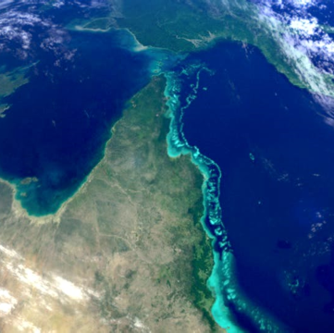
We would like to acknowledge all of the Aboriginal and Torres Straight Islander peoples who have connection to the Great Barrier Reef.
We recognise their continuing connection to land, water and community, and pay our respects to their Elders past, present and emerging.

Slide 4
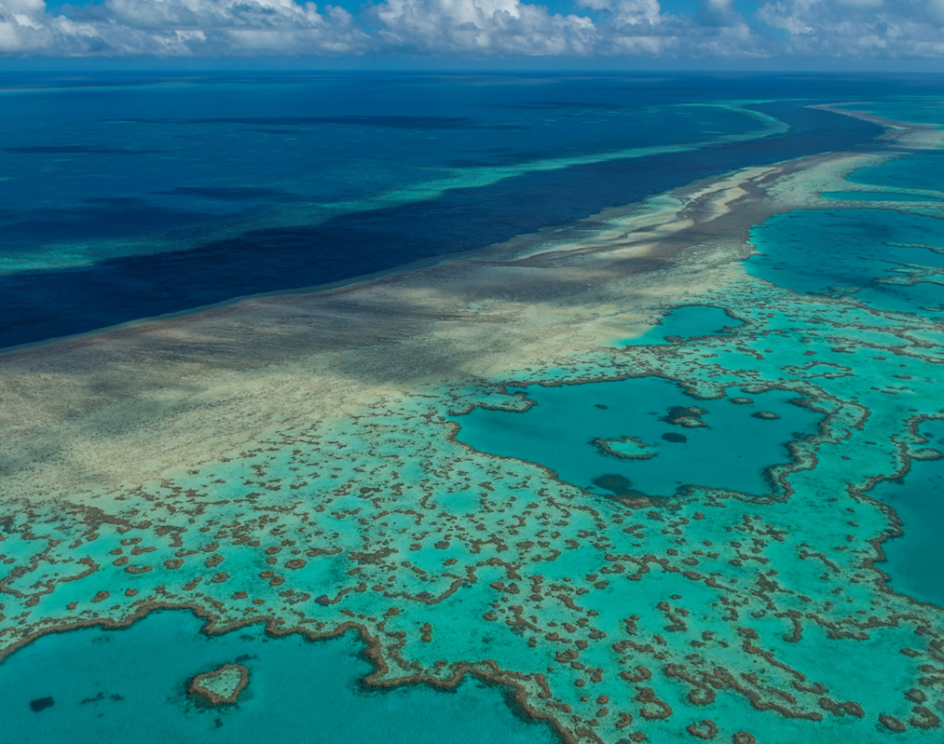
We would like to acknowledge the (insert name of local Traditional Owner group) peoples as the Traditional Owners of the Land and Sea Country that we visited as part of your excursion.

Slide 5

How can I help the
Great Barrier Reef?
Notes:
This is the overarching inquiry question that encompasses the entire BAMBFAD Program and is the starting slide to this presentation.

Slide 6
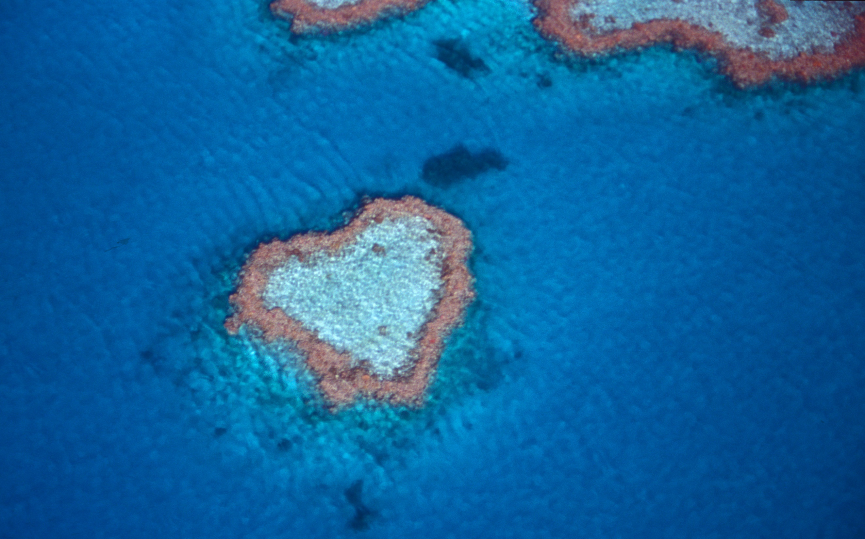
Notes:
Image: J. Johnson, Copyright Copyright Commonwealth of Australia (GBRMPA)

Slide 7
Hello again!
Thank you for helping me count the animals!
Notes:
Change name and picture to MRG (or not!)
Image: https://www.reefhq.com.au/_media/events/visit-reef-hq-digitally

Slide 8
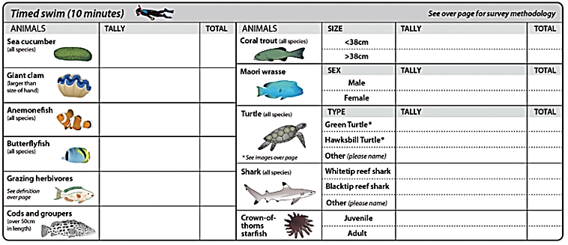
It’s now time to tell the Great Barrier Reef Marine
Park Authority what you saw!

Slide 9
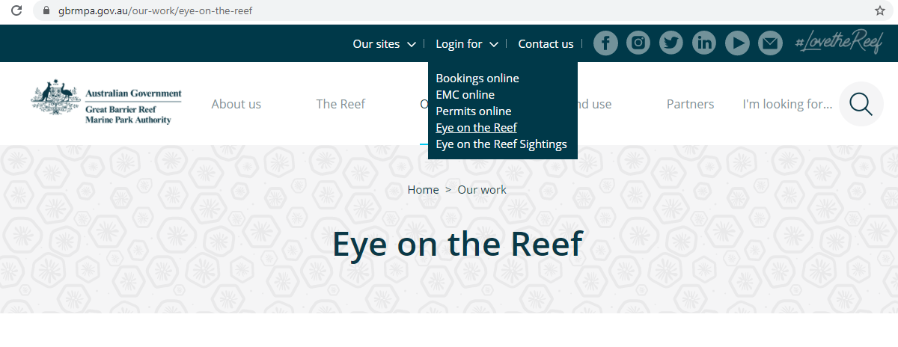
This is their website.
The link to connect is provided at the end of this presentation.

Slide 10
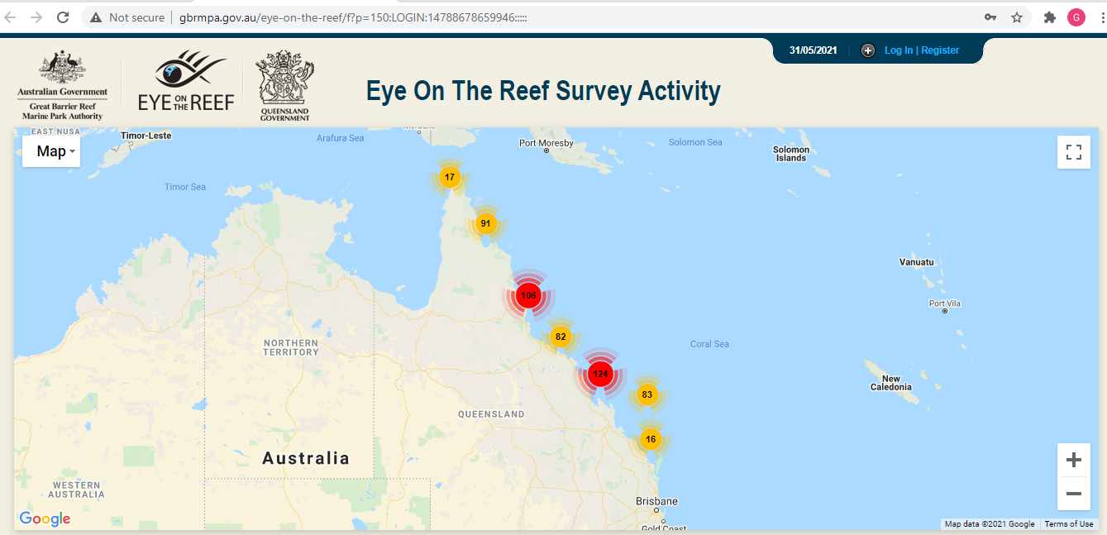
Login.

Slide 11
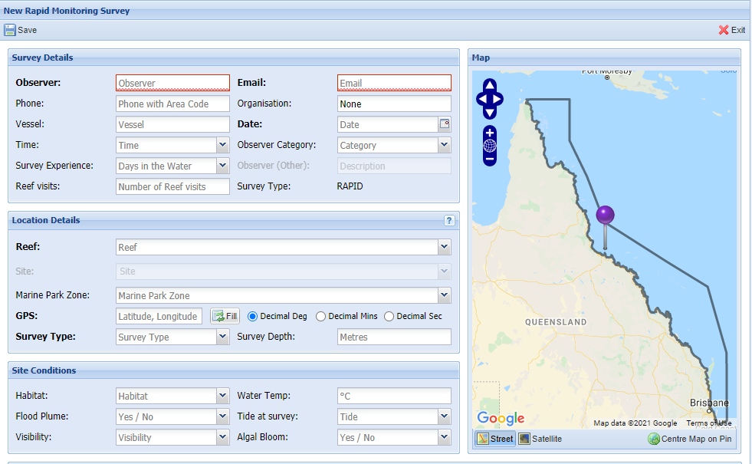
Select ‘Rapid Monitoring Survey’ tab.

Slide 12
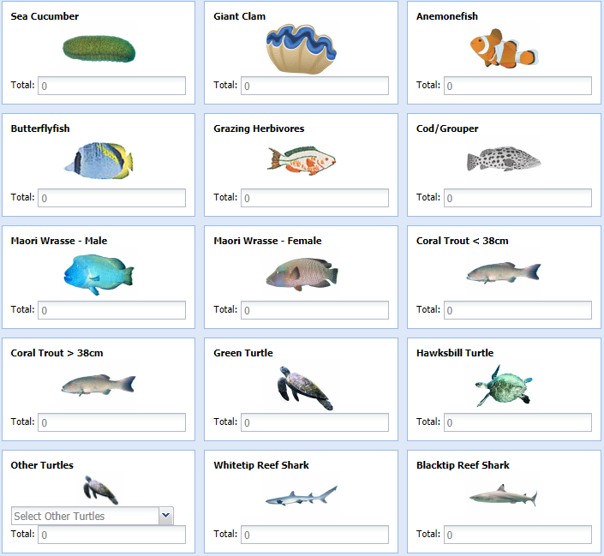
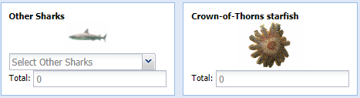
Enter your data.

Slide 13
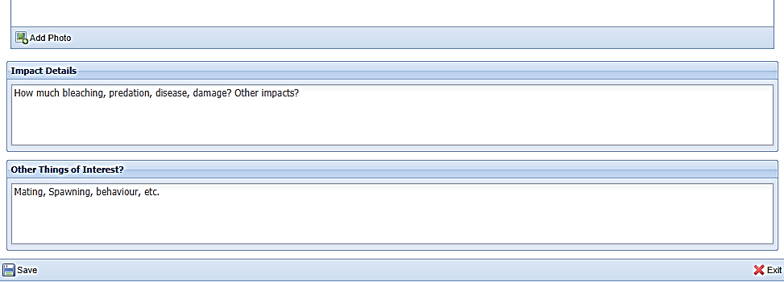
Save!
Scroll down to the bottom of the page to ‘Save’.

Slide 14
Are you ready?
Click on the image below to connect.
Notes:
www.gbrmpa.gov.au/our-work/eye-on-the-reef

Slide 15
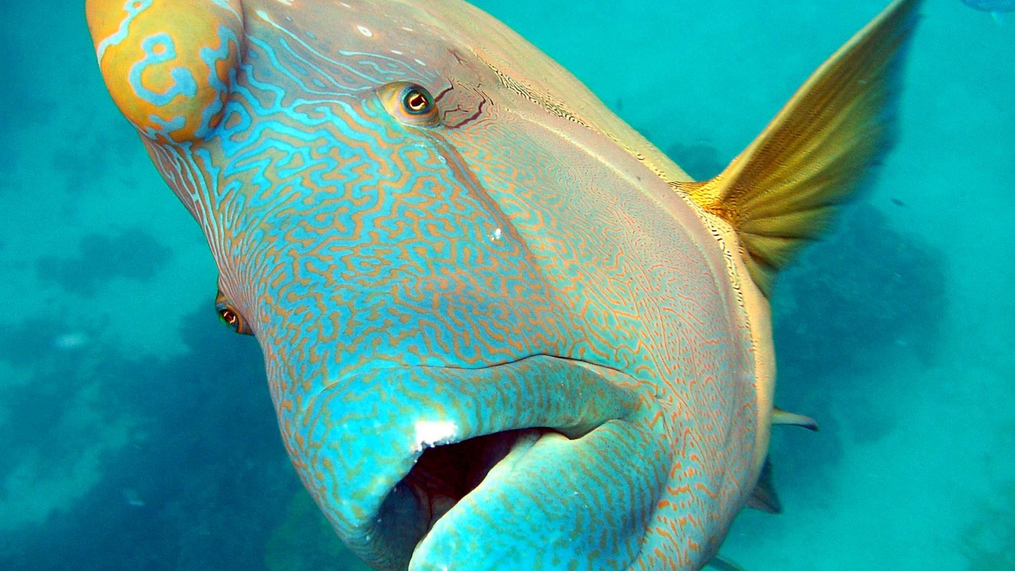
Thank
you
Male Maori wrasse
Notes:
Image: C. Jones, Copyright Copyright Commonwealth of Australia (GBRMPA)

Slide 16
Check understanding.
Next, is what you’ve all been waiting for.
The answers to questions asked in Part 1 (before the excursion) and/or Part 2 (on the excursion).
Let’s check how you went!
Notes:
The following questions are straight from the Rapid Monitoring Survey course exam questions.

Slide 17
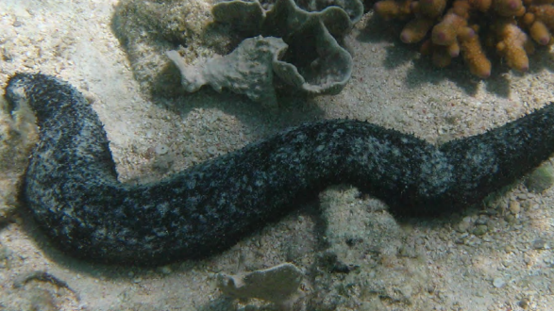

Sea cucumber
Notes:
Image: Copyright Commonwealth of Australia (GBRMPA)

Slide 18
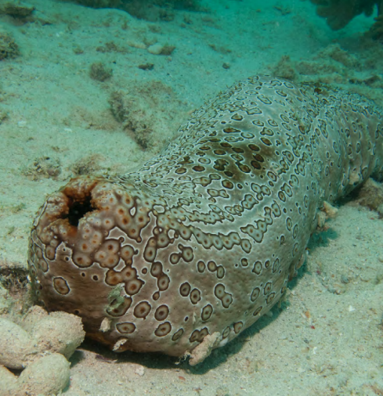
Where does
it live?
Notes:
Image: Copyright Commonwealth of Australia (GBRMPA)

Slide 19
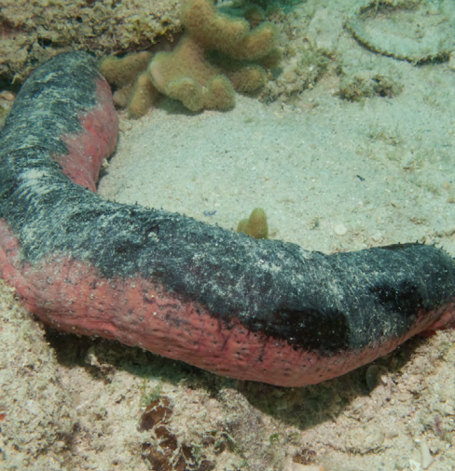
It lives on
the sand.
Notes:
Image: Copyright Commonwealth of Australia (GBRMPA)

Slide 20
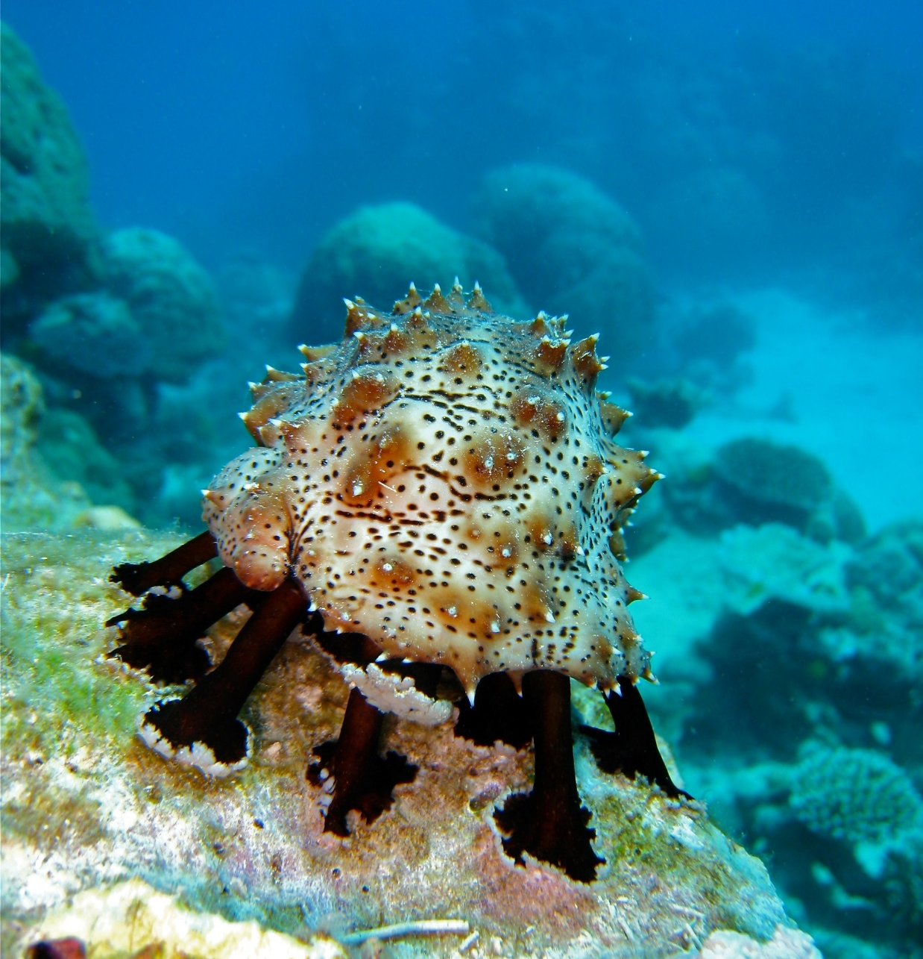
What does a sea cucumber eat?
Notes:
Image: C. Jones, Copyright Commonwealth of Australia (GBRMPA)

Slide 21
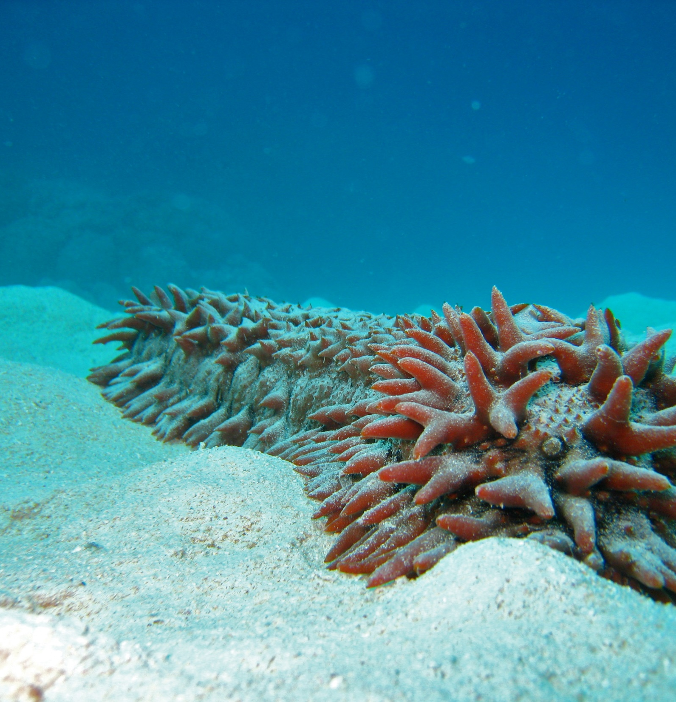
It eats food on
the sand or
in the water.
Pineapple trepang sea cucumber
Notes:
Image: C. Jones, Copyright Commonwealth of Australia (GBRMPA)

Slide 22
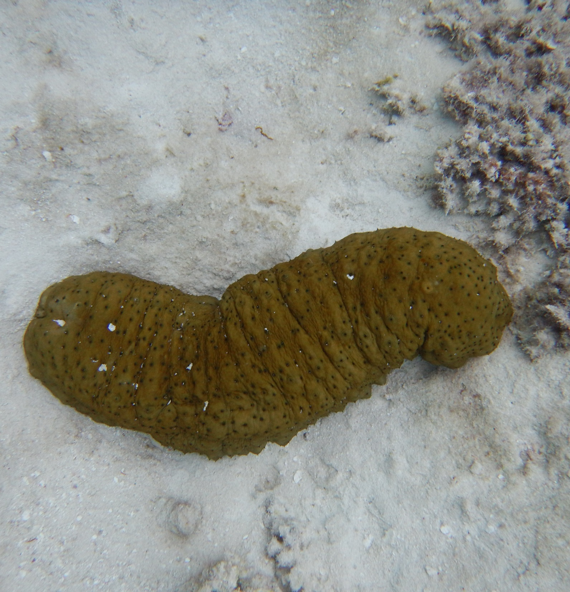
Food goes in
one end (the mouth) and comes out the other end (the anus).
Notes:
Image: K. Goudkamp, Copyright Commonwealth of Australia (GBRMPA)

Slide 23
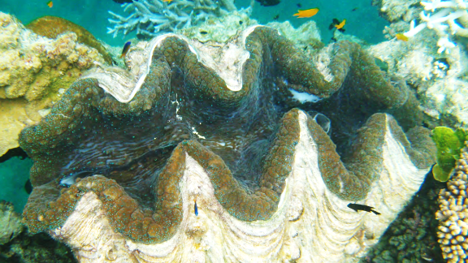
Giant clam
VULNERABLE TO EXTINCTION
Notes:
Image: Copyright Commonwealth of Australia (GBRMPA)

Slide 24
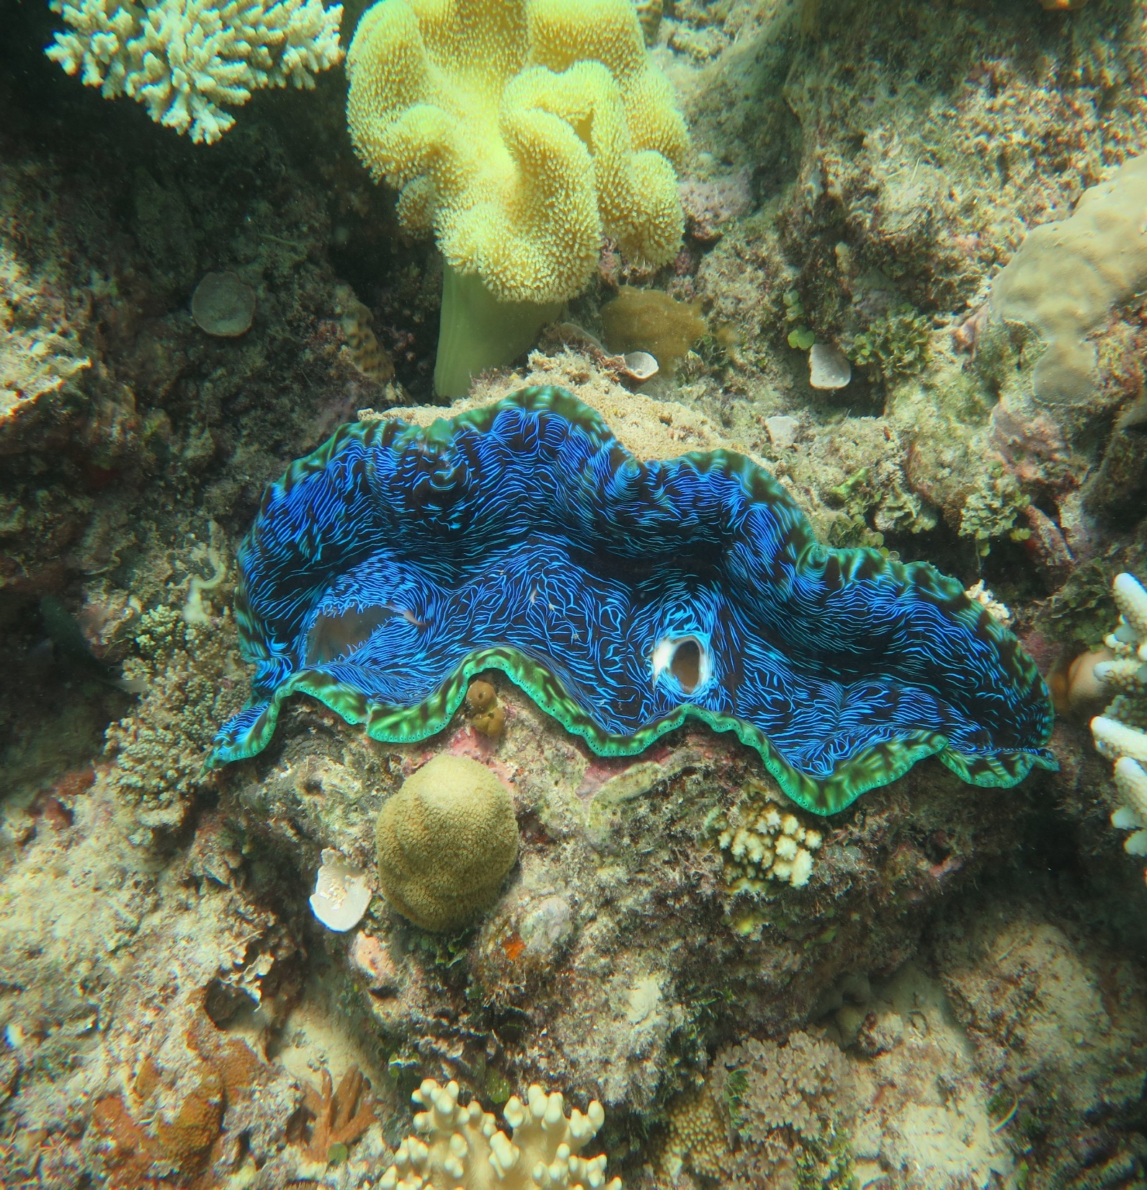
Where can you
find a giant clam?
Notes:
Image: J. Stella, Copyright Commonwealth of Australia (GBRMPA)

Slide 25
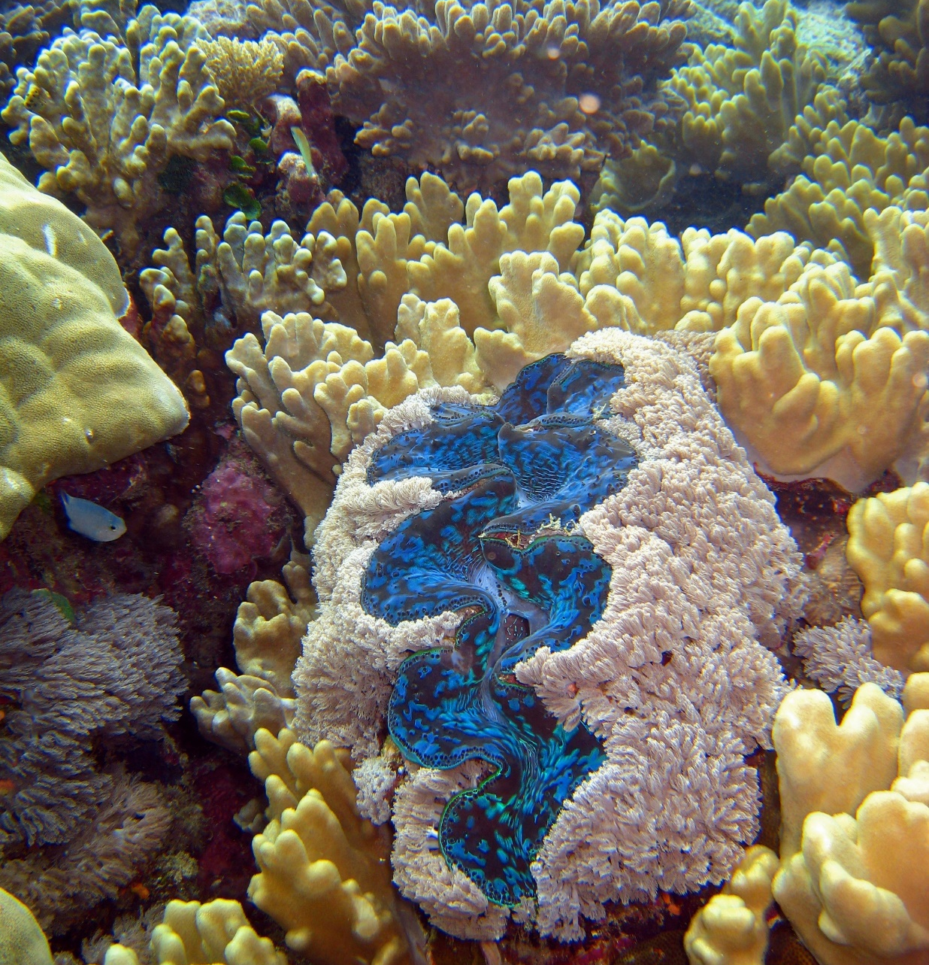
On the sand,
or between rocks
or coral in
shallow water.
Notes:
Image: C. Jones, Copyright Commonwealth of Australia (GBRMPA)

Slide 26
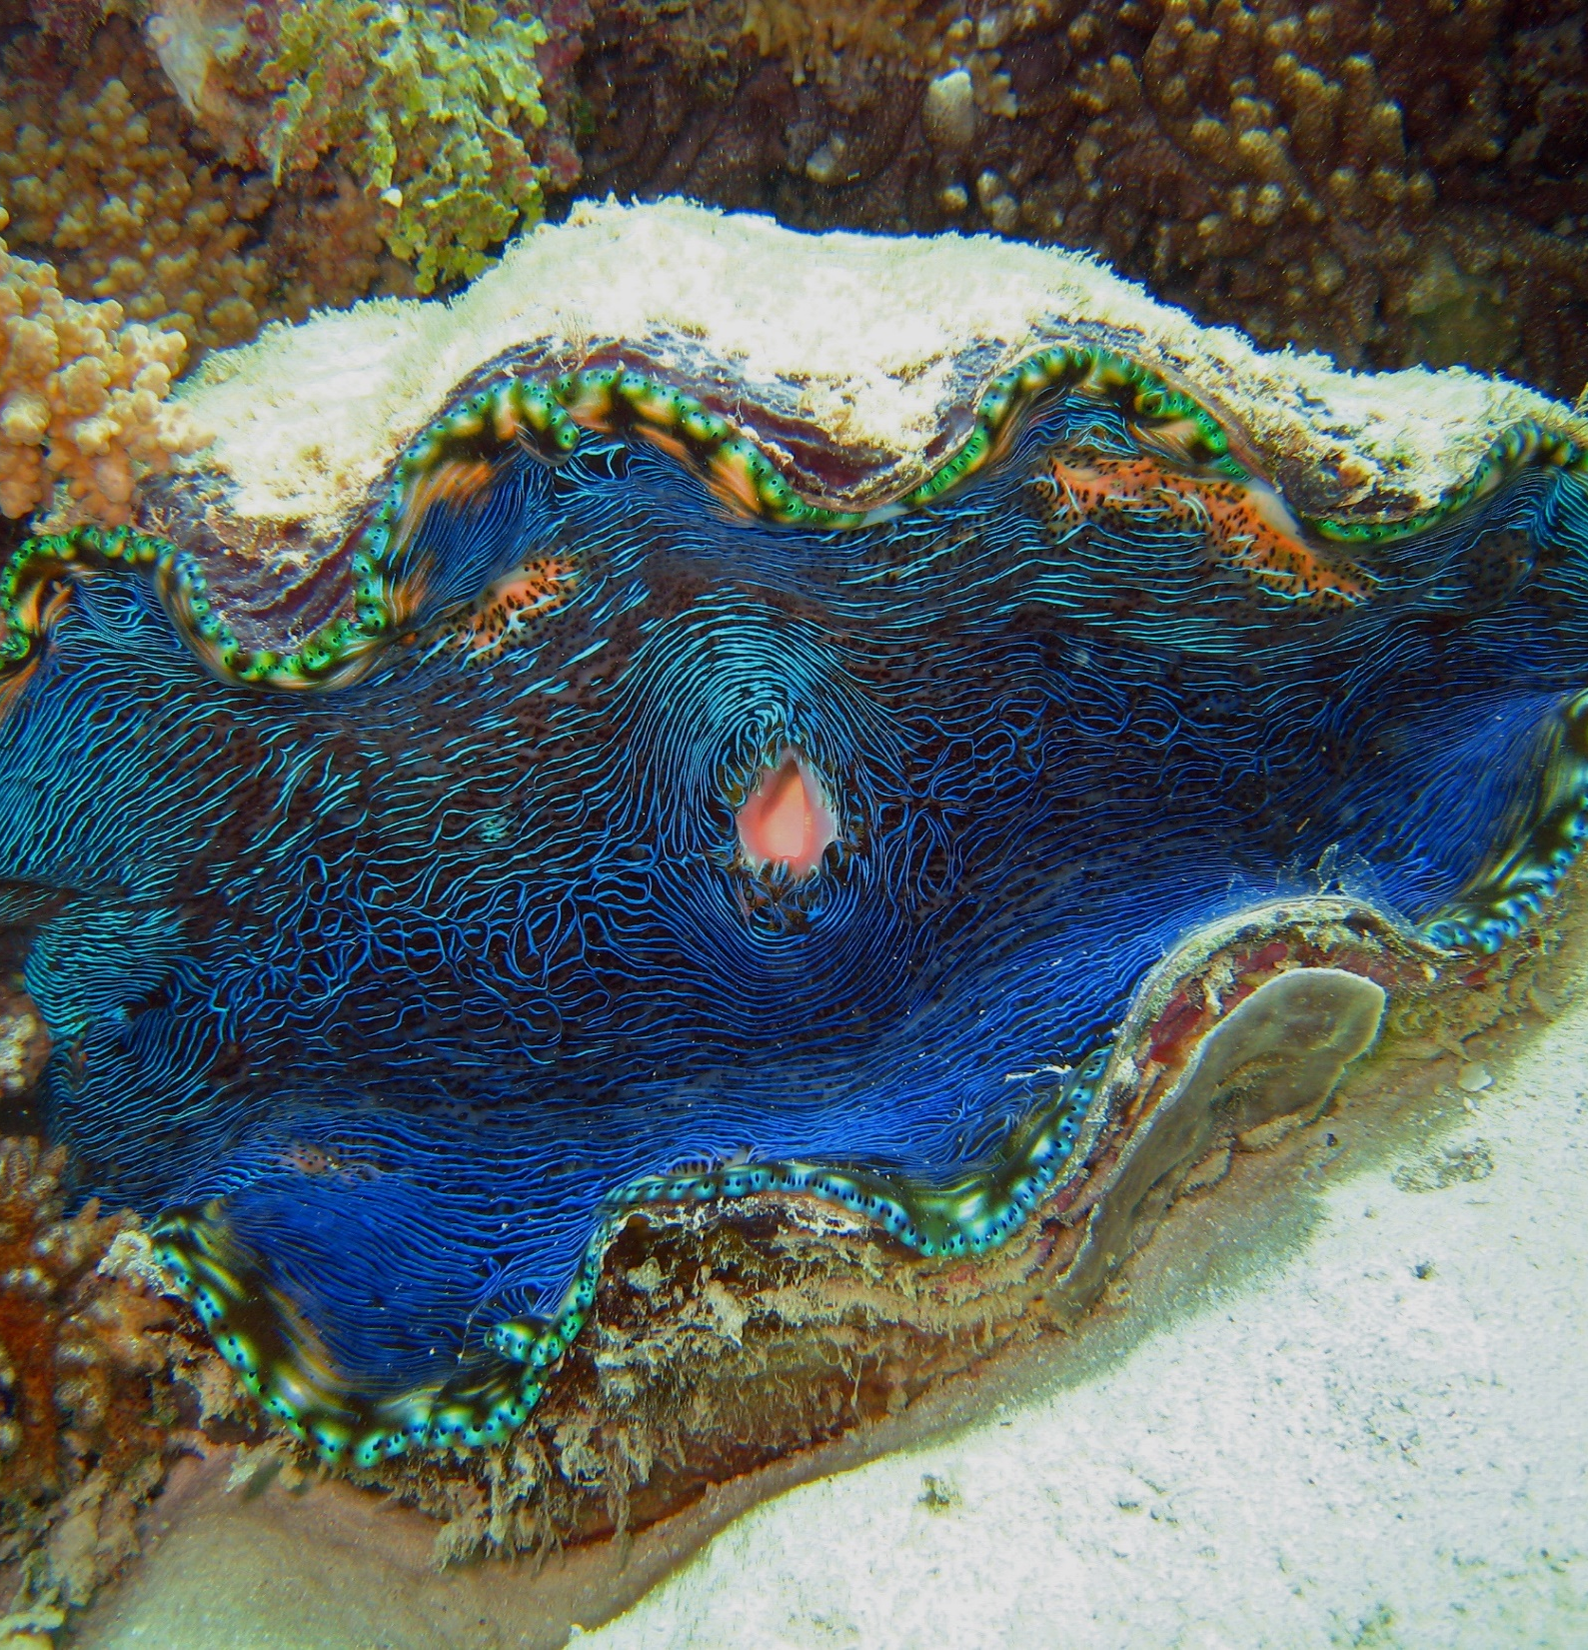
How big do giant clams grow to?
Notes:
Image: C. Jones, Copyright Commonwealth Government of Australia (GBRMPA)

Slide 27
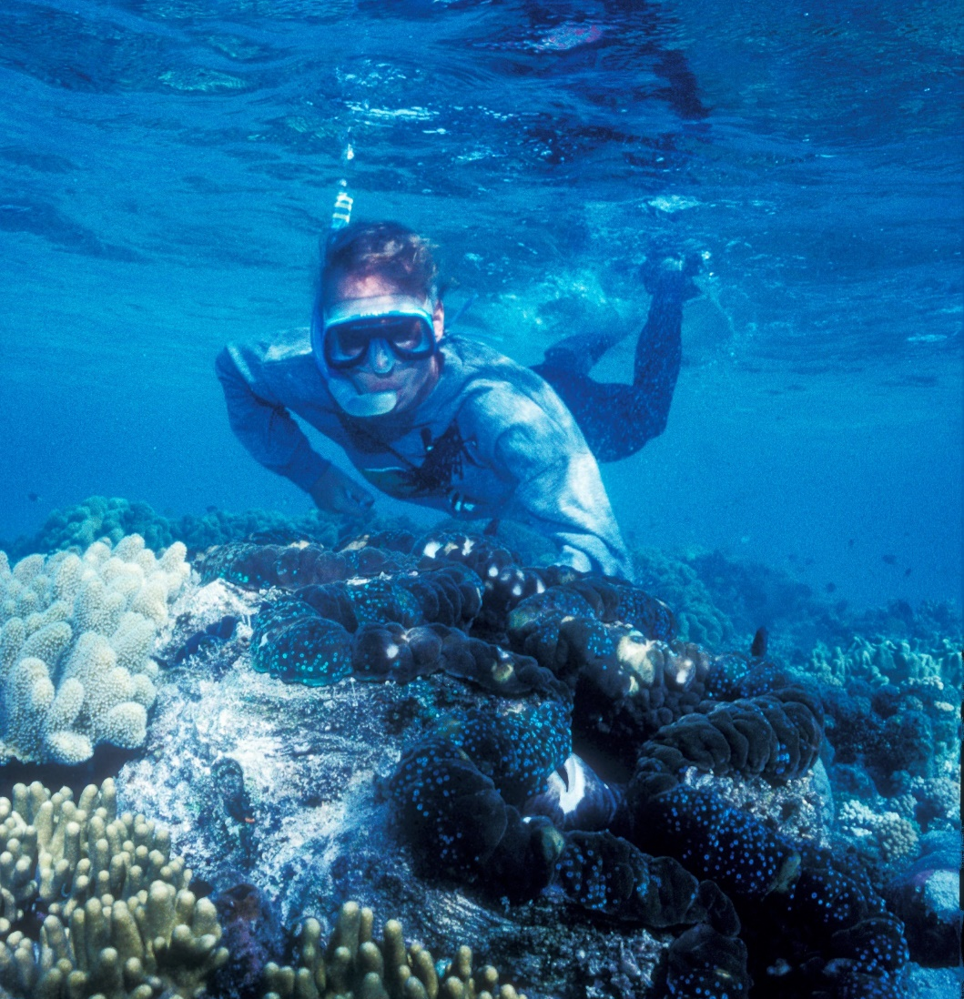
The biggest
giant clam recorded was 1.4m.
Bigger than you!
Notes:
Image: K. Anthony, Copyright Commonwealth of Australia (GBRMPA)

Slide 28
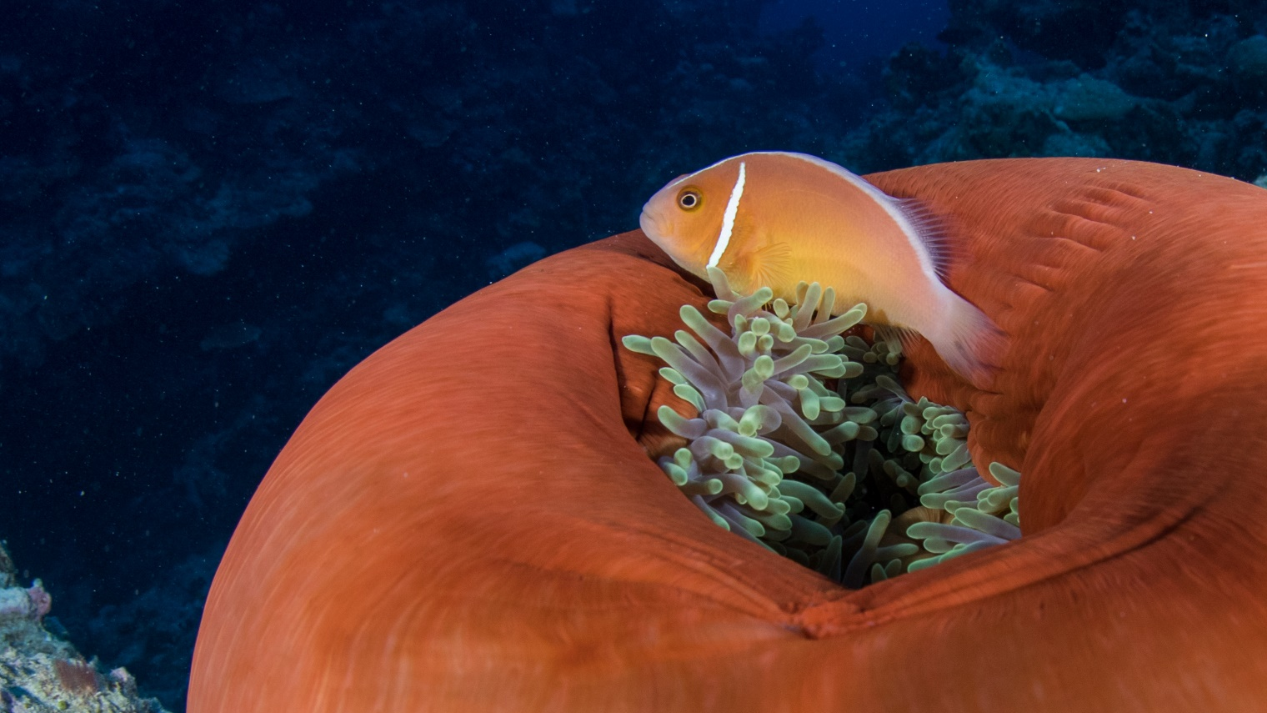
Anemonefish
Notes:
Image: J. Sumerling, Copyright Commonwealth Government of Australia (GBRMPA)

Slide 29
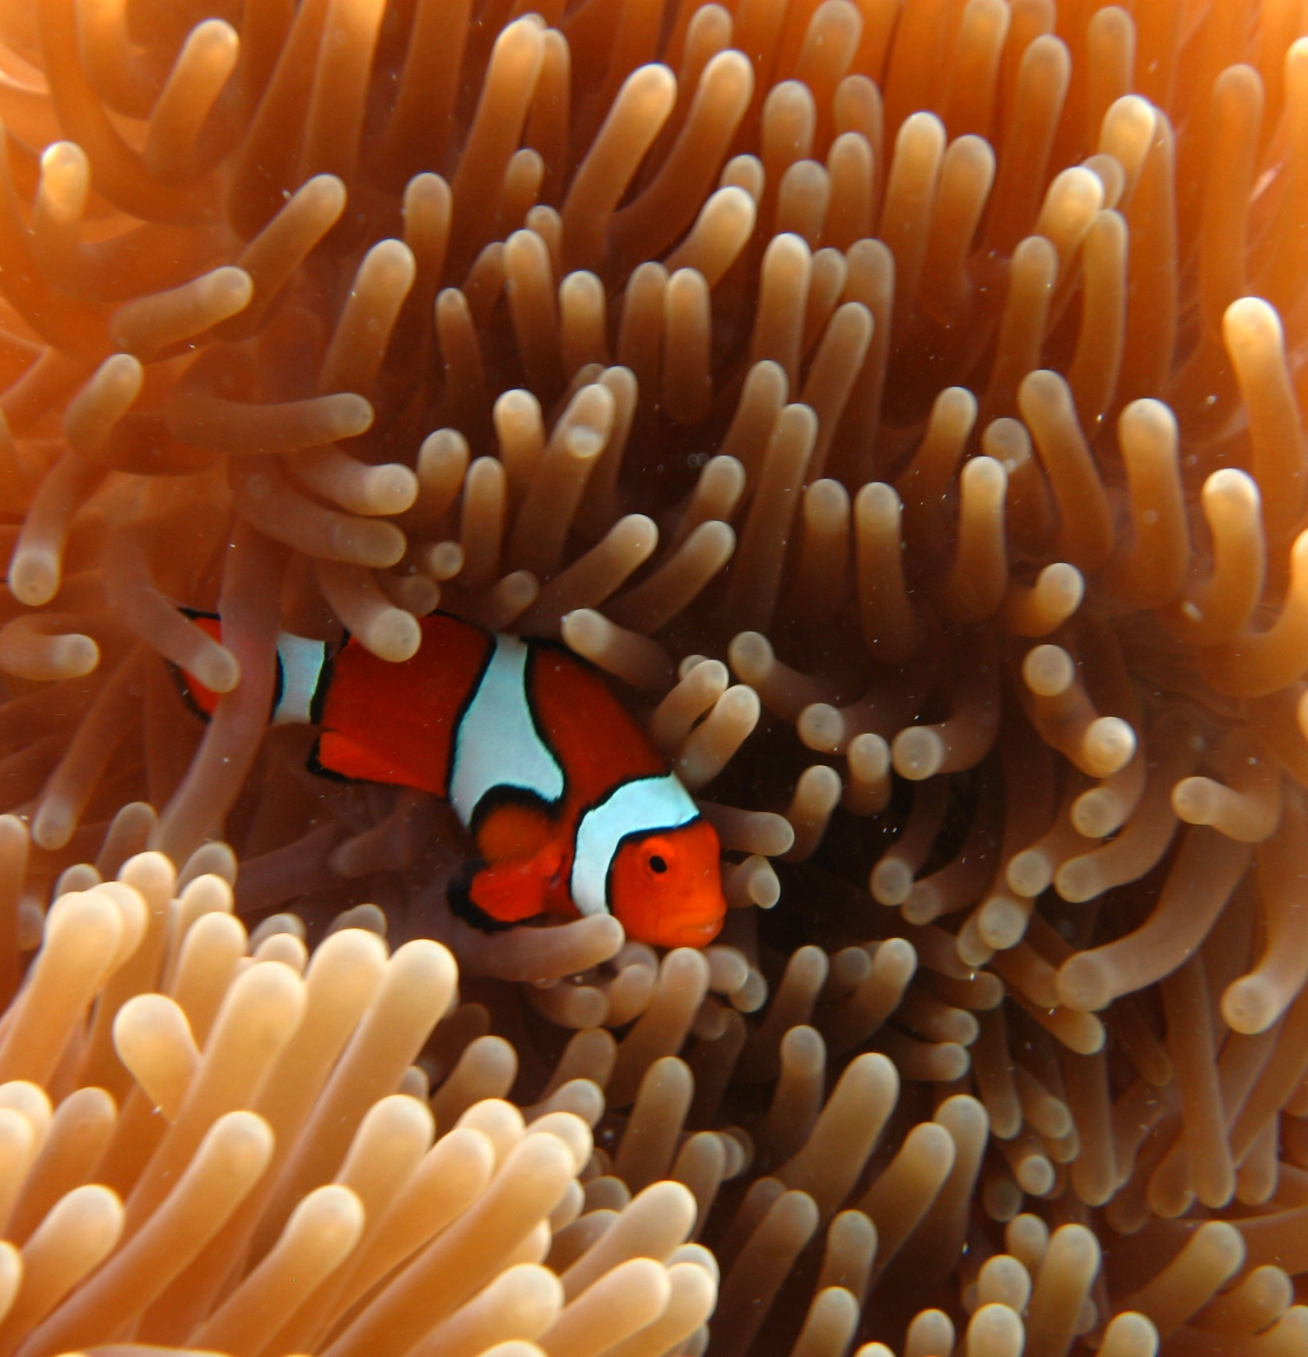
Nemo is an anemonefish.
Where does
he live?
Notes:
Image: E. Smart, Copyright Commonwealth Government of Australia (GBRMPA)

Slide 30
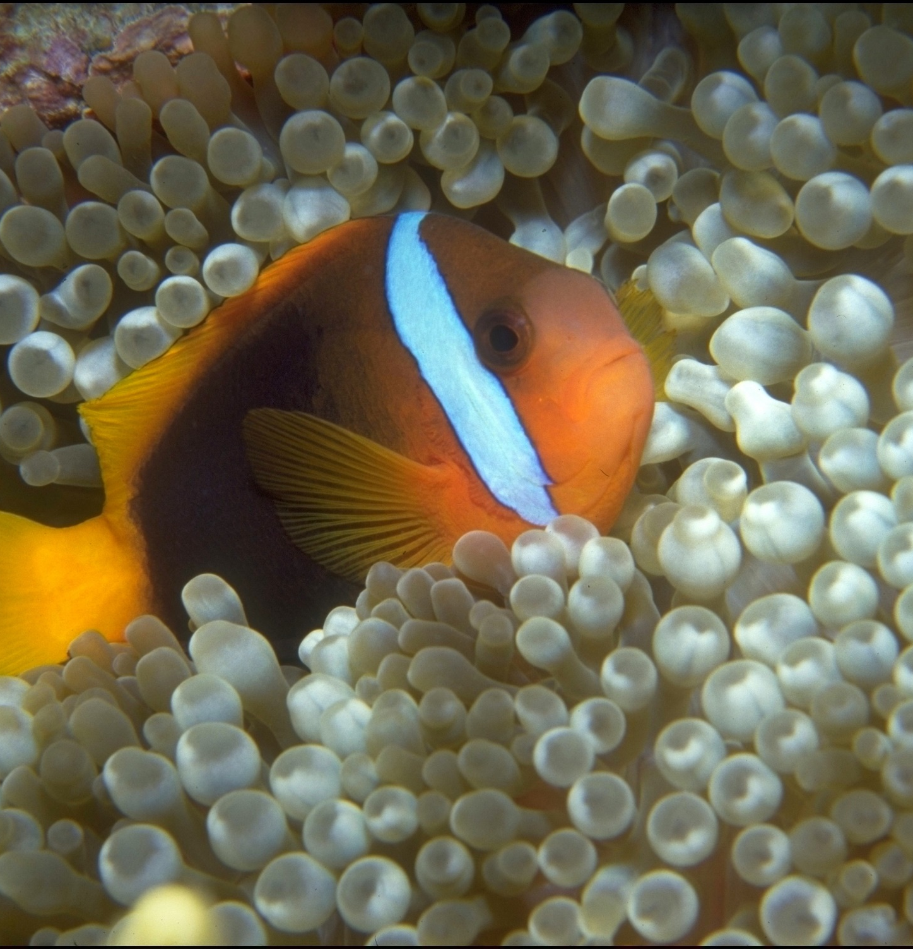
Nemo lives in an anemone.
Can you see his name in the word anemone?
Notes:
Image: T. Mayne, Copyright Commonwealth of Australia (GBRMPA)

Slide 31
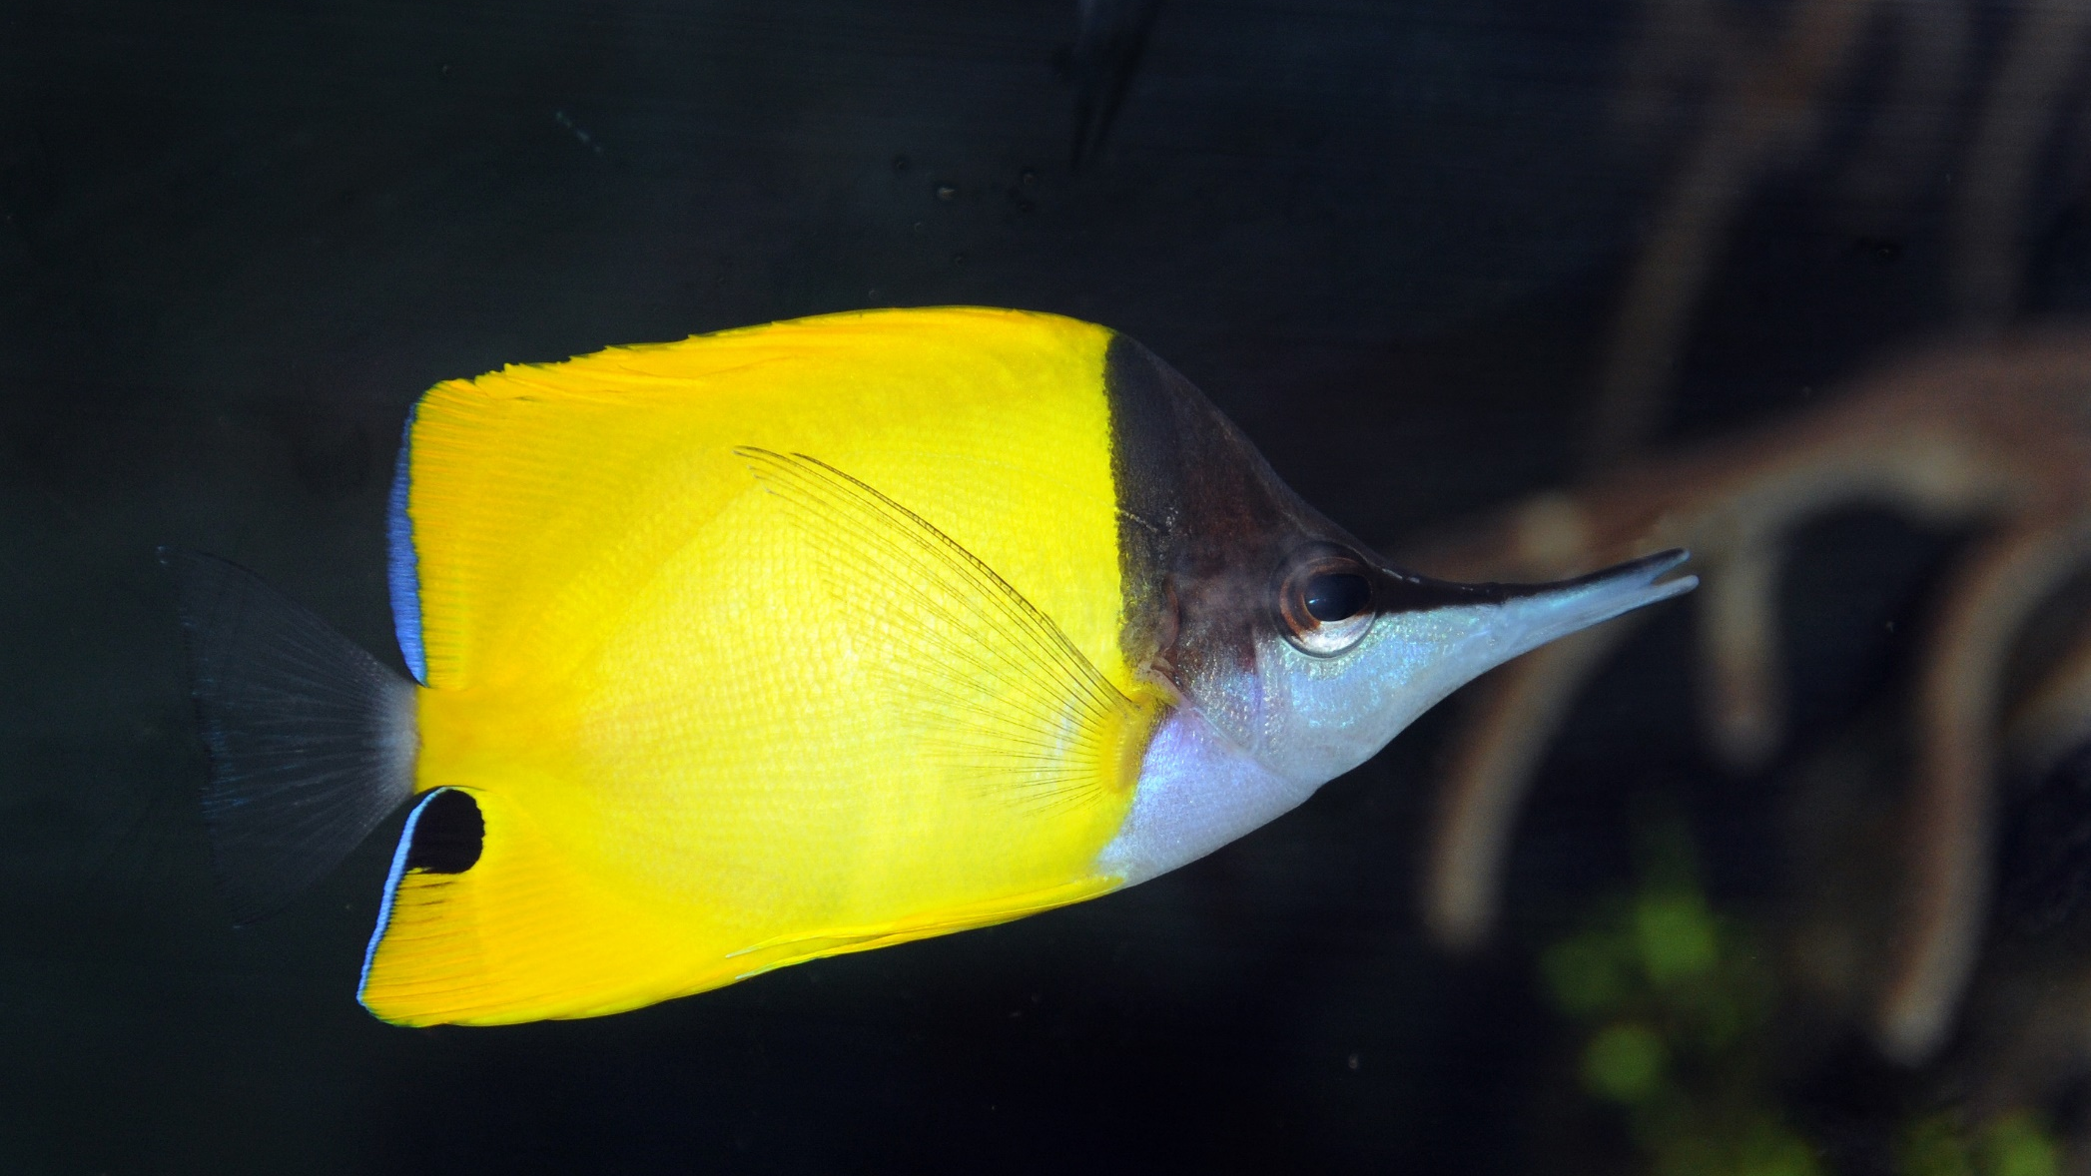
Butterflyfish
Bright colours and pretty patterns
Long snout and little mouth for eating coral polyps
Flat body
Notes:
Image: J. Jones, Copyright Commonwealth of Australia (GBRMPA)

Slide 32

Some have a
fake eye spot.
Why?
Notes:
Image: J. Jones, Copyright Commonwealth of Australia (GBRMPA)

Slide 33
To trick their predators.
Notes:
Image: J. Jones, Copyright Commonwealth of Australia (GBRMPA)

Slide 34
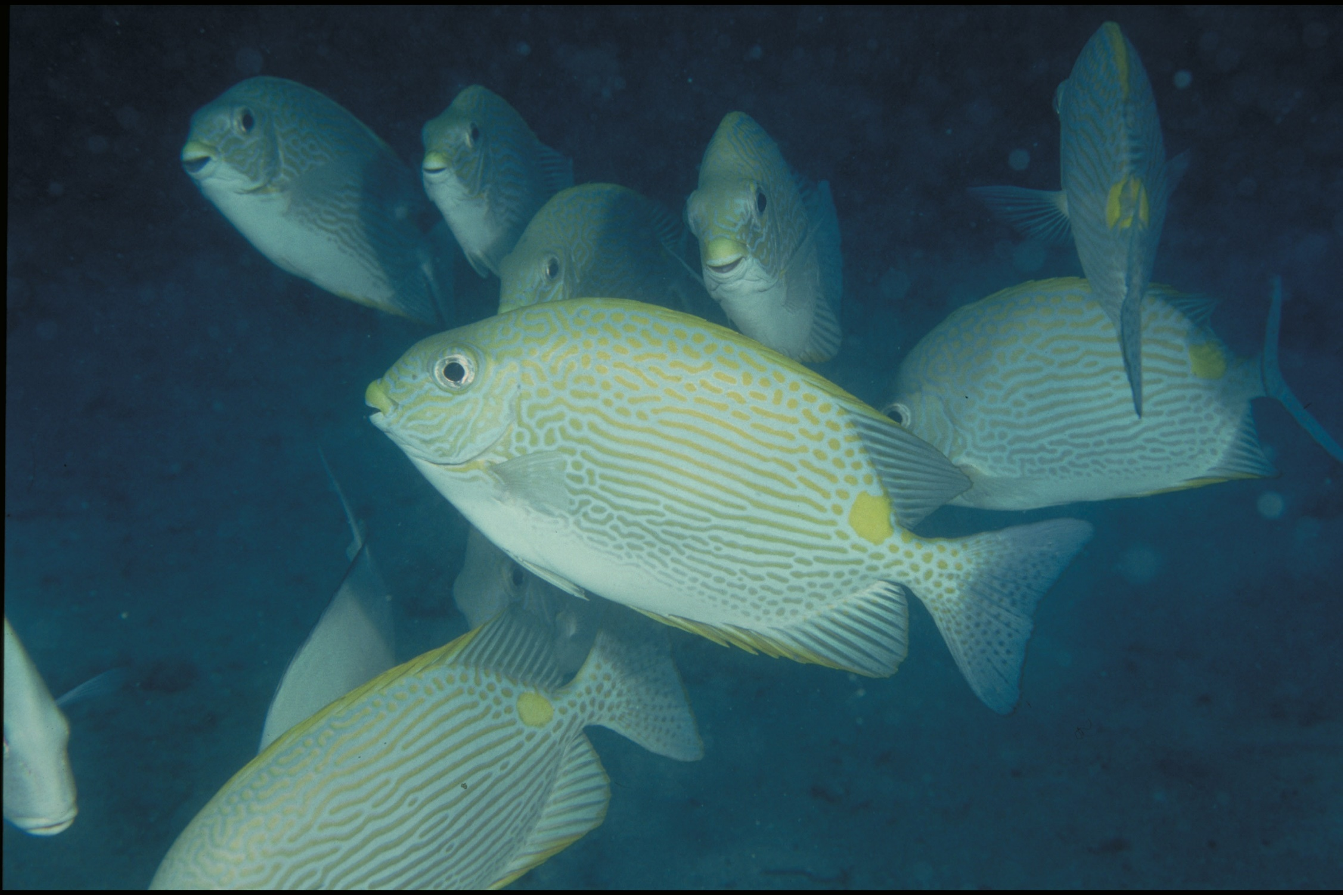
Grazing herbivores
Parrotfish / Surgeonfish / Rabbitfish / Unicornfish
Notes:
Image: W. Gladstone, Copyright Commonwealth of Australia (GBRMPA)

Slide 35
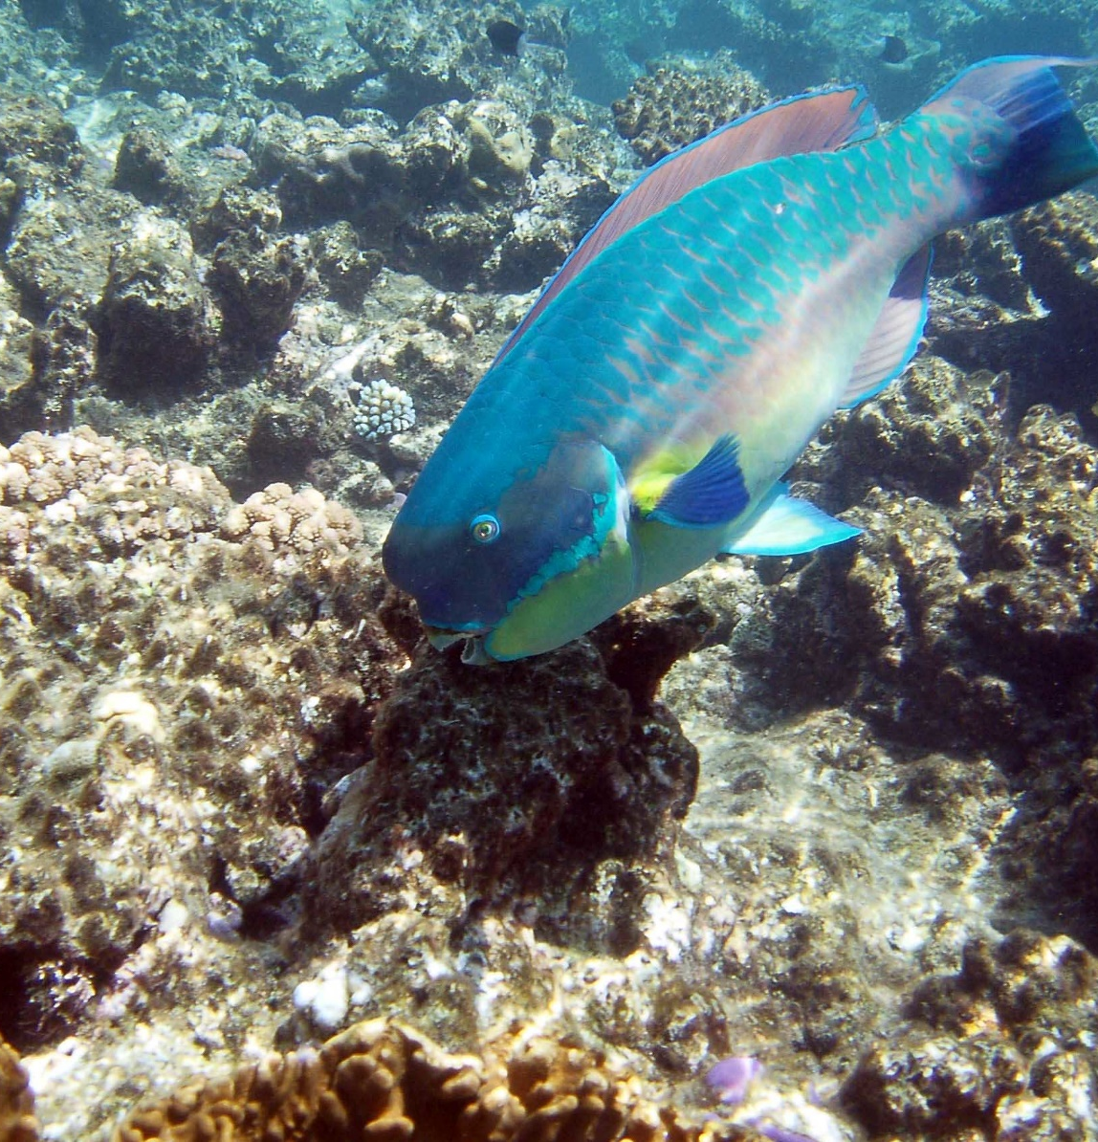
Why are grazing herbivores called
the lawnmowers of the Reef?
Notes:
Image: C. Jones, Copyright Commonwealth of Australia (GBRMPA)

Slide 36
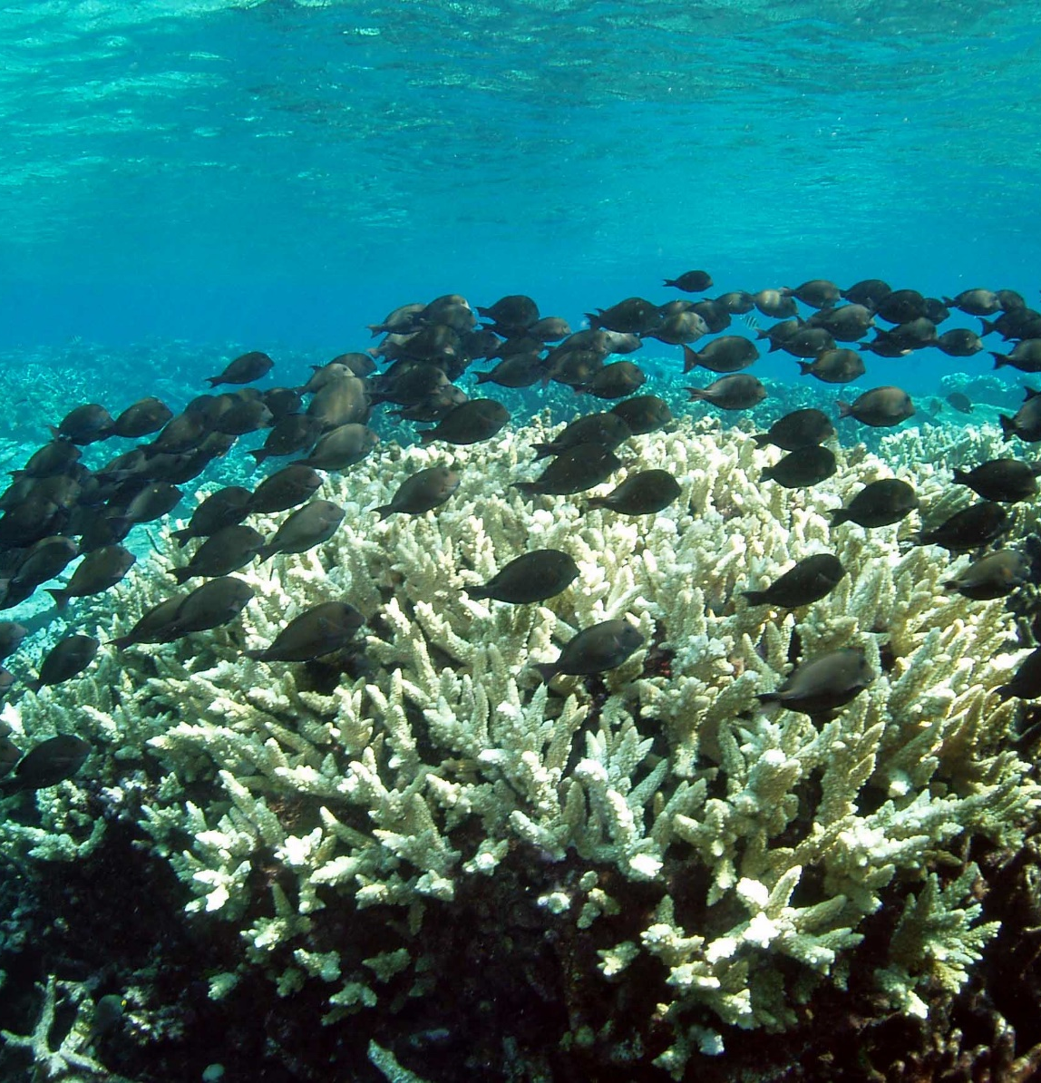
Because they graze on so much algae.
Notes:
Image: C. Jones, Copyright Commonwealth of Australia (GBRMPA)

Slide 37
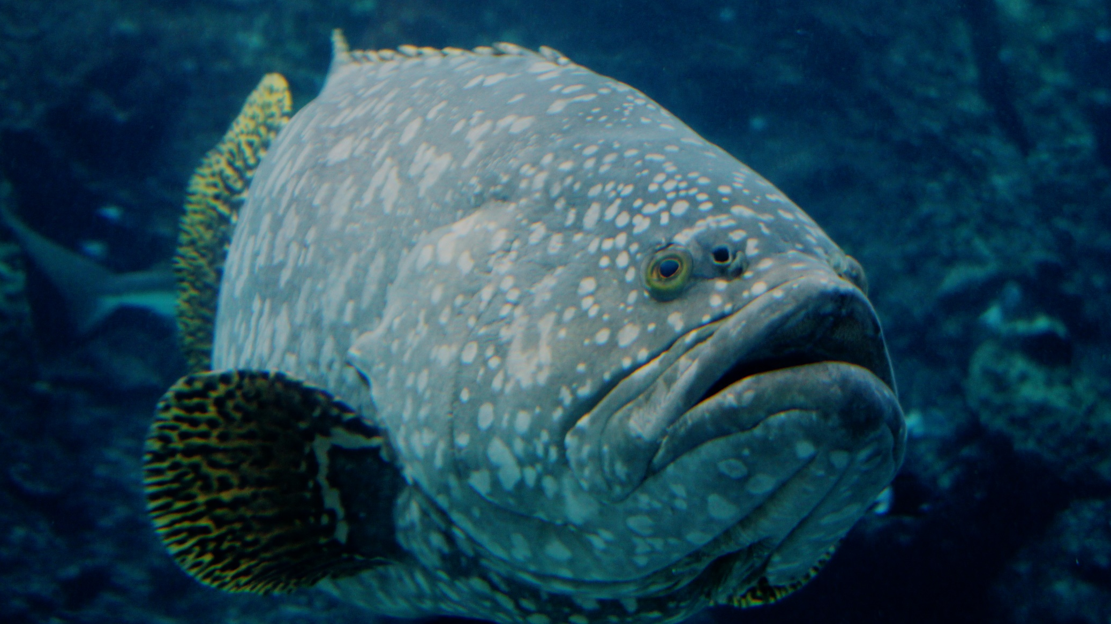
Cods and groupers
Pronounced grow-per.
Notes:
Image: J. Hurford, Copyright Commonwealth of Australia (GBRMPA)

Slide 38
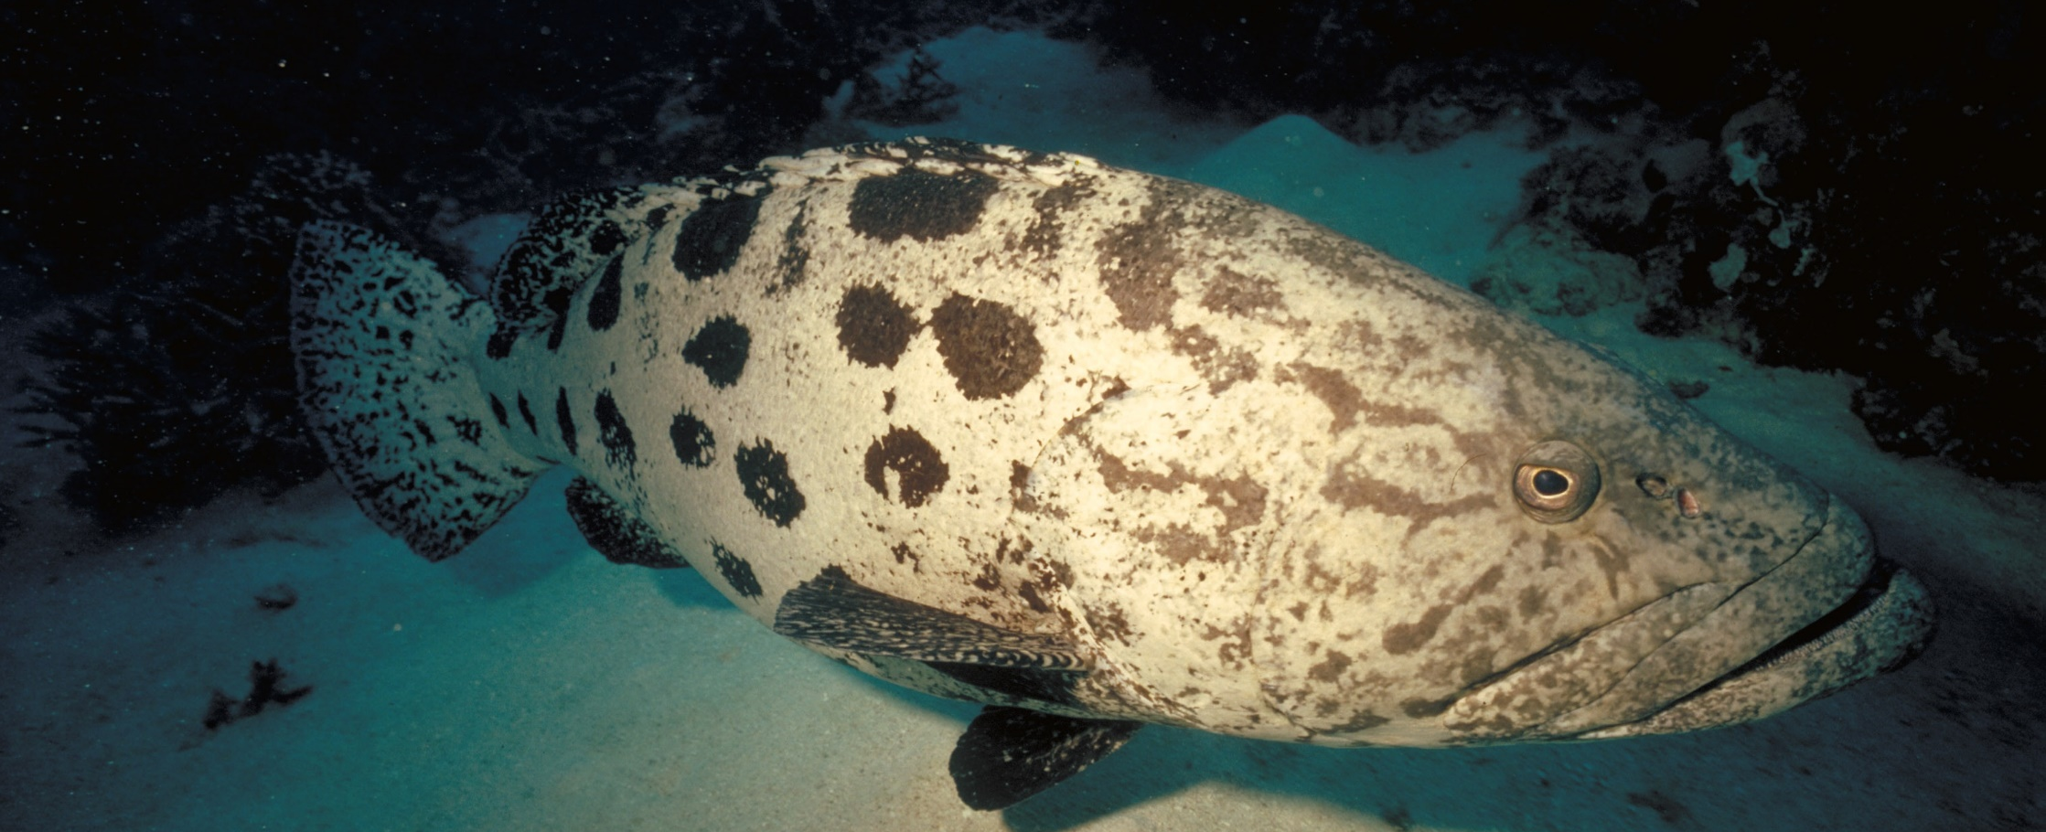
Is this big fish older than you?
Notes:
Image: P. McGinnity, Copyright Commonwealth of Australia (GBRMPA)

Slide 39
Yes!
Notes:
Image: P. McGinnity, Copyright Commonwealth of Australia (GBRMPA)

Slide 40
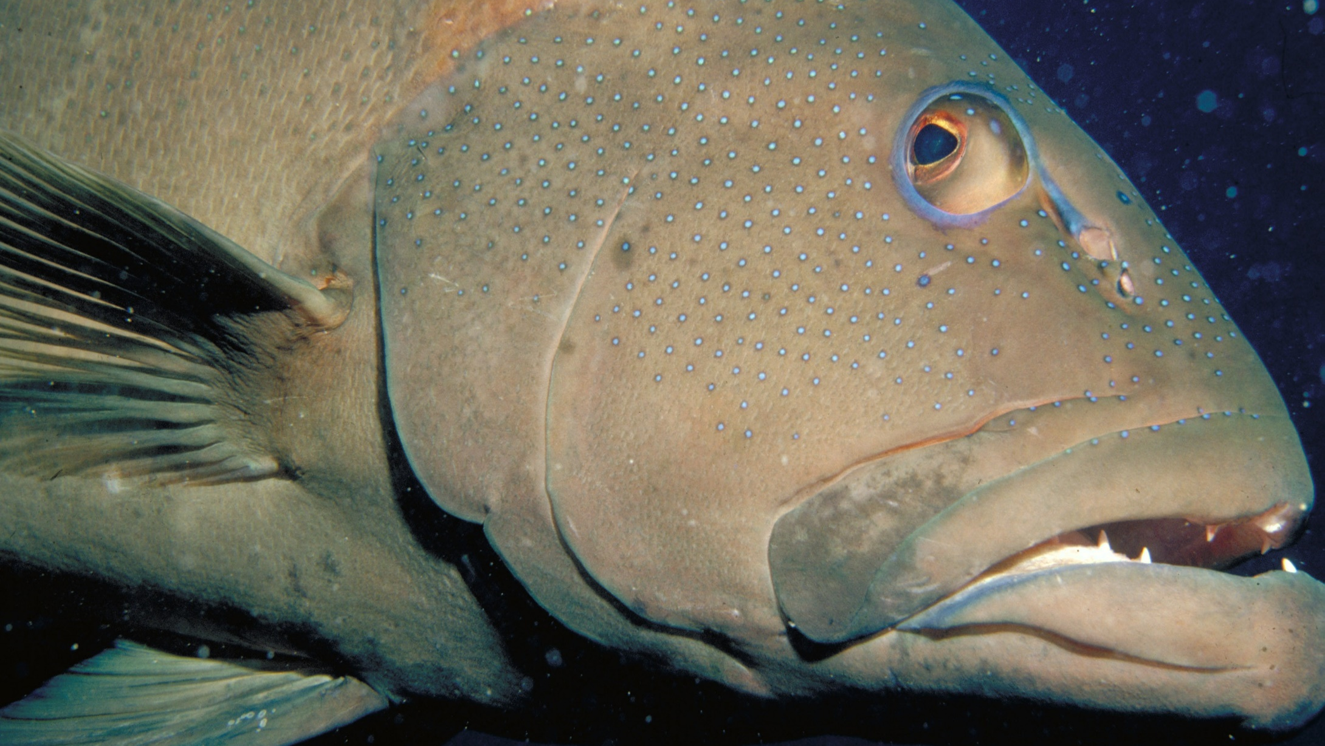
Coral trout
Notes:
Image: S. Summerhays, Copyright Commonwealth of Australia (GBRMPA)

Slide 41
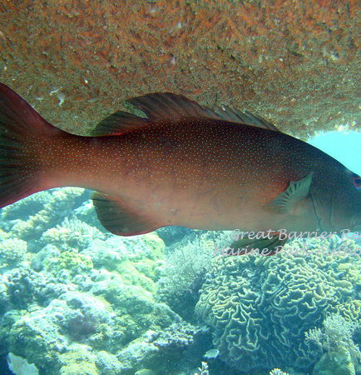

Where do
they live?
Notes:
Image: G. Goby, Copyright Commonwealth of Australia (GBRMPA)

Slide 42
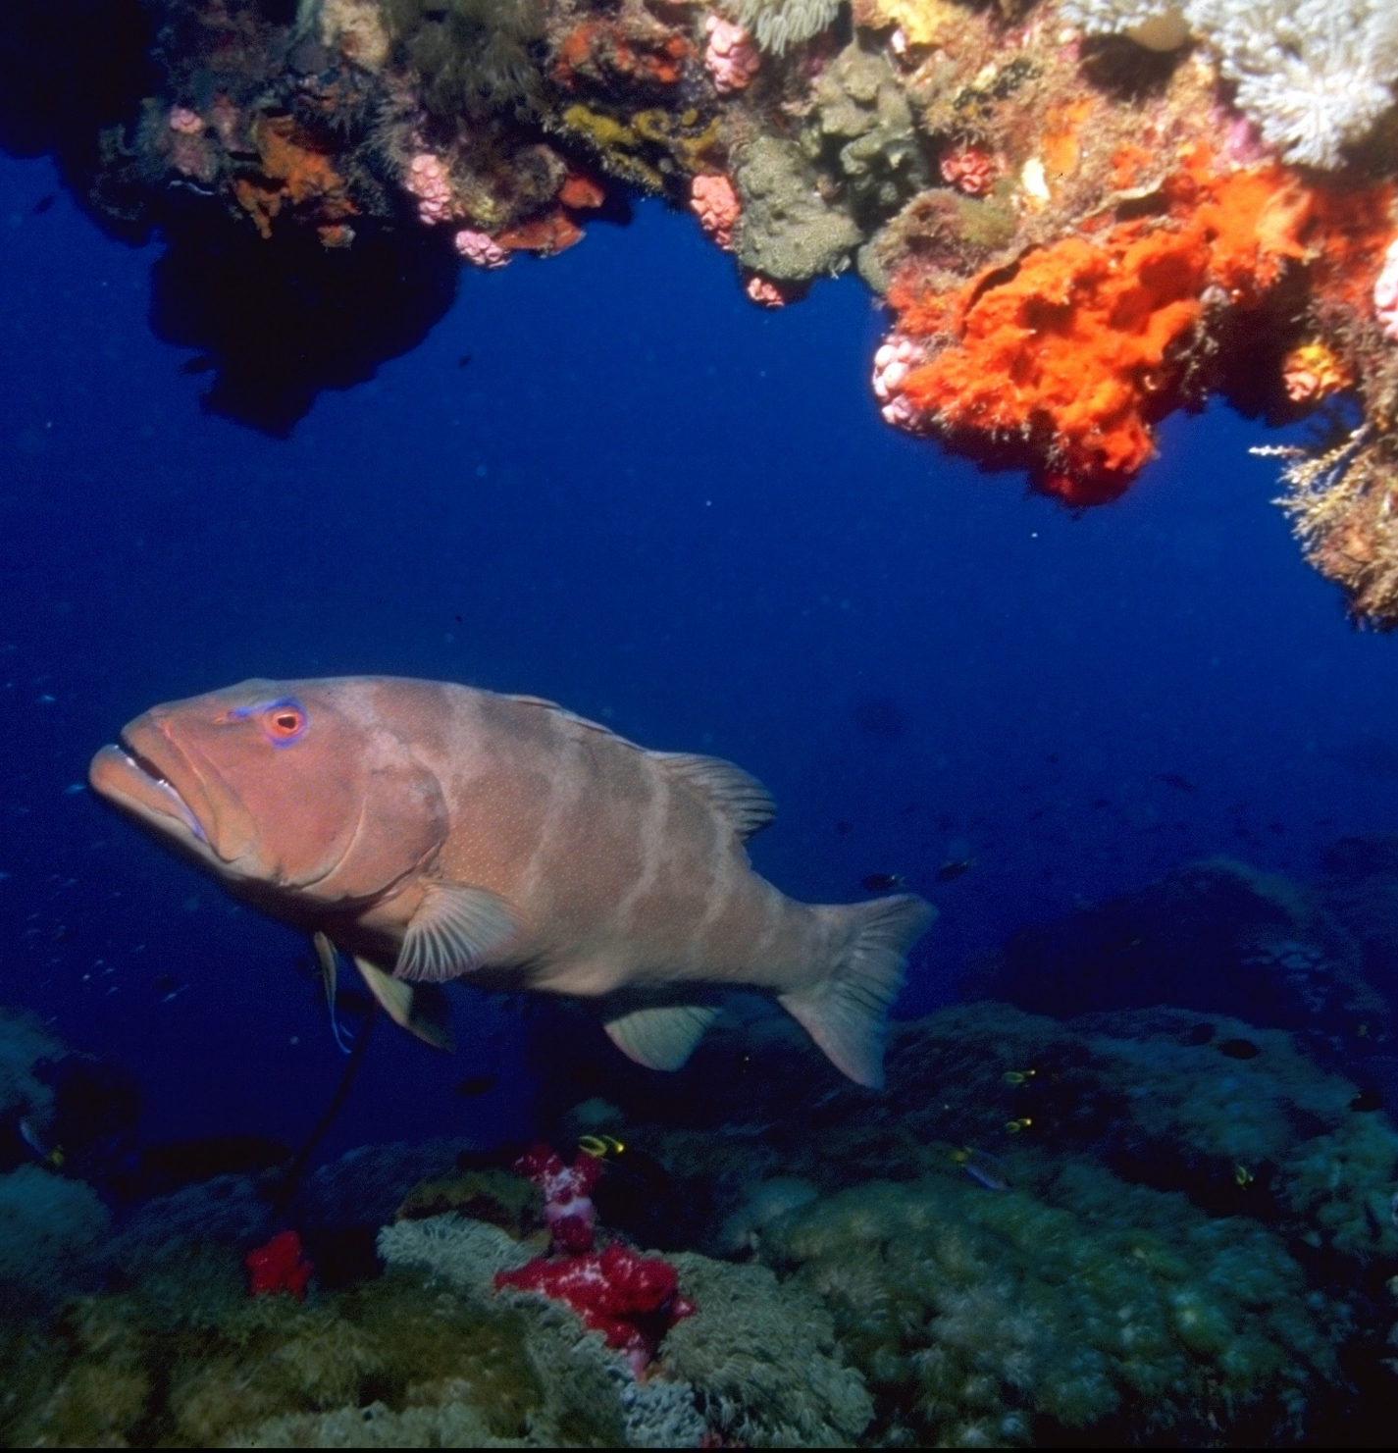
They are often hiding under ledges and overhangs.
Notes:
Image: T. Mayne, Copyright Commonwealth of Australia (GBRMPA)

Slide 43
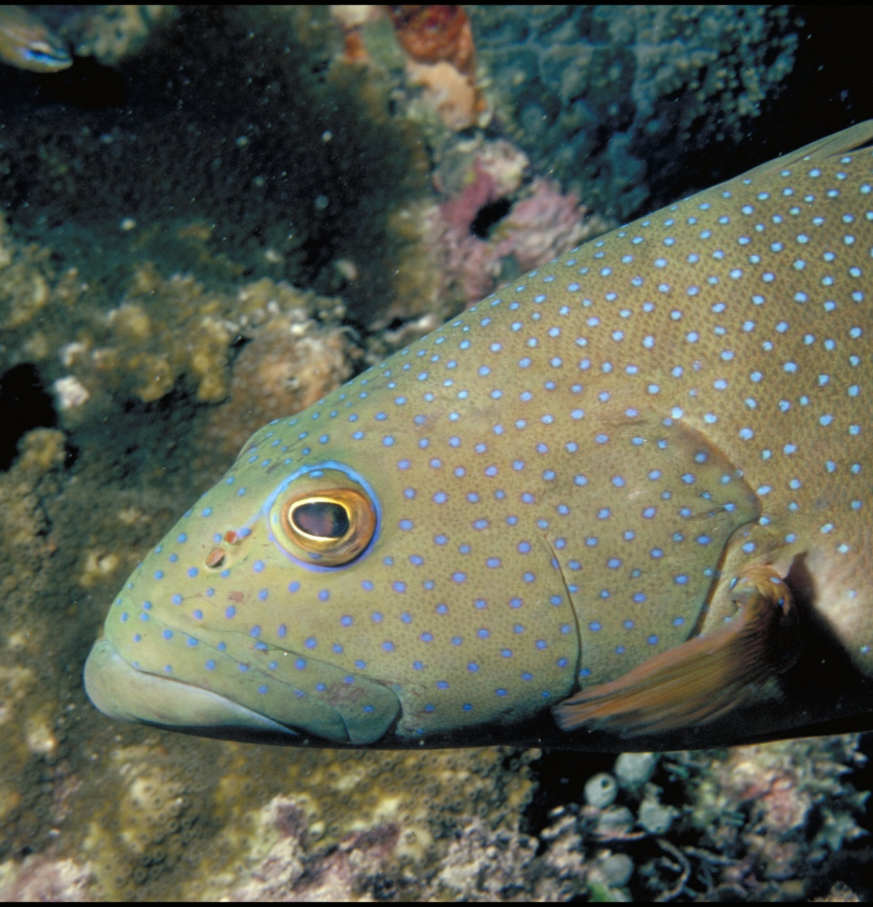
How big must they be to keep?
Notes:
Image: A. Zell, Copyright Commonwealth of Australia (GBRMPA)

Slide 44
At least 38cm.
Notes:
Image: A. Zell, Copyright Commonwealth of Australia (GBRMPA)

Slide 45
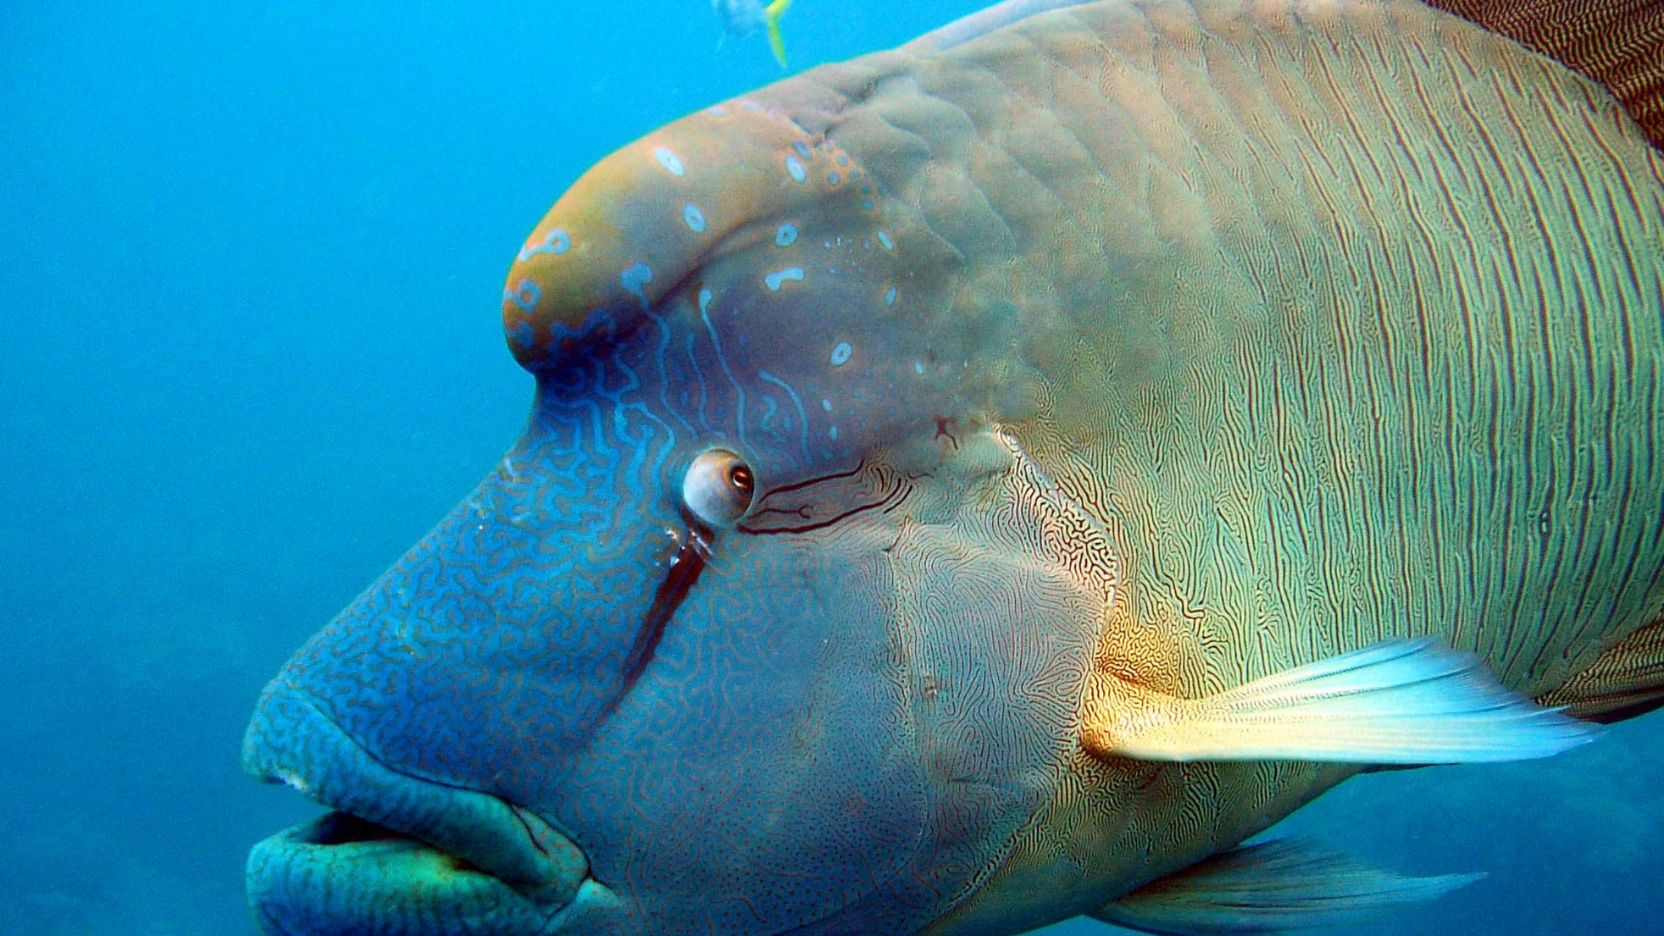
Maori wrasse
also called humphead wrasse or Napoleon wrasse.
Notes:
Image: C. Jones, Copyright Commonwealth of Australia (GBRMPA)

Slide 46
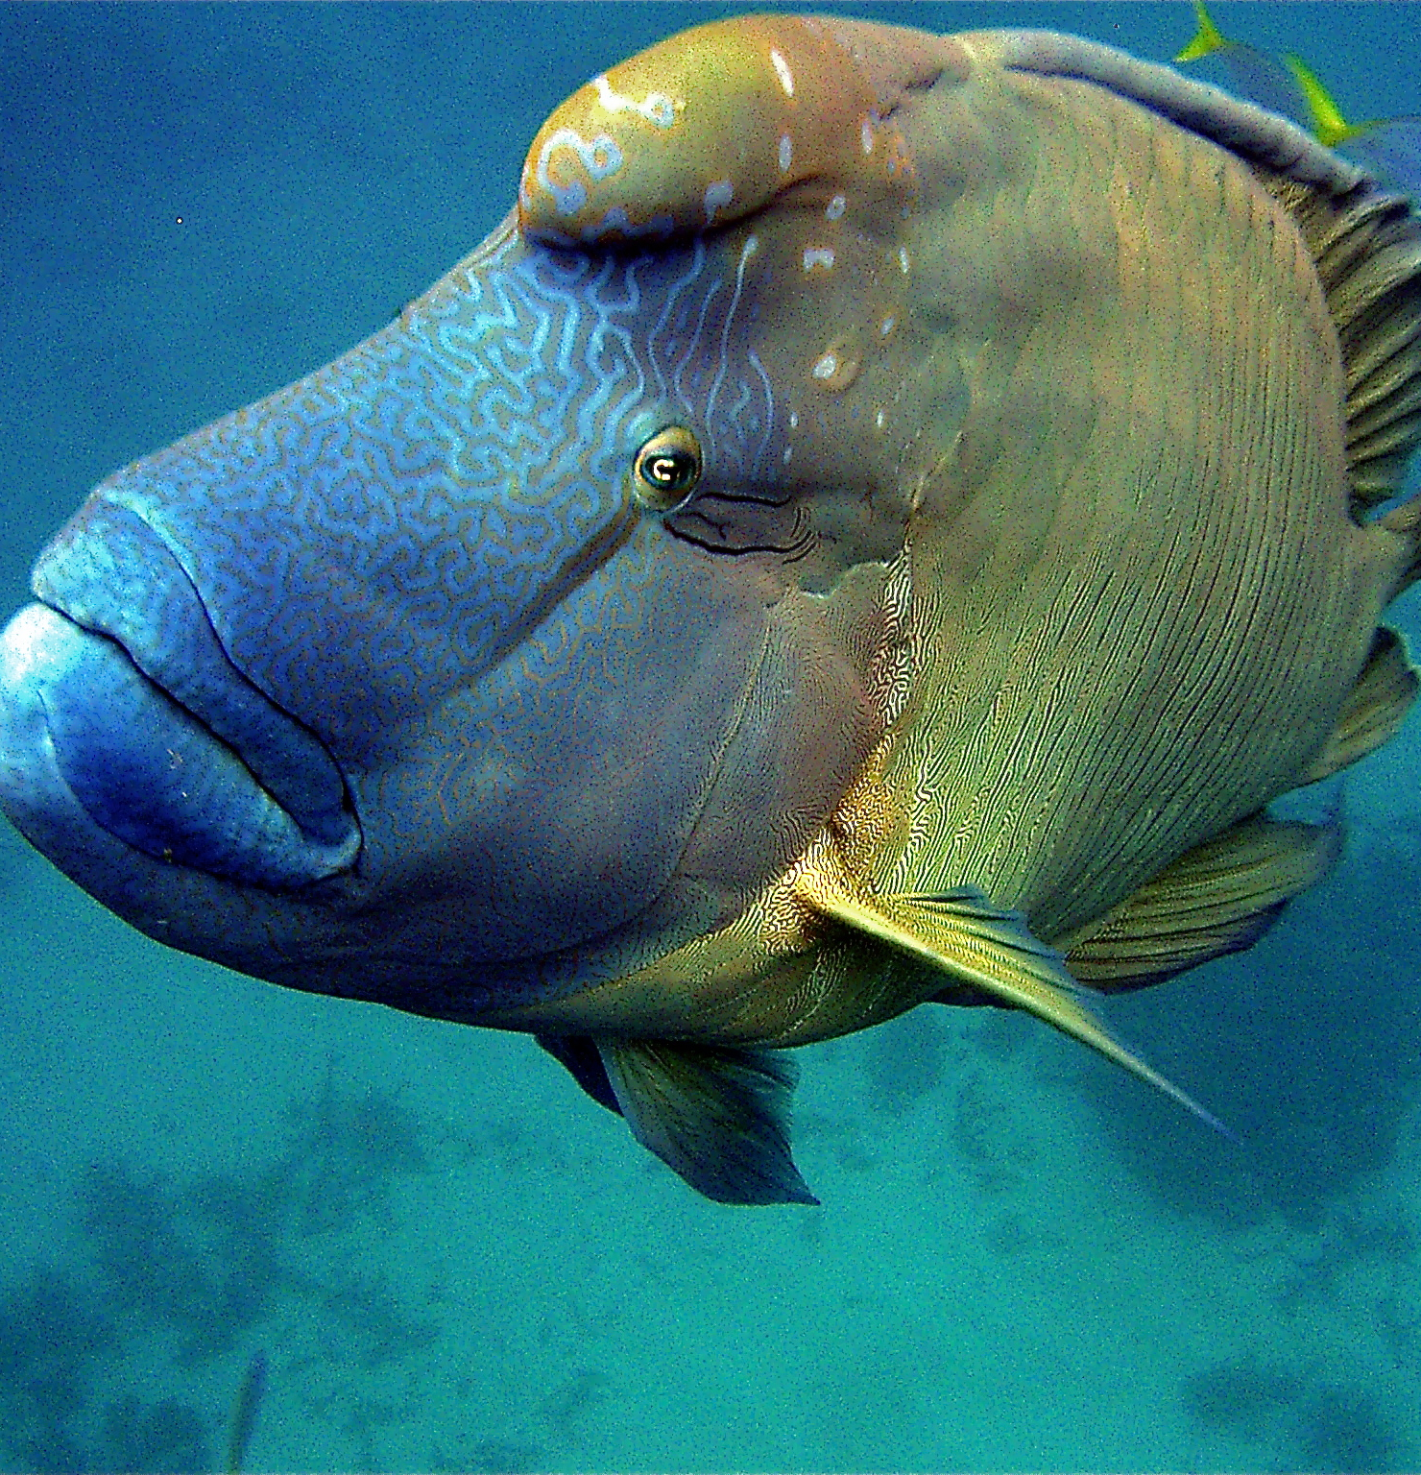
Where do
they live?
Notes:
Image: C. Jones, Copyright Commonwealth of Australia (GBRMPA)

Slide 47
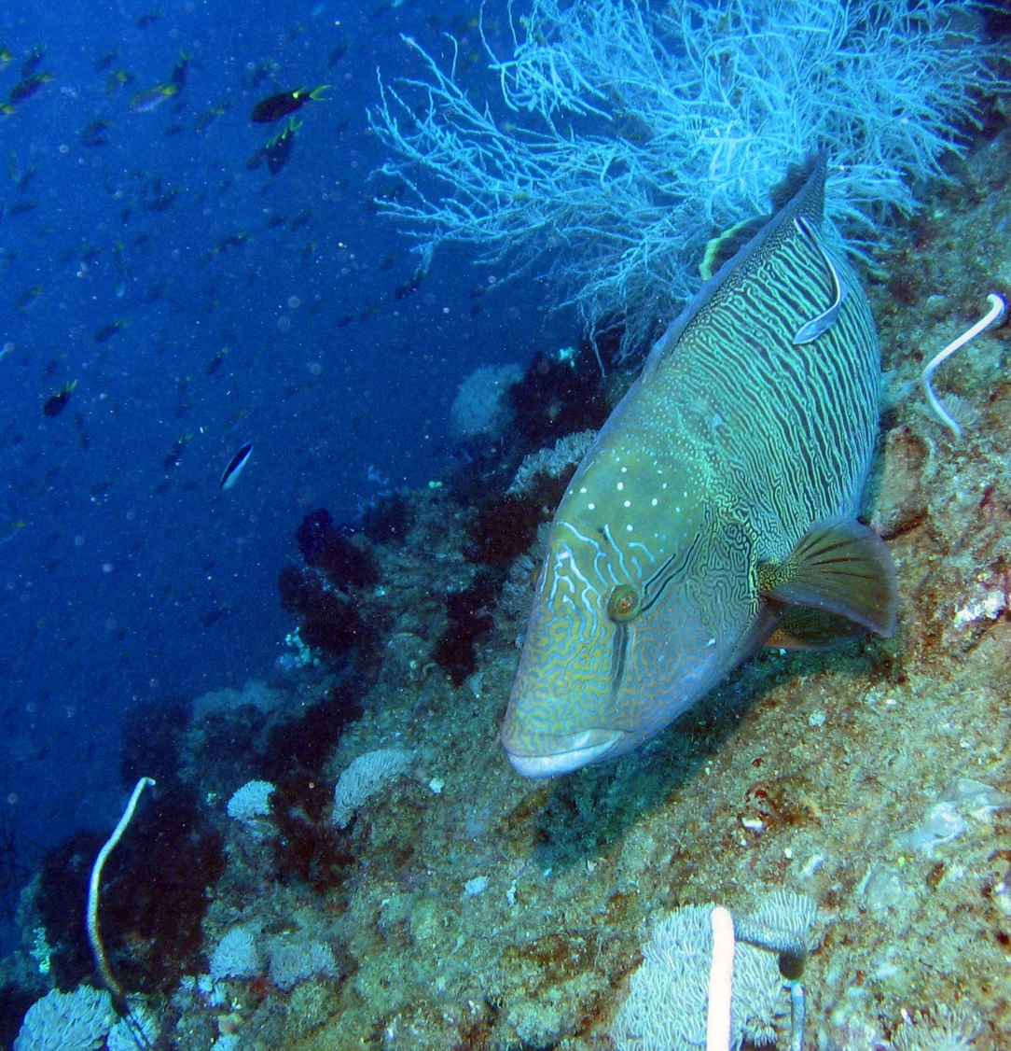
Maori wrasse
live on the Reef
and occupy limited home ranges.
Notes:
Image: J. Monkivitch, Copyright Commonwealth of Australia (GBRMPA)

Slide 48
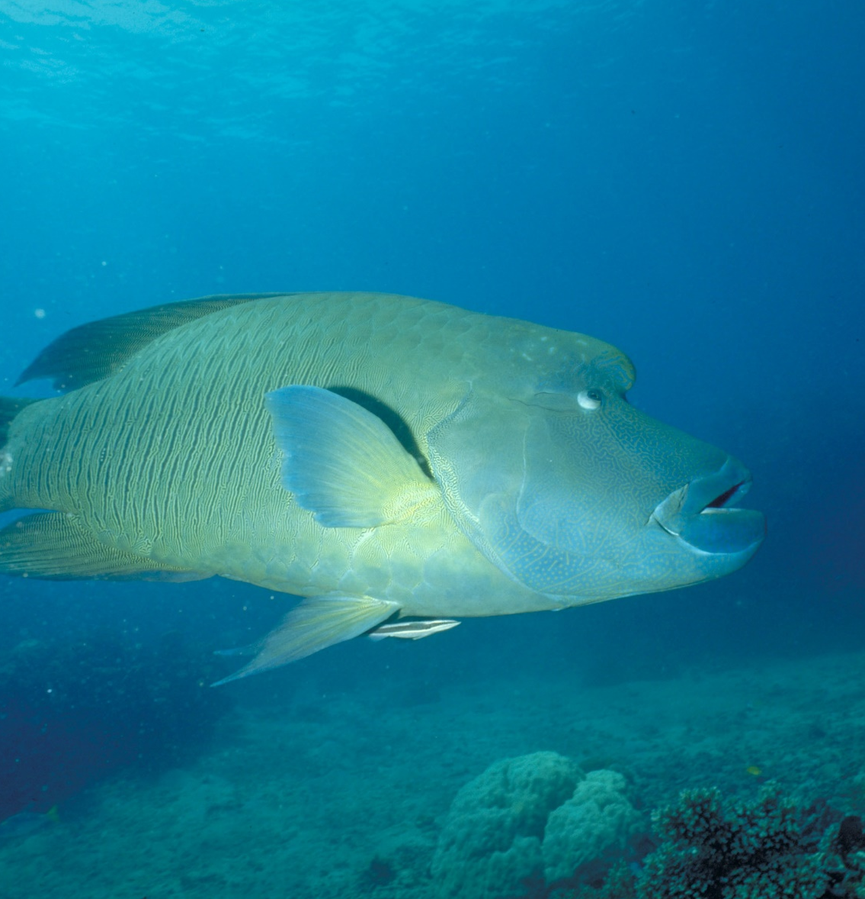
Adults swim across the reefs during the day, resting at night in caves and under coral ledges.
Notes:
Image: M. Simmons, Copyright Commonwealth of Australia (GBRMPA)

Slide 49
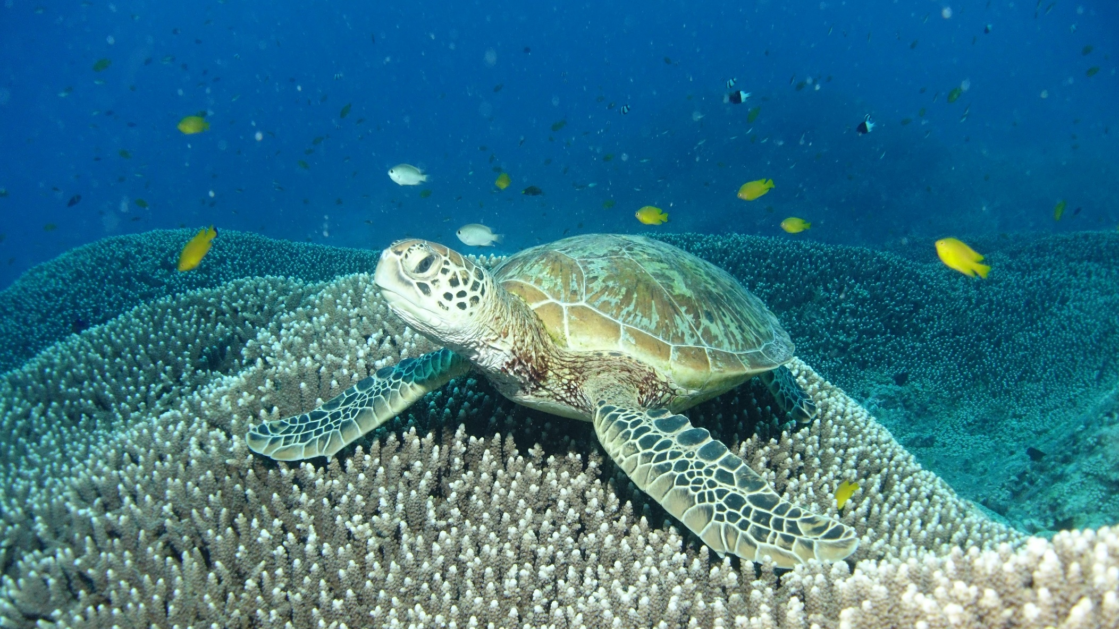
Sea turtles
Notes:
Image: C. Jones, Copyright Commonwealth of Australia (GBRMPA)

Slide 50
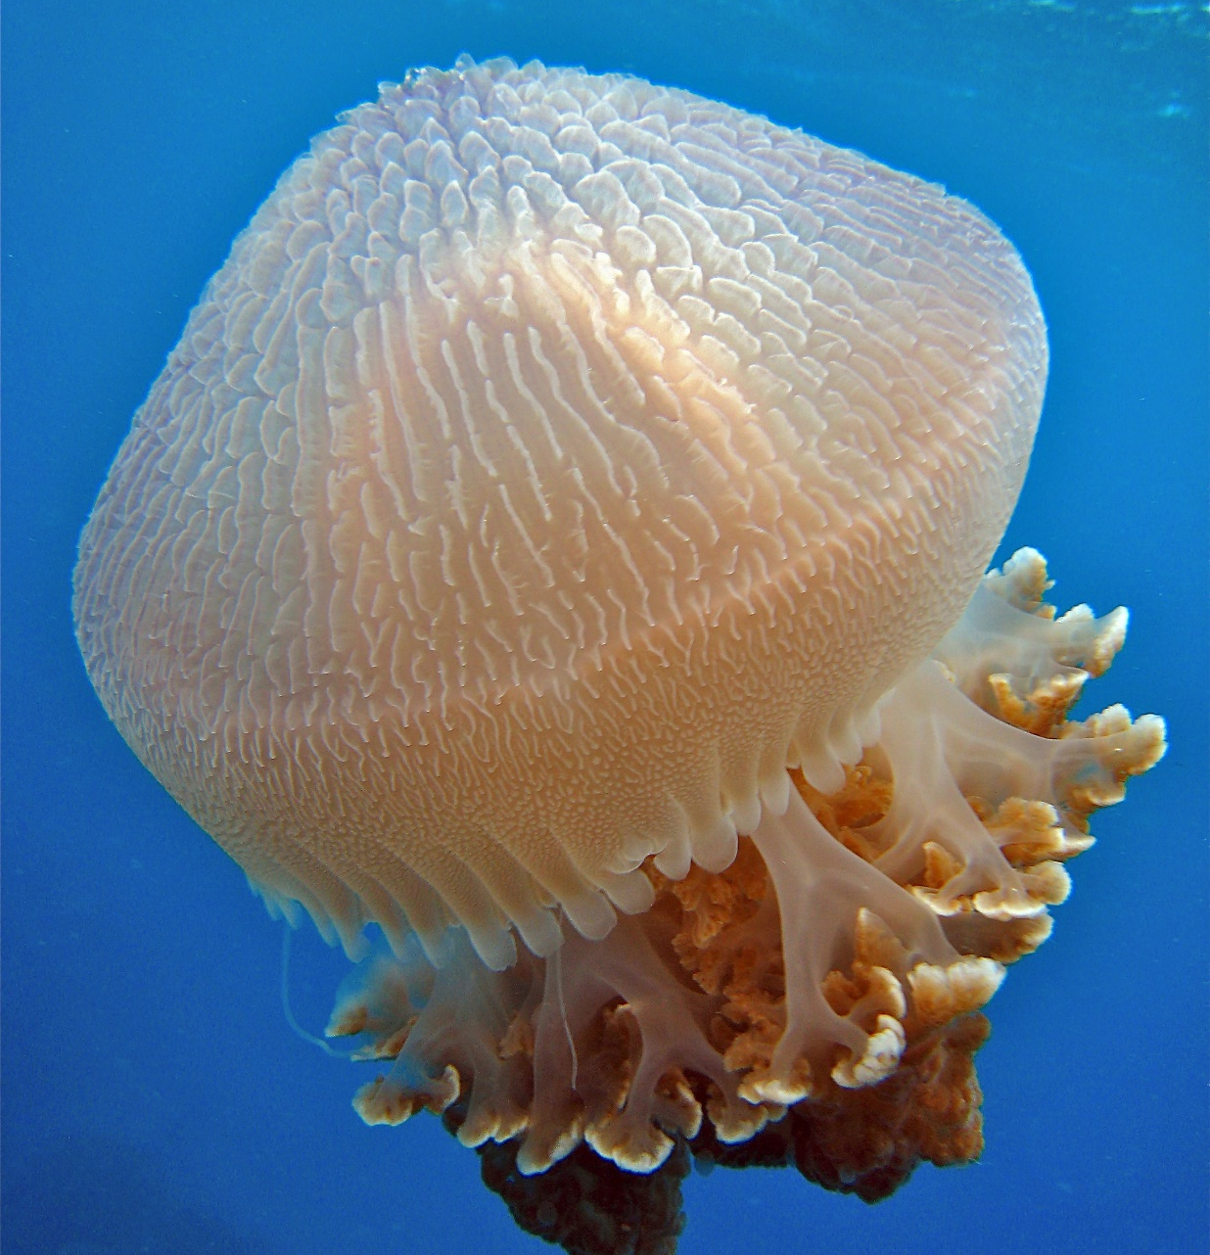
What do sea
turtles eat that look like jellyfish?
Notes:
Image: C. Jones, Copyright Commonwealth of Australia (GBRMPA)

Slide 51
Plastic
bags.
Notes:
Image: C. Jones, Copyright Commonwealth of Australia (GBRMPA)

Slide 52
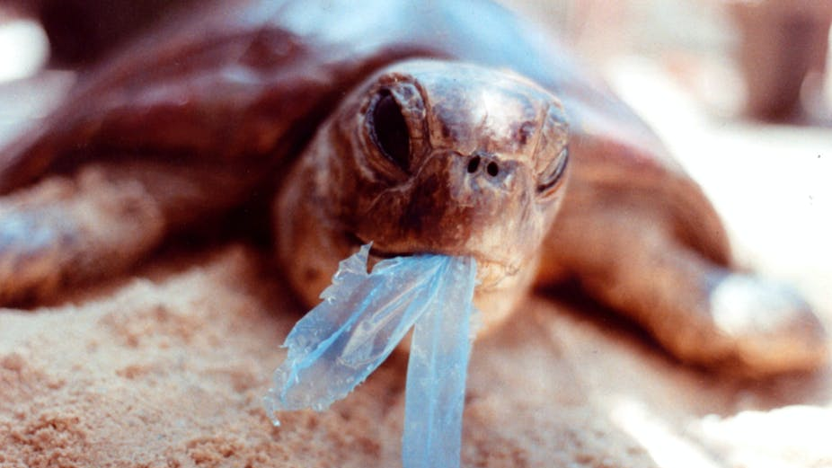
AAP Image/Department of the Environment and Heritage/Melbourne Zoo
Notes:
Image: https://theconversation.com/ghostnets-fish-on-marine-rubbish-threatens-northern-australian-turtles-11585

Slide 53
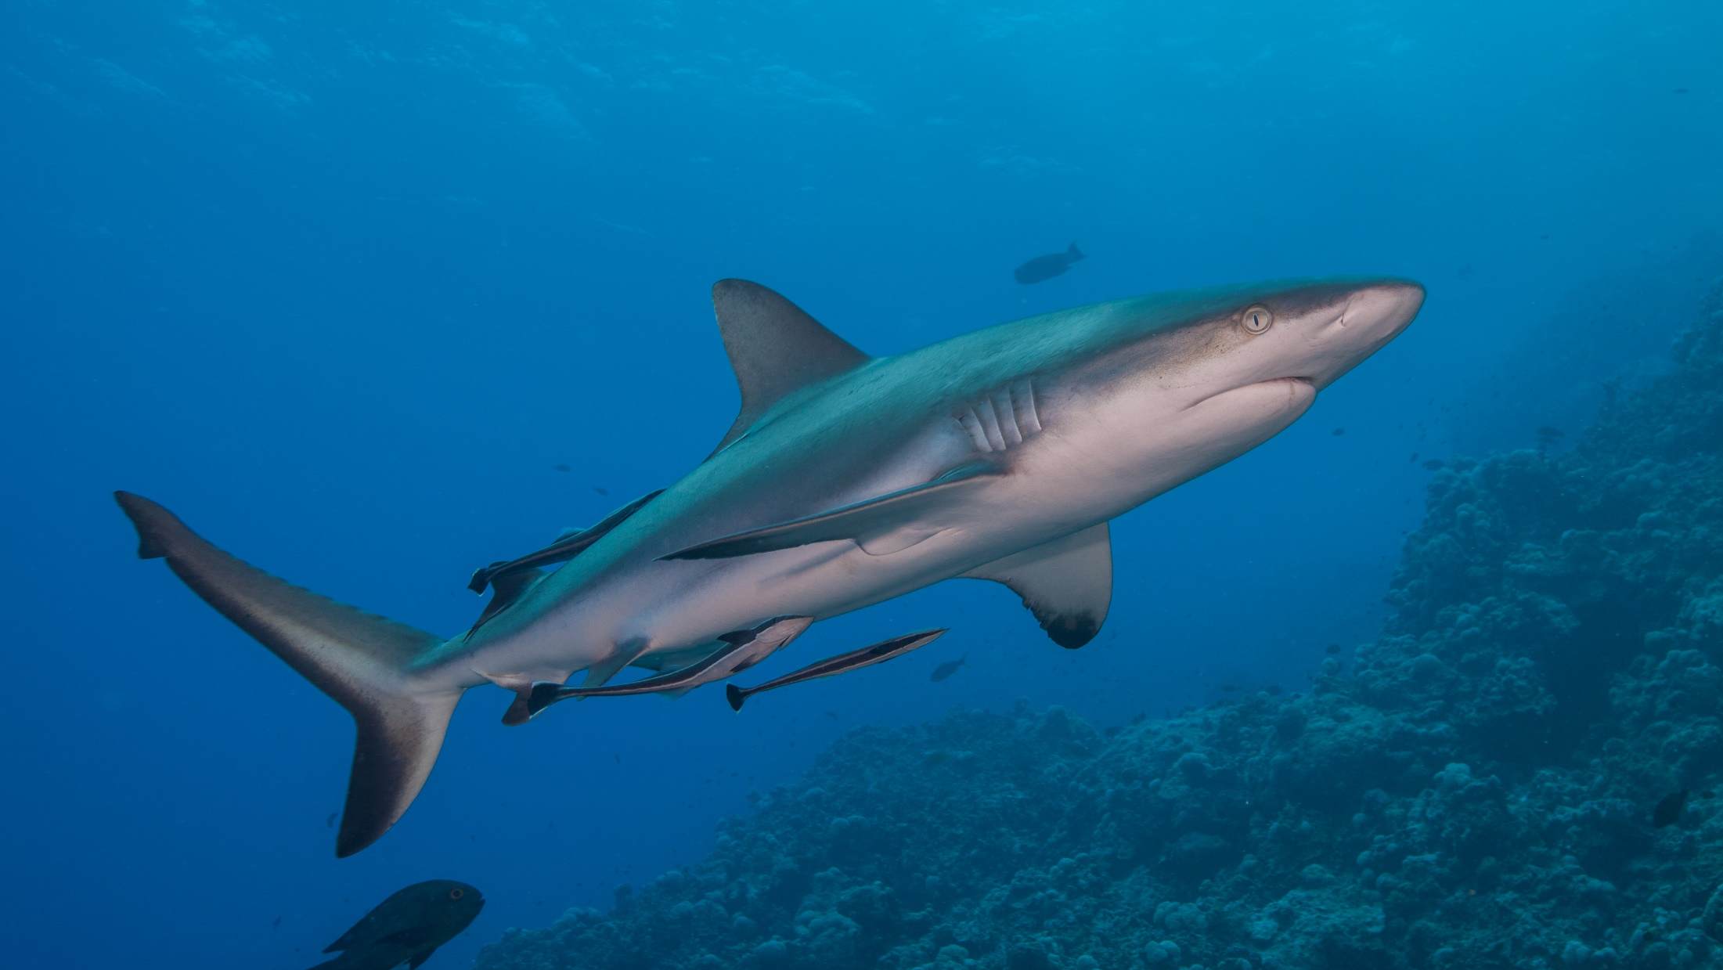
Sharks
Notes:
Image: J. Sumerling, Copyright Commonwealth of Australia (GBRMPA)

Slide 54
What is the biggest
shark alive?

Slide 55
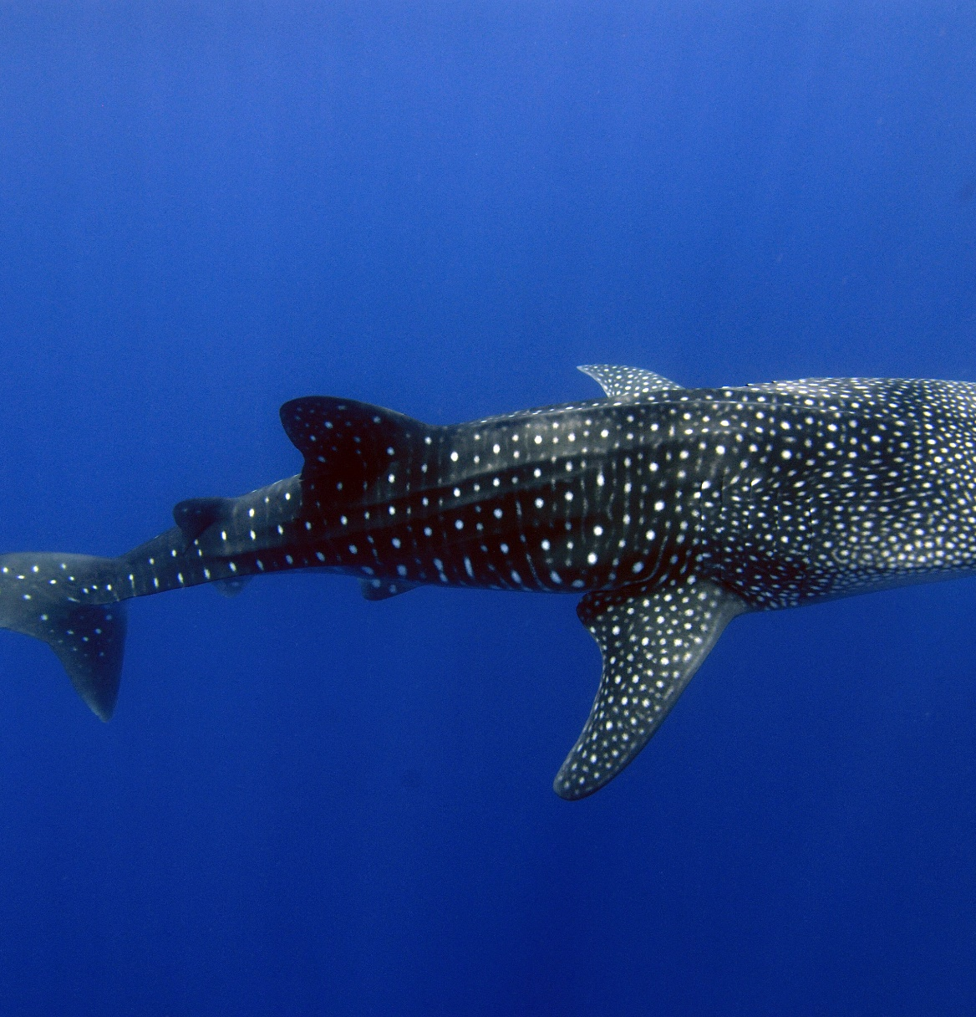
Whale sharks
are the biggest sharks alive.
They have small teeth. They eat plankton.
ENDANGERED
Notes:
Image: K. Hoppen, Copyright Commonwealth of Australia (GBRMPA)

Slide 56
How did you go?

Slide 57
Now that you have learnt about some of the animals on the Great Barrier Reef, how do you think you can help protect them?

Slide 58
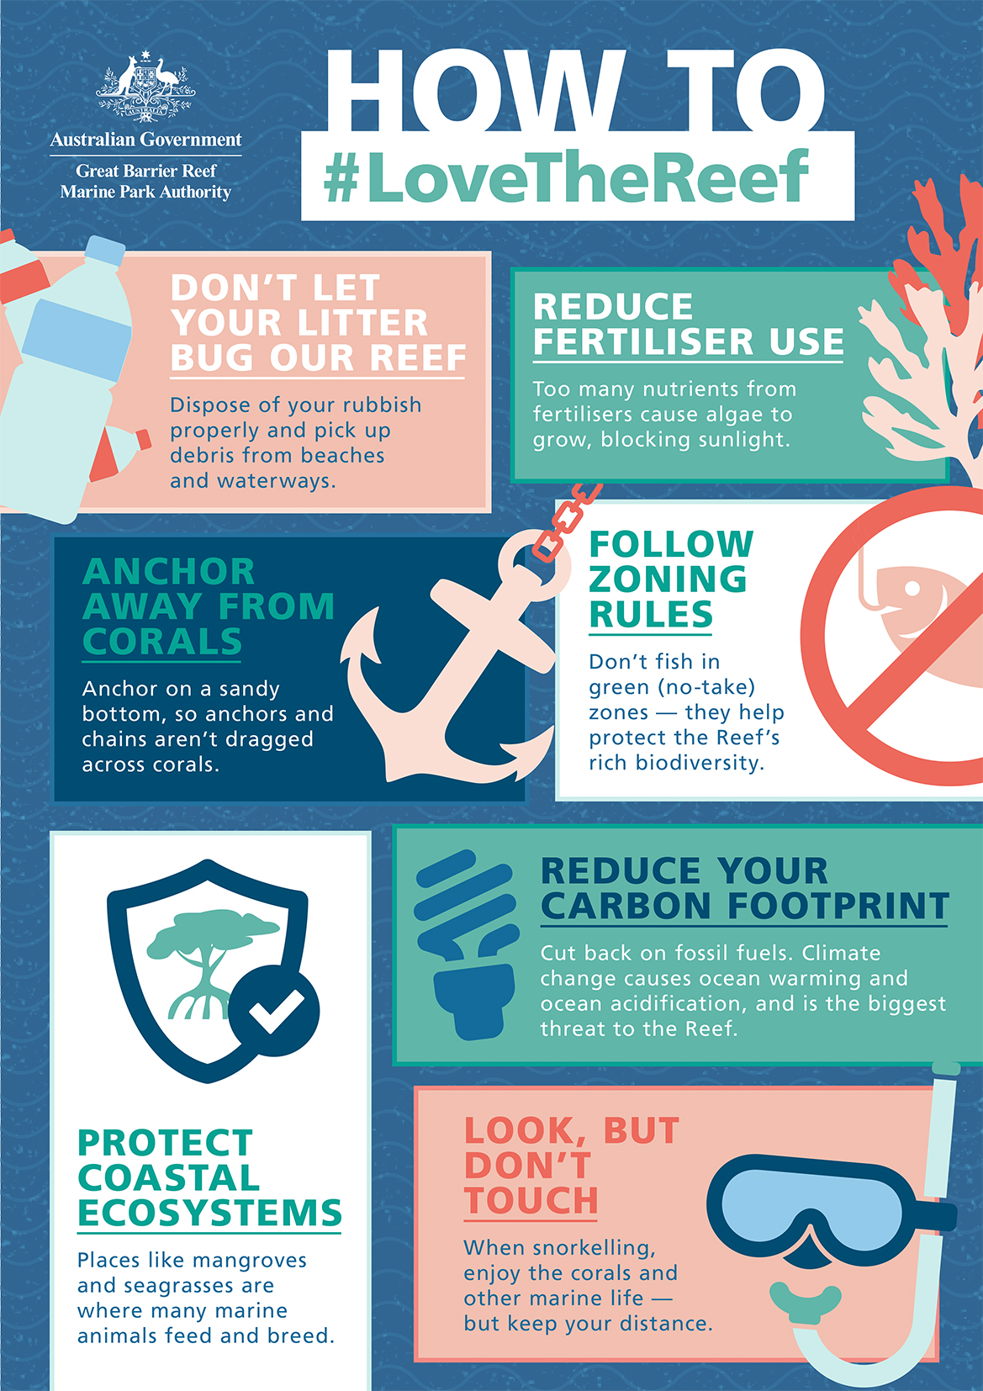
What actions can you take to protect the Great Barrier Reef?

Slide 59
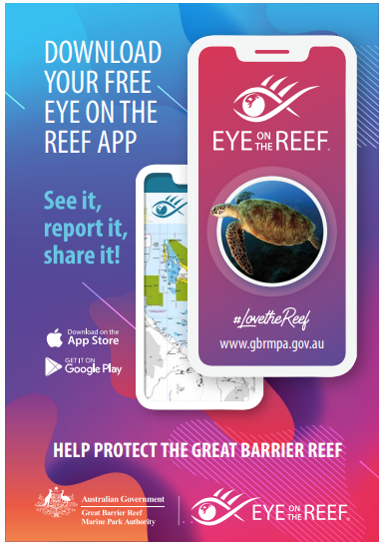
Download
the Eye on the
Reef app.
Notes:
App image: https://www.gbrmpa.gov.au/__data/assets/pdf_file/0020/265430/Eye-on-the-Reef-app-poster.pdf

Slide 60
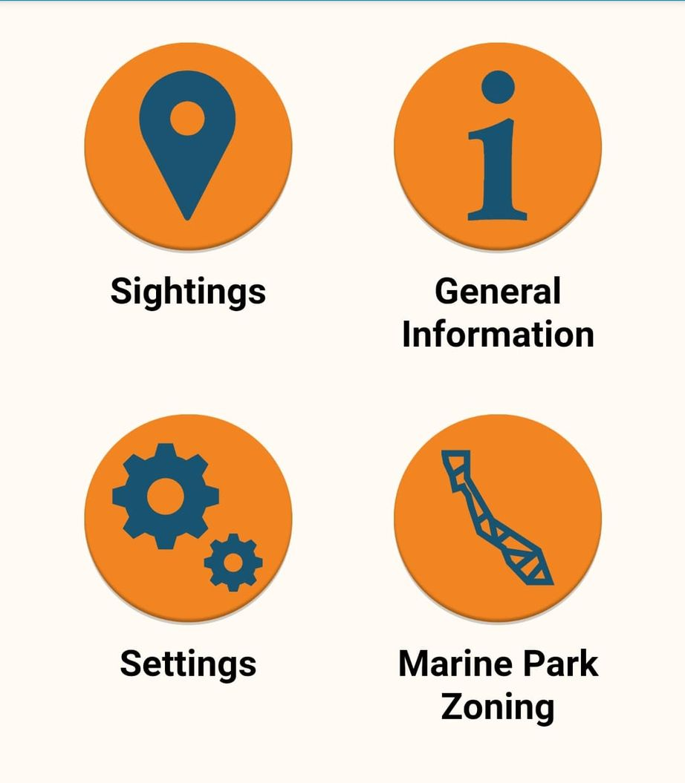
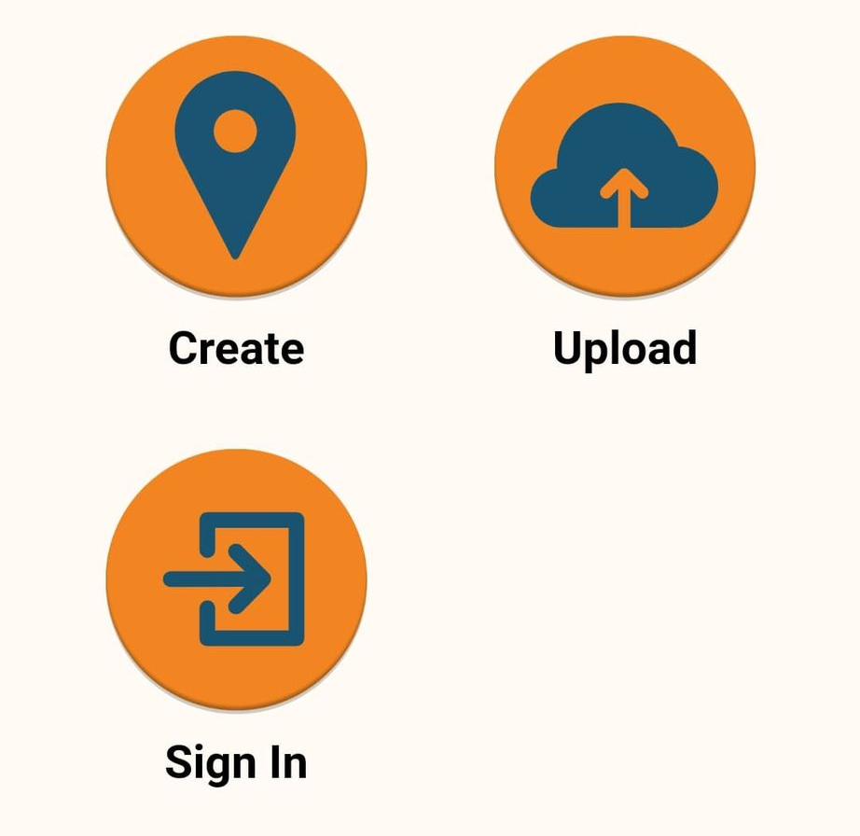
Press “Sightings” and “Create”.

Slide 61
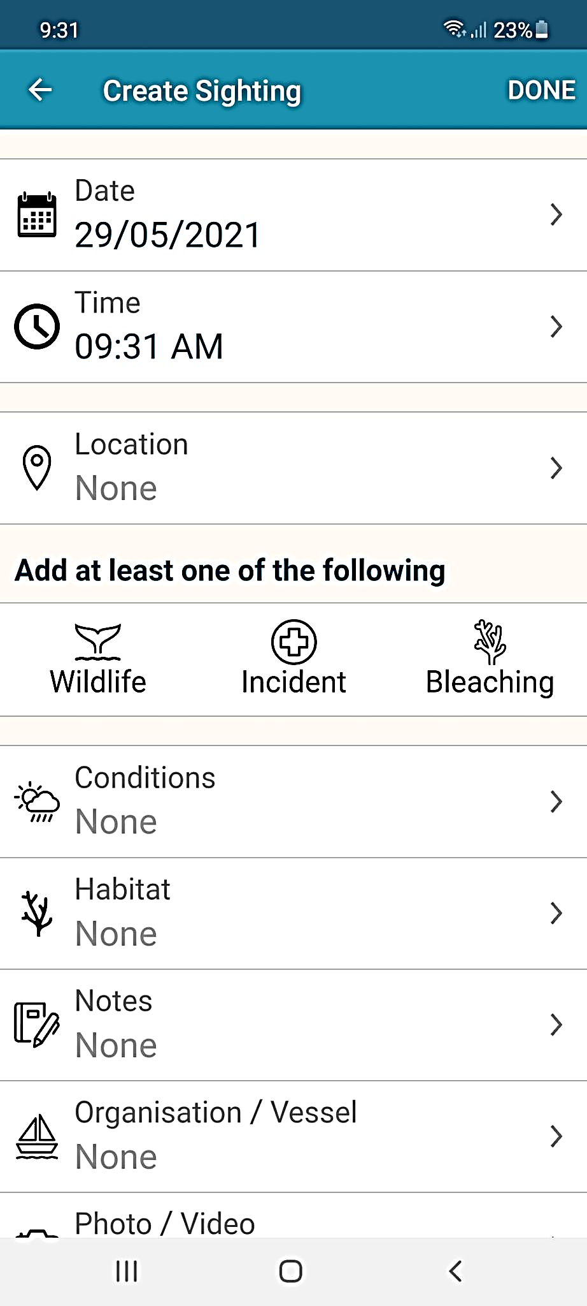
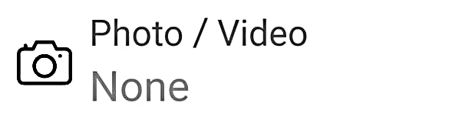
Press “Wildlife”.

Slide 62


Marine mammals.
Select your animal and press “INFORMATION” to learn more.

Slide 63


Marine reptiles.

Slide 64




Sharks and rays.

Slide 65



Fishes.

Slide 66











Slide 67





Birds.

Slide 68


Invertebrates.

Slide 69










Slide 70
Explore the other tabs too!

Slide 71
Create a poster to answer the question:
How can I help the Great Barrier Reef?
Display it proudly in your classroom.
Notes:
This is the last slide for students to view. The remaining slides are for the teachers.

Slide 72
Thank you for helping the Great Barrier Reef!
See the Reef • Love the Reef • Protect the Reef

