Slide 1
Be a Marine
Biologist for a Day
Part 2: Finding out
Advanced only
Post-snorkel presentation for
360° survey.
Notes:
Image: K. Goudkamp, Copyright Commonwealth of Australia (GBRMPA)

Slide 2

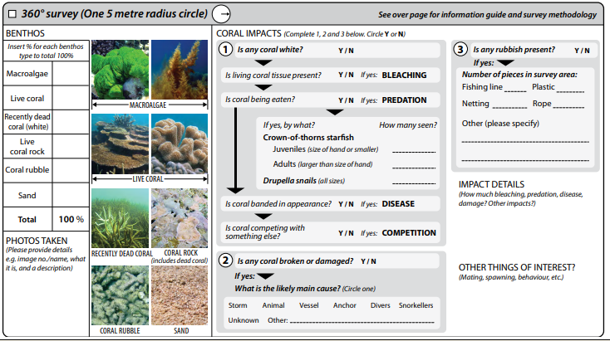

Slide 3
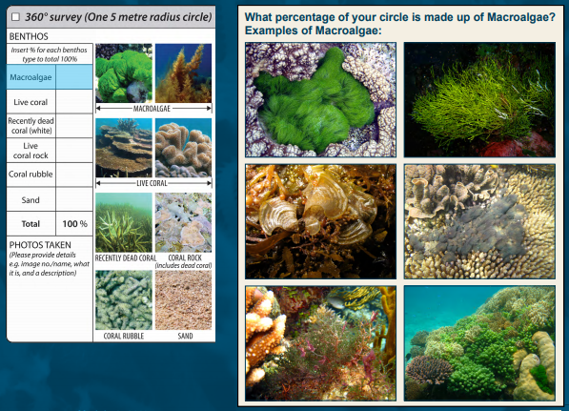
% of macroalgae?
Notes:
Copyright Commonwealth of Australia (GBRMPA)

Slide 4
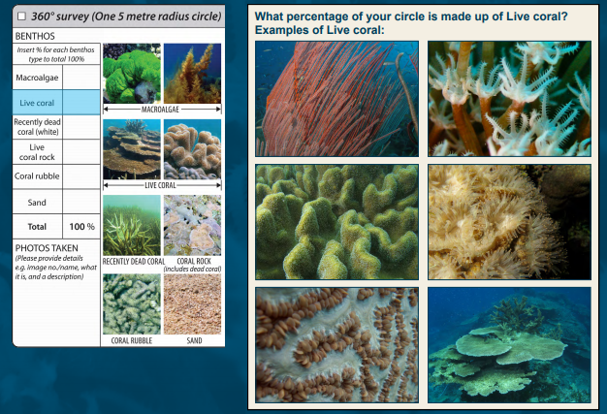
% of
live
coral?
Notes:
Copyright Commonwealth of Australia (GBRMPA)

Slide 5
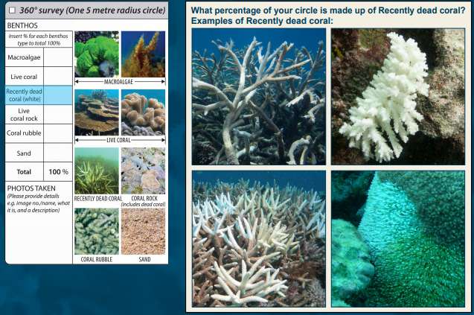
% of recently dead coral (white)?
Notes:
Copyright Commonwealth of Australia (GBRMPA)

Slide 6
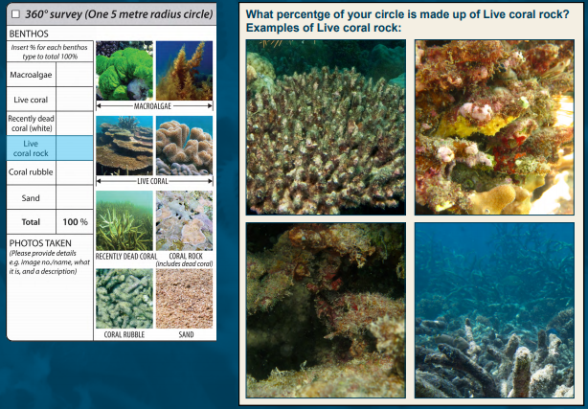
% of live coral rock?
Notes:
Copyright Commonwealth of Australia (GBRMPA)

Slide 7
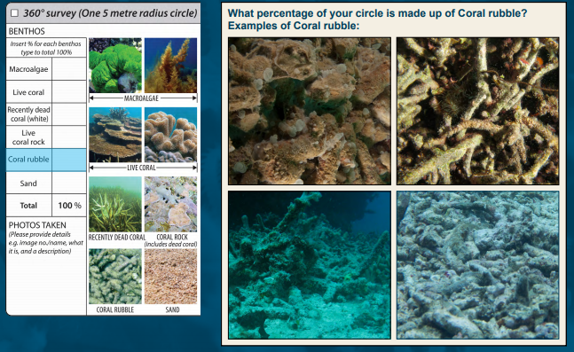
% of coral rubble?
Notes:
Copyright Commonwealth of Australia (GBRMPA)

Slide 8
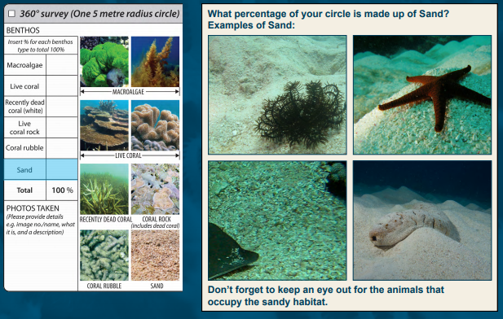
% of
sand?
Notes:
Copyright Commonwealth of Australia (GBRMPA)

Slide 9
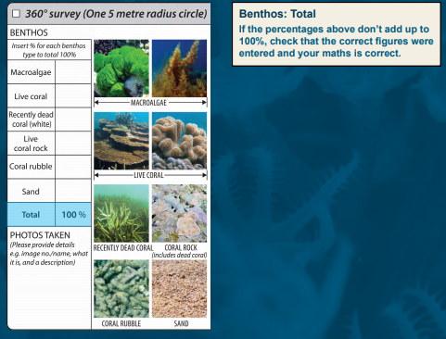
Does the total add up to 100%?
Notes:
Copyright Commonwealth of Australia (GBRMPA)

Slide 10
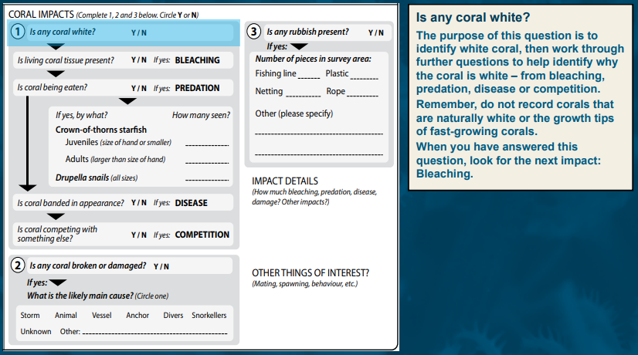

Slide 11
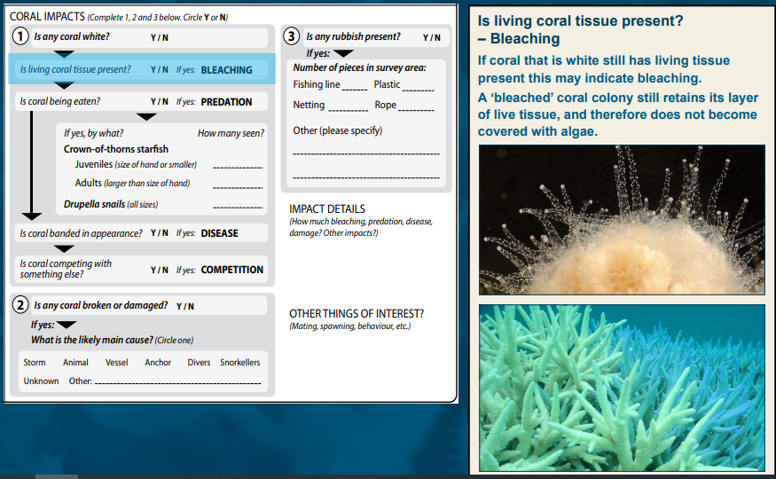

Slide 12
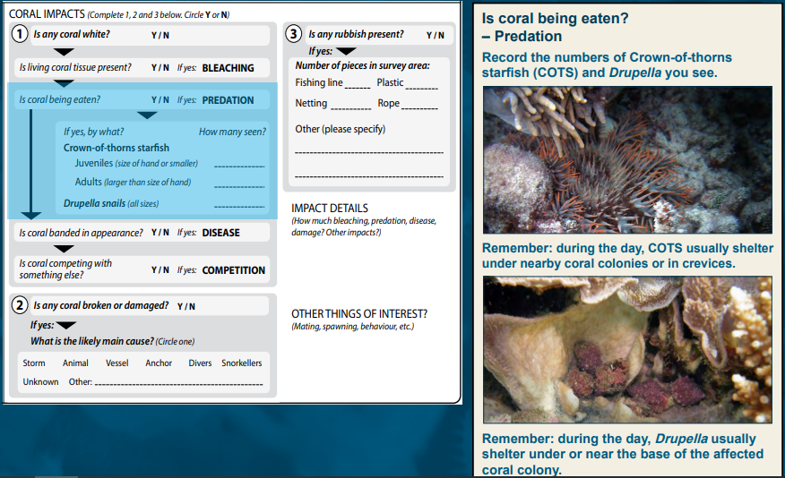

Slide 13
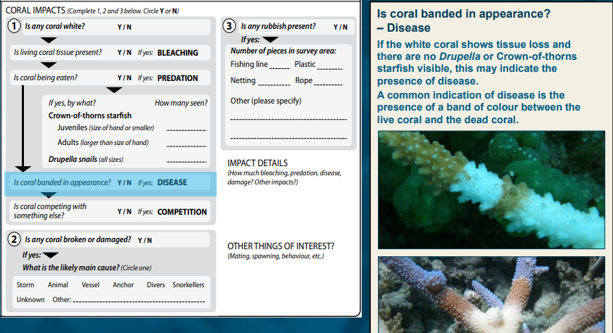

Slide 14
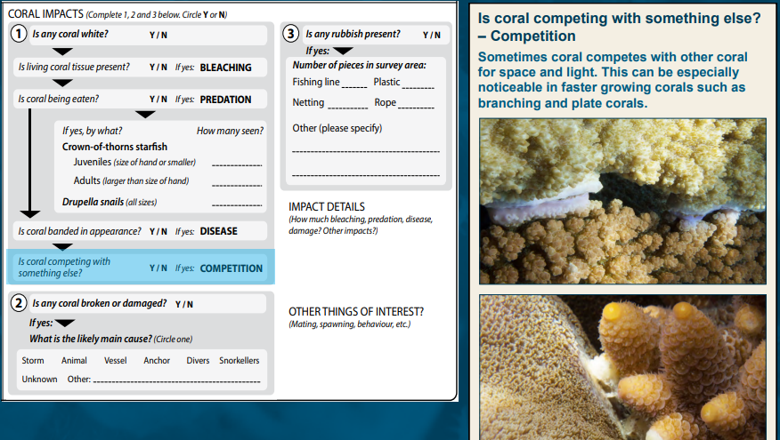

Slide 15
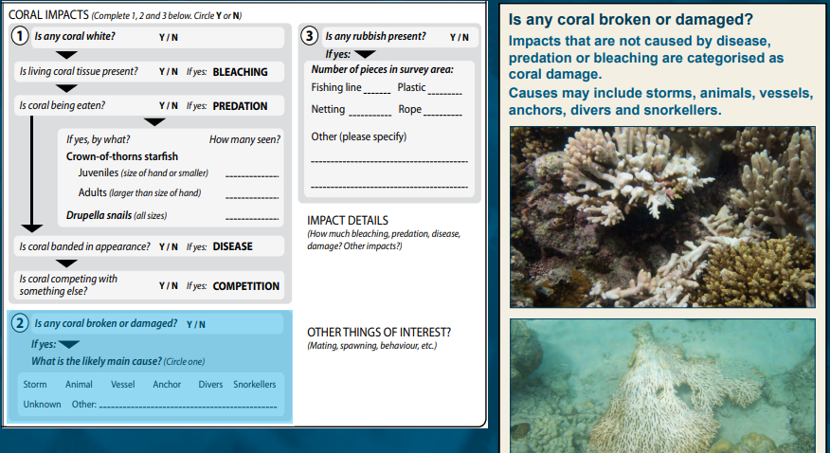

Slide 16
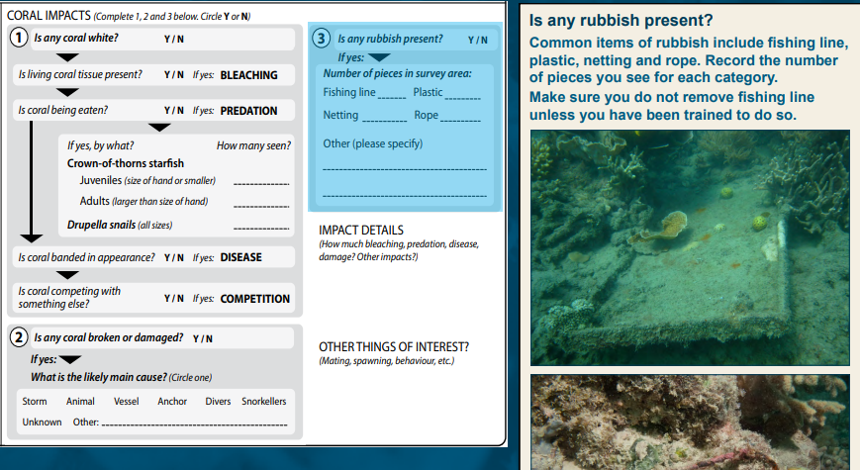

Slide 17
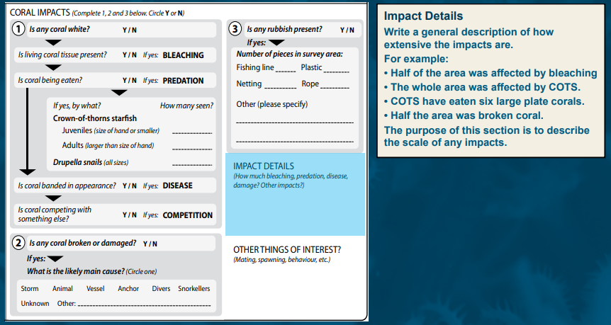

Slide 18
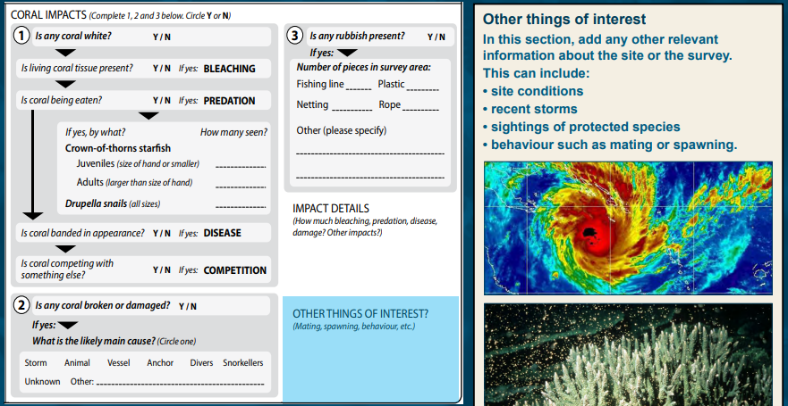
You will be shown how to upload your data in Part 3 back at school.
Notes:
You will be shown how to upload your data in Part 3.

Slide 19
We hope you enjoyed you day visiting the Great Barrier Reef!
See the Reef • Love the Reef • Protect the Reef

